Slide 1

Three-body force in the Quark Model
Su Houng Lee
- Exotics and the need for three-body forces
From Meson to Baryon
Quark Three-body force
Some thoughts on exotic production in heavy ion collision (if time allows)
Acknowledgments:
S. Noh, A. Park, H. Yun, S. Cho, SHL arXiv:2408.00715
+ExHIC collaboration (2011 with Akira Ohnishi)

Slide 2
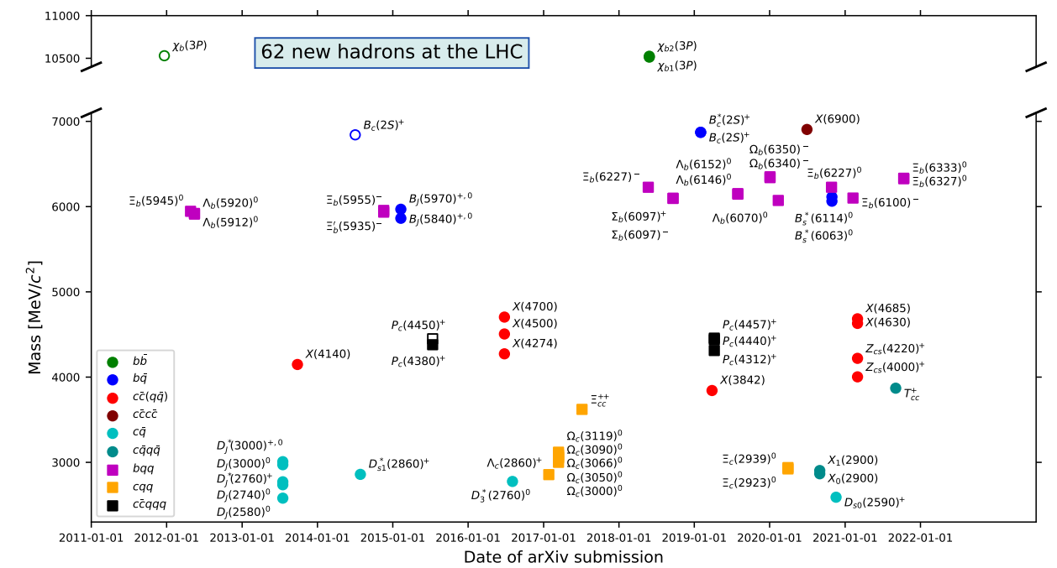

Exotics
1. Starting from X(3872) or χ_{c1}(3872)…..
Recent LHCb publication arXiv:2206.15233…..

Slide 3
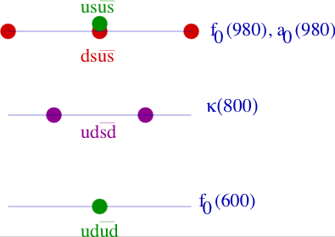
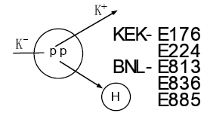
Revival of an old topic: Gell-Mann (64)
☞ Tetraquark:
scalar tetraquark (Jaffe 76)
→ Still controversial
☞ Dibaryon
H (ududss) dibaryon (Jaffe 77):
→ experimentally not found
☞ Pentaquark
Pcs (Gignoux, Silvestre-Brac, Richard 87)
Pcs (udusc) (Lipkin 87)
→ Fermilab E791 : not found
u
u
c
d
s
Θ ⁺ (Diakonov, Petrov, Polyaov 97)
→ LEPS 2003 but not confirmed

Slide 4
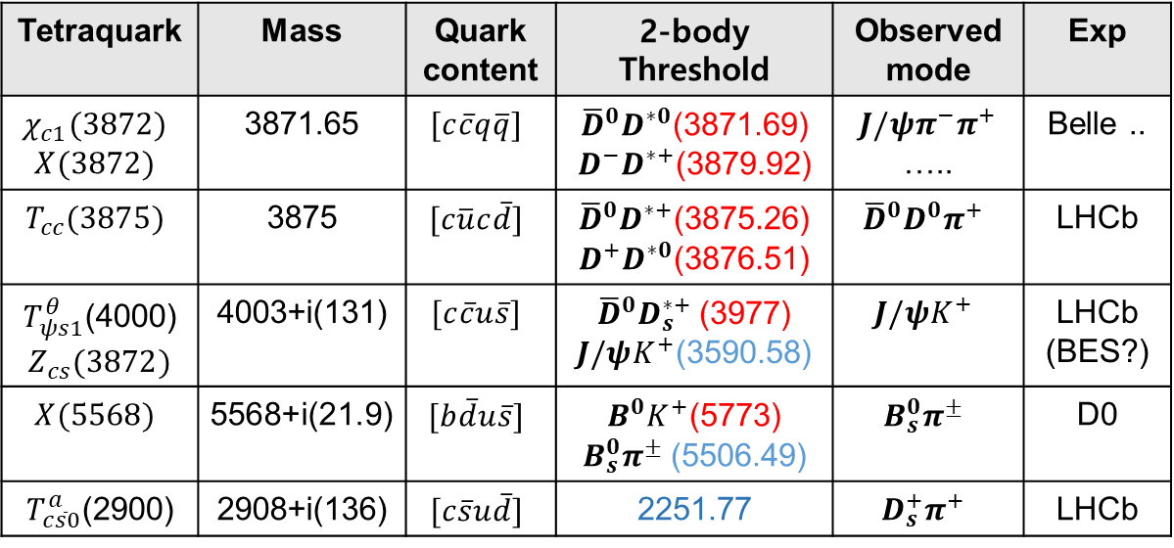
Few examples of recent findings
Tetraquark | Mass | Quark content | 2-body Threshold | Observed mode | Exp
$$χ_{c1}(3872)$$ $$X(3872)$$ | 3871.65 | $$[c\overline{c}q\overline{q}]$$ | ${\overline{D}}^{0}D^{∗0}$(3871.69) $D^{−}D^{∗+}$(3879.92) | $$J/ψ{π^{−}π}^{+}$$ ….. | Belle ..
$$T_{cc}(3875)$$ | 3875 | $$[c\overline{u}c\overline{d}]$$ | ${\overline{D}}^{0}D^{∗+}$(3875.26) $D^{+}D^{∗0}$(3876.51) | $${\overline{D}}^{0}D^{0}π^{+}$$ | LHCb
$T_{ψs1}^{θ}$(4000) $$Z_{cs}(3872)$$ | 4003+i(131) | $$[c\overline{c}u\overline{s}]$$ | ${\overline{D}}^{0}D_{s}^{∗+}$(3977) $J/ψK^{+}$(3590.58) | $$J/ψK^{+}$$ | LHCb (BES?)
$$X(5568)$$ | 5568+i(21.9) | $$[b\overline{d}u\overline{s}]$$ | $B^{0}K^{+}$(5773) $B_{s}^{0}π^{±}$(5506.49) | $$B_{s}^{0}π^{±}$$ | D0
$T_{c\overline{s}0}^{a}$(2900) | 2908+i(136) | $$[c\overline{s}u\overline{d}]$$ | 2251.77 | $$D_{s}^{+}π^{+}$$ | LHCb
Bound
Near Threshold
Above Threshold

Slide 5
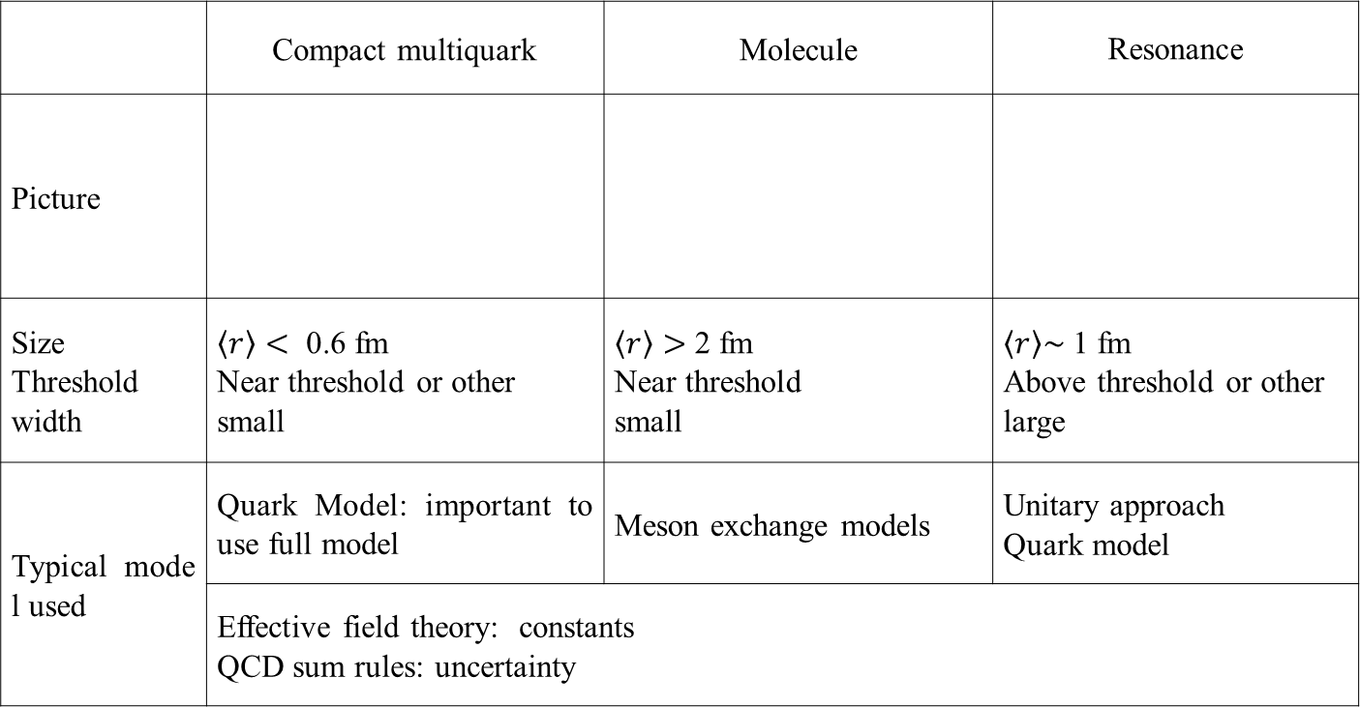
Types of Exotic particles
 | Compact multiquark | Molecule | Resonance
Picture
Size Threshold width | $\left\langle r\right\rangle <$ 0.6 fm Near threshold or other small | $\left\langle r\right\rangle >$ 2 fm Near threshold small | $\left\langle r\right\rangle \sim$ 1 fm Above threshold or other large
Typical model used | Quark Model: important to use full model | Meson exchange models | Unitary approach Quark model
 | Effective field theory: constants QCD sum rules: uncertainty
q
c
q
c
D
D
q
c
c
q
D*
D*
Problem:
In many cases, two pictures seem possible. Compact and Molecular

Slide 6
From mesons to Exotics in Quark model
☞ Ground state hadrons in quark model
Meson
Baryon
Tetraquark
Pentaquark
1
2
1
2
1
2
1
2
3
3
3
4
4
5
☞ Lessons from Nuclei
Deuteron: pion exchange + D-wave contribution
Nuclei with A>3: need nuclear three-body force
6

Slide 7
Two-body interaction in the quark model
Quarks have color and spin
Color-color
Color-spin

Slide 8
Quark Model perspectives on Interaction at short distance – color-color interaction
N-N interaction at short distance
☞ When brought together need to overcome Additional Kinetic energy >100 MeV
☞ Color-Color interaction is not important for short range N-N interaction
1
2
1
2
4
5
6
3
4
3
6
5
8

Slide 9
Quark Model perspectives on Interaction at short distance – color-spin interaction
☞ Color-spin interaction for 2 body:
 | Q-Q |  |  |  | Q-Q
Color | A | S | A | S | 1 | 8 | 1 | 8
Flavor | A | A | S | S
Spin | A(0) | S(1) | S(1) | A(0) | 0 | 0 | 1 | 1
K | -8 | -4/3 | 8/3 | 4 | -16 | 2 | 16/3 | -2/3
☞
Delta
Proton
d
u
u
d
u
u
9

Slide 10
Quark Model vs Lattice comparison : A.Park, Lee, Inoue, Hatsuda, EPJA 56(2020)3,93
☞ NN force in SU(2) spin 1 vs spin 0 channel: comparison to lattice
QCD HAL collaboration
→ comparison
☞ H dibaryon channel: Flavor 1 vs Flavor 27
10

Slide 11
Why Heavy quarks are needed for multiquark configuration
☞ Coulomb interaction becomes stronger (Karliner Rosner)
Q
Q
☞ Color-spin interaction becomes weaker with heavy quarks
When all light quarks
Fall apart into two mesons
When heavy quarks,
could be compact (Tcc)
q
q
Q
Q
q
q
q
q
meson
diquark
11

Slide 12
Indeed many heavy exotics were found
But still not clear about their structure
Compact multiquarks or loosely bound molecules
Will Look at X(3872) and Tcc(3875)
Can they be compact?

Slide 13
X(3872) : W. Park, SHLee, NPA924(2014) 161
c
q
c
q
Color-spin (X(3872))
13

Slide 14
Tcc(3875) : W. Park, SHLee, NPA924(2014) 161
u
c
d
c
Color-spin (Tcc)
14

Slide 15
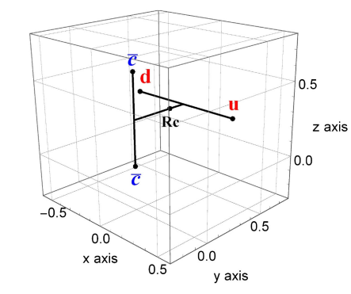
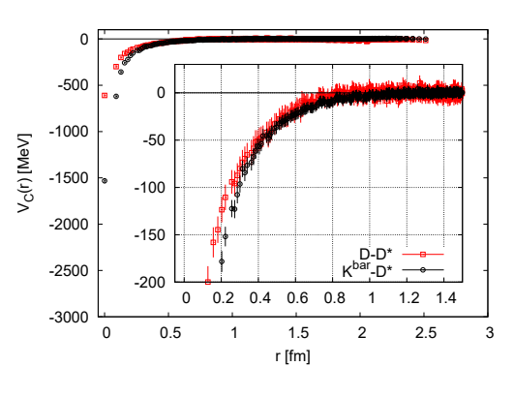
Attraction expected from quark Model for T_{cc}(3875)
☞ Quark model estimate
(S. No, W. Park, SHL, PRD10 (2021)114009 )
☞ Consistent to Lattice (HAL QCD): Phys. Lett. B 729 (2014) 85
15

Slide 16
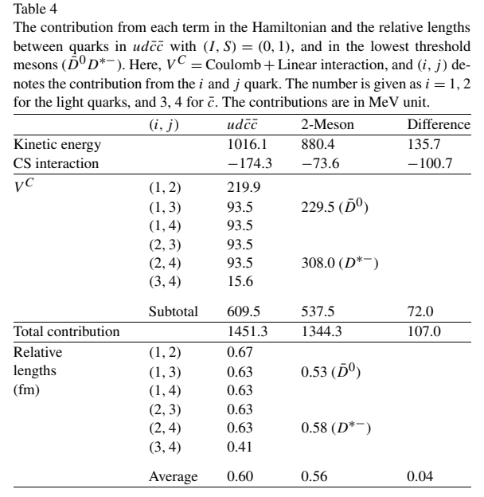
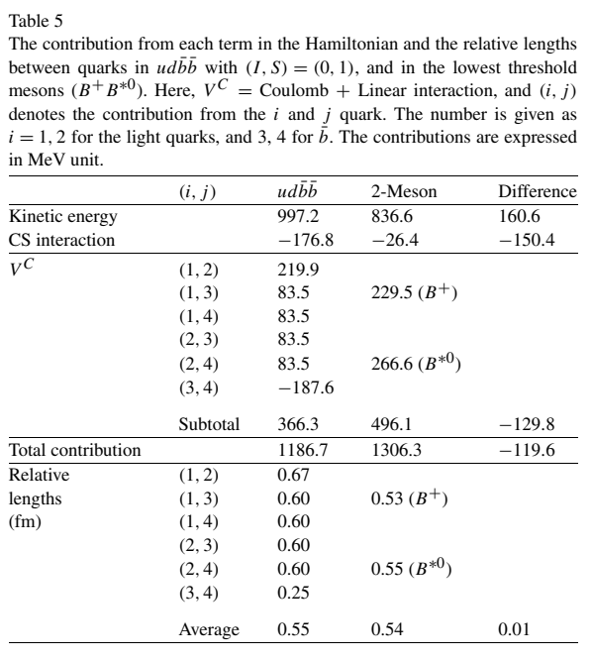
Quark Model calculation for Tcc: ex W. Park, S.Noh, Lee, NPA983 (2019)1
Detailed calculation show both color-spin and color-color effects are indeed important
Still Tcc is marginal but Tbb is definitely a strongly bound compact multiquark-state
u
d
c
c

Slide 17
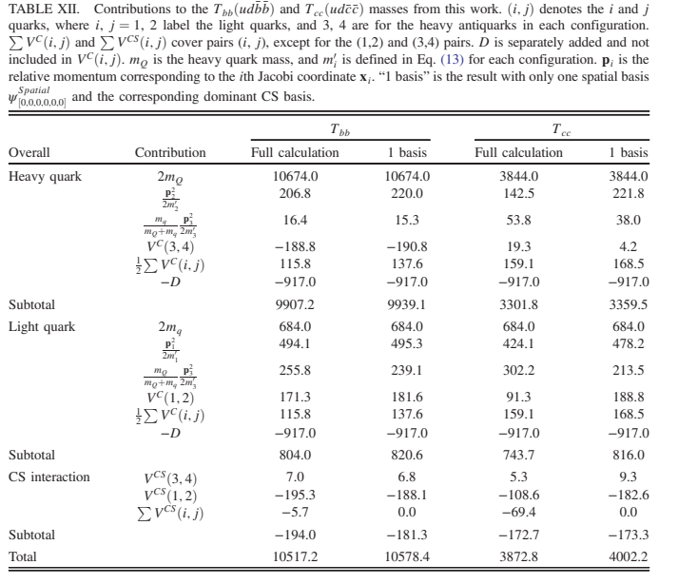
Full Quark Model calculation for Tcc: ex S.Noh, W.Park, Lee, PRD10(2021)114009
Also , full calculation (exact wave function) is important

Slide 18
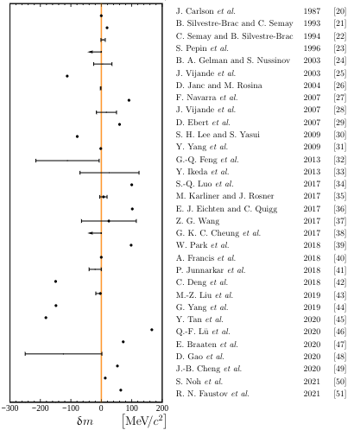
Full Quark Model calculation suggests: ex S.Noh, W.Park, Lee, PRD10(2021)114009
-2021- Tcc(3875) LHCb coll.
☞ There is a strong short range attraction for Tcc → Could be compact,
but depends sensitively on parameters:
☞ The short range attraction for X(3872) is very weak
→ Can not be compact
18

Slide 19
Can X(3872) and Tcc(3875) be molecules?
Perspectives from the p-exchange
Especially important when

Slide 20
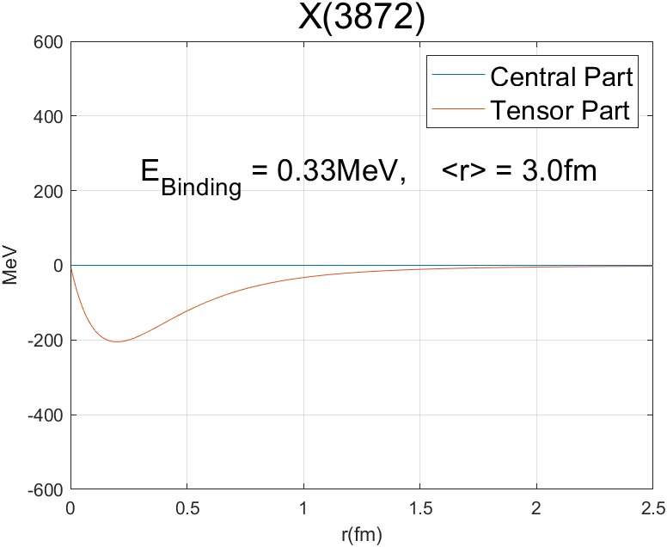
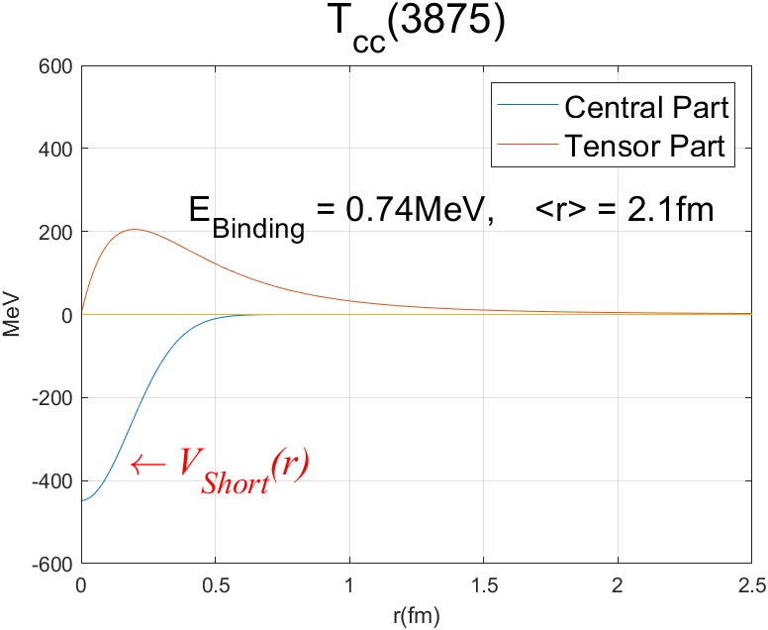
D-wave mixing through p-exchange Tcc: N.A. Tornqvist (94) + Short range attraction (D. Park, et al)
☞
20

Slide 21
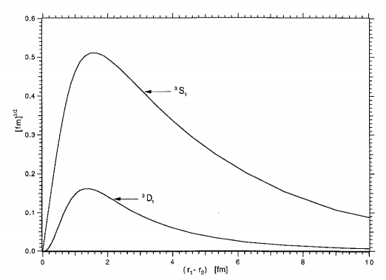
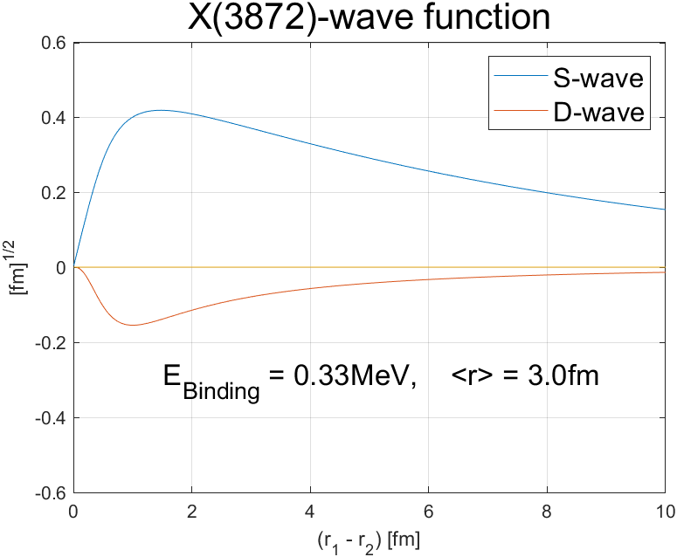
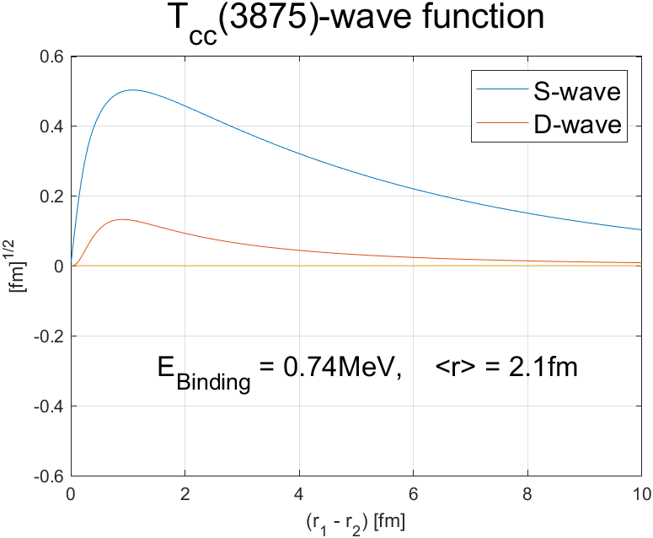
☞ Wave functions:
Similar to that of Deuteron

Slide 22
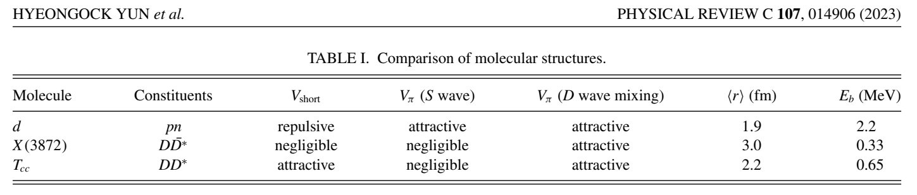
☞ Both X(3872) and Tcc(3875) could be a large molecular configuration
☞ X(3872) most likely not compact, but Tcc(3875) could also be compact

Slide 23
What does the quark model tell us
Three-body force: from meson to baryon and tetraquark

Slide 24
Quark-Three-body force Previous attempts
☞ f-type and d-type: Desplanques etal ZPA343(92), Dmitrasinovic, PLB499 (2001), Stancu, PRD65(2002), W.Park etal PRD92(2015)
→ Not important. However, the origin of d-type of interaction remains ambiguous.

Slide 25
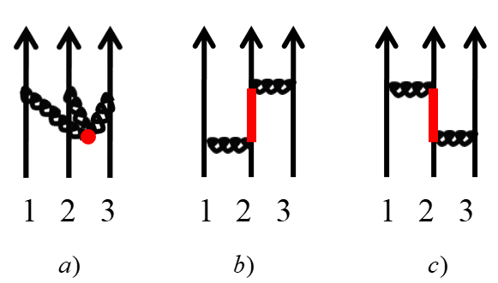
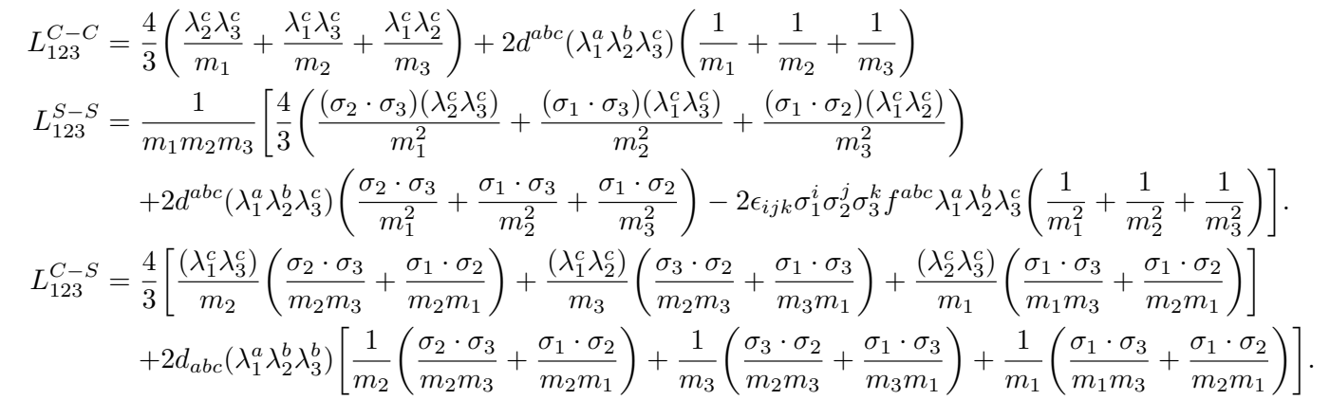
Quark-Three-body force A. Park, S.Noh, S. Cho, SH Lee, arXiv:2408.00715
☞ Origin could be similar to Nuclear-Three-body force

Slide 26
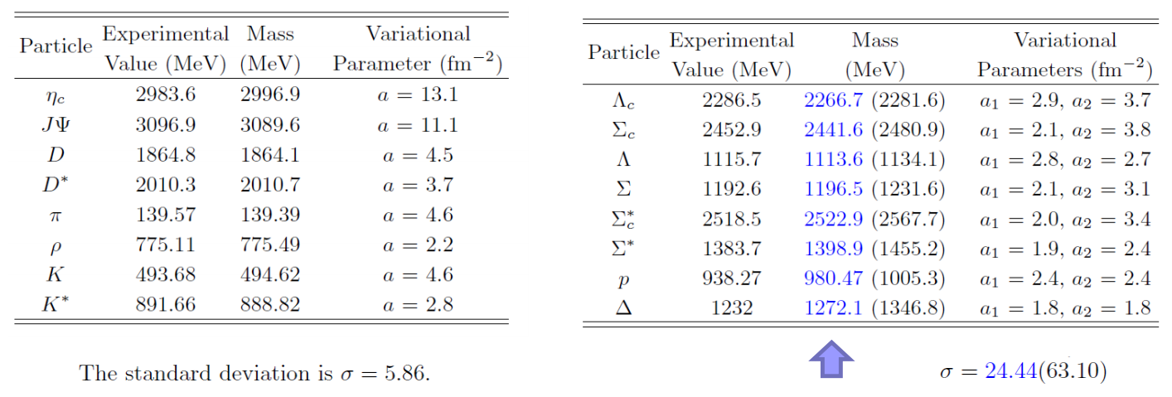
☞ Quark-three-body force: from meson to baryon
With quark-three-body force

Slide 27
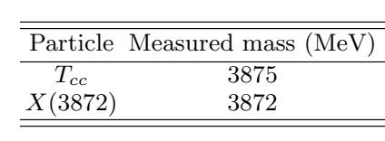
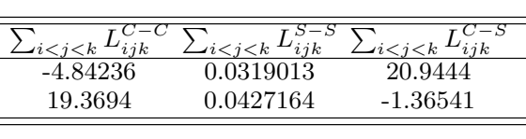
☞ Effect of 3-quark-interaction on Tetraquarks : Repulsive → supports molecular picture
☞ But there could be even 4-quark-interaction for Tetraquarks: although expect it to be smaller

Slide 28
II: Measuring Exotics in Heavy Ion Collision:
A possible hint to discriminate between
compact vs large molecules

Slide 29

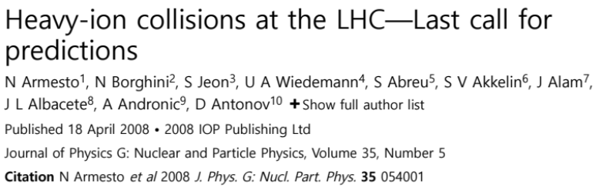
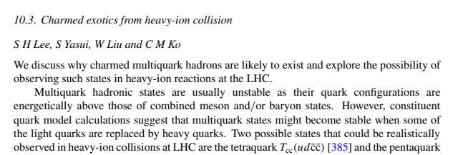


Some remarks: in 2008,
Our contribution to the volume

Slide 30
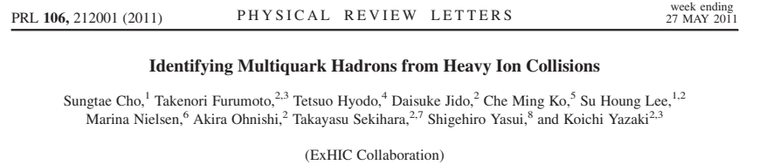
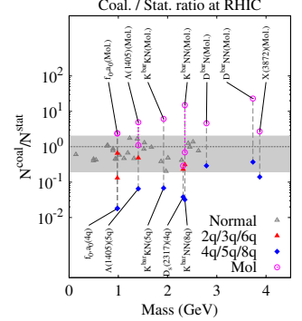
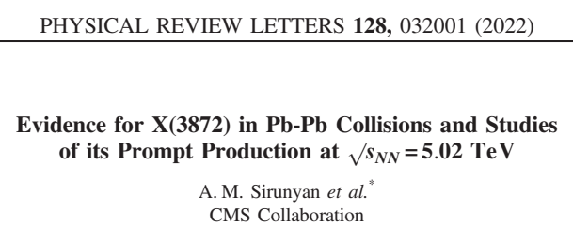
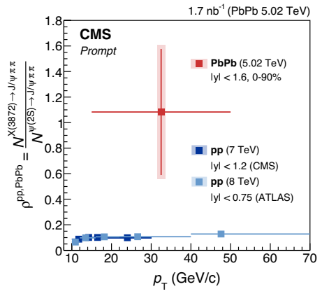
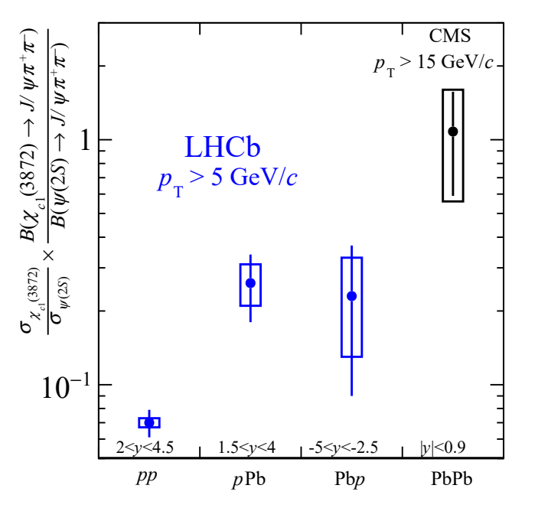
Original prediction from ExHIC collaboration (Theory) in 2011
Theory prediction
Experiment
30

Slide 31
Few points in Coalescence model - I
⊙ Normalization conditions
⊙ Wigner function
S. Cho, K.J. Sun, C.M. Ko, SH Lee, Y. Oh, PRC101(20)024909
⊙ σ → infinity limit

Slide 32
Few points in Coalescence model - II
⊙ Coalescence probability is suppressed for smaller object when

Slide 33
Few points in Coalescence model - I
A simple fit to Deuteron and ³He using (R_{b} ,V) - I
⊙ Deuteron Pt distribution should be determined by that of proton

Slide 34
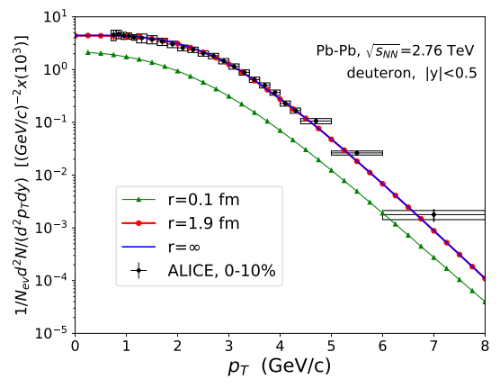
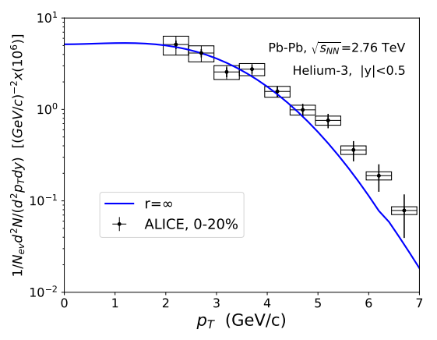
A simple fit to Deuteron and ³He using (R_{b} ,V) - II
For r>1.9 fm result are similar to σ→ infinity result
Both can be fit by choosing R_{b}=0.36 → similar to feed-down effects SHM
V(2-dim)=608 fm²

Slide 35
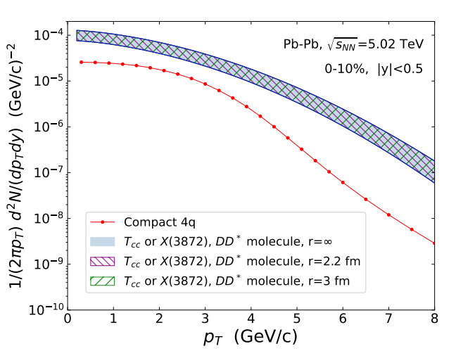
Expectation for Molecular configuration of X(3872) and Tcc
Use measured D and D* Pt distribution
Use R_{b}=0.31 from feed-down effects SHM
Use same V(2-dim)=608 fm²
X(3872)
Tcc if Molecular structure
Tcc if Compact multiquark

Slide 36
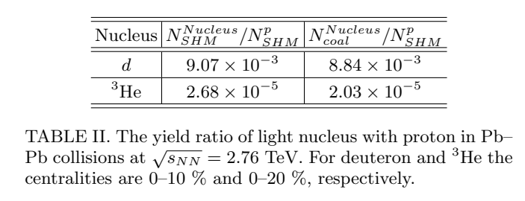
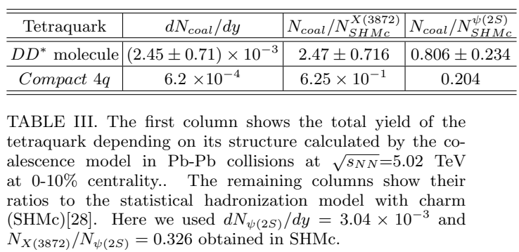
Integrated yields for loosely bound molecules
☞ For ,
results are similar SHM
☞ For X(3872) and Tcc, yields for molecular configurations are larger
no feed down for D*

Slide 37
Final Thoughts:

Slide 38
Quark Spatial wave function of X(3872) : molecule
☞ S-wave in basis
c
c
q
q
☞ Transformation into basis
c
c
q
q

Slide 39
Quark Color-spin wave function of X(3872): molecule
☞ In basis
c
c
q
q
☞ Transformation into basis
c
c
q
q

Slide 40
Possible explanation of abundant production of X(3872)
☞
☞
☞ ψ(2S) production at high Pt is dominated by but has to be multiplied by a small overlap into color singlets: NRQCD
☞ X(3872) production at high Pt might be a direct recombination of with in QGP

Slide 41
Summary
⊙ Most exotics have multiple heavy quark: HIC is an excellent factory
⊙ Exotics can be compact, molecules, resonances
But to study them in quark model,
need to understand quark 3-body, 4-body force
→ Use Wisdom from nuclear
⊙ Enhanced productions always are linked to strong correlation and/or resonance: For example, Hoyle state
→ Measurement of exotics in heavy ion collision will reveal new color configurations, strong correlations and possible resonance structures of quarks and gluons

Slide 42

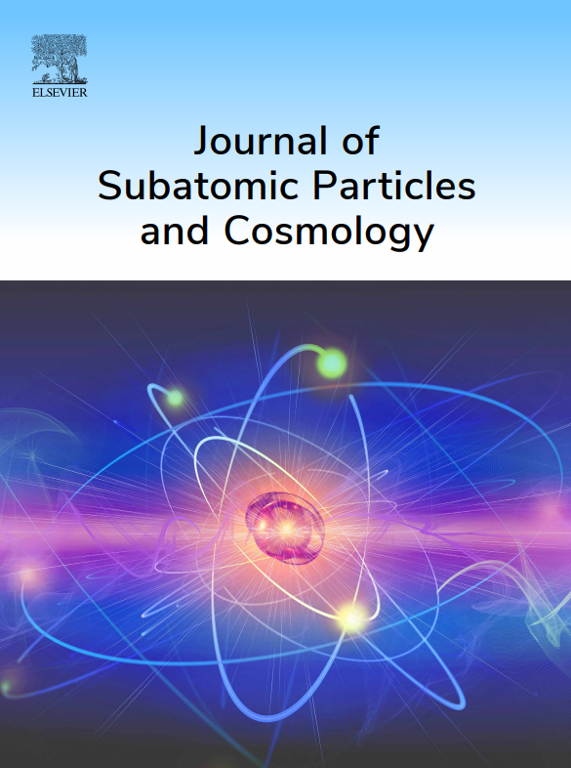
Visa-free entry to Jeju Island: using direct flight to Jeju
  Indico
https://indico.cern.ch/event/1339154/
Aims and Scopes: multidisciplinary journal,
Nuclear physics, high energy Physics, Experimental Physics, Cosmology, and interdisciplinary computing techniques.
Hybrid model operation:
Types of Articles: A peer-reviewed articles in various formats, including Original regular articles, reviews, conference proceedings, and technical reports.
Website: https://www.sciencedirect.com/journal/journal-of-subatomic-particles-and-cosmology
Editors: Su Houng Lee (EIC, Yonsei), Xu-Guang Huang (Fudan), Hee-Cheol Kim (Postech), Girish Kulkarni (TIFR), Chihiro Sasaki (Wroclaw), Seon-Hee Seo (Fermilab)
Publisher: Elsevier, Dr. Tanur Sinha (t.sinha@elsevier.com)

Slide 43
Ground state Mesons
p
r
d
u
d
u
P-wave Mesons
d
u
d
u

Slide 44
P-wave Mesons
d
u
d
s
d
u
s
s
s
u

Slide 45
X(3872) : W. Park, SHLee, NPA924(2014) 161
c
q
c
q
Color-Color (X(3872)
No additional attraction from color-color interaction
→ X(3872) can not be compact multiquark state
45

Slide 46
Tcc(3875) : W. Park, SHLee, NPA924(2014) 161
u
c
d
c
Color-Color (Tcc)
Hence there is additional attraction
→ Tcc(3875) could be a compact multiquark state
46

Slide 47
Quark Model perspectives on Interaction at short distance – color-spin interaction
☞ Color-spin interaction for 2 body:
 | Q-Q |  |  |  | Q-Q
Color | A | S | A | S | 1 | 8 | 1 | 8
Flavor | A | A | S | S
Spin | A(0) | S(1) | S(1) | A(0) | 0 | 0 | 1 | 1
K | -8 | -4/3 | 8/3 | 4 | -16 | 2 | 16/3 | -2/3
47

