Slide 1


Nucleon electric polarizabilities, nucleon-pion scattering and pion electroweak production from lattice QCD
Xu Feng (Peking U.)
2024.10.12

Slide 2
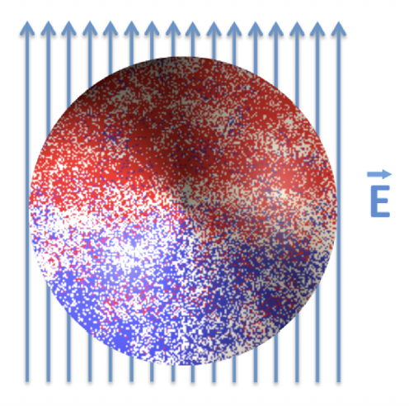
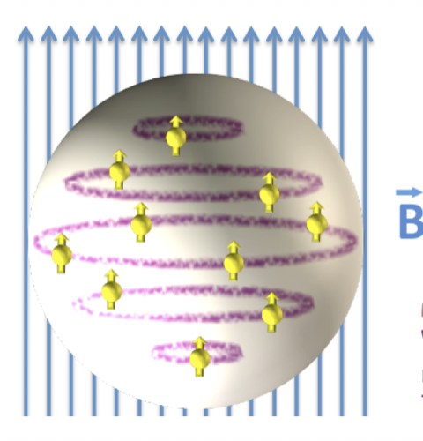



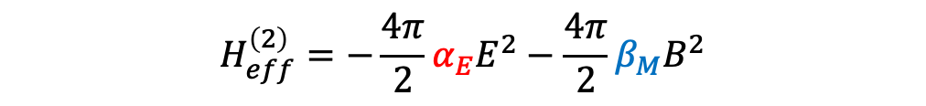
Electromagnetic polarizabilities
In the realm of nucleon properties, E&M polarizabilities represent crucial fundamental constants akin to the size and shape of the nucleon
Polarizabilities offer insights into the distribution of charge and magnetism within nucleons, revealing their response to external electromagnetic fields
$$H_{eff}^{\left(2\right)}=−\frac{4π}{2}α_{E}E^{2}−\frac{4π}{2}β_{M}B^{2}$$
Experimental determination of polarizabilities relies on Compton scattering, wherein external E&M fields polarize the target nucleon or deuteron
$$μ$$
$$ν$$
$$T^{μν}$$
2

Slide 3


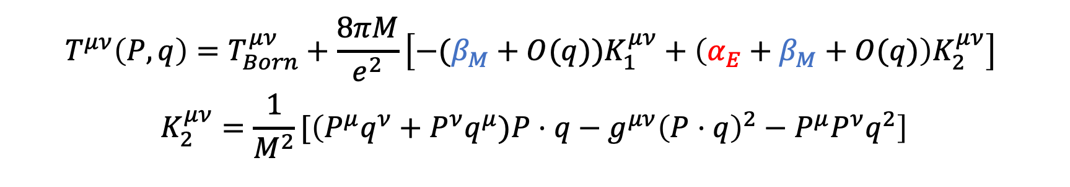



Nucleon polarizability and Compton scattering
Nucleon E&M polarizability are most central quantities relevant for Compton scattering
$$q$$
$$μ$$
$$ν$$
$$P$$
$$T^{μν}$$
Unpolarized doubly virtual Compton scattering
$$K_{1}^{μν}=q^{μ}q^{ν}−g^{μν}q^{2}$$
$$T^{μν}\left(P,q\right)=T_{Born}^{μν}+\frac{8πM}{e^{2}}\left[−(β_{M}+O(q))K_{1}^{μν}+\left(α_{E}+β_{M}+O(q)\right)K_{2}^{μν}\right]$$
$$K_{2}^{μν}=\frac{1}{M^{2}}[\left(P^{μ}q^{ν}+P^{ν}q^{μ})P⋅q−g^{μν}{\left(P⋅q\right)}^{2}−P^{μ}P^{ν}q^{2}\right]$$
Born term
Polarizabilities
+
+……
Intermeidate states: $N$
Intermeidate states: $Nπ,N^{∗},Δ, ⋯$
3

Slide 4
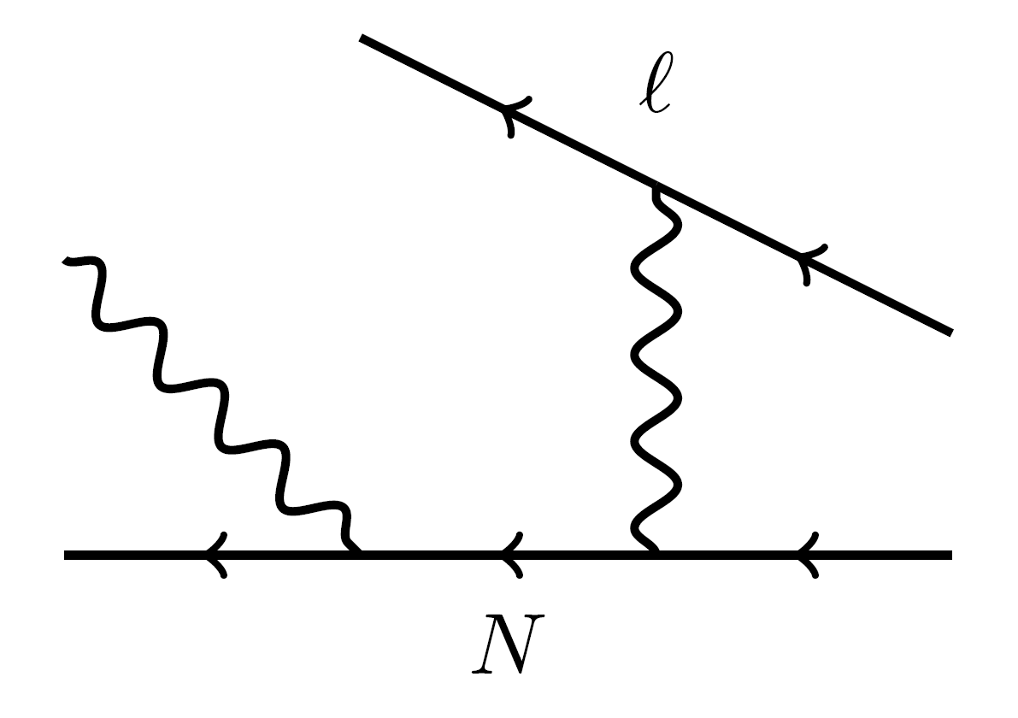



Generalized electric polarizabilities
In real-virtual Compton scattering
Measured proton E&M structure deviates from theoretical predictions
$$α_{E}$$
$$α_{E}(Q^{2})$$
$$Q$$
R. Li et al., Nature 611 (2022) 7935, 265-270
Abnormal peak of generalized proton electric polarizability at $Q^{2}≈0.35 GeV^{2}$ ?
4

Slide 5
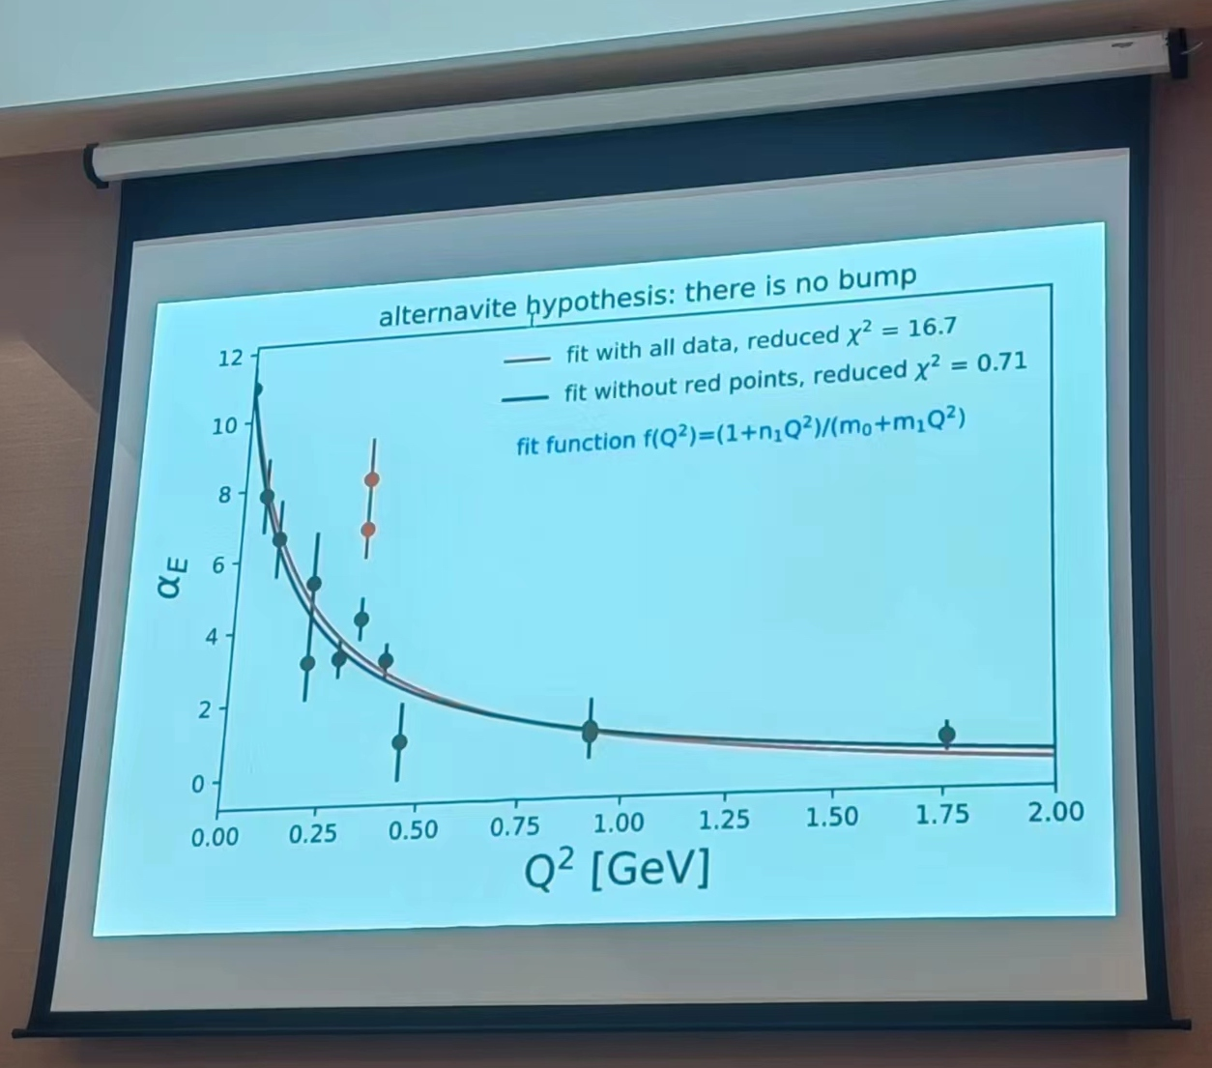
Generalized electric polarizabilities
Measured proton E&M structure deviates from theoretical predictions
Different viewpoints
VS
Figure shown by D. Higinbotham
@ 2nd Workshop on Nucleon Structure at Low Q
R. Li, N. Sparveris, et. al. Nature 611 (2022) 265
5

Slide 6
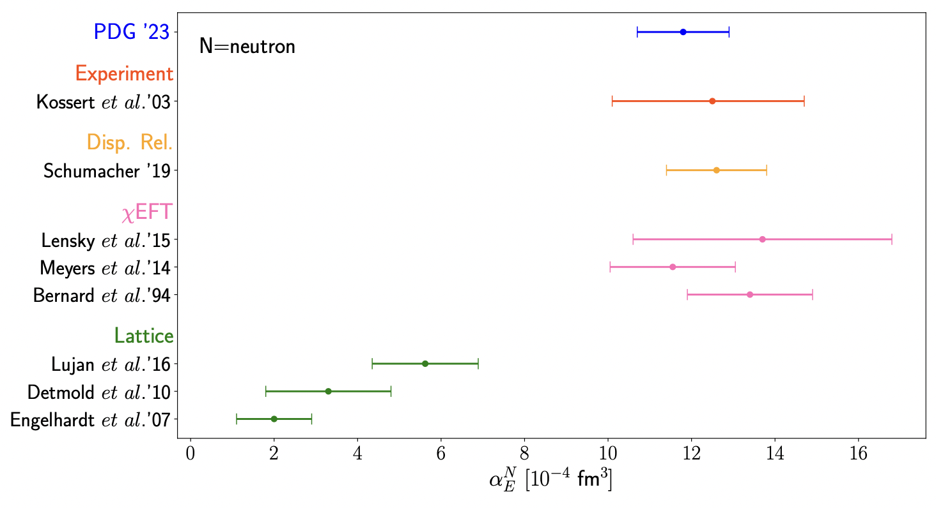

Determination of electric polarizabilities
For neutron
Experiments
$$χ_{EFT}$$
Lattice
6

Slide 7
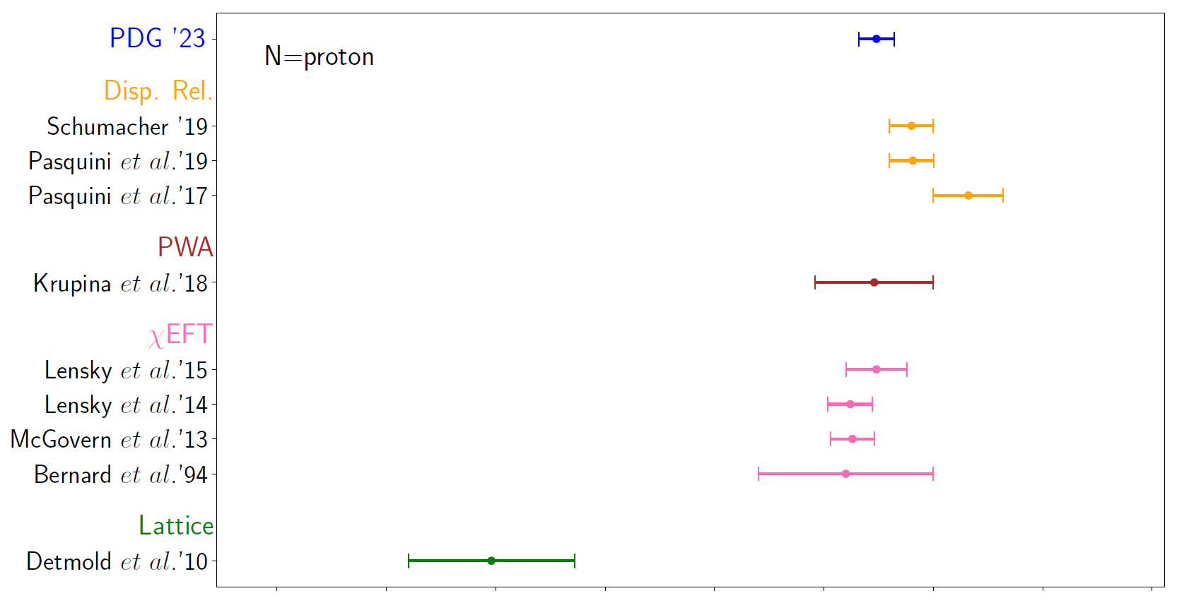
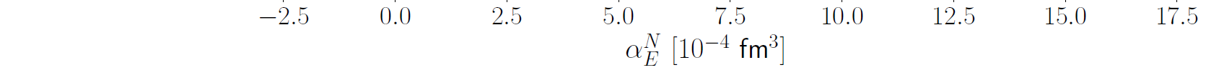

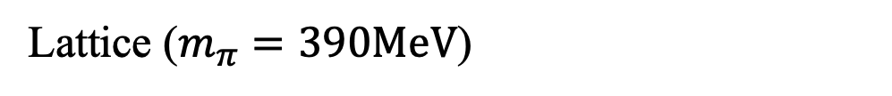
Determination of electric polarizabilities
For proton
Experiments
$$χ_{EFT}$$
Lattice ($m_{π}=390MeV$)
7

Slide 8
Determination of electric polarizabilities
What is the primary source of discrepancy between lattice QCD and other studies?
Lattice calculations are performed at unphysical pion masses, ranging from 227 - 759 MeV
Unphysical quark mass effects
Background field technique is used, which converts 4pt function to 2pt function using Feynman-Hellman theorem
Hard to explore intermediate-state contributions and control systematics
Perform calculation at physical pion mass, using 4pt function
8

Slide 9
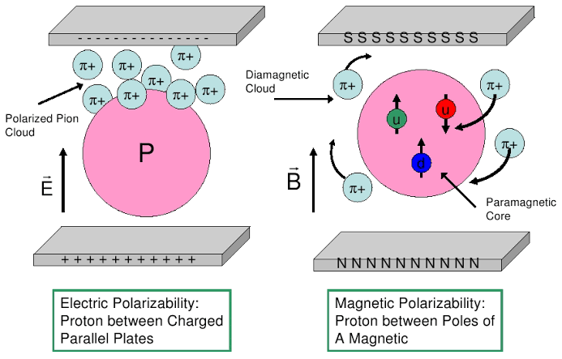
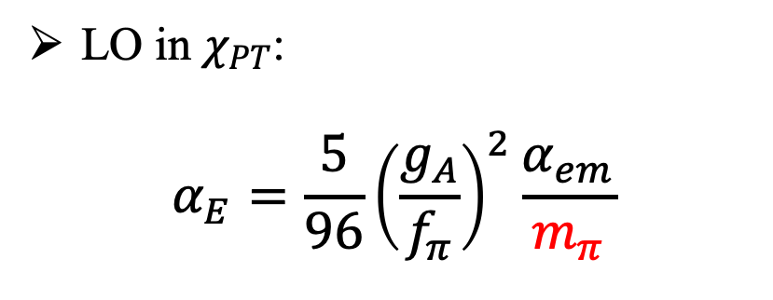
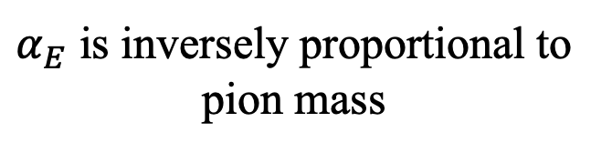
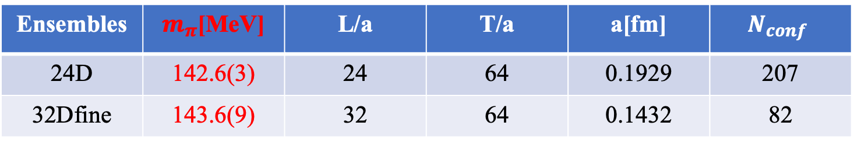
Why physical pion mass is important
Pion cloud in nucleon polarizabilities
LO in $χ_{PT}$:
$$α_{E}=\frac{5}{96}{\left(\frac{g_{A}}{f_{π}}\right)}^{2}\frac{α_{em}}{m_{π}}$$
V. Bernard et al., Phys. Rev. Lett. 67 (1991) 1515
$α_{E}$ is inversely proportional to pion mass
Use two DWF ensembles @ physical π mass
Ensembles | $m_{π}$[MeV] | L/a | T/a | a[fm] | $$N_{conf}$$
24D | 142.6(3) | 24 | 64 | 0.1929 | 207
32Dfine | 143.6(9) | 32 | 64 | 0.1432 | 82
9

Slide 10

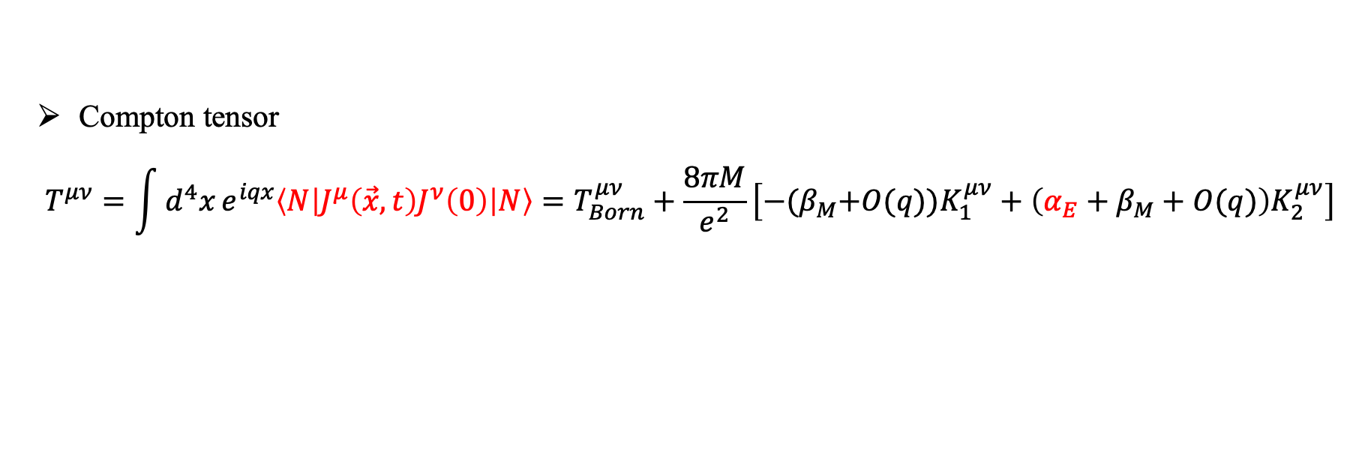

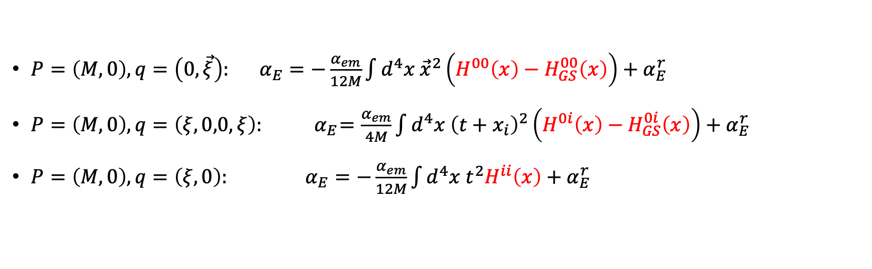






Electric polarizability from 4-pt function
$$q$$
$$μ$$
$$ν$$
Lattice QCD input $H^{μν}\left(x\right)$
Compton tensor
$$T^{μν}=\int{d^{4}x}e^{iqx}\left\langle N\left|J^{μ}\left(\vec{x},t\right)J^{ν}\left(0\right)\right|N\right\rangle =T_{Born}^{μν}+\frac{8πM}{e^{2}}\left[−{(β}_{M}+O(q))K_{1}^{μν}+\left(α_{E}+β_{M}+O(q)\right)K_{2}^{μν}\right]$$
$$P$$
$$T^{μν}$$
Derive 3 formula to calculate $α_{E}$
$P=\left(M,0\right), q=\left(0, \vec{ξ}\right): α_{E}=−\frac{α_{em}}{12M}\int{d^{4}x {\vec{x}}^{2}\left(H^{00}\left(x\right)−H_{GS}^{00}\left(x\right)\right)}+α_{E}^{r}$
$P=\left(M,0\right), q=\left(ξ,0,0,ξ\right): { α}_{E}=\frac{α_{em}}{4M}\int{d^{4}x{ \left(t+x_{i}\right)}^{2}\left(H^{0i}\left(x\right)−H_{GS}^{0i}\left(x\right)\right)}+α_{E}^{r}$
${P=\left(M,0\right), q=\left(ξ,0\right): α}_{E}=−\frac{α_{em}}{12M}\int{d^{4}x{ t}^{2}H^{ii}\left(x\right)}+α_{E}^{r}$
Our choice
Residual term $α_{E}^{r}$ is analytically known
$$H^{ii}\left(\vec{x},t\right)=⟨N|J^{i}\left(\vec{x},t\right)J^{i}\left(0\right)|N⟩$$
$α_{E}^{r}=\frac{α_{em}}{M}\left(\frac{G_{E}^{2}\left(0\right)+κ^{2}}{4M^{2}}+\frac{G_{E}\left(0\right)⟨r_{E}^{2}⟩}{3}\right)$,
anomalous magnetic moment & charge radius
$G_{E}\left(0\right)=1$/0, for proton/neutron
10

Slide 11
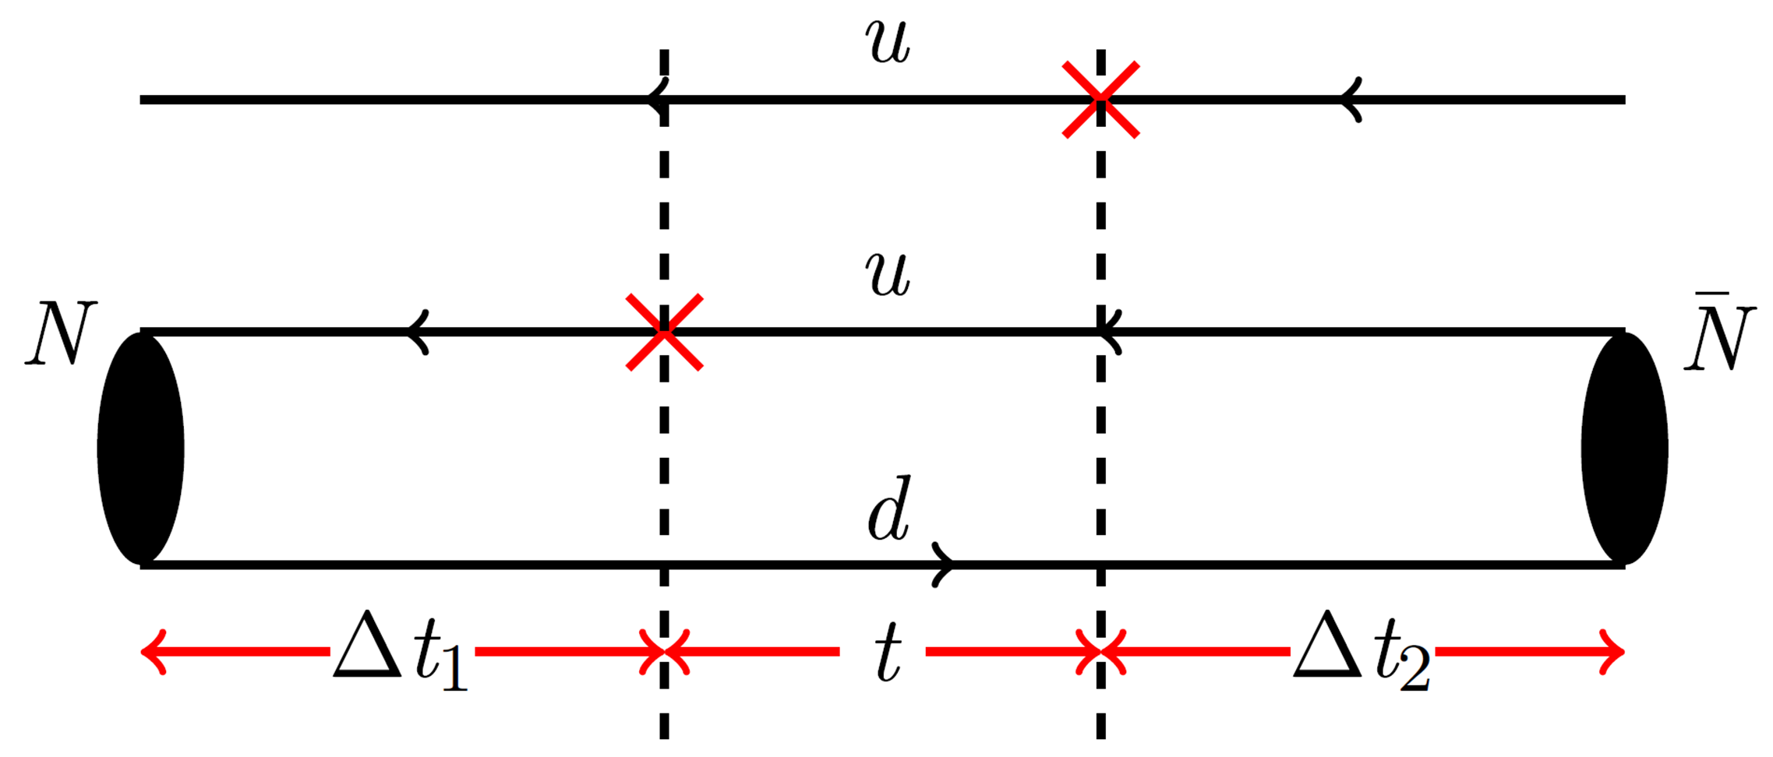
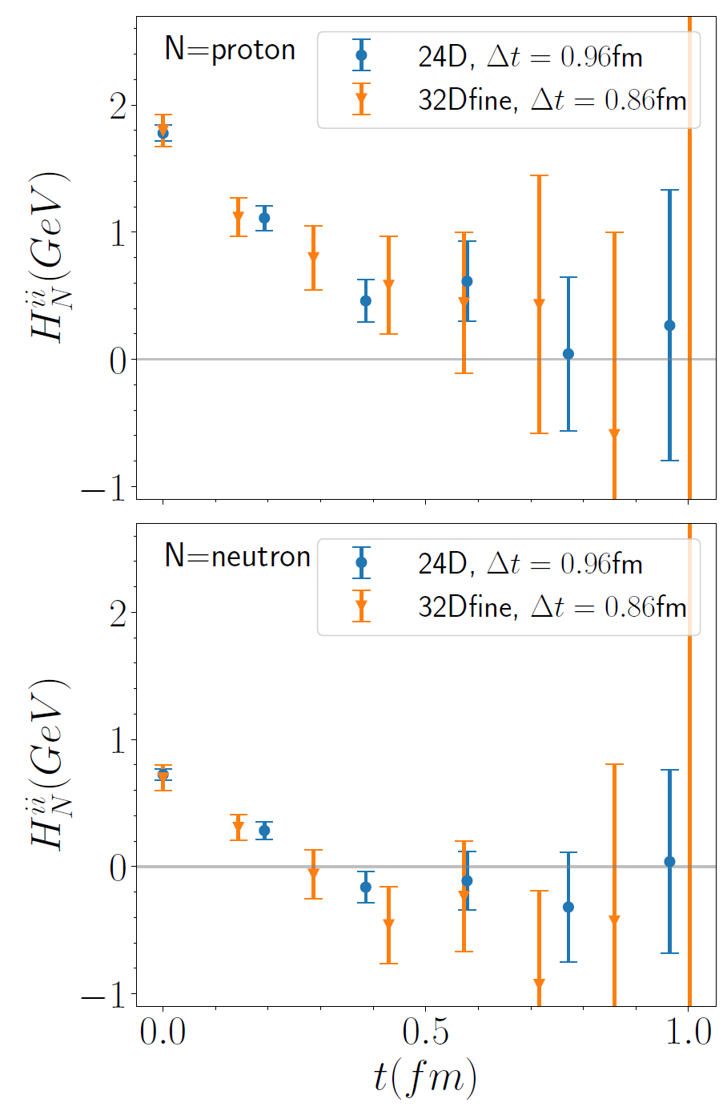
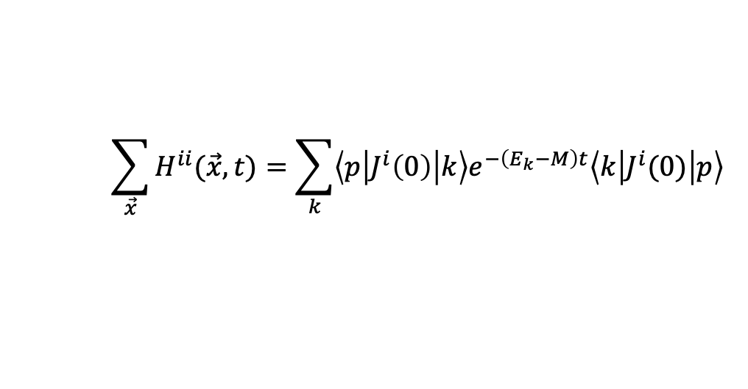
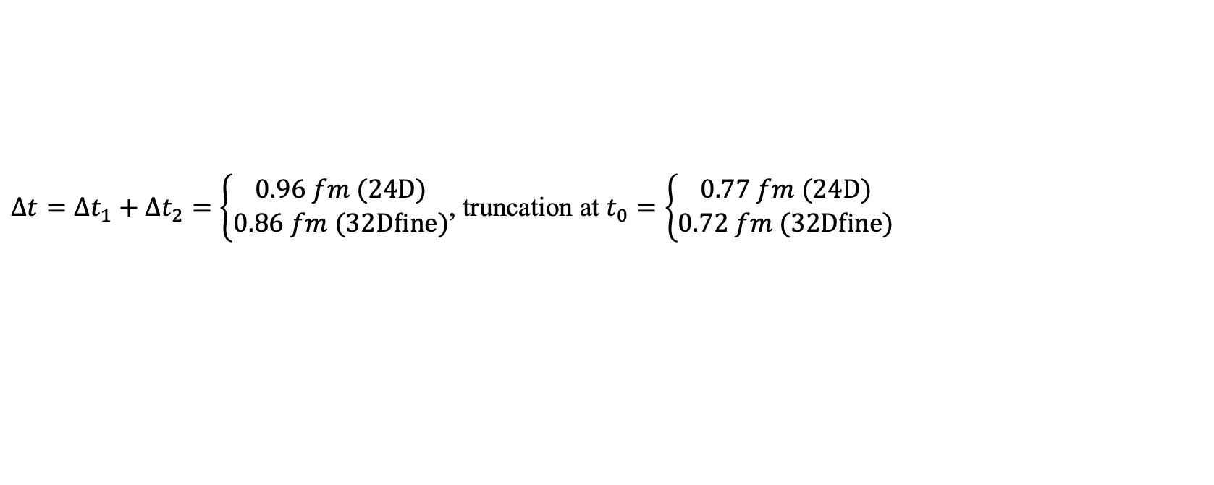
Signal of hadronic function
$$\sum_{\vec{x}}{H^{ii}(\vec{x},t)}=\sum_{k}{\left\langle p\left|J^{i}\left(0\right)\right|k\right\rangle e^{−\left(E_{k}−M\right)t}\left\langle k\left|J^{i}(0)\right|p\right\rangle }$$
signal region
Truncation
Truncation
$Δt=Δt_{1}+Δt_{2}=\left\{\begin{aligned}0.96 fm (24D) \\ 0.86 fm (32Dfine)\end{aligned}\right.$, truncation at $t_{0}=\left\{\begin{aligned}0.77 fm (24D) \\ 0.72 fm (32Dfine)\end{aligned}\right.$
In total, $Δt_{1}+Δt_{2}+t_{0}\sim$1.6-1.8 fm
11

Slide 12
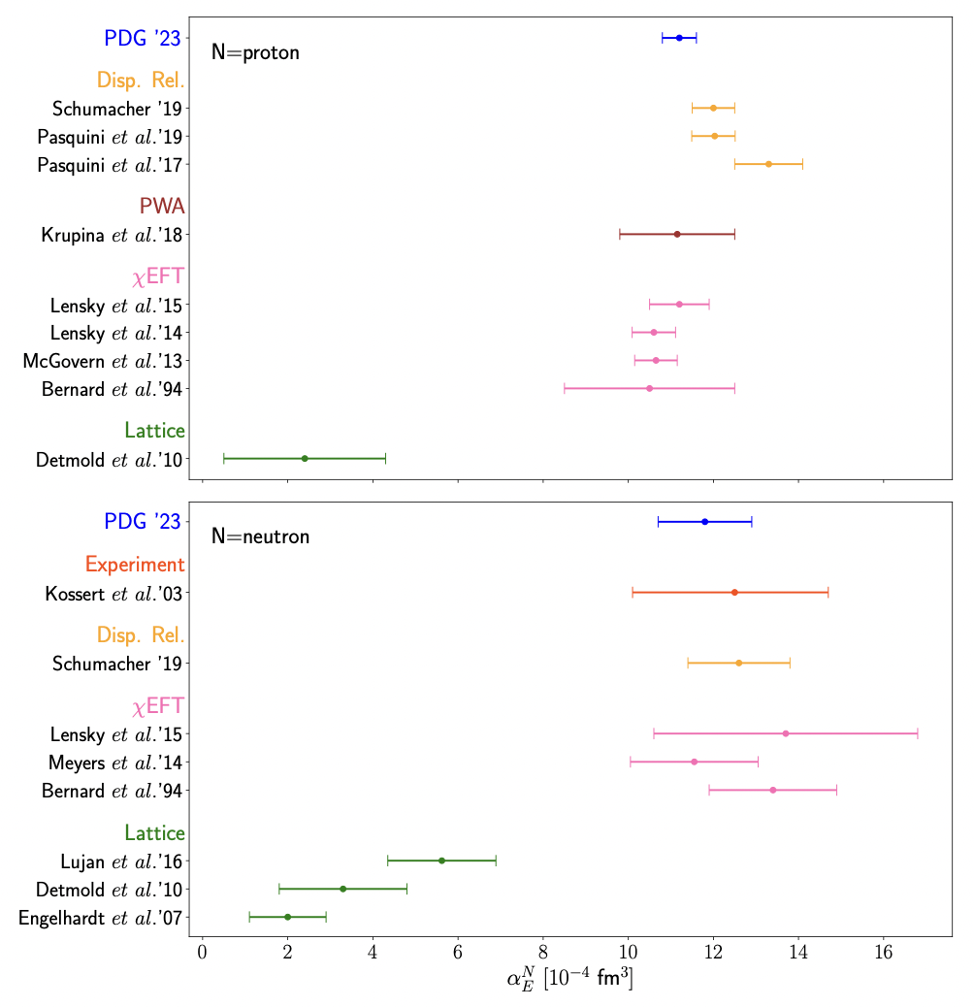
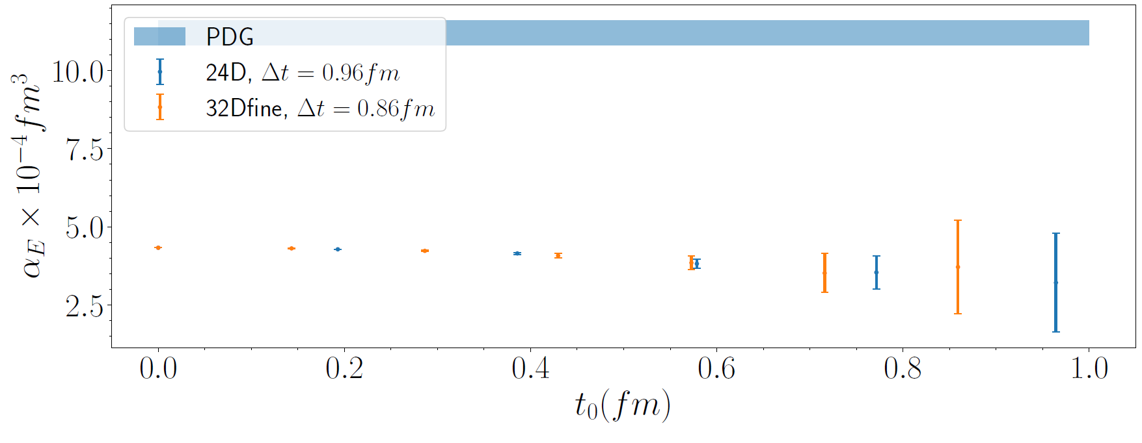
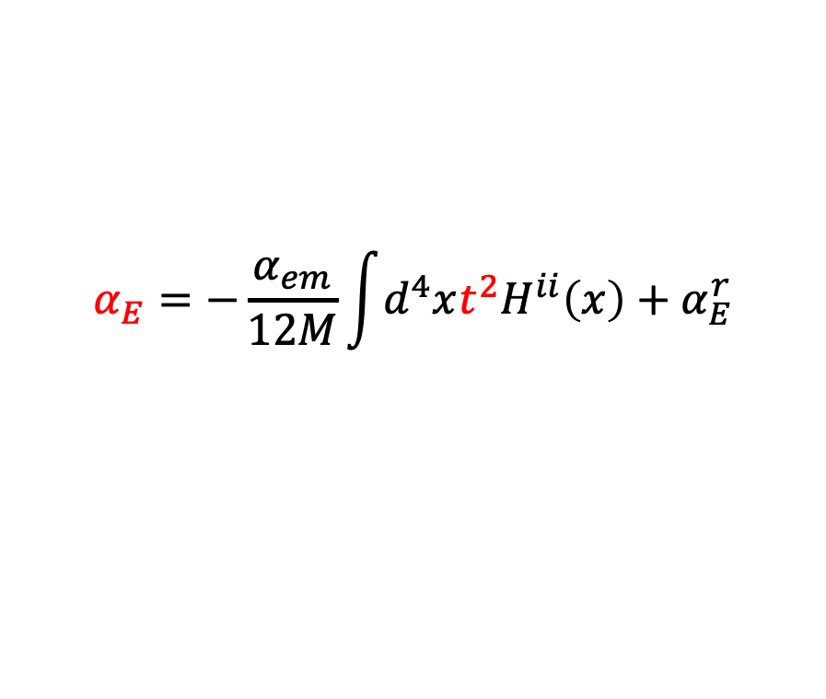

Polarizability $α_{E}$ from $H_{ii}(x)$
$$α_{E}=−\frac{α_{em}}{12M}\int{d^{4}xt^{2}H^{ii}\left(x\right)}+α_{E}^{r}$$
Polarizability extraction
PDG
Our truncation at $t_{0}$
However, lattice results are significantly below the PDG value.
12

Slide 13

Polarizability $α_{E}$ from $H_{ii}(x)$
$$α_{E}=−\frac{α_{em}}{12M}\int{d^{4}xt^{2}H^{ii}\left(x\right)}+α_{E}^{r}$$
Polarizability extraction
PDG
Our truncation at $t_{0}$
However, lattice results are significantly below the PDG value.
Need new insight to turn the decent to the magic!
13

Slide 14
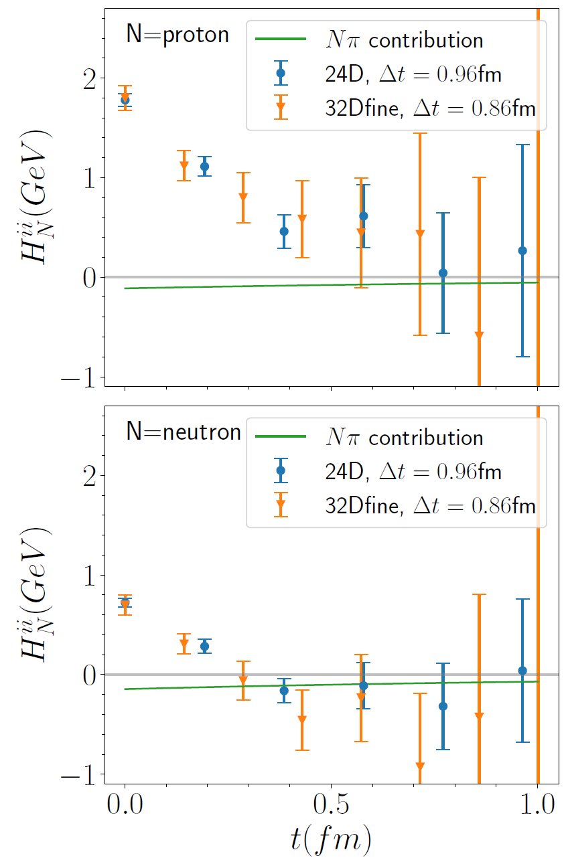
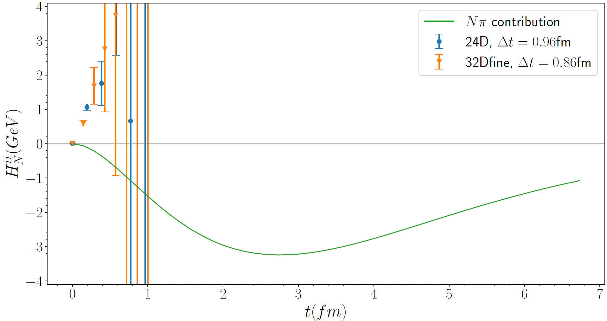
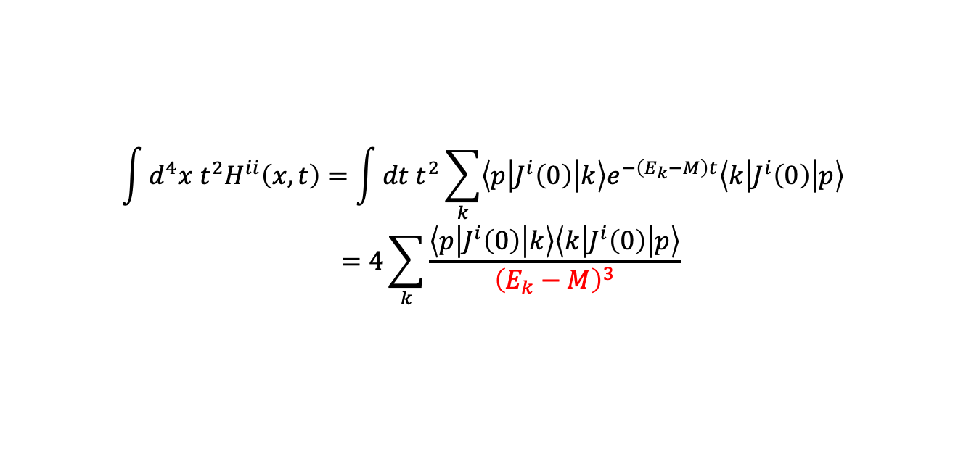




Nucleon polarizabilities and 𝑁𝜋 scattering
$$\int{d^{4}x t^{2}H^{ii}\left(x,t\right)=\int{dt t^{2}\sum_{k}{\left\langle p\left|J^{i}\left(0\right)\right|k\right\rangle e^{−\left(E_{k}−M\right)t}\left\langle k\left|J^{i}\left(0\right)\right|p\right\rangle }}}$$
$$=4\sum_{k}{\frac{\left\langle p\left|J^{i}\left(0\right)\right|k\right\rangle \left\langle k\left|J^{i}\left(0\right)\right|p\right\rangle }{{\left(E_{k}−M\right)}^{3}}}$$
Structure of hadronic function
The dominant contribution is given by $\left|k\right\rangle =|Nπ⟩$ states
$$t^{2}$$
Weight function
$$|Nπ⟩$$
$$|Nπ⟩$$
$|Nπ⟩$
$|Nπ⟩$ states contribution exhibits a peak at $t=2.8 fm$, far exceeding our truncation at $t_{0}≈0.75 fm$
Must calculate $Nπ$ contribution directly!
14

Slide 15
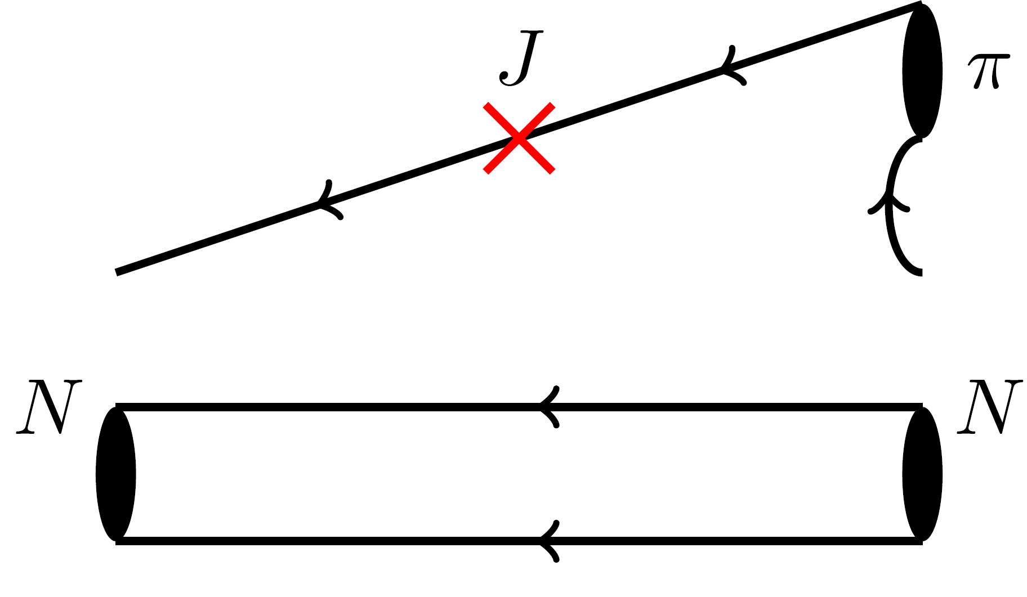
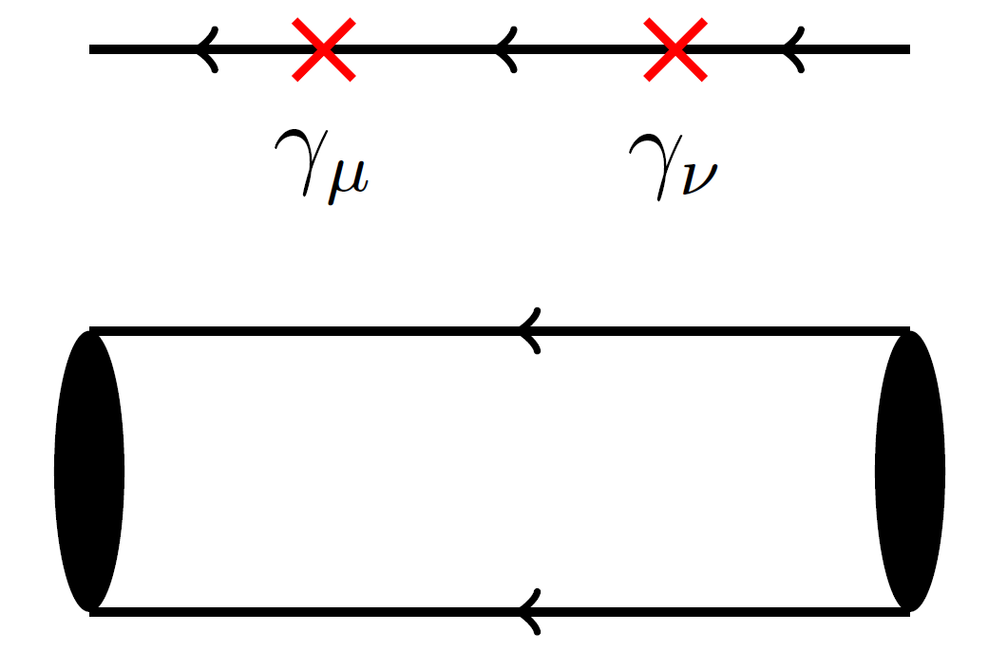
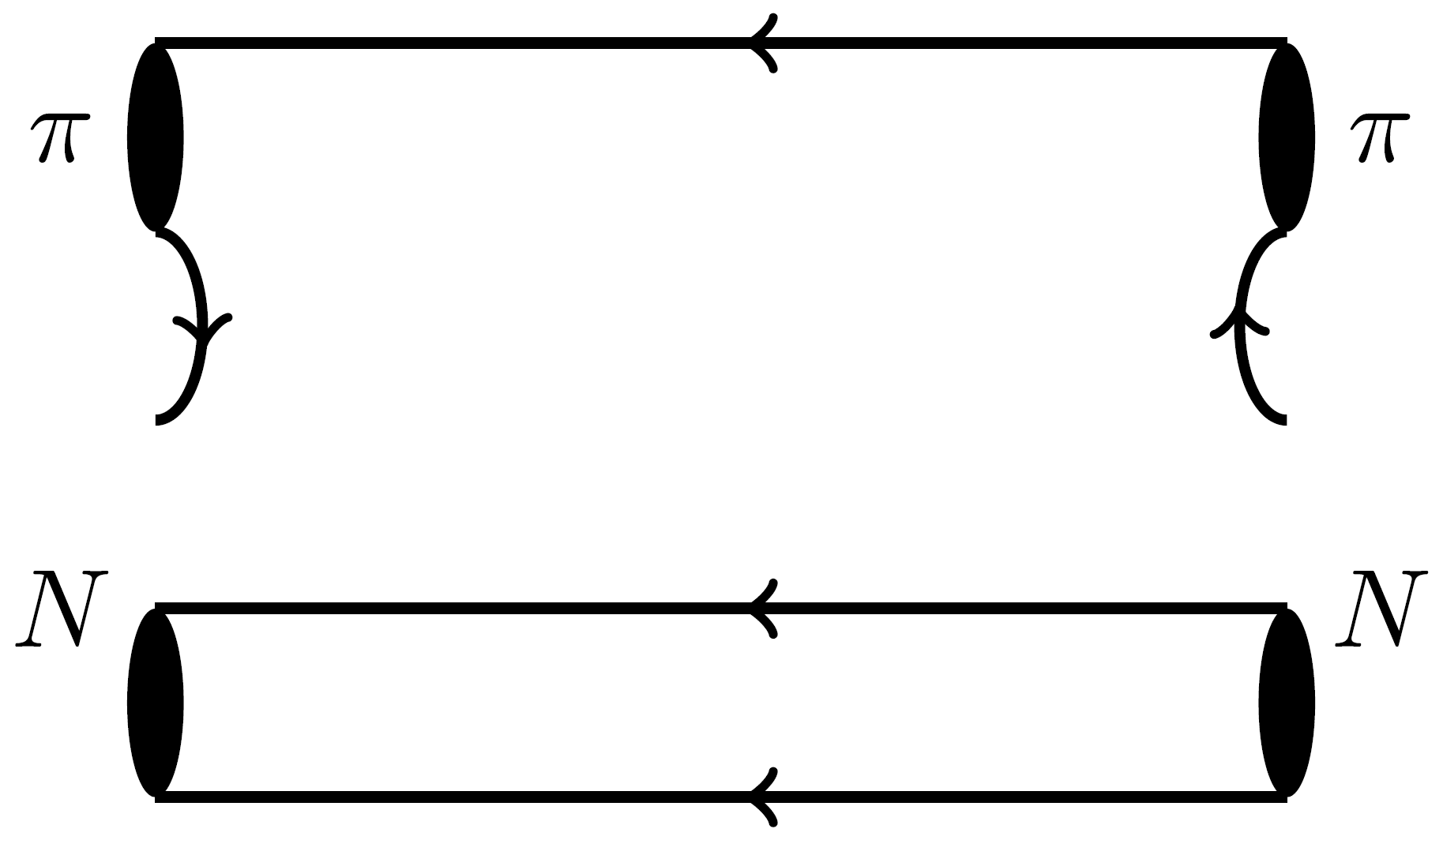


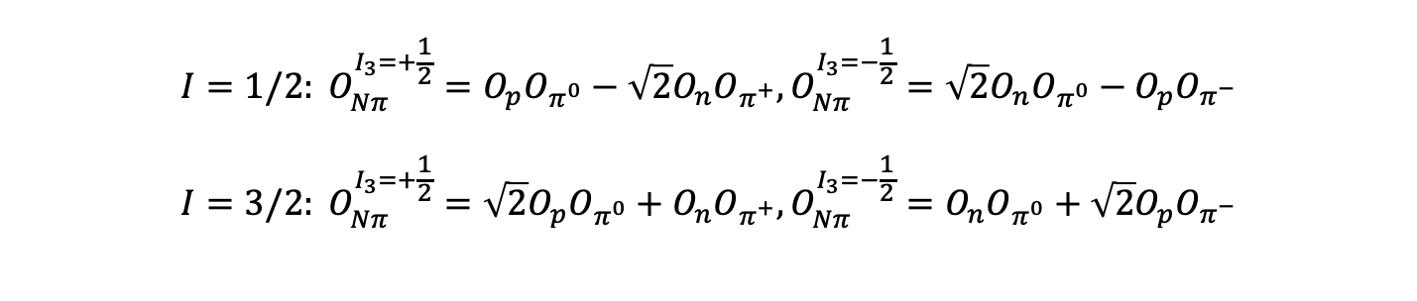
Wick contraction of $Nπ$ rescattering
$$N$$
$$N$$
$$I=1/2: O_{Nπ}^{I_{3}=+\frac{1}{2}}=O_{p}O_{π^{0}}−\sqrt{2}O_{n}O_{π^{+}},O_{Nπ}^{I_{3}=−\frac{1}{2}}=\sqrt{2}O_{n}O_{π^{0}}−O_{p}O_{π^{−}} \\ I=3/2: O_{Nπ}^{I_{3}=+\frac{1}{2}}=\sqrt{2}O_{p}O_{π^{0}}+O_{n}O_{π^{+}},O_{Nπ}^{I_{3}=−\frac{1}{2}}=O_{n}O_{π^{0}}+\sqrt{2}O_{p}O_{π^{−}}$$
}
Operators
15

Slide 16
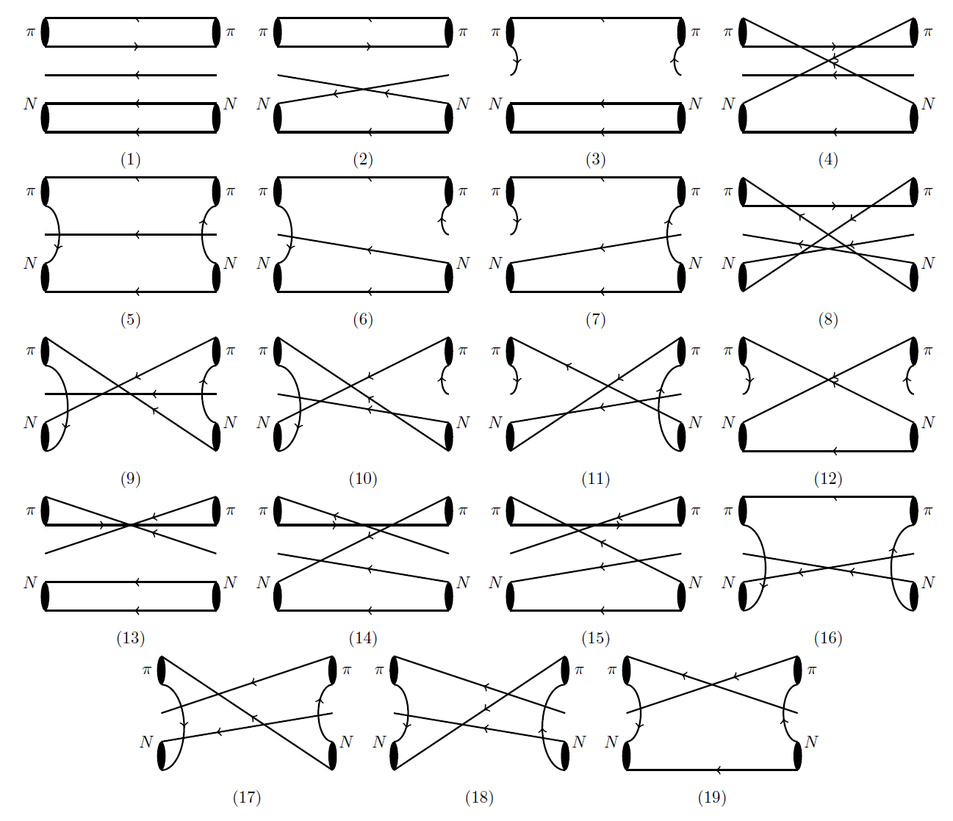
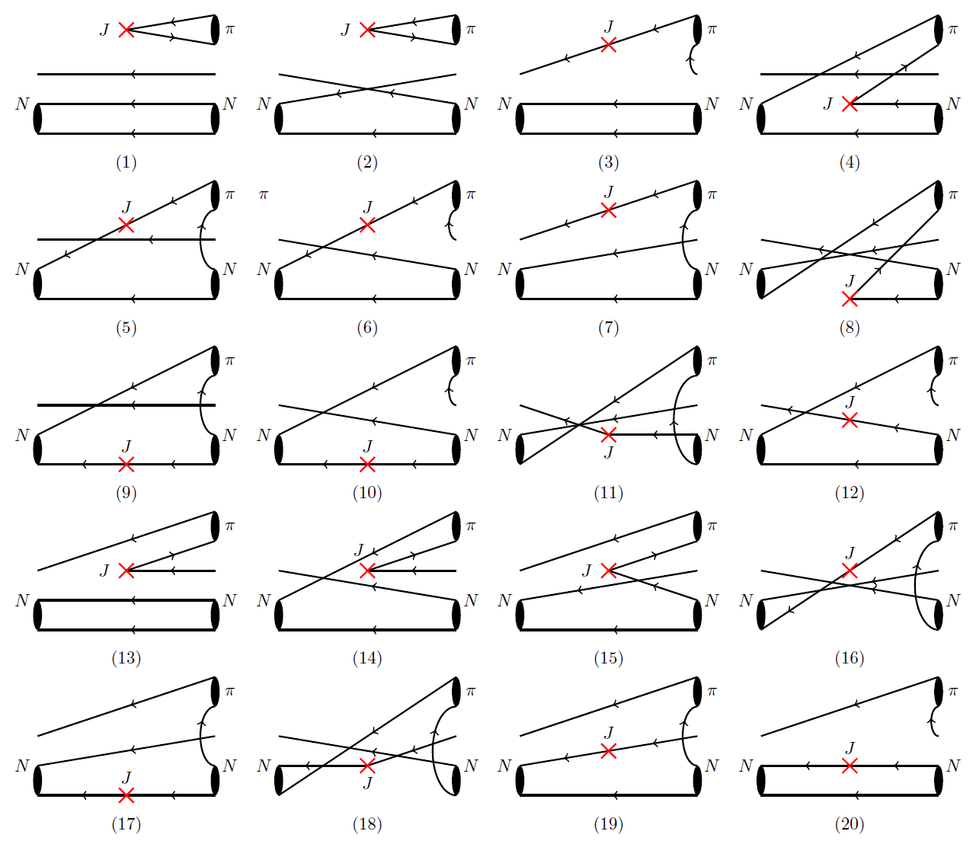
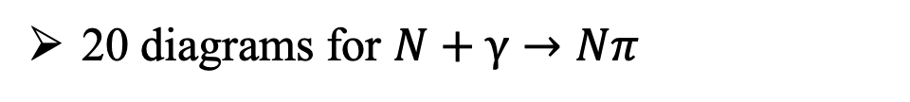
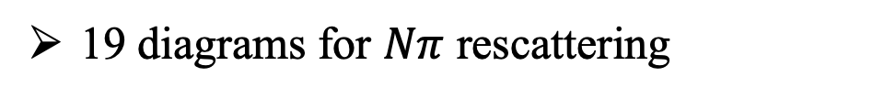
Wick contraction of $Nπ$ Rescattering
19 diagrams for $Nπ$ rescattering
20 diagrams for $N+γ→Nπ$
16

Slide 17
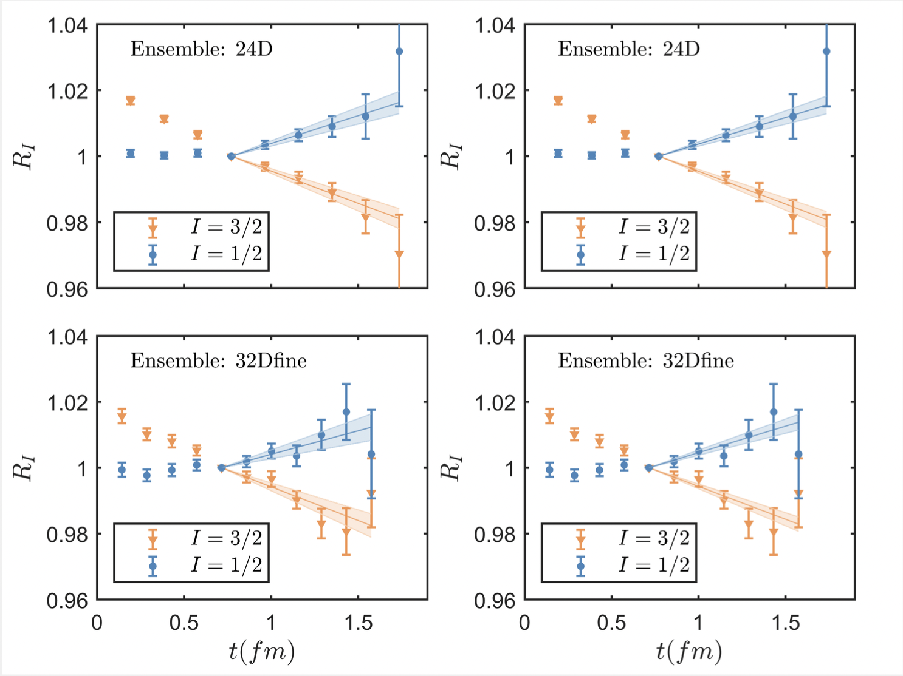

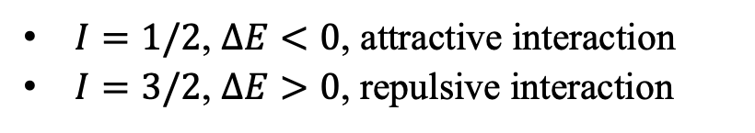
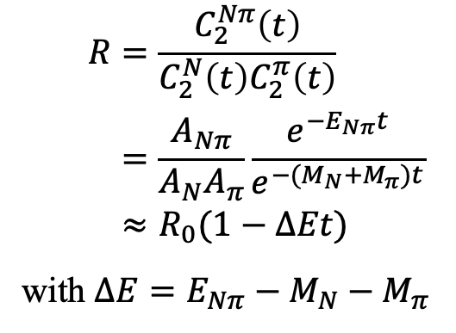
Results of $Nπ$ Scattering
Nπ scattering at m_{π}=142 MeV
combined
fit
$$R=\frac{C_{2}^{Nπ}\left(t\right)}{C_{2}^{N}\left(t\right)C_{2}^{π}\left(t\right)} \\ =\frac{A_{Nπ}}{A_{N}A_{π}}\frac{e^{−E_{Nπ}t}}{e^{−(M_{N}+M_{π})t}} \\ ≈R_{0}(1−ΔEt)$$
with $ΔE=E_{Nπ}−M_{N}−M_{π}$
Results using data at threshold
$$a_{0}^{1/2}m_{π}=0.0127\left(24\right), { a}_{0}^{3/2}m_{π}=−0.127\left(14\right)$$
ETMC [arXiv: 2307.12846] $a_{0}^{3/2}m_{π}=−0.13\left(4\right)$
Analysis based on cross section and πH, πD spectrum
$$a_{0}^{1/2}m_{π}=0.170\left(2\right), { a}_{0}^{3/2}m_{π}=−0.087\left(2\right)$$
Scattering for different isospin channel
$I=1/2$, $ΔE<0$, attractive interaction
$I=3/2$, $ΔE>0$, repulsive interaction
~3σ
M. Hoferichter et al, PLB 843 (2023) 138001
17

Slide 18
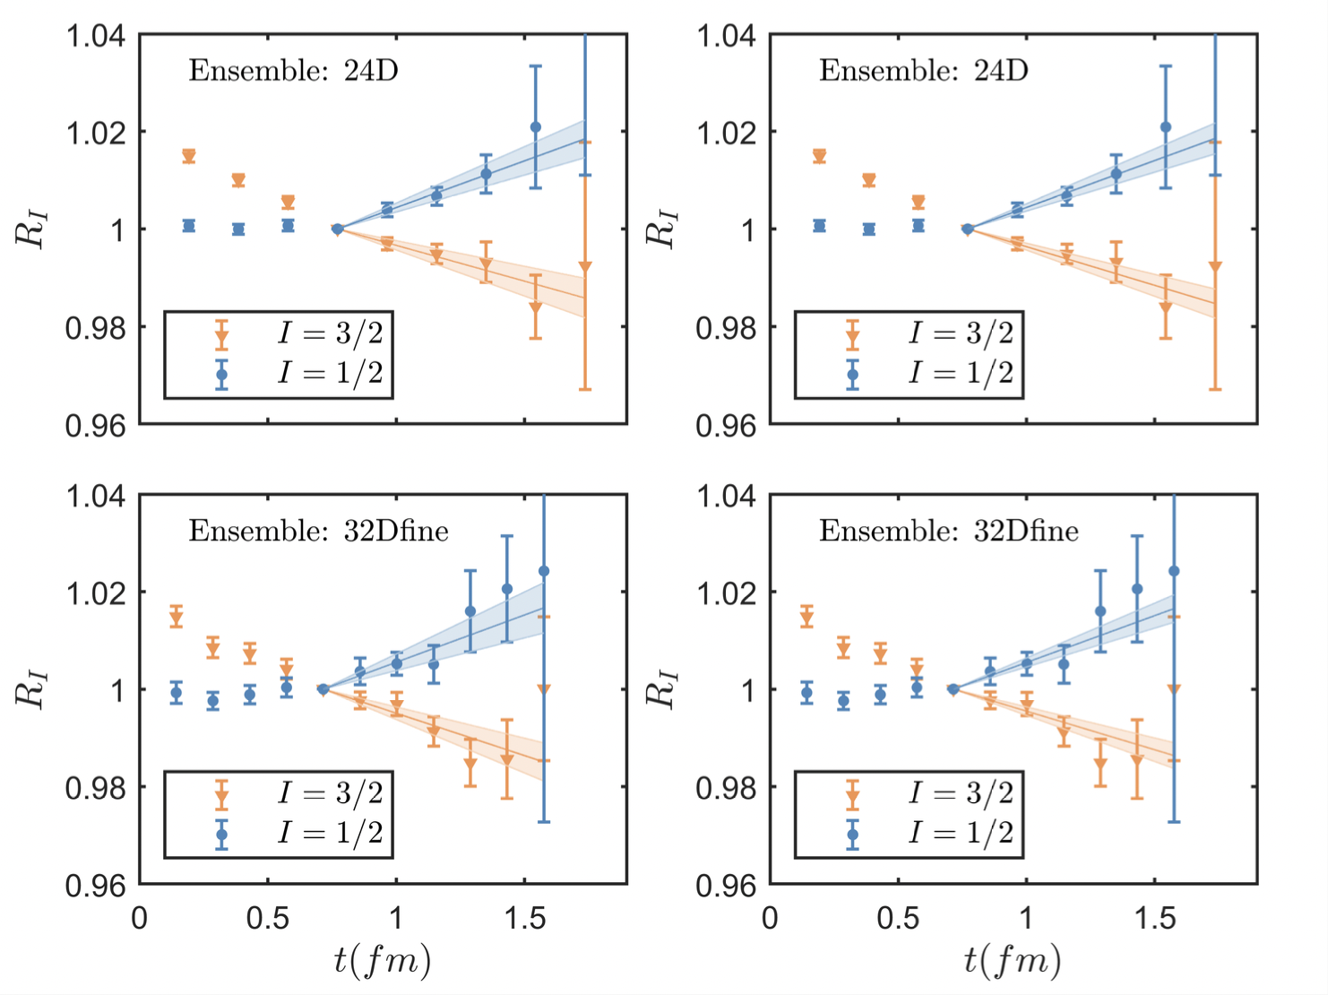
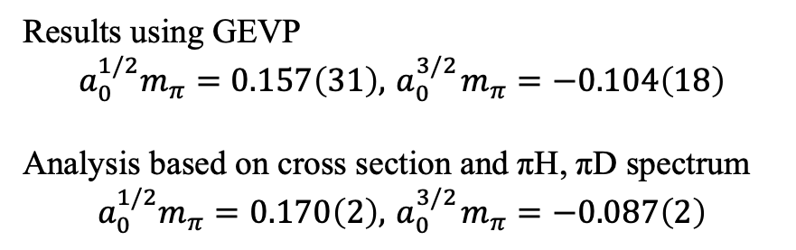
Results of $Nπ$ Scattering
Use Nπ operators with 4 lowest momenta & apply GEVP method
combined
fit
After GEVP, energy eigenvalues shift downwards for both I=1/2 & 3/2
Results using GEVP
$$a_{0}^{1/2}m_{π}=0.157\left(31\right), { a}_{0}^{3/2}m_{π}=−0.104\left(18\right)$$
Analysis based on cross section and πH, πD spectrum
$$a_{0}^{1/2}m_{π}=0.170\left(2\right), { a}_{0}^{3/2}m_{π}=−0.087\left(2\right)$$
~1σ
M. Hoferichter et al, PLB 843 (2023) 138001
18

Slide 19
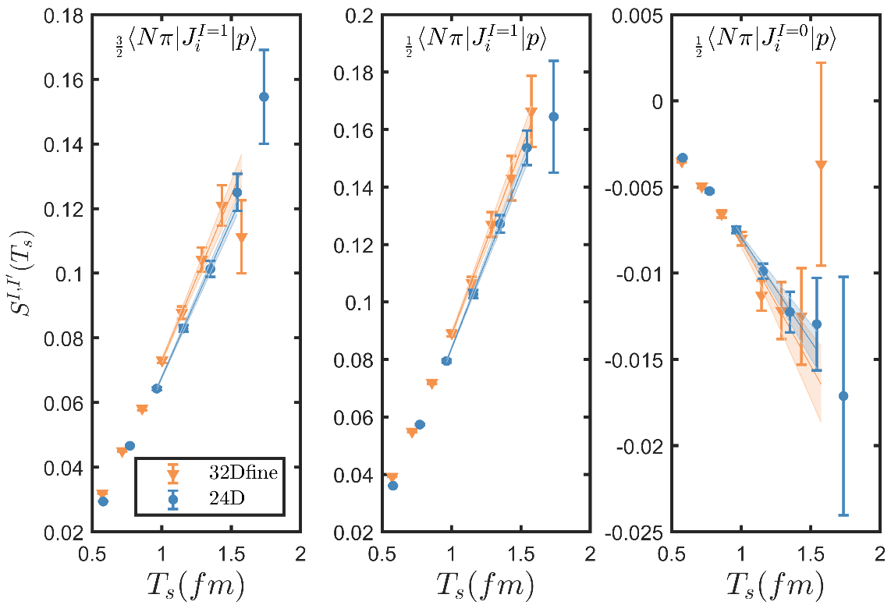
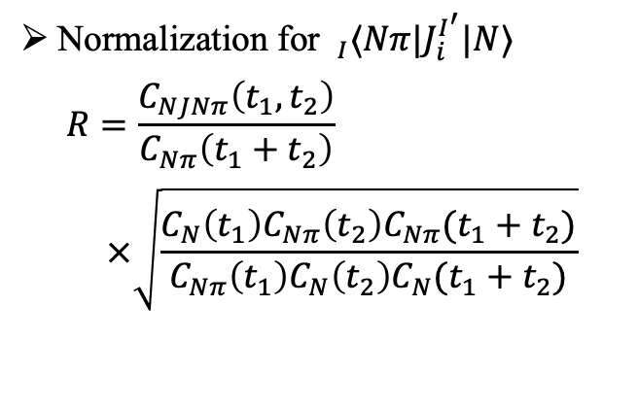

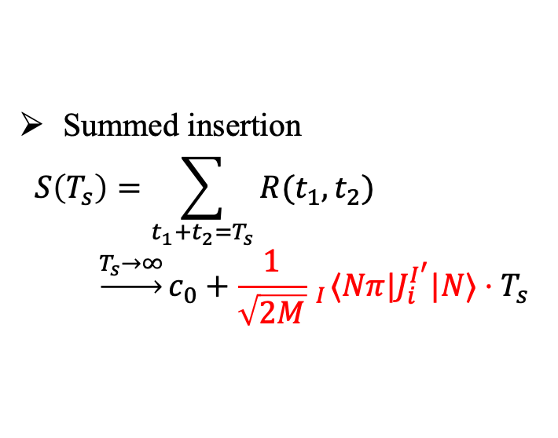
Matrix elements of 𝑁𝛾→𝑁𝜋
Nπ at the threshold
Normalization for $_{I}⟨Nπ|J_{i}^{I^{′}}|N⟩$
$$R=\frac{C_{NJNπ}\left(t_{1},t_{2}\right)}{C_{Nπ}\left(t_{1}+t_{2}\right)} \\ ×\sqrt{\frac{C_{N}\left(t_{1}\right)C_{Nπ}\left(t_{2}\right)C_{Nπ}(t_{1}+t_{2})}{C_{Nπ}\left(t_{1}\right)C_{N}\left(t_{2}\right)C_{N}(t_{1}+t_{2})}}$$
Maiani L. NPB, 293, 420(1987)
Summed insertion
$$S\left(T_{s}\right)=\sum_{t_{1}+t_{2}=T_{s}}{R(t_{1},t_{2})} \\ \underset{→}{T_{s}→∞}c_{0}+\frac{1}{\sqrt{2M}} _{I}⟨Nπ|J_{i}^{I^{′}}|N⟩⋅T_{s}$$
Linear fit $S\left(T_{s}\right)$ with $T_{s}$ to extract
19

Slide 20
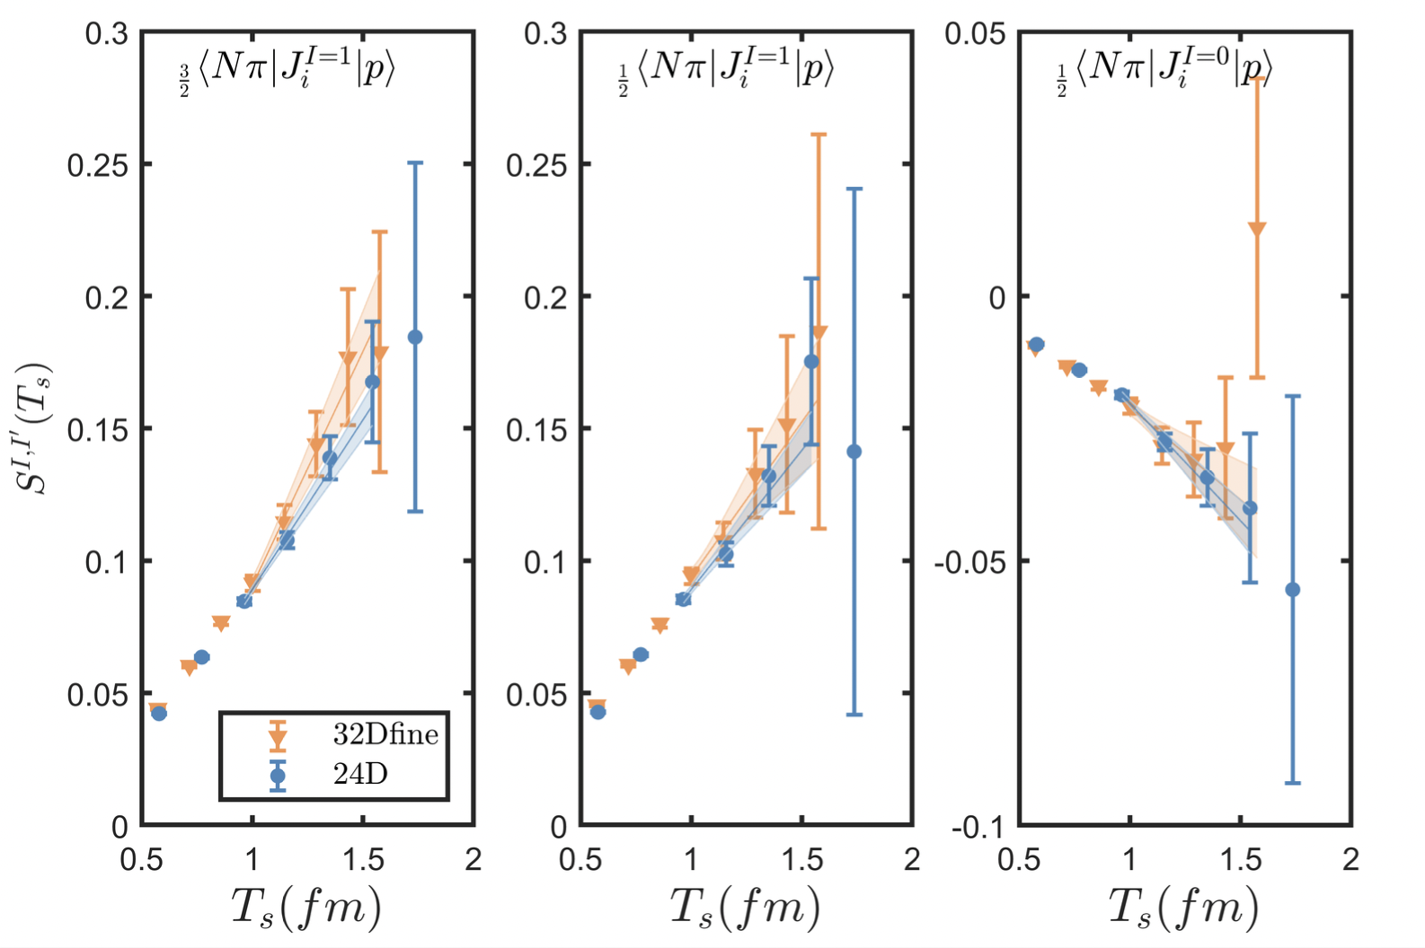
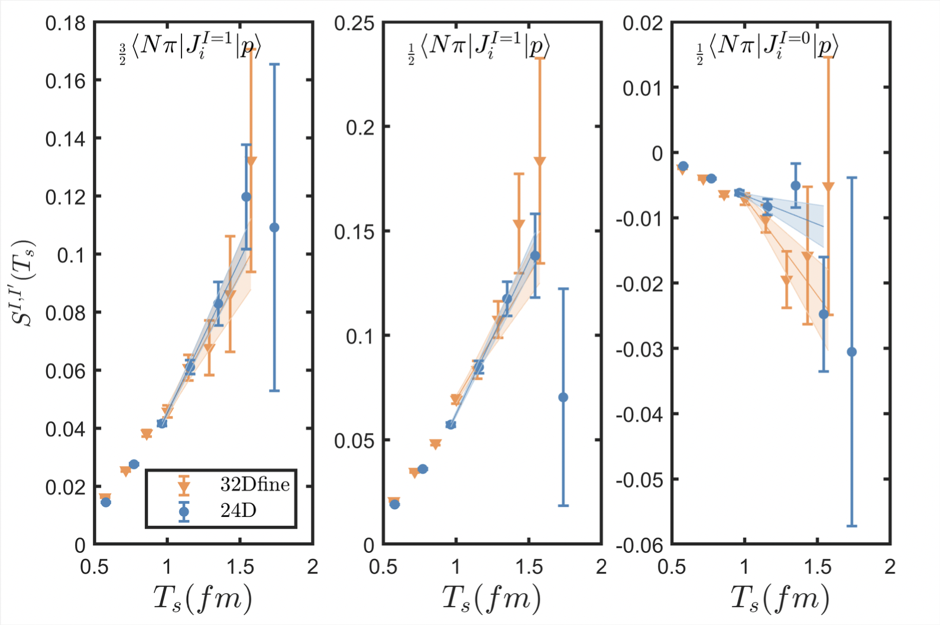


Matrix elements of 𝑁𝛾→𝑁𝜋
Nπ in the center of mass frame with mom. mode (100)
20

Slide 21
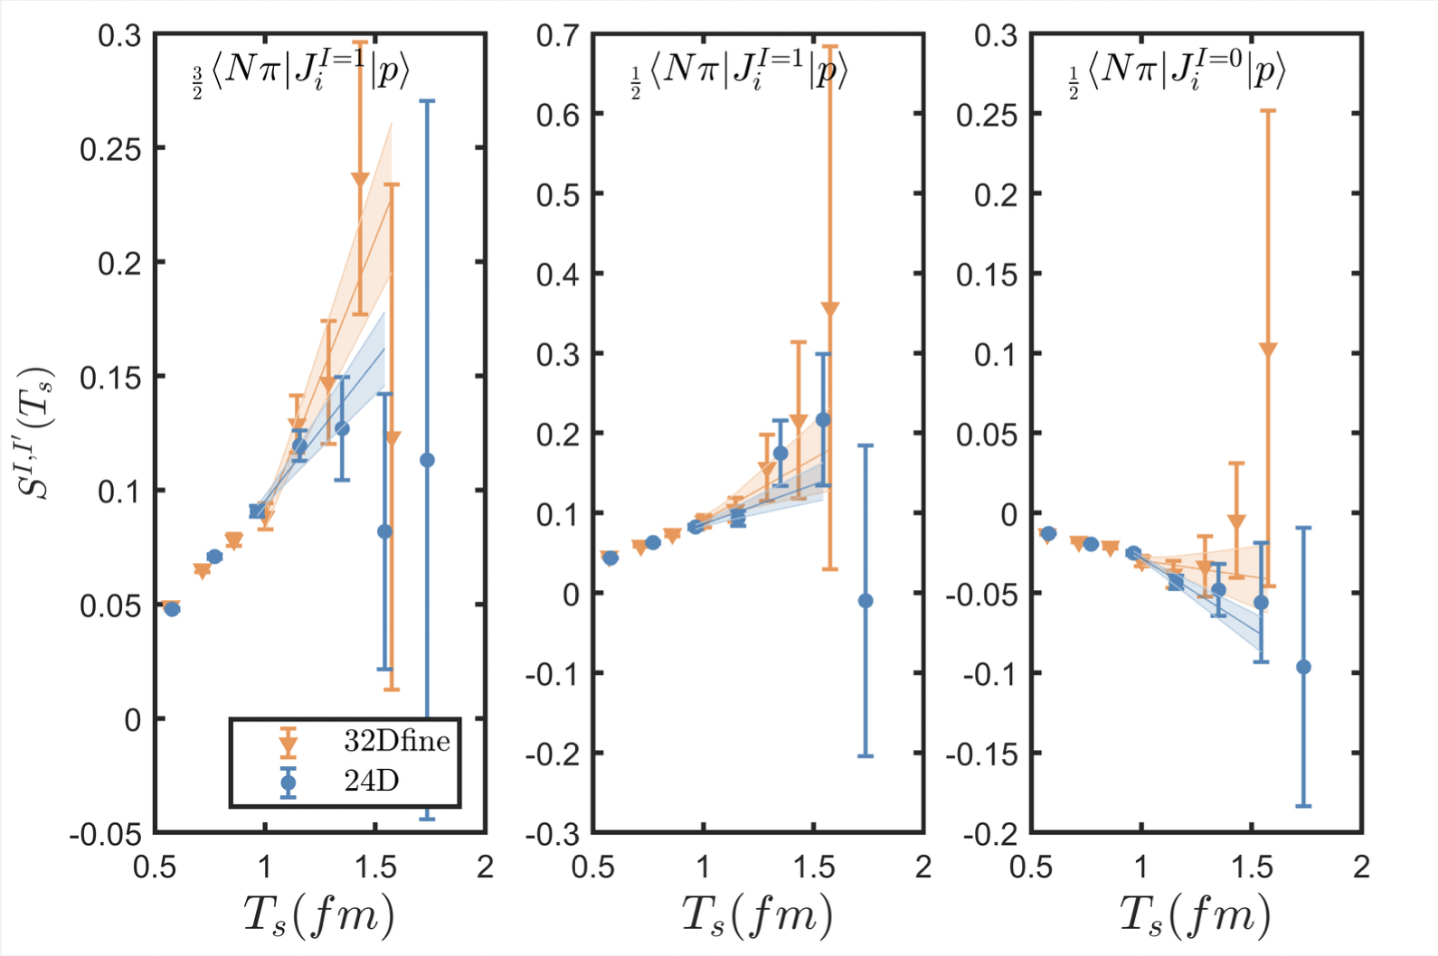
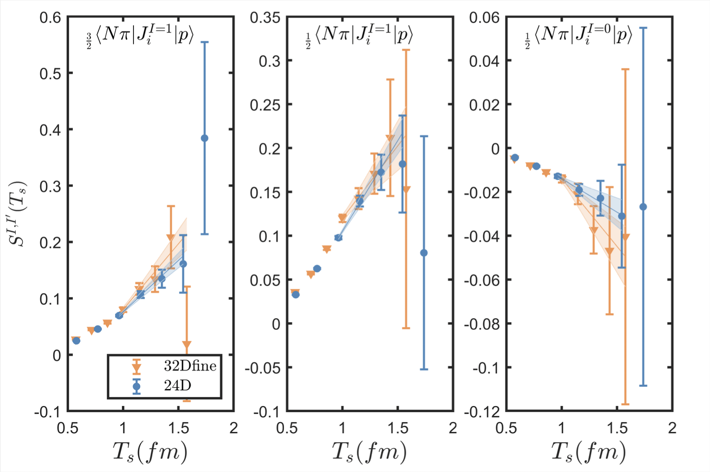
Matrix elements of 𝑁𝛾→𝑁𝜋
Nπ in the center of mass frame with mom. mode (110)
21

Slide 22
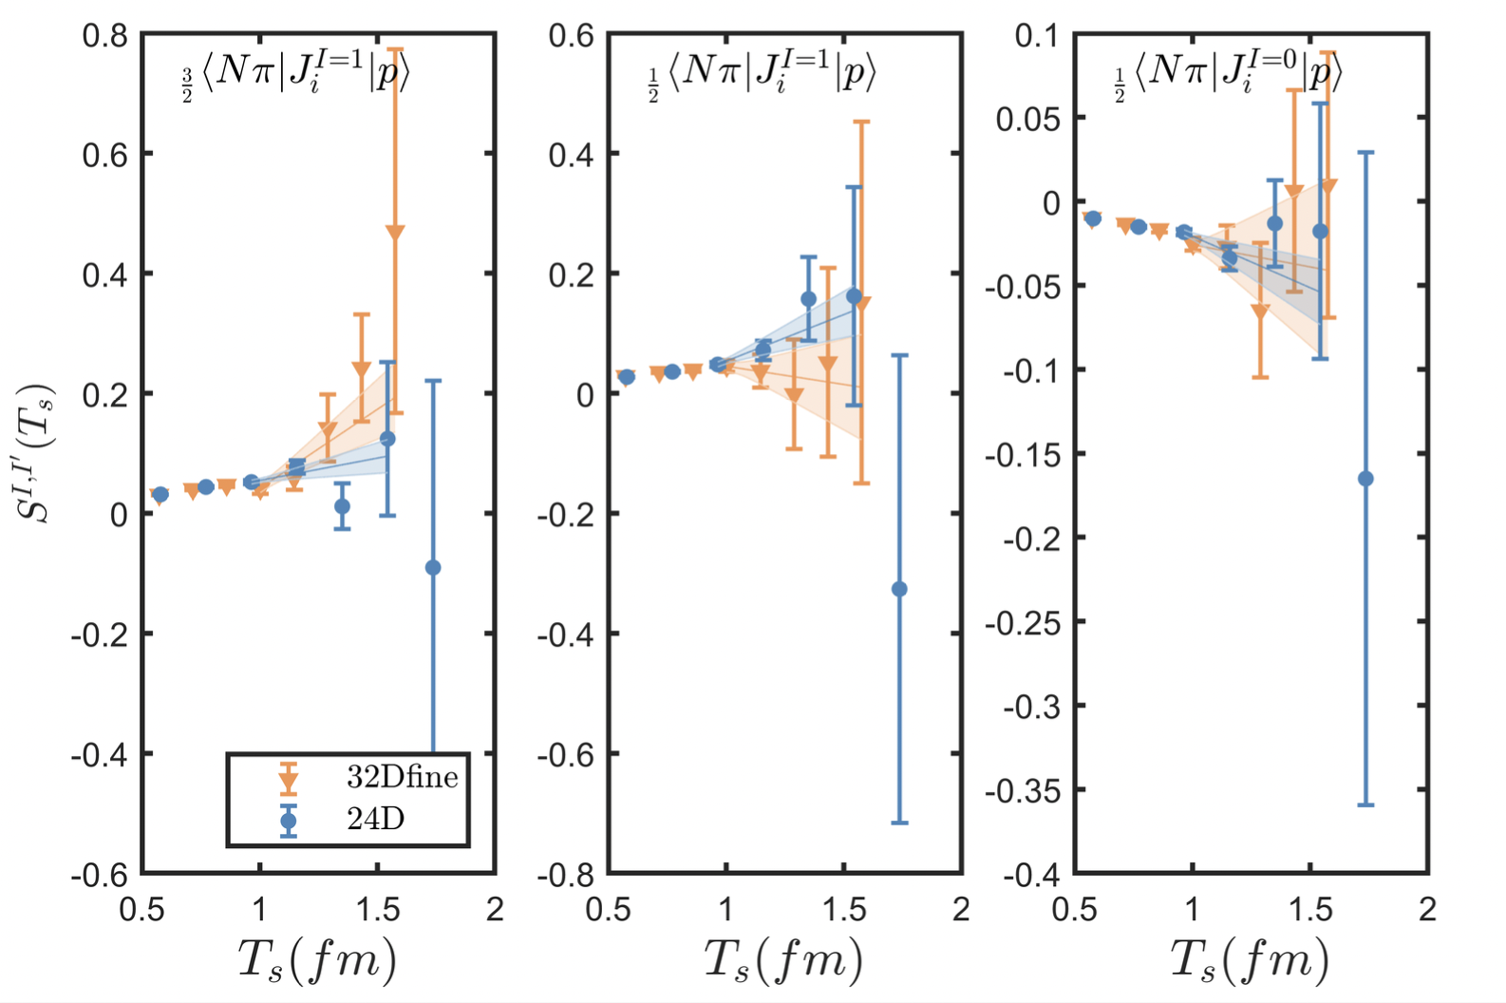
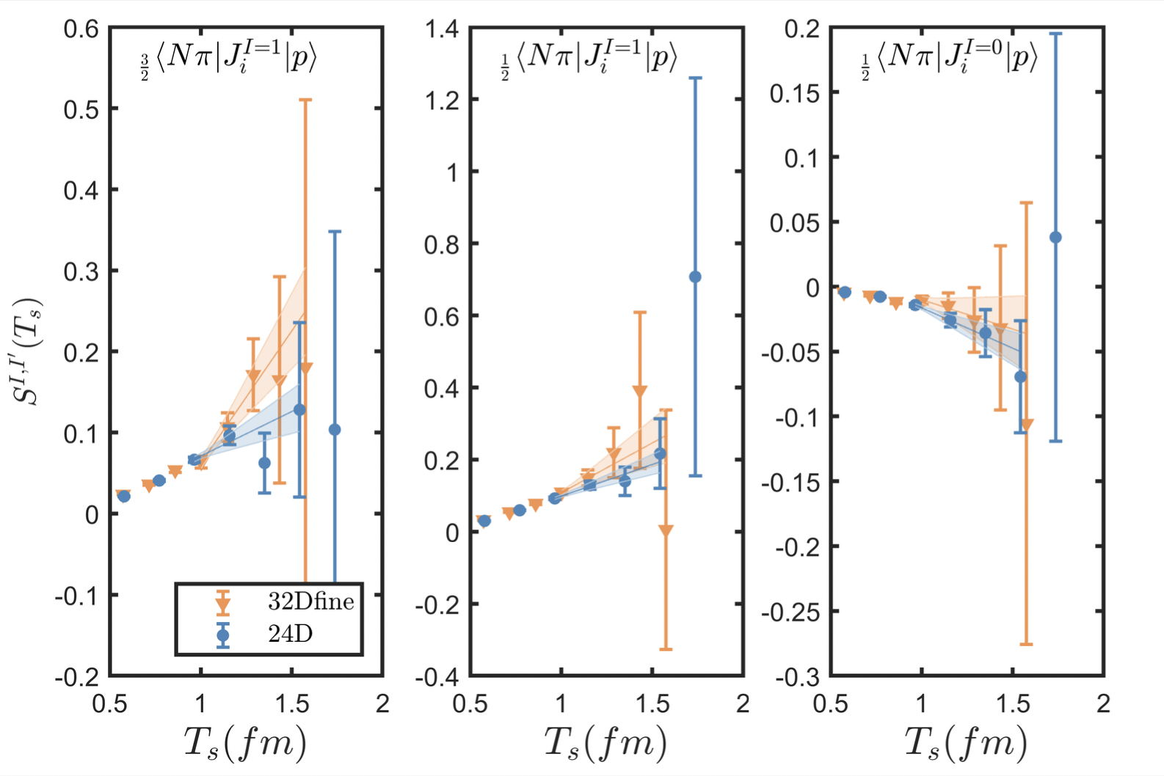
Matrix elements of 𝑁𝛾→𝑁𝜋
Nπ in the center of mass frame with mom. mode (111)
22

Slide 23
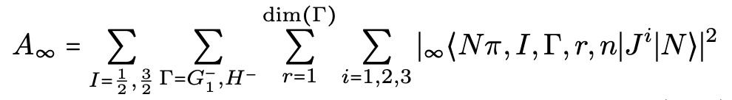



Matrix elements of 𝑁𝛾→𝑁(p)𝜋(-p) with 4 lowest mom modes
Proton
Neutron
(000)
Not convergent for $χ$PT
(001)
large gap
(011)
(111)
For lattice, momentum modes are limited
Limitations in the comparison between lattice QCD and $χ$PT:
For $χ$PT, photon is very timelike & $χ$PT does not work well
23

Slide 24








Momentum dependence of A∞
γ*
π
s
N
N
u
Keep quasi-singular in denominator
Taylor expansion in numerator
t
24

Slide 25


Finite-volume effects
Always positive and thus only exponentially suppressed FV effects
It is crucial to replace mom. summation by mom. integral
After replacement, residual FV effects are estimated to be < 10⁻⁵ fm³
25

Slide 26


Numerical results
Our results of $α_{E}$, in units of ${10}^{−4}fm^{3}$
X. Wang, Z. Zhang, et. al., PRL 133 (2024) 141901
 |  | 24D | 32Dfine | PDG
Proton | $$α_{E}^{Nπ}$$ | 5.65(53) | 6.5(1.2)
 | $$α_{E}$$ | 10.0(1.3) | 9.3(2.2) | 11.2(4)
Neutron | $$α_{E}^{Nπ}$$ | 8.33(75) | 9.8(1.5)
 | $$α_{E}$$ | 9.7(1.4) | 10.1(2.4) | 11.8(1.1)
Confirm large contributions of $Nπ$ states – 60% for proton & 90% for neutron
Develop the methodology for lattice QCD computation of polarizabilities
More sophisticated study to control systematic effects
Larger volume to have more momentum modes
Excited-state contamination from initial and final states
Finer lattice spacing for continuum extrapolations
26

Slide 27


Extended projects – threshold pion EW production
Consider the process γ*(k)+N(p₁) → π(q)+N(p₂)
Threshold pion production means that in the γ*N center of mass frame, pion is at threshold q_{μ}=(M_{π},0,0,0)
V. Bernard, N. Kaiser, T.-S. Lee, U.-G. Meissner, Phys. Rept. 246 (1994) 315
Multipole amplitude describes the transverse and longitudinal coupling of γ* to the nucleon spin
Parameters are define as
27

Slide 28


Extended projects – threshold pion EW production
Consider the process γ*(k)+N(p₁) → π(q)+N(p₂)
Threshold pion production means that in the γ*N center of mass frame, pion is at threshold q_{μ}=(M_{π},0,0,0)
28

Slide 29





Extended projects – threshold pion EW production
Consider the process W*(k)+N(p₁) → π(q)+N(p₂)
V. Bernard, N. Kaiser, U.-G. Meissner, PLB 331 (1994) 137

Slide 30
Interesting journey of research
Nucleon E&M polarizability
Nucleon structure
Nπ rescattering
Hadron spectroscopy
Pion EW production
Lepton-nucleon inelastic scattering
An interesting journey to explore nucleon properties!
30

Slide 31
Extended discussion on nucleon 4pt function

Slide 32
4-point correlation function – frontiers in lattice QCD
E&M corrections including IB effects
Higher-order EW interactions
4-point correlation function
Hadronic tensor using optical theorem
HLbL contributions in muon g-2
32

Slide 33



Challenges in nucleon 4pt correlation functions (I)
Nucleon system – severe signal/noise (S/N) problem
Statistics tells us that variance is given by <O²>-<O>²
Square of signal
Variance is dominated by <O²>
<O>² =
<O²>=
4-pt function requires operators at 4 diff. time slices and thus needs large t separation
S/N is
Solution: optimized operators, variational analysis, reconstruction of ground/excited states
33

Slide 34





Challenges in nucleon 4pt correlation functions (II)
Hadronic part from a typical 4-point function
Solution：Field sparsening method
【Y. Li, S. Xia, XF, L. Jin, C. Liu, PRD 103 (2021) 014514】
【W. Detmold, D. Murphy, et. al. PRD 104 (2021) 034502】
2
【See also HLbL calculation in muon g-2】
1
3
4
Perform the volume summation for each point
$$\sum_{x∈L^{3}}{}$$
Less summation points may lead to lower precision
It is not the case because of high correlation in lattice data
Used for pion, proton, g_{A} to verify its application
From 3-point to 4-point function
$$x_{1}$$
$$x_{3}$$
$$x_{2}$$
$$x_{1}$$
$$x_{3}$$
$$x_{4}$$
$$x_{2}$$
10²-10³ times less points yields similar precision
3-point: $L^{6}$ summation
4-point: $L^{9}$ summation
Utilize field sparsening method
Increasing each point, computational cost increases by 10⁴-10⁵ times!
Reduce the computational cost by a factor of 10²-10³ with almost no loss of precision!
34

Slide 35



Challenges in nucleon 4pt correlation functions (III)
Short-distance divergence
γW-box contribution to β decays
Low Q² - lattice QCD + Large Q² - OPE
XF, M. Gorchtein, L. Jin, et.al. PRL124 (2020) 19, 192002
J. Yoo, T. Bhattacharya, R. Gupta et.al. PRD 108 (2023) 034508
P. Ma, XF, M. Gorchtein, et.al. PRL132 (2024) 191901
Non-trivial bilocal operator renormalization in rare kaon decays
N. Christ, XF, A. Portelli, C. Sachrajda, PRD93 (2016) 114517
Z. Bai, N. Christ, XF, et.al. PRL118 (2017) 252001
35

Slide 36







Challenges in nucleon 4pt correlation functions (IV)
IR divergence
Two-photon exchange contribution to muonic hydrogen Lamb shift
Y. Fu, XF, L. Jin, C. Lu, PRL 128 (2022) 172002
Two photon propagators, very IR divergent!
(IR divergence is related with vector form factor and its derivative at q²=0)
Idea to solve IR divergence: infinite-volume reconstruction method
【X. Feng, L. Jin, PRD 100 (2019) 094509】
at large
At large x separation, is dominated by intermediate nucleon state
With appropriate weight functions, we can use
to reproduce charge conservation & charge radius
For Nπ intermediate state, although no IR divergence, convergence of Euclidean time integral can be very slow
We have seen it in this talk → Reconstruction of low-lying state contribution is necessary!
36

Slide 37




Challenges in nucleon 4pt correlation functions (V)
Exponentially growing contamination in Euclidean time
Parity violating e-p scattering
On-shell intermediate states
On-shell intermediate states
N. Christ, XF, L. Jin, C. Tu, Y. Zhao, PRL 130 (2023) 191901
Possibly
or
Exponentially growing contamination in temporal integral!
If X contains only single hadron or no hadron, a correct EW weight function in Euclidean time can be constructed
If X contains two hadrons, finite-volume effects must be addressed properly
X. Tuo & X. Feng, arXiv:2407.16930
37

Slide 38
Conclusion and outlook
E&M corrections including IB effects
Higher-order EW interactions
4-point correlation function
Hadronic tensor using optical theorem
HLbL contributions in muon g-2
New frontiers, new methodology and new findings!
38

