Slide 1


Gravitational form factors
and
Mechanical Properties of the Nucleon
Hyun-Chul Kim
Department of Physics, Inha University
Incheon, Korea

Slide 2
Introduction: What do we know about nucleon?
Proton (1920 named by Rutherford)
Neutron (found in 1932 by Chadwick)
Mass: 938.27 MeV
Mass: 939.57 MeV
Spin: 1/2
Spin: 1/2
Charge: 1
Charge: 0
Magnetic moment: 2.79
Magnetic moment: -1.91
We still do not know the origin of the nucleon mass and spin.
EIC: Physics of gluons
Understanding the gravitational form factors
Mechanical properties of the nucleon

Slide 3
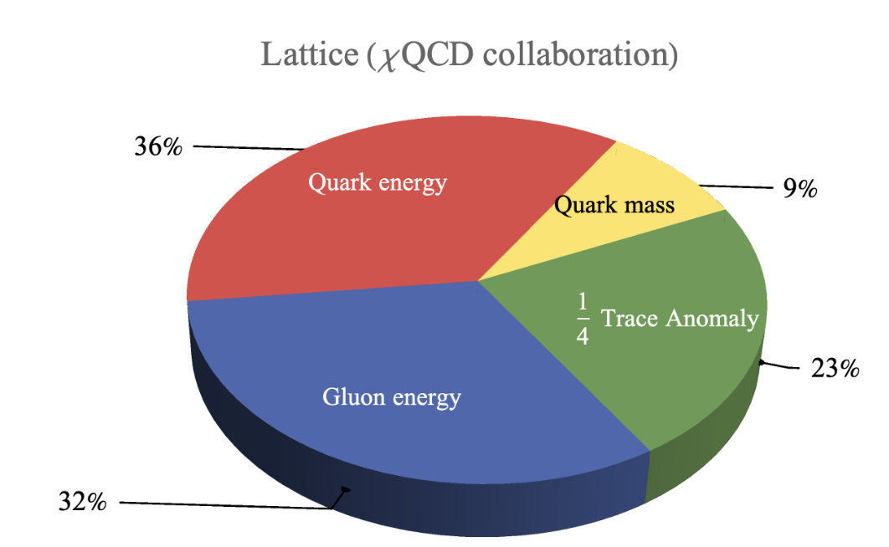
Introduction: Nucleon Mass
Ji’s mass decomposition:
X. Ji, Front. Phys. (Beijing) 16, 64601 (2021)
Example
Yang et al. PRL 121, 212001 (2018)
C. Lorce, JHEP 11, 121 (2021)
W. Liu, Shuryak, Zahed, 2404.03057
K.F. Liu, 2302.11600

Slide 4
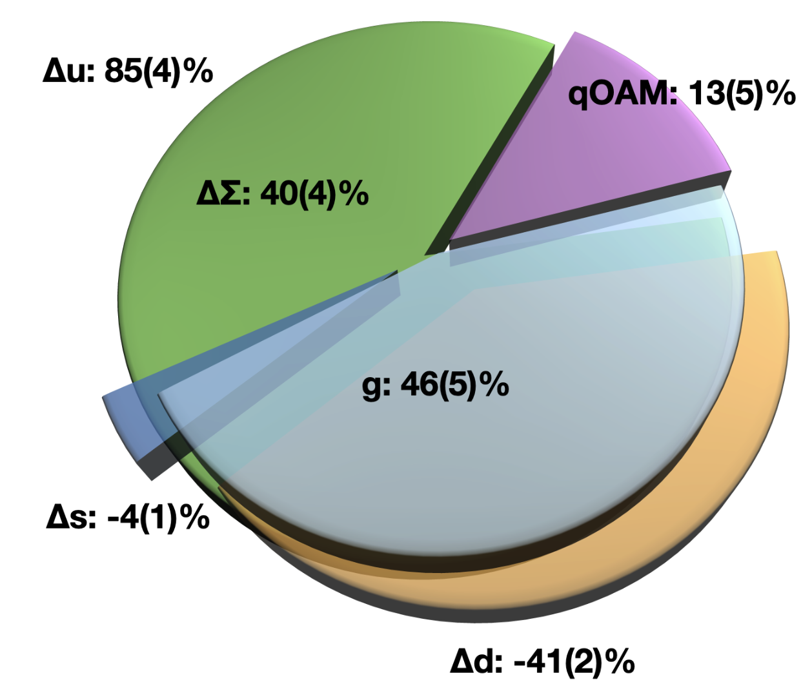
Introduction: Nucleon Spin
Ji’s spin sum rule:
X. Ji, Phys. Rev. Lett. 78 610, (1997)
Example
G. Wang et al. 2111.09329

Slide 5
All information on mass & spin from GFFs
The gravitational form factors of the nucleon reveal all information
related to the nucleon mass & spin.
EIC: Physics of gluons
Understanding the gravitational form factors
Mechanical properties of the nucleon

Slide 6


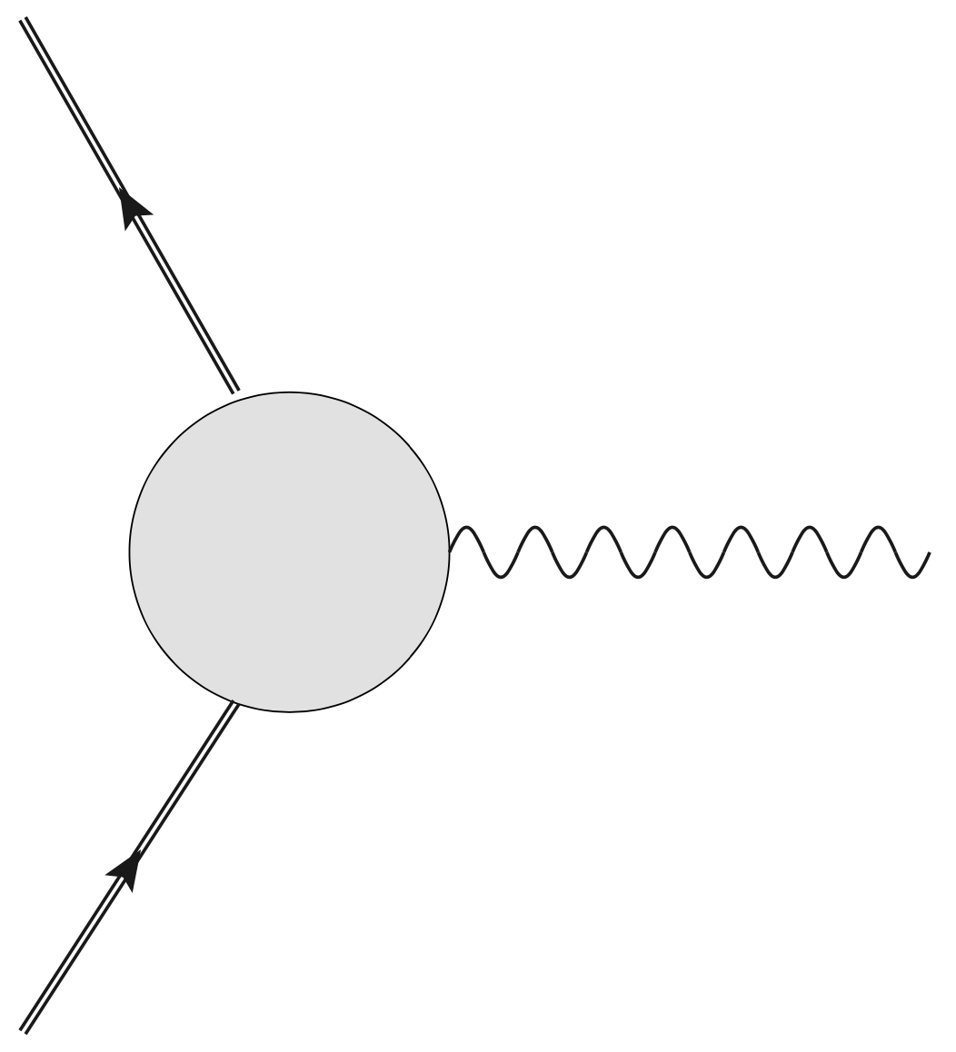
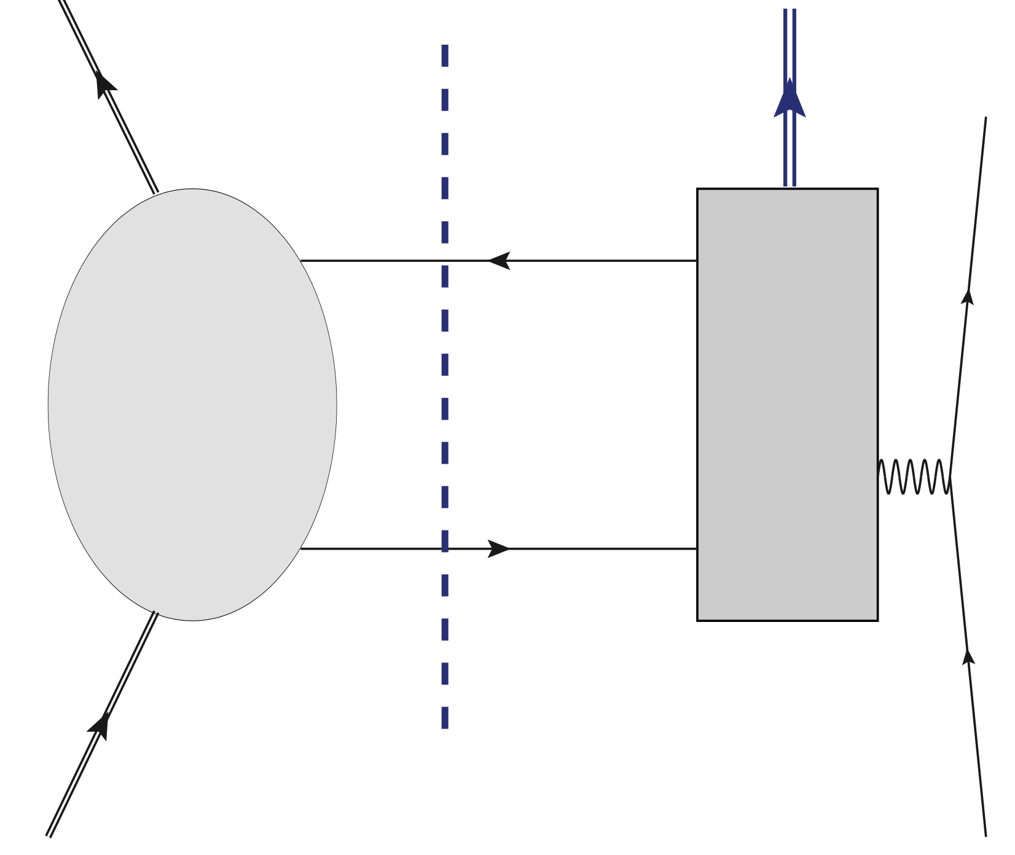








Introduction: Hadron Structure in QCD
Noether current as a probe
QCD operators
Scale invariance
Soft part (npQCD)
Hard part (pQCD)
EM form factors
Electroweak form factors
Gravitational form factors
Scale-dependent
Gluons enter!
Hadronic matrix
elements
governed by symmetries
Exception: Tensor form factors

Slide 7





Effective QCD operators
QCD
Low-energy Effective
quark-gluon dynamics
(Essential physics: SBXB)
QCD operators
Effective QCD operators
Twist-2 effective operators
are determined by dynamics.
Twist-2
(from the instanton vacuum)

Slide 8
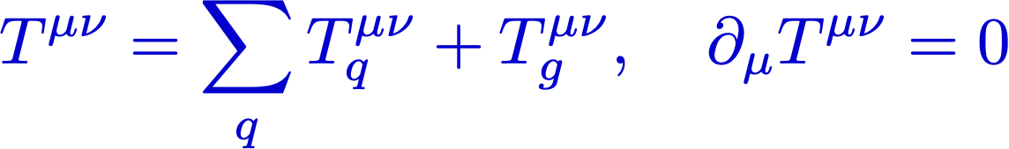
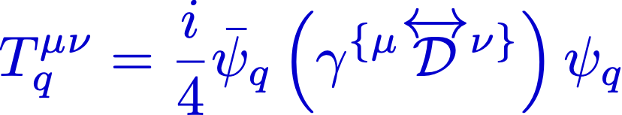
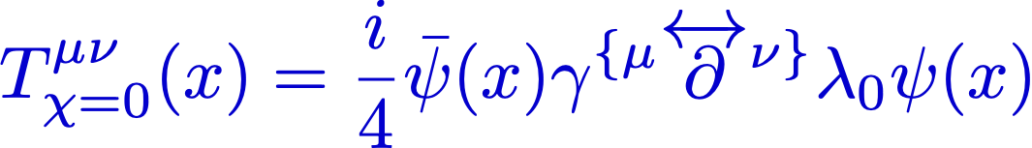
Example: Flavor-decomposition of EMT operators
Energy-momentum tensor operators:
M.V. Polyakov and P. Schweitzer, IJMP. A 33 (2018)
QCD operators
Effective QCD operators
(Gluons integrated out)
However…
Flavor decomposition of GFFs requires both twist-2 & twist-4 EMT operators.
But we don’t know yet how to derive the flavor-nonsinglet EMT currents
without ambiguity.
H-Y. Won, HChK, J.-Y. Kim, JHEP 05 (2024)

Slide 9
Gravitational form factors
of
the proton

Slide 10
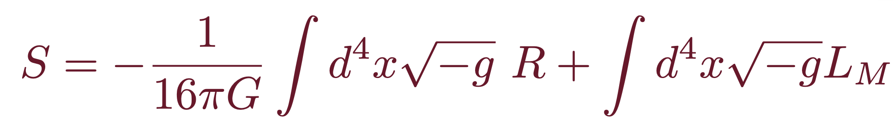


Energy-Momentum Tensor operators
Hilbert-Einstein Action
Changing the metric in the long-wave approximation,
we find the energy-momentum tensor (EMT) that characterizes the response of
the nucleon to the static variation of the space-time metric:
Bellifante-Rosen type QCD EMT Current
Quark part
Gluon part

Slide 11




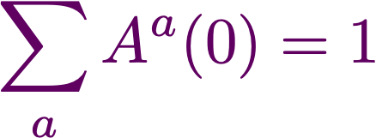
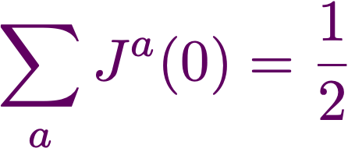
Gravitational (EMT) form factors
Gravitational form factors of the nucleon in QCD
Kobzarev et al. 1962; Pagels, 1966
D(Druck)-term
Weiss & Polyakov, 1999
Non-conservation
of EMT pieces
(cosmological constant)
Mass
Spin
O. V. Teryaev, Front. Phys. 11 (2016)
K.-F. Liu, PRD 104 (2021)
Deformation of space
= mechanical properties of the nucleon
Pressure & Shear-force distributions (pressure anisotropy)
Pressure & Shear-force distributions (pressure anisotropy)
Twist-4 operators
MV Polyakov, HD Son, JHEP (2018)

Slide 12
Twist-projected EMT currents
H-Y. Won, HChK, J.-Y. Kim, JHEP 05 (2024)
Twist-4 EMT current:
Twist-2 EMT current:
Twist-2 baryon matrix elements
Twist-4 baryon matrix elements
cbar form factor comes from
the twist-4 operator!
MV Polyakov, HD Son, JHEP (2018)
Y Hatta, A Rajan, K Tanaka, JHEP (2018)

Slide 13
Flavor decomposition of GFFs
To decompose the GFFs, we need to compute the generalized EMT
form factors for the flavor triplet & octet.
From the current conservation
Naive effective EMT-like flavor nonsinglet currents
Note that they are not conserved.
Extracting flavor-decomposed cbar form factors are the most challenging one!
The role of gluons
H. Y. Won, HChK, and J.-Y. Kim, PRD 108 (2023)
H-Y. Won, HChK, J.-Y. Kim, JHEP 05 (2024)

Slide 14
3-D Distributions

Slide 15
3D distributions
2D EMT distributions are unambiguously defined in the 2D IMF or LF
(Abel transform)
(JY Panteleeva, MV Polyakov, PLB (2020), A Freese, GA Miller, PRD (2021), JY Kim, HChK, PRD (2021)).
However, in the large Nc limit, it is natural and sufficient to focus on the 3D distributions.
The large Nc approximation yields the equivalence between the light-front helicity state and the canonical spin state at rest (C. Lorce et al. PRD 106 (2022)).
This allows one to perform matching between the 3D components of the EMT and the 2D LF ones (J.Y Kim et al. PLB 884 (2023)).
In the Breit frame
H. Y. Won, HChK, and J.-Y. Kim, PRD 108 (2023)
H-Y. Won, HChK, J.-Y. Kim, JHEP 05 (2024)

Slide 16
Mass distribution
Temporal component of the EMT
Mass monople form factors
In the forward limit
Twist-4 contributions
H-Y. Won, HChK, J.-Y. Kim, JHEP 05 (2024)

Slide 17
Mass distribution
Baryon masses
Twsit-4
Mass radii
H-Y. Won, HChK, J.-Y. Kim, JHEP 05 (2024)

Slide 18
Angular momentum distribution
0i component of the EMT
H-Y. Won, HChK, J.-Y. Kim, JHEP 05 (2024)
The angular momentum of a baryon
The decomposition of the angular momentum into the OAM and the quark spin requires the twist-3 component of the EMT (the antisymmetric part of the EMT current): Spin-Orbit correlation
C Lorce PLB 735 (2014); JY Kim, Ch Weiss PLB 848 (2024); J.-Y. Kim , H-Y. Won, HChK, Ch Weiss 2403.07186

Slide 19
Mechanical Properties
ij component of the EMT
Pressure densities
Shear-force densities
Pressure form factors
In the forward limit,
The unambiguous definition of the flavor-decomposed pressure distribution is not possible without the twist-4 form factors considered.
H-Y. Won, HChK, J.-Y. Kim, JHEP 05 (2024)

Slide 20
Stability conditions (Equilibrium eqs)
Conservation of the EMT
Internal force fields
M. V. Polyakov & P. Schweitzer, IJMPA33 (2018)
Equilibrium Equation
H-Y. Won, HChK, J.-Y. Kim, JHEP 05 (2024)
H. Y. Won, HChK, and J.-Y. Kim, PRD 108 (2023)

Slide 21
Stability conditions (Equilibrium eqs)
Von Laue condition
Pressure density must have at least one nodal point.
Local stability condition
IA Perevalova, MV Polyako, P Schweitzer, PRD 94 (2016).
See also Lorce et al. EPJC 79 (2019) for other
stability conditions.
Mechanical radius
H-Y. Won, HChK, J.-Y. Kim, JHEP 05 (2024)
H. Y. Won, HChK, and J.-Y. Kim, PRD 108 (2023)

Slide 22
Effective EMT operators

Slide 23
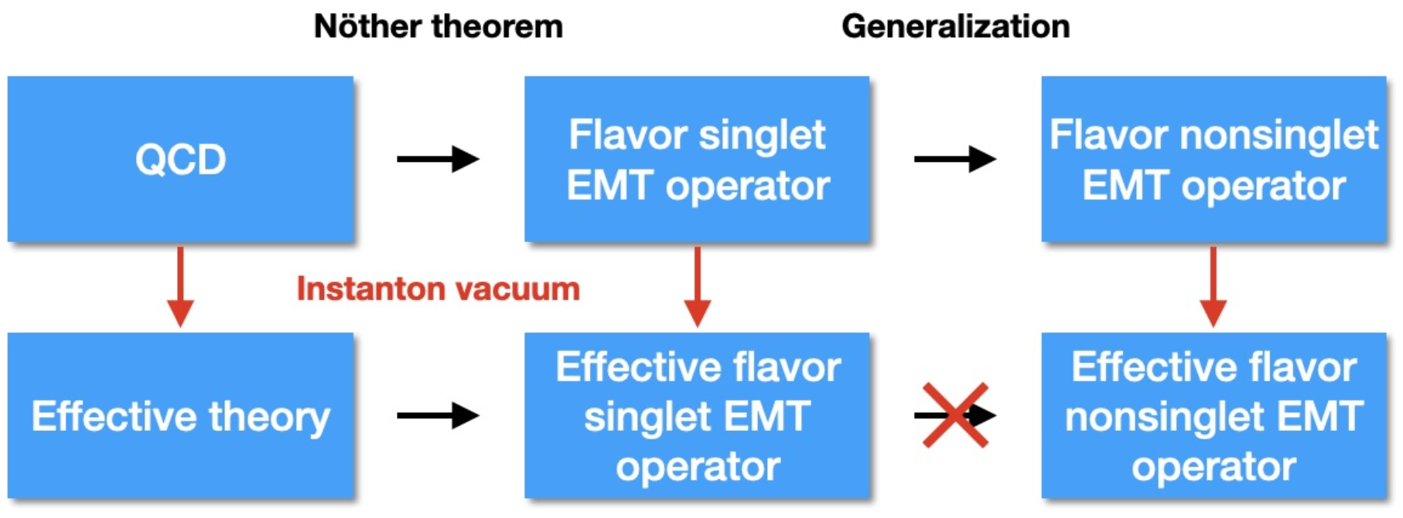
Effective EMT Operator
H-Y. Won, HChK, J.-Y. Kim, JHEP 05 (2024)
Effective operators:
?
Flavor nonsinglet operators require careful derivation!

Slide 24
Effective EMT Operator
Sum rules in QCD
Sum rules in the effective theory
Gluons are integrated out.
H-Y. Won, HChK, J.-Y. Kim, JHEP 05 (2024)

Slide 25
EMT Operator from the instanton vacuum
Effective quark operators
Pion mean fields
D. Diakonov et al. NPB 461 (1996)
J. Balla et al. NPB 510 (1998)
Dilute instanton medium
Bosonization
All low-energy theorems are satisfied (chiral anomaly, trace anomaly, etc).
The chiral-even twist-2 local operator is generated by expanding the non-local vector
current, which measures the vector GPDs, with respect to the space-time distance:
Twist-2 gluon operators are suppressed with respect to the packing fraction.
H-Y. Won, HChK, J.-Y. Kim, JHEP 05 (2024)

Slide 26
EMT Operator from the instanton vacuum
Twist-3 gluon operators
The contributions from these operators have been found to be crucial for satisfying the QCD equation of motion.
Essential role in the decomposition of the nucleon spin
Spin-orbit correlations are also related to them.
C. Lorce, PLB 735
J.Y. Kim et al. PRD 110
Twist-4 gluon operators should be also replaced by
flavor-dependent quark operators.
Gluons should be considered when the flavor decomposition
is considered, in particular, for the cbar form factors.
We will restrict ourselves to the twist-2 case for the GFFs.
H-Y. Won, HChK, J.-Y. Kim, JHEP 05 (2024)

Slide 27
Effective chiral theory
of
the Nucleon

Slide 28

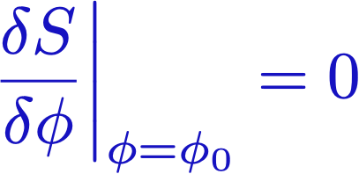



Mean fields
Given action ,
: Solution of this saddle-point equation
This classical solution is regarded as a mean field.
Mean-field potential that is produced by
all other particles.
Nuclear shell models
Ginzburg-Landau theory for superconductivity
Quark potential models for baryons

Slide 29
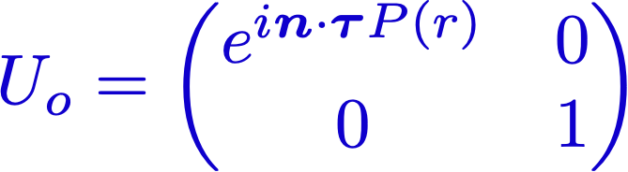

Pion mean-field approach (Chiral Quark-Soliton model)
Baryons as a state of Nc quarks bound by mesonic mean fields.
E. Witten (1979)
Effective chiral action from the instanton vacuum:
D. Diakonov & V. Petrov (1986)
Key point: Hedgehog Ansatz
D. Diakonov, V. Petrov, P. Pobylitsa (1988)
P(r): profile function
It breaks spontaneously
Witten’s trivial embedding
Ch. Christov, HChK, K. Goeke et al. PPNP (1996)
D. Diakonov hep-ph/9802298

Slide 30
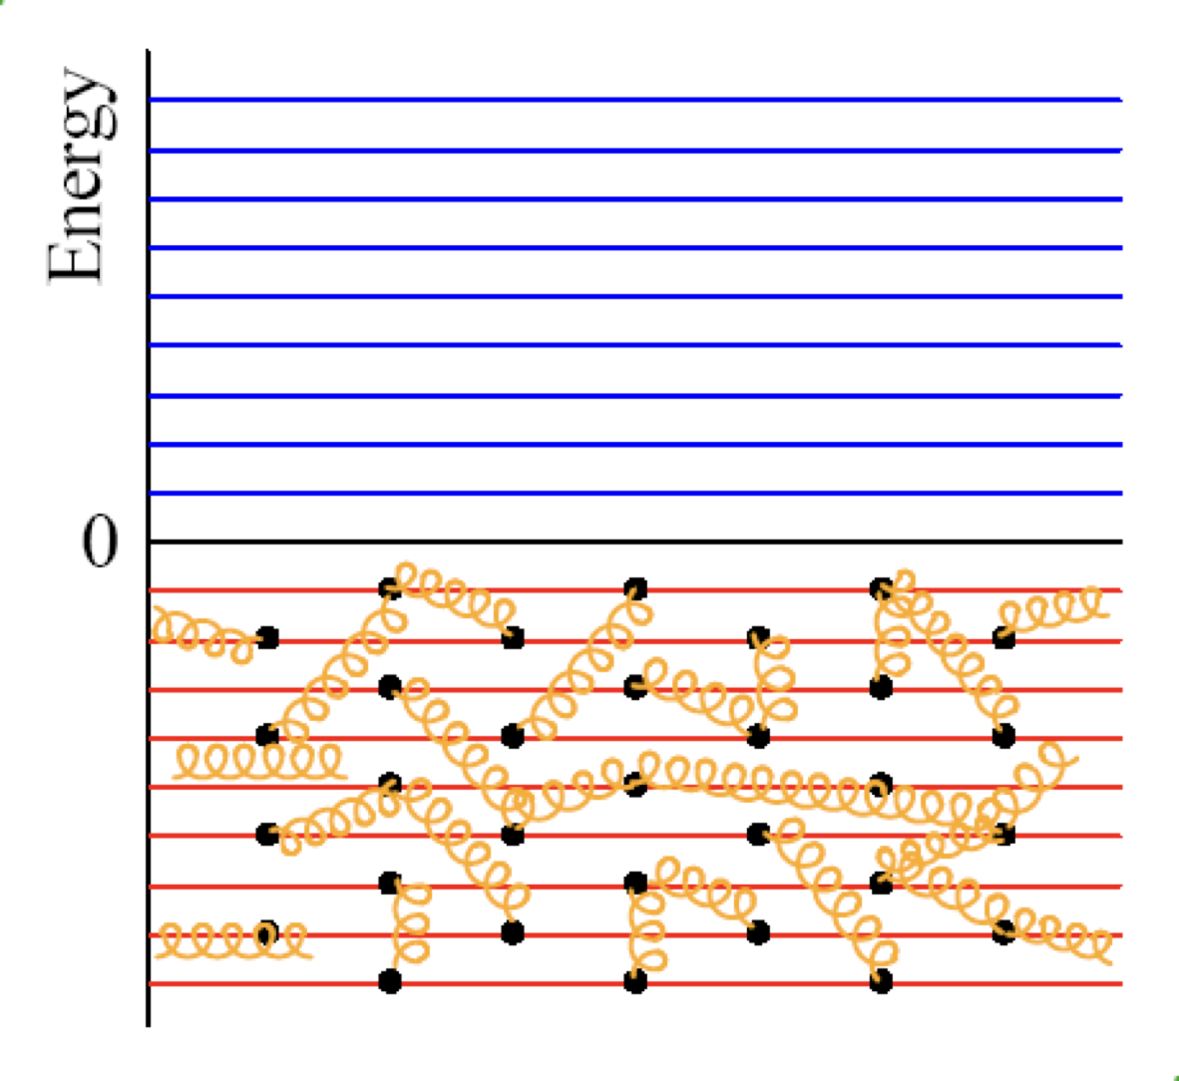
Schematic view on the XQSM
Interacting vacuum

Slide 31
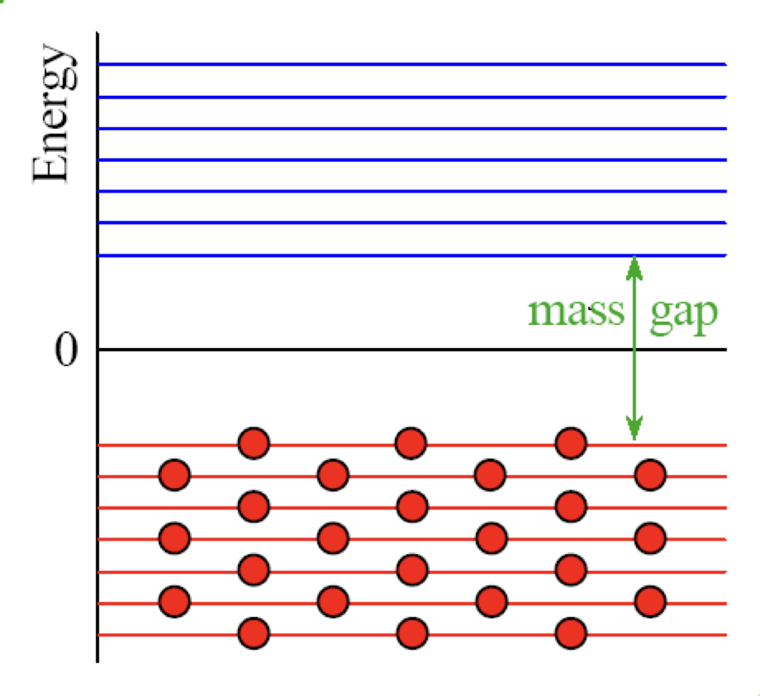
Schematic view on the XQSM
Spontaneous breakdown of chiral symmetry

Slide 32
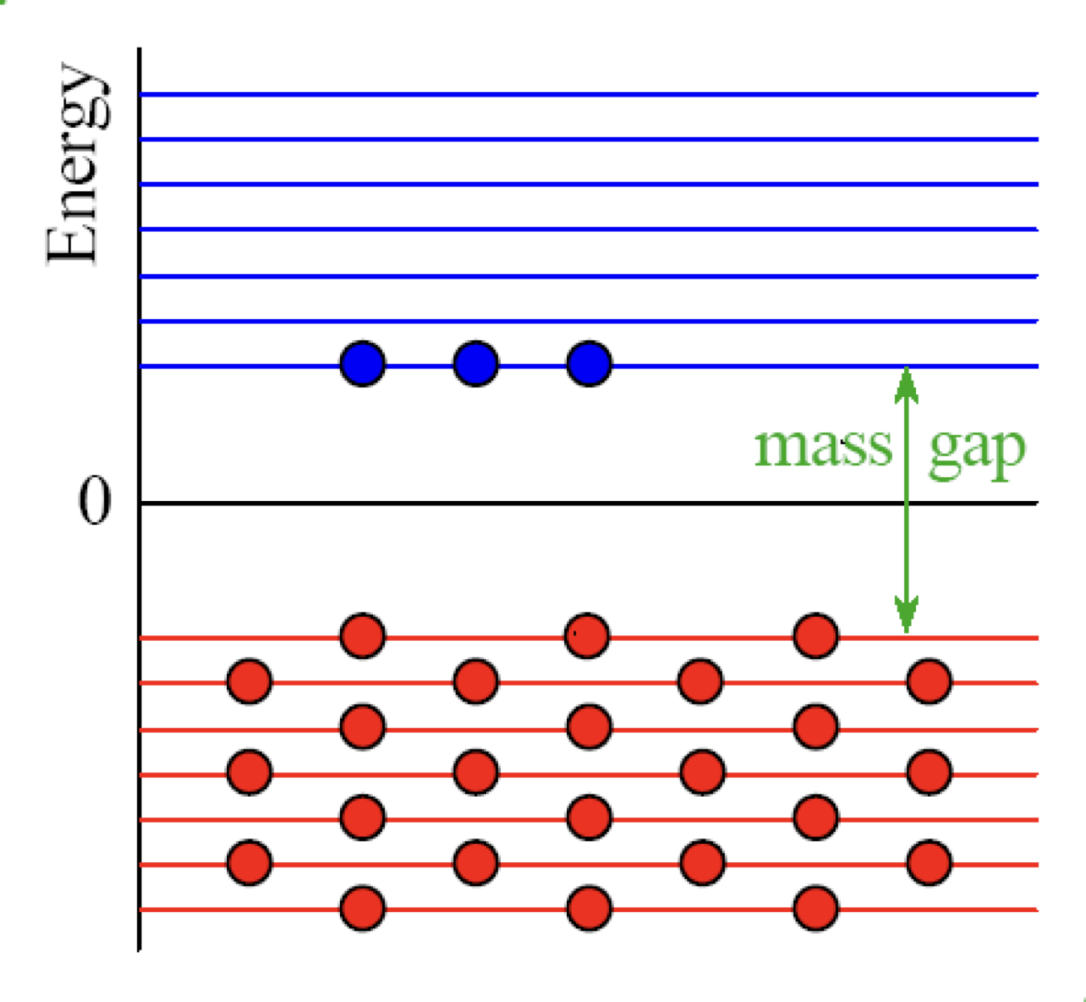



Schematic view on the XQSM
Interaction between quarks and pion background fields

Slide 33
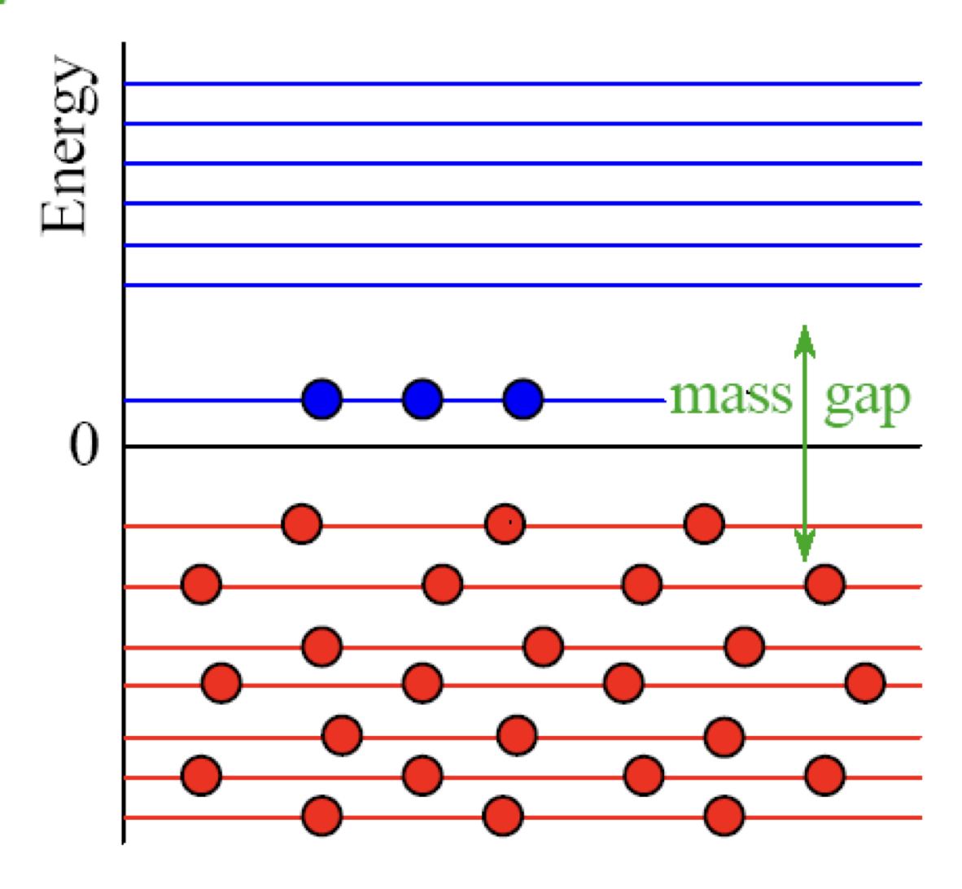
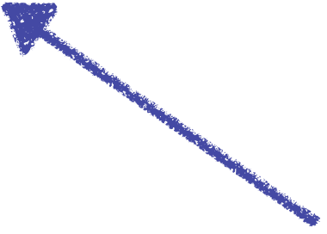
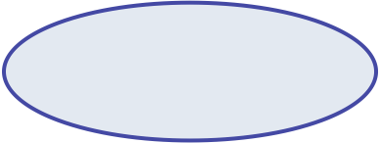

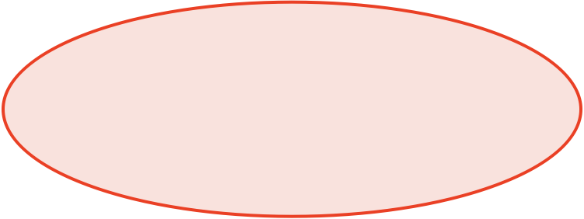
Schematic view on the XQSM
Nc quarks are bounded by the pion mean fields self-consistently.
Valance level:
Energy decreases
Sea level:
Energy increase
The system is stabilized!

Slide 34



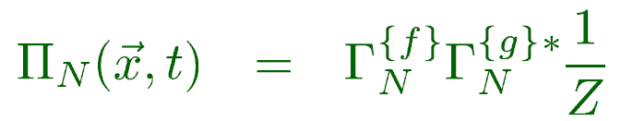
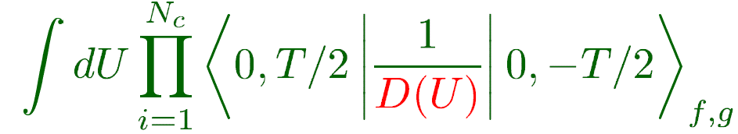

Baryon correlation function
Baryon as Nc valence quarks bound by pion mean fields
Presence of Nc quarks will polarize the vacuum or create mean fields.
Nc valence quarks
Vacuum polarization or meson mean fields
Ch. Christov, HChK, K. Goeke et al. PPNP (1996)
D. Diakonov hep-ph/9802298

Slide 35
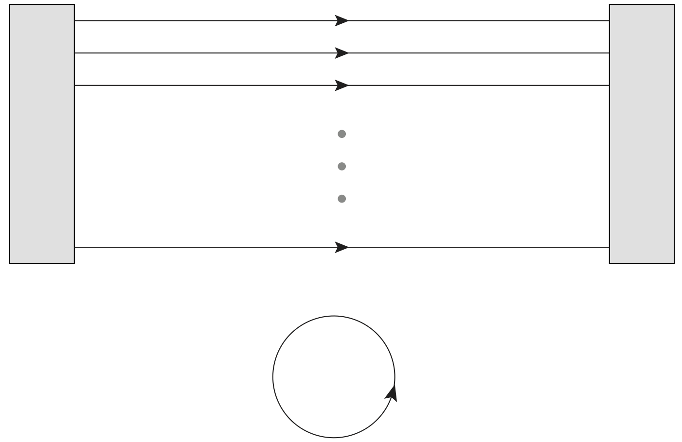




Baryon correlation function
Baryon as Nc valence quarks bound by pion mean fields
Classical Nucleon mass is described by the Nc valence-quark energy
and sea-quark energy.
Ch. Christov, HChK, K. Goeke et al. PPNP (1996)
P(r): Soliton profile function
or Soliton field

Slide 36
Zero-mode(collective) quantization
Rotational & Translational zero modes
Collective Hamiltonian & Wavefunctions in flavor SU(3) symmetry
Ch. Christov, HChK, K. Goeke et al. PPNP (1996)
D. Diakonov hep-ph/9802298

Slide 37
GFFs from the XQSM
Rotational & Translational zero modes
For detailed results, see the Refs. H. Y. Won, HChK, J.-Y. Kim JHEP (2024) & PRD 108 (2023)

Slide 38
Results & Discussion

Slide 39
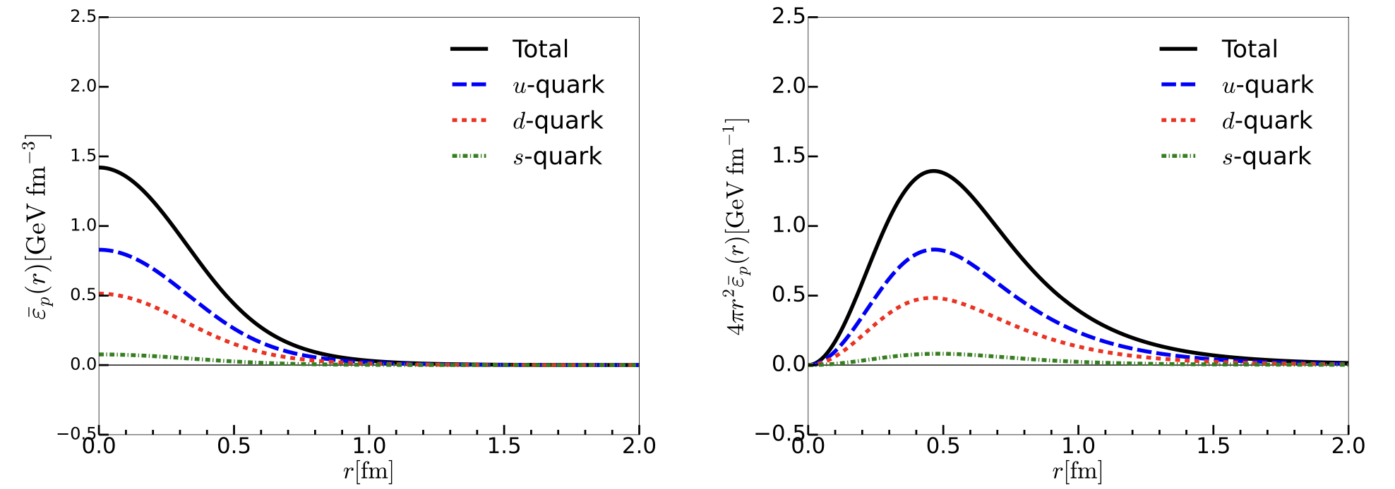
Mass distributions
Contribution from the s quark is negligible.
H-Y. Won, HChK, J.-Y. Kim, JHEP 05 (2024)

Slide 40
Mass distributions
The gluon contributions to the leading-twist operators are parametrically
suppressed with respect to the instanton packing fraction.
J. Balla et al. NPB 510 (1998)
M. Polyakov &. H. Son, JHEP 09 (2018)
In the neutron,
u for d and d for u.
H-Y. Won, HChK, J.-Y. Kim, JHEP 05 (2024)

Slide 41
Mass distributions
These numbers can be understood as the second Mellin moments of the PDFs.
We list the predictions of the proton momentum fraction carried
by the u-, d-, and s-quarks:
H-Y. Won, HChK, J.-Y. Kim, JHEP 05 (2024)

Slide 42
Angular momentum distribution
Strange quark contribution is negligible.
: Ji’s relation
X. Ji, PRL 78 (1997)
Suppressed by the instanton packing fraction.
H-Y. Won, HChK, J.-Y. Kim, JHEP 05 (2024)

Slide 43
Problem of the naïve decomposition
Decomposition of the isotriplet J
M. Wakamatsu & H. Nakakoji, PRD 71 (2005)
Violation of Ji’s sum rule (X.D. Ji, PRL 78 (1997))
Origin of : role of gluons
The second moment of the chiral-odd twist-3 quark distribution
P. Schweitzer, PRD 67 (2005)
Ohnishi & M. Wakamatsu, PRD 69 (2004)
This makes the second moment deviate from QCD.
Indication: If the covariant derivatives had been used,
these discrepancies would have been resolved.
Spin-orbit correlations are also very important to consider.
H.W. Won, J.-Y. Kim, HChK, PRD 108 (2023)

Slide 44
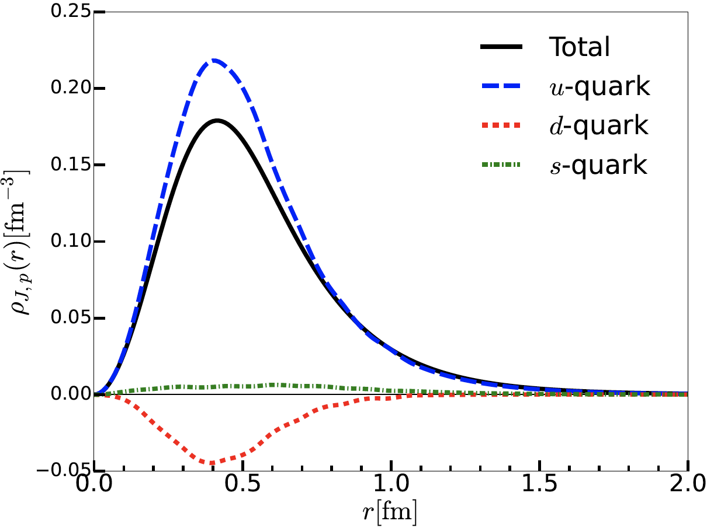
Angular momentum distribution
Strange quark contribution is negligible.
H-Y. Won, HChK, J.-Y. Kim, JHEP 05 (2024)

Slide 45
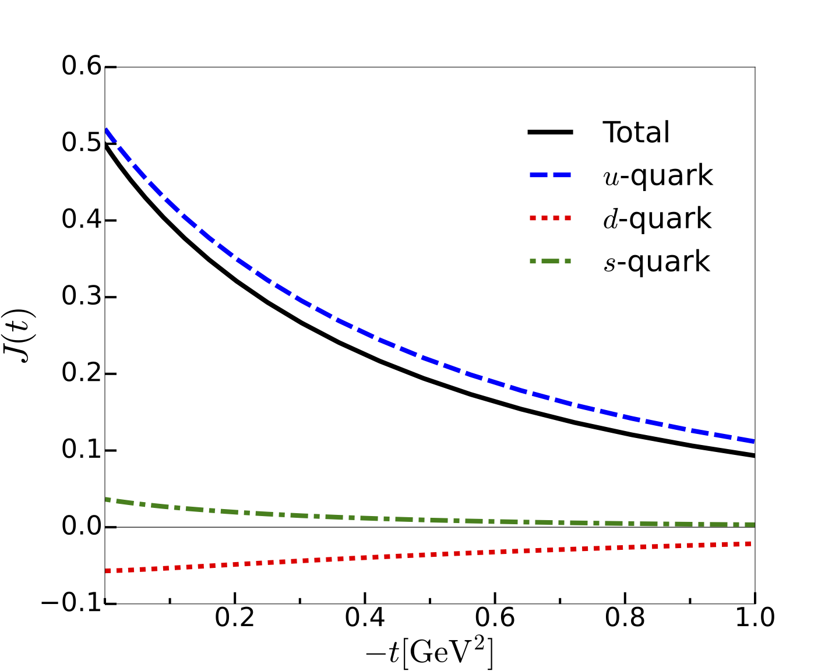
Flavor-decomposed J form factors
Strange quark contribution is negligible.
H.W. Won, J.-Y. Kim, HChK, PRD 108 (2023)

Slide 46
Mechanical properties: Twist-2 case
Stability condition in SU(3)
However, there is no proper way of constructing the effective flavor-triplet
and -octet EMT currents by a global symmetry.
Our strategy
: It contains both twist-2 & twist-4 operators.
We first consider the twist-2 EMT operator
H-Y. Won, HChK, J.-Y. Kim, JHEP 05 (2024)

Slide 47
Mechanical properties: Twist-2 case
Stability condition in SU(3)
Twist-2 case
Twist-4 contribution
Both quark and gluon contribution should
be considered.
H-Y. Won, HChK, J.-Y. Kim, JHEP 05 (2024)

Slide 48
Twist-4 effective operator
Decomposition of the quark and gluon contributions in cbar ff.
Regularization and renormalization scheme dependence
Discrepancy between Hatta et al. and Polyakov & Son
Hatta et al. JHEP 12, 008 (2018)
Polyakov & Son JHEP 09, 156 (2018)
Ratio of the quark and gluon contribution
Dimensional regularization

Slide 49
Twist-4 effective operator
Quark part of the twist-4 operators
Isovector part:
Derivation of the isoscalar part (EMT) is under way
Gluon part of the twist-4 operators
Polyakov & Son JHEP 09, 156 (2018)
JY Kim, Ch. Weiss, in progress
HY Won, JY Kim, HChK, in progress

Slide 50
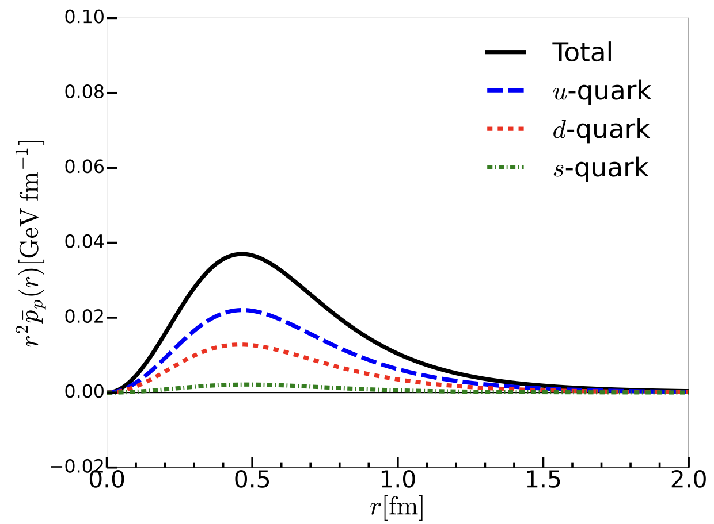
Mechanical properties: Twist-2 case
H-Y. Won, HChK, J.-Y. Kim, JHEP 05 (2024)
Twist-2 part of the pressure density.
No nodal point.
H.W. Won, J.-Y. Kim, HChK, PRD 108 (2023)

Slide 51




Color blindness in SU(3)
in SU(2)
in SU(3)
The flavor blindness is only valid
in SU(3)!
The strange quarks should essentially be
considered in the proton!
Burkert et al. assumed the flavor blindness.
Lattice QCD arrives at a similar conclusion.
(D. Hackett et al. 2310.08484)
H.W. Won, J.-Y. Kim, HChK, PRD 108 (2023)

Slide 52
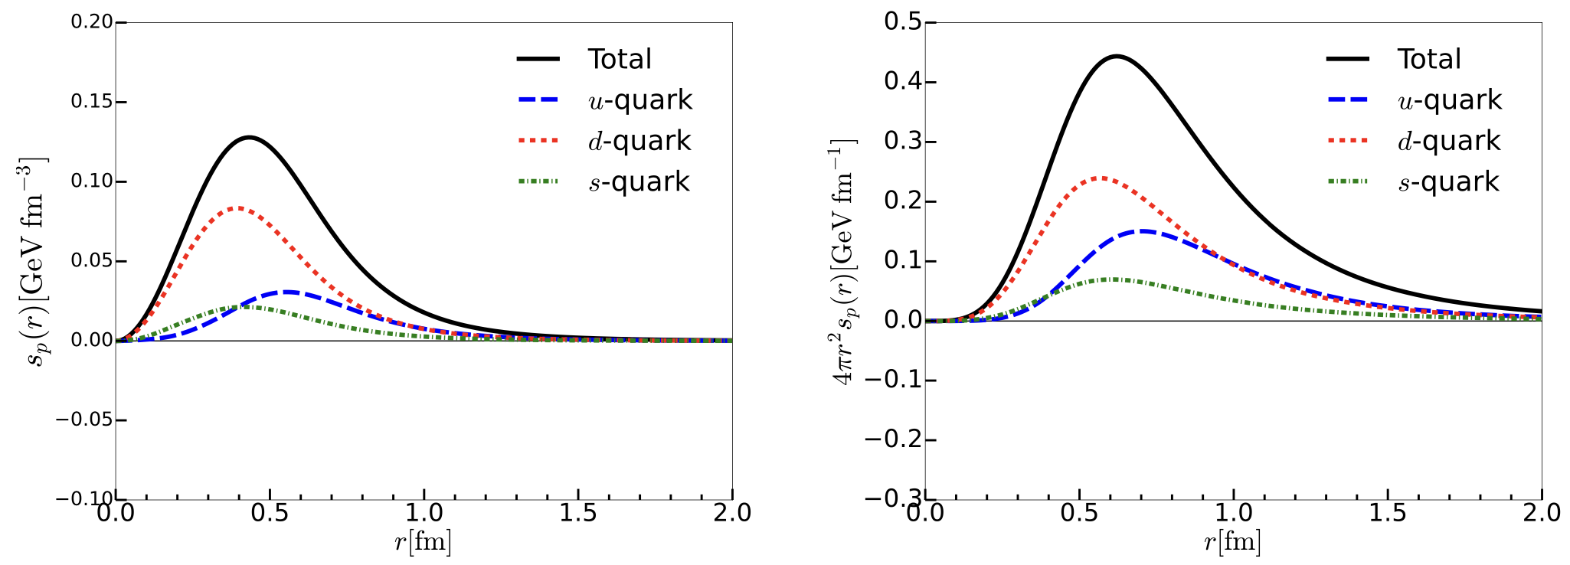
Shear force densities
ij off-diagonal component of the EMT: No twist-4 contribution
Local equilibrium condition
H-Y. Won, HChK, J.-Y. Kim, JHEP 05 (2024)

Slide 53
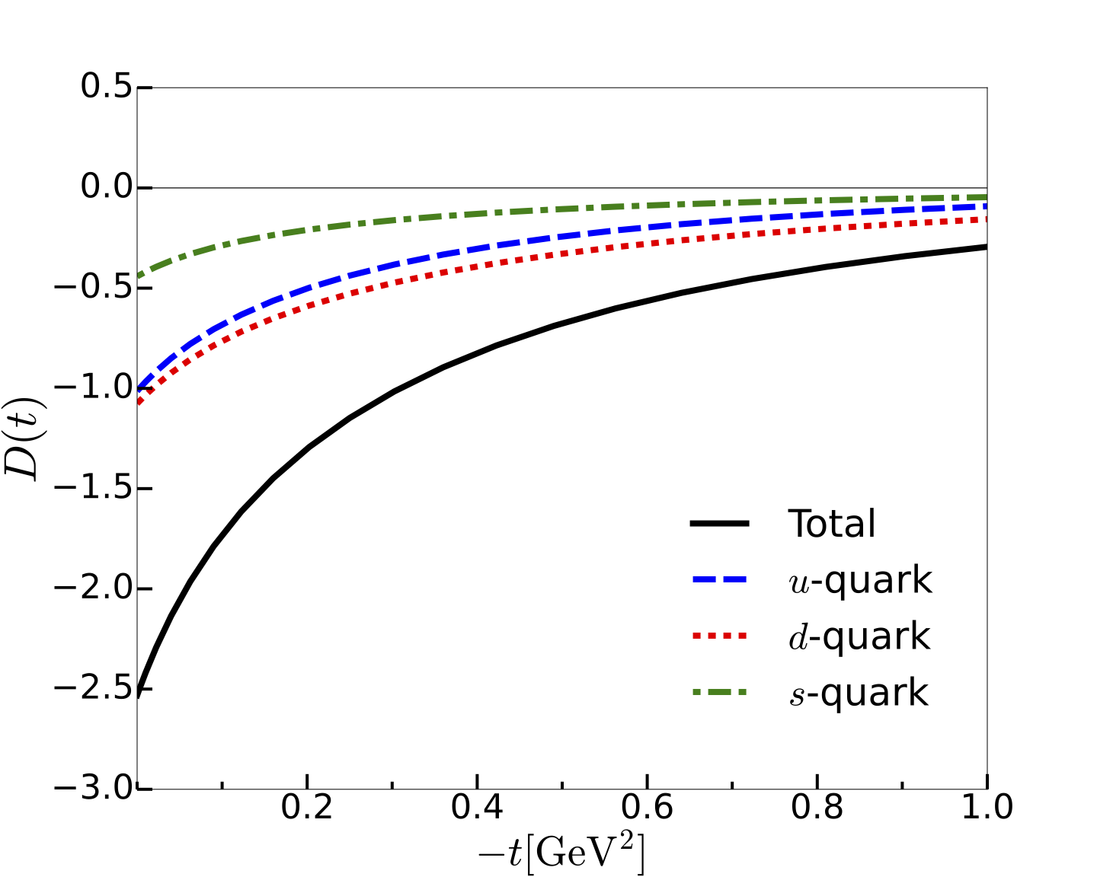
Flavor-decomposed D-term form factors
D-term can be evaluated at
the twist-2 level.
Similar situation in the EM transitions of the delta isobar
Sea quarks (Dirac continuum)
play a significant role.
Y Hatta, M Strikman, PLB (2021)
The strange-quark contributions are essential for flavor blindness!
H.W. Won, J.-Y. Kim, HChK, PRD 108 (2023)

Slide 54



Estimation of mechanical Radius
V. Burkert et al. (2022)
in SU(3)
Mechanical radius
Charge radius
H.W. Won, J.-Y. Kim, HChK, PRD 108 (2023)

Slide 55
Estimation of mechanical radius
Mechanical radius
Charge radius
Mass radius
H.W. Won, J.-Y. Kim, HChK, PRD 108 (2023)

Slide 56
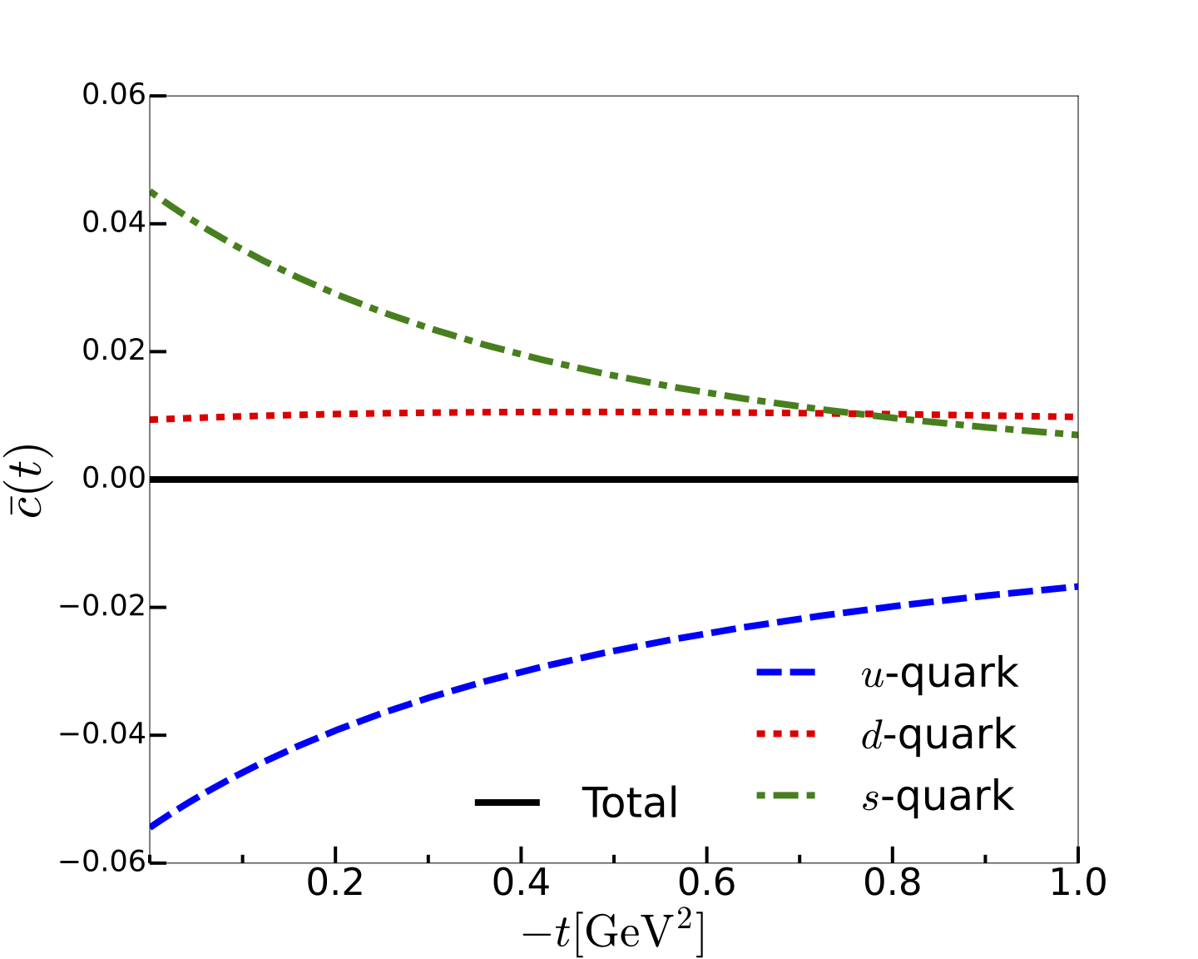
Flavor-decomposed cbar form factors
Following Polyakov & Son, i.e.,
strange-quark contribution
down-quark contribution
up-quark contribution
The down & strange-quark contributions exactly cancel out the
up-quark contribution!
H.W. Won, J.-Y. Kim, HChK, 2310.04670 [hep-ph] (2023)

Slide 57
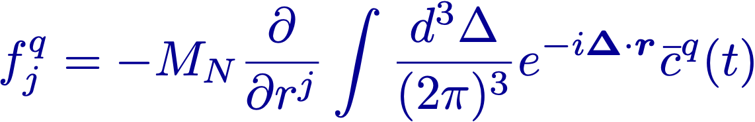
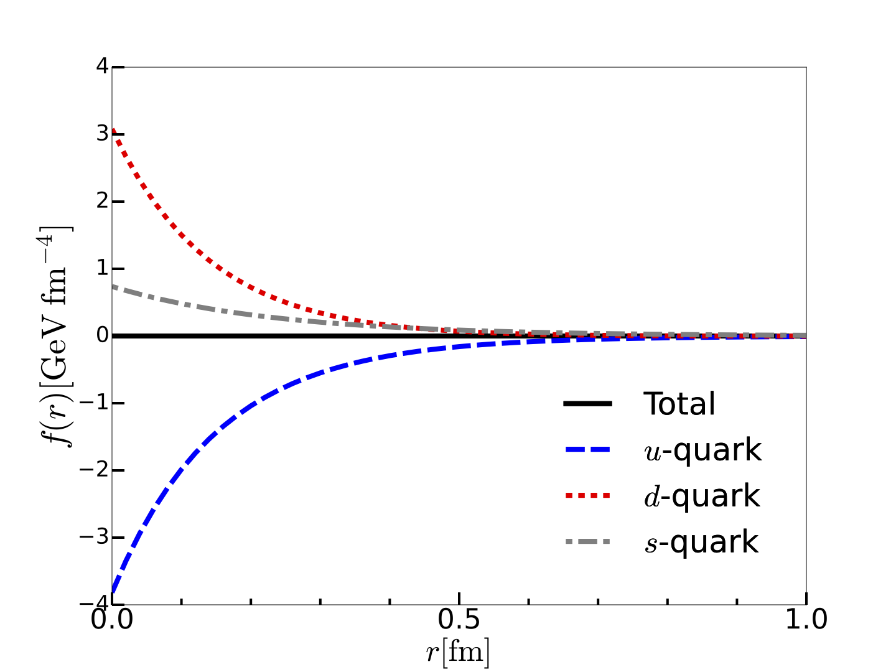
Flavor-decomposed cbar form factors
Force field densities inside the nucleon:
down-quark contribution
Strange-quark contribution
up-quark contribution
H.W. Won, J.-Y. Kim, HChK, 2310.04670 [hep-ph] (2023)

Slide 58

Cancelation of the force fields from cbar
The up-quark contribution is balanced with the down & strange-quark contributions.
up-quark force
down-quark force
strange-quark force

Slide 59
Advertisement

Slide 60
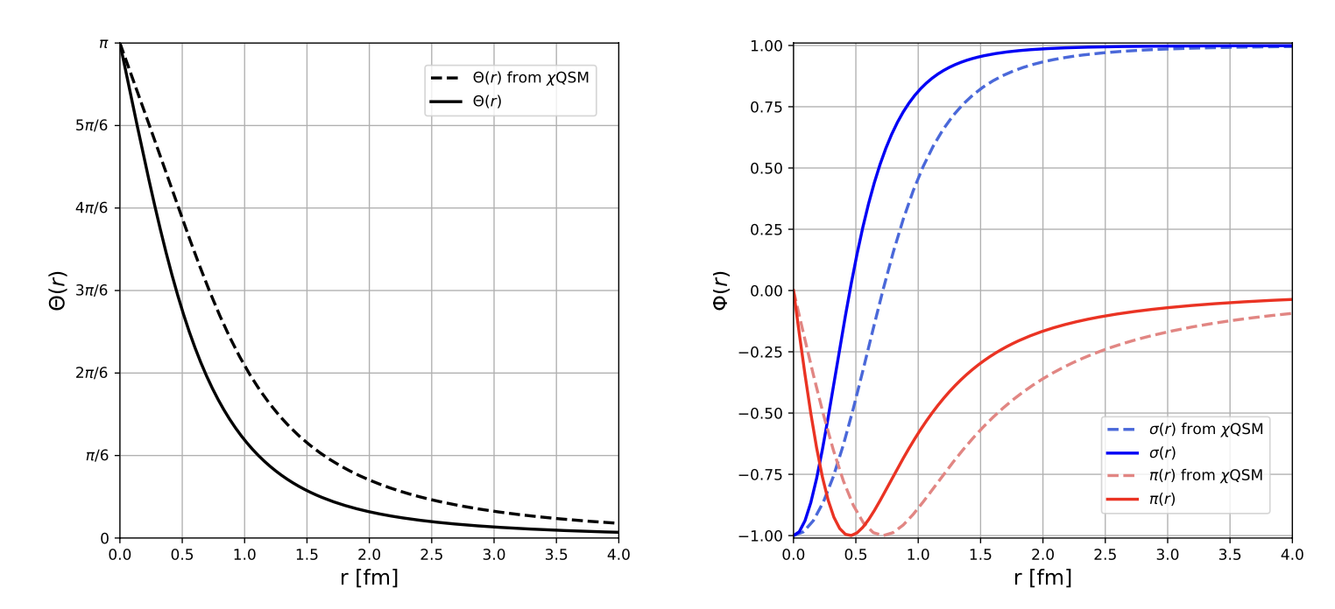
Nucleon from the QCD instanton vacuum
Motivation: aiming at dealing with gluonic matrix elements
Starting from the effective low-energy QCD partition function
Y. Choi, HChK, in preparation

Slide 61
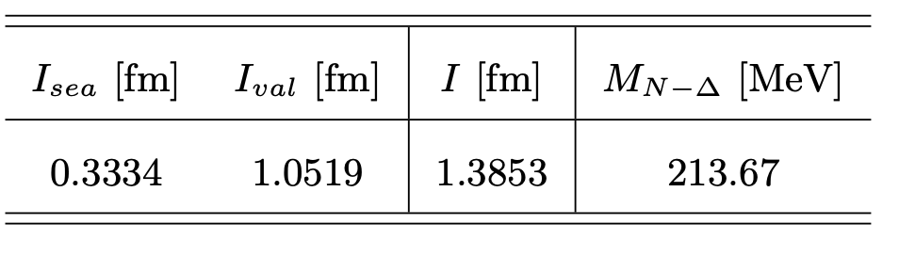
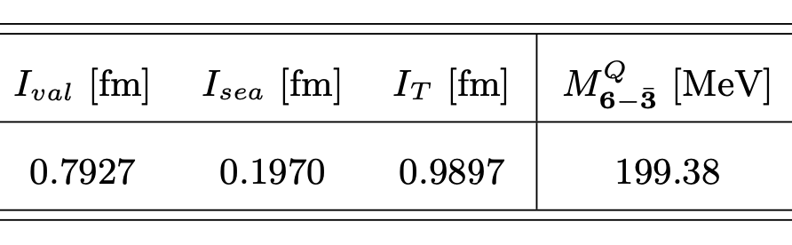
Nucleon from the QCD instanton vacuum
Y. Choi, HChK, in preparation

Slide 62
Summary
Flavor decomposition of GFFs requires the flavor nonsinglet EMT operators
that cannot be constructed without any ambiguity so far.
Both the twist-2 and twist-4 EMT operators should be considered.
Twist-4 operator also contribute to the GFFs, in particular cbar one.
Gluons come into essential play in describing the GFFs
even with the effective theory.
The flavor decomposition of the nucleon mass and pressure requires
information on cbar form factors.
Cbar form factors may interplay between the quarks and gluons.
As far as the total gravitational form factors are concerned,
the results from the effective theory are still OK.

Slide 63
Though this be madness,
yet there is method in it.
Hamlet Act 2, Scene 2
by Shakespeare
Many thanks to J-Y. Kim, H-Y. Won, and Ch. Weiss
for wonderful collaborations!
Thank you very much for the attention!

