Slide 1
Impact of quark flavor violating SUSY on h(125) decays at future lepton colliders
K. Hidaka
Tokyo Gakugei University
H. Eberl, E. Ginina
HEPHY, Vienna
References:
Phys. Rev. D 91 (2015) 015007 [arXiv:1411.2840 [hep-ph]]
JHEP 1606 (2016) 143 [arXiv:1604.02366 [hep-ph]]]
IJMP A34 (2019) 1950120 [arXiv:1812.08010 [hep-ph]]
PoS(EPS-HEP2021) 594, 2021 [arXiv:2111.02713 [hep-ph]]
PoS(ICHEP2022) 536, 2022 [arXiv:2211.07243 [hep-ph]]
PoS(EPS-HEP2023) 487, 2023
PPP2024, 19-23 Aug 2024, University of Kyoto

Slide 2
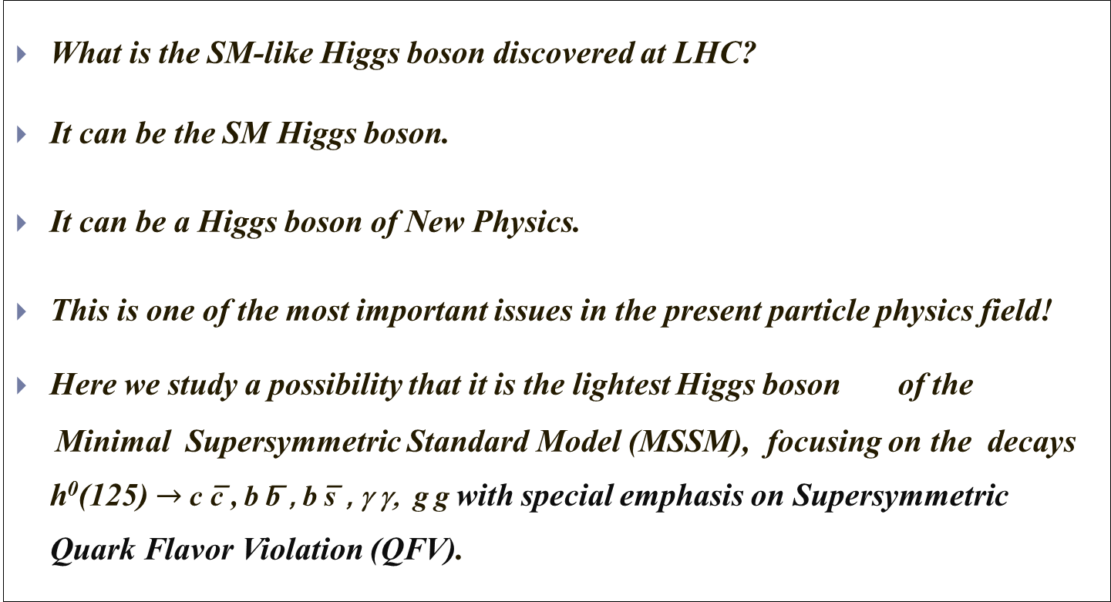
1. Introduction
What is the SM-like Higgs boson discovered at LHC?
It can be the SM Higgs boson.
It can be a Higgs boson of New Physics.
This is one of the most important issues in the present particle physics field!
Here we study a possibility that it is the lightest Higgs boson of the
Minimal Supersymmetric Standard Model (MSSM), focusing on the decays h⁰(125) $→$c c̅ , b b̅ , b s̅ , γ γ, g g with special emphasis on Supersymmetric Quark Flavor Violation (QFV).

Slide 3
2. MSSM with general QFV
Key parameters in this study are:
* QFV parameters: c̃_{L/R} – t̃_{L/R} & s̃_{L/R} – b̃_{L/R} mixing parameters
* QFC parameter: t̃_{L} – t̃_{R} & b̃_{L} – b̃_{R} mixing parameters
These QFV parameters are absent in the MSSM with
minimal flavor violation (MFV)!

Slide 4
3. Constraints on the MSSM
We respect the following experimental and theoretical constraints:
(1) The recent LHC limits on SUSY particle masses.
(2) The constraint on (m_{A / H+ ,} tanβ ) from recent MSSM Higgs boson search at LHC.
(3) The constraints on the QFV parameters from the B meson data.
etc.
(4) The constraints from the observed Higgs boson mass and couplings at LHC
121.6 GeV < m_h⁰ < 128.6 GeV (allowing for theoretical uncertainty) ,
0.68 < κ_{b} < 1.11 (ATLAS), 0.68 < κ_{b} < 1.32 (CMS)
(5) The experimental limit on SUSY contributions to the electroweak ρ parameter
Δρ(SUSY) < 0.0012.
(6) Theoretical constraints from the vacuum stability conditions for the
trilinear couplings T_{Uab} and T_{Dab} .
(7) We also take into account the expected SUSY particle mass limits from the future HL-LHC experiment in our analysis.
Notes:
Experimental constraint from B(b -> s l+ l-) ;
The low-s region (1 GeV^2 < s < 6 GeV^2) is dominated by the Wilson
coefficients C_9 and C_10, has sizable integrated branching ratio and is very
sensitive to the C_7 - C_9 interference. In the following, we utilize the latter
to put constraints on the Wilson coefficients C_7,8,9,10.
We calculate the integrated branching ratio in the low-s region following Ref. [52]:

Slide 5
4. Parameter scan in the MSSM
We compute h⁰(125) decay widths in the MSSM with general QFV.
- We take parameter scan ranges as follows:
10 < tanβ < 80
2500 < M₃ < 5000 GeV
100 < M₂ < 2500 GeV
100 < M₁ < 2500 GeV
100 < μ < 2500 GeV
1350 < m_{A}(pole) < 6000 GeV
etc. etc.
1 TeV < M_{SUSY} < 5 TeV

Slide 6
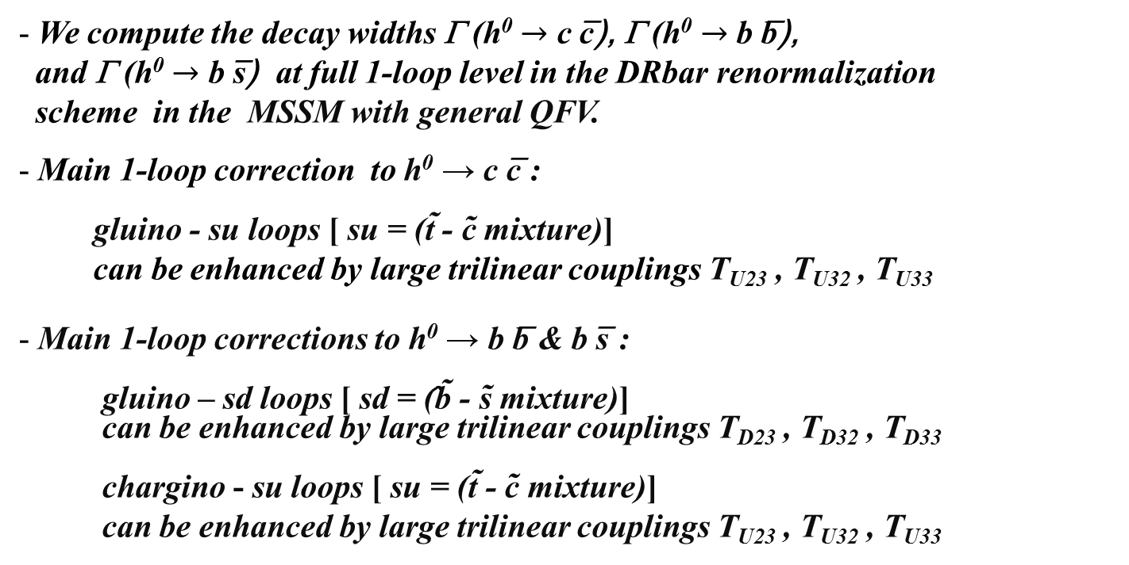
5. h⁰ → c c̅ , b b̅ , b s̅ in the MSSM
We compute the decay widths Γ (h⁰ $→$ c c̅), Γ (h⁰ $→$ b b̅),
and Γ (h⁰ $→$ b s̅) at full 1-loop level in the DRbar renormalization
scheme in the MSSM with general QFV.
Main 1-loop correction to h⁰ → c c̅ :
gluino - su loops [ su = (t̃ - c̃ mixture)]
can be enhanced by large trilinear couplings T_{U23} , T_{U32} , T_{U33}
Main 1-loop corrections to h⁰ → b b̅ & b s̅ :
gluino – sd loops [ sd = (̂b̃ - s̃ mixture)]
can be enhanced by large trilinear couplings T_{D23} , T_{D32} , T_{D33}
chargino - su loops [ su = (t̃ - c̃ mixture)]
can be enhanced by large trilinear couplings T_{U23} , T_{U32} , T_{U33}

Slide 7
In large & mixing scenario;
h⁰ ̴ H₂⁰
g̃
In our scenario, “trilinear couplings“ ( , ,
couplings) = (T_{U23} T_{U32} , T_{U33} ) are large!
couplings are large!
Gluino loop contributions can be large!
Deviation of Γ (h⁰ → c c̅) from SM width can be large!

Slide 8
In large s̃_{R/L} - b̃_{R/L} & b̃_{L} - b̃_{R} mixing scenario;
b
h⁰ ̴ - sα H₁⁰ + cα H₂⁰
d̃_{1,2}
d̃_{1,2} ̴ s̃_{R/L} + b̃_{R/L}
h⁰
g̃
d̃_{1,2}
b̅ / s̅
In our scenario, “trilinear couplings“(T_{D23} T_{D32} , T_{D33} ) =
(s̃_{R} - b̃_{L} - H₁⁰ , s̃_{L} - b̃_{R} - H₁⁰ , b̃_{L} - b̃_{R} - H₁⁰ couplings) are large!
d̃_{1,2} - d̃_{1,2} - h⁰ couplings are large!
Gluino loop contributions can be large!
Deviation of Γ (h⁰ → b b̅/s̅ ) from SM width can be large!

Slide 9
In large c̃_{R/L} - t̃_{R/L} & t̃_{L} - t̃_{R} mixing scenario;
b
h⁰ ̴ H₂⁰
ũ_{1,2}
ũ_{1,2} ̴ c̃_{R/L} + t̃_{R/L}
h⁰
χ̃±
χ̃± ~ W̃± + H̃±
ũ_{1,2}
b̅ / s̅
In our scenario, “trilinear couplings“ ( , ,
couplings) = (T_{U23} T_{U32} , T_{U33} ) are large!
couplings are large!
Chargino loop contributions can be large!
Deviation of Γ (h⁰ → b b̅/s̅ ) from SM width can be large!

Slide 10
5.1 Deviation of the width from the SM prediction
- Deviation of the width from the SM prediction:
_ _ _
DEV(h⁰ -> X X) = Γ(h⁰ -> X X)_{MSSM} / Γ (h⁰ -> X X)_{SM} - 1
X = c, b
Coupling modifier:
κ_{X} = g(h⁰X X) / g(h⁰X X)_{SM}
DEV - κ_{X} relation:
DEV(h⁰ -> X X) = κ_{X}² – 1

Slide 11
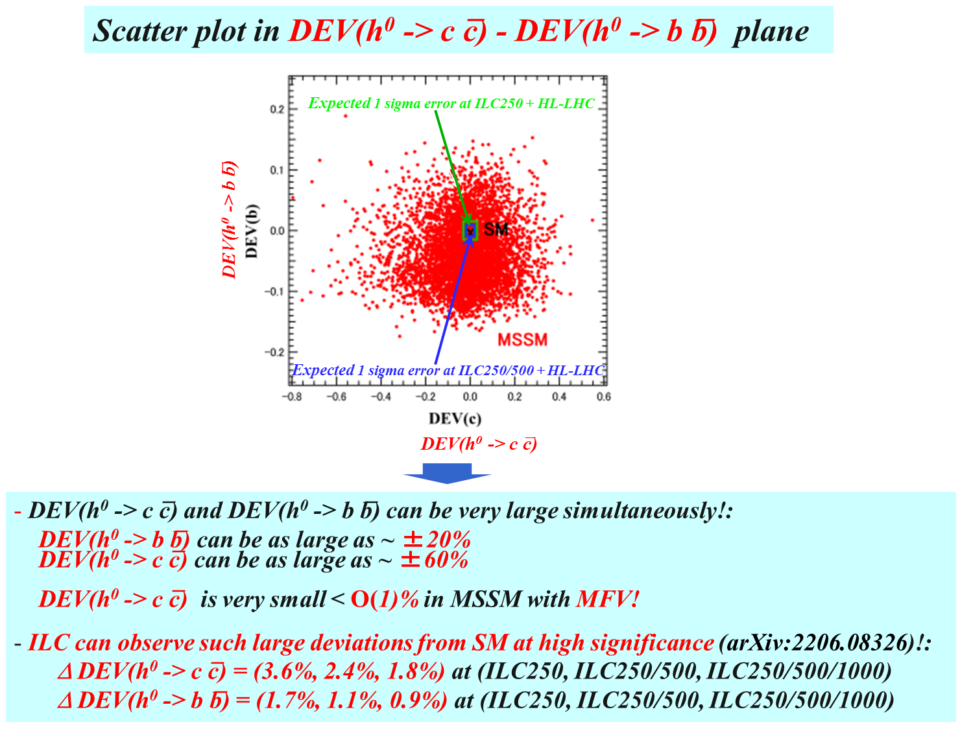

Slide 12

5.2 BR(h⁰ → b s̅ / s b̅)
BR(h⁰ -> b s̅ / s b̅) $≅$ 0 ( < 10 ⁻⁷ ) (SM)
BR(h⁰ -> b s̅ / s b̅) can be as large as ~ 0.15% (MSSM with QFV)!
(See also Gomez-Heinemeyer-Rehman, PR D93 (2016) 095021 [arXiv:1511.04342]. )
ILC(250+500+1000) sensitivity could be ~ 0.1% (at 4 σ significance)!
Private communication with Junping Tian;
See also Barducci et al., JHEP 12 (2017) 105 [arXiv:1710.06657].
Expected CEPC bound is BR(h⁰ -> b s̅ / s b̅) < 2.2· 10 ⁻⁴ (at 95% CL)
See H. Liang et al., arXiv:2310.03440.

Slide 13

6. h⁰ → γ γ, g g in the MSSM
As the h⁰ decays to photon photon and gluon gluon are loop-induced decays,
these decays are very sensitive to New Physics!
We compute the widths Γ (h⁰ $→$ γ γ) and Γ (h⁰ $→$ g g) at NLO QCD level
in the MSSM with general QFV .
Main 1-loop contributions to h⁰ $→$ γ γ :
[W⁺/ top-quark / su] - loops [ su = (t̃ - c̃ mixture)]
The su-loops can be enhanced by large trilinear couplings T_{U23} , T_{U32} , T_{U33} ,
resulting in sizable deviation of Γ (h⁰ → γ γ) from the SM width!
Main 1-loop contributions to h⁰ → g g:
[top-quark / su] - loops [ su = (t̃ - c̃ mixture)]
The su-loops can be enhanced by large trilinear couplings T_{U23} , T_{U32} , T_{U33 ,}
resulting in sizable deviation of Γ (h⁰ → g g) from the SM width!

Slide 14
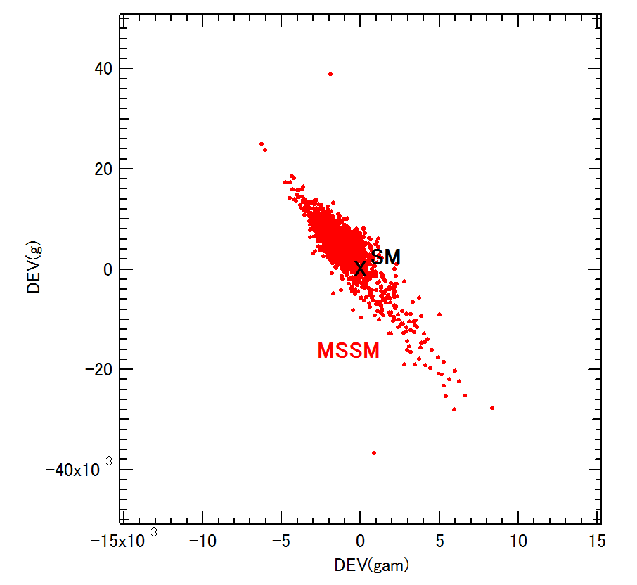
Scatter plot in DEV(h⁰ → γ γ ) - DEV(h⁰ → g g) plane
DEV(h⁰ → g g)
DEV(h⁰ → γ γ )
There is a strong correlation between DEV(h⁰ → γ γ ) and DEV(h⁰ → g g)!
DEV(h⁰ → γ γ ) and DEV(h⁰ → g g) can be sizable simultaneously!:
DEV(h⁰ → γ γ ) can be as large as ~ ±1%
DEV(h⁰ → g g) can be as large as ~ ±4%.
Expected absolute 1 σ errors at (ILC250, ILC250+500, ILC250+500+1000):
Δ DEV(h⁰ → γ γ ) = (2.4%, 2.2%, 2.0%)
Δ DEV(h⁰ → g g) = (1.8%, 1.4%, 1.1%)
[Jorge de Blas et al., Snowmass2021 Report: arXiv:2206.08326;
Private communication with Jorge de Blas.] (See Backup slides)
- ILC can observe such sizable deviation DEV(h⁰ → g g) at high significance!

Slide 15
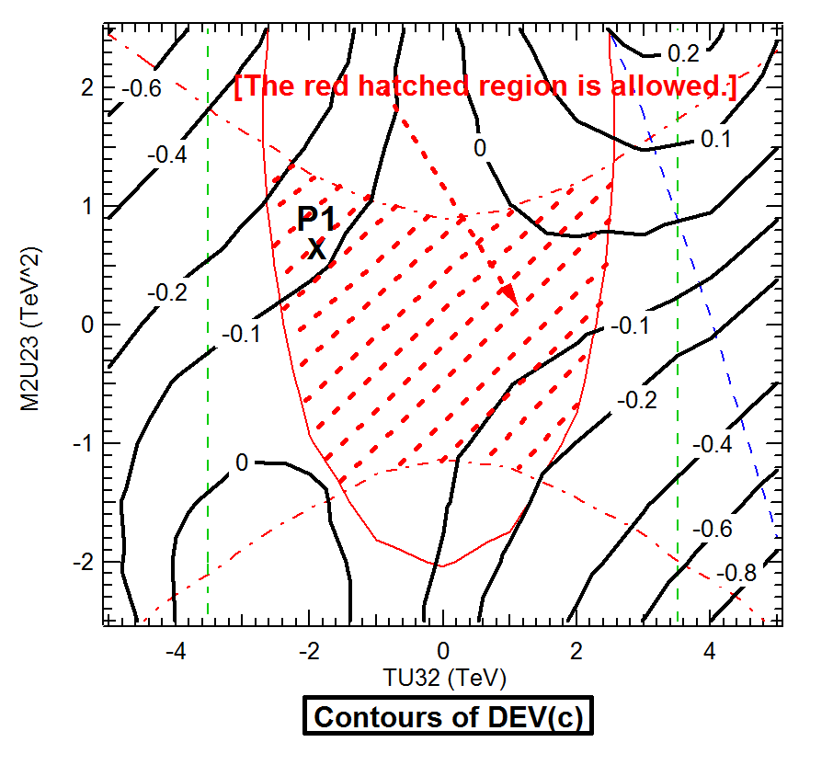
7. Contours of DEVs in the MSSM
Contours of DEV(h⁰ -> c c̅) in T_{U32} - M²_{U23} plane around P1
We find that DEV(c) can be very large (about -30% to 10%) in a sizable region allowed by all the constraints including the expected sparticle mass limits from the future HL-LHC experiment!

Slide 16
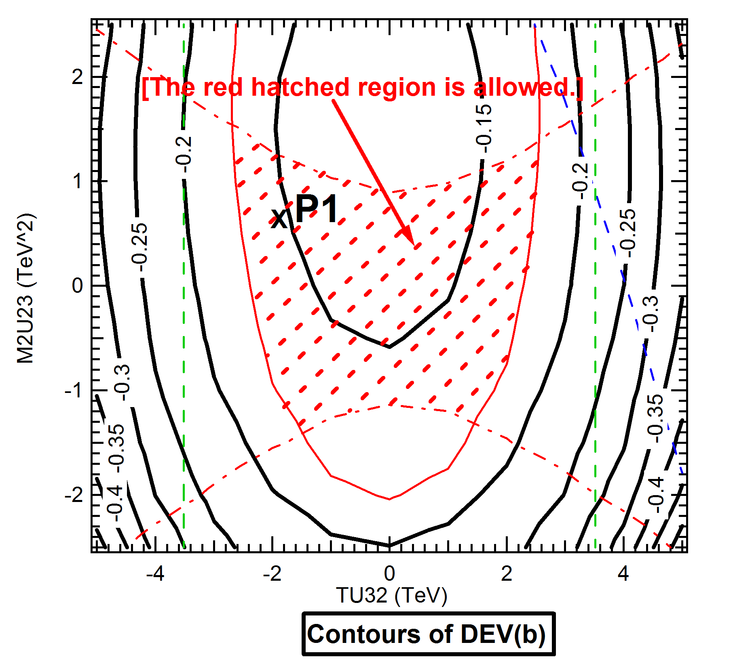
Contours of DEV(h⁰ -> b b̅) in T_{U32} - M²_{U23} plane around P1
We find that DEV(b) can be very large (about -10% to -18%) in a sizable region allowed by all the constraints including the expected sparticle mass limits from the future HL-LHC experiment!
For DEV(g), DEV(γ ), DEV(γ /g) and DEV(b/c) we have obtained similar results
to those for DEV(c) and DEV(b).

Slide 17
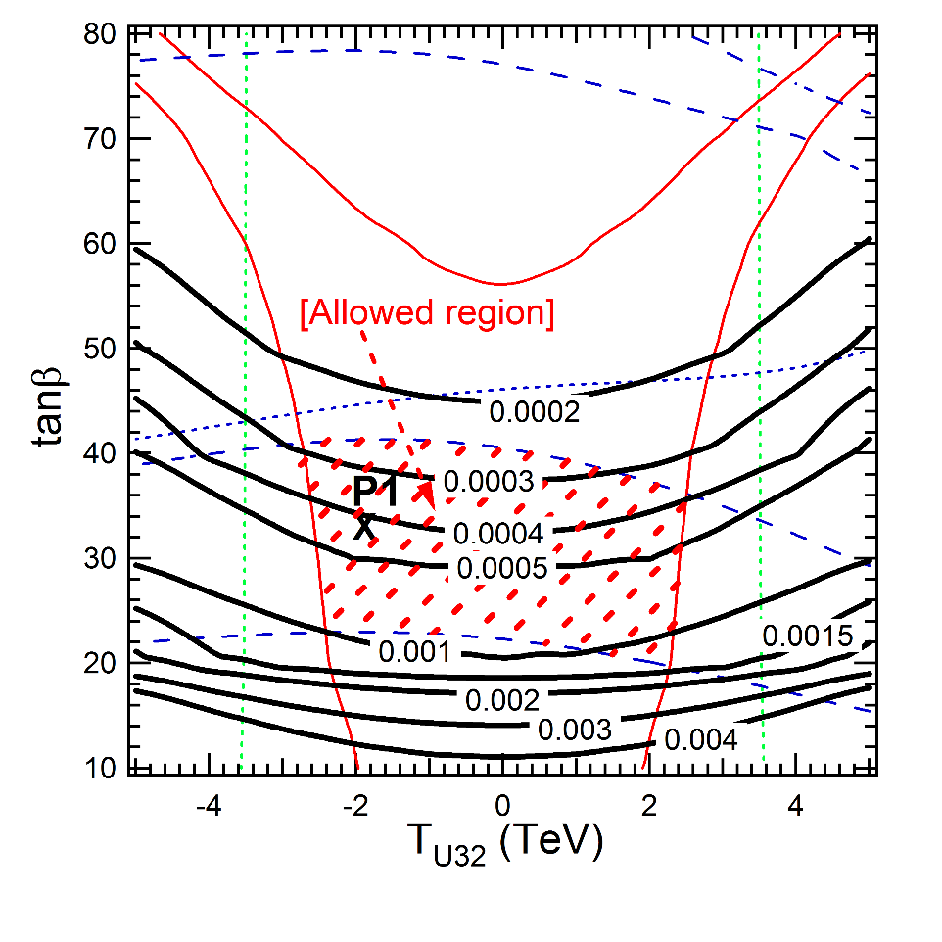
Contours of B(h⁰ -> b s̅ / s b̅) in T_{U32} – tanβ plane around P1
- B(h⁰ -> b s̅ / s b̅) can be as large as ~ 0.15% in a sizable region allowed by all the
constraints including the expected sparticle mass limits from the future HL-LHC!
ILC(250 + 500 + 1000) sensitivity could be ~ 0.1% at 4σ significance!
Private communication with Junping Tian;
See also Barducci et al., JHEP 12 (2017) 105 [arXiv:1710.06657].

Slide 18
8. Conclusion
- We have studied decays h⁰ (125GeV) → c c̅ , b b̅ , b s̅ , γ γ, g g in MSSM with general QFV.
- For the first time, we have performed a systematic MSSM parameter scan
respecting all of the relevant theoretical and experimental constraints.
- In strong contrast to the usual studies in the MSSM with minimal flavor violation (MFV),
we have found that the deviations of these MSSM decay widths and width ratios
from the SM values can be quite sizable in the MSSM with general QFV.
- All of these large deviations in the h (125) decays are due to
large c̃ - t̃ mixing & large c̃ / t̃ involved trilinear couplings T_{U23}, T_{U32}, T_{U33} and
large s̃ - b̃ mixing & large s̃ / b̃ involved trilinear couplings T_{D23}, T_{D32}, T_{D33} .
- Future lepton colliders such as ILC, CLIC, CEPC, FCC-ee and MuC can
observe such sizable deviations from the SM at high signal significance
even after the failure of SUSY particle discovery at the HL-LHC.
- In case the deviation pattern shown here is really observed at the lepton colliders,
then it would strongly suggest the discovery of QFV SUSY (the MSSM with general QFV).

Slide 19
Our analysis suggests the following:
PETRA/TRISTAN e- e+ collider discovered virtual Z⁰
effect for the first time.
Later, CERN p p̄ collider discovered the Z⁰ boson.
Similarly, lepton colliders, such as ILC, could discover virtual Sparticle effects for the first time in h⁰(125) decays!
Later, FCC-hh p p collider could discover the Sparticles!

