Slide 1



Nucleosynthesis and Evolution of Neutron Stars, YITP, Kyoto, January 27-30, 2025
Nuclear structure and dynamics at finite temperature
in the relativistic nuclear energy density functional approach
N. Paar
Department of Physics
Faculty of Science
University of Zagreb
Croatia

Slide 2
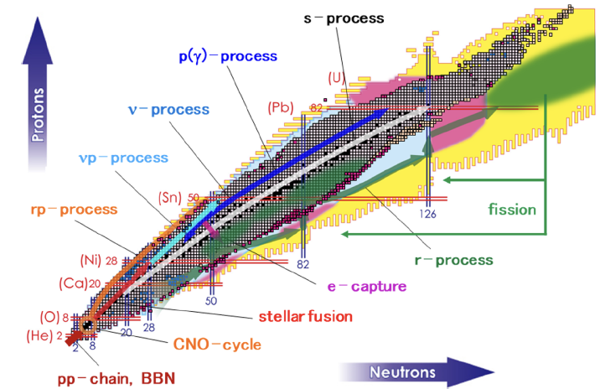
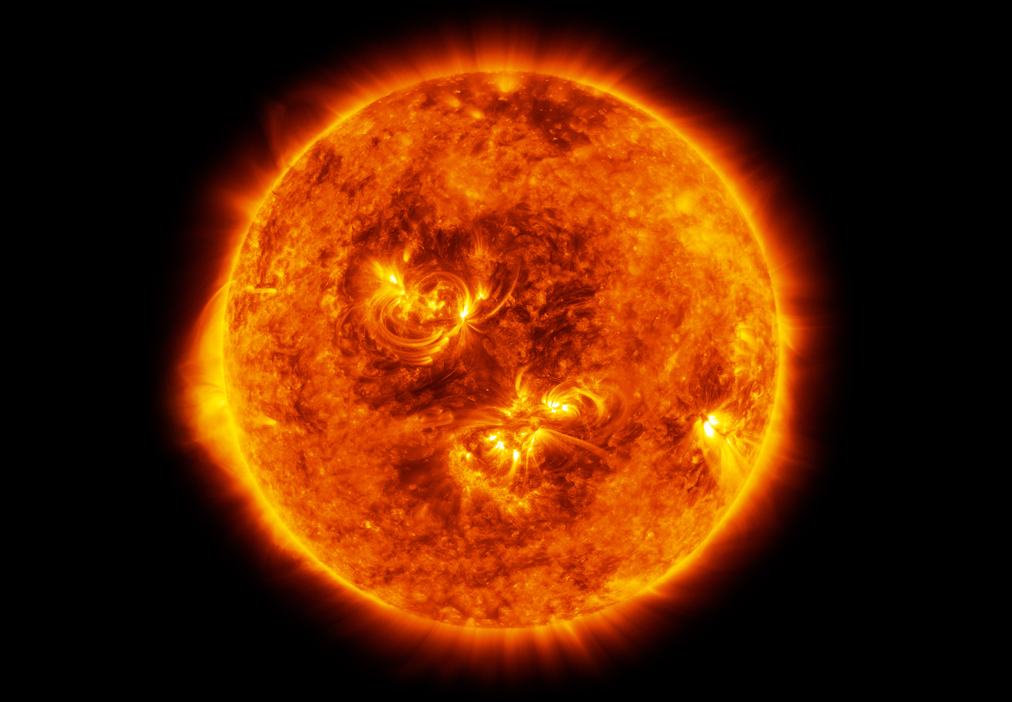
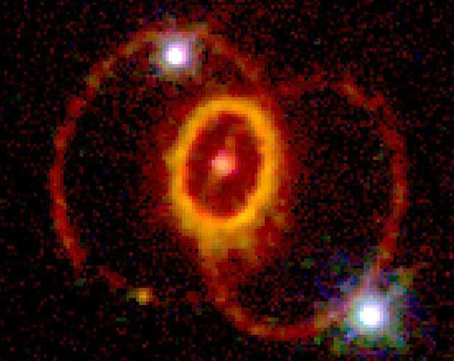
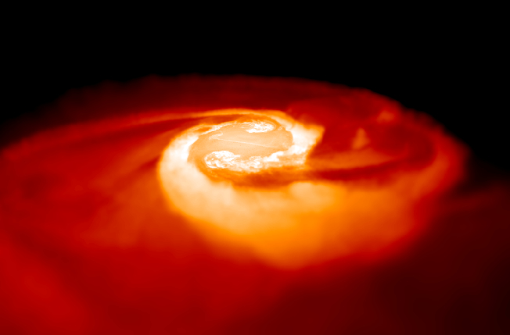
NUCLEAR CHART AND NUCLEOSYNTHESIS
The properties of unstable nuclei and their processes are important for understanding the evolution of stars and nucleosynthesis
Large number of nuclei are beyond reach for the experiment.
→ Consistent and universal microscopic theory is required.
Credit: NASA/ESA
Aziz et al. AAPPS Bulletin 31, 18 (2021)

Slide 3
Outline
Nuclear properties at finite temperature
Stellar electron capture on nuclei
Beta decays at finite temperature
Photon strength functions at finite temperature
Nuclear equation of state (zero temperature limit)
Conclusions

Slide 4
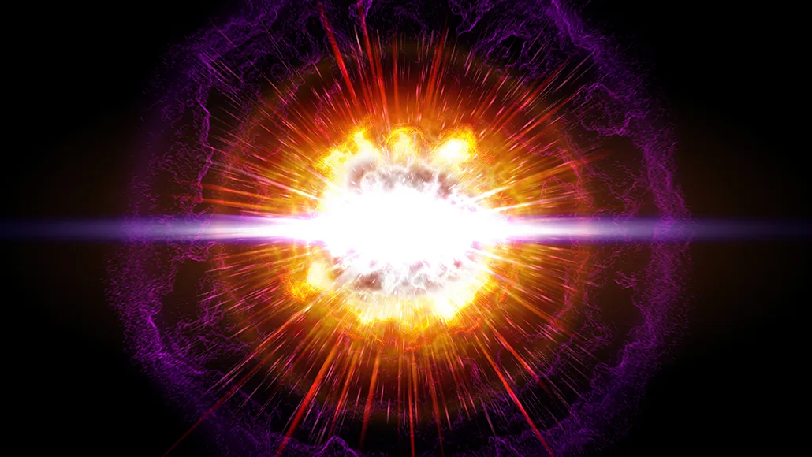
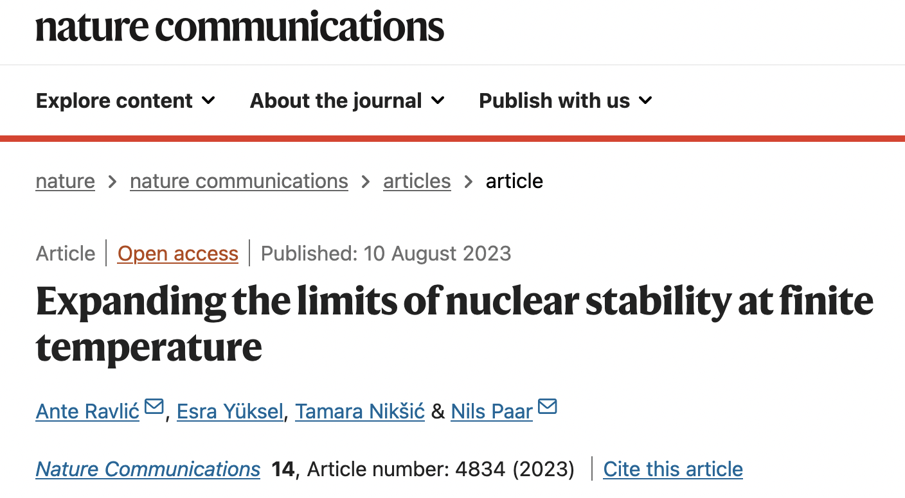
NUCLEAR PROPERTIES AT FINITE TEMPERATURE
In stellar environments nuclei are hot, becoming extremely hot in core-collapse supernovae and neutron-star mergers (e.g. ~10⁹ - 10¹⁰ K)
Due to theoretical and computational complexity, model calculations of nuclear properties are often performed at zero temperature
Finite temperature effects in nuclei are experimentally challenging
ScienceNews (2020)
Key science questions on hot nuclei?
How nuclear structure and dynamics change with temperature increase?
How the interplay of temperature, nuclear deformation and pairing effects determine the properties of nuclei
How the nuclear drip lines evolve with temperature?
What are implications of the finite temperature effects in nuclei on astrophysically relevant processes?

Slide 5
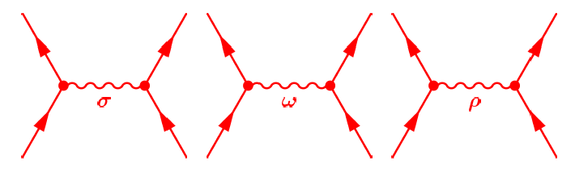
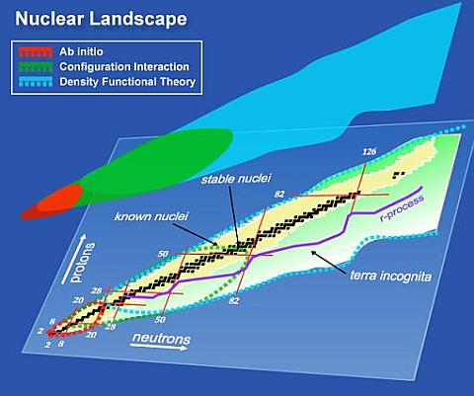
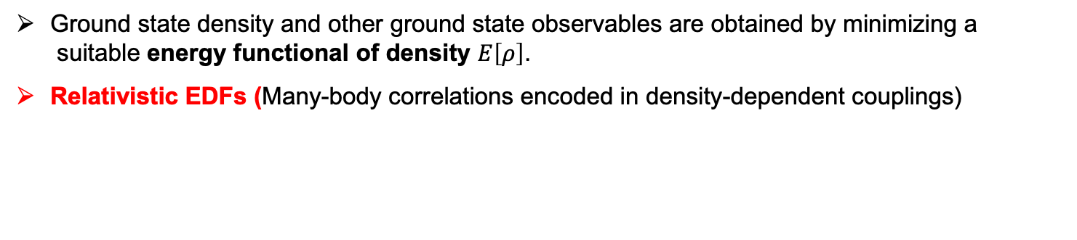
NUCLEAR ENERGY DENSITY FUNCTIONAL (EDF)
Ground state density and other ground state observables are obtained by minimizing a
suitable energy functional of density $E\left[ρ\right]$.
Relativistic EDFs (Many-body correlations encoded in density-dependent couplings)
i) Nucleons are Dirac particles coupled ii) Four-fermion contact interaction
by the exchange mesons and the photon field T (Point-coupling model)
σ
ω
ρ
WHY EDF?
Universal, consistent and quantitative microscopic theory (the same functional used along the whole nuclide map)
Systematic large-scale calculations are feasible. Astrophysical applications.
(UNEDF)

Slide 6
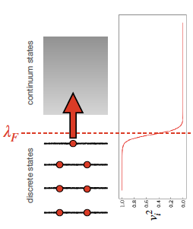
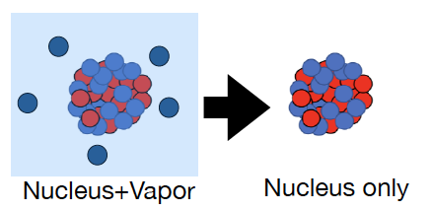
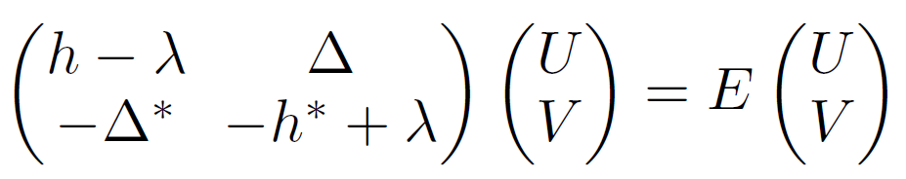
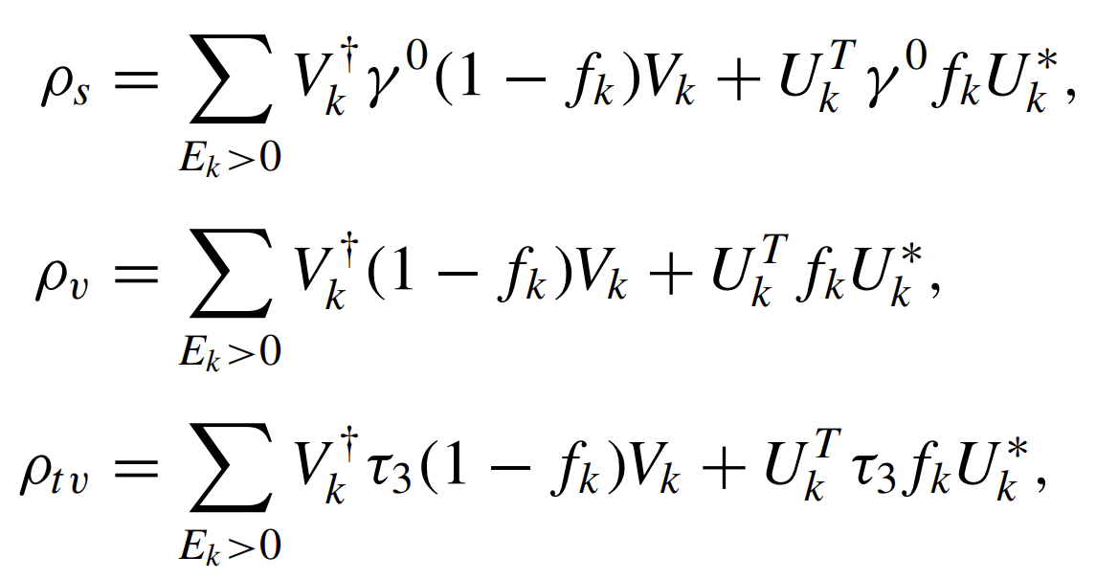



FINITE TEMPERATURE EFFECTS
The nucleons can scatter above the Fermi level, and temperature smears the Fermi surface.
Free energy of a nucleus
$F=E−TS$
$$f_{k}=\frac{1}{1+\exp^{{E_{k}}/{k_{B}T}}}$$
Treatment of the continuum
P. Bonche, S. Levit, D. Vautherin, Nuclear Physics A 427 278 (1984)
Finite-temperature relativistic Hartree Bogoliubov (FT-RHB) equations, axial symmetry
Subtracted free energy
$$\overline{F}=F_{Nucl+Vap}−F_{Vap}$$

Slide 7
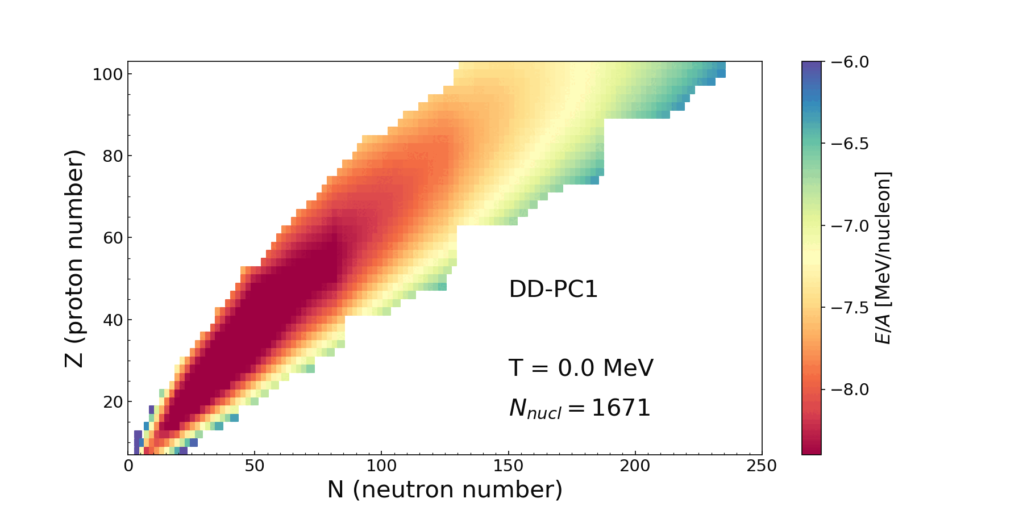
HOW NUCLEAR PROPERTIES EVOLVE WITH INCREASING TEMPERATURE?
NUCLEAR LANDSCAPE AT FINITE TEMPERATURE
The evolution of nuclear binding
energies for temperatures
T = 0 - 2 MeV (0 - 2.3・10¹⁰ K)
FT-RHB calculations including nuclear deformation, pairing correlation effects, and treatment of nucleon states in the continuum.
A. Ravlić, E. Yuksel, T. Nikšić, N.P., Nature Comm. 14, 4834 (2023); PRC 109, 014318 (2024)

Slide 8
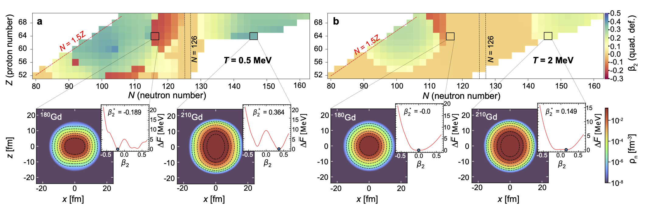
TEMPERATURE EVOLUTION OF QUADRUPOLE DEFORMATION
quadrupole deformation (β₂) for neutron-rich nuclei in the transition/lanthanide region
at temperatures T = 0.5 MeV and T = 2.0 MeV.
The continuum subtracted neutron density profiles for ¹⁸⁰Gd and ²¹⁰Gd, demonstrating the optimal shapes
Dependence of the relative subtracted free energy (ΔF), on the nuclear shape (β₂), with respect to minimum configuration
A. Ravlić, E. Yuksel, T. Nikšić, N.P., Nature Comm. 14, 4834 (2023);

Slide 9
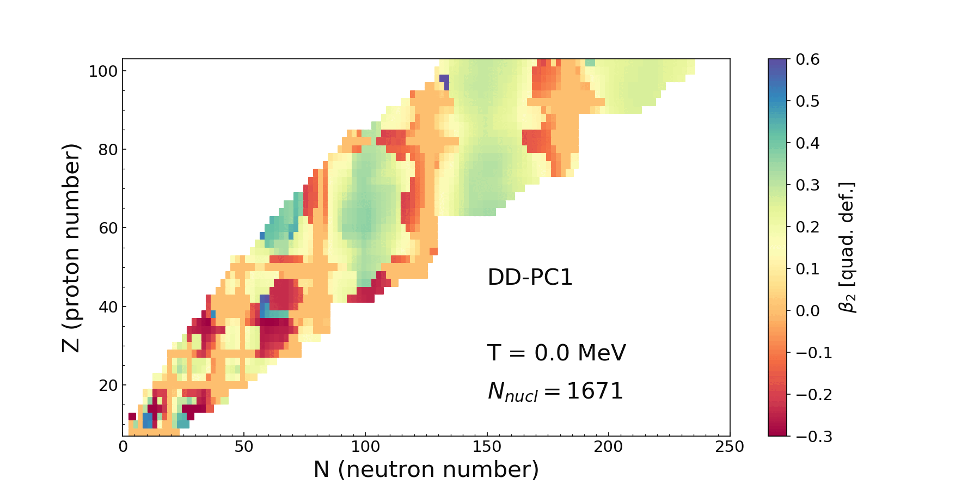
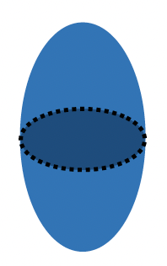


TEMPERATURE EVOLUTION OF QUADRUPOLE DEFORMATION
The temperature evolution of the isoscalar quadrupole deformation β₂ for T = 0 - 2 MeV
PROLATE
SPHERICAL
OBLATE
With temperature increase, shape-phase transitions occur from deformed nuclei toward spherical shapes.
A. Ravlić, E. Yuksel, T. Nikšić, N.P., PRC 109, 014318 (2024)

Slide 10
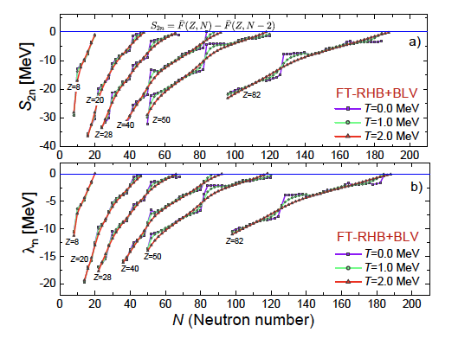
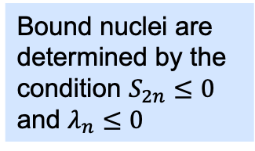
TWO-NEUTRON SEPARATION ENERGIES IN ISOTOPE CHAINS
Isotopic dependence of two-neutron separation energy (a) $S_{2n}=\overline{F}\left(Z,N\right)−\overline{F}\left(Z,N−2\right)$
neutron chemical potential λ_{n} (b) for the selected even-even nuclei
Bound nuclei are determined by the condition $S_{2n}≤0$ and $λ_{n}≤0$
Drip lines
Thermal quenching of the shell effects → by increasing temperature, smoother dependence of $S_{2n}$ and $λ_{n}$ along the isotope chains, the shell effects gradually disappear

Slide 11
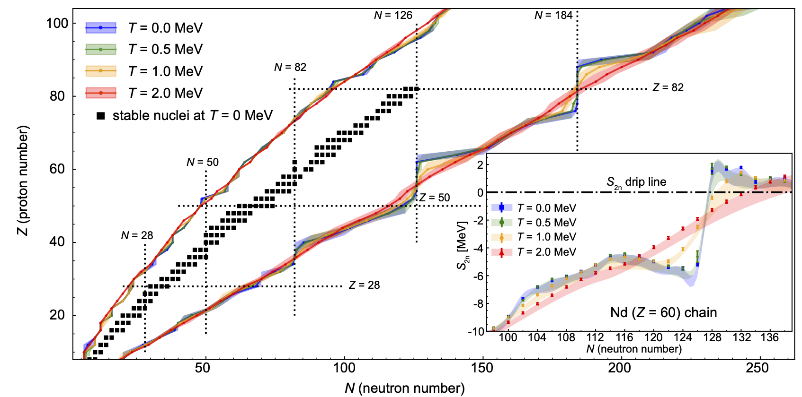
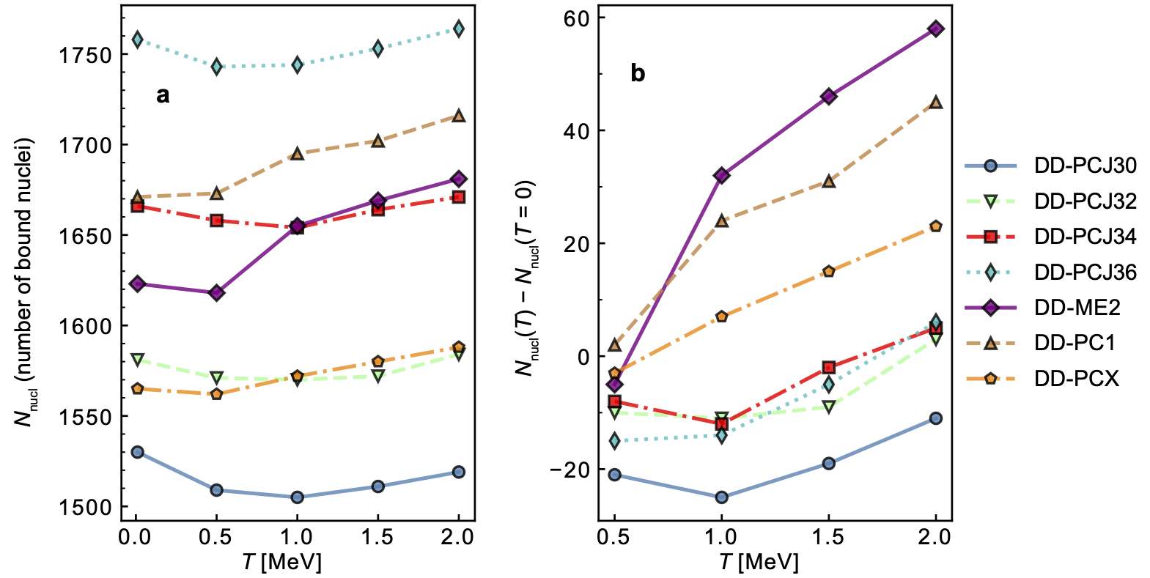
HOW THE NUCLEAR DRIP LINES EVOLVE WITH TEMPERATURE?
The drip-lines are changing dynamically with the temperature increase
Increase of the number of bound nuclei with temperature due to thermal quenching of the shell effects
Different than expected for hot nuclei !
A. Ravlić, E. Yuksel, T. Nikšić, N.P., Nature Comm. 14, 4834 (2023)

Slide 12
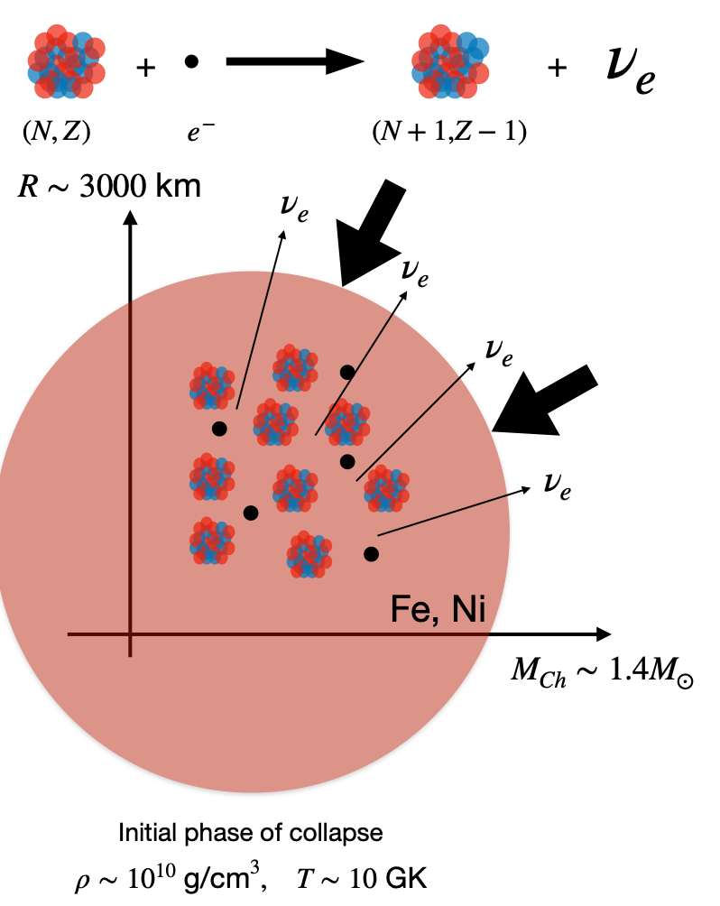
STELLAR ELECTRON CAPTURE
The core of a massive star at the end of hydrostatic burning is stabilized by electron degeneracy pressure
Electron capture (on protons and nuclei) reduces the number of electrons available for pressure support, initiates the gravitational collapse of the core of a massive star, triggering a supernova explosion
Weak interaction process, occurs at finite temperature and at various densities depending on the stage of the stellar evolution
Finite-temperature proton-neutron relativistic QRPA (FT-PNRQRPA) is used for the description of relevant nuclear charge-exchange transitions
Electron capture cross sections
Electron capture rates are obtained by folding the cross section with Fermi-Dirac distribution for electrons

Slide 13
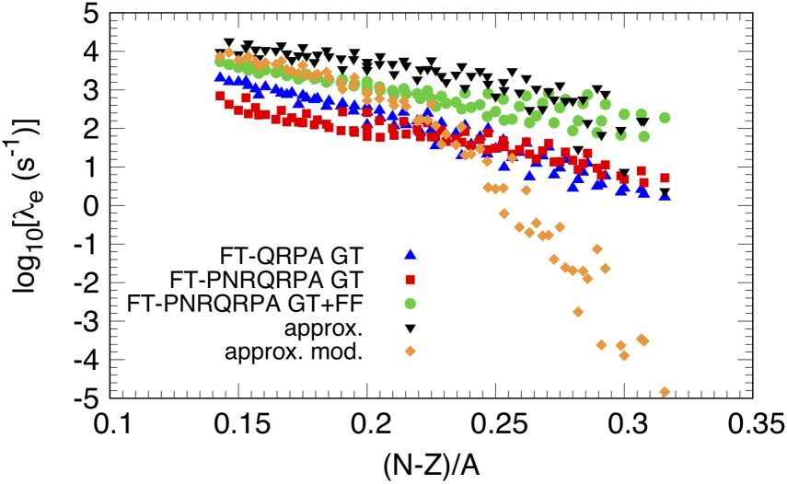
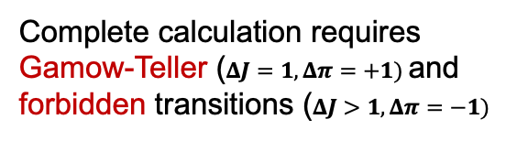
ELECTRON CAPTURE RATES AROUND N=50 SHELL CLOSURE
Electron capture around N=50 shell closure
Complete calculation requires Gamow-Teller ($ΔJ=1, Δπ=+1)$and forbidden transitions ($ΔJ>1, Δπ=−1)$
Comparison of the electron capture rates calculated using relativistic and nonrelativistic energy density functionals
→ Only recent FT-PNRQRPA calculation is complete (GT+ first forbidden transitions)
  A. Ravlić, E. Yuksel, Y. F. Niu, G. Colo, E. Khan, N. P, PRC 102, 065804 (2020)
S. Giraud, E. M. Ney, A. Ravlić, R. G. T. Zegers, J. Engel, N. P. et al., PRC 105, 055801 (2022)

Slide 14
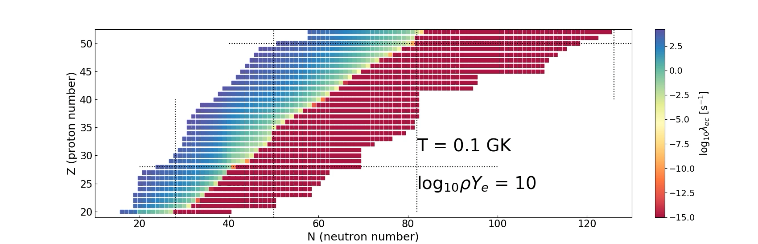
SYSTEMATIC CALCULATIONS OF STELLAR ELECTRON CAPTURE RATES
Completing the large-scale calculations of electron capture rates (EC) in the relativistic energy density functional approach using the FT-PNRQRPA
Covering astrophysically relevant range of temperature and densities
For example, for ⍴Ye=10¹⁰ g/cm³ :
Future applications of these EC rates in state-of-the-art core collapse supernova simulations are called for

Slide 15
CORE-COLLAPSE SUPERNOVA SIMULATION RESULTS
Initial test case for the new electron capture rates
core collapse supernova simulation with spherically symmetric code GR1D
E. O’Connor, Astrophys. J. Suppl. Ser. 219, 24 (2015)
C. Sullivan, E. O’Connor, R. G. T. Zegers, T. Grubb, and S. M. Austin, Astrophys. J. 816, 44 (2015)
s15WW95 progenitor S. E. Woosley and T. A. Weaver, Astrophys. J. Suppl. 101, 181 (1995).
SFHo equation of state to determine NSE A.W. Steiner, M. Hempel, and T. Fischer, Astrophys. J. 774, 17 (2013).
The electron-fraction Y_{e}
as a function of central
baryon density ρ
The electron neutrino luminosity
at a radius of 500 km as a
function of time after bounce,
The central velocity as a function of the enclosed mass.
S. Giraud, E. M. Ney, A. Ravlić, R. G. T. Zegers, J. Engel, N. P. et al., PRC 105, 055801 (2022)
A. Ravlić, S. Giraud, N.P., R. G. T. Zegers, (2025)

Slide 16
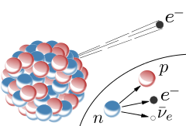
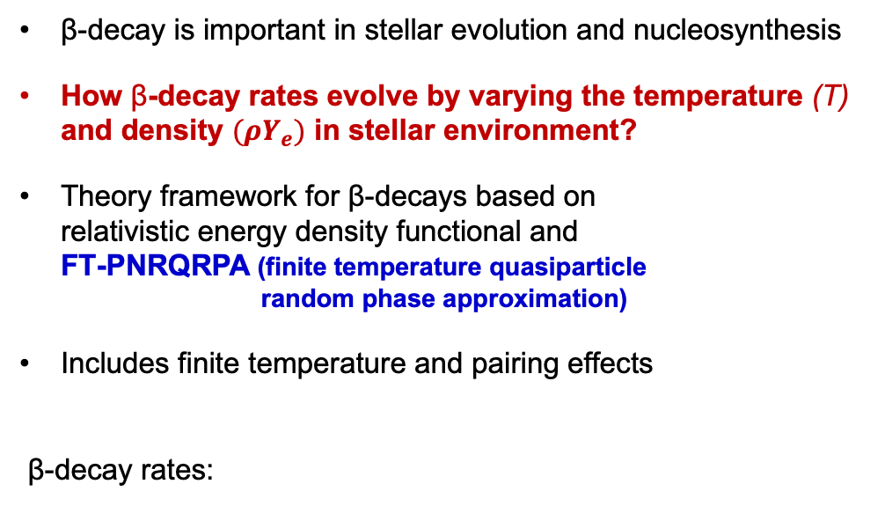

NUCLEAR BETA-DECAY IN STELLAR CONDITIONS
β-decay is important in stellar evolution and nucleosynthesis
How β-decay rates evolve by varying the temperature (T) and density $(ρY_{e})$ in stellar environment?
Theory framework for β-decays based on
relativistic energy density functional and
FT-PNRQRPA (finite temperature quasiparticle
random phase approximation)
Includes finite temperature and pairing effects
β-decay rates:
A. Ravlić, E. Yuksel, Y. F. Niu, N. P., PRC 104, 054318 (2021)
Fermi-Dirac distribution
for outgoing electrons
electron
energy and
momentum
Fermi
function
Shape factor
(=B(GT) for allowed
transitions)
$$T_{1/2}=\frac{ln⁡(2)}{λ}$$
β-decay half-life
Benchmarking the model with the
experimental data at zero temperature

Slide 17
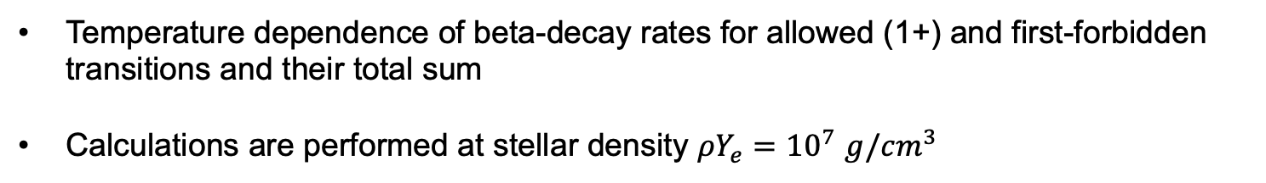
EVOLUTION OF BETA-DECAY RATES IN STELLAR ENVIRONMENT
Temperature dependence of beta-decay rates for allowed (1+) and first-forbidden transitions and their total sum
Calculations are performed at stellar density $ρY_{e}={10}^{7}$ $g/{cm}^{3}$
A. Ravlić, E. Yuksel, Y. F. Niu, N. Paar, PRC 104, 054318 (2021)

Slide 18
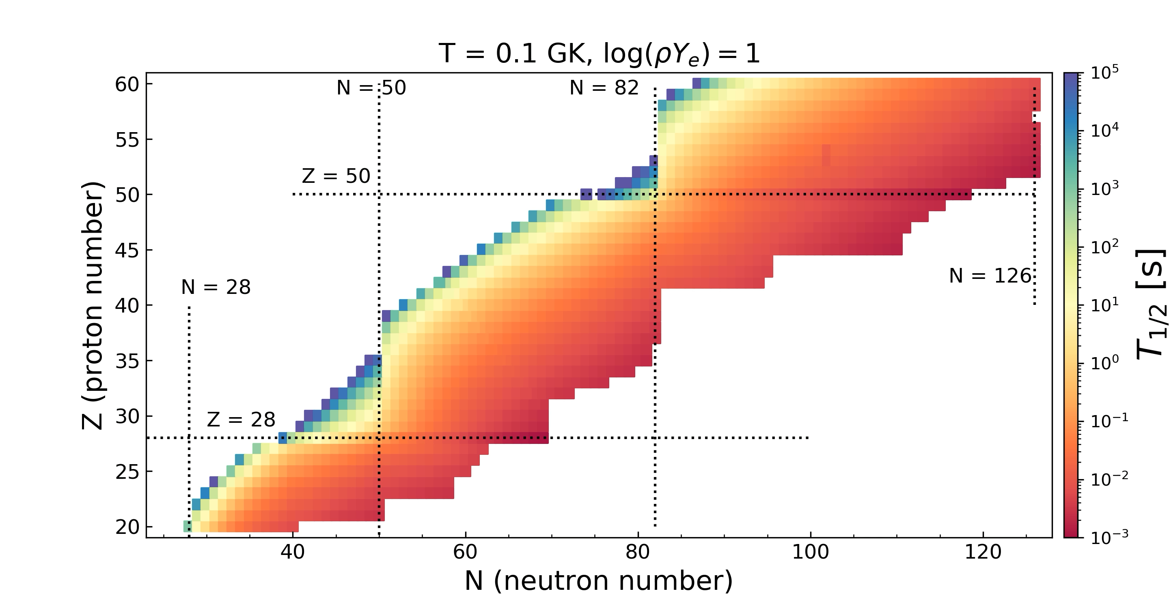
EVOLUTION OF BETA-DECAY HALF LIVES WITH TEMPERATURE INCREASE
A. Ravlić et al. (2024)
Largest temperature effect on nuclei with long half-lives at T=0
With temperature increase more nuclei start to decay (initially with long T_{1/2})
For most of nuclei half-lives decrease with temperature increase

Slide 19
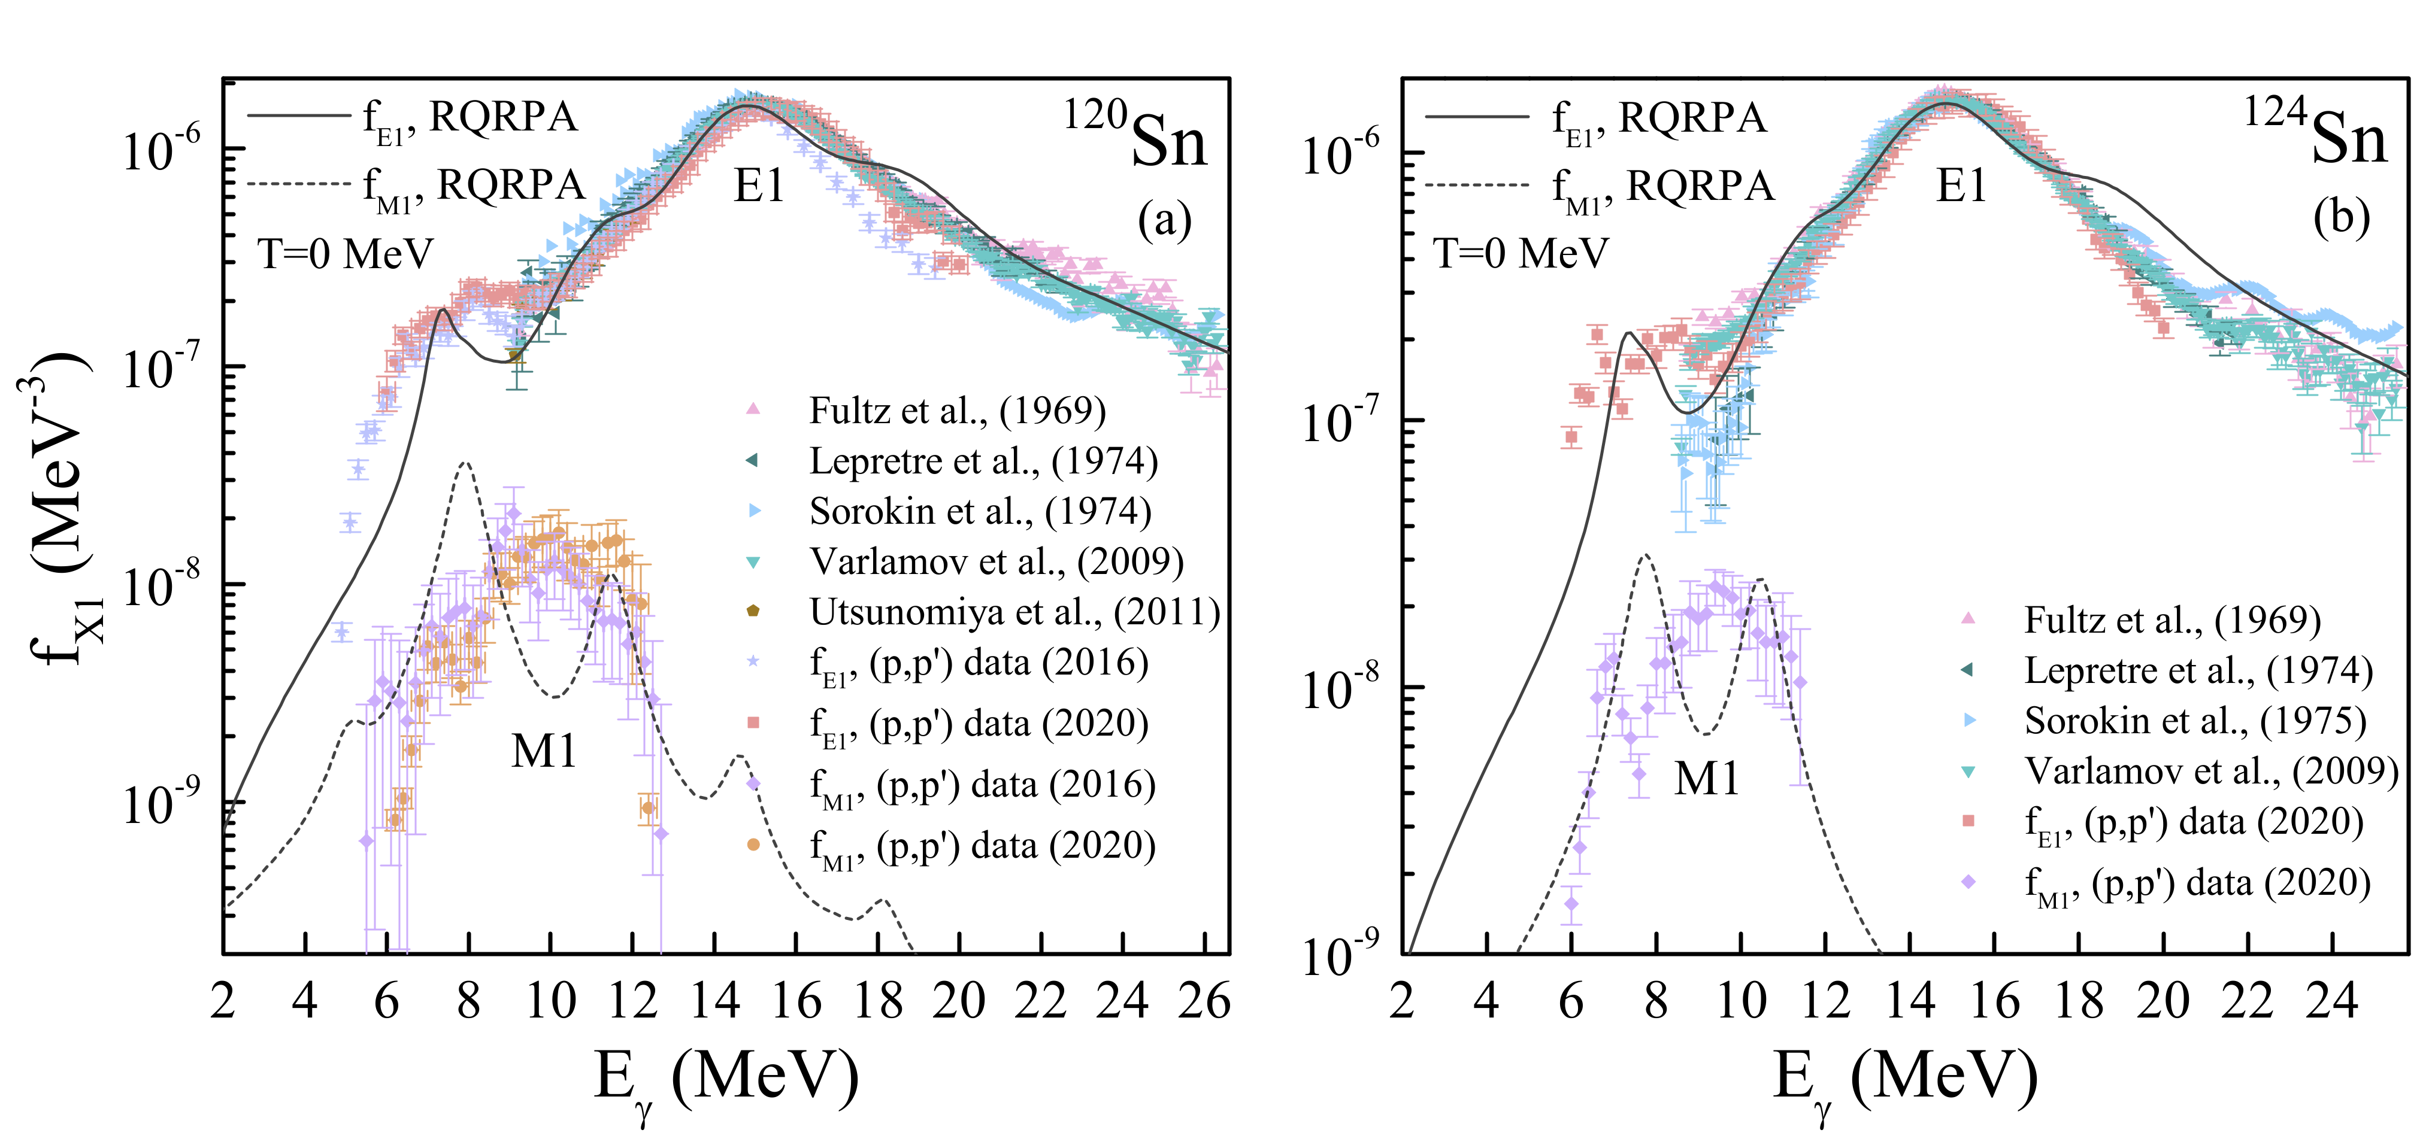


E1 and M1 𝛾-ray strength functions
𝛾-ray strength functions have important role in radiative neutron capture processes and reaction rates in stellar environment ➔ talk Bryn Knight
Relativistic QRPA calculations of E1 and M1 transitions for gamma strength funcitons (DD-PCX)
$$\vec{f_{E1}^{RQRPA}}(E_{γ})({MeV}^{−3})=\frac{16{πe}^{2}}{27ℏ^{3}c^{3}}×S_{E1}(E_{γ})$$
$$\vec{f_{M1}^{RQRPA}}(E_{γ})({MeV}^{−3})=\frac{16π}{27ℏ^{3}c^{3}}×S_{M1}(E_{γ})$$
Kaur, E. Yuksel, N.P. (2025)
A. Kaur, E. Yüksel, N. P., PRC 109, 014314 (2024)

Slide 20
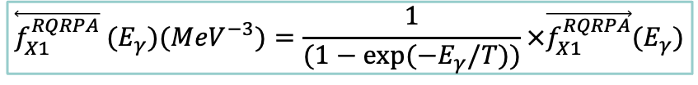
Photon Strength functions in Hot nuclei
E1+M1 photon strength functions at T>0 MeV
De-excitation strength function is calculated using
$$\overset{⃖}{f_{X1}^{RQRPA}} (E_{γ})({MeV}^{−3})=\frac{1}{(1−exp⁡(−E_{γ}/T))}×\vec{f_{X1}^{RQRPA}}(E_{γ})$$
A. Kaur, E. Yuksel, N.P. (2025)

Slide 21
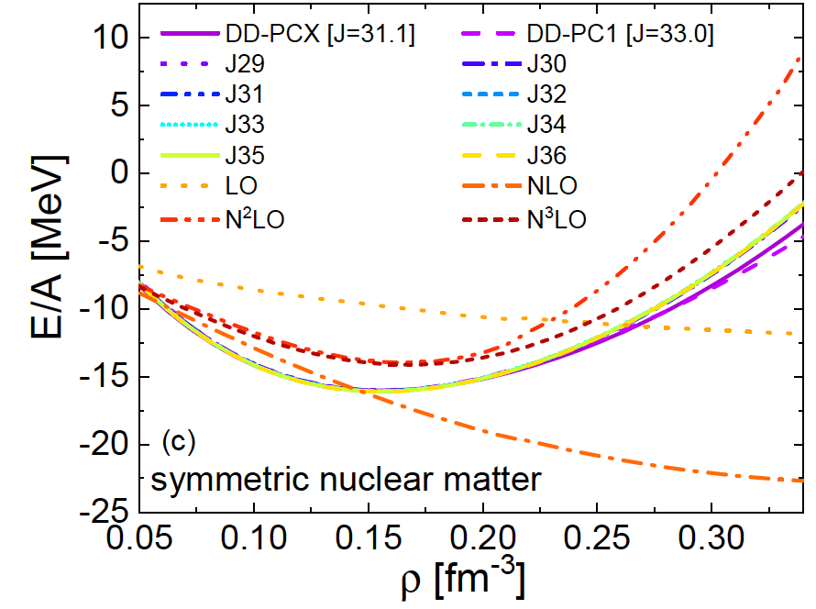
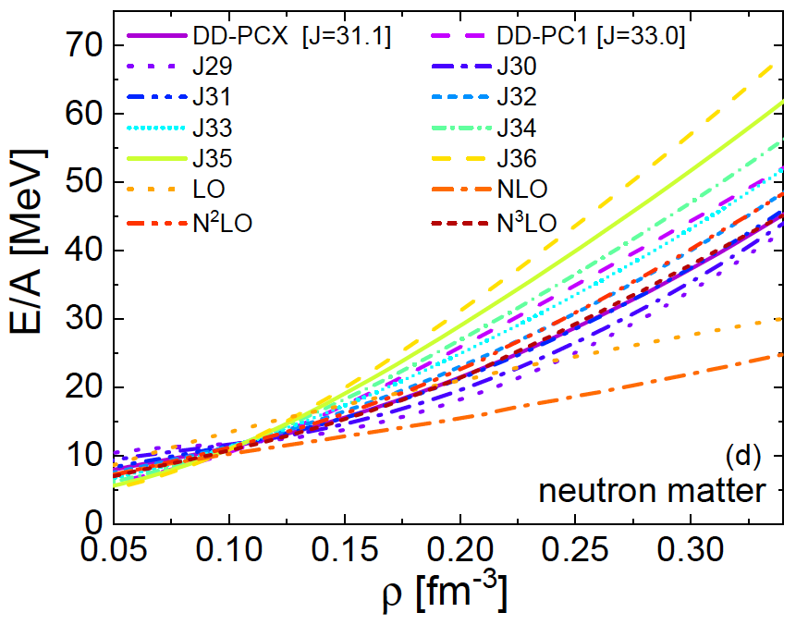
NUCLEAR MATTER EQUATION OF STATE
Nuclear matter equation of state
(for the uniform and infinite system)
EOS for the family of relativistic interactions which vary the symmetry energy J=30-36 MeV
Symmetry energy S₂(ρ) describes the increase in the energy of the N≠Z system as protons are turned into neutrons
THEORY FRAMEWORK
J – symmetry energy at saturation density
L – slope of the symmetry energy
(related to the pressure of neutron matter)
E. Yuksel, N.P., Univ. 7, 71 (2021)

Slide 22
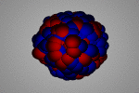

CONSTRAINING THE SYMMETRY ENERGY WITH NUCLEAR EXCITATIONS
Can we relate the symmetry energy
with dipole transitions in nuclei?
Isovector dipole transition strength for a set of relativistic point coupling interactions which vary the symmetry energy properties
J=30,31,…,36 MeV E. Yuksel, N.P., Univ. 7, 71 (2021).
Symmetry energy
Strategy to determine symmetry energy parameters (J,L):
build the EDFs which reproduce experimental data on dipole polarizabilty $α_{D}$ ➡︎ DD-PCX
E. Yuksel, T. Marketin, N.P., PRC 99, 034318 (2019)
Pygmy
dipole strength
Isovector giant
dipole resonance
Exp. data: A. Tamii et al., PRL 107, 062502 (2011)
J. Birkhan et al., PRL118, 252501 (2017)
T. Hashimoto et al., PRC 92, 031305 (2015).

Slide 23
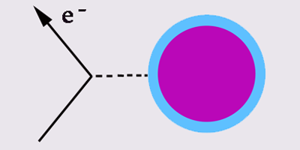
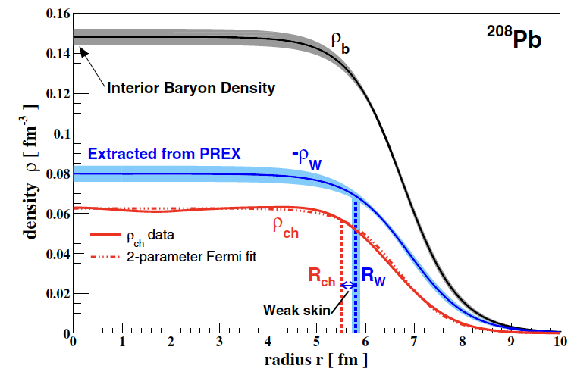


PARITY VIOLATING ELECTRON SCATTERING EXPERIMENTS (PREX,CREX)
Can we relate exp. data on parity violating scattering of electrons on nuclei with the symmetry energy?
significantly larger coupling of the Z₀ boson to neutrons compared to protons
▶︎ Parity violating (PV) asymmetry
$$A_{PV}=\frac{σ_{R}−σ_{L}}{σ_{R}+σ_{L}}≈\frac{G_{F}Q^{2}\left|Q_{W}\right|}{4\sqrt{2}παZ}\frac{F_{W}(Q^{2})}{F_{ch}(Q^{2})}$$
→ nuclear weak form factor F_{W} → r_{n} → r_{np}
⁴⁸Ca (CREX)
F_{W}(q=0.8733 fm⁻¹)=
0.1304±0.0052(stat)±0.0020(syst.)
D. Adhikari et al., PRL 129, 042501 (2022).
²⁰⁸Pb (PREX II)
F_{W}(q=0.3978 fm⁻¹)=0.368±0.013
D. Adhikari et al., PRL 126, 172502 (2021).
S. Abrahamyan et al., PRL 108, 112502 (2012).
Z₀
D. Adhikari et al.,
PRL 126, 172502 (2021).
Strategy to determine symmetry energy parameters (J,L) and r_{np} :
build the EDFs which reproduce the measured electron scattering form factors $F_{\begin{aligned}W \\ \end{aligned}}$
E. Yuksel, N.P., PLB B 836, 137622 (2023)

Slide 24
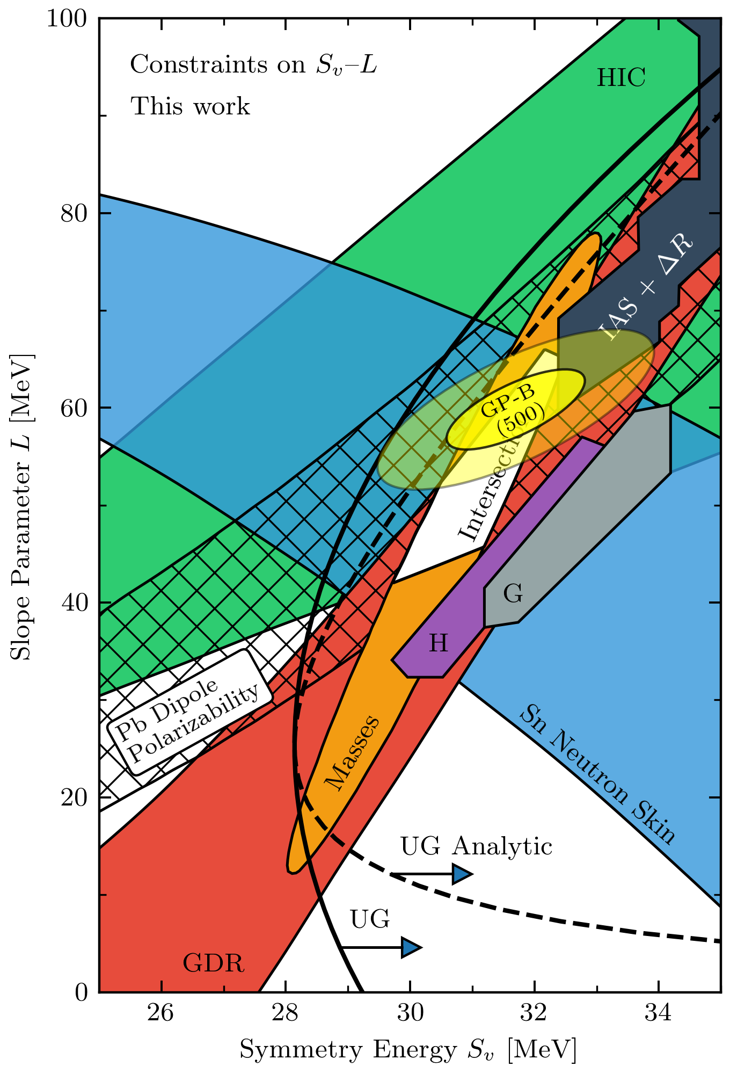
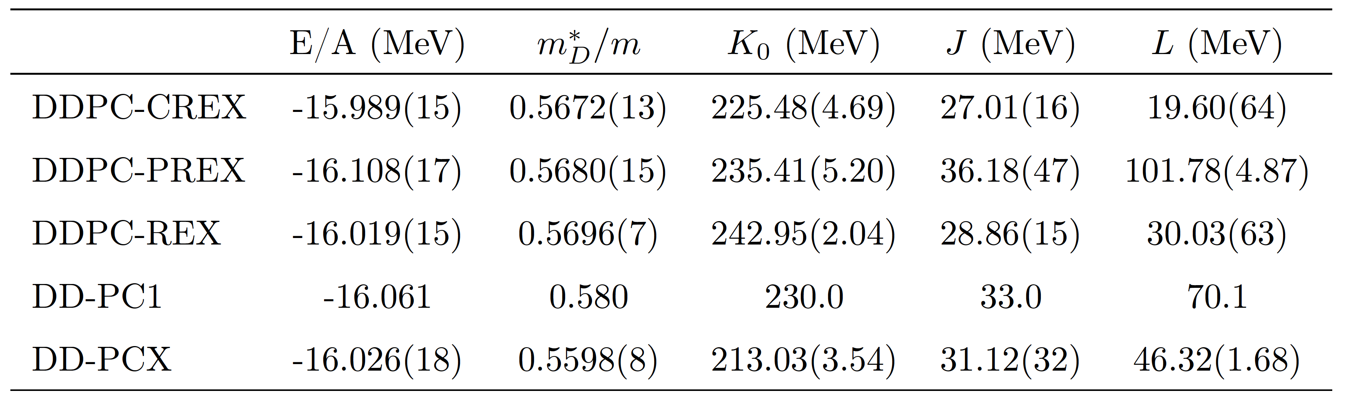

NUCLEAR MATTER PROPERTIES
DDPC-PREX
DD-PCX
Constrained by collective nuclear excitations
DDPC-REX
Point coupling EDFs constrained by CREX and PREX
data result in rather different values of the symmetry
energy (J) and its slope parameter (L)
Discrepancy with the DD-PCX interaction constrained
by nuclear ground state and collective excitation properties
New experiments?
DDPC-CREX
C. Drischler, R. J. Furnstahl, J. A. Melendez, and D. R. Phillips PRL, 125, 202702, 2020.
https://github.com/buqeye/nuclear-matter-convergence/tree/master/analysis/Esym-L

Slide 25
NEUTRON STAR PROPERTIES
Neutron star mass-radius relationship for density-dependent point coupling EDFs
DD-PCX - optimal interaction constrained by nuclear ground state and excitation data (dipole polarizability, ISGMR)
DD-PC-CREX – based on nuclear ground state data and parity violating electron scattering data for 48Ca (CREX)
DD-PC-PREX - interaction based on nuclear ground state data and parity violating electron scattering data for 208Pb (PREX II)
DD-PC-J29-J36 – family of interactions adjusted to the range of symmetry energy J=29-36 MeV
P.S. Koliogiannis, E. Yüksel, N. P., arXiv:2412.15936 (2024).

Slide 26
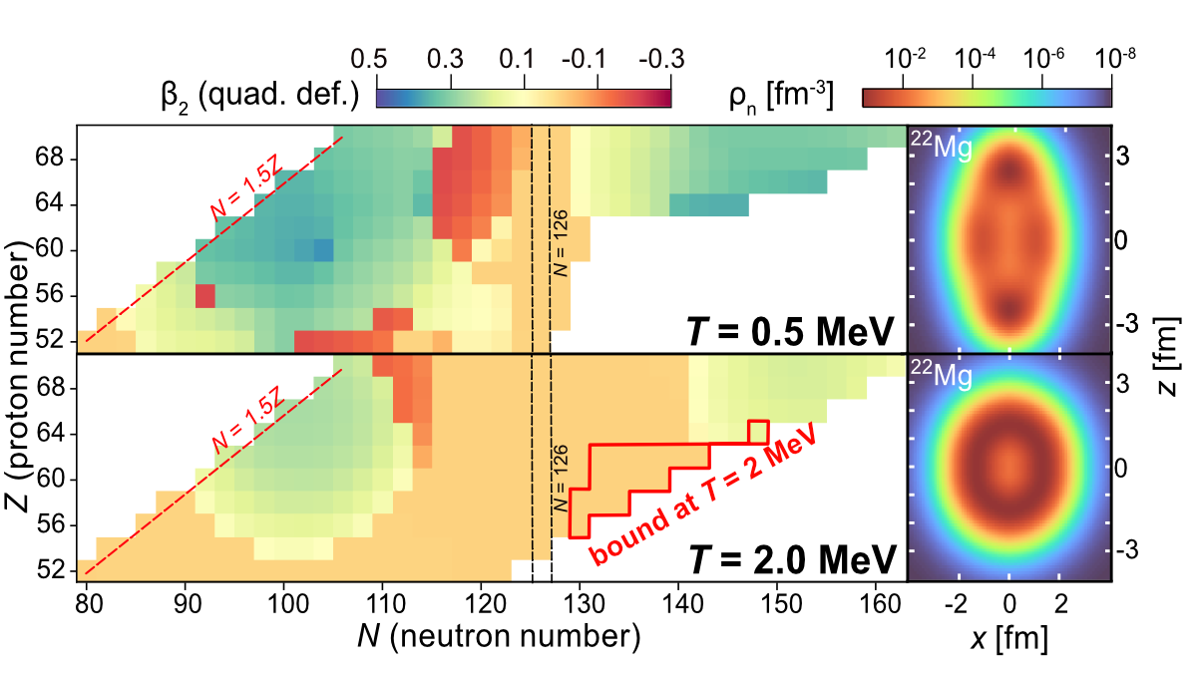
CONCLUDING REMARKS
Microscopic theoretical description of nuclear structure and dynamics from zero to finite temperature in the relativistic energy density functional framework
Experimental studies benchmark the model calculations (starting from T=0 limit)
The interplay of temperature, pairing, deformation effects;
changes in nuclear structure, excitation properties and
weak processes
The nuclear drip lines should be viewed
as limits that change dynamically with
temperature.
The rates for various nuclear processes increase with temperature along the nuclide map, these changes are now quantified by microscopic model (β-decays, electron capture, neutron emission-, gamma strength functions, …)
Applications in astrophysical simulations and nucleosynthesis calculations
THANKS TO: A. Ravlić (MSU, Zagreb), A. Kaur, T. Nikšić, P.S. Koliogiannis, T. Ghosh (Zagreb),
E. Yuksel (Surrey), Y. F. Niu (Lanzhou), S. Giraud, R.G.T. Zegers (MSU)
This work is supported by the Croatian Science Foundation under the project
Relativistic Nuclear Many-Body Theory in the Multimessenger Observation Era (IP-2022-10-7773).

Slide 27
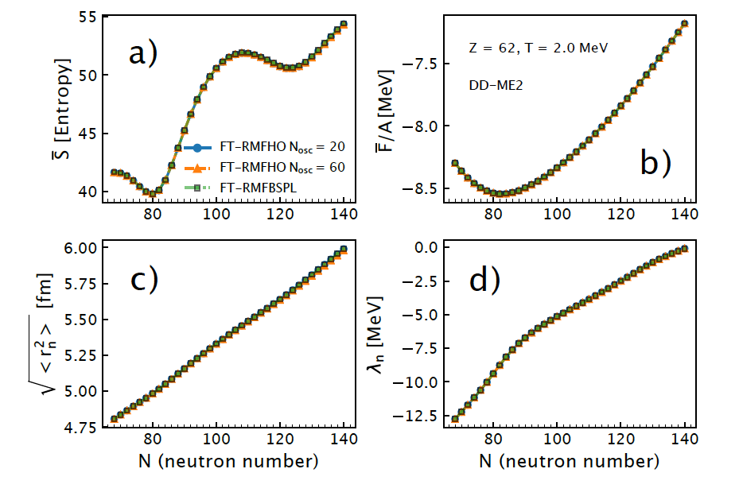
MODEL VALIDATION
Test of the FT-RMFHO model in comparison to FT-RMFBSPL model

Slide 28
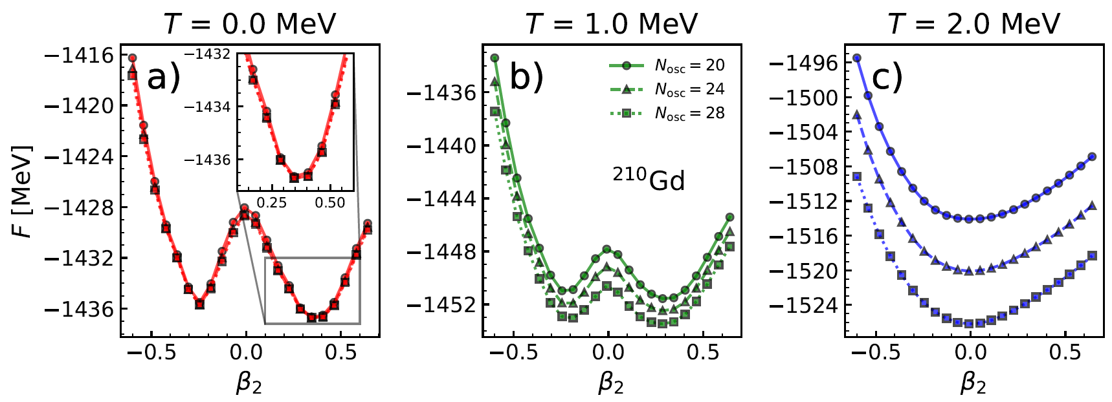
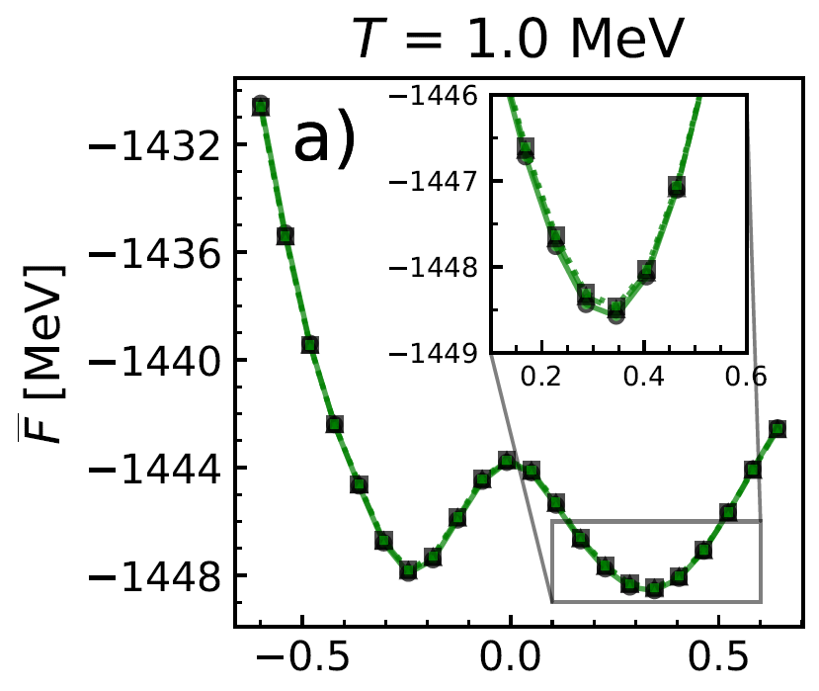
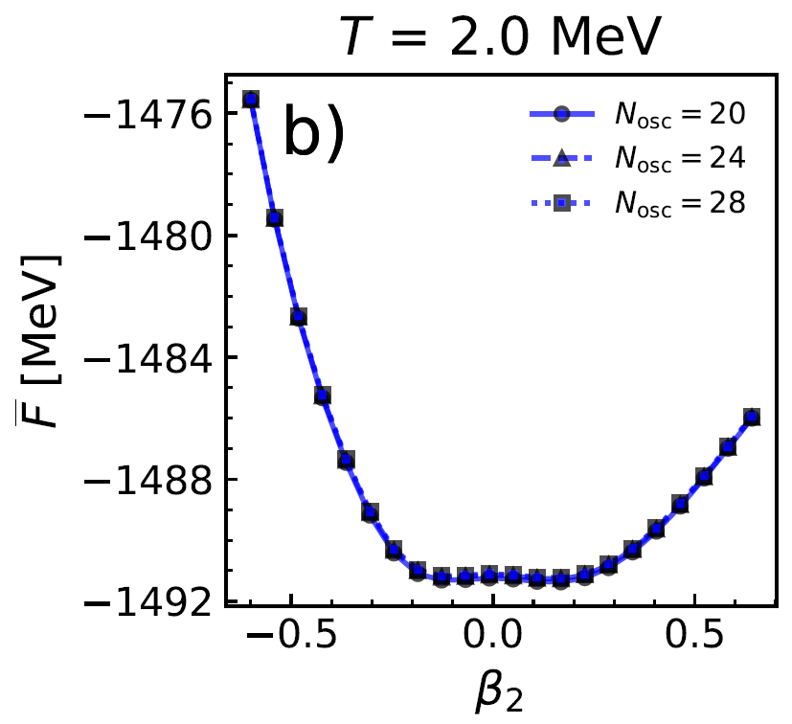
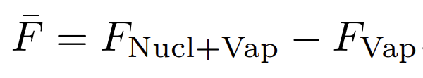

Convergence test of the FT-RHB model
Potential energy curves (F,β₂) for ²¹⁰Gd calculated for T = 0, 1, and 2 MeV for different numbers of harmonic-oscillator shells. No convergence of the results!
Improvement of the FT-RHB model with the treatment of the nucleon states in the continuum. → Excellent convergence.
Subtracted free energy
A- Ravlić, E. Yüksel, T. Nikšić, N. P., PRC 109, 014318 (2024)

Slide 29
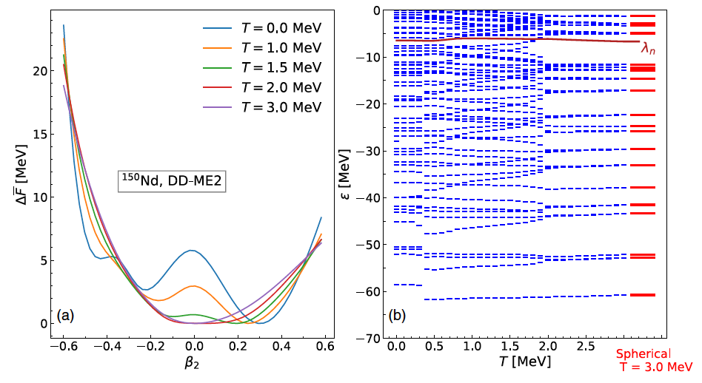
EVOLUTION OF SINGLE-PARTICLE STRUCTURE WITH TEMPERATURE

Slide 30
RELEVANCE OF THE CONTINUUM SUBTRACTION
Impact of continuum subtraction on the position of the two-neutron drip-line

Slide 31
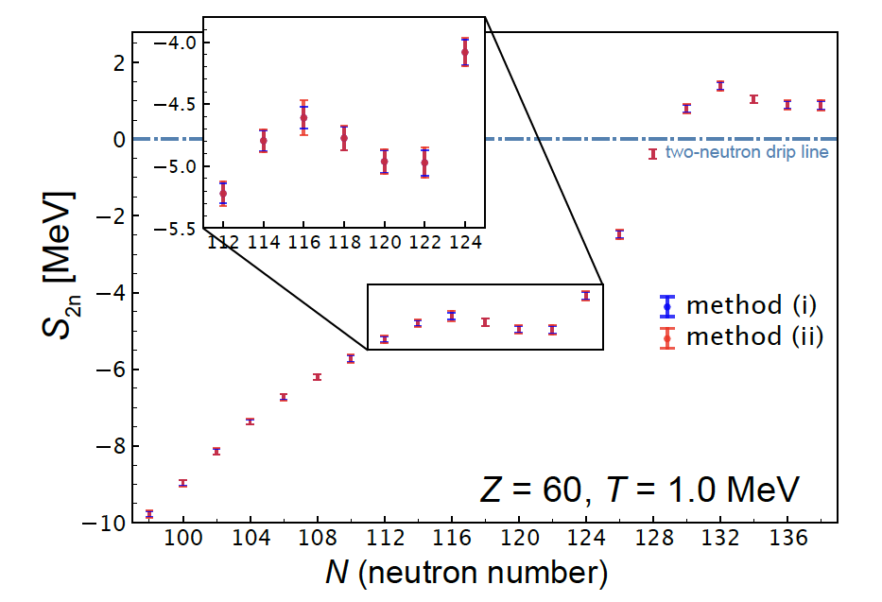
STATISTICAL UNCERTAINTIES

Slide 32
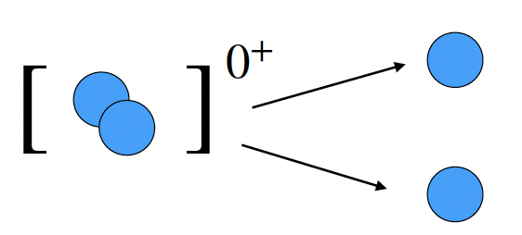

NUCLEAR PAIRING PROPERTIES AT FINITE TEMPERATURE
The temperature evolution of nuclear pairing properties
→ neutron pairing gaps in the temperature range T = 0 – 1 MeV
At lower temperatures, interplay of the pairing and temperature effects.
At critical temperature a phase transition occurs from the superfluid to a normal state.

Slide 33

EVOLUTION OF BETA-DECAY RATES IN STELLAR ENVIRONMENT
Beta-decay rates as a function of temperature for densities $ρY_{e}={10}^{7}$ $g/{cm}^{3}$ and $ρY_{e}={10}^{9}$ $g/{cm}^{3}$ A. Ravlić, E. Yuksel, Y. F. Niu, N. Paar, PRC 104, 054318 (2021).
Comparison with the shell model calculations (i) LSSM (K. Langanke et al. ADNDT 79, 1 (2001)) and (ii) pf-GXPF1J (K. Mori et al., AJ 833, 179 (2016))

Slide 34
STELLAR ELECTRON CAPTURE
Electron capture occurs at finite temperature and at various densities depending on the stage of the stellar evolution
We introduce a unified theoretical approach based on the RNEDF that includes both the finite temperature and nuclear pairing effects
  A. Ravlić, E. Yuksel, Y. F. Niu, G. Colo, E. Khan, N. Paar, PRC 102, 065804 (2020).
Ground state is described by finite temperature relativistic Hartree-BCS. Due to finite temperature, some occupied states become partially occupied, some empty states too
Finite-temperature proton-neutron relativistic QRPA (FT-PNRQRPA) is used for the description of relevant transitions
  E. Yuksel, N. Paar, G. Colo, E. Khan, and Y. F. Niu, PRC 101, 044305 (2020).

Slide 35
ELECTRON CAPTURE CROSS SECTIONS
Cross section is derived from the Fermi’s golden rule, assuming weak Hamiltonian in current-current form
Transition matrix elements include charge , longitudinal ,
transverse electric and transverse magnetic multipole operators

Slide 36
STELLAR ELECTRON CAPTURE ON ⁵⁶Fe
Gamow-Teller (GT⁺) transition strength at various temperatures. The range of values of isoscalar pairing strength V₀ is used for demonstration.
Electron capture cross sections at temperature T=0.3 MeV for different multipoles
  A. Ravlić, E. Yuksel, Y. F. Niu, G. Colo, E. Khan, N. Paar, PRC 102, 065804 (2020).

Slide 37
STELLAR ELECTRON CAPTURE ON ⁵⁶Fe
Temperature dependence of the
electron capture cross sections
Electron capture rates at different temperatures and isoscalar pairing strengths

Slide 38

What is the impact of individual nuclei
on core-collapse supernova dynamics?
The electron-to-baryon ratio change$\left|ΔY_{e}^{i}\right|$for individual nuclei, integrated from the onset of the collapse up to the time of neutrino trapping ($ρ≅{10}^{12}g/{cm}^{3})$
Nuclei with higher $\left|ΔY_{e}^{i}\right|$have a higher influence on driving the deleptonization and larger impact on CCSNe dynamics.
Regions around N = 50 and N = 82 have the most significant impact driving the deleptonization
Forbidden transitions result in shift toward lower-Z nuclei
.
Only Gamow-Teller
transitions in EC rates
full FT-pnRQRPA EC rates
A. Ravlić, S. Giraud, N.P., R. G. T. Zegers, (2025)

