Slide 1
Chiral symmetry and hadrons in matter
Su Houng Lee
1. Introduction
2. Chiral partners
3. K1 and K* mesons in medium
4. φ meson in medium: 2-π contribution in sum rules
SHLee, JSPC 1-2(2024)100014, arXiv:2410.00489
1. Introduction

Slide 2
Vector meson in Flavor SU(3) symmetry and broken symmetry
Octet
Singlet
Mixing due to
$m_{s}≫m_{d}∼m_{u}$
1. Introduction

Slide 3
Why does meson representation mix for Y=0, I=0 ?
Consider correlation function: SU(2) case
1. Introduction

Slide 4
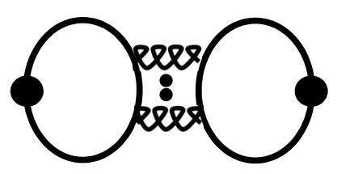
- If SU(3) symmetric limit: Δ =0, there is no mixing, and singlet and octet do not mix.
- If SU(3) symmetry is broken
1) Ideal mixing when D=0<< Δ (Vector meson)
2) Small mixing when D >> Δ (Pseudo-scalar meson)
1. Introduction

Slide 5
Chiral transformation of quark bilinears
Chiral symmetry SU(3)_{R}XSU(3)_{L}
Spontaneous breaking of Chiral symmetry SU(3)_{R}XSU(3)_{L} → SU(3)_{V}
Broken part is
- Quark bilinear
1. Introduction

Slide 6
Spin-1 Flavor Octet
Spin-1 Flavor Singlet
$$m_{s}≫m_{d}∼m_{u}$$
1. Introduction

Slide 7
1. Introduction

Slide 8
Chiral Partners
Quark Operators
2-quark
4-quark
=0 in Vacuum saturation
J. Kim, SHL (PRD 2021,2022): vacuum saturation works well, as big as breaking part
2. Chiral partners

Slide 9
Quark Operators
Operator product expansion for K* and K1
☞
- Only connected diagrams contribute
2. Chiral partners

Slide 10
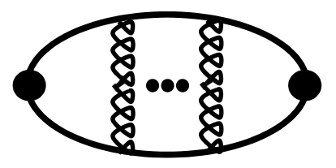
Operator product expansion for φ and f₁(1420)
☞
- Difference has contribution from disconnect diagram, and is chiral symmetric
- Disconnect diagram is known to be small in vacuum (ideal mixing)
2. Chiral partners

Slide 11
Which vector meson should one study in medium
1) Hadrons with small width: φ is the best candidate
J^{PC}=1⁻⁻ | Mass | Width | J^{PC}=1⁺⁺ | Mass | Width
ρ | 770 MeV | 150 MeV | a₁ | 1260 | 250-600
ω | 782 | 8.49 | f₁ | 1285 | 24.2
φ | 1020 | 4.266 | f₁ | 1420 | 54.9
K*(1⁻) | 892 | 50.3 | K₁(1⁺) | 1270 | 90
J-PARC E16, E88
2) Chiral partner: K* and K1 is the best candidate
- Decay mode of chiral partners typically has one more pion
3) If possible measurement of f₁(1420) is also interesting (parity partner of φ )
2. Chiral partners

Slide 12
Which vector meson should one study in medium
1) Hadrons with small width
J^{PC}=1⁻⁻ | Mass | Width | J^{PC}=1⁺⁺ | Mass | Width
ρ | 770 MeV | 150 MeV | a₁ | 1260 | 250-600
ω | 782 | 8.49 | f₁ | 1285 | 24.2
φ | 1020 | 4.266 | f₁ | 1420 | 54.9
K*(1⁻) | 892 | 50.3 | K₁(1⁺) | 1270 | 90
J-PARC E16, E88
2) Use condensate based Operator Product Expansion (OPE) methods
- Can identify Chiral symmetry breaking effects
- Can relate them to mass
3. K1,K1*mass and chiral symmetry

Slide 13
K* and K1 mass in the chiral symmetric vacuum
Sum rules in the chiral symmetric vacuum
☞
3. K1,K1*mass and chiral symmetry

Slide 14
K1/K* production in heavy ion collision
b
T
T_{initial}
Hadron production
Kinetic freeze-out
Large b
Small b
T_{μ}
T_{C}
T_{F}
τ
QGP
Hadron phase
1 fm/c
5 fm/c
7 fm/c
17 fm/c
3. K1,K1*mass and chiral symmetry

Slide 15
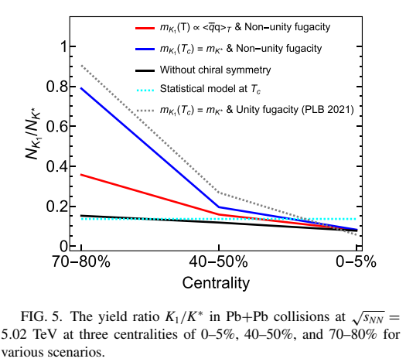
5) K1/K* vs Centrality
3. K1,K1*mass and chiral symmetry

Slide 16
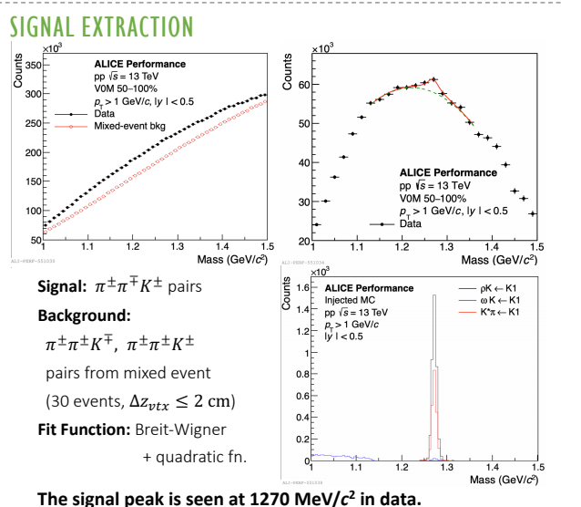
5) K1/K* vs Centrality
3. K1,K1*mass and chiral symmetry

Slide 17
6) K1/K* at JPARC
Kaon beam
Nuclear target
I. Park, H. Sako, K. Aoki, P. Gubler, SHLee, PRD109 (2024) 11, 114042
3. K1,K1*mass and chiral symmetry

Slide 18
Possible future experiment to measure masses of chiral partners
K₁ excitation energy measurement at JPARC
Decay mode of K₁ (Γ=90MeV)
Decay mode | Fraction
K1(1270)→ K ρ | 42 %
K1(1270)→ K* π | 16 %
Kaon beam (2GeV)
Nuclear target
3. K1,K1*mass and chiral symmetry

Slide 19
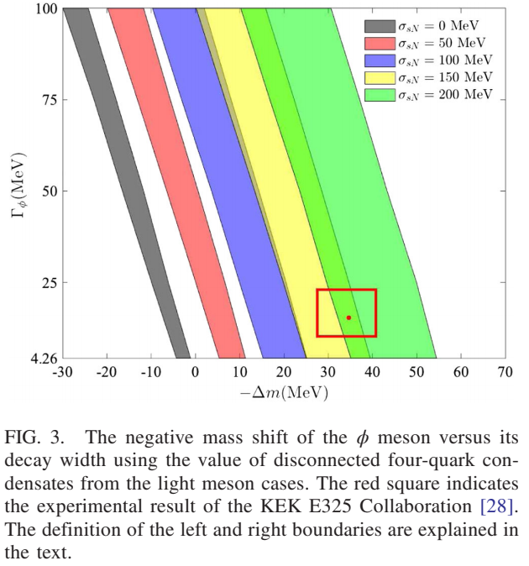
φ –meson in medium: QCD sum rule
Sum rule result
J.Kim, P. Gubler, SHL, PRD105,114053(22)
Up to α_{s} and dim 6
(Breaking part can be estimated)→ Need large σ_{sN} content of a nucleon?
4. Φ sum rule

Slide 20
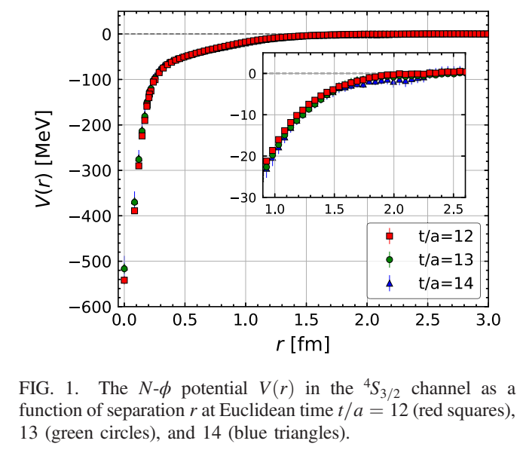
φ-N potential: Lattice
Y. Lyu et al (HAL) PRD106,074507(22)
Long range part: attraction 2-π
→ Coupling to 2-π
Up to α_{s} and dim 6
Not present in sum rules
4. Φ sum rule

Slide 21
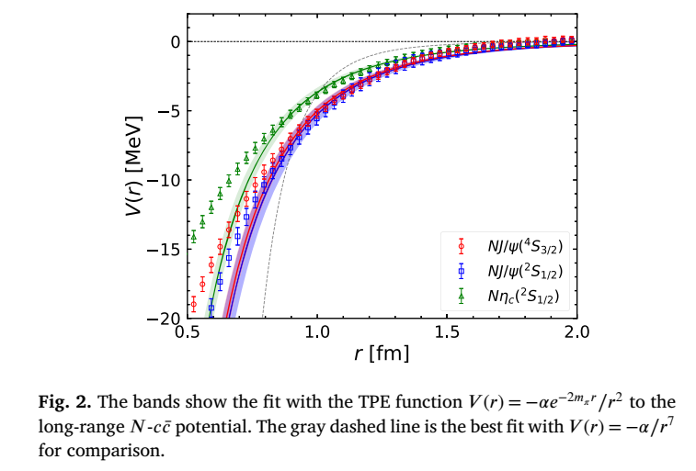
J/ψ-N potential: Lattice
Y. Lyu et al (HAL) PLB860,139178(25)
Long range part: attraction 2-π
→ Coupling to 2-π
Up to α_{s} and dim 4
Not present in sum rules
2. Φ sum rule

Slide 22
J/ψ –sum rule to dim-6 (S.Kim, SHL, NPA679(2001)517)
Up to dim 6
 | Spin=0 | Spin=2 | Spin=4
Dim 4
Dim 6
4. Φ sum rule

Slide 23
Contribution of 4-quark operator in J/ψ
- Vacuum saturation (only chiral symmetry breaking part contributes)
- Fiertz transformation to extract 2-π contribution
Use linear density part of the chiral symmetry breaking operators
→ 2-π and 2-K contributions leads to small attraction around 1 MeV
4. Φ sum rule

Slide 24
φ-N potential: Lattice
Y. Lyu et al (HAL) PRD106,074507(22)
Long range part: attraction 2-π
→ Coupling to 2-π
Up to α_{s} and dim 6
Not present in sum rules
2. Φ sum rule

Slide 25
Contribution of 4-quark operator in φ
- Naïve extension of J/ψ sum rules to φ gives larger attraction
- But Wilson coefficient is more complicated
Use linear density part of the chiral symmetry breaking operators
→ 2-π + 2-K contribution leads to attraction of around (less reliable) 2 MeV
→ Chiral symmetric operators should be non-trivial
4. Φ sum rule

Slide 26
Summary
1) Hadrons with small width: φ is the best candidate
J^{PC}=1⁻⁻ | Mass | Width | J^{PC}=1⁺⁺ | Mass | Width
ρ | 770 MeV | 150 MeV | a₁ | 1260 | 250-600
ω | 782 | 8.49 | f₁ | 1285 | 24.2
φ | 1020 | 4.266 | f₁ | 1420 | 54.9
K*(1⁻) | 892 | 50.3 | K₁(1⁺) | 1270 | 90
J-PARC E16, E88
2) Chiral partner: K* and K1 is the best candidate
- Decay mode of chiral partners typically has one more pion
3) Lattice vs Sum rule for φ : Non-trivial attraction from chiral breaking operators
4) If possible measurement of f₁(1420) is also interesting (parity partner of φ )
4. Summary and outlook

Slide 27
Different effects from the medium: Perspectives from OPE
Chiral symmetry breaking operators
Chiral symmetric operators
3. K1,K1*mass and chiral symmetry

