Slide 1


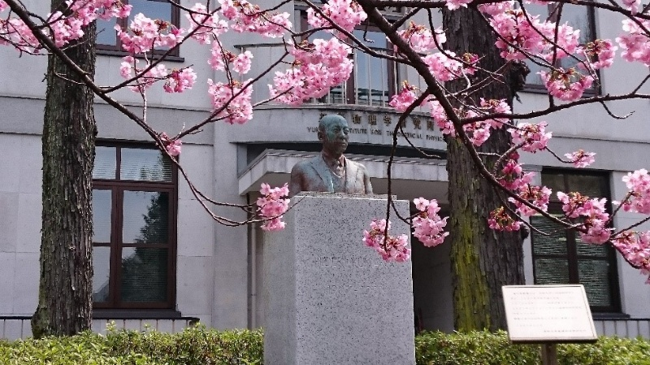
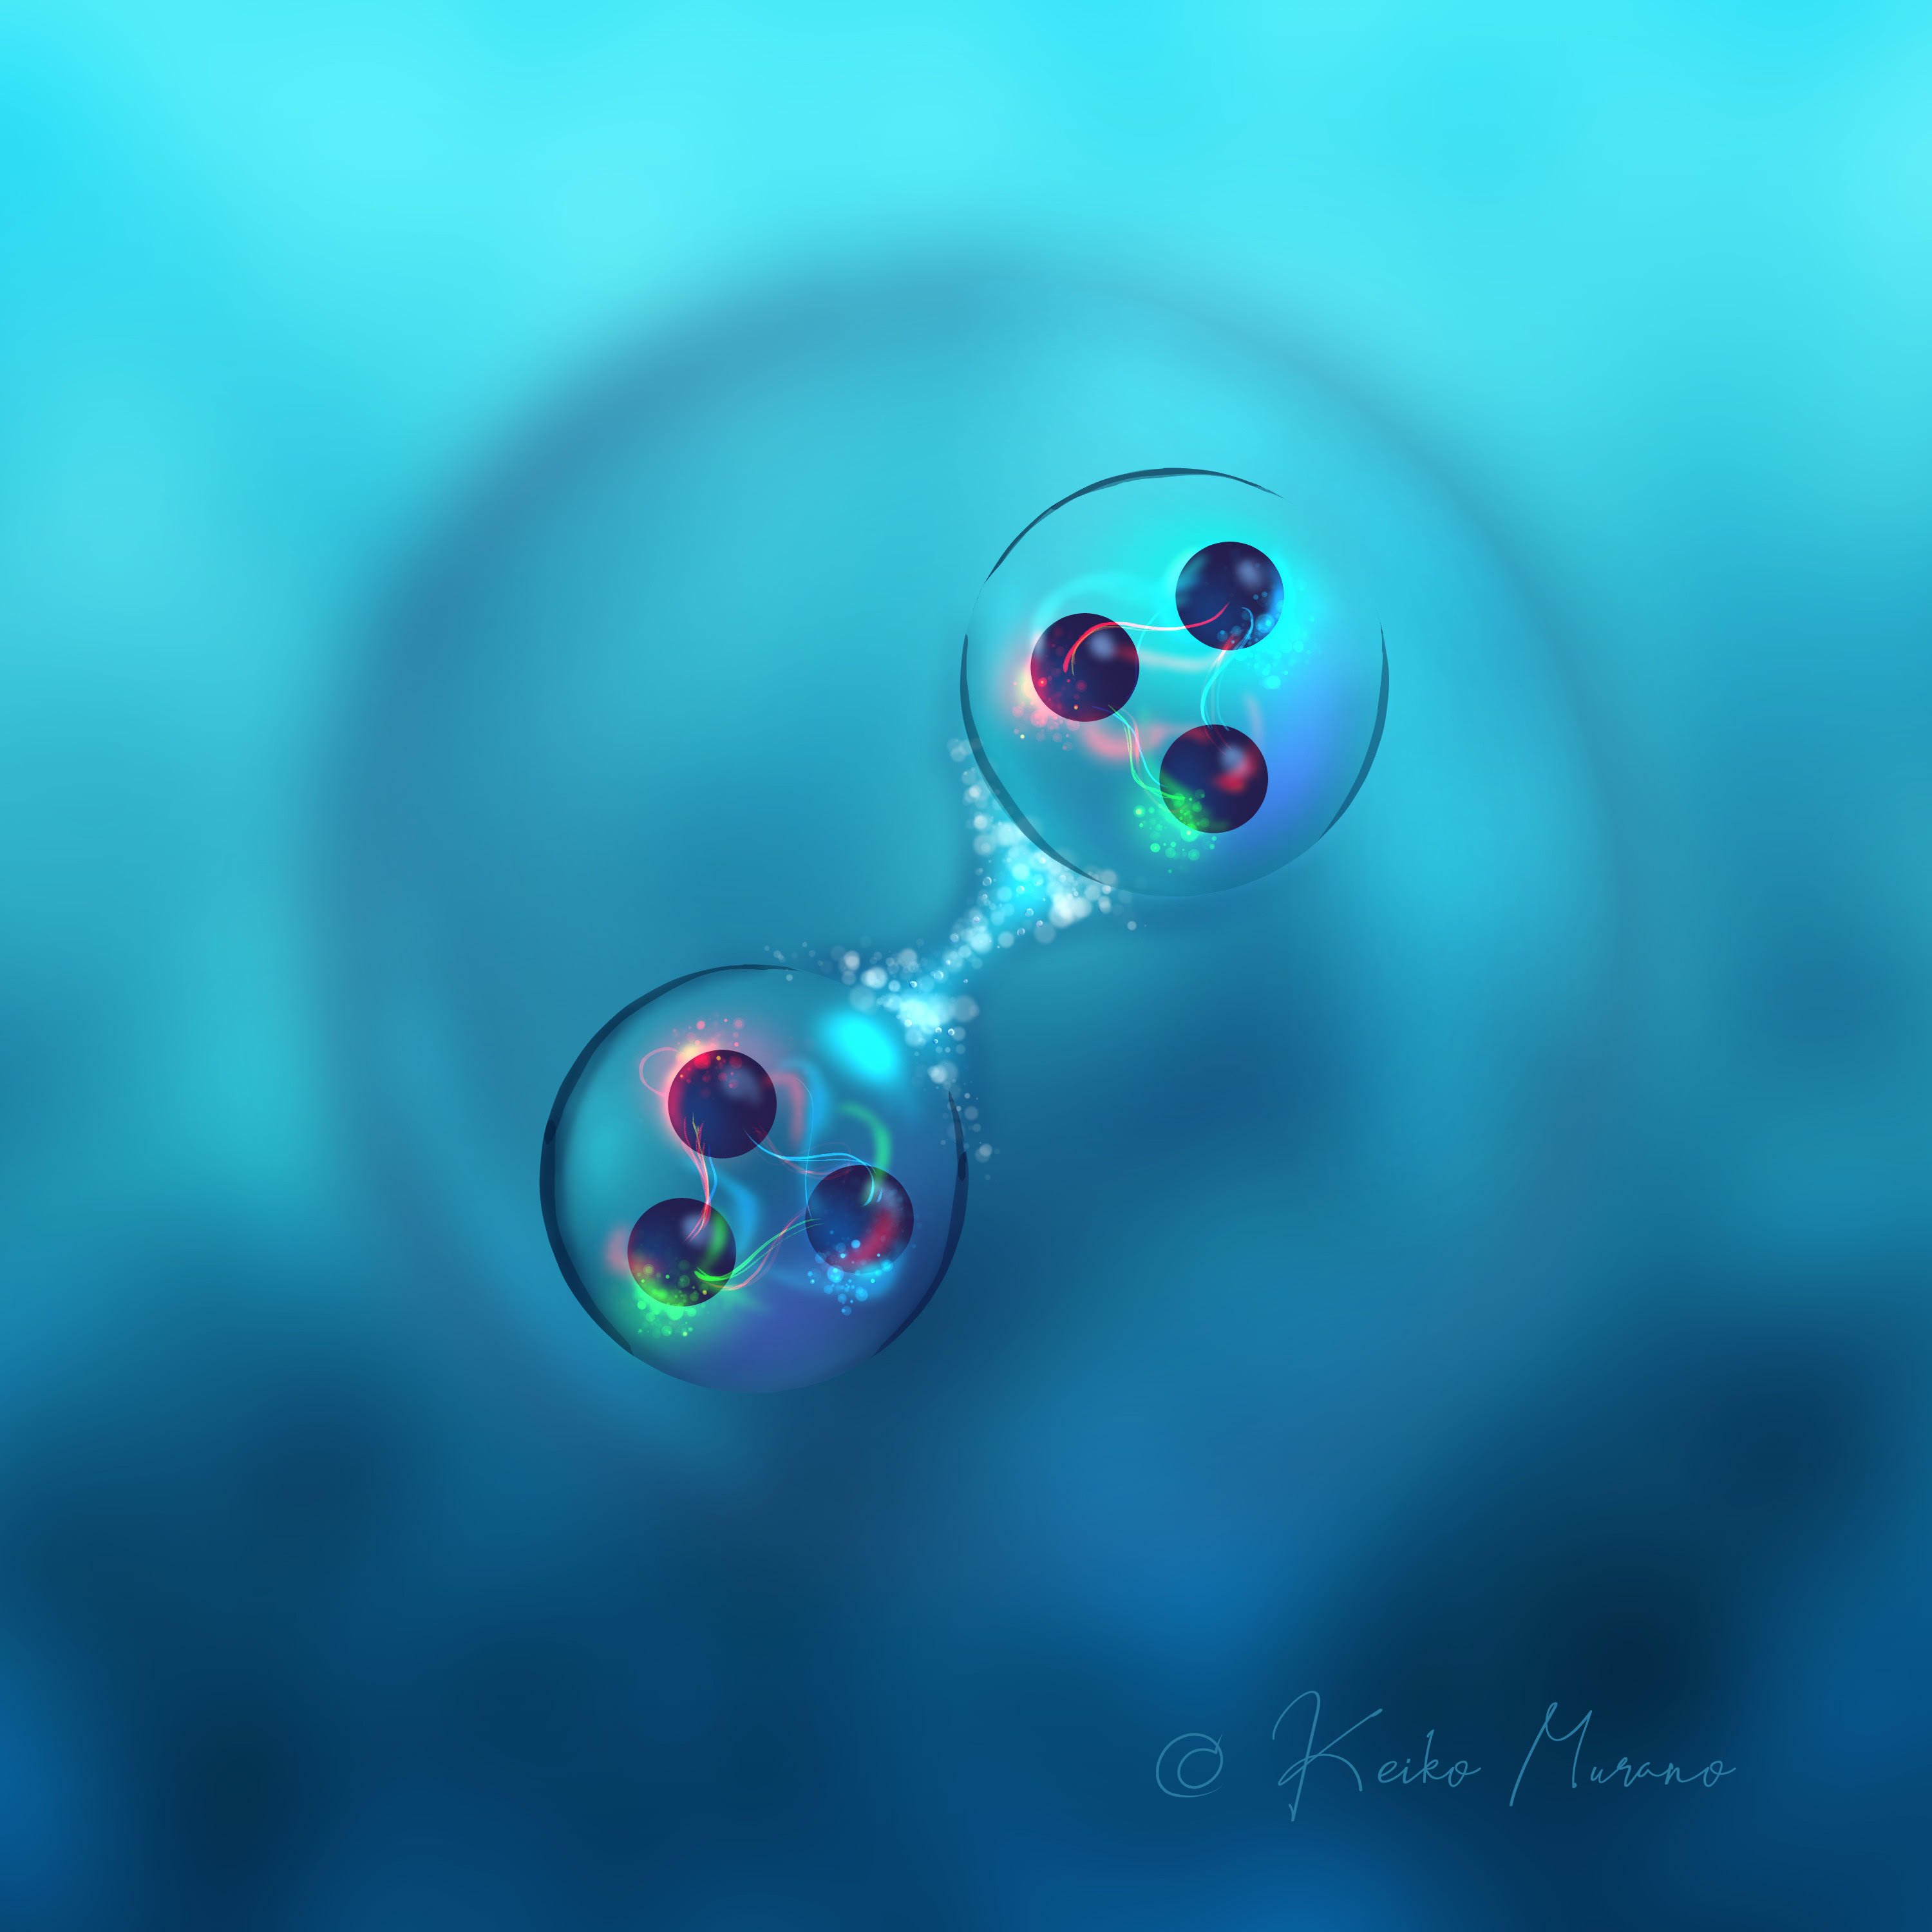
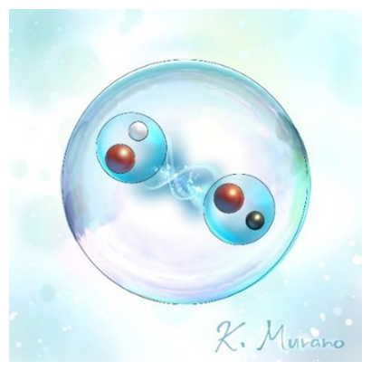
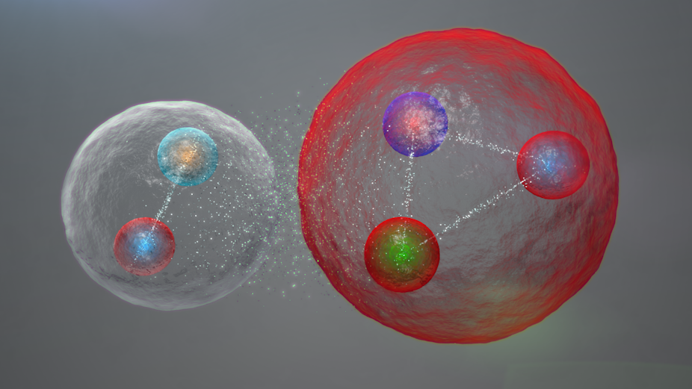
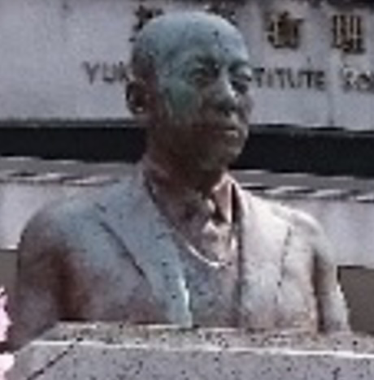

I. Building blocks of matter (10 min.)
II. QCD phase structure (05 min.)
III. Hot QCD plasma (15 min.)
IV. Cold QCD plasma (15 min.)
V. Summary (05 min.)
Hadron-Hadron Interactions from Lattice QCD
- Theory meets experiments -
Tetsuo Hatsuda (RIKEN iTHEMS)
Introduction to HAL QCD Method
Baryon-Baryon Interactions (ΛΛ−ΝΞ, ΝΩ, ΩΩ)
Meson-Meson Interactions (D-D* and T_{cc}⁺ )
4. Meson-Baryon Interactions ($s\overline{s}$ -$N$, $c\overline{c}$ -$N$)
cf. Kbar-N and Dbar-N → K. Murakami and R. Yamada
5. Two-pion Exchange universality
6. Summary
Lattice QCD
Hadron-hadron int.
Baryon-baryon int.
Meson-meson int. (T_{cc}⁺)
Meson-baryon int. (φ-N, J/ψ-N, η_{c}-N)
Summary
-
u
s
s
s
c
Hadrons in Nuclei 2025 (HIN2025) YITP, Kyoto, April 3, 2025
c
s
s
s
-
d

Slide 2
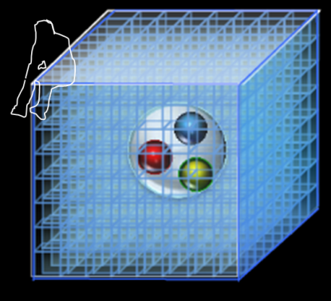
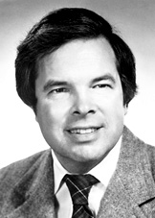


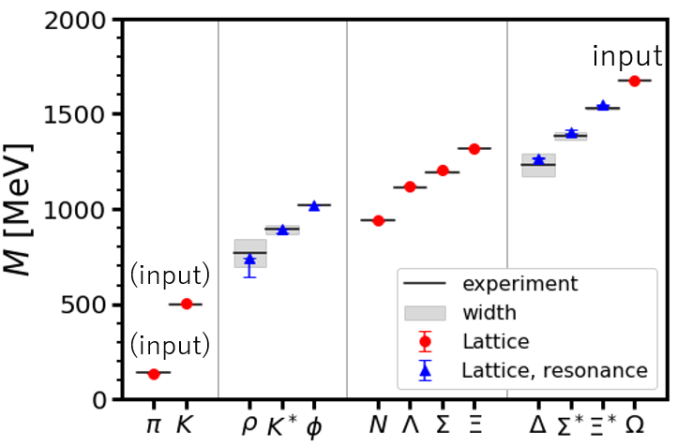
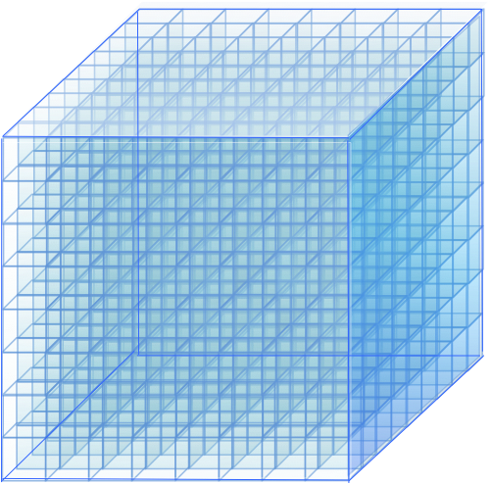
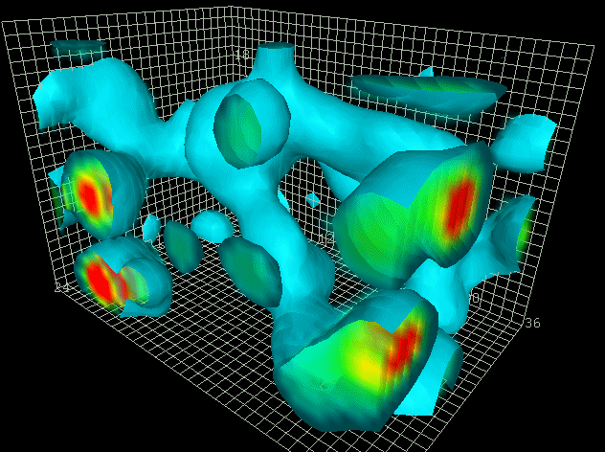
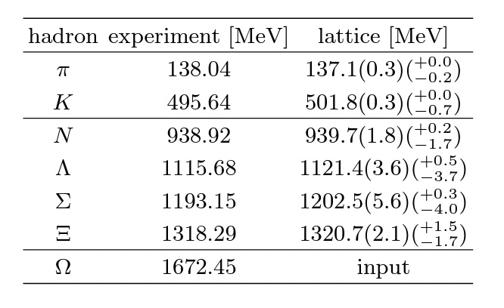
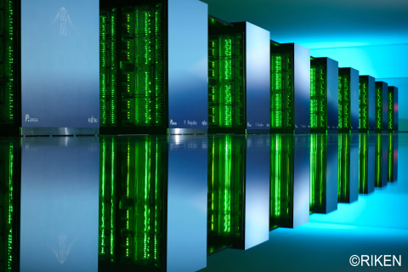
LQCD (since 1974) : Ab initio approach to solve QCD
K. Wilson
quarks
gluons
(2+1)-flavor QCD on
FUGAKU@RIKEN (440PFlops)
m_{π}=137.1 MeV, L=8.1 fm
Aoyama et al. [HAL QCD Coll.]
Phys. Rev. D110 (2024) 094502
a
4-dim.
Euclidean
Lattice
L
by D.Leinweber
Hybrid Monte Carlo method
to carry out 10⁹⁻¹⁰ dim. integrals

Slide 3


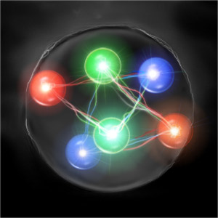
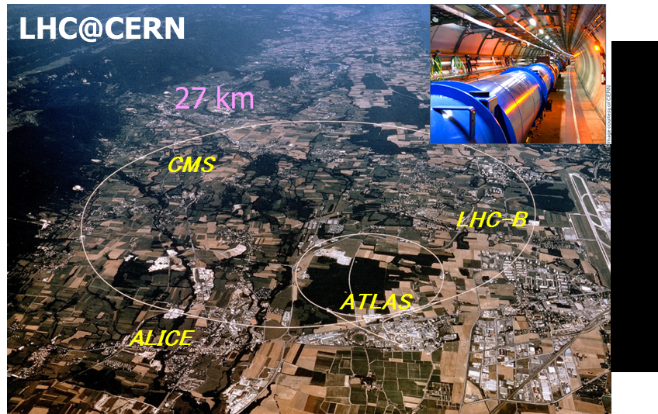
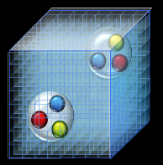
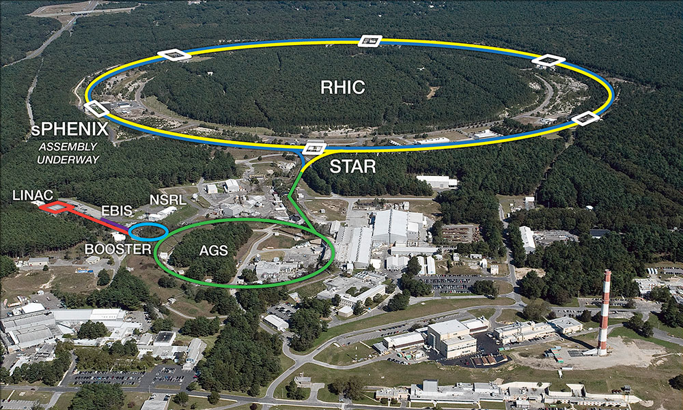
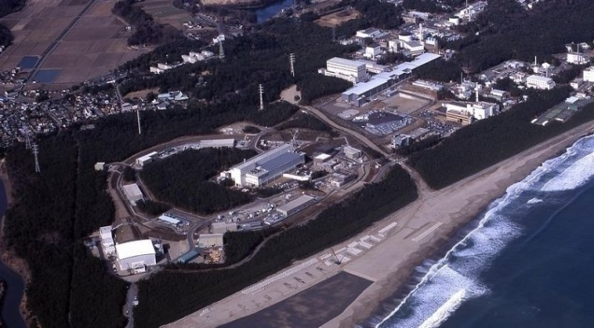
Hadron-hadron interactions : Why do we care ?
Nuclear forces & Hyperon forces
⇔ Atomic nuclei, hypernuclei, and EoS for neutron stars
Exotic hadrons & Exotic nuclei
⇔ Deeper understanding of “confinement”
Scattering experiments,
hadron spectroscopy,
hypernuclear spectroscopy
Femtoscopy (RHIC, LHC)
NS and NS merger observations
Era of “co-evolution”
of LQCD and Expt.
RHIC@BNL
J-PARC@KEK
GSI, J-Lab., BESIII, Belle, BaBar …

Slide 4
HAL QCD Method
4

Slide 5

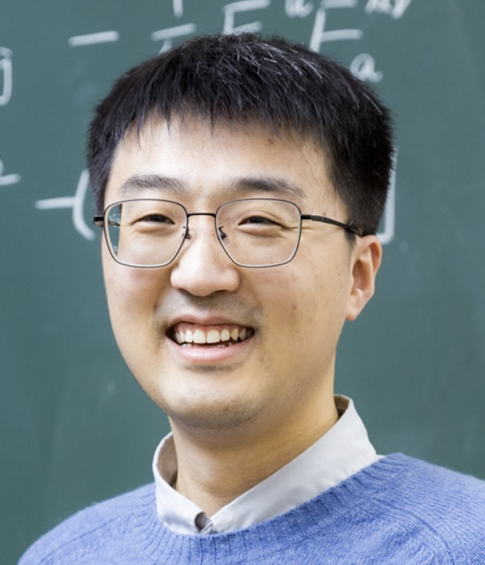
How to extract hadron-hadron int. in LQCD ?
Spacetime correlation of composite particles
・ Haag-Nishijima-Zimmermann formula (1958)
・ Borchers Theorem (1960)
HAL QCD Method
Correlation of “almost-local” composite operators
R (r,τ) → LS equation (T =U +G₀UT ) → phase shift, binding energy
Ishii, Aoki & Hatsuda, PRL 99 (2007) 022001
T → U (Inverse Problem)
・ Haag-Nishijima-Zimmermann formula (1958)
・ Borchers Theorem (1960)
Derivative expansion U(r,r’) = Σ V_{n}(r) ∇^{n}δ(r-r’) : Aoki, Hatsuda, Ishii (2010)
Separable potential U(r,r’) = Σ F_{n}(r) F_{n}(r’) : L. Meng & Epelbaum (2023)
・ Machine leaning U(r,r’) :
L. Wang, T. Hastuda, Y. Lyu, arXiv:2502.00054
Lingxiao Wang
Notes:
\begin{eqnarray}
& & \! \! \! \! \! \! \! \! \! \! \! \! \! \! \! \! \! \! \! \! \! \langle N_1({\bf x},t) N_2({\bf y},t) {\cal J}_1^{\dagger}(0) {\cal J}_2^{\dagger}(0) \rangle \nonumber \\
& =& \! \! \! \! \! \! \sum_{n}\langle 0| N_1({\bf x})N_2({\bf y})|n\rangle a_n e^{-E_n t} \nonumber \\
& \xrightarrow{t>t^*} &\! \! \! \! \phi({\bf r},t) = \sum_{n<n^*} b_n \phi_n({\bf r}) e^{-E_n t} \nonumber
\end{eqnarray}
\begin{align*}
C(r,\tau) = \sum_n \Psi_{n}(r) e^{-E_n \tau}
\end{align*}

Slide 6
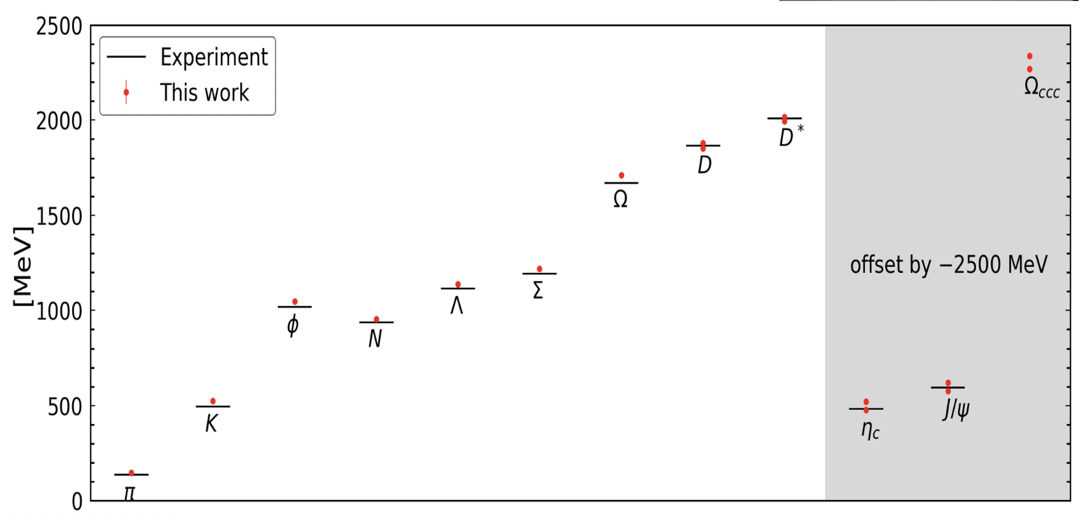
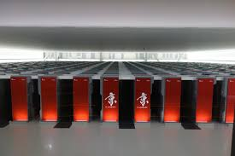
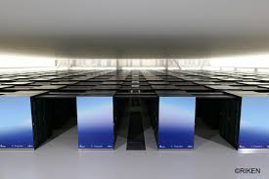
Fugaku
@RIKEN
400 PFlops
(2020-)
(2+1)-flavor
V=(8.1 fm)³ , m_{π}=138 MeV
(2+1)-flavor
V=(8.1 fm)³ , m_{π}=146 MeV
Large Scale LQCD Simulations of Hadron-Hadron Int.
(case for HAL QCD Collaboration since 2010)
(KEK) T. Aoyama
(RIKEN) S. Aoki, T. Doi, T. Hatsuda, Y. Liu,
L. Zhang, R. Yamada, L. Wang
(Nihon) T. Inoue
(Rissho) T. Sugiura
(TIT) K. Murakami
(TMU) K. Murase
(YITP) E. Itou
(Kyoto) T. M. Doi
(RCNP) N. Ishii, P. Junnarkar, H. Nemura
(Osaka) Y. Ikeda, K.Sasaki
(Birjand) F. Etminan
(Bonn) H. Tong
V=(8.1 fm)³ , m_{π}=146 MeV
V=(8.1 fm)³ , m_{π}=137 MeV
K @RIKEN: 11PFlops (2011-2019)
FUGAKU @RIKEN: 440 PFlops (2020-)

Slide 7
Baryon-Baryon Interactions
ΛΛ−ΝΞ
ΝΩ
ΩΩ
Baryon-baryon
Meson-baryon
Meson-meson
ΛΛ-NΞ : Sasaki+ [HAL QCD Coll.] Nucl. Phys. A998 (2020) 121737
N-Ω : Iritani+ [HAL QCD Coll.] PLB 792 (2019) 284
Ω-Ω : Gongyo+ [HAL QCD Coll.] PRL 120 (2018) 212001
Ω_{ccc}-Ω_{ccc} : Tong, Yan+ [HAL QCD Coll.] PRL 127 (2021) 072003

Slide 8
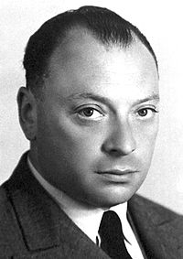
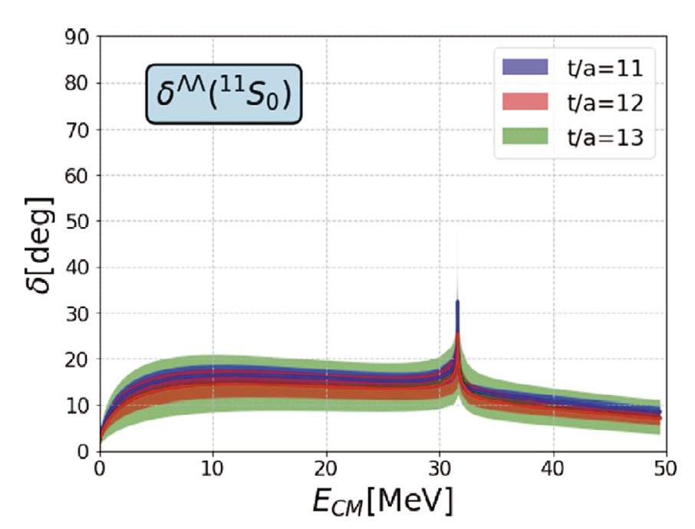
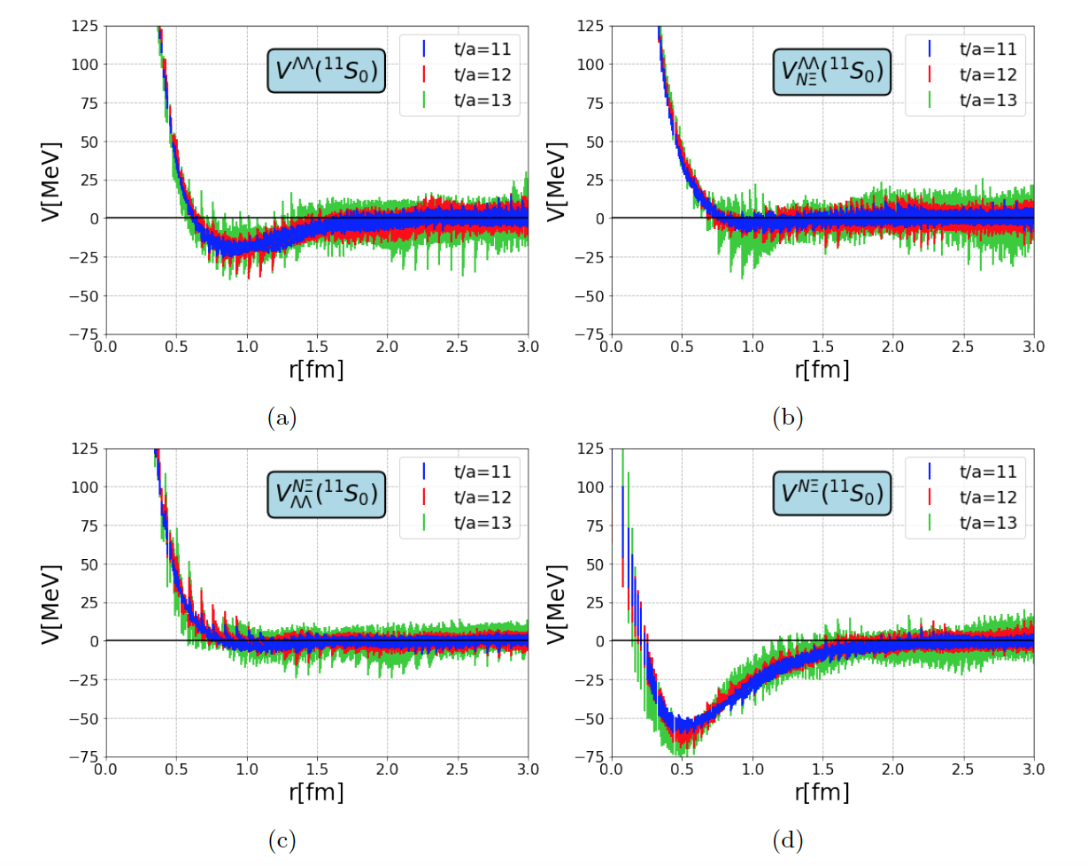
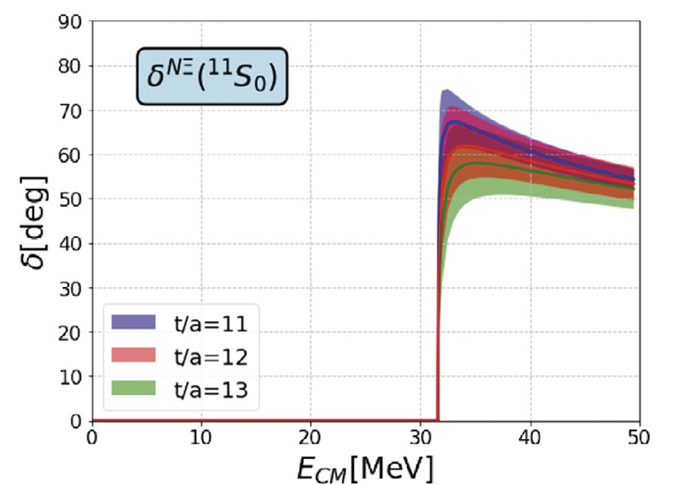
ΛΛ-NΞ system (LQCD)
Sasaki+ [HAL QCD Coll.]
Nucl. Phys. A998 (2020) 121737
Small ΛΛ
attraction
Short-range
NΞ-ΛΛ coupling
I=0, J^{P}=0⁺
Short-range
NΞ-ΛΛ coupling
Large NΞ
attraction

Slide 9





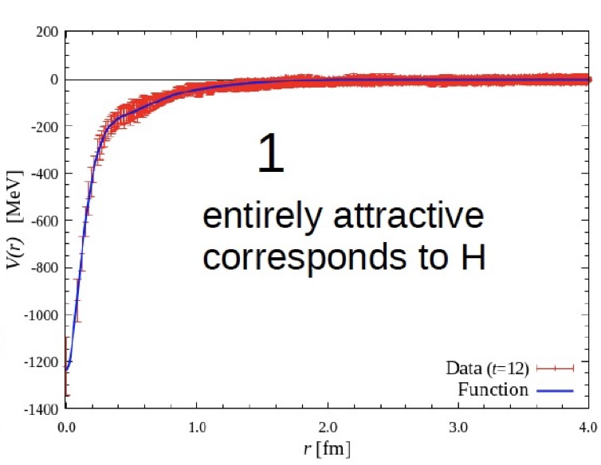
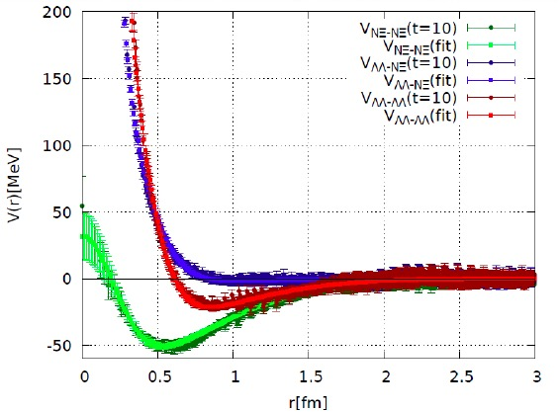
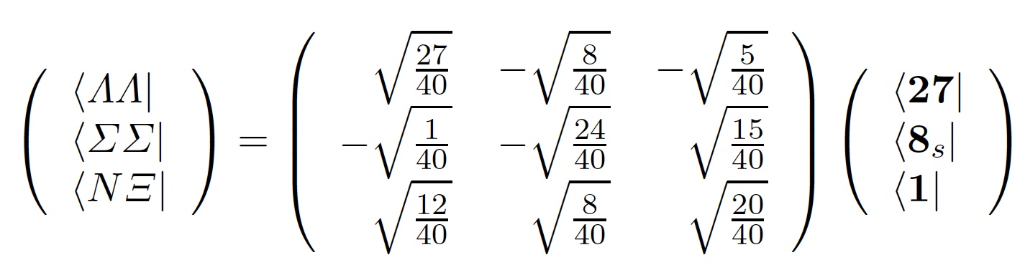



H-resonance (?)
Fate of “H (uuddss)” dibaryon from LQCD
m_{ud}=m_{s}
_{(~ 100 MeV)}
m_{ud} < m_{s}
_{(~10MeV) (~100MeV)}
Inoue et al., [HAL QCD Coll.]
Nucl. Phys. A881 (2012) 28
Sasaki et al., [HAL QCD Coll.]
Nucl. Phys. A998 (2020) 121737

Slide 10
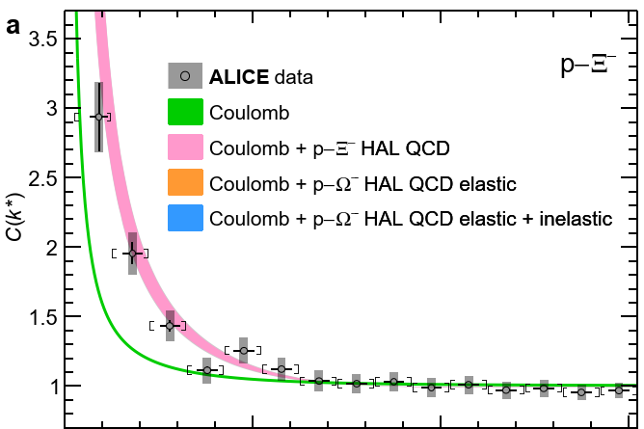
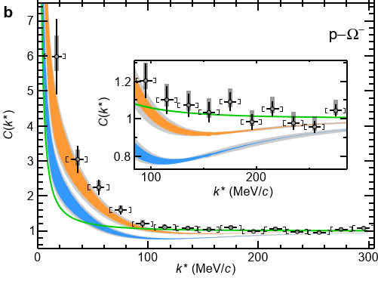


NΞ femtoscopy (expt.)
ALICE Coll. (LHC), Nature 588 (2020) 232
(pp, √s = 13 TeV)

Slide 11
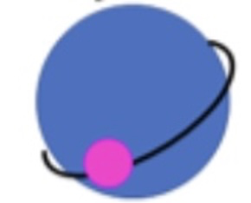
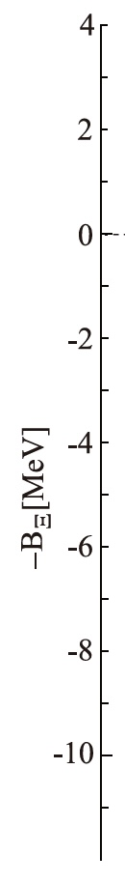
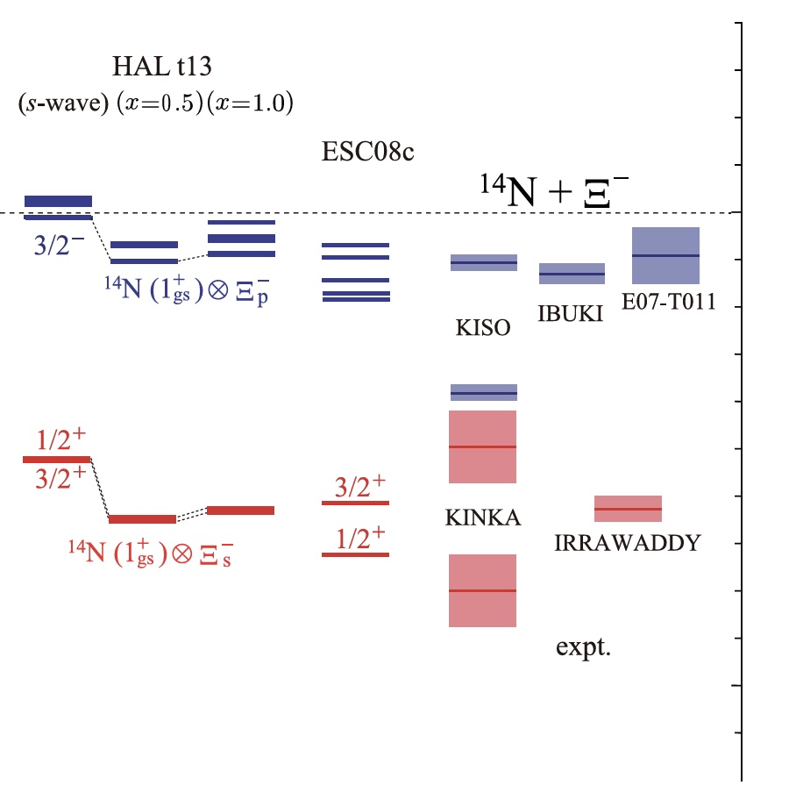
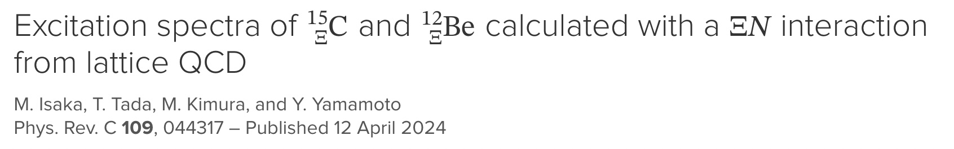
Isaka+,
Phys.Rev. C109 (2024) 044317
¹⁴N
p-state
Ξ⁻
¹⁴N
s-state
Ξ⁻
HyperAMD calculation
with HAL QCD NΞ int.
KEK/J-PARC
expt.
LQCD prediction of
・attraction in NΞ in ¹¹S₀
・weak NΞ- ΛΛ coupling
conisistent with the expt.data
Attempts towards lighter Ξ-nuclei such as ³He-Ξ and ααNΞ:
Hiyama+, PRL 124 (2020); PRC 106 (2022)

Slide 12
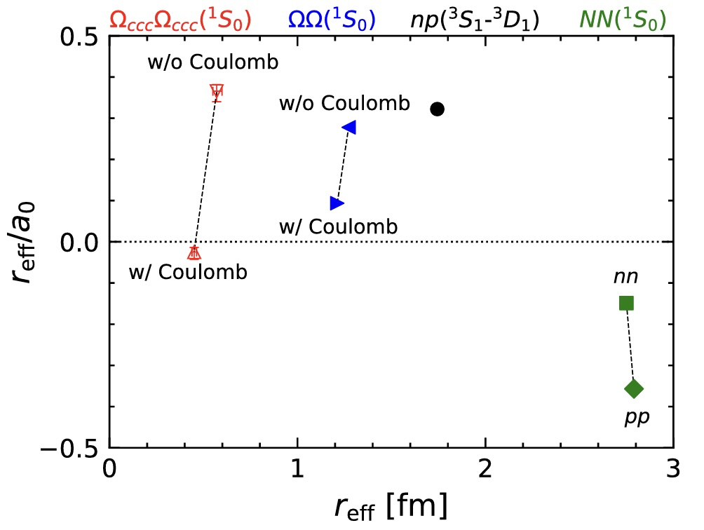
NΩ and ΩΩ systems in LQCD
Lyu, Tong + [HAL QCD Coll.],
PRL 127 (2021) 072003
NΩ (⁵S₃)
bound
.
system | n-p | n-Ω | Ω-Ω | Ω_{ccc}-Ω_{ccc}
channel | ³SD₁ | ⁵S₂ | ¹S₀ | ¹S₀
a₀ [fm] | +5.4 | +5.3(4) | +12.9 | -19(10)
B [MeV] | 2.2 | 1.5(3) | 0.7(7) | -
unbound
LQCD with Coulomb correction
system | n - Ω⁻ | Ω⁻ - Ω⁻ | Ω_{ccc}⁺⁺-Ω_{ccc}⁺⁺
channel | ⁵S₂ | ¹S₀ | ¹S₀
a₀ [fm] | +5.3(4) | +12.9 | -19(10)
B [MeV] | 1.5(3) | 0.7(7) | -
w/ Coulomb attraction
system | p - Ω⁻ | Ω⁻ - Ω⁻
channel | ⁵S₂ | ¹S₀
B [MeV] | 2.5(4) | 0.7(7)
w/ Coulomb repulsion

Slide 13
Meson-Meson Interactions
D⁰
-
u
c
-
d
c
D*⁺
T_{cc}⁺(3875)
13

Slide 14
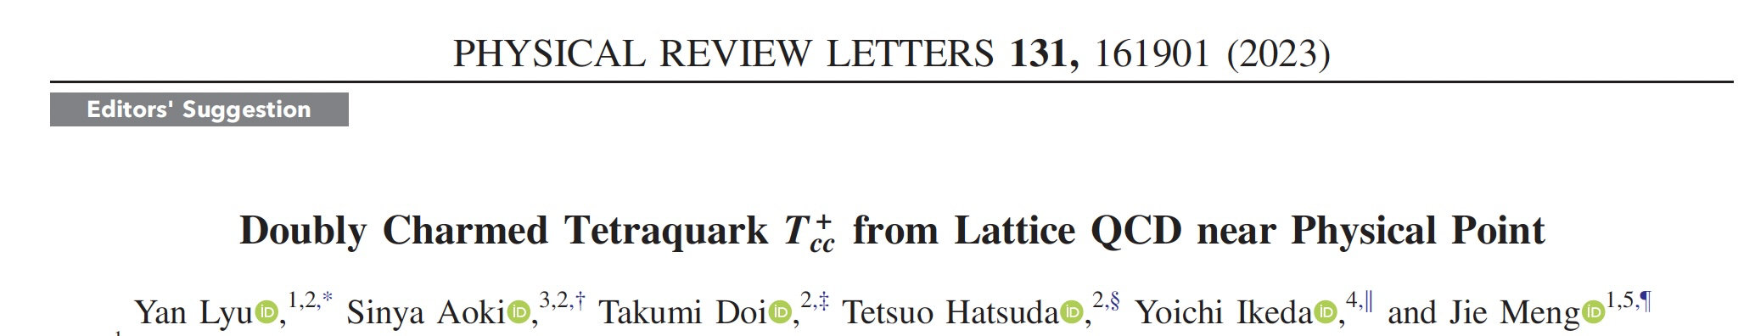
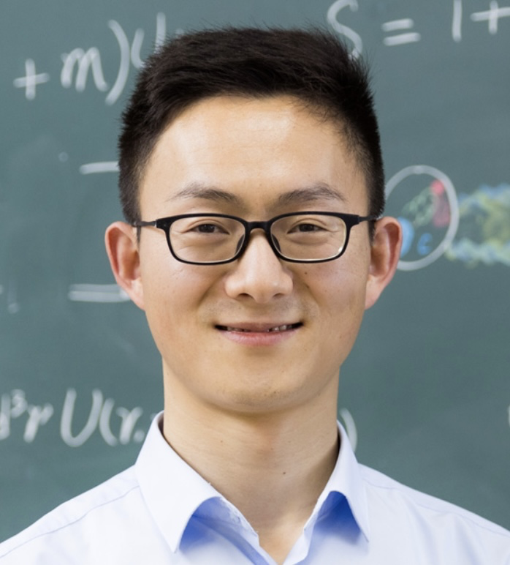
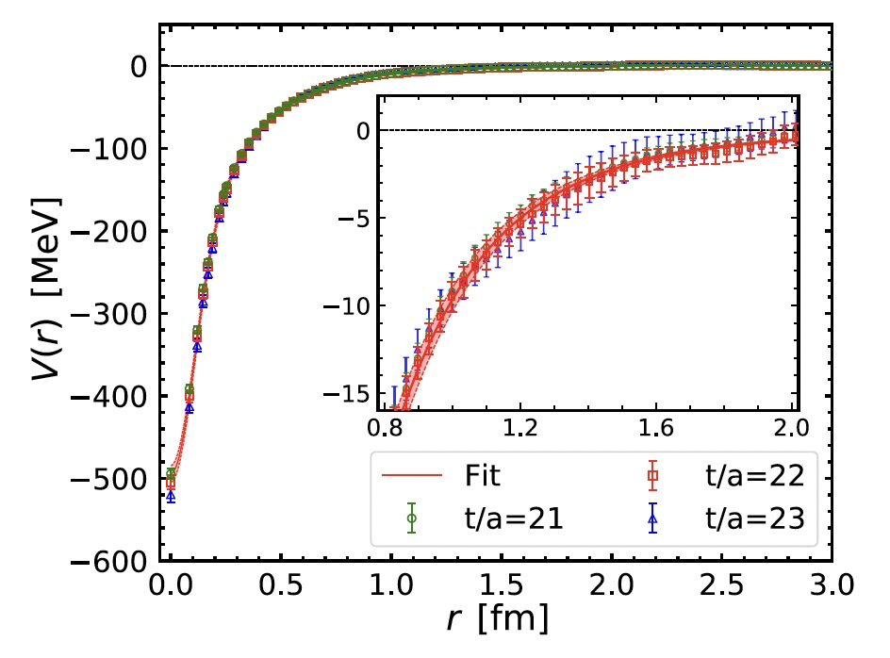
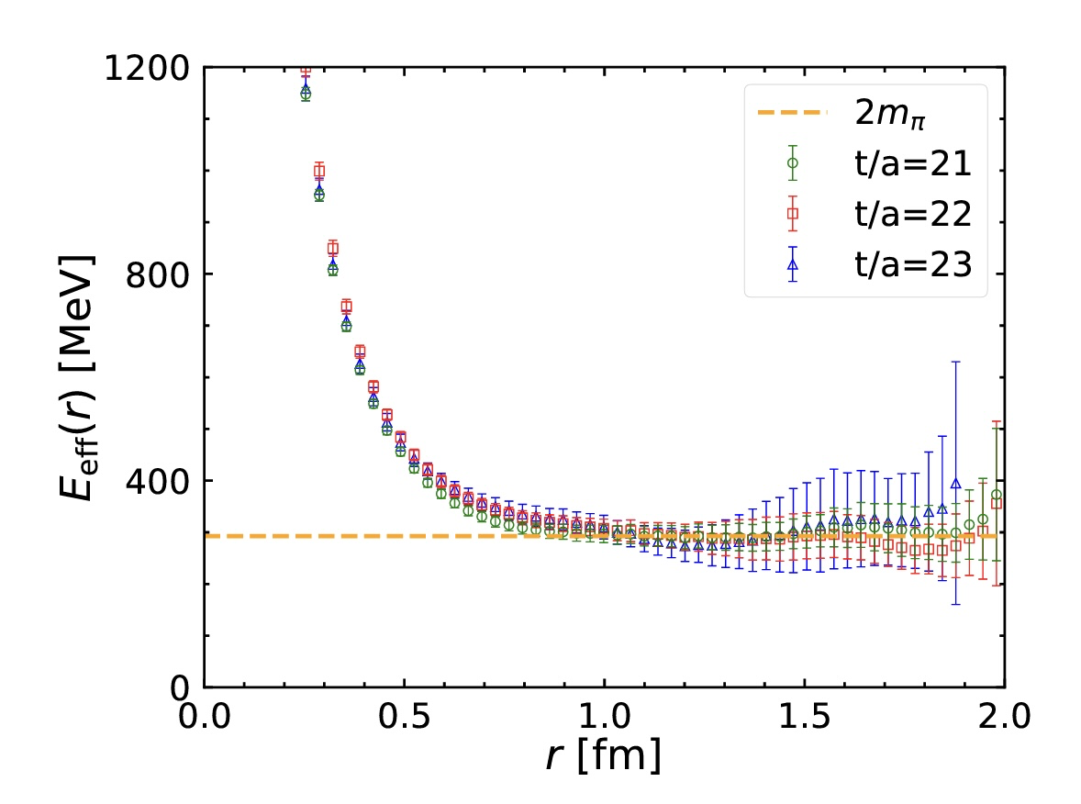
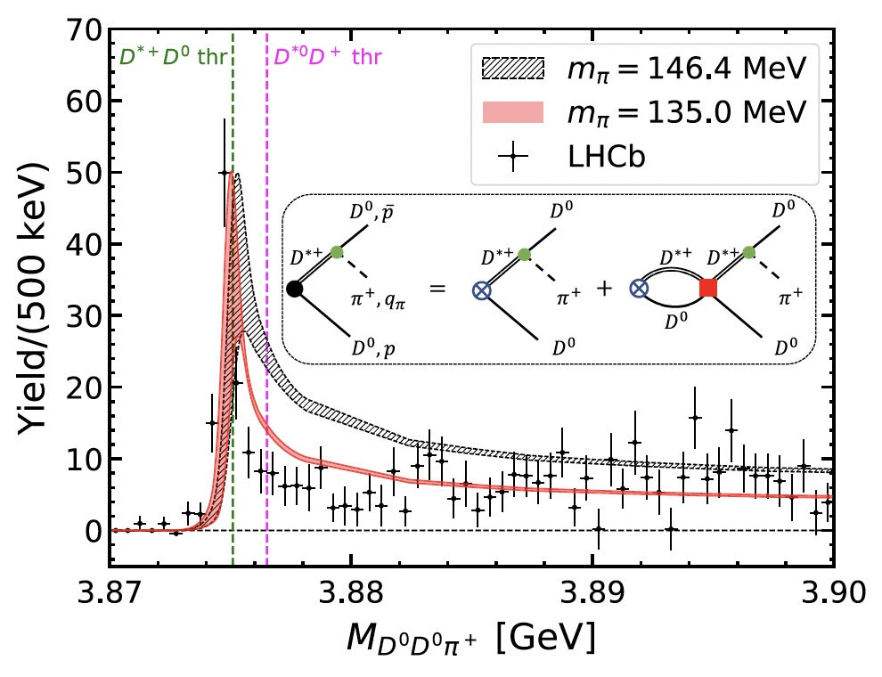
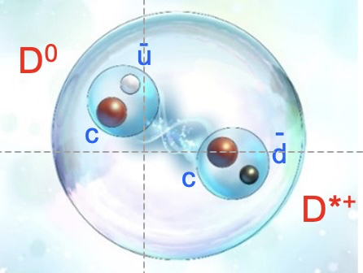
Lyu+ [HAL QCD Coll.],
PRL 131 (2023)
HAL QCD Collaboration
Yan Lyu
14
14

Slide 15
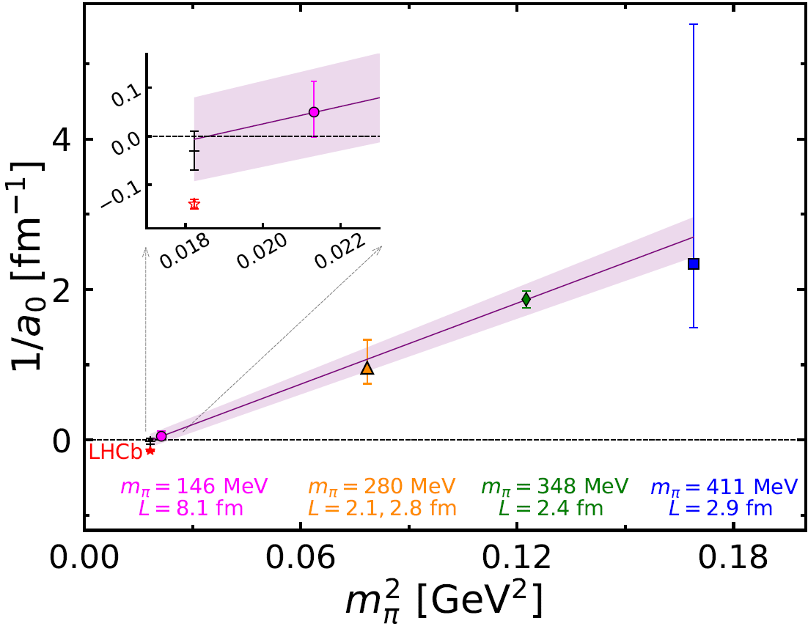
DD* scattering length as a function of the pion mass
HAL QCD: Ikeda+, PLB (2014)
Luscher: Chen et al., PLB (2022)
Luscher: Padmanath and Prelovsek, PRL (2022)
HAL QCD: Yan+, PRL(2023)
Future problems
(i) Isospin breaking (QED and QCD)
(ii) coupled channel effect at the physical point simulations
(iii) consideration of the left-hand-cut from OPEP : Lyu, Doi, Aoki, arXiv:2501.16804
15

Slide 16




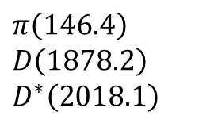
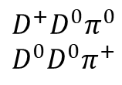
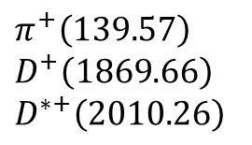

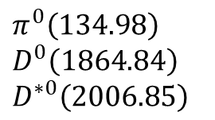
Energy levels
Nature
Lattice
[MeV]
$$π^{0}\left(134.98\right)$$
$$D^{0}\left(1864.84\right)$$
$$D^{∗0}\left(2006.85\right)$$
$$π^{+}\left(139.57\right)$$
$$D^{+}\left(1869.66\right)$$
$$D^{∗+}\left(2010.26\right)$$
$$π\left(146.4\right)$$
$$D\left(1878.2\right)$$
$$D^{∗}\left(2018.1\right)$$
$$D^{∗}D^{∗}$$
4036.2
4017.1
$$D^{∗+}D^{∗0}$$
$DDπ$($L=8.1$fm)
3974.3
$$DDπ\left(L→∞\right)$$
$$D^{∗}D$$
3902.8
3896.3
3876.5
3875.1
$$D^{∗0}D^{+}$$
$$D^{∗+}D^{0}$$
3869.5
3869.3
$$D^{+}D^{0}π^{0}$$
$$D^{0}D^{0}π^{+}$$
The lowest energy level of $DDπ$ ($D^{∗}D^{∗}$) is around 78 (140) MeV above on the lattice

Slide 17
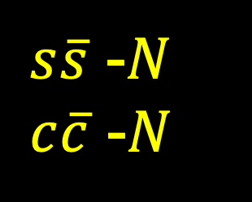
Meson-Baryon Interactions
$s\overline{s}$ -$N$
$c\overline{c}$ -$N$
17

Slide 18






HAL QCD Collaboration
Spin 3/2 potential
Spin 3/2 phase shift
Spin 3/2
scattering length
$s\overline{s}$ $N$

Slide 19

An attempt to combine Expt. data and Lattice data
spin-1/2 φp interaction
= ALICE data (spin-3/2 & spin-1/2) - Lattice data (spin-3/2)
Chizzali, Kamiya, Del Grande, Doi, Fabbietti, Hatsuda and Lyu,
Phys.Lett. B 848 (2024) 138358

Slide 20




HAL QCD Collaboration
$c\overline{c}$ $N$

Slide 21



Scattering length and effective range
Preliminary
J/ψ optical potential in nuclear matter
(Pauli correction necessary? → A. Gal (PLB & NPA (2023))
Krein, Tsushima, Thomas,
Nuclear-bound quankonia and heavy-flavor hadrons
Prog. in Part. Nucl. Phys. 100 (2018) 161
⇔

Slide 22

Two-pion exchange universality
Question:
What is the force between
“neutral particles” at long range ?
Answer:
QED
2-photon exchange force
= van der Waals (Casimir-Polder) force → -1/r⁷
QCD
2-pion exchange force

Slide 23




TPE between nucleons (NN):
Kaiser, Brockmann Weise, Nucl. Phys. A (1997)
TPE between two flavor-singlet hadrons (e.g. J/ψ-J/ψ)
Bhanot and Peskin, Nucl. Phys. B (1979)
Fujii and Kharzeev, Phys. Rev.D (1999)
Brambilla et al., Phys. Rev.D (2016)
TPE between flavor-singlet hadron and N (e.g. φ-N, J/ψ-N)
Krein, Casttela , Phys. Rev. D (2018)
23

Slide 24




“Evidence” of uncorrelated TPE at long distance
φp
J/ψ-N
η_{c}-N

Slide 25

Summary
Hadron-hadron int. from LQCD near the physical pion mass (146 MeV)
opens the door to the “coevolution” of LQCD and Expt.
(examples)
BB: ΛΛ−ΝΞ, ΝΩ, ΩΩ, MM: T_{cc}⁺ , MB: $s\overline{s}$ -$N$, $c\overline{c}$ -$N$
Take-home message
1. No H dibaryon below ΛΛ.
2. ΩΩ could be bound (first stable B=2 system other than the deuteron?)
3. Two-pion exchange universality for interaction of flavor-singlet hadrons.
New results on hadron-hadron int.
at the physical pion mass (137 MeV)
will come soon.
Open issues:
- three body force
- isospin breaking (QED & QCD)
especially near threshold.
Stay tuned !
m_{π}=137 MeV , V=(8.1 fm)³
FUGAKU @RIKEN: 440 PFlops (2020-)

Slide 26
Thank you !

Slide 27
Backup slides

Slide 28

Coupled Channel S=-2 system (¹¹S₀)
K. Sasaki+ [HAL QCD Coll.]
Nucl. Phys. A998 (2020)
Small ΛΛ
attraction
ΞN phase shift in HAL QCD
I=0, S=0: attractive
I=0, S=1: weakly attractive
I=1, S=0: weakly repulsive
I=1, S=1: weakly attractive
Short-range
NΞ-ΛΛ coupling
I=0, J^{P}=0⁺
Short-range
NΞ-ΛΛ coupling
Large NΞ
attraction

Slide 29

Theory history (< 2022) of T_{cc}⁺ ($cc\overline{u}\overline{d})$ ($IJ^{P}={01}^{+}$)
Quark models
Hadronic molecule
Hybrid
QCS sum rules
Lattice QCD
H.-X. Chen et al., Rept. Prog. Phys. 86 (2023) 026201
  $±300$ MeV uncertainty with respect to DD* threshold

Slide 30





Thresholds
[MeV]
(Lat., Exp.)
$Λ_{c}\overline{D}$ (4169, 4156)
$120$ MeV
$NJ/ψ$ (4047, 4036)
$100$MeV
$Nη_{c}$ (3948, 3923)

Slide 31


quasi-bound NΩ and bound ΩΩ ?
NΩ (⁵S₃)
NΩ (⁵S₂)
Iritani+ [HAL QCD Coll.], PLB 792 (2019) 284
Gongyo+ [HAL QCD Coll.], PRL 120 (2018) 212001
Tong+ [HAL QCD Coll.], PRL 127 (2021) 072003
w/ Coulomb attraction
w/ Coulomb repulsion

Slide 32
quasi-bound NΩ and bound ΩΩ ?
NΩ (⁵S₃)
NΩ (⁵S₂)
Iritani+ [HAL QCD Coll.], PLB 792 (2019) 284
Gongyo+ [HAL QCD Coll.], PRL 120 (2018) 212001
Tong+ [HAL QCD Coll.], PRL 127 (2021) 072003
w/ Coulomb attraction
w/ Coulomb repulsion

Slide 33


Two-pion Tail at r > (2m_{π})⁻¹
Krein and Casttela , Phys. Rev. D98 (2018) 0140289.

Slide 34
LQCD (since 1974) : Ab initio approach to solve QCD
K. Wilson
quarks
gluons
a
4-dim.
Euclidean
Lattice
L
by D.Leinweber
Hybrid Monte Carlo method
to carry out 10⁹⁻¹⁰ dim. integrals

Slide 35
How to extract hadron-hadron int. in LQCD ?
Spacetime correlation of composite particles
・ Haag-Nishijima-Zimmermann formula (1958)
・ Borchers Theorem (1960)
Luscher’s Method
Correlation of “almost-local” composite operators
E_{n} → relative momentum k_{n} → phase shift, binding energy
Luscher, Nucl. Phys. B354 (1991) 531
HAL QCD Method
R (r,τ) → LS equation (T =U +GUT ) → phase shift, binding energy
・ Haag-Nishijima-Zimmermann formula (1958)
・ Borchers Theorem (1960)
Ishii, Aoki & Hatsuda, PRL 99 (2007) 022001
Relation between the two: Iritani+ [HAL QCD Coll.], JHEP 03 (2019) 007.
Lyu+ [HAL QCD Coll.] , PRD 105 (2022) 074512.
Notes:
\begin{eqnarray}
& & \! \! \! \! \! \! \! \! \! \! \! \! \! \! \! \! \! \! \! \! \! \langle N_1({\bf x},t) N_2({\bf y},t) {\cal J}_1^{\dagger}(0) {\cal J}_2^{\dagger}(0) \rangle \nonumber \\
& =& \! \! \! \! \! \! \sum_{n}\langle 0| N_1({\bf x})N_2({\bf y})|n\rangle a_n e^{-E_n t} \nonumber \\
& \xrightarrow{t>t^*} &\! \! \! \! \phi({\bf r},t) = \sum_{n<n^*} b_n \phi_n({\bf r}) e^{-E_n t} \nonumber
\end{eqnarray}
\begin{align*}
C(r,\tau) = \sum_n \Psi_{n}(r) e^{-E_n \tau}
\end{align*}

Slide 36




HAL QCD Procedure: an example
(ΩΩ at m_{π}=146MeV)
Gongyo+ [HAL QCD], PRL 120 (2018) 212001
Lyu+ [HAL QCD], PRD 105 (2022) 074512
Ω
Ω
Potential
V_{C} (x,y,0)
Ψ_{n} (r) and E_{n} in a finite volume
Phase shift in the infinite volume

Slide 37
ΛΛ-NΞ system (LQCD)
Sasaki+ [HAL QCD Coll.]
NPA (2020)
Small ΛΛ
attraction
Short-range
NΞ-ΛΛ coupling
I=0, J^{P}=0⁺
Short-range
NΞ-ΛΛ coupling
Large NΞ
attraction

Slide 38
NΩ and ΩΩ systems in LQCD
NΩ (⁵S₃)
NΩ (⁵S₂)
Iritani+ [HAL QCD Coll.], PLB (2019)
⇔ ALICE Coll. (LHC), Nature (2020)
system | n-p | n-Ω | Ω-Ω | Ω_{ccc}-Ω_{ccc}
channel | ³SD₁ | ⁵S₂ | ¹S₀ | ¹S₀
a₀ [fm] | +5.4 | +5.3(4) | +12.9 | -19(10)
B [MeV] | 2.2 | 1.5(3) | 0.7(7) | -
LQCD with Coulomb correction
Gongyo+ [HAL QCD Coll.], PRL (2018)
Tong+ [HAL QCD Coll.], PRL (2021)
system | n - Ω⁻ | Ω⁻ - Ω⁻ | Ω_{ccc}⁺⁺-Ω_{ccc}⁺⁺
channel | ⁵S₂ | ¹S₀ | ¹S₀
a₀ [fm] | +5.3(4) | +12.9 | -19(10)
B [MeV] | 1.5(3) | 0.7(7) | -
w/ Coulomb attraction
system | p - Ω⁻ | Ω⁻ - Ω⁻
channel | ⁵S₂ | ¹S₀
B [MeV] | 2.5(4) | 0.7(7)
w/ Coulomb repulsion

Slide 39






T_{cc}⁺(3875)

Slide 40




→ possible spin ½ bound φΝ system; Chizzali+, Phys. Lett. B848 (2024) 138358

Slide 41
Percent-level determination of g_{A} from LQCD
Chang (LBNL/iTHEMS)+, Nature 558 (2018) 91
(g_{A})_{LQCD} = 1.271(13)
(g_{A})_{expt} = 1.272(2)
(τ_{ｎ})_{LQCD} = 884(15) s
(τ_{ｎ})_{PDG} = 880.2(1.0) s

Slide 42




Femtoscopy : particle correlations in pp, pA and AA
C(k*)
Koonin, Phys. Lett. B 70, 43 (1977).
Lednicky and Lyuboshits, Yad. Fiz. 35, 1316 (1981).
Pratt, Phys. Rev. D 33, 1314 (1986).
Anchishkin, Heinz, and Renk, Phys. Rev. C 57, 1428 (1998).
Lednicky, Lyuboshits, and Lyuboshits, Phys. At. Nucl. 61, 2950 (1998).
Haidenbauer, Nucl. Phys. A 981, 1 (2019).
R k*
Morita et al., Phys. Rev. C101 (2020) 015201
Notes:
\begin{align*}
C_{\rm expt}(k^*) = \frac{\xi(k^*) N_{\rm same}(k^*)}{N_{\rm mixed}(k^*)} =
\end{align*}
\begin{eqnarray*}
& & C_{\rm theo}(k^*) \\
& & = \int d^3 r \textcolor[rgb]{1,0.4,0.4}{S(r,k^*)} \textcolor[rgb]{0.2,0.4,1}{|\Psi(r,k^*)|^2} \nonumber \\
& & = 1+ \int d^3 r {S(r,k^*)} [ {|\Psi_0(r,k^*)|^2 - |j_0( k^* r)|^2 }]
\end{eqnarray*}

Slide 43



Fully coupled channel analysis
Kamiya+, Phys. Rev. C 105 (2022) 014915

Slide 44





NΩ correlation in pp
LHC ALICE Coll., Nature 588 (2020) 232

Slide 45
What is the lightest Ξ hypernuclei?
Can we test the spin-isospin
dependence of ΞN int.?
Ξ
Hiyama, Sasaki, Miyamoto, Doi,
Hatsuda, Yamamoto, Rijken,
Phys.Rev.Lett.124 (2020) 092501
p
n
n
α
Ξ
Hiyama, Isaka, Doi, Hatsuda,
Phys. Rev. C 106 (2022) 064318
n
α
Notes:
Less than 5% accuracy for mq

Slide 46





Q1. What is the lightest Ξ hypernuclei?
Hiyama, Sasaki, Miyamoto, Doi, Hatsuda, Yamamoto, Rijken,
Phys.Rev.Lett.124 (2020) 092501
Gaussian expansion method
(Hiyama et al., 2003)
Γ ~ 60 keV

Slide 47



Inversion of spin-doublets in ΞNαα system
Hiyama, Isaka, Doi, Hatsuda,
arXiv:2209.06711 [nucl-th]
α
Ξ
n
α
Γ=20-40 keV

Slide 48

Q2. Can we test the spin-isospin dependence of ΞN int.?
Hiyama, Isaka, Doi, Hatsuda, arXiv:2209.06711 [nucl-th]
α
Ξ
n
α
Gaussian expansion method (Hiyama et al., 2003)

Slide 49
Central BB interactions in the flavor basis
8 x 8 = 27 + 8_{s} + 1 + 10* + 10 + 8_{a}
T. Inoue [HAL QCD Coll.], Few-body Syst. 62 (2021) 106

Slide 50
Central BB interactions in the flavor basis
8 x 8 = 27 + 8_{s} + 1 + 10* + 10 + 8_{a}
BB interactions at short distances:
(i) flavor dependent
(ii) consistent with Pauli + OGE
Park, Lee, Inoue, Hatsuda, Eur. Phys. J., A56 (2020)
T. Inoue [HAL QCD Coll.], Few-body Syst. 62 (2021) 106

Slide 51


Tensor BB interactions in the flavor basis
8 x 8 = 27 + 8_{s} + 1 + 10* + 10 + 8_{a}
T. Inoue [HAL QCD Coll.], Few-body Syst. 62 (2021) 106

Slide 52

Hyperon embedded in cold nuclear matter (HAL QCD + BHF)
Inoue [HAL QCD Coll.], Few-body Syst. 62 (2021) 106
Hiyama, Sasaki, Miyamoto, Doi, Hatsuda, Yamamoto, and Rijken, PRL 124 (2020) 092501
29

Slide 53
Hyperon embedded in cold nuclear matter (HAL QCD + BHF)
ΞN phase shift in HAL QCD
I=0, S=0: attractive
I=0, S=1: weakly attractive
I=1, S=0: weakly repulsive
I=1, S=1: weakly attractive
Inoue [HAL QCD Coll.], Few-body Syst. 62 (2021) 106
Hiyama, Sasaki, Miyamoto, Doi, Hatsuda, Yamamoto, and Rijken, PRL 124 (2020) 092501
30

Slide 54



φp bound state
in spin ½ channel?
(B = 12.8- 56.1 MeV)

Slide 55

Spin averaged $J/ψ$ $−N$scattering length

