Slide 1


Kinetic theory of moderately dense dry granular particles under a simple shear
Hisao Hayakawa (YITP, Kyoto Univ.)
Collaboration with Shunsuke Iizuka and Satoshi Takada (Tokyo Univ. Agriculture & Tech.)

Slide 2
Contents
Introduction
Formulation
Results of the kinetic theory
Discussion
Summary

Slide 3
Contents
Introduction
Formulation
Results of the kinetic theory
Discussion
Summary

Slide 4
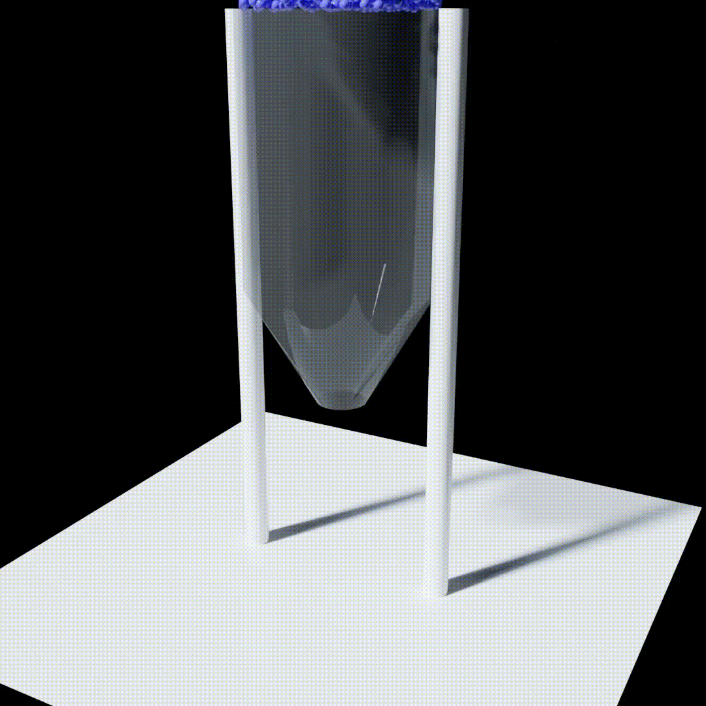
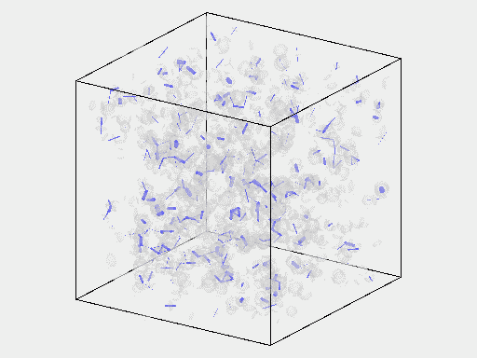
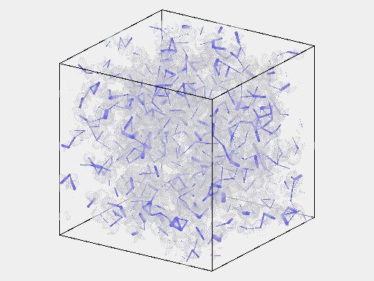
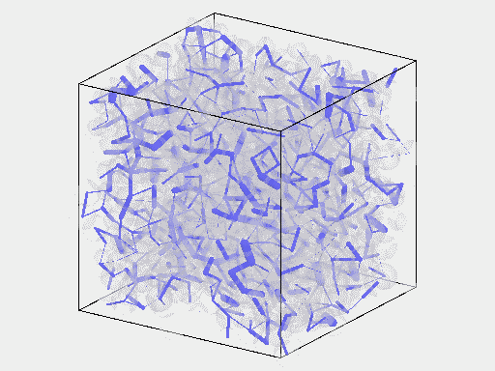
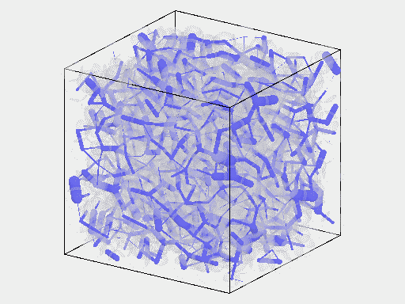
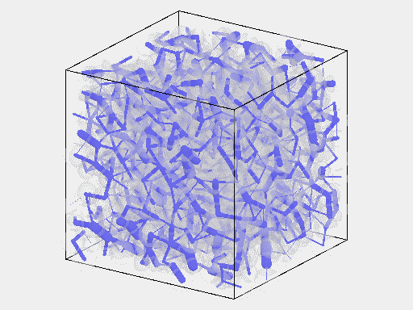






What is a granular flow?
Granular flows can be observed in daily life.
Chute flows can be approximated by a simple shear flow.
The flow behavior depends on density.
Movies©Satoshi Takada
$$0.1$$
$$0.3$$
$$0.5$$
$$0.6$$
$$0.65$$
$$φ$$
Notes:
Movies©Satoshi Takada

Slide 5
Background of this problem
There is no equilibrium base state.
  (Kinetic) temperature is not conserved and is determined by the kinetics.<= inelastic collisions!
  However, we need dissipations to realize a steady state under shear.
There is no scale separation for moderately dense gases.
There are long-range correlations induced by shear.
There is a cutoff of long-time tail by shear.
How can we obtain an approximate but quantitatively correct results based on the kinetic theory?
  We do not consider the long-range correlation but get good agreement with simulation results.
FHD
Notes:
FHD

Slide 6
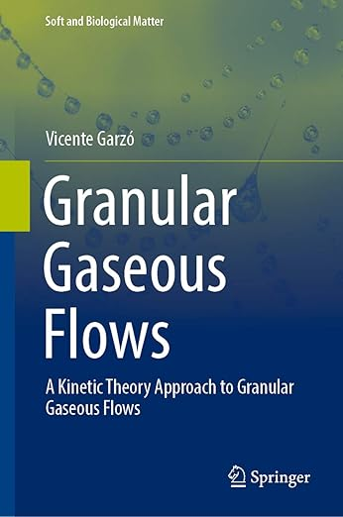

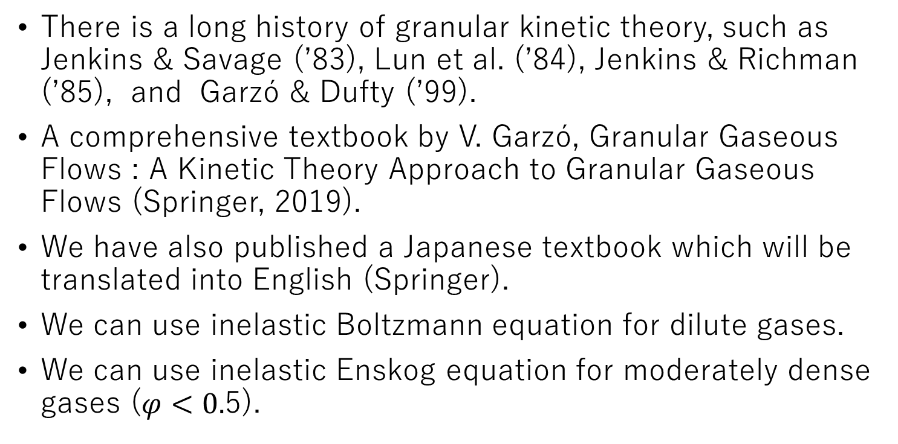
Brief review of kinetic theory of granular gases
There is a long history of granular kinetic theory, such as Jenkins & Savage (’83), Lun et al. (’84), Jenkins & Richman (’85), and Garzó & Dufty (’99).
A comprehensive textbook by V. Garzó, Granular Gaseous Flows : A Kinetic Theory Approach to Granular Gaseous Flows (Springer, 2019).
We have also published a Japanese textbook which will be translated into English (Springer).
We can use inelastic Boltzmann equation for dilute gases.
We can use inelastic Enskog equation for moderately dense gases ($φ<0.$5).

Slide 7
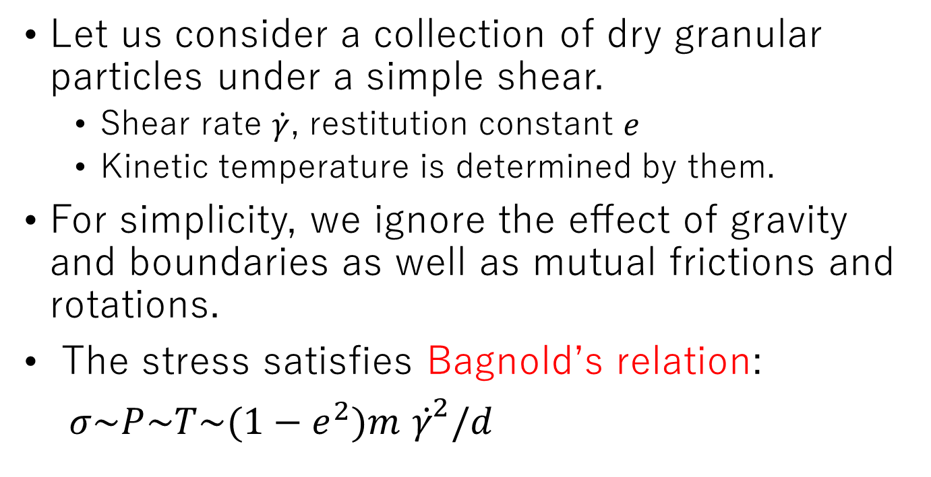
Simple shear flow
Let us consider a collection of dry granular particles under a simple shear.
  Shear rate $\dot{γ}$, restitution constant $e$
  Kinetic temperature is determined by them.
For simplicity, we ignore the effect of gravity and boundaries as well as mutual frictions and rotations.
The stress satisfies Bagnold’s relation:
$σ\sim P\sim T\sim (1−e^{2})m$ ${γ̇}^{2}/d$

Slide 8
Garzó & Dufty (1999)
Garzó & Dufty developed a granular kinetic theory for moderately dense gases based on Chapman-Enskog theory.
Some people suggested that their theory can describe simple shear flows.

Slide 9
Is their theory applicable to shear flows?
No, it is not (V. Garzó).
The shear flow is homogeneous and anisotropic, while Garzó-Dufty theory assumes inhomogeneous and isotropic states.
There are normal stress differences for shear flows, but Garzó-Dufty cannot predict them.
Alternative method: Saha & Alam (JFM 2016) adopted anisotropic Gaussian method.
  This gives very good agreement with the Monte-Carlo simulation.

Slide 10
Saha & Alam (2016)
They adopt an anisotropic Gaussian ansatz under the Enskog approximation.
The results look perfect.

Slide 11
Motivation
We would like to construct a granular hydrodynamics under a simple shear.
We should get a reasonable quantitative model under controllable approximations.
  Instead of anisotropic Gaussian, we adopt Grad’s expansion.
We should clarify the advantage of our approach from the comparison with the other papers.

Slide 12
Contents
Introduction
Formulation
Results of the kinetic theory
Discussion
Summary

Slide 13
Our approach
We examine the Enskog’s decoupling approximation and Grad’s expansion.
This gives a precise approximate description for the stress.

Slide 14
Moment equation
If $ψ\left(v\right)$is a collisional invariance.
Notes:
If $ψ\left(v\right)$is a collisional invariance.

Slide 15
Stress equation

Slide 16
Stress equations=> Equations for temperatures
We can rewrite the stress equations

Slide 17
Enskog approximation
Contact stress
Notes:
Contact stress

Slide 18
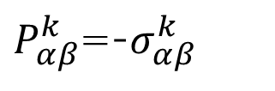
Grad’s expansionk
$P_{αβ}^{k}$=-$σ_{αβ}^{k}$
Once we adopt the truncation of Sonine expansion up to l=2, we can get exact expressions.=> VDF determines the contact stress.
Notes:
$P_{αβ}^{k}$=-$σ_{αβ}^{k}$

Slide 19
Contents
Introduction
Formulation
Results of the kinetic theory
Discussion
Summary

Slide 20
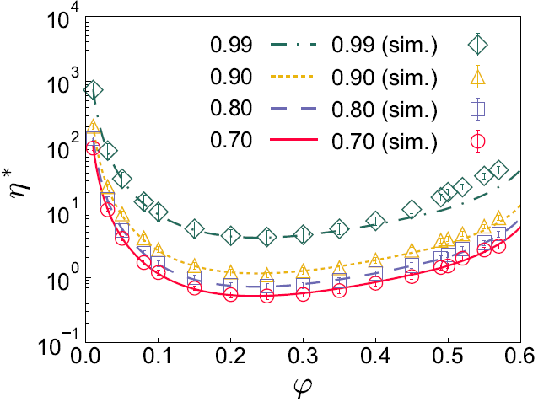

Results (1)
Our theory gives the precise viscosity even for $φ≥0.5$!

Slide 21

Results (2)
Our theory is precise for $φ≤0.5$ if the inelasticity is not too small.

Slide 22
Results (3)
Kinetic temperature
diameter
Notes:
diameter

Slide 23
Results (4)
Kinetic temperature: better results!

Slide 24
Results (5)
We can capture the normal stress differences.

Slide 25
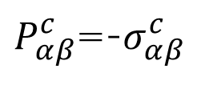
Results (6)
Comparison of our result with Saha & Alam (2016)
  Our theory predicts the better viscosity.
$P_{αβ}^{c}$=-$σ_{αβ}^{c}$

Slide 26
Results (7)
Comparison of our result with Saha & Alam (2016).
  The normal stress differences are as good as theirs.

Slide 27
Contents
Introduction
Formulation
Results of the kinetic theory
Discussion
Summary

Slide 28
Relaxation dynamics
There is the Mpemba-like relaxation.
Viscosity: starting from an equilibrium initial condition does not exhibit monotonic relaxation.
  There is a cross of the viscosity relaxation.
Viscosity
Time
Notes:
Time

Slide 29
Fluctuating hydrodynamics; long-range interaction
So far, we do not argue the fluctuations.
We can obtain the long-range correlation based on the fluctuating hydrodynamics (ignoring the energy equation).
  See e.g. Otsuki & HH, PRE (2009) and Nakano & Minami, PRR (2022).
  It seems that they are one-way coupling.=> Are fluctuations not not important?

Slide 30
Denser systems
Denser systems must include intrinsic correlation effects, such as dynamical heterogeneity.
  We should consider the spatial heterogeneity.
There are quadrupole excitations, which is not included in the kinetic theory.

Slide 31
Contents
Introduction
Formulation
Results of the kinetic theory
Discussion
Summary

Slide 32
Summary
We have developed the granular kinetic theory under a simple shear.
  Theory is based on the Enskog+ Grad approximations.
    We succeed the exact calculation within Grad’s expansion.
  This is an approximate theory but quantitatively correct.
  This covers wide range of hydrodynamic behavior of granular gases.
  The long-range correlation does not play any role.
We will need to establish the theory for denser granular kinetics, which might have properties of disordered solids.

