Slide 1
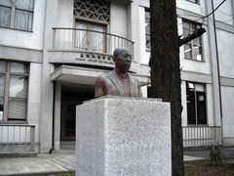
Opening address for Hydrodynamics of low-dimensional interacting systems: Advances, challenges, and future directions, June 2nd-13th, 2025
Hisao Hayakawa (YITP, Kyoto Univ)
Notes:
Yukawa Memorial Foundation

Slide 2
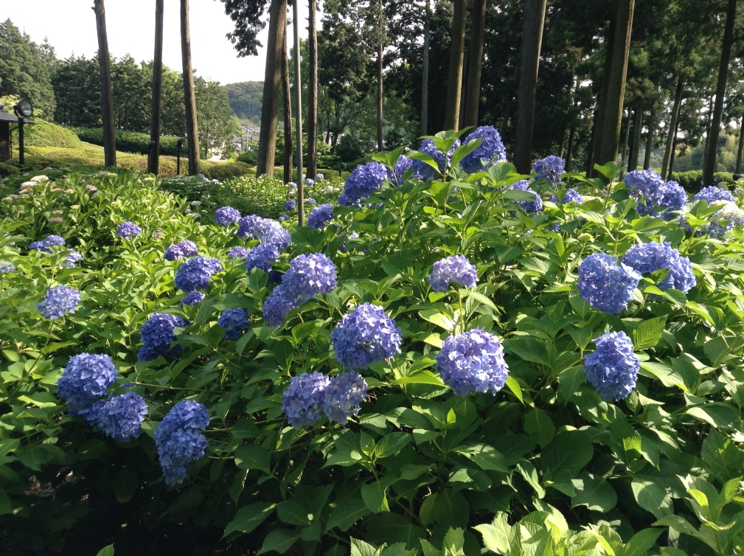
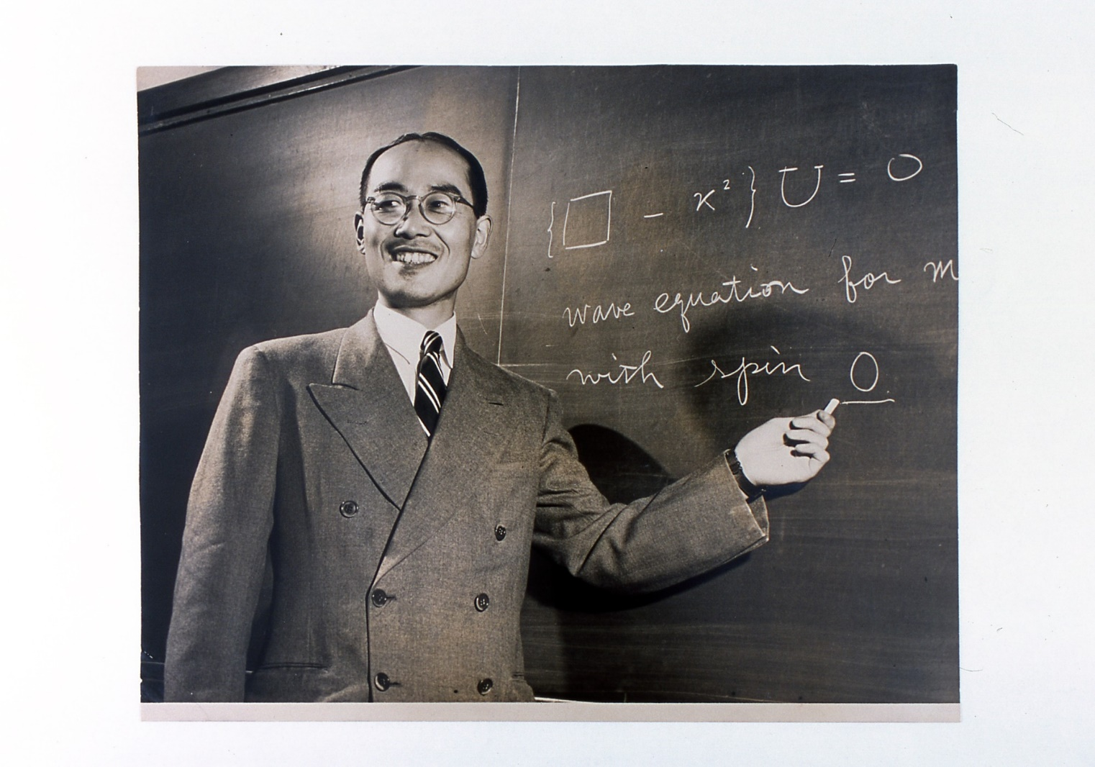
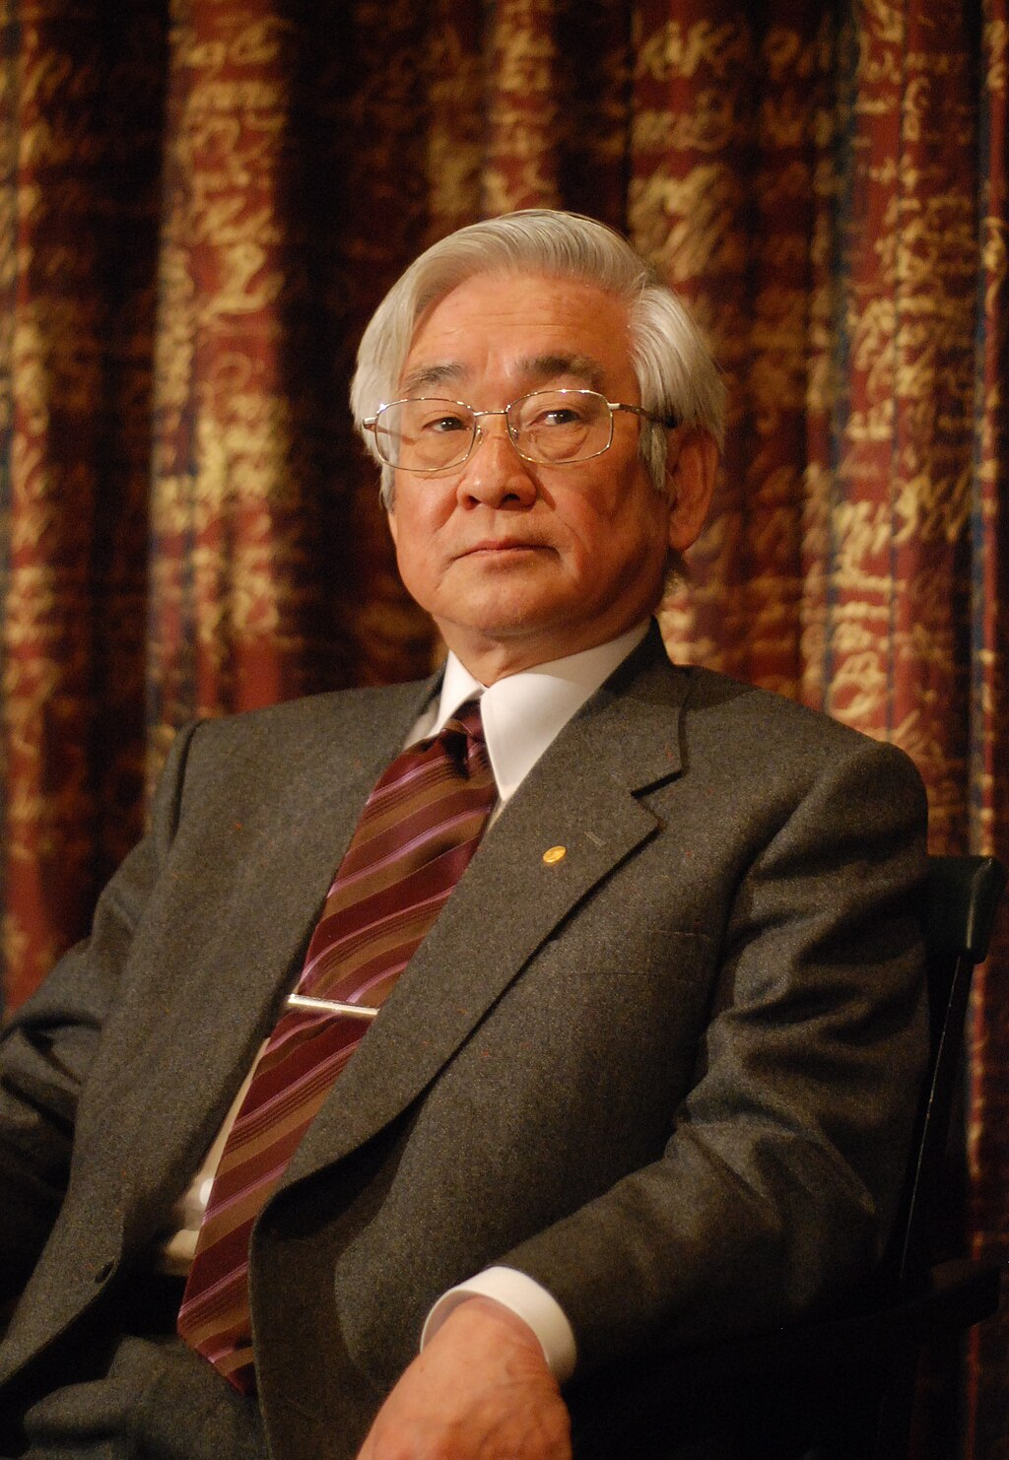
Welcome to Kyoto
Notes:
Although this weak is in a rainy season, three days would be hot, humid and fine.

Slide 3
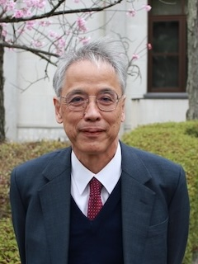
Message from the director
The Yukawa Institute for Theoretical Physics (YITP) was founded in 1953 in commemoration of Hideki Yukawa being awarded the Nobel Prize. The institute was started as the first national research center with its facilities open to the community of theoretical physicists in Japan. In 1990, the institute was unified with the Research Institute for Theoretical Physics (RITP) of Hiroshima University and was relaunched as the new Institute. The current English name, Yukawa Institute for Theoretical Physics, was adopted at the time of the unification of the two institutes. In 2008, Toshihide Maskawa, the 7th director of the institute, was awarded the Nobel Prize in Physics, the second Nobel laureate from YITP.

Slide 4
Short summary
This is the opening of the molecular-type workshop “Hydrodynamics of low dimensional interacting systems” till June 13th.
An invited speaker has 90 minutes slot (70 min. talk+20min. discussion)
We have a special talk on June 11th (Thu) from 3:30 PM to 5 PM by Herbert Spohn as a YITP colloquium.
Each contributed talk has 45 minutes slot (35 min. talk +10 min. discussion)
We will collect presentation files after your talks. So please prepare the files which can post on the web page.

Slide 5
Free time
We have a lot of free time in the afternoon.
Please use free time for your discussion, work and self-organized sessions.
There will be the coffee break around at 4 PM even if there is no afternoon session.
You should check the program for coffee breaks.

Slide 6
Notification for participants (1)
Facility- You can use YITP facilities during your stay here as a YITP member.
Registration– Please check your name tag which may include 1) date of reimbursement if you chose cash, and 2) the exchange card of the key for participants in the long-term workshop.
Card- We will provide a card key for your office to on-site participants.
Please acknowledge this meeting if you are inspired by the meeting or the the work is developed by the discussion during the meeting (YITP-T-25-03).

Slide 7
Notification for participants (2)
Reimbursement:
Ms. Yayoi Yagi has already contacted you. Please check her mails.
Network Overview - To connect to the network, you need to enter the ID and the password common to all participants. They are written in a leaflet "Computer Facilities for Workshop Participants".
Internet
Wired: available at all offices for the workshop.
Wireless: wireless network using WEP encryption is available in any place.

Slide 8
Banquet, coffee and the others
There will be the banquet on Wednesday evening in each week.
Fee is 5000JPY (cash only) for one banquet.
Pay for cost today or the next Monday for each banquet during coffee breaks.=> 11:00 on the next Monday.
Place: Saloon (in front of the auditorium)
Coffee and cakes are available during the breaks.
Please come to coffee time at 3 PM every week-day.

Slide 9
Let’s enjoy this workshop!

