Slide 1
Sommerfeld effect and unitarity
Ryosuke Sato
K. Blum, R. Sato, T. R. Slatyer, 1603.01383, JCAP 06 (2016) 021
A. Parikh, R. Sato, T. R. Slatyer, 2410.18168
2025. 6. 19 @ The Frontier of Particle Physics:
Exploring Muons, Quantum Science and the Cosmos

Slide 2
Plan
Dark matter and Sommerfeld effect
Sommerfeld effect and unitarity

Slide 3
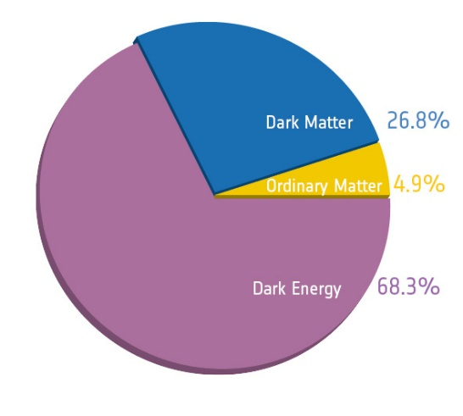
Dark matter and its annihilation
~ 27% of our current universe is made of dark matter
Many evidences but only through gravitational effects.
Dark Matter could have some interaction with SM particles :
[ Planck collaboration]
Dark matter
Dark matter
DM pair creation
DM annihilation
SM particle
SM particle
Elastic scattering w/ SM particles

Slide 4
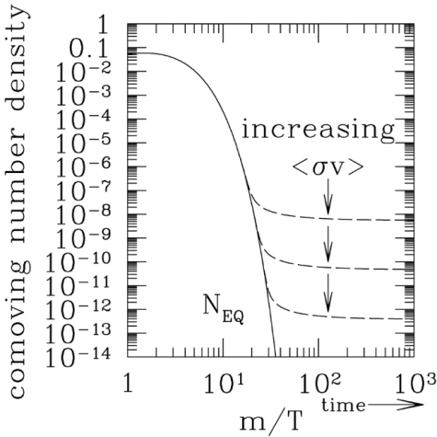
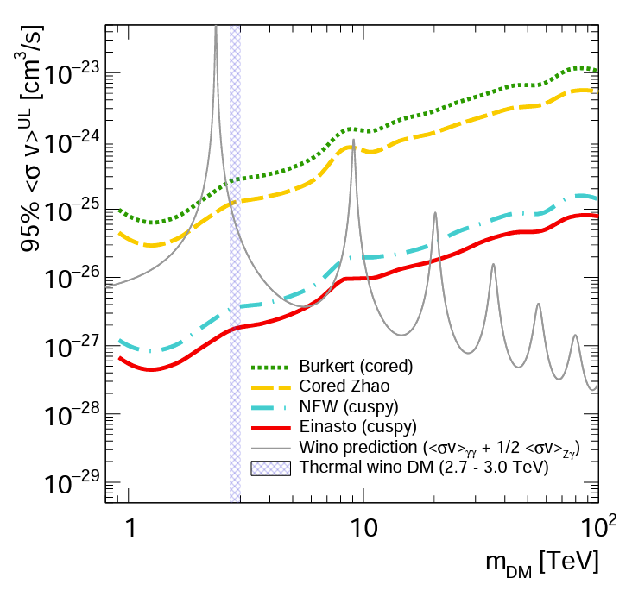
Dark matter annihilation cross section
Freeze-out scenario
Relic abundance today
$$Ω_{DM}h^{2}∼0.1×\frac{3×{10}^{−26}cm^{3}/s}{σv}$$
→
Indirect detection
High energy cosmic ray from DM annihilation
DM
DM
…
[MAGIC, 2212.10527]

Slide 5
How to calculate $σv$
If the coupling is $<∼$ 1, perturbative calculation is efficient.
DM
SM
DM
SM
etc…
Typical example (higgs portal) :
$$σv_{rel}=\frac{λ^{2}}{64π^{2}m_{φ}^{2}}\sqrt{1−\frac{m_{h}^{2}}{m_{φ}^{2}}}$$
$$L ∋ −\frac{λ}{4}φ^{2}h^{2}$$
$$iM\left(φφ→hh\right)=−iλ$$

Slide 6
How to calculate $σv$
Even if the coupling is $<∼$ 1, non-perturbative resummation is required,
if dark matter couples to a light force mediator boson
$$(m_{boson}≪m_{DM})$$
DM
SM
+
+
+ …
DM
SM
$$∼M\frac{α}{v}$$
$$∼M{\left(\frac{α}{v}\right)}^{2}$$
$$M$$
Wino / Higgsino dark matter
SU(2) 5-plet dark matter
…
ex)
Sommerfeld effect
[Sommerfeld (1931)]
[Hisano, Matsumoto, Nojiri (2003)]

Slide 7
Strategy
[Blum, Sato, Slatyer (2016)] [Parikh, Sato, Slatyer (2024)]
See also [Agrawal, Parikh, Reece (2020)]
We are interested in DM annihilation at non-relativistic regime.
Freeze-out ($T≃m/20$)
$v≃{10}^{−3}c$ in galaxy
Schroedinger equation provides effective description!
$$Eψ=−\frac{1}{2μ}∇^{2}ψ+V\left(x\right)ψ$$
$$V_{short}\left(r\right)$$
$$(r<a)$$
complex
Annihilation etc.
$$V\left(r\right) =$$
$$V_{long}\left(r\right)$$
$$(r≥a)$$
real
Exchange of light boson(s)
ex)
$$V\left(r\right) ∼ u δ^{3}\left(x\right) + \frac{α}{r} e^{−mr}$$

Slide 8
How to calculate DM annihilation
[Blum, Sato, Slatyer (2016)] [Parikh, Sato, Slatyer (2024)]
Two body scattering problem (à la undergrad quantum mechanics)
$$Eψ=−\frac{1}{2μ}∇^{2}ψ+V\left(x\right)ψ$$
$$ψ→ e^{ipz} + f\left(θ\right)\frac{e^{ikr}}{r}$$
with
Flux of probability
“Non-conservation” of probability
$$\vec{j}(x)=\frac{1}{μ}Im\left[ψ^{∗}(x)\vec{∇}ψ(x)\right]$$
$$\vec{∇}⋅\vec{j}\left(x\right)=2ImV(x){\left|ψ(x)\right|}^{2}$$
$$=2ImV_{short}(x){\left|ψ(x)\right|}^{2}$$

Slide 9
How to calculate DM annihilation
[Blum, Sato, Slatyer (2016)] [Parikh, Sato, Slatyer (2024)]
Two body scattering problem (à la undergrad quantum mechanics)
$$Eψ=−\frac{1}{2μ}∇^{2}ψ+V\left(x\right)ψ$$
$$ψ→ e^{ipz} + f\left(θ\right)\frac{e^{ikr}}{r}$$
with
Flux of incoming wave
Definition of cross section
$$j_{in}=\frac{1}{μ}Im\left[ψ_{in}^{∗}\left(x\right)\vec{∇}ψ_{in}(x)\right]=\frac{p}{μ}=v$$
$$σ×j_{in}=−\frac{dP}{dt}$$
Rate of annihilation
$$−\frac{dP}{dt}=\int_{r<a}{d^{3}x 2ImV_{short}(x){\left|ψ(x)\right|}^{2}}$$

Slide 10
How to calculate DM annihilation
[Blum, Sato, Slatyer (2016)] [Parikh, Sato, Slatyer (2024)]
Two body scattering problem (à la undergrad quantum mechanics)
$$Eψ=−\frac{1}{2μ}∇^{2}ψ+V\left(x\right)ψ$$
$$ψ→ e^{ipz} + f\left(θ\right)\frac{e^{ikr}}{r}$$
with
Annihilation cross section
$$σv = \int_{r<a}{d^{3}x 2ImV_{short}(x){\left|ψ(x)\right|}^{2}}$$

Slide 11
How to calculate DM annihilation
[Blum, Sato, Slatyer (2016)] [Parikh, Sato, Slatyer (2024)]
$$σv = \int_{r<a}{d^{3}x 2ImV_{short}(x){\left|ψ(x)\right|}^{2}}$$
$$≃ \int_{r<a}{d^{3}x 2ImV_{short}(x){\left|ψ_{long}(x)\right|}^{2}}$$
$$ψ≃ψ_{long}$$
(a.k.a. Distorted Wave Born Approximation)
This should be OK as long as $σv$ is not so large…
(will come back to this point soon)
$$\left[−\frac{1}{2μ}∇^{2}+V_{long}\left(x\right)−E\right]ψ_{long}=0$$
s. t.
s-wave case:
$$σv ≃{ \left|ψ_{long}\left(0\right)\right|}^{2} × \int_{r<a}{d^{3}x 2ImV_{short}(x) }$$
Enhancement factor

Slide 12
How to calculate DM annihilation
[Blum, Sato, Slatyer (2016)] [Parikh, Sato, Slatyer (2024)]
$$σv = \int_{r<a}{d^{3}x 2ImV_{short}(x){\left|ψ(x)\right|}^{2}}$$
$$≃ \int_{r<a}{d^{3}x 2ImV_{short}(x){\left|ψ_{long}(x)\right|}^{2}}$$
$$ψ≃ψ_{long}$$
(a.k.a. Distorted Wave Born Approximation)
This should be OK as long as $σv$ is not so large…
(will come back to this point soon)
$$\left[−\frac{1}{2μ}∇^{2}+V_{long}\left(x\right)−E\right]ψ_{long}=0$$
s. t.
s-wave case:
[Hisano, Matsumoto, Nojiri (2002)]
[Arkani-hamed, Finkbeiner, Slatyer, Weiner (2008)]
etc
$$σv ≃{ \left|ψ_{long}\left(0\right)\right|}^{2} × {\left(σv\right)}_{0}$$
Enhancement factor
Annihilation cross section
w/o long-range force

Slide 13
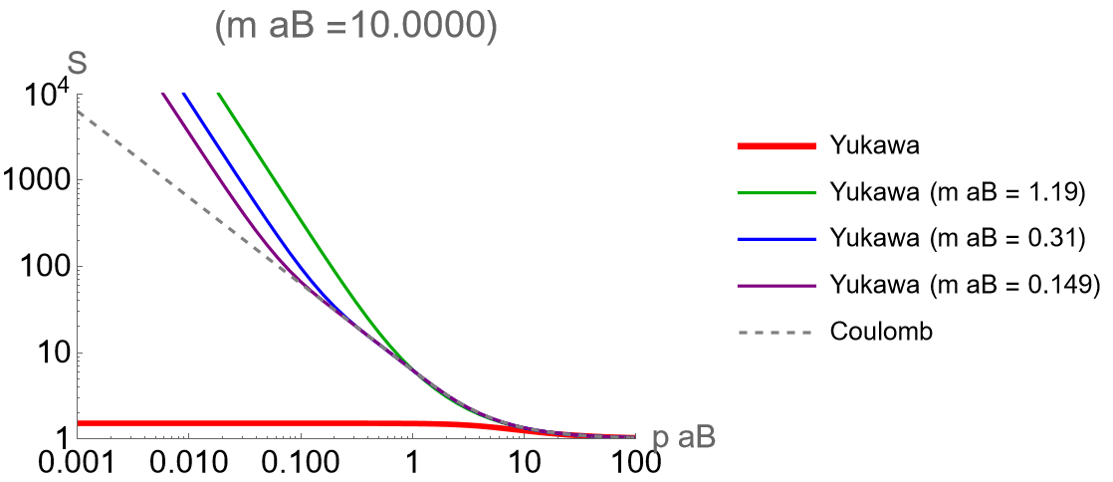
Sommerfeld factor
$$V\left(r\right)=−\frac{α}{r}\exp{(−mr)}$$
Bohr radius :
$$a_{B}≡\frac{1}{αμ}$$
$σv$ enhances when $m<\frac{1}{a_{B}}$ & $p<\frac{1}{a_{B}}$
At some specific value of $ma_{B}$, $σv$ violently enhances
$${\left|ψ_{long}\left(0\right)\right|}^{2}$$
$$∝p^{−2}$$
$$∝p^{−1}$$
$${\left|ψ_{long}\left(0\right)\right|}^{2}=\frac{2π}{pa_{B}}\frac{1}{1−exp\left(−\frac{2π}{pa_{B}}\right)}$$

Slide 14
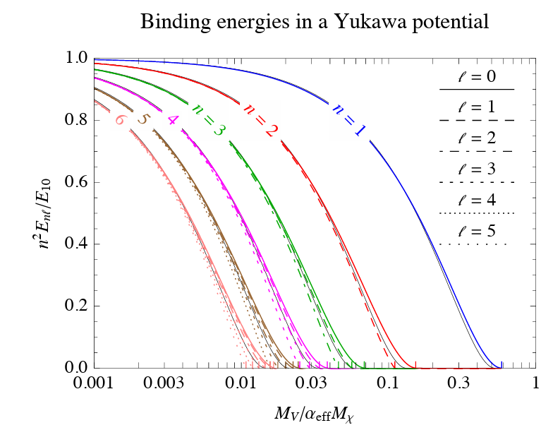
Sommerfeld factor
$$V\left(r\right)=−\frac{α}{r}\exp{(−mr)}$$
Bohr radius :
$$a_{B}≡\frac{1}{αμ}$$
$σv$ enhances when $m<\frac{1}{a_{B}}$ & $p<\frac{1}{a_{B}}$
At some specific value of $ma_{B}$, $σv$ violently enhances
$${\left|ψ_{long}\left(0\right)\right|}^{2}$$
$$=ma_{B}/2$$
$$∝p^{−2}$$
Taken from [Mitridate, Redi, Smirnov, Strumia (2017)]
$$∝p^{−1}$$
$${\left|ψ_{long}\left(0\right)\right|}^{2}=\frac{2π}{pa_{B}}\frac{1}{1−exp\left(−\frac{2π}{pa_{B}}\right)}$$

Slide 15
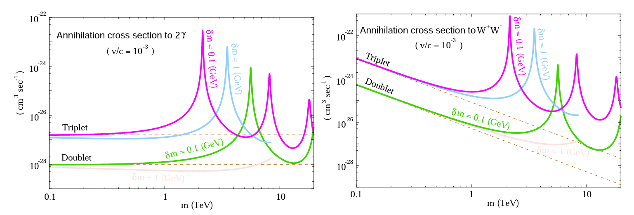
Wino / Higgsino DM in SUSY
Dashed lines : usual perturbative calculation (w/o Sommerfeld effect)
Colored curves : non-perturbative calculation (w/ Sommerfeld effect)
[Hisano, Matsumoto, Nojiri (2003)]
Huge difference!

Slide 16
Plan
Dark matter and Sommerfeld effect
Sommerfeld effect and unitarity

Slide 17
Unitarity bound?
$$σ=σ_{0}×S(v)$$
LO cross section :
$$σ_{0}$$
Enhancement factor :
$$S\left(v\right)=|{ψ(0)|}^{2}$$
$σ_{0}$ and $S(v)$ are irrelevant each other.
Unitarity bound on s-wave :
$$σ≤\frac{π}{p^{2}}$$
[Griest, Kamionkowski (1992)]
[Landau-Lifshits’s textbook]
Problematic situations
Large $σ_{0}v$
At zero energy resonance ($S\left(v\right)∝v^{−2}→σ∝v^{−3}$)
(for s-wave)

Slide 18
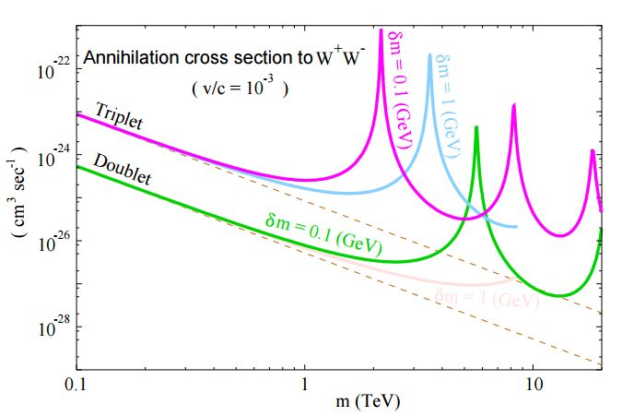
Unitarity bound?
Wino / Higgisno :
$$σ=σ_{0}×S(v)$$
LO cross section :
$$σ_{0}$$
Enhancement factor :
$$S\left(v\right)=|{ψ(0)|}^{2}/{\left|ψ_{0}\left(0\right)\right|}^{2}$$
with $ψ_{0}(x)=e^{ipz}$
$σ_{0}$ and $S(v)$ are irrelevant each other.
Yukawa potential :
Unitarity bound on s-wave :
$$σ≤\frac{π}{p^{2}}$$
[Griest, Kamionkowski (1992)]
[Landau-Lifshits’s textbook]
Problematic situations
Large $σ_{0}v$
At zero energy resonance ($S\left(v\right)∝v^{−2}→σ∝v^{−3}$)
(for s-wave)

Slide 19
Unitarity bound vs. zero-energy resonance
Annihilation cross section on zero-energy resonance
$${\left|ψ_{long}\right|}^{2}∝p^{−2}$$
$$σ_{ann,s} = \frac{1}{v}×{\left|ψ_{long}\right|}^{2}×{\left(σv\right)}_{0} ∝ \frac{1}{p^{3}}$$
(for s-wave)
violates
unitarity bound
at small p
Partial wave expansion in two body scattering
$$Eψ=−\frac{1}{2μ}∇^{2}ψ+V\left(x\right)ψ$$
$$ψ → e^{ipz} + f\left(θ\right)\frac{e^{ikr}}{r}$$
$$= \sum_{ℓ}{P_{ℓ}(\cos{θ)}\frac{S_{ℓ}e^{ipr}−{\left(−1\right)}^{ℓ}e^{−ipr}}{2ipr}}$$
with
Annihilation cross section
$$σ_{ann}=\frac{π}{p^{2}}\sum_{ℓ}{(2ℓ+1)(1−{\left|S_{ℓ}\right|}^{2})}$$
$$σ_{ann,s}≤\frac{π}{p^{2}}$$

Slide 20
Need to solve Schroedinger eq, seriously
Going back to cross section formula…
$$σv = \int_{r<a}{d^{3}x 2ImV_{short}(x){\left|ψ(x)\right|}^{2}}$$
$$≃ \int_{r<a}{d^{3}x 2ImV_{short}(x){\left|ψ_{long}(x)\right|}^{2}}$$
$$ψ≃ψ_{long}$$
(a.k.a. Distorted Wave Born Approximation)
This should be OK as long as $σv$ is not so large…
(will come back to this point soon)
$$\left[−\frac{1}{2μ}∇^{2}+V_{long}\left(x\right)−E\right]ψ_{long}=0$$
s. t.
$ψ$ is quite different from $ψ_{long}$ if $σv$ is large!

Slide 21
Need to solve Schroedinger eq, seriously
Diagramatic interpretation
DM
SM
$$V_{short}$$
+
+
+ …
DM
SM
$$V_{long}$$
DM
SM
+
+
+ …
DM
SM
+ …
+ …
+ …

Slide 22
S-matrix from Schroedinger eq.
$$ψ=\sum_{ℓ}{P_{ℓ}(\cos{θ)}\frac{{\left(−1\right)}^{ℓ}χ_{ℓ}(r)}{pr}}$$
What we need:
Schroedinger eq.
$$\left[−\frac{1}{2μ}∇^{2}+V\left(r\right)−\frac{p^{2}}{2μ}\right]ψ\left(r\right)=0$$
$$\left[−\frac{1}{2μ}\frac{d^{2}}{dr^{2}}+\frac{ℓ\left(ℓ+1\right)}{2μr^{2}}+V\left(r\right)−\frac{p^{2}}{2μ}\right]χ_{ℓ}\left(r\right)=0$$
$$V_{short}\left(r\right)$$
$$(r<a)$$
complex
$$V\left(r\right) =$$
$$V_{long}\left(r\right)$$
$$(r≥a)$$
real
Boundary condition at $r→∞$
$$χ_{ℓ}\left(r\right) → \frac{S_{ℓ}\exp\left(ipr\right) − \exp{(−ipr)}}{2i}$$
Boundary condition at $r=a$ (condition for short-range effect)
$χ_{ℓ}′\left(r\right)/χ_{ℓ}(r)$ at $r=a$ is $p$-independent

Slide 23
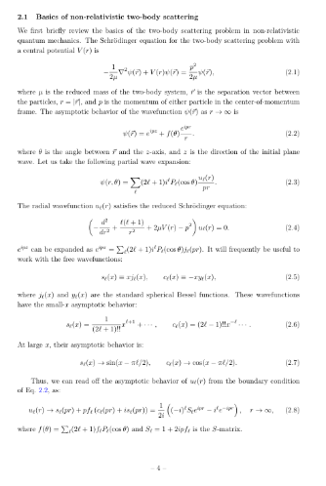
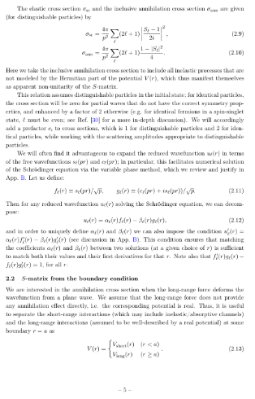
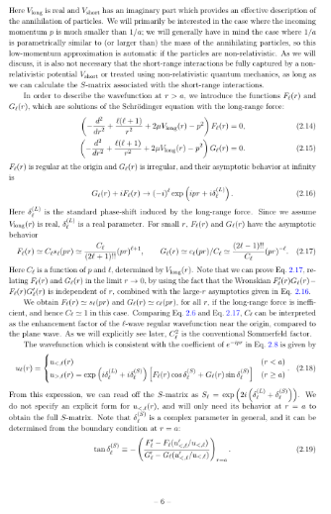
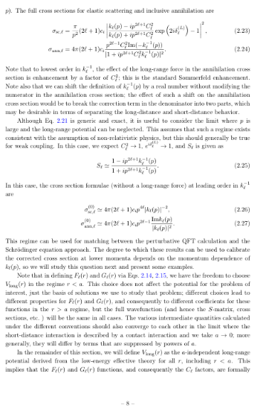
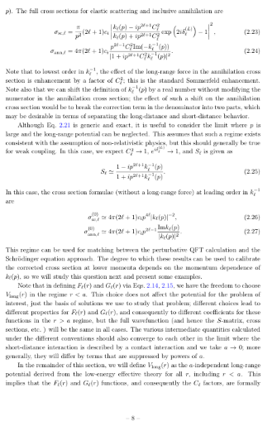
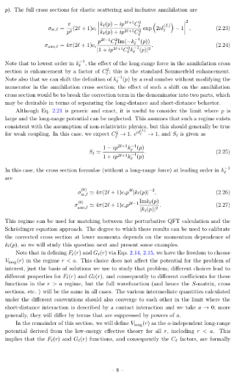
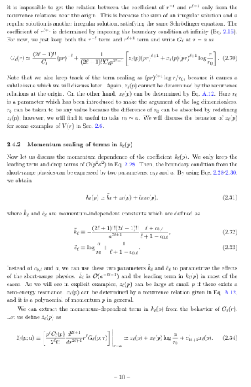
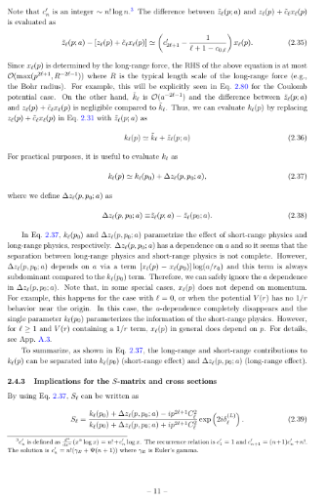
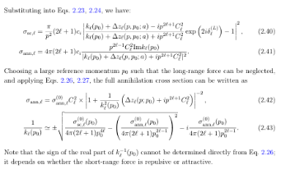
Straightforward (but lengthy) calculation

Slide 24
S-matrix
We obtain S-matrix for each $ℓ$ as
$$S_{ℓ} ≃ \exp\left(2iδ_{ℓ}^{\left(L\right)}(p)\right) ×$$
$$\frac{k_{ℓ,0}+z_{ℓ}(p)−ip^{2ℓ+1}C_{ℓ}^{2}(p)}{k_{ℓ,0}+z_{ℓ}(p)+ip^{2ℓ+1}C_{ℓ}^{2}(p)}$$
Phase-shift
by long-range force
Relevant part for annihilation
a single complex parameter :
$$k_{ℓ,0}$$
Three real functions :
$$C_{ℓ}^{2}\left(p\right), z_{ℓ}\left(p\right), δ_{ℓ}(p)$$

Slide 25
S-matrix
We obtain S-matrix for each $ℓ$ as
$$S_{ℓ} ≃ \exp\left(2iδ_{ℓ}^{\left(L\right)}(p)\right) ×$$
$$\frac{k_{ℓ,0}+z_{ℓ}(p)−ip^{2ℓ+1}C_{ℓ}^{2}(p)}{k_{ℓ,0}+z_{ℓ}(p)+ip^{2ℓ+1}C_{ℓ}^{2}(p)}$$
Phase-shift
by long-range force
Relevant part for annihilation
Annihilation cross section :
Unitarity bound✓
$$σ_{ann,ℓ} = \frac{π}{p^{2}}\left(2ℓ+1\right)(1−{\left|S_{ℓ}\right|}^{2})$$
$$< \frac{\left(2ℓ+1\right)π}{p^{2}}$$

Slide 26
S-matrix
We obtain S-matrix for each $ℓ$ as
$$S_{ℓ} ≃ \exp\left(2iδ_{ℓ}^{\left(L\right)}(p)\right) ×$$
$$\frac{k_{ℓ,0}+z_{ℓ}(p)−ip^{2ℓ+1}C_{ℓ}^{2}(p)}{k_{ℓ,0}+z_{ℓ}(p)+ip^{2ℓ+1}C_{ℓ}^{2}(p)}$$
Phase-shift
by long-range force
Relevant part for annihilation
Annihilation cross section :
Unitarity bound✓
$$σ_{ann,ℓ} = \frac{π}{p^{2}}\left(2ℓ+1\right)(1−{\left|S_{ℓ}\right|}^{2})$$
$$< \frac{\left(2ℓ+1\right)π}{p^{2}}$$
$$= \frac{π}{p^{2}}\left(2ℓ+1\right) × 4Re\left[\frac{ip^{2ℓ+1}C_{ℓ}^{2}}{k_{ℓ,0}}\right] × {\left|1+\frac{z_{ℓ}+ip^{2ℓ+1}C_{ℓ}^{2}}{k_{ℓ,0}}\right|}^{−2}$$

Slide 27
S-matrix
We obtain S-matrix for each $ℓ$ as
$$S_{ℓ} ≃ \exp\left(2iδ_{ℓ}^{\left(L\right)}(p)\right) ×$$
$$\frac{k_{ℓ,0}+z_{ℓ}(p)−ip^{2ℓ+1}C_{ℓ}^{2}(p)}{k_{ℓ,0}+z_{ℓ}(p)+ip^{2ℓ+1}C_{ℓ}^{2}(p)}$$
Phase-shift
by long-range force
Relevant part for annihilation
Annihilation cross section :
Unitarity bound✓
$$σ_{ann,ℓ} = \frac{π}{p^{2}}\left(2ℓ+1\right)(1−{\left|S_{ℓ}\right|}^{2})$$
$$< \frac{\left(2ℓ+1\right)π}{p^{2}}$$
$$= 4π\left(2ℓ+1\right)p^{2ℓ−1} Im\left[−\frac{1}{k_{ℓ,0}}\right] × C_{ℓ}^{2} × {\left|1+\frac{z_{ℓ}+ip^{2ℓ+1}C_{ℓ}^{2} }{k_{ℓ,0}}\right|}^{−2}$$
Annihilation cross section
w/o long-range force
Conventional
Sommerfeld factor
Correction factor

Slide 28
Examples
[Parikh, Sato, Slatyer (2024)]
Spherical well potential
$$V\left(r\right)=−\frac{p_{V}^{2}}{2μ}θ(R−r)$$
(Conventional) Sommerfeld factor : $C_{ℓ}^{2}$
S-wave
P-wave
D-wave
Effective range
momentum

Slide 29
Examples
[Parikh, Sato, Slatyer (2024)]
Spherical well potential
$$V\left(r\right)=−\frac{p_{V}^{2}}{2μ}θ(R−r)$$
$$\frac{σ_{ann}}{σ_{ann,LO}}$$
Enhancement factor
Effective range

Slide 30
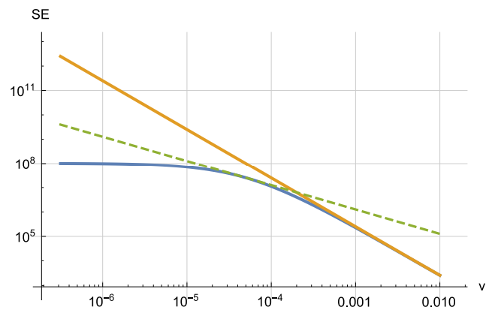
Examples
[Blum, Sato, Slatyer (2016)]
Hulthen potential :
$$V\left(r\right)=−\frac{αm_{∗}e_{}^{−m_{∗}r}}{1−e^{−m_{∗}r}}$$
(Good approximation of $V\left(r\right)=−\frac{αe_{}^{−mr}}{r}, m_{∗}=\frac{π^{2}}{6}m$)
$$α=1, σv=\frac{1}{32πM^{2}}, σ_{sc}=\frac{μ^{2}}{4π}{\left(σv\right)}^{2}$$
$$m_{∗}=0.0625M$$
Yellow : usual formula
Blue : our formula
Green dotted : Unitarity bound

Slide 31
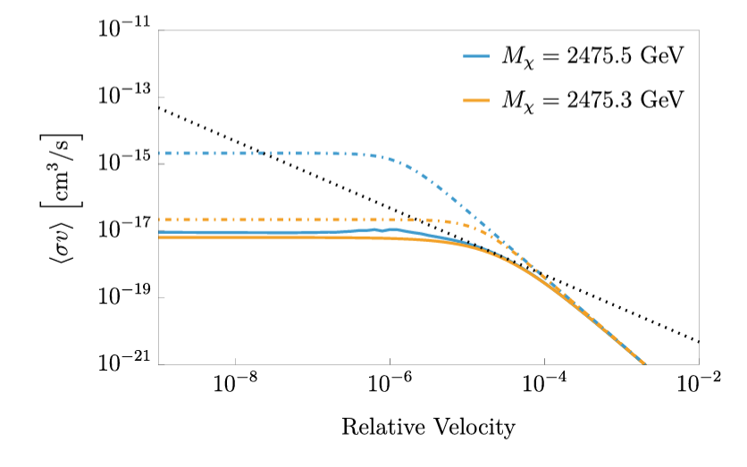
Examples
[Parikh, Sato, Slatyer (2024)]
Wino

Slide 32
Examples
[Parikh, Sato, Slatyer (2024)]
Wino
[MAGIC, 2212.10527]

Slide 33
Summary & Outlook
Annihilation cross section is important for DM phenomenology
Schroedinger equation can treat long-range force by a light mediator
The effect of annihilation can be treated as potential with complex coefficient
This formulation is consistent with unitarty of QM.
Can be relevant for large LO annihilation cross section (higher mass)

Slide 34
Backup

Slide 35
Wave function w/ long-range force
$$\left[−\frac{d^{2}}{dr^{2}}+\frac{ℓ\left(ℓ+1\right)}{r^{2}}+2μV\left(r\right)−p^{2}\right]H_{ℓ}^{+}\left(r\right)=0,$$
$$H_{ℓ}^{+}\left(r\right)→{\left(−i\right)}^{ℓ}\exp\left(ipr+δ_{ℓ}^{\left(L\right)}\right)$$
$$C_{ℓ}p^{ℓ+1} × \left[ \frac{r^{ℓ+1}}{\left(2ℓ+1\right)‼} + … \right]$$
$$F_{ℓ}\left(r\right) ≡ ImH_{ℓ}^{+} ≃$$
Leading term
$$G_{ℓ}\left(r\right) ≡ ReH_{ℓ}^{+} ≃$$
$$\frac{1}{C_{ℓ}p^{ℓ}} × \left[ \frac{\left(2ℓ−1\right)‼}{r^{ℓ}} + … + z_{ℓ}\left(p\right)\frac{r^{ℓ+1}}{\left(2ℓ+1\right)‼} + … \right]$$
(basically) leading term
Sizable in some cases
On zero energy resonance,
$$p^{−2} (ℓ=0)$$
$$p^{0} (ℓ=0)$$
$$C_{ℓ}^{2}(p) ∝$$
$$z_{ℓ}(p) ∝$$
$$p^{−4} (ℓ≥1)$$
$$p^{−2} (ℓ≥1)$$
See also [Kamada, Kuwahara, Patel (2023)]

Slide 36
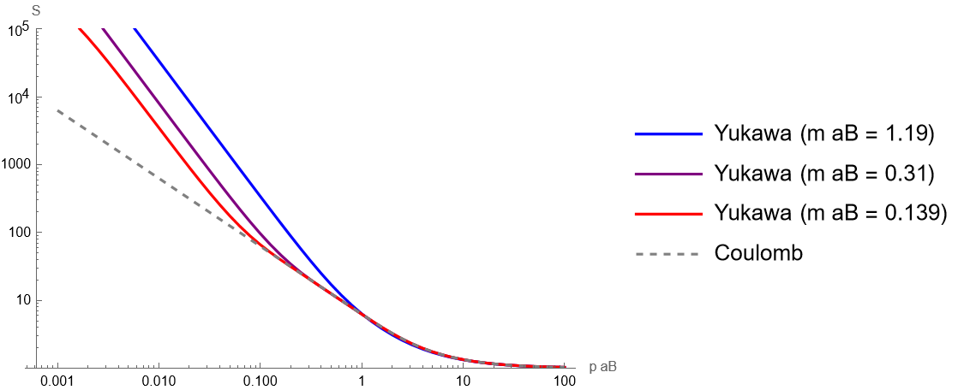
Resonant points
At some specific points ($ma_{B}=1.19, 0.31, 0.139, …$),
$${\left|ψ_{long}\right|}^{2} ∝ \frac{1}{p^{2}}$$
(zero energy resonance : bound state with zero binding energy)
$$∝p^{−2}$$
$$σ≤ {\sim k}^{−2}$$
$$∝p^{−1}$$
$$σ = \frac{1}{v}×{\left|ψ_{long}\right|}^{2}×{\left(σv\right)}_{0} ∝ \frac{1}{p^{3}}$$

Slide 37
Zero energy resonance
Schroedinger eq
Boundary cond.
$$\left[−\frac{1}{2μ}\frac{d^{2}}{dr^{2}}+V\left(r\right)−\frac{p^{2}}{2μ}\right]χ\left(r\right)=0,$$
$$χ\left(r\right) → \frac{S\exp\left(ipr\right) − \exp{(−ipr)}}{2i}$$
Bound state w/ $E=−\frac{κ^{2}}{2m}$
pole in $S(k)$ at $p=iκ$
$$χ\left(r\right) → \exp{(−κr)}$$
→
$$S=e^{2iδ}=−\frac{p+iκ}{p−iκ}$$
$$\sin{δ}=−\frac{κ}{p}$$
→
$$ψ(\vec{x})=\frac{χ(r)}{pr}$$
$${\left|ψ_{long}\left(0\right)\right|}^{2} ∝ \frac{χ^{2}\left(0\right)}{p^{2}} = \frac{\sin^{2}{δ}}{p^{2}} = \frac{1}{p^{2}+κ^{2}}$$

Slide 38
Solution of Schroedinger eq.
[Blum, Sato, Slatyer (2016)]
[Parikh, Sato, Slatyer (2024)]
Schroedinger equation:
$$\left[−\frac{d^{2}}{dr^{2}}+\frac{ℓ\left(ℓ+1\right)}{r^{2}}+2μV\left(r\right)−p^{2}\right]u_{ℓ}\left(r\right)=0,$$
$$V_{short}\left(r\right)$$
$$(r<a)$$
complex
$$V\left(r\right) =$$
$$V_{long}\left(r\right)$$
$$(r≥a)$$
real

Slide 39
Solution of Schroedinger eq.
[Blum, Sato, Slatyer (2016)]
[Parikh, Sato, Slatyer (2024)]
Schroedinger equation:
$$\left[−\frac{d^{2}}{dr^{2}}+\frac{ℓ\left(ℓ+1\right)}{r^{2}}+2μV\left(r\right)−p^{2}\right]u_{ℓ}\left(r\right)=0,$$
$$V_{short}\left(r\right)$$
$$(r<a)$$
complex
$$V\left(r\right) =$$
$$V_{long}\left(r\right)$$
$$(r≥a)$$
real
$u_{ℓ}$ should be a linear combination of
$F_{ℓ}(r)$ (regular solution)
$G_{ℓ}\left(r\right)$ (irregular solution)
at $r>a$
$$\left[−\frac{d^{2}}{dr^{2}}+\frac{ℓ\left(ℓ+1\right)}{r^{2}}+2μV_{long}\left(r\right)−p^{2}\right]F_{ℓ}\left(r\right)=0$$
&
$$\left[−\frac{d^{2}}{dr^{2}}+\frac{ℓ\left(ℓ+1\right)}{r^{2}}+2μV_{long}\left(r\right)−p^{2}\right]G_{ℓ}\left(r\right)=0$$
$$r≃0$$
$$r→∞$$
$$F_{ℓ}(r)$$
$$\frac{C_{ℓ}}{\left(2ℓ+1\right)‼}{\left(pr\right)}^{ℓ+1}$$
$$\sin\left(pr+δ_{ℓ}^{(L)}−\frac{πℓ}{2}\right)$$
$$G_{ℓ}(r)$$
$$\frac{\left(2ℓ−1\right)‼}{C_{ℓ}}{\left(pr\right)}^{−ℓ}$$
$$\cos\left(pr+δ_{ℓ}^{(L)}−\frac{πℓ}{2}\right)$$
$C_{ℓ}≃1, δ_{ℓ}^{\left(L\right)}≃0$ for $V_{long}(r)≃0$

Slide 40
Solution of Schroedinger eq.
[Blum, Sato, Slatyer (2016)]
[Parikh, Sato, Slatyer (2024)]
Schroedinger equation:
$$\left[−\frac{d^{2}}{dr^{2}}+\frac{ℓ\left(ℓ+1\right)}{r^{2}}+2μV\left(r\right)−p^{2}\right]u_{ℓ}\left(r\right)=0,$$
$$V_{short}\left(r\right)$$
$$(r<a)$$
complex
$$V\left(r\right) =$$
$$V_{long}\left(r\right)$$
$$(r≥a)$$
real
$u_{ℓ}$ should be a linear combination of
$F_{ℓ}(r)$ (regular solution)
$G_{ℓ}\left(r\right)$ (irregular solution)
at $r>a$
$$u_{ℓ,<}(r)$$
$$(r<a)$$
$$u_{ℓ}\left(r\right)=$$
$$\exp\left(iδ_{ℓ}^{\left(L\right)}+iδ_{ℓ}^{\left(S\right)}\right)\left[\cos{δ_{ℓ}^{\left(S\right)}F_{ℓ}\left(r\right)+\sin{δ_{ℓ}^{\left(S\right)}G_{ℓ}(r)}}\right]$$
$$(r≥a)$$
$$→ \frac{1}{2i}\left({\left(−i\right)}^{ℓ}{\exp\left(2iδ_{ℓ}^{(L)}+2iδ_{ℓ}^{(S)}\right)e}^{ipr}−i^{ℓ}e^{−ipr}\right)$$

Slide 41
Solution of Schroedinger eq.
[Blum, Sato, Slatyer (2016)]
[Parikh, Sato, Slatyer (2024)]
Schroedinger equation:
$$\left[−\frac{d^{2}}{dr^{2}}+\frac{ℓ\left(ℓ+1\right)}{r^{2}}+2μV\left(r\right)−p^{2}\right]u_{ℓ}\left(r\right)=0,$$
$$V_{short}\left(r\right)$$
$$(r<a)$$
complex
$$V\left(r\right) =$$
$$V_{long}\left(r\right)$$
$$(r≥a)$$
real
$u_{ℓ}$ should be a linear combination of
$F_{ℓ}(r)$ (regular solution)
$G_{ℓ}\left(r\right)$ (irregular solution)
at $r>a$
$$u_{ℓ,<}(r)$$
$$(r<a)$$
$$u_{ℓ}\left(r\right)=$$
$$\exp\left(iδ_{ℓ}^{\left(L\right)}+iδ_{ℓ}^{\left(S\right)}\right)\left[\cos{δ_{ℓ}^{\left(S\right)}F_{ℓ}\left(r\right)+\sin{δ_{ℓ}^{\left(S\right)}G_{ℓ}(r)}}\right]$$
$$(r≥a)$$
$$→ \frac{1}{2i}\left({\left(−i\right)}^{ℓ}{\exp\left(2iδ_{ℓ}^{(L)}+2iδ_{ℓ}^{(S)}\right)e}^{ipr}−i^{ℓ}e^{−ipr}\right)$$
Outgoing wave
Incoming wave

Slide 42
Solution of Schroedinger eq.
[Blum, Sato, Slatyer (2016)]
[Parikh, Sato, Slatyer (2024)]
Schroedinger equation:
$$\left[−\frac{d^{2}}{dr^{2}}+\frac{ℓ\left(ℓ+1\right)}{r^{2}}+2μV\left(r\right)−p^{2}\right]u_{ℓ}\left(r\right)=0,$$
$$V_{short}\left(r\right)$$
$$(r<a)$$
complex
$$V\left(r\right) =$$
$$V_{long}\left(r\right)$$
$$(r≥a)$$
real
$u_{ℓ}$ should be a linear combination of
$F_{ℓ}(r)$ (regular solution)
$G_{ℓ}\left(r\right)$ (irregular solution)
at $r>a$
$$u_{ℓ,<}(r)$$
$$(r<a)$$
$$u_{ℓ}\left(r\right)=$$
$$\exp\left(iδ_{ℓ}^{\left(L\right)}+iδ_{ℓ}^{\left(S\right)}\right)\left[\cos{δ_{ℓ}^{\left(S\right)}F_{ℓ}\left(r\right)+\sin{δ_{ℓ}^{\left(S\right)}G_{ℓ}(r)}}\right]$$
$$(r≥a)$$
$$→ \frac{1}{2i}\left({\left(−i\right)}^{ℓ}{\exp\left(2iδ_{ℓ}^{(L)}+2iδ_{ℓ}^{(S)}\right)e}^{ipr}−i^{ℓ}e^{−ipr}\right)$$
Outgoing wave
Incoming wave
$$S_{ℓ}$$

Slide 43
S-matrix
[Blum, Sato, Slatyer (2016)]
[Parikh, Sato, Slatyer (2024)]
$$u_{ℓ,<}(r)$$
$$(r<a)$$
$$u_{ℓ}\left(r\right)=$$
$$\exp\left(iδ_{ℓ}^{\left(L\right)}+iδ_{ℓ}^{\left(S\right)}\right)\left[\cos{δ_{ℓ}^{\left(S\right)}F_{ℓ}\left(r\right)+\sin{δ_{ℓ}^{\left(S\right)}G_{ℓ}(r)}}\right]$$
$$(r≥a)$$
$$→ \frac{1}{2i}\left({\left(−i\right)}^{ℓ}{\exp\left(2iδ_{ℓ}^{(L)}+2iδ_{ℓ}^{(S)}\right)e}^{ipr}−i^{ℓ}e^{−ipr}\right)$$
Outgoing wave
Incoming wave
$$S_{ℓ}$$

Slide 44
S-matrix
[Blum, Sato, Slatyer (2016)]
[Parikh, Sato, Slatyer (2024)]
$$u_{ℓ,<}(r)$$
$$(r<a)$$
$$u_{ℓ}\left(r\right)=$$
$$\exp\left(iδ_{ℓ}^{\left(L\right)}+iδ_{ℓ}^{\left(S\right)}\right)\left[\cos{δ_{ℓ}^{\left(S\right)}F_{ℓ}\left(r\right)+\sin{δ_{ℓ}^{\left(S\right)}G_{ℓ}(r)}}\right]$$
$$(r≥a)$$
$$→ \frac{1}{2i}\left({\left(−i\right)}^{ℓ}{\exp\left(2iδ_{ℓ}^{(L)}+2iδ_{ℓ}^{(S)}\right)e}^{ipr}−i^{ℓ}e^{−ipr}\right)$$
Outgoing wave
Incoming wave
$$S_{ℓ}$$
$$\frac{u_{ℓ}′}{u_{ℓ}}$$
$$\frac{u_{ℓ,<}′}{u_{ℓ,<}} = \frac{\cos{δ_{ℓ}^{\left(S\right)}F_{ℓ}^{′}+}\sin{δ_{ℓ}^{(S)}G_{ℓ}^{′}}}{\cos{δ_{ℓ}^{\left(S\right)}F_{ℓ}+}\sin{δ_{ℓ}^{(S)}G_{ℓ}}}$$
is continuous at $r=a$

Slide 45
S-matrix
[Blum, Sato, Slatyer (2016)]
[Parikh, Sato, Slatyer (2024)]
$$u_{ℓ,<}(r)$$
$$(r<a)$$
$$u_{ℓ}\left(r\right)=$$
$$\exp\left(iδ_{ℓ}^{\left(L\right)}+iδ_{ℓ}^{\left(S\right)}\right)\left[\cos{δ_{ℓ}^{\left(S\right)}F_{ℓ}\left(r\right)+\sin{δ_{ℓ}^{\left(S\right)}G_{ℓ}(r)}}\right]$$
$$(r≥a)$$
$$→ \frac{1}{2i}\left({\left(−i\right)}^{ℓ}{\exp\left(2iδ_{ℓ}^{(L)}+2iδ_{ℓ}^{(S)}\right)e}^{ipr}−i^{ℓ}e^{−ipr}\right)$$
Outgoing wave
Incoming wave
$$S_{ℓ}$$
$$\frac{u_{ℓ}′}{u_{ℓ}}$$
$$\frac{u_{ℓ,<}′}{u_{ℓ,<}} = \frac{F_{ℓ}^{′}+\tan{δ_{ℓ}^{(S)}G_{ℓ}^{′}}}{F_{ℓ}+\tan{δ_{ℓ}^{(S)}G_{ℓ}}}$$
is continuous at $r=a$

Slide 46
S-matrix
[Blum, Sato, Slatyer (2016)]
[Parikh, Sato, Slatyer (2024)]
$$u_{ℓ,<}(r)$$
$$(r<a)$$
$$u_{ℓ}\left(r\right)=$$
$$\exp\left(iδ_{ℓ}^{\left(L\right)}+iδ_{ℓ}^{\left(S\right)}\right)\left[\cos{δ_{ℓ}^{\left(S\right)}F_{ℓ}\left(r\right)+\sin{δ_{ℓ}^{\left(S\right)}G_{ℓ}(r)}}\right]$$
$$(r≥a)$$
$$→ \frac{1}{2i}\left({\left(−i\right)}^{ℓ}{\exp\left(2iδ_{ℓ}^{(L)}+2iδ_{ℓ}^{(S)}\right)e}^{ipr}−i^{ℓ}e^{−ipr}\right)$$
Outgoing wave
Incoming wave
$$S_{ℓ}$$
$$\frac{u_{ℓ}′}{u_{ℓ}}$$
$$\tan{δ_{ℓ}^{(S)}}=−\frac{F_{ℓ}^{′}−F_{ℓ} \left(u_{ℓ,<}^{′}/u_{ℓ,<}\right)}{G_{ℓ}^{′}−G_{ℓ} \left(u_{ℓ,<}^{′}/u_{ℓ,<}\right)}$$
is continuous at $r=a$
$S_{ℓ} = \exp\left(2iδ_{ℓ}^{\left(L\right)}\right)×$ $\exp\left(2iδ_{ℓ}^{\left(S\right)}\right)$

Slide 47
S-matrix
[Blum, Sato, Slatyer (2016)]
[Parikh, Sato, Slatyer (2024)]
$$u_{ℓ,<}(r)$$
$$(r<a)$$
$$u_{ℓ}\left(r\right)=$$
$$\exp\left(iδ_{ℓ}^{\left(L\right)}+iδ_{ℓ}^{\left(S\right)}\right)\left[\cos{δ_{ℓ}^{\left(S\right)}F_{ℓ}\left(r\right)+\sin{δ_{ℓ}^{\left(S\right)}G_{ℓ}(r)}}\right]$$
$$(r≥a)$$
$$→ \frac{1}{2i}\left({\left(−i\right)}^{ℓ}{\exp\left(2iδ_{ℓ}^{(L)}+2iδ_{ℓ}^{(S)}\right)e}^{ipr}−i^{ℓ}e^{−ipr}\right)$$
Outgoing wave
Incoming wave
$$S_{ℓ}$$
$$\frac{u_{ℓ}′}{u_{ℓ}}$$
$$\tan{δ_{ℓ}^{(S)}}=−\frac{F_{ℓ}^{′}−F_{ℓ} \left(u_{ℓ,<}^{′}/u_{ℓ,<}\right)}{G_{ℓ}^{′}−G_{ℓ} \left(u_{ℓ,<}^{′}/u_{ℓ,<}\right)}$$
is continuous at $r=a$
$$\frac{1+i\tan{δ_{ℓ}^{(S)}}}{1−i\tan{δ_{ℓ}^{(S)}}}$$
$$S_{ℓ} = \exp\left(2iδ_{ℓ}^{\left(L\right)}\right) ×$$

Slide 48
S-matrix
[Blum, Sato, Slatyer (2016)]
[Parikh, Sato, Slatyer (2024)]
$$\frac{1+i\tan{δ_{ℓ}^{(S)}}}{1−i\tan{δ_{ℓ}^{(S)}}}$$
$$\tan{δ_{ℓ}^{(S)}}=−\frac{F_{ℓ}^{′}−F_{ℓ} \left(u_{ℓ,<}^{′}/u_{ℓ,<}\right)}{G_{ℓ}^{′}−G_{ℓ} \left(u_{ℓ,<}^{′}/u_{ℓ,<}\right)}$$
$$S_{ℓ} = \exp\left(2iδ_{ℓ}^{\left(L\right)}\right) ×$$

Slide 49
S-matrix
[Blum, Sato, Slatyer (2016)]
[Parikh, Sato, Slatyer (2024)]
$$\frac{1+i\tan{δ_{ℓ}^{(S)}}}{1−i\tan{δ_{ℓ}^{(S)}}}$$
$$\tan{δ_{ℓ}^{(S)}}=−\frac{F_{ℓ}^{′}−F_{ℓ} \left(u_{ℓ,<}^{′}/u_{ℓ,<}\right)}{G_{ℓ}^{′}−G_{ℓ} \left(u_{ℓ,<}^{′}/u_{ℓ,<}\right)}$$
$$S_{ℓ} = \exp\left(2iδ_{ℓ}^{\left(L\right)}\right) ×$$
Solutions for $V\left(r\right)=V_{long}(r)$
$$F_{ℓ}\left(r\right) ≃ \frac{C_{ℓ}}{\left(2ℓ+1\right)‼}{\left(pr\right)}^{ℓ+1}$$
$$G_{ℓ}\left(r\right)≃\frac{\left(2ℓ−1\right)‼}{C_{ℓ}}{\left(pr\right)}^{ℓ+1}$$

Slide 50
S-matrix
[Blum, Sato, Slatyer (2016)]
[Parikh, Sato, Slatyer (2024)]
$$\frac{1+i\tan{δ_{ℓ}^{(S)}}}{1−i\tan{δ_{ℓ}^{(S)}}}$$
$$\tan{δ_{ℓ}^{(S)}}=−p^{2ℓ+1}C_{ℓ}^{2}\frac{f_{ℓ}^{′}−f_{ℓ} \left(u_{ℓ,<}^{′}/u_{ℓ,<}\right)}{g_{ℓ}^{′}−g_{ℓ} \left(u_{ℓ,<}^{′}/u_{ℓ,<}\right)}$$
$$S_{ℓ} = \exp\left(2iδ_{ℓ}^{\left(L\right)}\right) ×$$
Solutions for $V\left(r\right)=V_{long}(r)$
$$f_{ℓ}\left(r\right) ≡ \frac{F_{ℓ}}{C_{ℓ}p^{ℓ+1}} ≃ \frac{r^{ℓ+1}}{\left(2ℓ+1\right)‼}$$
$$g_{ℓ}\left(r\right) ≡ \frac{C_{ℓ}}{p^{ℓ}}G_{ℓ} ≃ \frac{\left(2ℓ−1\right)‼}{r^{ℓ}}$$

Slide 51
S-matrix
[Blum, Sato, Slatyer (2016)]
[Parikh, Sato, Slatyer (2024)]
$$\frac{1+i\tan{δ_{ℓ}^{(S)}}}{1−i\tan{δ_{ℓ}^{(S)}}}$$
$$\tan{δ_{ℓ}^{(S)}}=−p^{2ℓ+1}C_{ℓ}^{2}\frac{f_{ℓ}^{′}−f_{ℓ} \left(u_{ℓ,<}^{′}/u_{ℓ,<}\right)}{g_{ℓ}^{′}−g_{ℓ} \left(u_{ℓ,<}^{′}/u_{ℓ,<}\right)}$$
$$S_{ℓ} = \exp\left(2iδ_{ℓ}^{\left(L\right)}\right) ×$$
Solutions for $V\left(r\right)=V_{long}(r)$
$$f_{ℓ}\left(r\right) ≡ \frac{F_{ℓ}}{C_{ℓ}p^{ℓ+1}} ≃ \frac{r^{ℓ+1}}{\left(2ℓ+1\right)‼}$$
$$g_{ℓ}\left(r\right) ≡ \frac{C_{ℓ}}{p^{ℓ}}G_{ℓ} ≃ \frac{\left(2ℓ−1\right)‼}{r^{ℓ}}$$
$$k_{ℓ}\left(p\right) ≡ −\frac{p^{2ℓ+1}C_{ℓ}^{2}}{\tan{δ_{ℓ}^{\left(S\right)}}}$$
$$= \frac{g_{ℓ}^{′}−g_{ℓ}\left(u_{ℓ,<}^{′}/u_{ℓ,<}\right)}{f_{ℓ}^{′}−f_{ℓ}\left(u_{ℓ,<}^{′}/u_{ℓ,<}\right)}$$
$k_{ℓ}(p)$ is *almost* independent on p
(will be discussed later)

Slide 52
S-matrix
[Blum, Sato, Slatyer (2016)]
[Parikh, Sato, Slatyer (2024)]
$$\frac{1+i\tan{δ_{ℓ}^{(S)}}}{1−i\tan{δ_{ℓ}^{(S)}}}$$
$$\tan{δ_{ℓ}^{(S)}}=−p^{2ℓ+1}C_{ℓ}^{2}\frac{f_{ℓ}^{′}−f_{ℓ} \left(u_{ℓ,<}^{′}/u_{ℓ,<}\right)}{g_{ℓ}^{′}−g_{ℓ} \left(u_{ℓ,<}^{′}/u_{ℓ,<}\right)}$$
$$S_{ℓ} = \exp\left(2iδ_{ℓ}^{\left(L\right)}\right) ×$$
Solutions for $V\left(r\right)=V_{long}(r)$
$$f_{ℓ}\left(r\right) ≡ \frac{F_{ℓ}}{C_{ℓ}p^{ℓ+1}} ≃ \frac{r^{ℓ+1}}{\left(2ℓ+1\right)‼}$$
$$g_{ℓ}\left(r\right) ≡ \frac{C_{ℓ}}{p^{ℓ}}G_{ℓ} ≃ \frac{\left(2ℓ−1\right)‼}{r^{ℓ}}$$
$$k_{ℓ}\left(p\right) ≡ −\frac{p^{2ℓ+1}C_{ℓ}^{2}}{\tan{δ_{ℓ}^{\left(S\right)}}}$$
$$= \frac{g_{ℓ}^{′}−g_{ℓ}\left(u_{ℓ,<}^{′}/u_{ℓ,<}\right)}{f_{ℓ}^{′}−f_{ℓ}\left(u_{ℓ,<}^{′}/u_{ℓ,<}\right)}$$
$u_{ℓ,<}(r)$
: $p$ independent
$f_{ℓ}(r)$
: $p$ independent
$k_{ℓ}(p)$ is *almost* independent on p
(will be discussed later)
$$g_{ℓ}(r)$$
: *almost* $p$ independent
$$\frac{k_{ℓ}\left(p\right)−ip^{2ℓ+1}C_{ℓ}^{2}}{k_{ℓ}\left(p\right)+ip^{2ℓ+1}C_{ℓ}^{2}}$$
$$S_{ℓ} = \exp\left(2iδ_{ℓ}^{\left(L\right)}\right) ×$$

Slide 53
S-matrix
[Blum, Sato, Slatyer (2016)] [Parikh, Sato, Slatyer (2024)]
$$\frac{k_{ℓ}\left(p\right)−ip^{2ℓ+1}C_{ℓ}^{2}}{k_{ℓ}\left(p\right)+ip^{2ℓ+1}C_{ℓ}^{2}}$$
$$k_{ℓ}(p) = \frac{g_{ℓ}^{′}−g_{ℓ}\left(u_{ℓ,<}^{′}/u_{ℓ,<}\right)}{f_{ℓ}^{′}−f_{ℓ}\left(u_{ℓ,<}^{′}/u_{ℓ,<}\right)}$$
$$S_{ℓ} = \exp\left(2iδ_{ℓ}^{\left(L\right)}\right) ×$$

Slide 54
S-matrix
[Blum, Sato, Slatyer (2016)] [Parikh, Sato, Slatyer (2024)]
$$\frac{k_{ℓ}\left(p\right)−ip^{2ℓ+1}C_{ℓ}^{2}}{k_{ℓ}\left(p\right)+ip^{2ℓ+1}C_{ℓ}^{2}}$$
$$k_{ℓ}(p) = \frac{g_{ℓ}^{′}−g_{ℓ}\left(u_{ℓ,<}^{′}/u_{ℓ,<}\right)}{f_{ℓ}^{′}−f_{ℓ}\left(u_{ℓ,<}^{′}/u_{ℓ,<}\right)}$$
$$S_{ℓ} = \exp\left(2iδ_{ℓ}^{\left(L\right)}\right) ×$$
Solutions for $V\left(r\right)=V_{long}(r)$
$$f_{ℓ}\left(r\right) ≃ \frac{r^{ℓ+1}}{\left(2ℓ+1\right)‼}+…$$
$$g_{ℓ}\left(r\right) ≃ \frac{\left(2ℓ−1\right)‼}{r^{ℓ}} +…+z_{ℓ}\left(p\right)\frac{r^{ℓ+1}}{\left(2ℓ+1\right)‼}+…$$

Slide 55
S-matrix
[Blum, Sato, Slatyer (2016)] [Parikh, Sato, Slatyer (2024)]
$$\frac{k_{ℓ}\left(p\right)−ip^{2ℓ+1}C_{ℓ}^{2}}{k_{ℓ}\left(p\right)+ip^{2ℓ+1}C_{ℓ}^{2}}$$
$$k_{ℓ}(p) = \frac{g_{ℓ}^{′}−g_{ℓ}\left(u_{ℓ,<}^{′}/u_{ℓ,<}\right)}{f_{ℓ}^{′}−f_{ℓ}\left(u_{ℓ,<}^{′}/u_{ℓ,<}\right)}$$
$$S_{ℓ} = \exp\left(2iδ_{ℓ}^{\left(L\right)}\right) ×$$
Solutions for $V\left(r\right)=V_{long}(r)$
$$f_{ℓ}\left(r\right) ≃ \frac{r^{ℓ+1}}{\left(2ℓ+1\right)‼} + …$$
Leading term
$$g_{ℓ}\left(r\right) ≃ \frac{\left(2ℓ−1\right)‼}{r^{ℓ}} + … + z_{ℓ}\left(p\right)\frac{r^{ℓ+1}}{\left(2ℓ+1\right)‼} + …$$
(basically) leading term
Sizable in some cases

Slide 56
S-matrix
[Blum, Sato, Slatyer (2016)] [Parikh, Sato, Slatyer (2024)]
$$\frac{k_{ℓ}\left(p\right)−ip^{2ℓ+1}C_{ℓ}^{2}}{k_{ℓ}\left(p\right)+ip^{2ℓ+1}C_{ℓ}^{2}}$$
$$k_{ℓ}(p) = \frac{g_{ℓ}^{′}−g_{ℓ}\left(u_{ℓ,<}^{′}/u_{ℓ,<}\right)}{f_{ℓ}^{′}−f_{ℓ}\left(u_{ℓ,<}^{′}/u_{ℓ,<}\right)}$$
$$S_{ℓ} = \exp\left(2iδ_{ℓ}^{\left(L\right)}\right) ×$$
Solutions for $V\left(r\right)=V_{long}(r)$
$$f_{ℓ}\left(r\right) ≃ \frac{r^{ℓ+1}}{\left(2ℓ+1\right)‼} + …$$
Leading term
$$g_{ℓ}\left(r\right) ≃ \frac{\left(2ℓ−1\right)‼}{r^{ℓ}} + … + z_{ℓ}\left(p\right)\frac{r^{ℓ+1}}{\left(2ℓ+1\right)‼} + …$$
(basically) leading term
Sizable in some cases
$$\frac{k_{ℓ,0}+z_{ℓ}(p)−ip^{2ℓ+1}C_{ℓ}^{2}}{k_{ℓ,0}+z_{ℓ}(p)+ip^{2ℓ+1}C_{ℓ}^{2}}$$
$$S_{ℓ} ≃ \exp\left(2iδ_{ℓ}^{\left(L\right)}\right) ×$$
$$k_{ℓ}\left(p\right) ≃ k_{ℓ,0} + z_{ℓ}(p)$$
(basically)
Leading term
Sizable in some cases

Slide 57
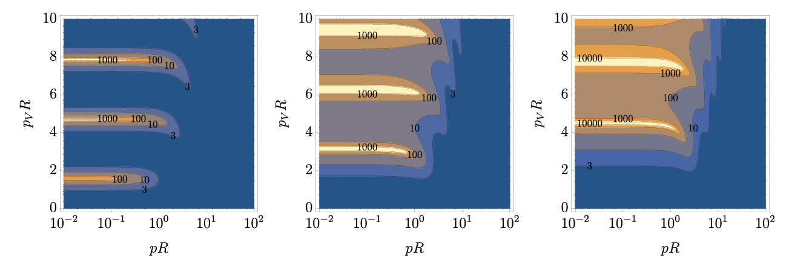
SE for Spherical-well potential

Slide 58
Z function for Spherical-well potential

Slide 59
SE for finite range Coulomb potential

Slide 60
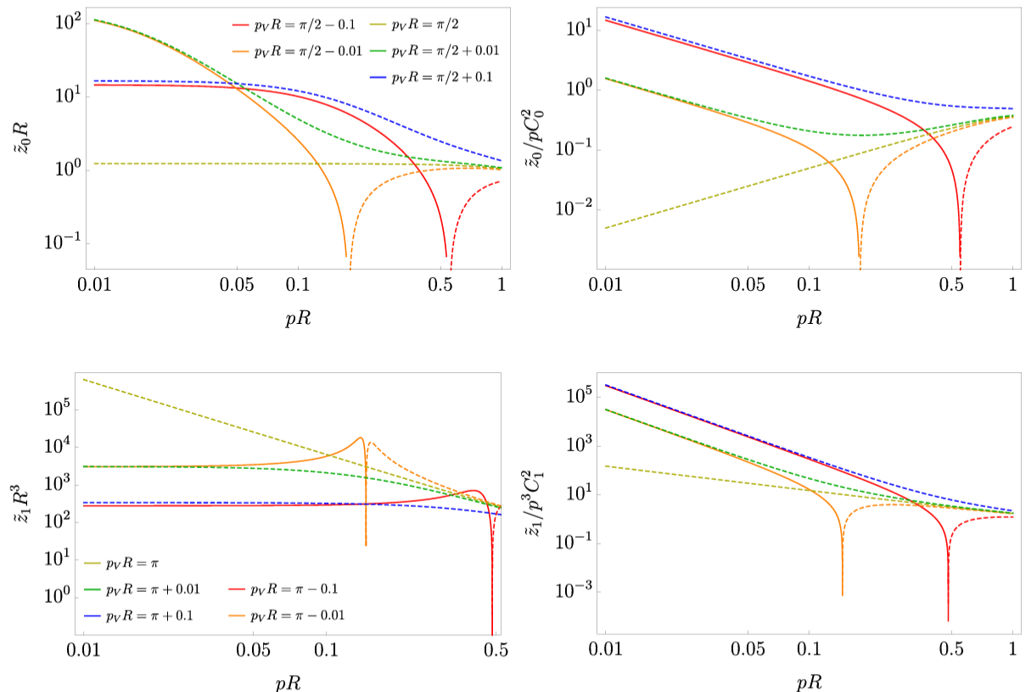
Z function for finite range Coulomb potential

