Slide 1

TMD Theory and Phenomenology
@ZhongboK
International School on EIC Physics
March 2 – 13, 2026

Slide 2

Outline
Lecture 1: Introduction and Overview
  From collinear to TMD factorization
  Phenomenology
Lecture 2: TMD theory in standard processes
  TMD parton model, operator analysis
Lecture 3: TMD factorization and evolution
  TMD evolution and rapidity divergence
  Global fitting
Lecture 4: TMDs via jets and jet substructure
  Jet TMD and jet fragmentation functions
2304.03302

Slide 3
Lecture 4: TMDs via jets and jet substructure
In the first three lectures we learned the theory of TMDs
In the final lecture, I want to show you where the field is going
Core messages
  Jets are new probes of TMD physics
  Hadron-in-jet probes TMD fragmentation
  Jets allow direct access to TMDPDFs
Strong synergy between LHC and EIC communities
  New ideas: jet charge for flavor separation
  Energy-energy correlators as probes of TMD structure

Slide 4


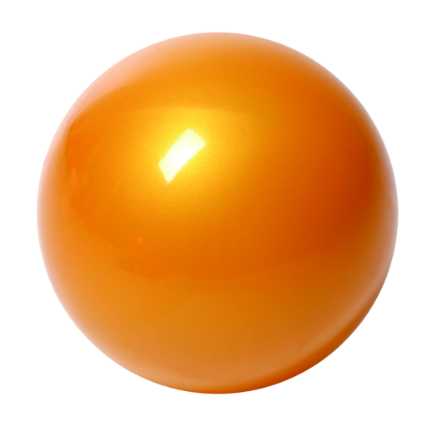
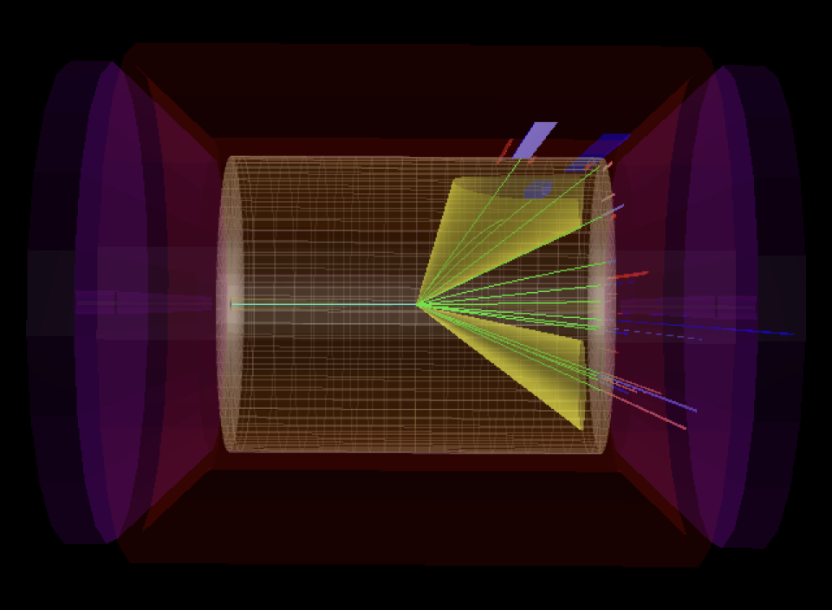

Processes to extract TMDs
Standard processes: SIDIS, Drell-Yan, dihadron in e⁺e⁻
New opportunities: jets and jet-like observables
h₁
electron
p
p
p
h₂
h
EIC
quark

Slide 5
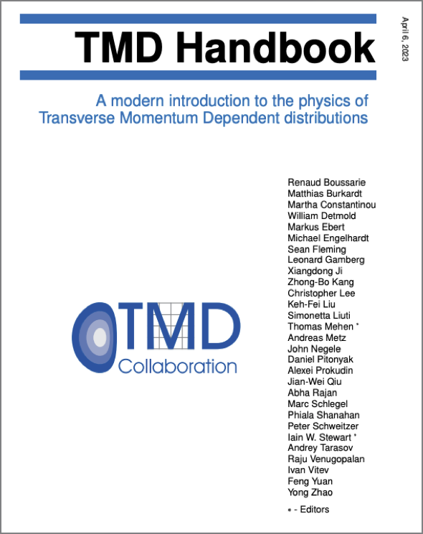
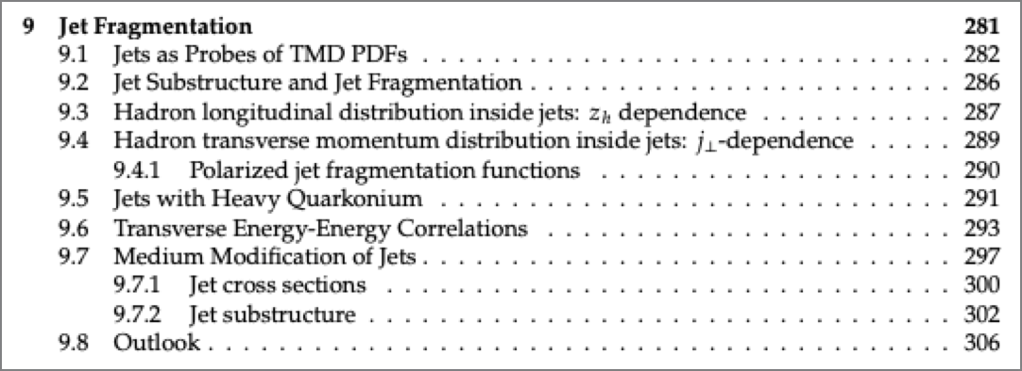

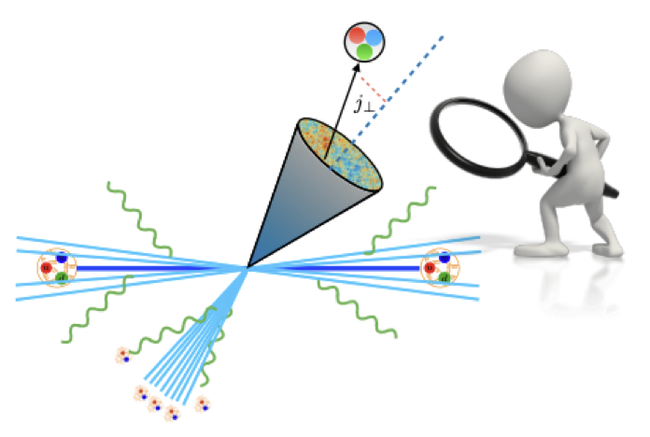
Jet fragmentation function

Slide 6
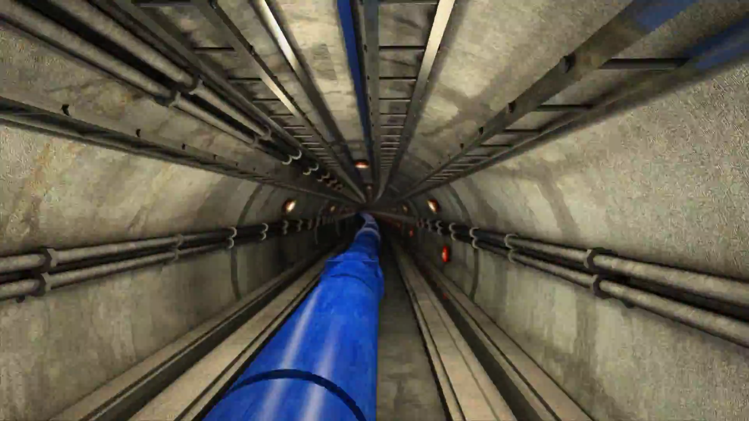
What are jets and why jets?
Look at high energy events in p+p collisions

Slide 7
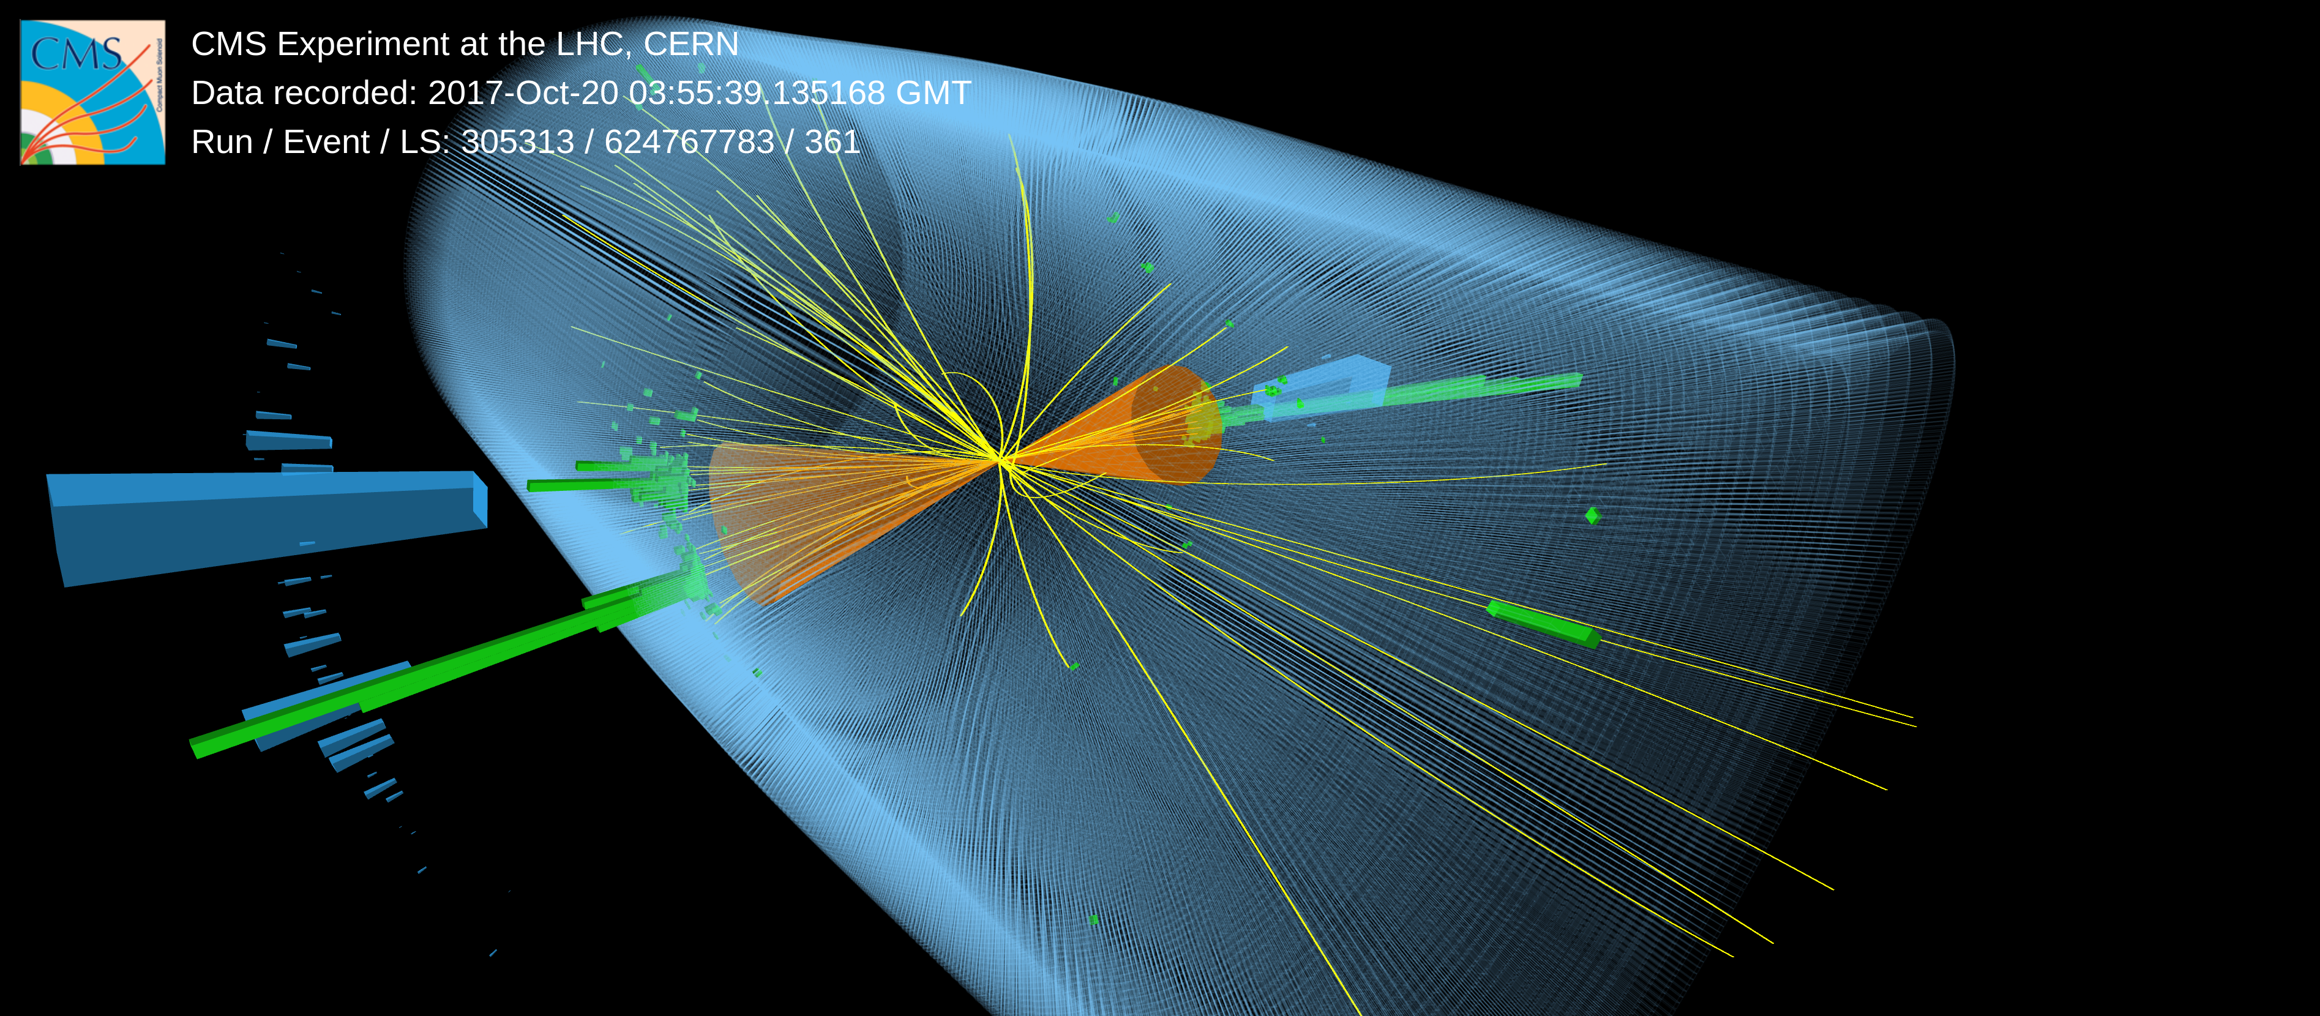
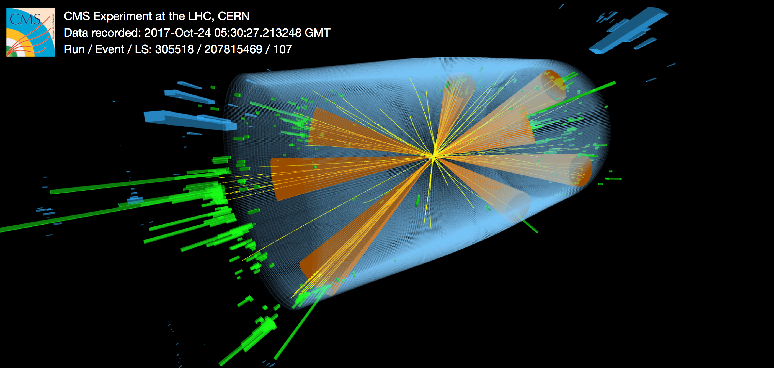
Characteristics of the event: jets
Jets are something that happen in high energy events
  a dominant phenomenon in high energy collisions
Jets: collimated spray of particles flying roughly in the same direction
  Sometimes, we could even eyeball the collimated sprays
  They reflect configurations of quarks and gluons produced in the collisions
EIC
LHC

Slide 8
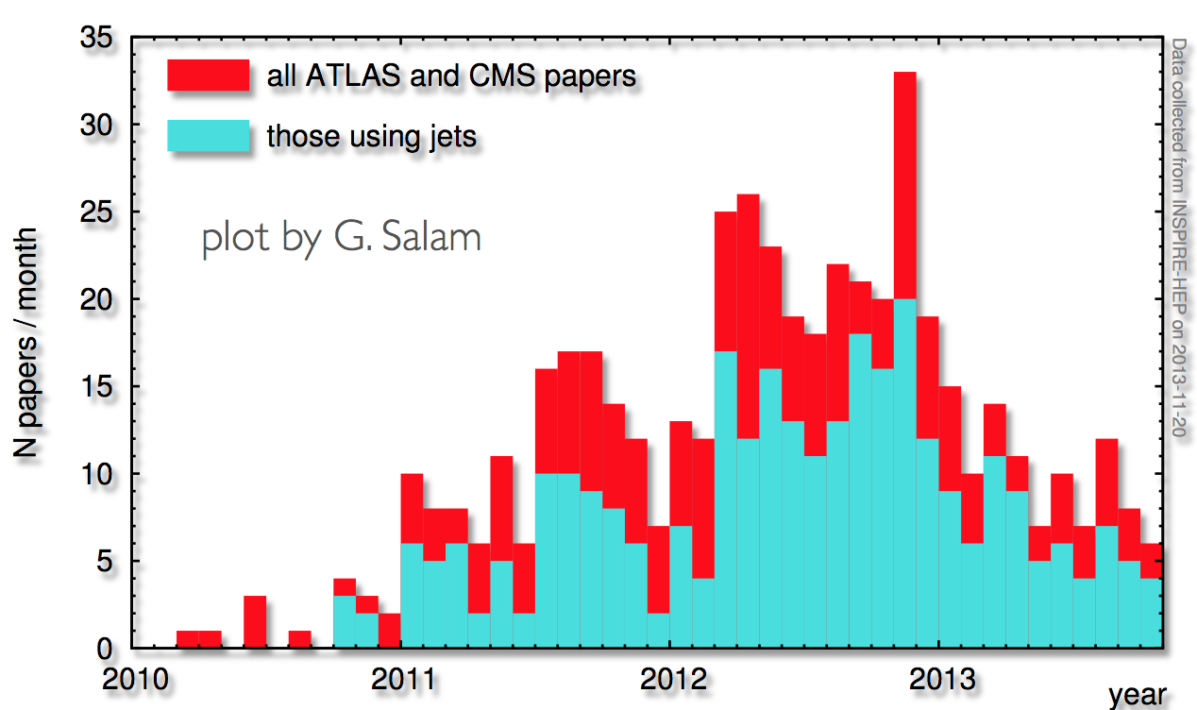
Renaissance of jet physics: a new frontier
They are most common at the LHC
  At the LHC, 60% of ATLAS & CMS papers use jets in their analysis!
  not mention ALICE (80%+)
CERN Document Server
Active study at the EIC
  EIC jet papers grow exponentially

Slide 9
QCD factorization involving jets
Two types of jet production: different factorization formalism
  Single inclusive jet production
    Only care about the signal jet, inclusive on all other final state particles
  Exclusive jet production
    Have the fixed-number of jets in the final state: back-to-back dijet production
Single jet production
dijet production

Slide 10
Case 1: single inclusive jet production
involving collinear PDFs
since only one scale pT is measured for the jet
Kang, Ringer, Vitev, 1606.06732, 1606.07063, Dai, Kim, Leibovich, 1606.07411, see also, Kaufmann, Mukherjee, Vogelsang, 1506.01415

Slide 11
What are these jet functions?
They are usually referred to as “semi-inclusive jet function”
They follow DGLAP evolution equation: a conjecture at NLO in 2016
  All jet substructures are contained in these functions
hadron
jet
Kang, Ringer, Vitev, 1606.06732, 1606.07063, Dai, Kim, Leibovich, 1606.07411, Kaufmann, Mukherjee, Vogelsang, 1506.01415

Slide 12
New development: beyond NLO
We conjectured the standard convolution structure
However, going up to NNLO and insights from energy-energy correlator community
Lee, Moult, Zhang, 2409.19045, JHEP 2025

Slide 13
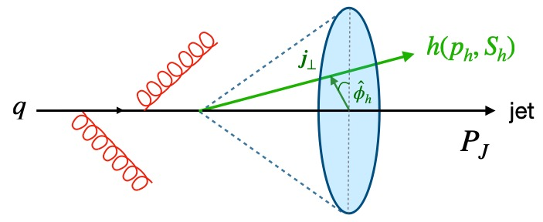
How do you probe TMDs?
For single inclusive jet production, since it involves collinear PDFs, how could we probe TMD physics?
  Via jet substructure to probe TMD fragmentation functions
  Apparent advantage: only one TMD FF is probed
Jet fragmentation function
    measures only the z_{h} distribution (integrated over jT), one probes collinear FFs
    measures both zh and jT distribution (3D), one probes TMD FFs
quark

Slide 14
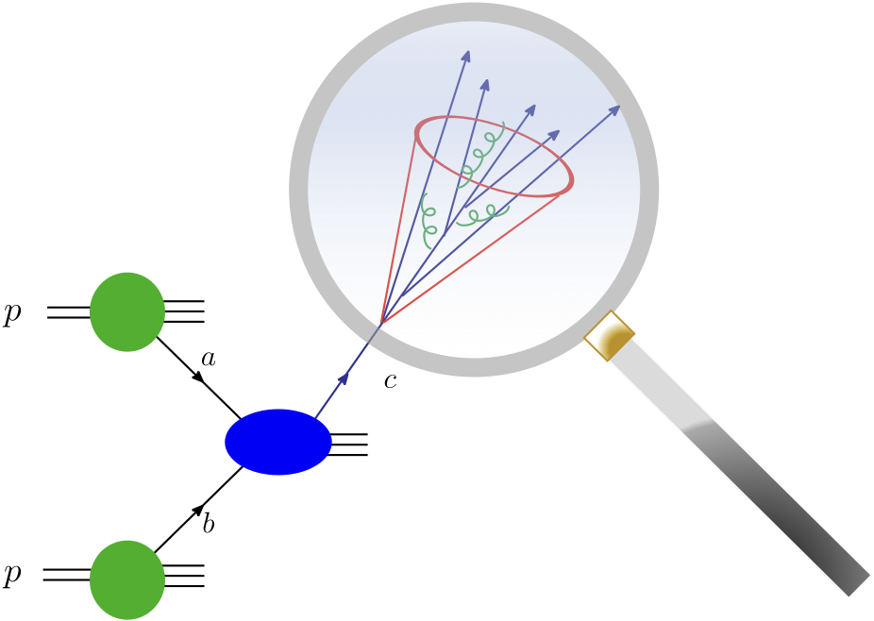
Factorization for jet substructure
Kang, Lee, Liu, Ringer, 18, 19
Kang, Liu, Ringer, Xing, 17
Kang, Ringer, Vitev, 16
Involving only collinear PDFs, but TMD FFs
  1st step: the production of the jet [collinear fact.]
  2nd step: jet substructure [TMD fact.]
  Thus only involve TMD FFs
  Different soft function
2nd step
1st step

Slide 15
Characteristics: hadron in the jet
Soft radiation
  At NLO, the soft radiation inside the jet can change the hadron transverse momentum with respect to the jet axis
Restricts soft radiation to be within the jet
  Cuts half of the rapidity divergence
Rapidity divergence cancel between restricted “soft factor” and TMD FFs
  At NLO perturbatively, the combined evolution is the same as the usual TMD evolution in SIDIS, e+e-; justify the use of same TMD evolution here

Slide 16
Hadron distribution inside the jet
Works pretty well in comparison with LHC data
Kang, Ringer, Vitev, 16

Slide 17
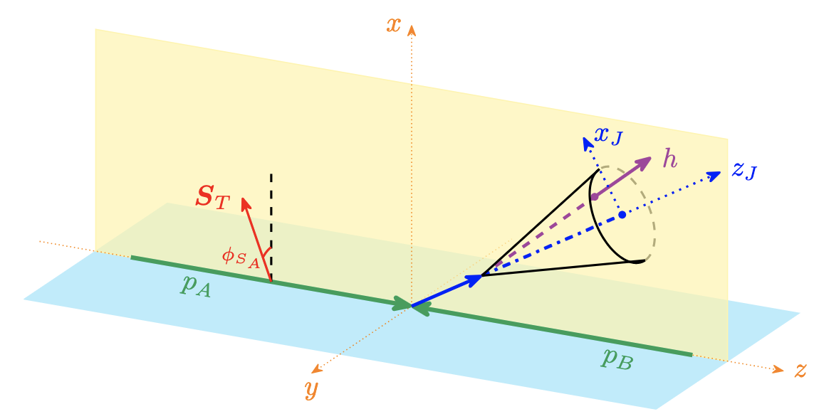
Collins asymmetry in p+p
Collins asymmetry can also be studied through the azimuthal distribution of hadrons inside a jet in p+p collisions
Such an asymmetry has been measured by STAR at RHIC
  Could be used to test the universality of the Collins functions

Slide 18
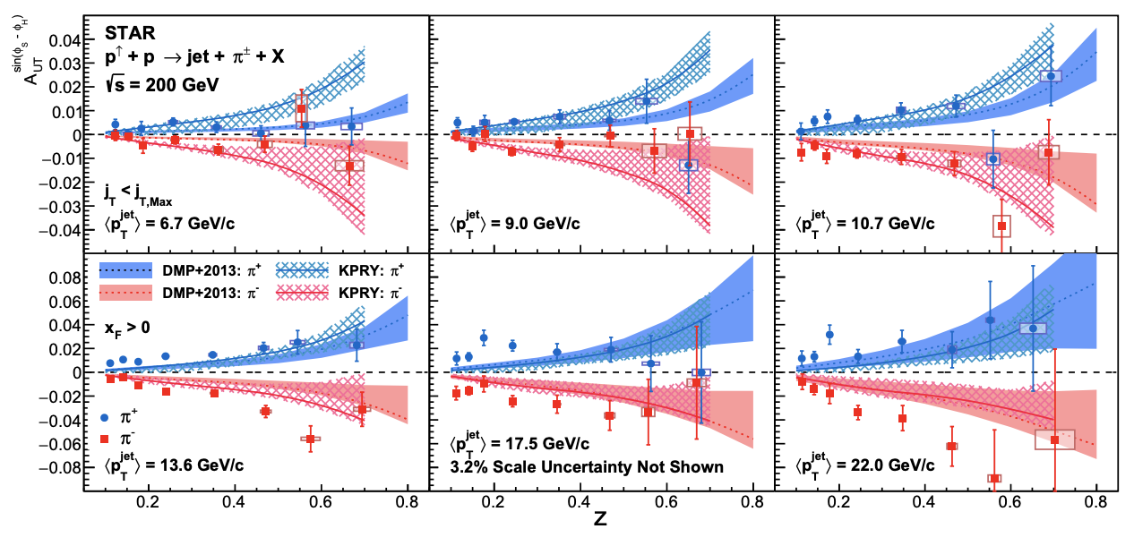
Collins effect inside the jet
STAR measurements: Collins asymmetry for hadron inside the jet in transversely polarized p+p collisions
STAR, 2205.11800
Kang, Prokudin, Ringer, Yuan, 1707.00913, PLB
Kang, Kyle, Zhao, arXiv:2005.02398, PLB

Slide 19
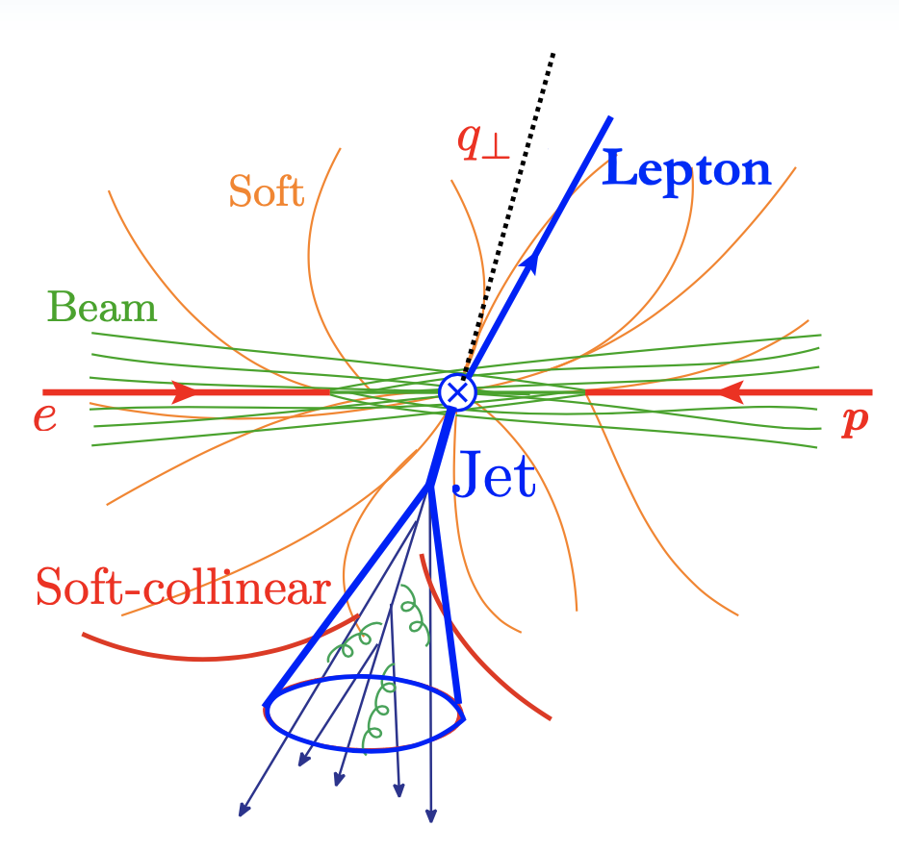
Case 2: exclusive jet production
Take for example, back-to-back lepton+jet production at e+p collisions
  One probes the small imbalance region
  Sensitive to TMD PDFs
  Different soft functions: now two soft functions
    Global: can radiate everywhere
    Collinear-soft: soft radiation inside jet does not affect imbalance
Arratia, Kang, Prokudin, Ringer, Zhao, 20, 22, 23
Liu, Ringer, Vogelsang, Yuan, 18, 20, …

Slide 20
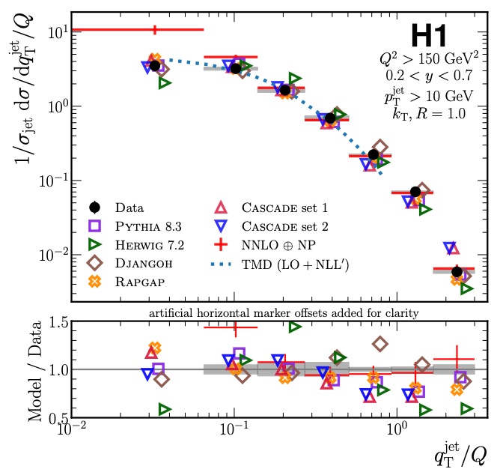
Jets for 3D imaging
Constrain TMDs (without fragmentation function)
  Unpolarized scattering: recent HERA measurement
  Transversely polarized proton scattering: Sivers function (right plot)
HERA, arXiv:2108.12376, PRL 22
Arratia, Kang, Prokudin, Ringer, 2007.07281, PRD

Slide 21
Jet substructure: polarized jet fragmentation function
One can further measure distribution of hadrons inside the jet
  Two axes: imbalance controls TMD PDFs, while the hadron transverse momentum w.r.t jet axis controls TMD FFs
Kang, Lee, Zhao, PLB 20
Arratia, Kang, Ringer, Prokudin, 20
Kang, Lee, Shao, Zhao, JHEP 21
Kang, Terry, Vossen, Xu, Zhang, PRD 22
quark

Slide 22
Effective field theory
To be more sensitive to the small parton transverse motion
  One could further measure a small transverse momentum in the experiment, such as transverse momentum imbalance ( ) in a dijet production
Construction of the theory formalism is nontrivial
  Multiple scales in the problem
  We would rely on effective field theory
Kang, Lee, Shao, Terry, 20
Buffing, Kang, Lee, Liu, 18

Slide 23
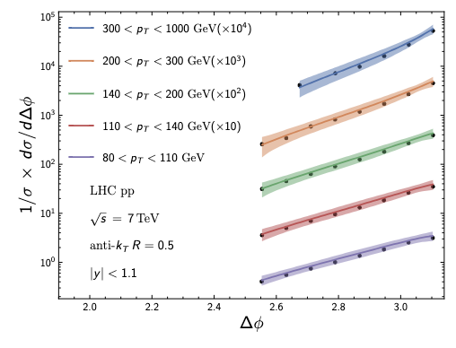
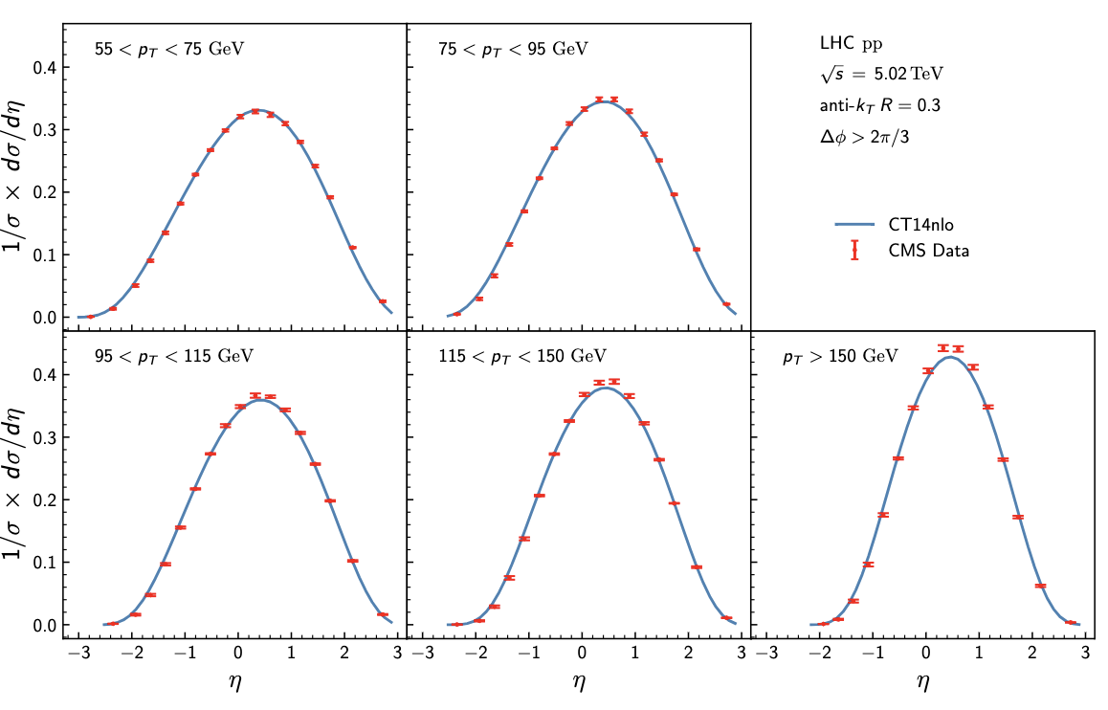
Dijet production: cross section
Theory comparison work well
Caveat: strictly speaking, no TMD factorization for dijet production in p+p
Gao, Kang, Shao, Terry, Zhang, arXiv: 2306.09317
Collins, Qiu, 07; Mulders, Rogers, 10

Slide 24
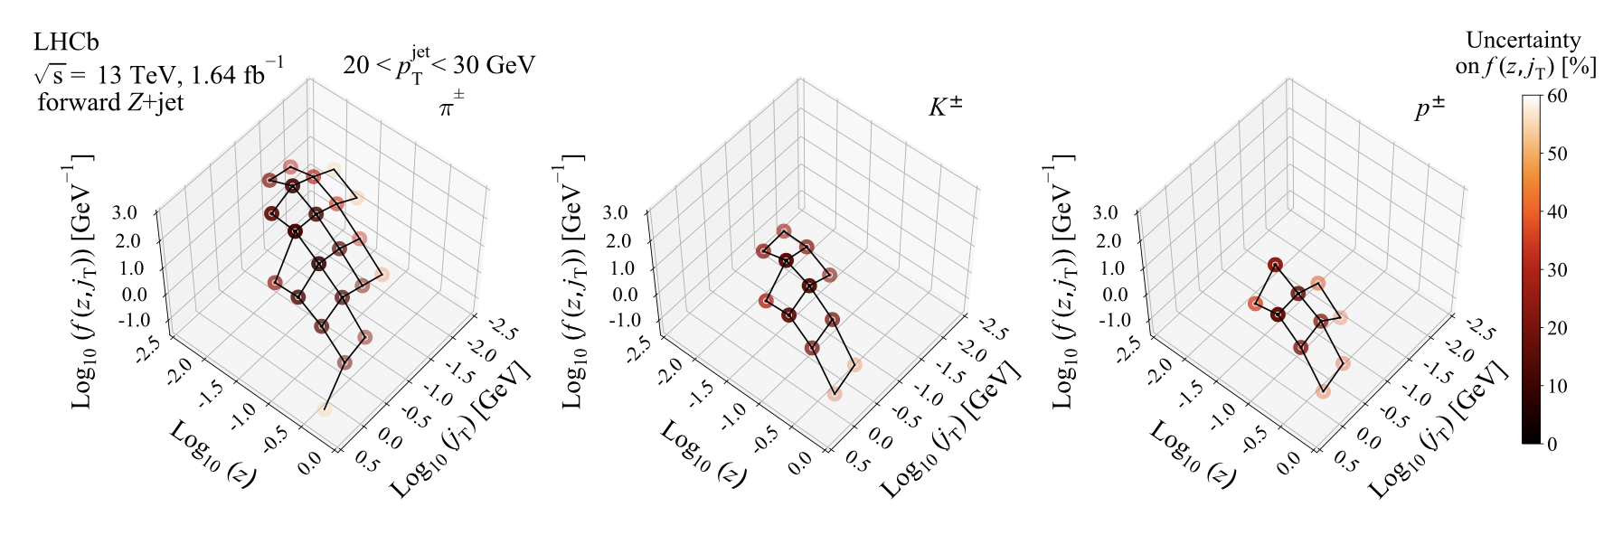
Jet fragmentation function at LHC
Example: recent LHCb measurement Z-tagged jet production
LHCb, 2208.11691

Slide 25
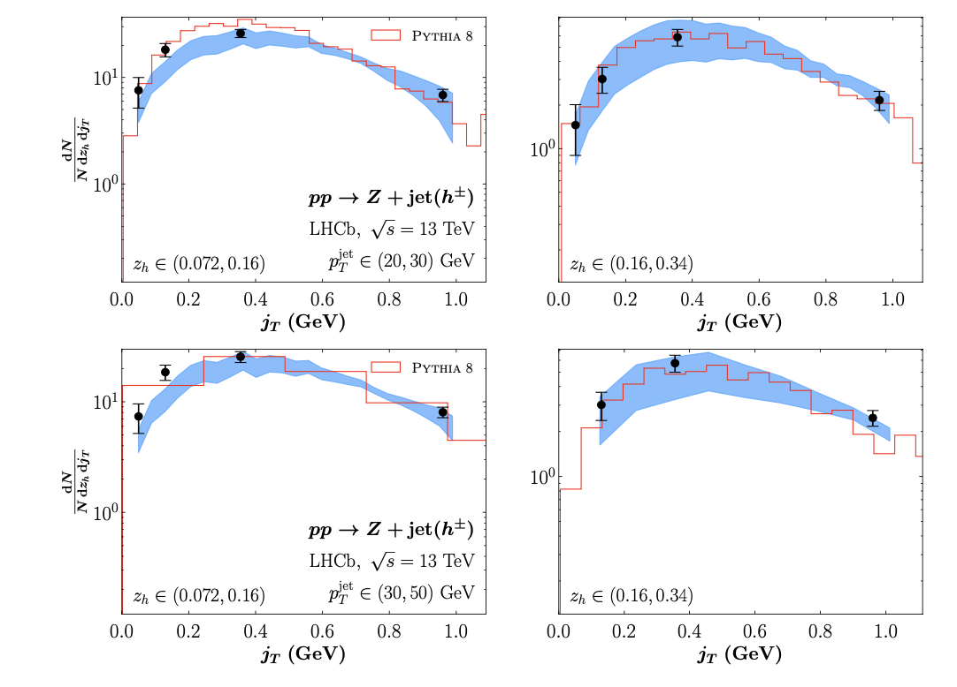
Theory comparison
Most recent theory comparison with LHCb data
Kang, Xing, Zhou, in preparation

Slide 26
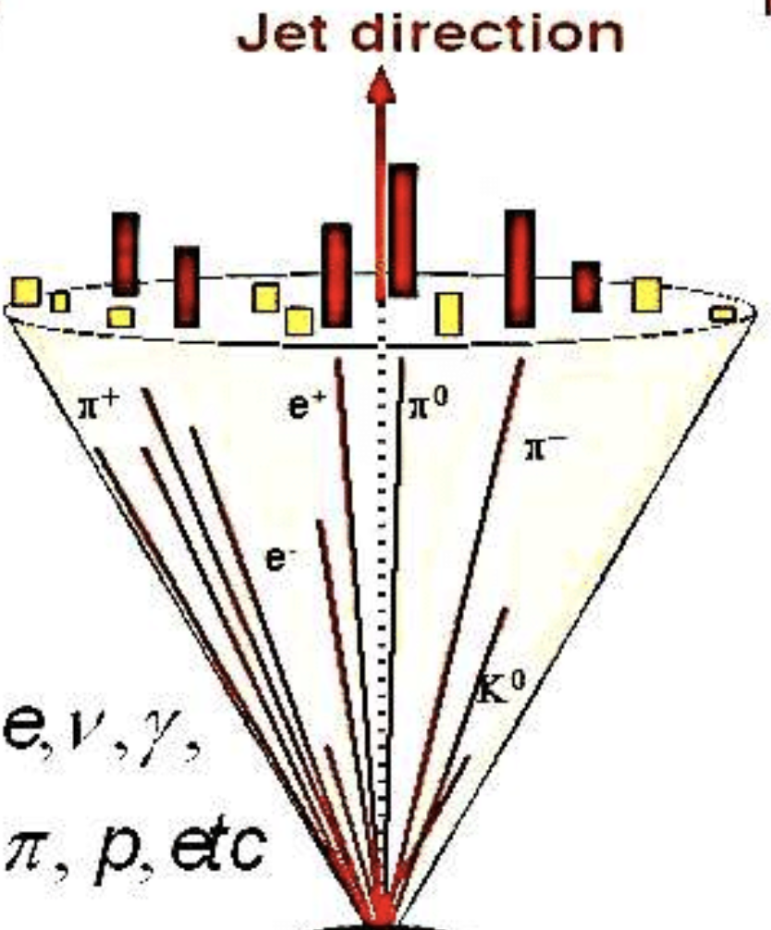
Disadvantage and solution
A jet is an inclusive sum of all particles within a given jet radius R
Because of that, jets are usually flavor blinded
Yet, flavor separation is particularly important for spin-dependent structure

Slide 27
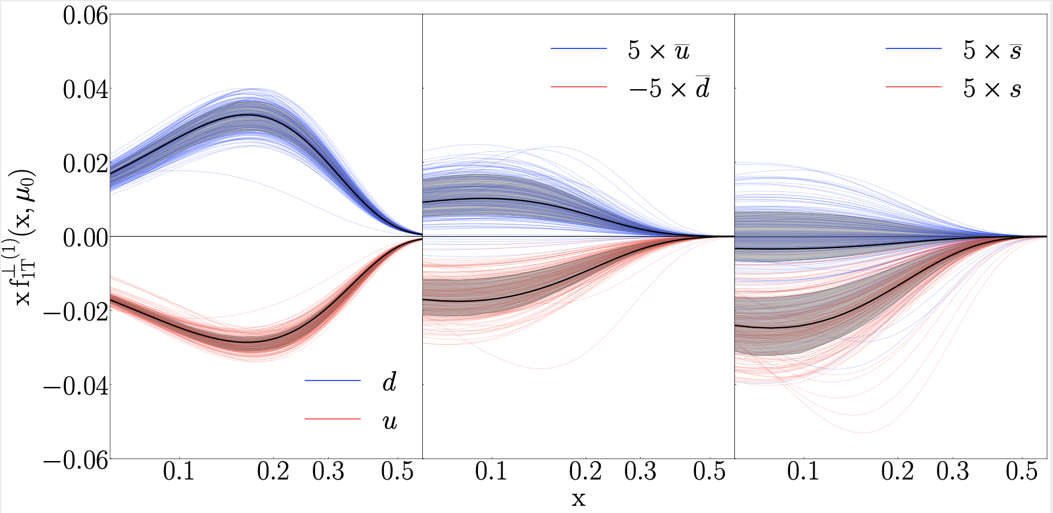
Sivers functions
Extracted Sivers correlation/function for different quark flavor
Sivers function for u and d quarks have opposite sign, comparable size
Small asymmetry for single jet and dijet are due to cancelation from jets initiated by the u and d quark
u and d quark jets

Slide 28
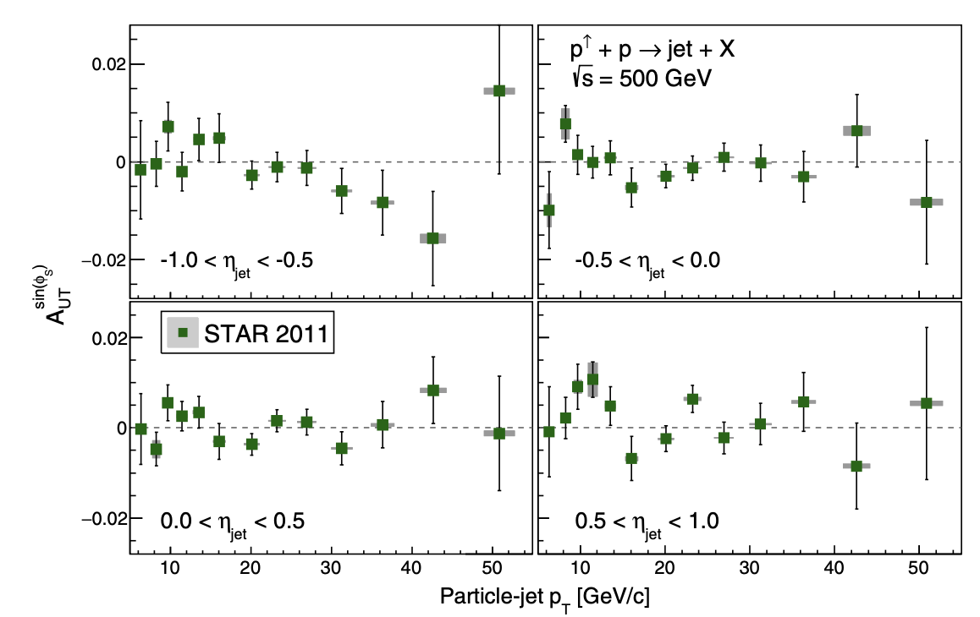
Jet asymmetry
Jet asymmetry tends to be small
  Because of the cancelation between u and d quarks
STAR 2018

Slide 29
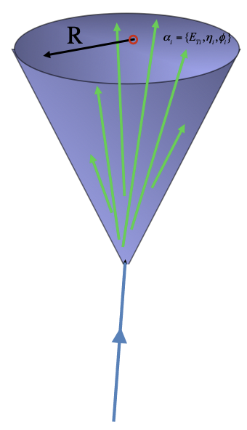

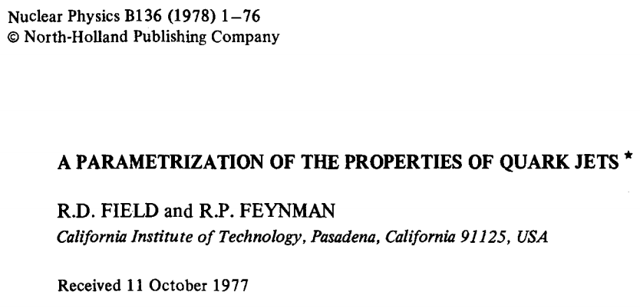
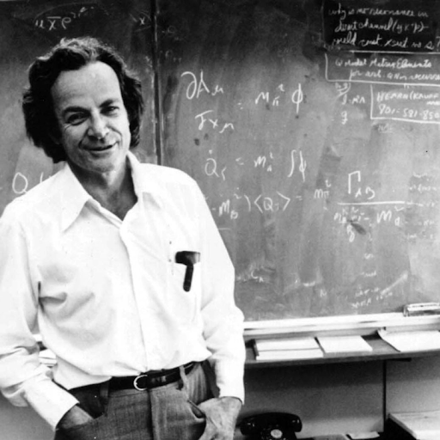
Need flavor separation, how?
Brainstorm
Kang, Liu, Mantry, Shao, PRL, 20
u
d
jet charge
u or d
counting particle charges reconstructs initiating quark charge

Slide 30

Jet charge: a flavor prism
Recall: light prism (general physics)
Jet charge definition
  A weighted sum of charges for hadrons inside the jet
white light
Charge of the hadron

Slide 31
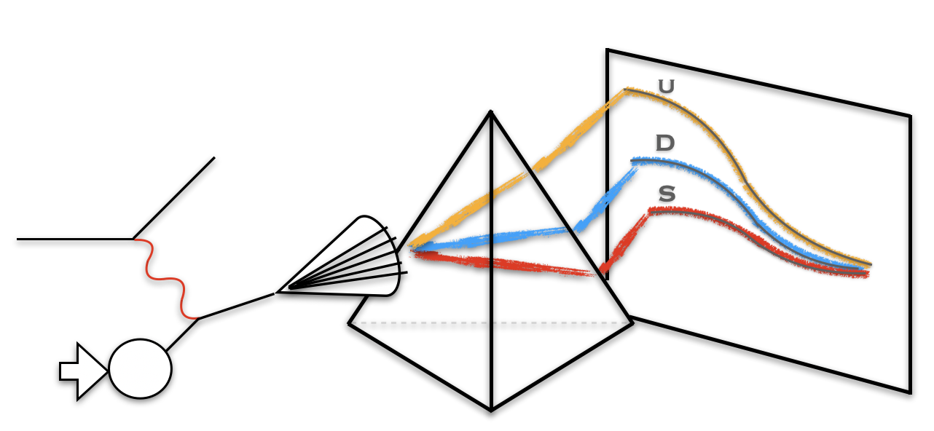
Jet charge at the EIC
To get started, we decide to first look at jet production at the EIC
  e+p collisions: simpler
Jet charge distribution of u and d jets

Slide 32
Jet production with jet charge measurement
Back-to-back lepton+jet production at e+p collisions
Organize the cross section via jet charge bin
Kang, Liu, Mantry, Shao, 20

Slide 33
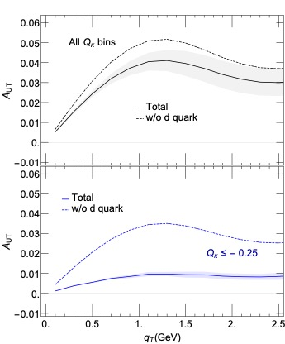
Enhanced sensitivity for d quark
Spin asymmetry in e+p collisions
  No jet charge selection: taking out d quark, small change, thus no sensitivity
  With negative jet charge bin selection: dramatic change, much greater sensitivity
Kang, Liu, Mantry, Shao, 20

Slide 34
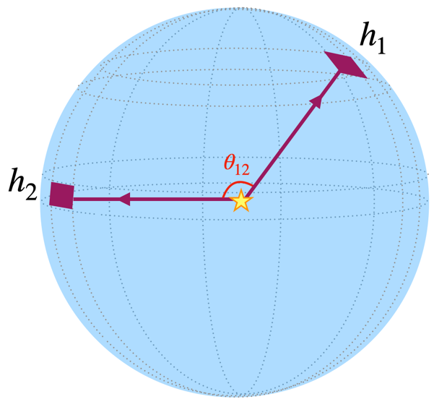
Energy-Energy Correlators (EECs)
One of the earliest infrared safe event shape observables
Measure energy correlation as a function of the opening angle between pairs of particles

Slide 35
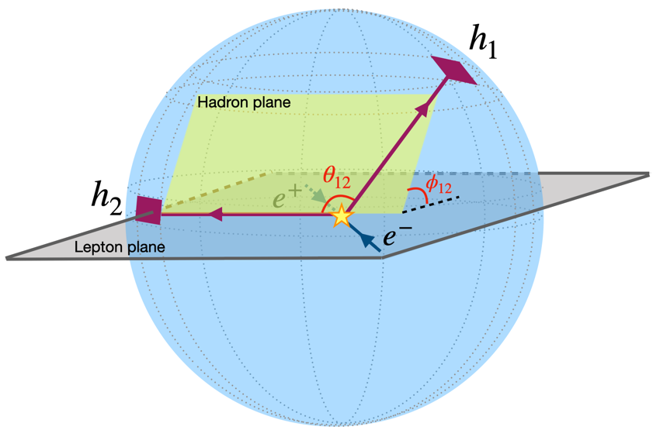
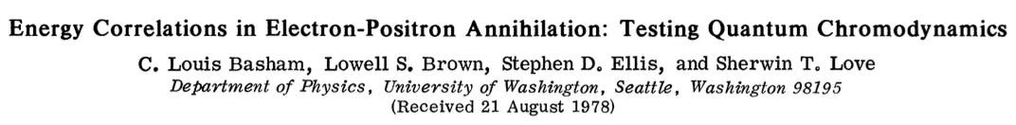
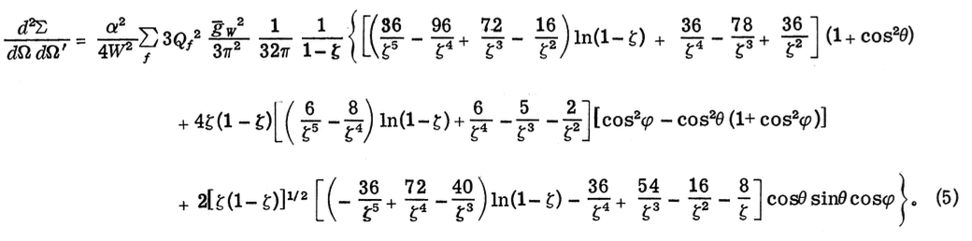
EEC can involve more angles
azimuthal angle between hadron plane and lepton plane
  Discussed in original paper, decided not interesting, forgotten afterwards
Recent study: by including azimuthal angle, one can access unpolarized and polarized TMDs, allowing for 3D imaging
Kang, Lee, Shao, Zhao, JHEP, 24

Slide 36
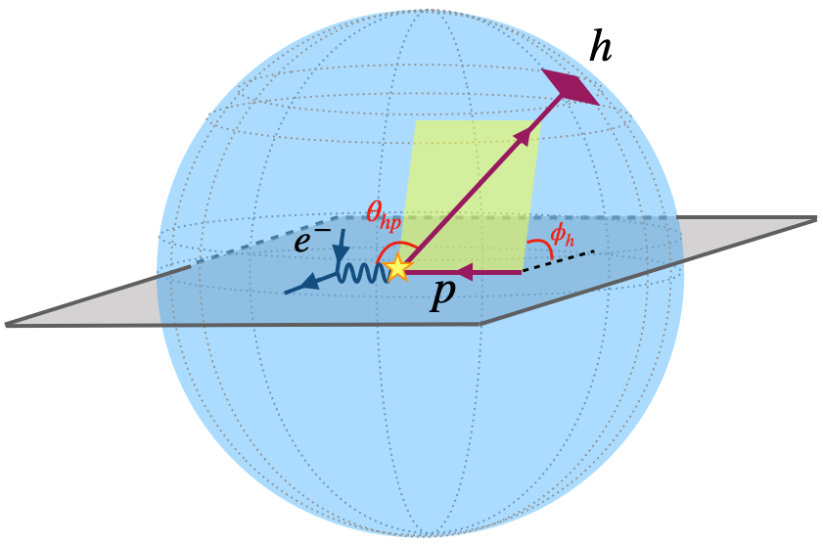
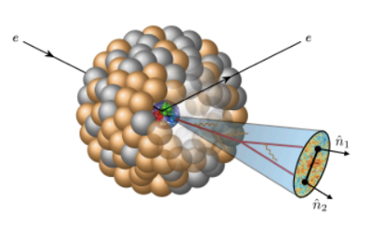
Azimuthal dependent EEC
Kang, Lee, Shao, Zhao, JHEP, 24
Note: also a lot of studies for the in-jet EEC, in comparison with the global EEC

Slide 37
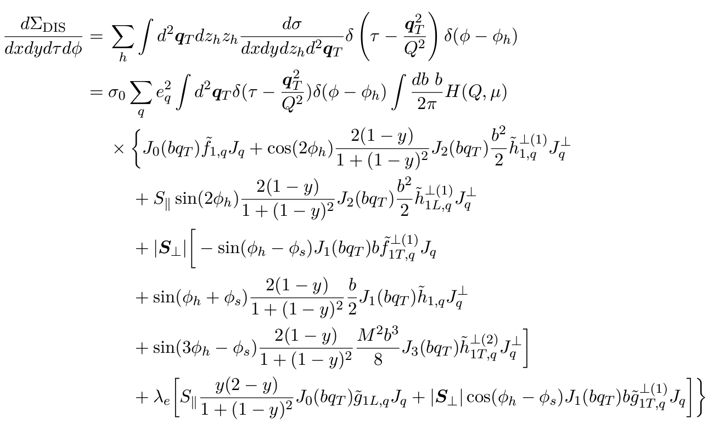
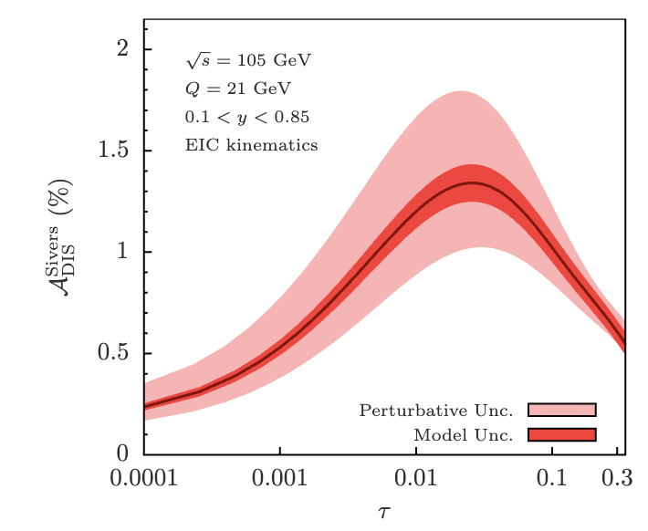
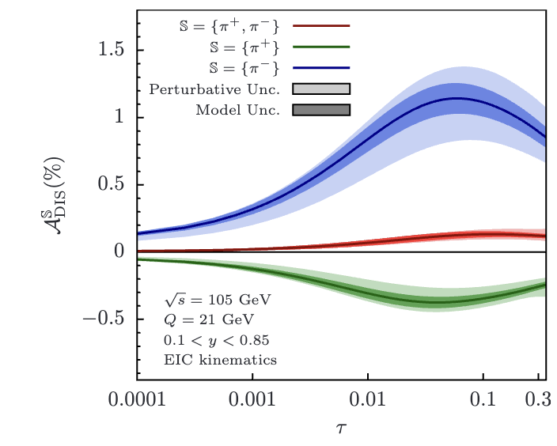
EEC in polarized ep scattering
EEC with azimuthal dependence
Kang, Lee, Shao, Zhao, JHEP, 24
Unpolarized TMDFF
Collins TMDFF
Collins-type EEC

Slide 38
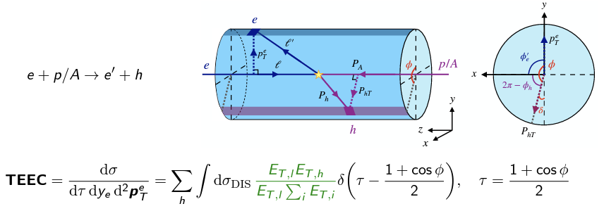
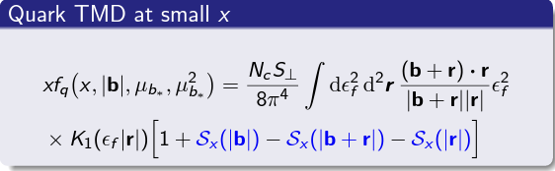

Transverse EEC in color-glass condensate
TEEC between lepton and final hadron
Factorized formula
  Quark TMD expanded in terms of small-x gluon dipoles
Kang, Penttala, Zhao, Zhou, PRD 24
See also Li, Vitev, Zhu, JHEP 20
Marquet, Xiao, Yuan, 0906.1454

Slide 39
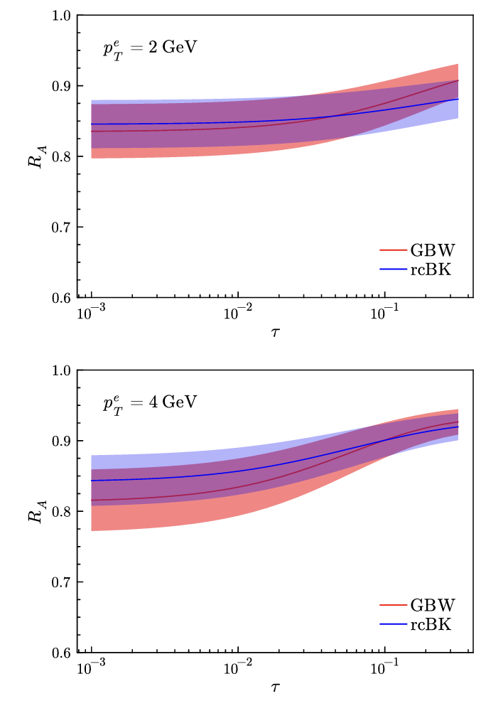
TEEC in eA vs ep
Nuclear modification factor
Kang, Penttala, Zhao, Zhou, PRD 24

Slide 40
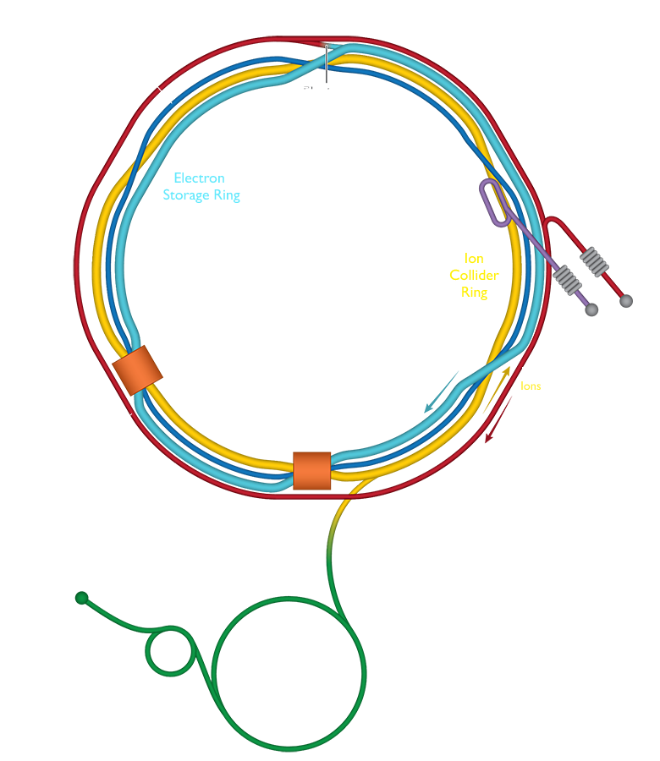

Summary
TMDs provide a 3D picture of parton motion inside the proton
Jets and jet substructure provide powerful new probes of TMDs
Jet observables allow access to both
  TMD fragmentation function
  TMD parton distribution
Jet physics forms a natural bridge between LHC and EIC physics
The EIC will open a new era of 3D imaging of nucleon structure
Thank you!

