Slide 1
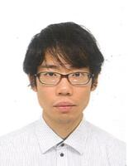

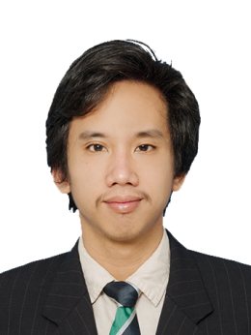
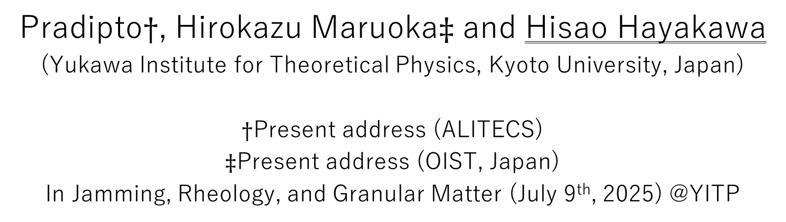
Impact induced hardening in dense suspensions
Pradipto$†$, Hirokazu Maruoka$‡$ and Hisao Hayakawa
(Yukawa Institute for Theoretical Physics, Kyoto University, Japan)
$†$Present address (ALITECS)
$‡$Present address (OIST, Japan)
In Jamming, Rheology, and Granular Matter (July 9th, 2025) @YITP
Notes:
This talk is presented on July 10th.

Slide 2
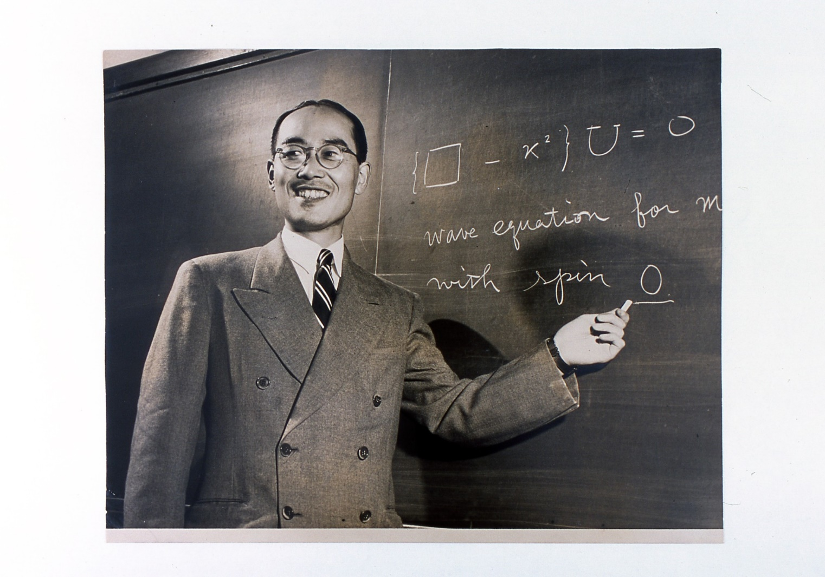
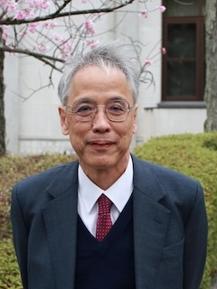
Welcome message
Welcome to the YITP, Kyoto University.
YITP was founded in 1953 in commemoration of Hideki Yukawa being awarded the Nobel Prize.
Hideki was the first director, and I am 11th director.
Granular Physics is a minor field in this institute, but let us enjoy the meeting.

Slide 3
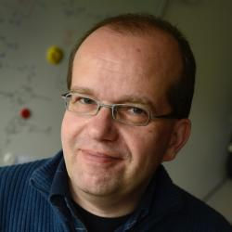
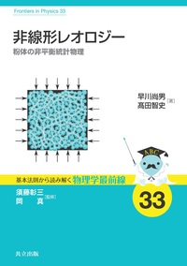
Brief overview of this meeting
Granular physics is a matured field as a result of the effort in last 40 years.
Stefan Luding is a leader of this field.
Hayakawa and Takada recently published a Japanese-textbook on nonlinear rheology: non-equilibrium statistical mechanics of granular materials, which will be translated in Springer.
  Chapters 5-7 contains subjects in today’s meeting.

Slide 4
Contents
Introduction
Simulation & theory
  LBM simulation
  Floating model in early stage
  Effects of elastic force
Experiment
Conclusion

Slide 5
Contents
Introduction
Simulation & theory
  LBM simulation
  Floating model in early stage
  Effects of elastic force
Experiment
Conclusion

Slide 6
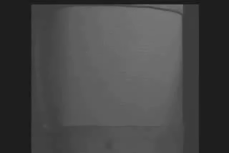
Impact induced hardening
Impact induced hardening can be commonly observed in dense suspensions.
This is applicable to protective vests.
The mechanism of running on liquids is not “discontinuous shear thickening (DST)” but impact induced hardening.
http://youtube-video-download.info/video/EhdgkziFhrY

Slide 7


Some exotic phenomena
A corresponding experiment by our group
Running on a liquid
A pool filled with non newtonian fluid
https://www.youtube.com/watch?v=TY0JeMyRCdY

Slide 8
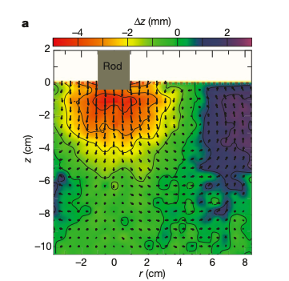
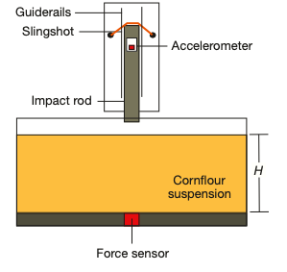
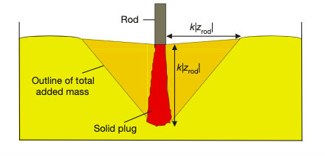
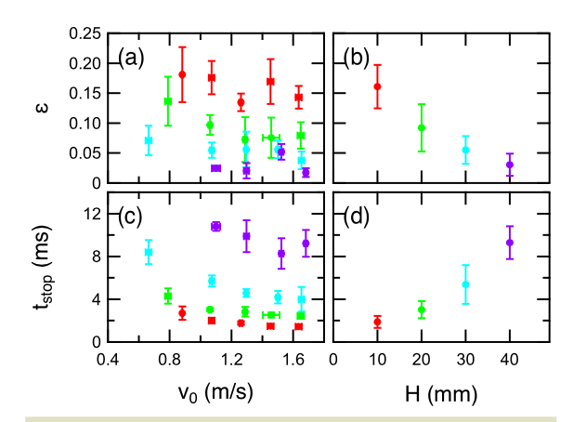
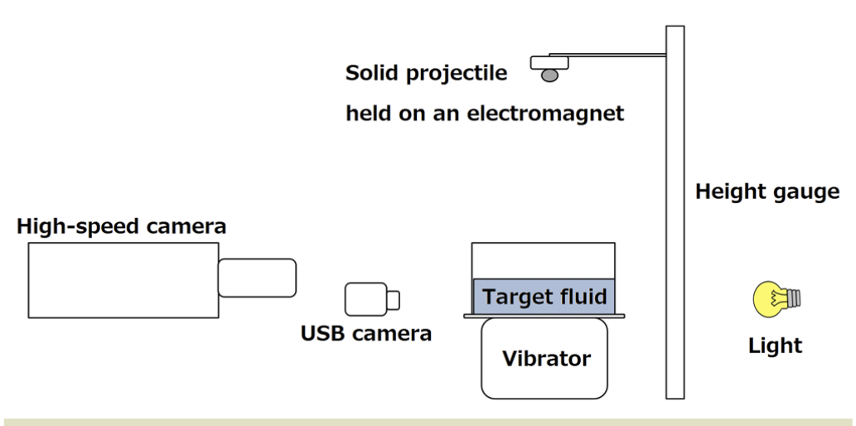
Some previous experiments
Waitukaitis and Jaeger, Nature 487, 205 (2012)
Egawa & Katsuragi, Phys. Fluids 31, 053304 (2019).

Slide 9
Contents
Introduction
Simulation & theory
  LBM simulation
  Floating model in early stage
  Effects of elastic force
Experiment
Conclusion
See Pradipto & HH, PRF 6, 033301 (2021), Phys. Fluids 33, 093110 (2021) & PRE 108, 024604 (2023)

Slide 10
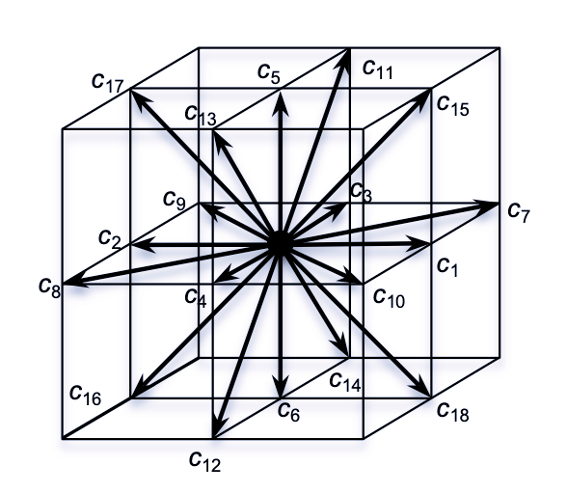
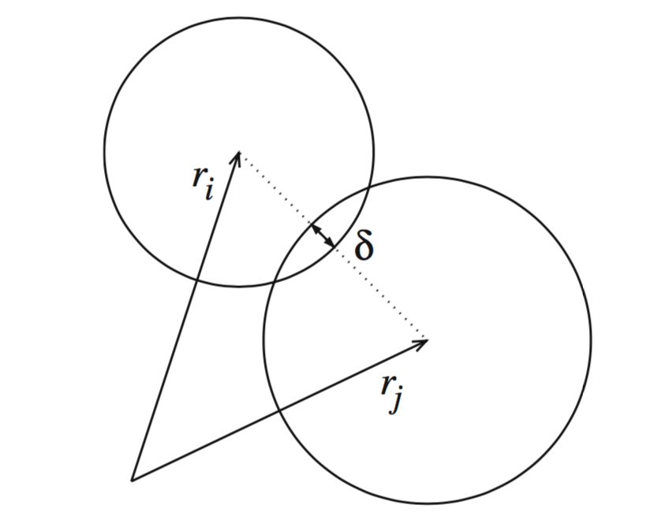
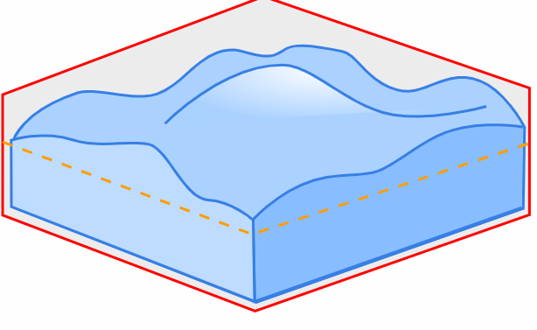
Simulation
Lattice-Boltzmann method for suspensions (Ladd, 1994)
DEM for frictional grains (Cundall & Strack, 1971)
Free surface (Leonardi et al, 2014,15)

Slide 11
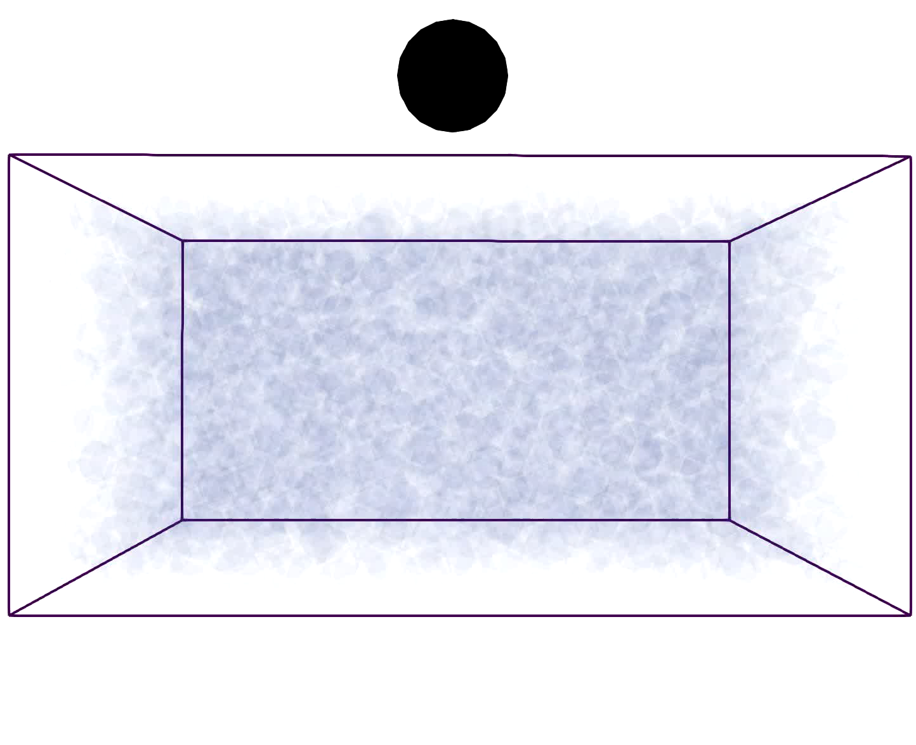
Free-falling projectile simulation
Pradipto & HH,
PRE 108, 024604 (2023).
Notes:
Pradipto & HH, PRE 108, 024604 (2023).

Slide 12
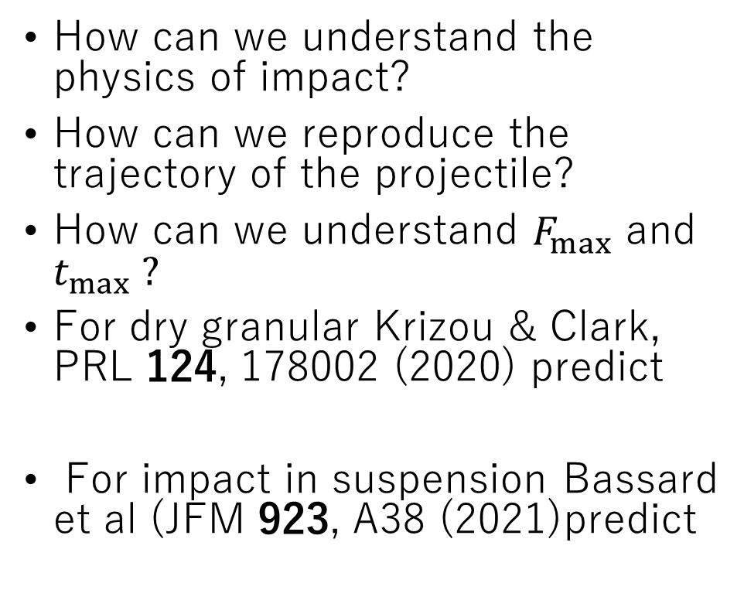
Analysis
How can we understand the physics of impact?
How can we reproduce the trajectory of the projectile?
How can we understand $F_{max}$ and $t_{max} ?$
For dry granular Krizou & Clark, PRL 124, 178002 (2020) predict
For impact in suspension Bassard et al (JFM 923, A38 (2021)predict

Slide 13
Our analysis
We propose the floating model for an early-stage impact.
Equation of motion can be described by
The force only contain the buoyancy force and viscous drag force.
The drag force can be understood by the Stokes drag for partially filled case.

Slide 14
Comparison of the floating model with the simulation
For
It works well!

Slide 15
Effect of elasticity
The floating model cannot be used for late stage.
To get rebounds we need the elastic force.
This elastic force is enhanced by the force chain between the projectile and bottom boundary.
Pradipto & HH, Phys. Fluids 33, 093110 (2021)
Notes:
Pradipto & HH, Phys. Fluids 33, 093110 (2021)

Slide 16
Elastic force acting on the projectile without bottom boundary effect
Pradipto & HH, PRE 108, 024604 (2023)
The energy is totally dissipated at $z_{cut}$.
Notes:
Pradipto & HH, PRE 108, 024604 (2023)

Slide 17
Summary of simulation & theory
We can simulate the motion of a projectile in a viscous suspension.
The projectile motion can be understood by the floating model in early stage.
To get rebound the elastic force induced by percolating force chains is important.
There is elastic contribution even if there are no percolating force chains.
The spring between the body and foot is important to run on a liquid.

Slide 18
Contents
Introduction
Simulation & theory
  LBM simulation
  Floating model in early stage
  Effects of elastic force
Experiment
Conclusion

Slide 19

Experimental project (H. Maruoka)
Size of simulation is small ($\# of particles\sim {10}^{3})$.
  Size of the container is small=> Unrealistic?
  Size of grains is large=> Non-Stokesian?
To clarify the role of inertia in the fluid motion, we have performed experiments of both large grains and cornstarch.

Slide 20
Overview of experimental setup and picture

Slide 21
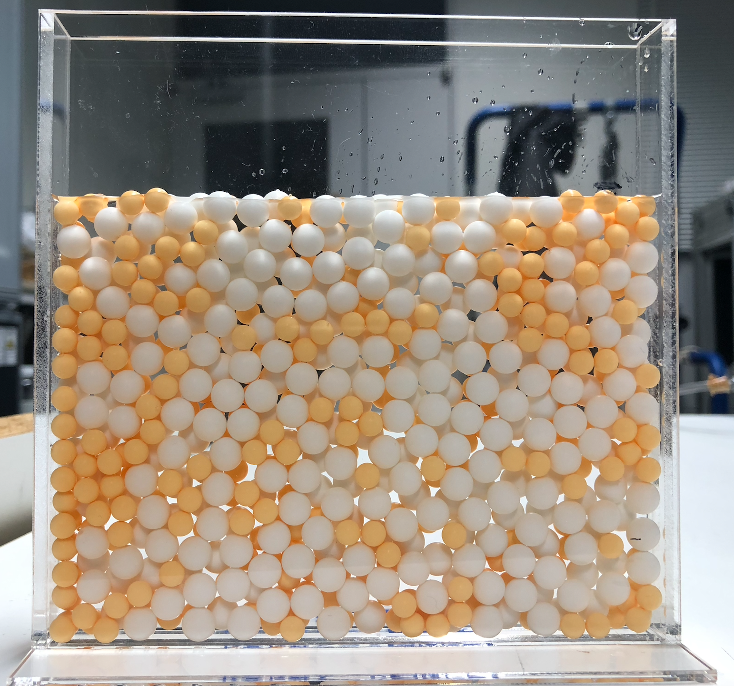
Dynamical impacts on suspension 𝜙 = 0.56
𝝓 = 0.56
D_{I} = 4a_{min} = 12 mm
a_{max} = 4/3 a_{min} = 3.0 mm
𝛒_{I}=7.57𝛒_{f} = 7.8 g /cm3
10W = D = 144 mm
W = 1 .15D_{I} = 13.9 mm
H = 112 mm
h = 1.5, 3.0, 6.0, 9.0, 12, 18, 25, 38, 50 cm
(N = 10 times for every height)
Na_{max} = Na_{min} = 338

Slide 22
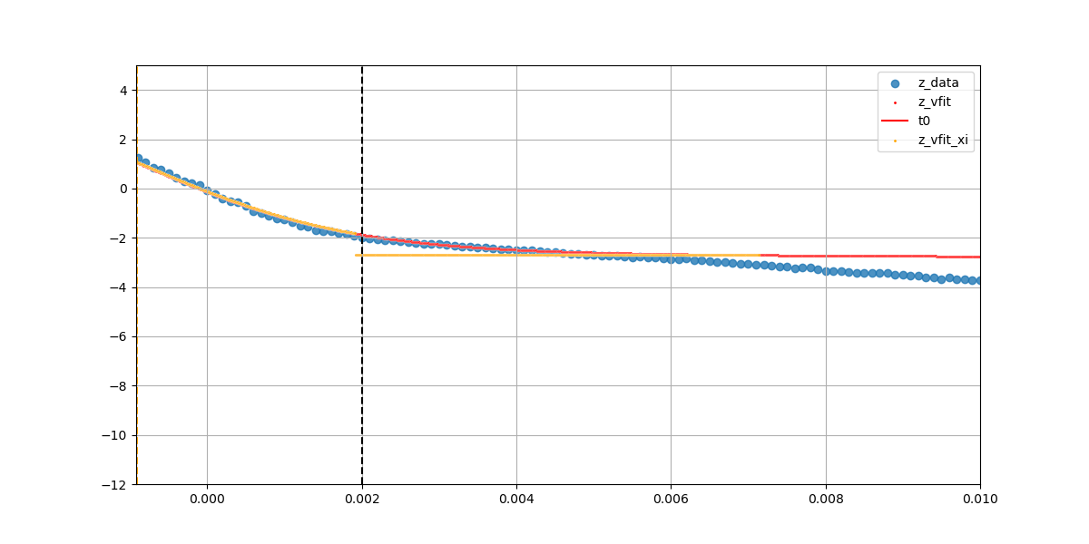
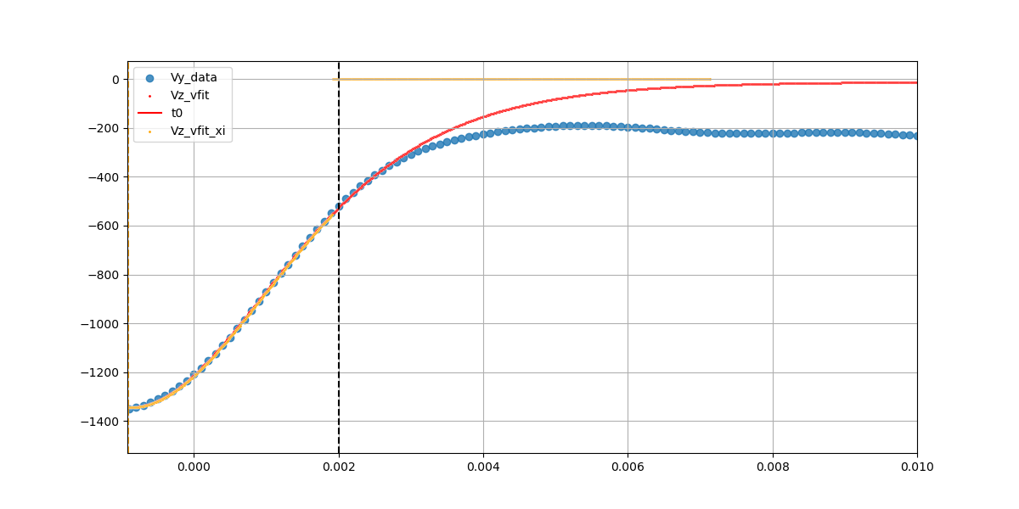

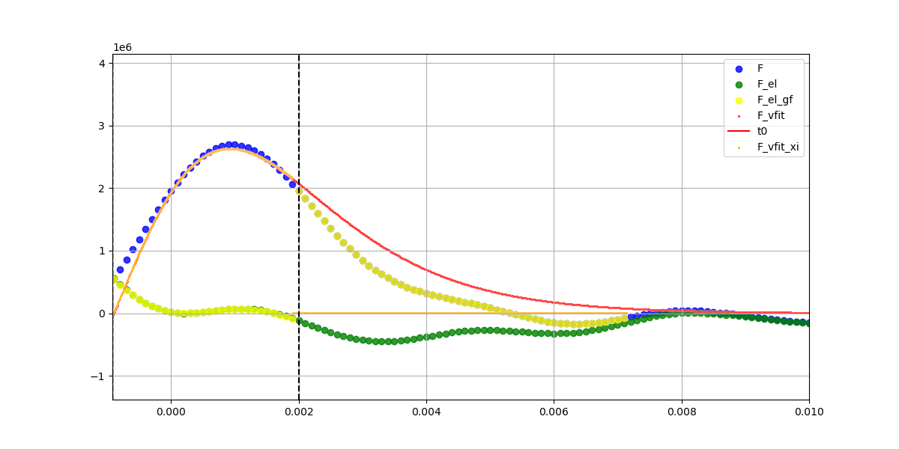
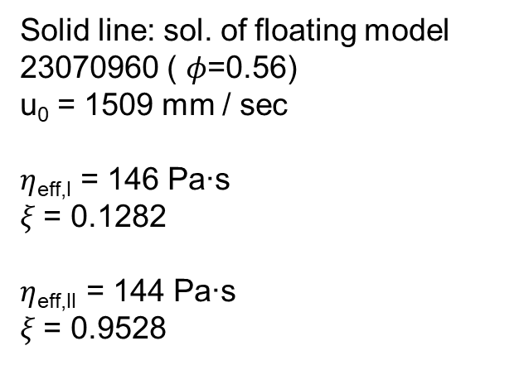
Experiment of high packing fraction, 𝜙 = 0.56.
V_{Z} (mm/s)
Z (mm)
0.000
0.002
t (s)
0.008
0.010
t (s)
0.000
0.002
0.008
0.010
Solid line: sol. of floating model
23070960 ( 𝜙=0.56)
u₀ = 1509 mm / sec
$η$_{eff,I} = 146 Pa∙s
𝜉 = 0.1282
$η$_{eff,II} = 144 Pa∙s
𝜉 = 0.9528
F (g∙mm/s²)
0.000
0.002
0.008
0.010
22
t (s)

Slide 23



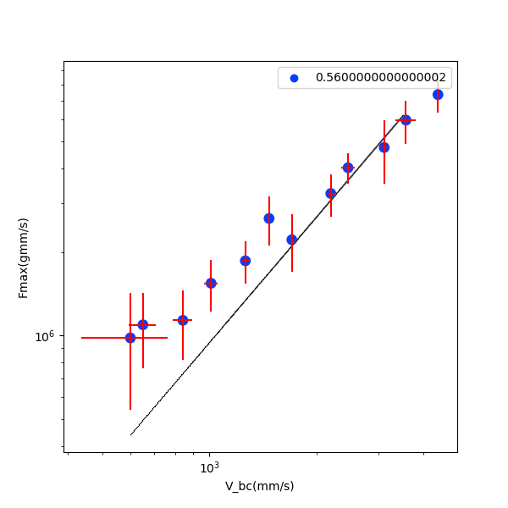


Experiment of high packing fraction, 𝜙 = 0.53, 0.56.
u₀ = 600 mm / sec
u₀ = 1707 mm / sec
u₀ =40401 mm / sec
2000 fps
$η$_{eff} = 169 Pa∙s
F_{max} (g∙mm/s²)
A step around u₀ = 1707 mm/sec may comes from the boundary effect?
$η$_{eff} = 60 Pa∙s
u₀ (mm/s)

Slide 24
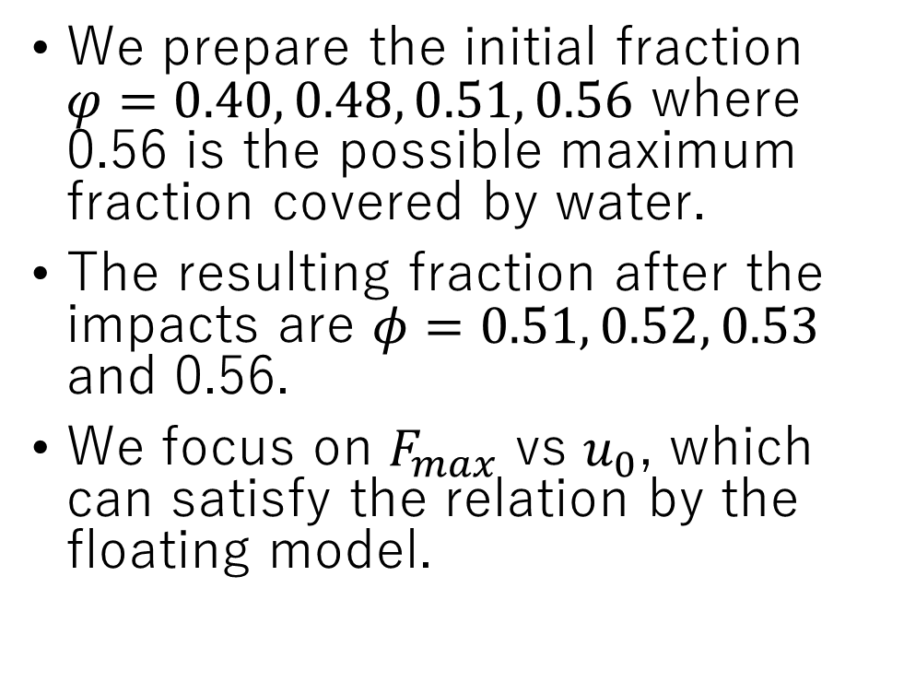
Experimental results
We prepare the initial fraction $φ=0.40, 0.48, 0.51, 0.56$ where 0.56 is the possible maximum fraction covered by water.
The resulting fraction after the impacts are $φ=0.51, 0.52, 0.53$ and 0.56.
We focus on $F_{max}$ vs $u_{0}$, which can satisfy the relation by the floating model.

Slide 25
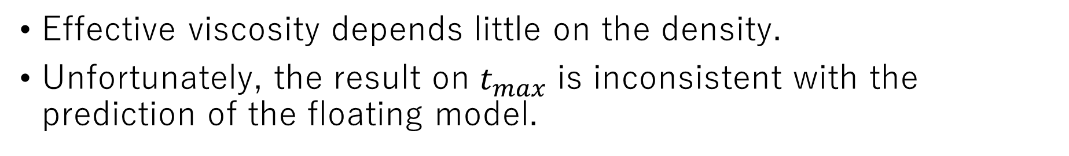
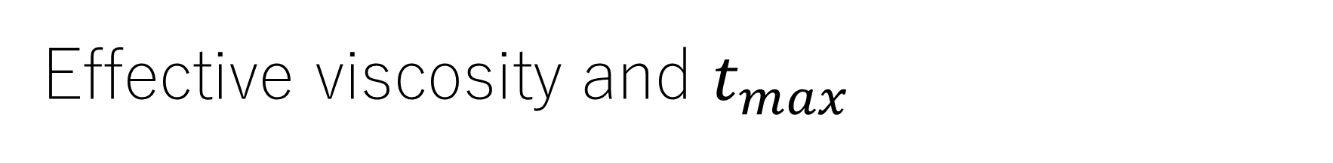
Effective viscosity and $t_{max}$
Effective viscosity depends little on the density.
Unfortunately, the result on $t_{max}$ is inconsistent with the prediction of the floating model.

Slide 26
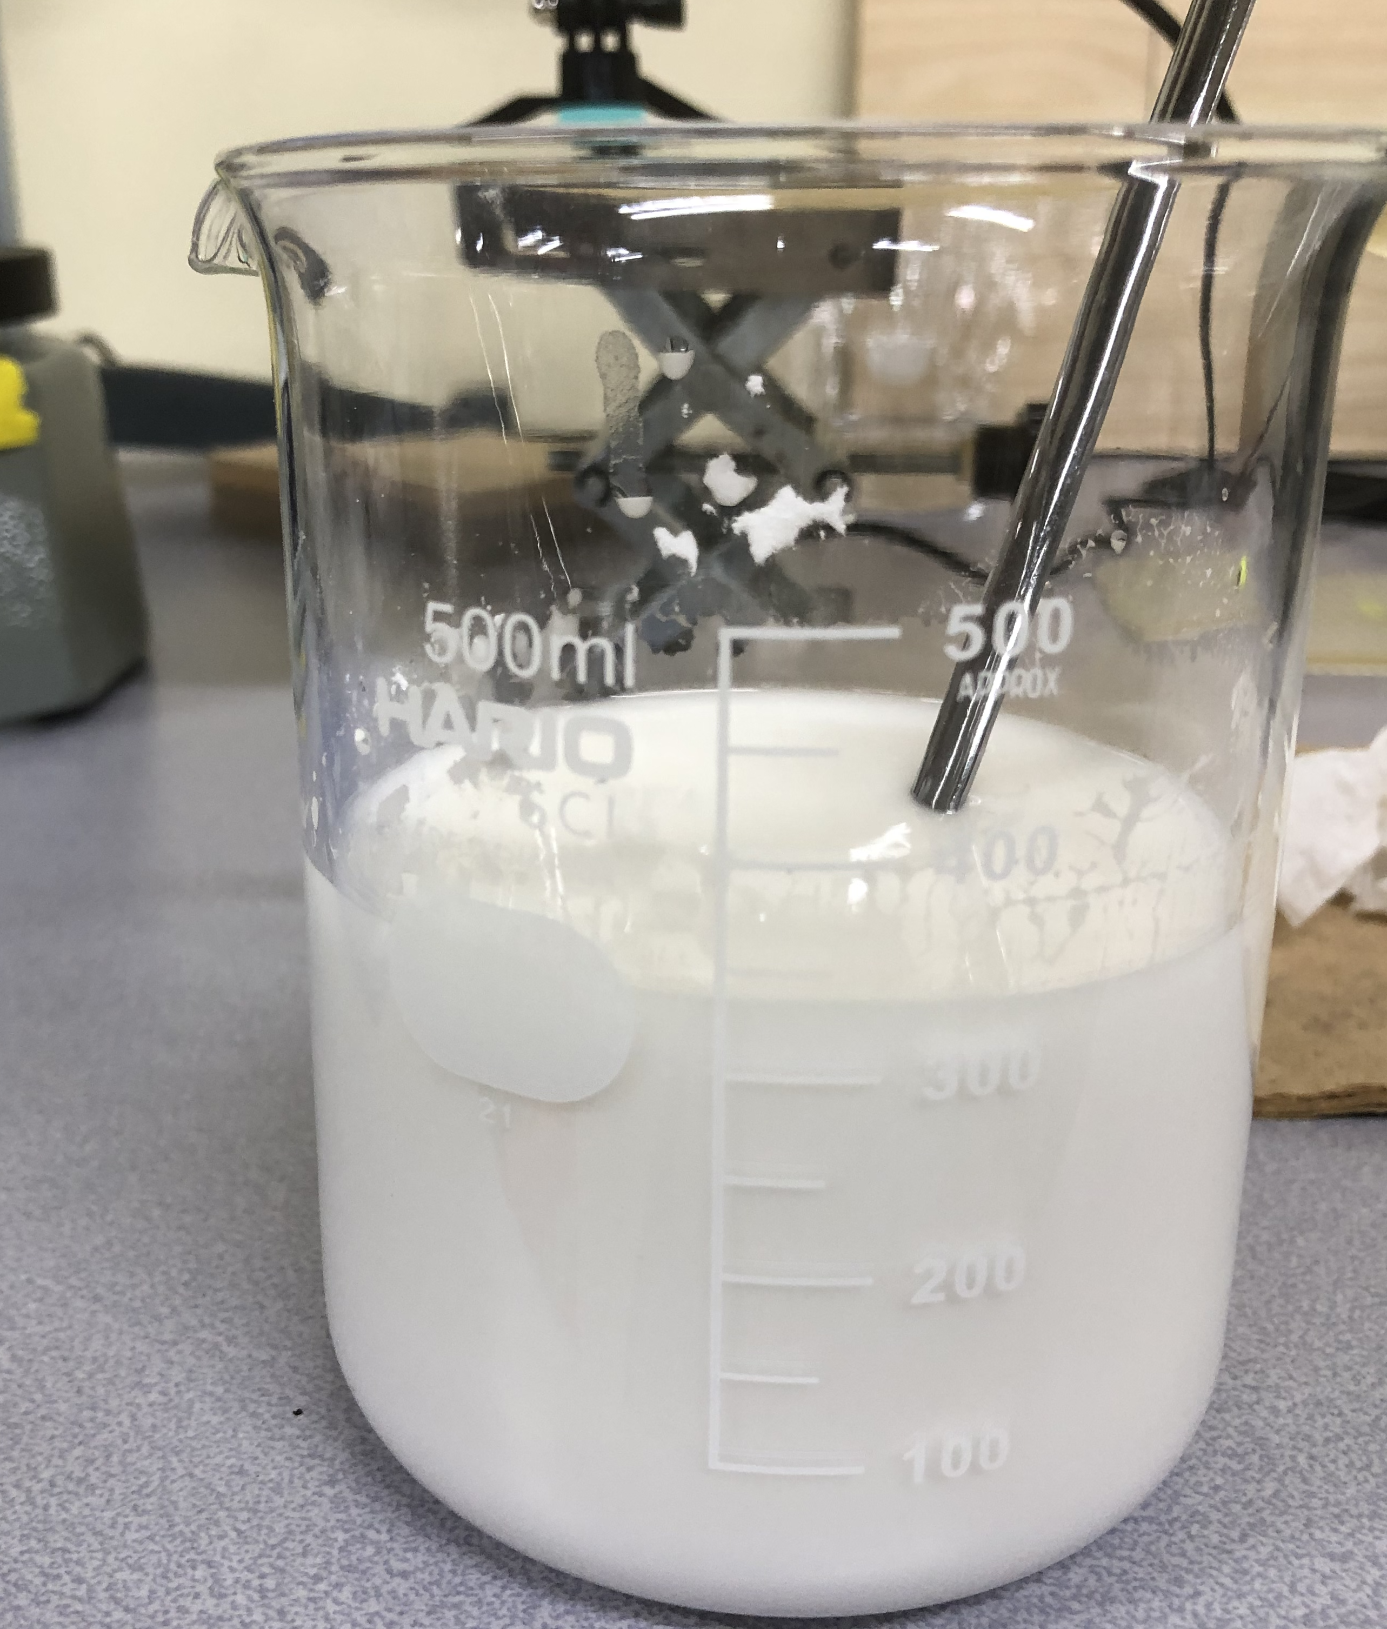

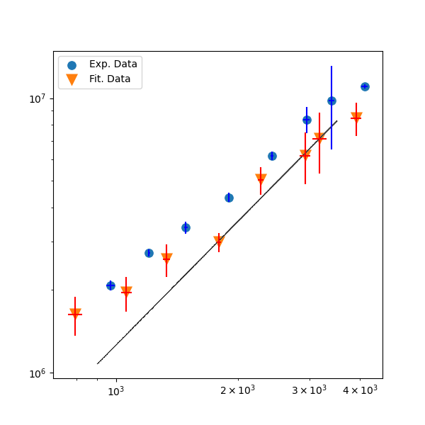
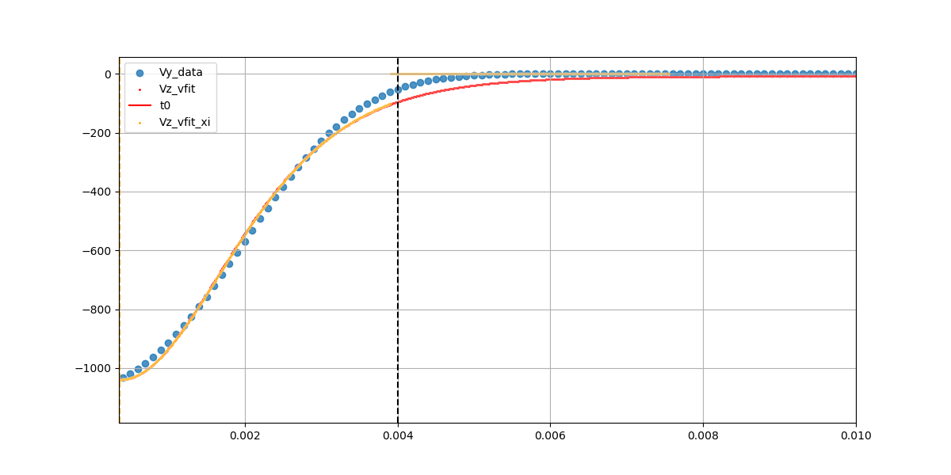
Cornstarch
F_{max} ∝ u₀^{3/2}
Water : cornstarch = 1 : 1.5
F_{max} (g∙mm/s²)
u₀ = 1272 mm / sec
The solid line: The solution of the floating model
V_{Z} (mm/s)
u₀ (mm/s)
t (s)

Slide 27
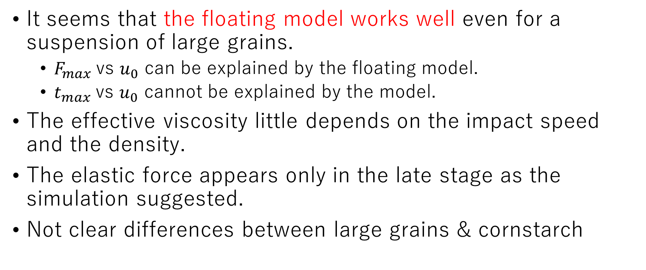
Summary of experiments
It seems that the floating model works well even for a suspension of large grains.
  $F_{max}$vs $u_{0}$ can be explained by the floating model.
  $t_{max}$vs $u_{0}$ cannot be explained by the model.
The effective viscosity little depends on the impact speed and the density.
The elastic force appears only in the late stage as the simulation suggested.
Not clear differences between large grains & cornstarch
Notes:
Dense suspensions have large effective viscosities.

Slide 28
Contents
Introduction
Simulation & theory
  LBM simulation
  Floating model in early stage
  Effects of elastic force
Experiment
Conclusion

Slide 29
Conclusion
We have performed simulation for impact induced hardening.
Our simulation reproduces experimental results.
  Friction between grains is important.
Simulation suggests that impact induced hardening differs from DST.
Floating model works well in early stage even for experiments.
See Pradipto & HH, PRF 6, 033301 (2021), Phys. Fluids 33, 093110 (2021) & PRE 108, 024604 (2023) as well as H. Maruoka & HH, arXiv:2406.19202.

Slide 30
Thank you for your attention.

