Slide 1

Nonlinear Analysis Based on Unstable Modes in Amorphous Solids
Mini-workshop on "Jamming, rheology and granular matter“
July 9th, 2025
Kota Noto, Kuniyasu Saitoh(A),
Harukuni Ikeda, Hisao Hayakawa
YITP, Kyoto Sangyo Univ.(A)
@ YITP K202

Slide 2
Outline
Introduction
Derivation of Unstable Modes with Wavenumber
Weakly Nonlinear Analysis for Unstable Modes

Slide 3
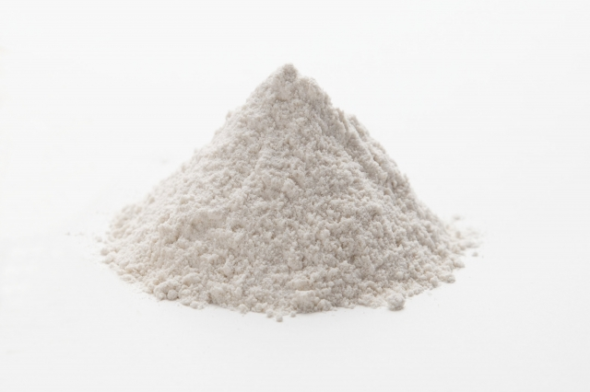

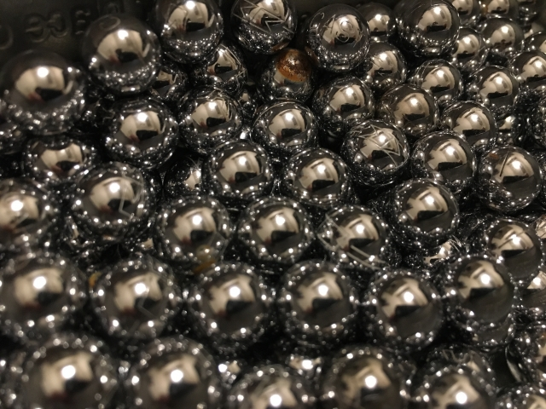
Granular material
Powder
Sand
Ball
Granular materials governed by repulsive interactions in amorphous solids
Macroscopic objects at T = 0, negligible thermal fluctuations
Energy dissipation plays a major role

Slide 4
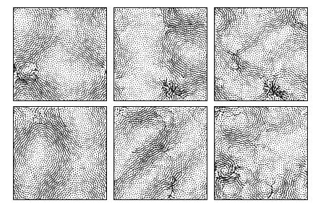
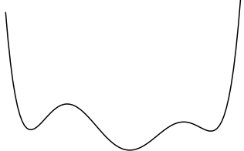
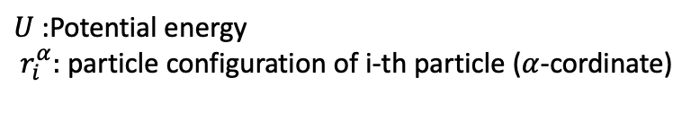

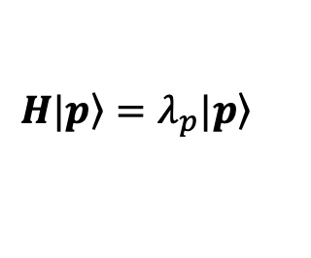
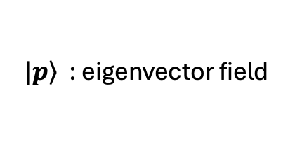
Hessian Matrix
We can get other property
(Shear modules ,,, )
$$H|\left.p\right\rangle =λ_{p}|\left.p\right\rangle$$
$U$ :Potential energy
$r_{i}^{α}:$ particle configuration of i-th particle ($α$-cordinate)
Eigenvalue analysis of 2N degree
$λ_{p}$: corresponding to curvature of PEL
$|\left.p\right\rangle$ : eigenvector field
PEL in a 2N-dimention
Notes:
不均一な系のため、解析に粒子配置を用いる。

Slide 5
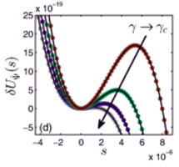
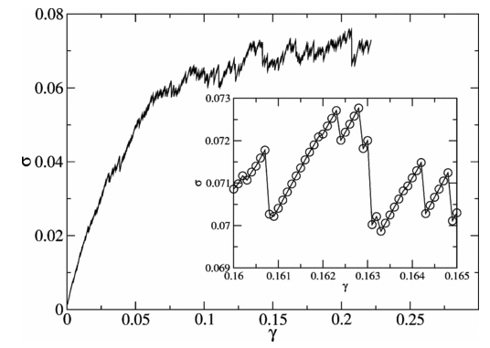
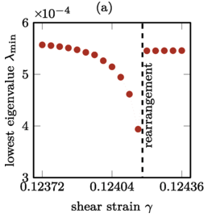
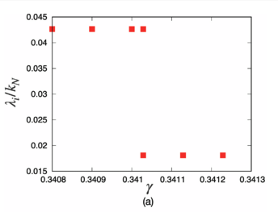
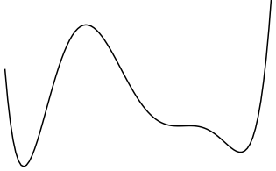

Unstable Particle Configuration
$$λ_{p}∼\sqrt{γ_{c}−γ}$$
Anharmonic
Harmonic
E. Lerner, Phys. Rev. E 93, 053004, (2016)
C. E. Maloney and A. Lemaître PRE (2006)
F. Ebrahem et al., Phys. Rev. E 102, 033006 (2020).
D. Ishima et al., PRE 2023
Repeatedly performing eigenvalue analysis for different particle configurations is necessary.
Motivation
・Focus on configurations with negative eigenvalues.
・Analyzed configurations that become unstable with a single perturbation from the initial condition.

Slide 6
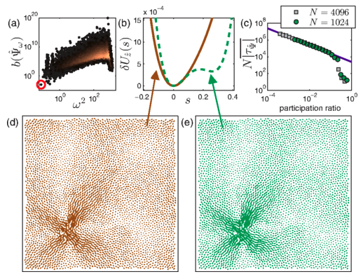

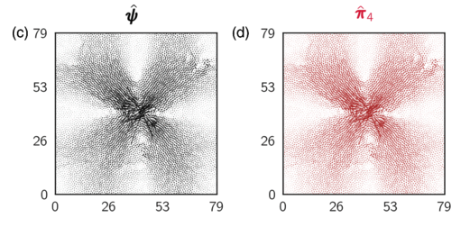

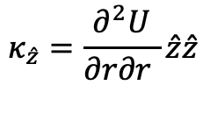
Nonlinear Analysis of Amorphous Solids
NPM(Nonlinear plastic modes),
$$κ_{\hat{z}}=\frac{∂^{2}U}{∂r∂r }\hat{z}\hat{z}$$
$$τ_{\hat{z}} =\frac{∂^{3}U}{∂r∂r∂r} \hat{z}\hat{z}\hat{z}$$
Luka Gartner and Edan Lerner, Phys. Rev. E 93, 011001(2016)
Case for Positive Eigenvalues
→ Apply Negative mode
NQE(Nonlinear quasilocalized excitations)
Geert Kapteijns et al., Phys. Rev. E 101, 032130 (2020)

Slide 7
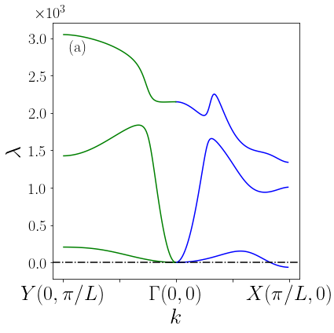
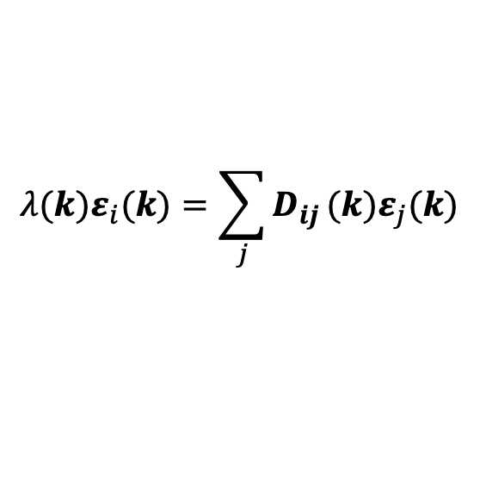
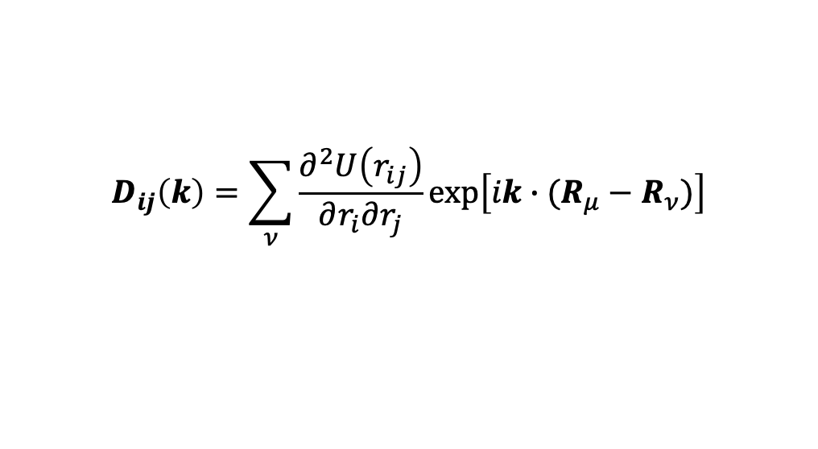
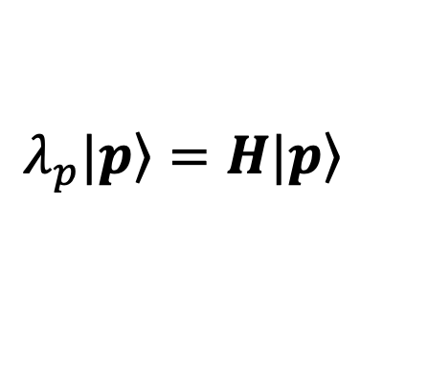
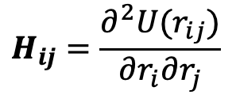
Hessian matrix including wavenumber
Hessian matrix
$$H_{ij}=\frac{∂^{2}U(r_{ij})}{∂r_{i}∂r_{j}}$$
$$λ_{p}|\left.p\right\rangle =H|\left.p\right\rangle$$
Hessian matrix including wavenumber
$$D_{ij}\left(k\right)=\sum_{ν}{\frac{∂^{2}U\left(r_{ij}\right)}{∂r_{i}∂r_{j}}exp\left[ik∙(R_{μ}−R_{ν})\right]}$$
$$λ(k)ε_{i}(k)=\sum_{j}{D_{ij}}(k)ε_{j}(k)$$
S. Schoenholz et al. Soft Matter, 9, 11000 (2013).
Dispersion relation
Get negative eigenvalue!
Notes:
今までの解析は、k = 0の正の固有値のみを用いて行われてきた。
システムに負の固有モードが存在する場合、
変形を加えた際の応答を
理論解析およびシュミレーションを用いて確かめる。

Slide 8



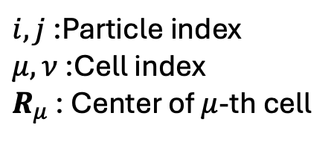

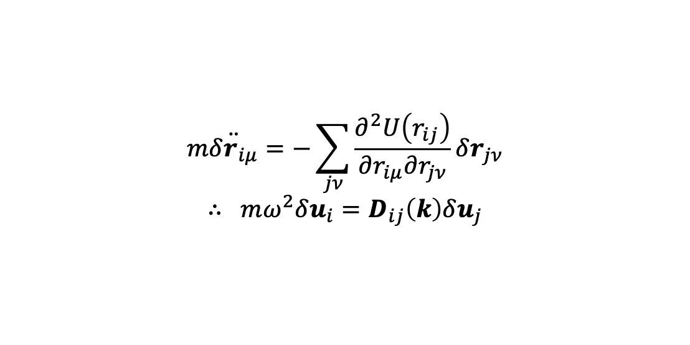
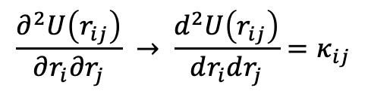



How introduce wavenumber
Equation of motion
Put plane wave anzats
$$m\ddot{δr_{iμ}}=−\sum_{jν}{\frac{∂^{2}U\left(r_{ij}\right)}{∂r_{iμ}∂r_{jν}}δr_{jν}}$$
$$∴ mω^{2}δu_{i}=D_{ij}\left(k\right)δu_{j}$$
$δr_{iμ}$= Re{$exp\left[i\left(k⋅R_{μ}− ωt\right)\right]$} $δu_{i}$
$i, j$:Particle index
$μ, ν$:Cell index
$R_{μ}$ : Center of $μ$-th cell
$$D_{ij}\left(k\right)=\sum_{ν}{\frac{∂^{2}U\left(r_{ij}\right)}{∂r_{iμ}∂r_{jν}}exp\left[ik⋅(R_{μ}−R_{ν})\right]}$$
$κ_{ij}$ : Spring constant
In the case of 1d3atoms chain、
$$\frac{∂^{2}U\left(r_{ij}\right)}{∂r_{i}∂r_{j}} → \frac{d^{2}U\left(r_{ij}\right)}{dr_{i}dr_{j}}{=κ}_{ij}$$
$$K_{3}$$
$$K_{1}$$
$$K_{2}$$
$$K_{3}$$
Notes:
周期境界ではない。
異なるセルにおける同一粒子に対して、異なる変位を許す。
a crystal-like tiling structure where each unit cell contains an amorphous region”
“a tile-like structure that resembles a crystal but has an amorphous configuration within each unit cell”

Slide 9
Linear response
Plane wave can be rewritten for arbitrary displacement as:
: Displacement of
the reference cell
Solution obtained by applying initial conditions
Negative: Divergence
Positive: Oscillation
For any initial condition,
only the negative modes become dominant
Notes:
An arbitrary displacement can be expanded in terms of eigenvectors

Slide 10
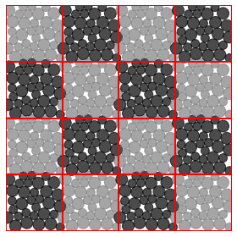

Use Edge Mode
Case: $\left|k\right|=\frac{π}{L}$ -> Wavelength = $2L$
Deformation of X mode
infinite system
2cell system
The outer boundary is periodic.

Slide 11



Deformation corresponding to wavenumber
Isotropic compression at pressure P
Case: $\left|k\right|=\frac{π}{L}$ -> Wavelength = $2L$
$$A={10}^{−4}$$
①lowest eigenvector
Y : Stable Case
:lowest eigenvectors of edge mode
X : Unstable Case
Notes:
固有値が波数に対応しているため、変形も波数に対応する必要がある。
そのため、波数に対応した変形を考える。
“Since the wavelength at the edge wavenumber is 2L, the deformation can be captured using a system with two unit cells. Therefore, we analyze this two-cell configuration below.”

Slide 12
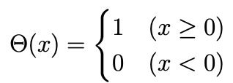

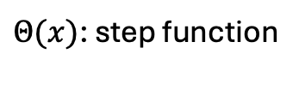

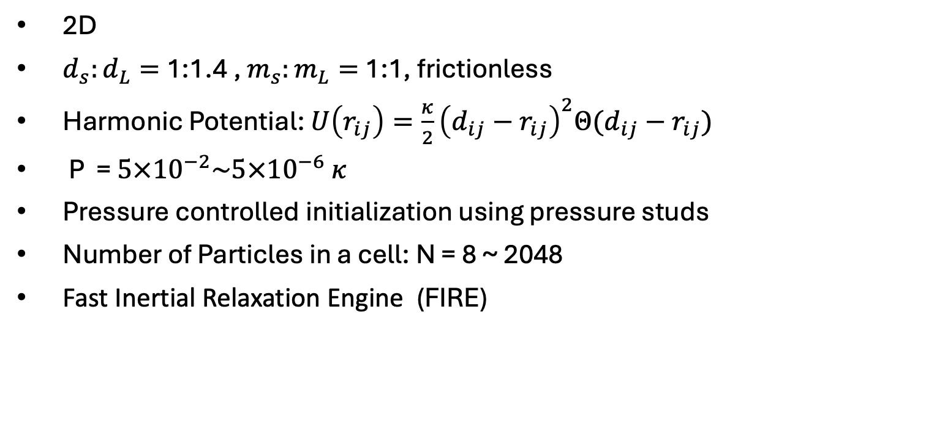


Setting of sumilation
$Θ(x)$: step function
2D
$d_{s}:d_{L}=$1:1.4 , $m_{s}:m_{L}=$1:1, frictionless
Harmonic Potential: $U\left(r_{ij}\right)=\frac{κ}{2}{\left(d_{ij}−r_{ij}\right)}^{2}Θ(d_{ij}−r_{ij})$
P = $5×{10}^{−2}\sim 5×{10}^{−6} κ$
Pressure controlled initialization using pressure studs
Number of Particles in a cell: N = 8 ~ 2048
Fast Inertial Relaxation Engine (FIRE)
P>0
P<0
$$v$$
$$v=0$$
$${10}^{−9}k_{n}d$$

Slide 13
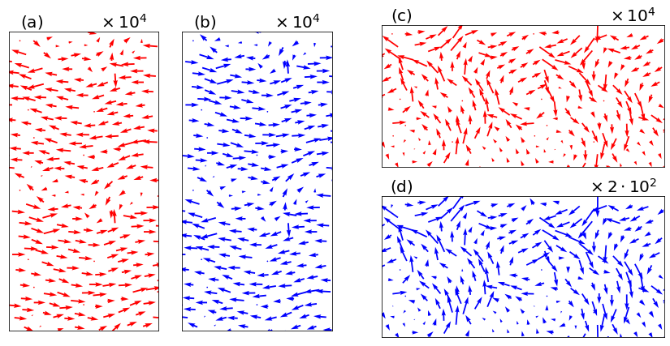


Lowest eigenvector
$$A={10}^{−4}$$
Stable case
Unstable case
deformation
response
deformation
×50
Response
$$×1$$
Returns to the original state after deformation
Amplifies the deformation further
→Unstable modes can be captured！
Notes:
拡大率： Magnification
Scale Factor

Slide 14
Deformation corresponding to wavenumber
Isotropic compression at pressure P
Case: $\left|k\right|=\frac{π}{L}$ -> Wavelength = $2L$
$$A={10}^{−4}$$
Three type of deformation
①lowest eigenvector
:lowest eigenvectors
② sinusoidal transverse wave
③ square transverse wave
Notes:
固有値が波数に対応しているため、変形も波数に対応する必要がある。
そのため、波数に対応した変形を考える。
“Since the wavelength at the edge wavenumber is 2L, the deformation can be captured using a system with two unit cells. Therefore, we analyze this two-cell configuration below.”

Slide 15
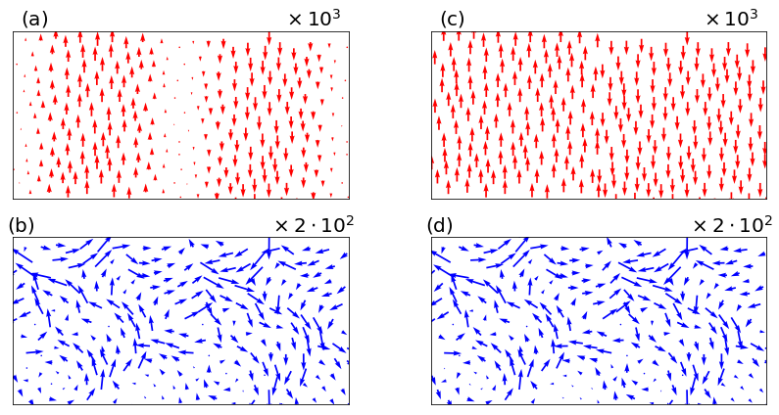
Response of various perturbations
Sinusoidal wave
Square wave
Lowest eigenvector
The responses are independent of the initial perturbations.

Slide 16
Outline
Introduction
Derivation of Unstable Modes with Wavenumber
Weakly Nonlinear Analysis for Unstable Modes

Slide 17
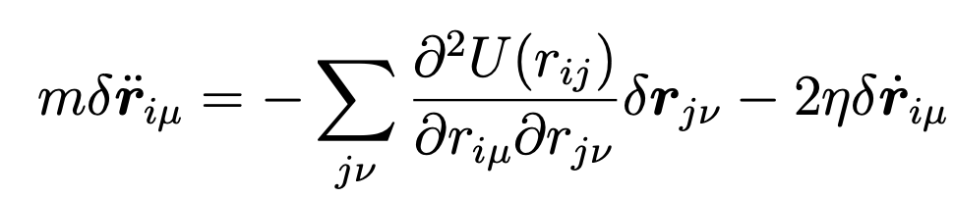
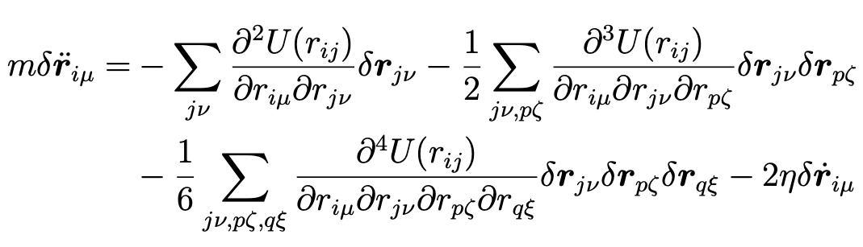

Weakly nonlinear analysis
・ negative eigenvalue system
Oscillation term aaaa
$$≈$$
Negative: Divergence
Overdamped equation
Weakly nonlinear analysis
Notes:
We expand the potential to higher-order terms to capture nonlinear effects.
expand the potential to higher-order terms

Slide 18

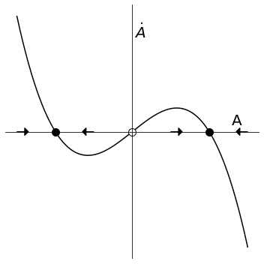
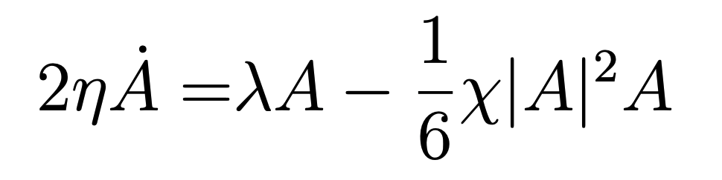

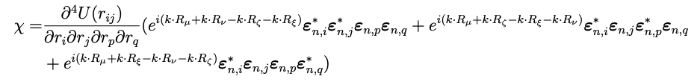

Nonlinear equation
Put ansatz
We get bellow equation
$$λ=−λ′$$
evaluated at the saddle point
Notes:
take a contraction of the tensor

Slide 19


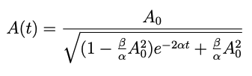
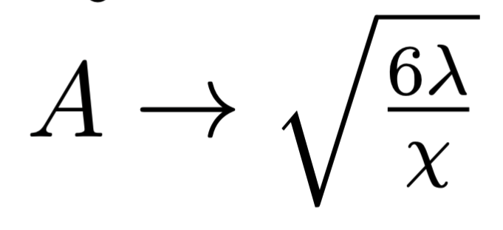

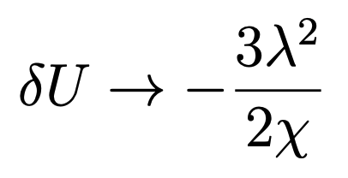


Time Evolution
・Amplitude
Then, we obtain
$$t→∞$$
・Potential
$$t→∞$$

Slide 20
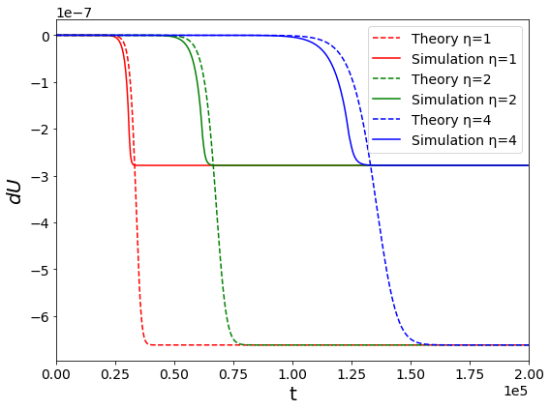
Comparison with simulations
η Dependence
• Quantitatively different, qualitatively consistent
Notes:
“This is the plot when η is varied. The potential change does not perfectly match, but the response agrees quantitatively when the parameter is varied.”

Slide 21

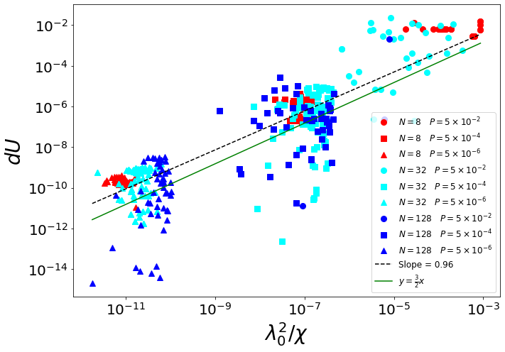
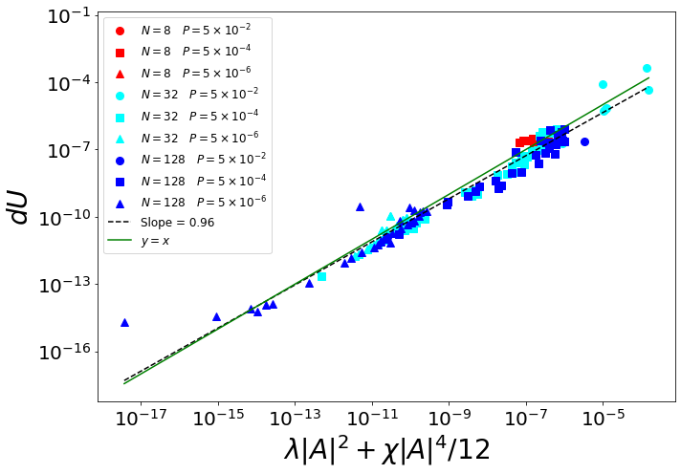






Comparison with simulations
$$5×{10}^{−4}$$
$$P= 5×{10}^{−4}$$
$$5×{10}^{−2}$$
P = $5×{10}^{−2}$
$$5×{10}^{−6}$$
$$P= 5×{10}^{−6}$$
-

Slide 22
Summary
We investigated the response of a system with negative eigenmodes by applying external perturbations.
Regardless of the type of perturbation, the negative eigenmode dominates, leading to the same response.
Weakly nonlinear analysis supports the relationship between the energy decrease and the corresponding eigenvalue.

