Slide 1

Jamming of deformable foams
Jamming, rheology and granular matter
YITP, Kyoto University, 9 July, 2025
Kuniyasu Saitoh¹ and Brian P. Tighe²,
1. Kyoto Sangyo University, Japan
2. Delft University of Technology, The Netherlands

Slide 2
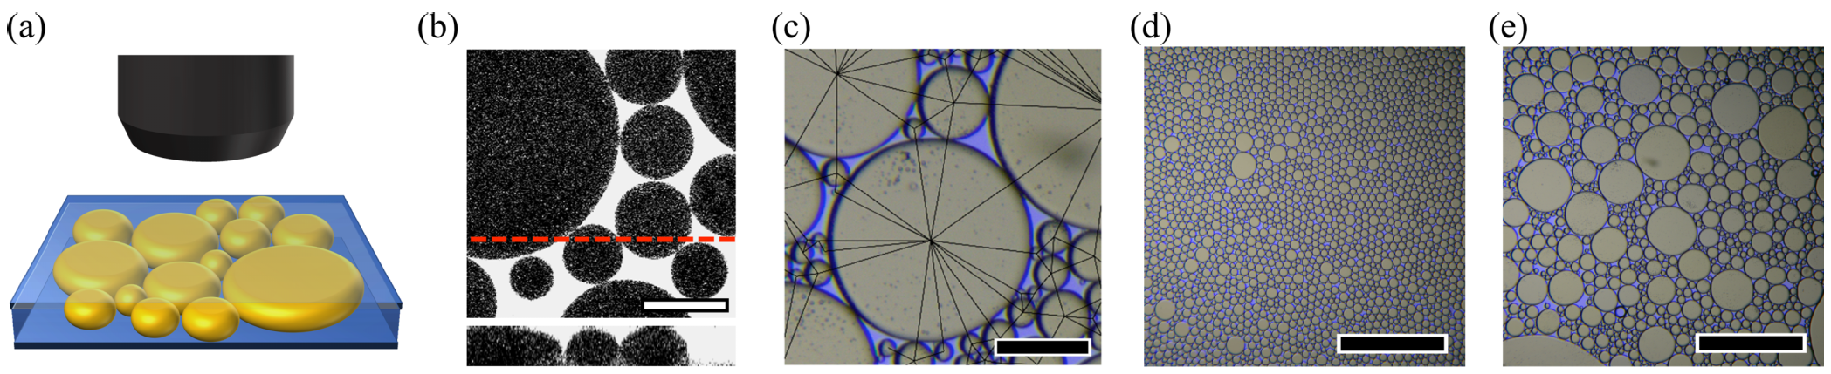
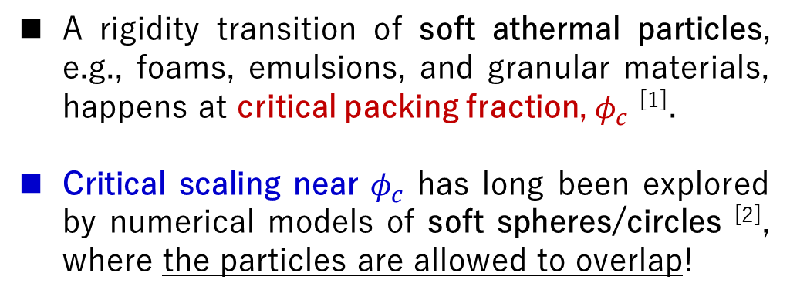
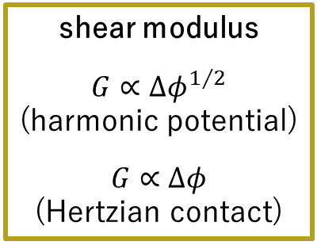
Jamming transition
D. S. Shimamoto and M. Yanagisawa (2023)
A rigidity transition of soft athermal particles, e.g., foams, emulsions, and granular materials, happens at critical packing fraction, $φ_{c}$ ^{[1]}.
Critical scaling near $φ_{c}$ has long been explored by numerical models of soft spheres/circles ^{[2]}, where the particles are allowed to overlap!
Molecular dynamics (MD) simulations
shear modulus
$$G∝{Δφ}^{1/2}$$
(harmonic potential)
$$G∝Δφ$$
(Hertzian contact)
overlap
[1] M. van Hecke, J. Phys.:Condens. Matter 22, 033101 (2010).
[2] C. S. O'Hern, L. E. Silbert, A. J. Liu, and S. R. Nagel, Phys. Rev. E 68, 011306 (2003).

Slide 3
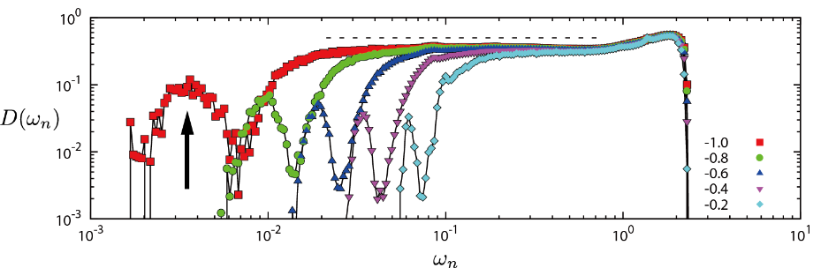



Normal modes
Small vibrations of soft athermal particles around their equilibrium positions are characterized by eigen-frequencies, $ω$.
Vibrational density of states (VDOS) $D\left(ω\right)$ exhibits a plateau in $ω>ω^{∗}$ above jamming, where $ω^{∗}∝∆z$ with excess coordination number, $∆z$ ^{[1, 2]}.
In contrast, $D\left(ω\right)$ below jamming shows an isolated special mode which scales as $ω_{min}∝{\left|∆z\right|}^{1.6}$ ^{[3, 4]}.
The quartic mode of non-spherical particles (ellipses) scales as $ω_{q}∝{∆φ}^{1/2}$ ^{[5]}.
$$ω_{min}$$
[1] M. Wyart, S.R. Nagel, and T.A. Witten, Europhys. Lett. 72, 486 (2005).
[2] H. Mizuno, K. Saitoh, and L.E. Silbert, Phys. Rev. E 93, 062905 (2016).
[3] A. Ikeda, T. Kawasaki, L. Berthier, K. Saitoh, and T. Hatano, Phys. Rev. Lett. 124, 058001 (2020).
[4] K. Saitoh, T. Hatano, A. Ikeda, and B. P. Tighe, Phys. Rev. Lett. 124, 118001 (2020).
[5] C. F. Schreck, M. Mailman, B. Chakraborty, and C. S. O’Hern, Phys. Rev. E 85, 061305 (2012).
$$ω_{q}$$

Slide 4
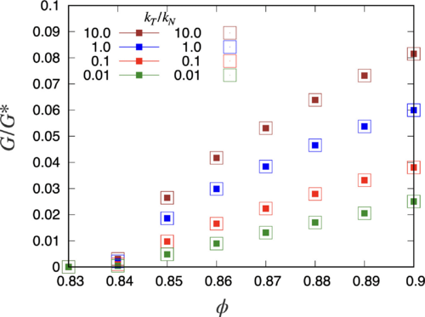
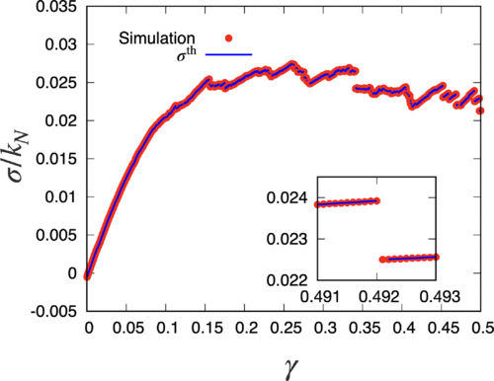
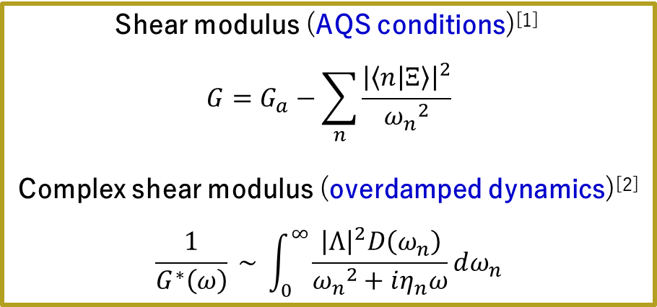
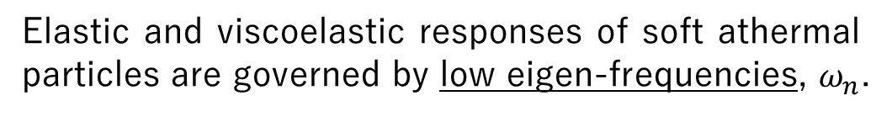
Elasticity & viscoelasticity
Shear modulus (AQS conditions)^{[1]}
$$G=G_{a}−\sum_{n}{\frac{{\left|\left\langle n | Ξ\right\rangle \right|}^{2}}{{ω_{n}}^{2}}}$$
Complex shear modulus (overdamped dynamics)^{[2]}
$$\frac{1}{G^{∗}\left(ω\right)} \sim \int_{0}^{∞}{\frac{{\left|Λ\right|}^{2}D\left(ω_{n}\right)}{{ω_{n}}^{2}+iη_{n}ω}}dω_{n}$$
Elastic and viscoelastic responses of soft athermal particles are governed by low eigen-frequencies, $ω_{n}$.
[1] C. Maloney and A. Lemaitre, Phys. Rev. Lett. 93, 195501 (2004).
[2] B. P. Tighe, Phys. Rev. Lett. 107, 158303 (2011).
[3] D. Ishima, K. Saitoh, M. Otsuki, and H. Hayakawa, Phys. Rev. E 107, 054902 (2023).
[4] D. Ishima, K. Saitoh, M. Otsuki, and H. Hayakawa, Phys. Rev. E 107, 034904 (2023).

Slide 5
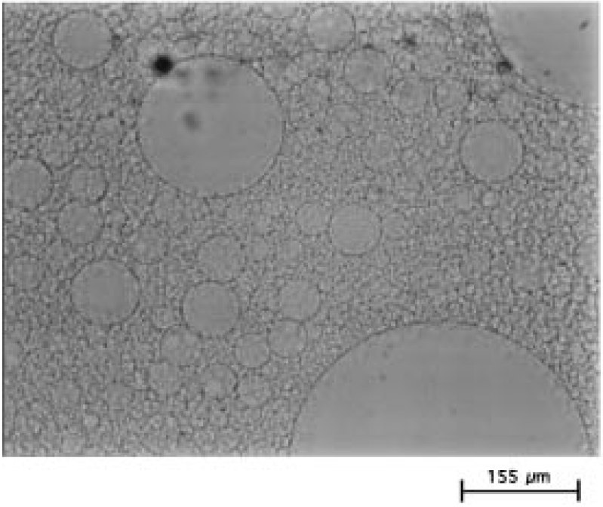
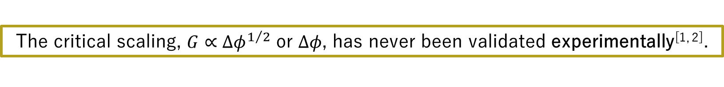
Motivation
The critical scaling, $G∝{∆φ}^{1/2}$ or $∆φ$, has never been validated experimentally^{[1, 2]}.
What is missing in theories and simulations: deformability of the particles?
✖
[1] T. G. Mason and J. Bibette, Phys. Rev. Lett. 77, 3481 (1996).
[2] T. G. Mason et al., Phys. Rev. E 56, 3150 (1997).
[3] A. Boromand et al., Phys. Rev. Lett. 121, 248003 (2018).
[4] A. Boromand et al., Soft Matter 15, 5854 (2019).

Slide 6
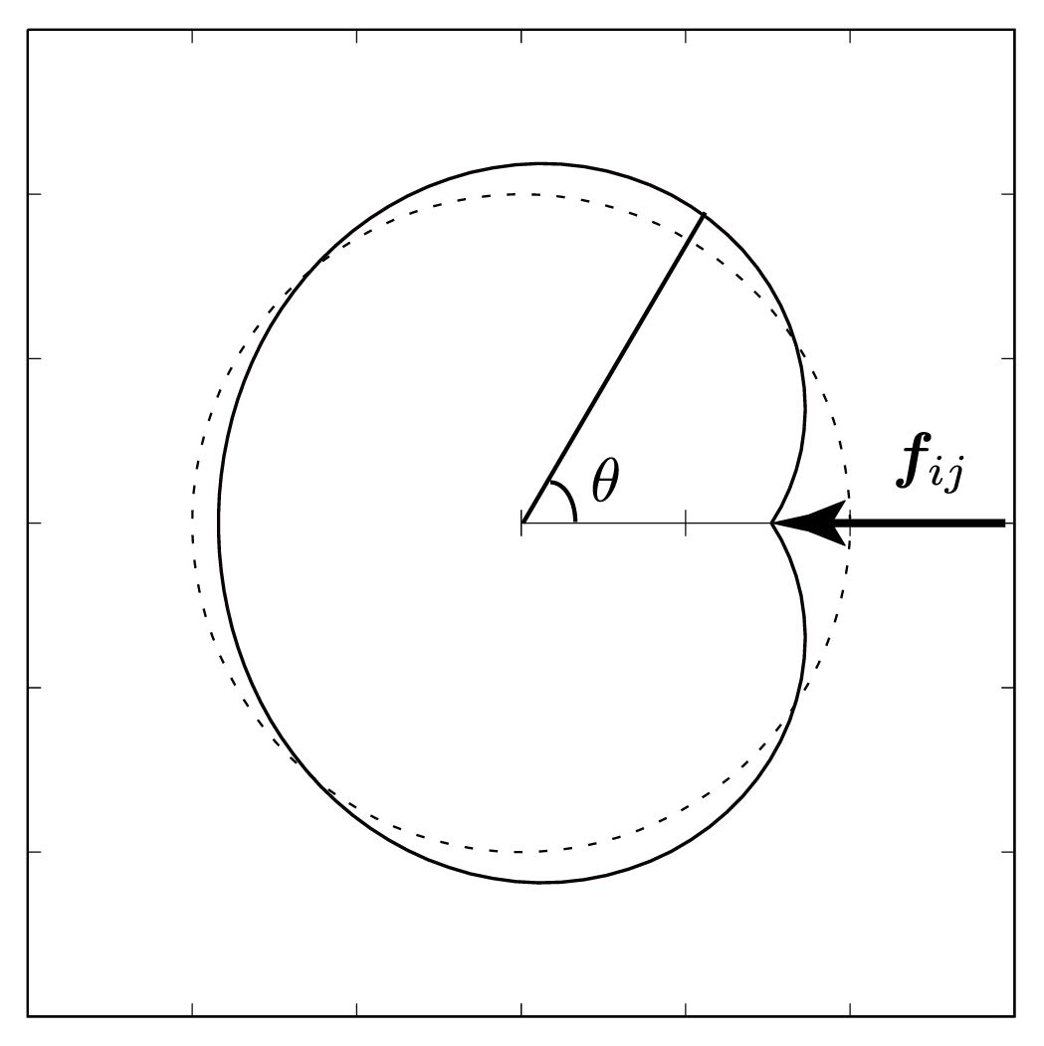

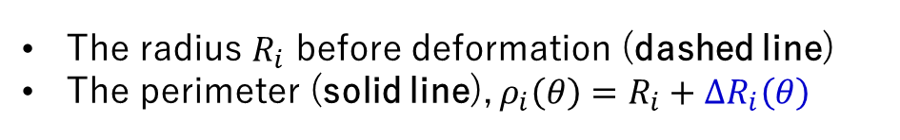
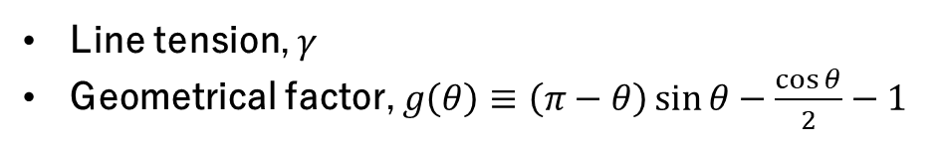
Morse-Witten theory
A theoretical model of deformable foams in 2D: (i) the force law is derived from the Young-Laplace equation and (ii) non-spherical shapes are given by an analytical expression^{[1]}.
The radius $R_{i}$ before deformation (dashed line)
The perimeter (solid line), $ρ_{i}\left(θ\right)=R_{i}+ΔR_{i}\left(θ\right)$
$$ΔR_{i}\left(θ\right)=\frac{R_{i}}{2πγ}f_{ij}g\left(θ\right)$$
Line tension, $γ$
Geometrical factor, $g\left(θ\right)≡\left(π−θ\right)\sin{θ}−\frac{\cos{θ}}{2}−1$
[1] D. Morse and T. Witten, EPL 22, 549 (1993).

Slide 7
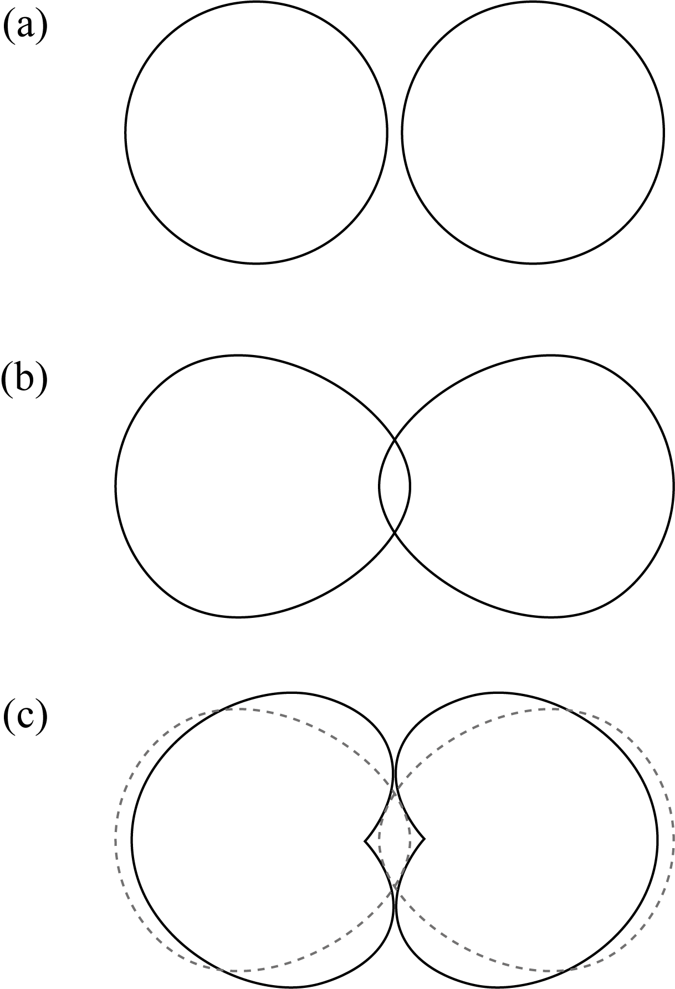
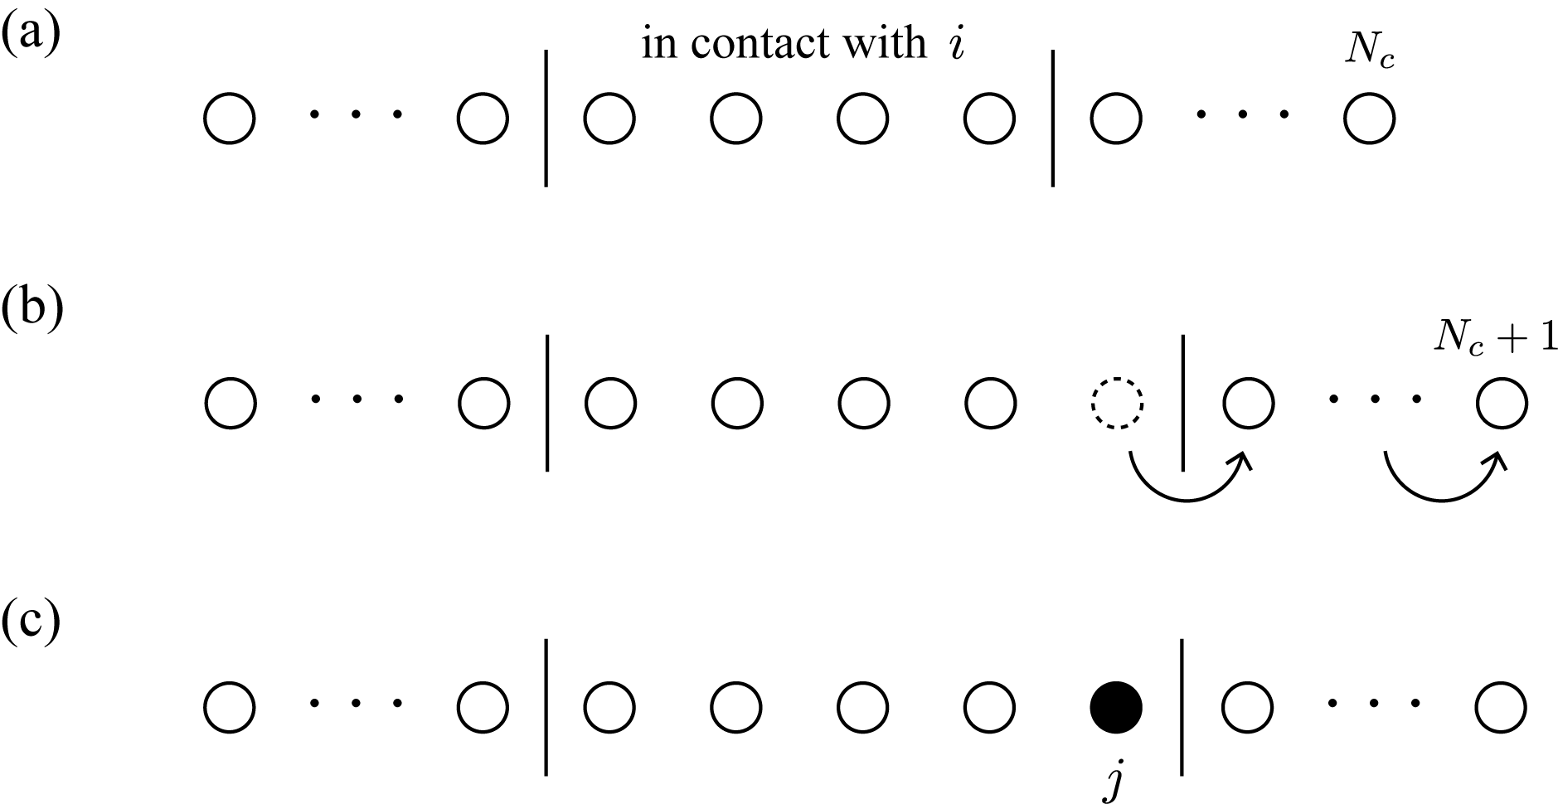
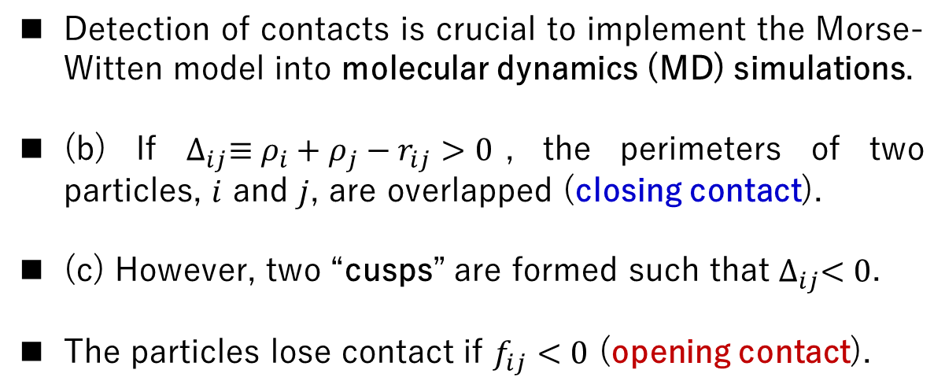
Opening/closing contacts
Detection of contacts is crucial to implement the Morse-Witten model into molecular dynamics (MD) simulations.
(b) If $∆_{ij}≡ρ_{i}+ρ_{j}−r_{ij}>0$, the perimeters of two particles, $i$ and $j$, are overlapped (closing contact).
(c) However, two “cusps” are formed such that $∆_{ij}<0$.
The particles lose contact if $f_{ij}<0$ (opening contact).

Slide 8
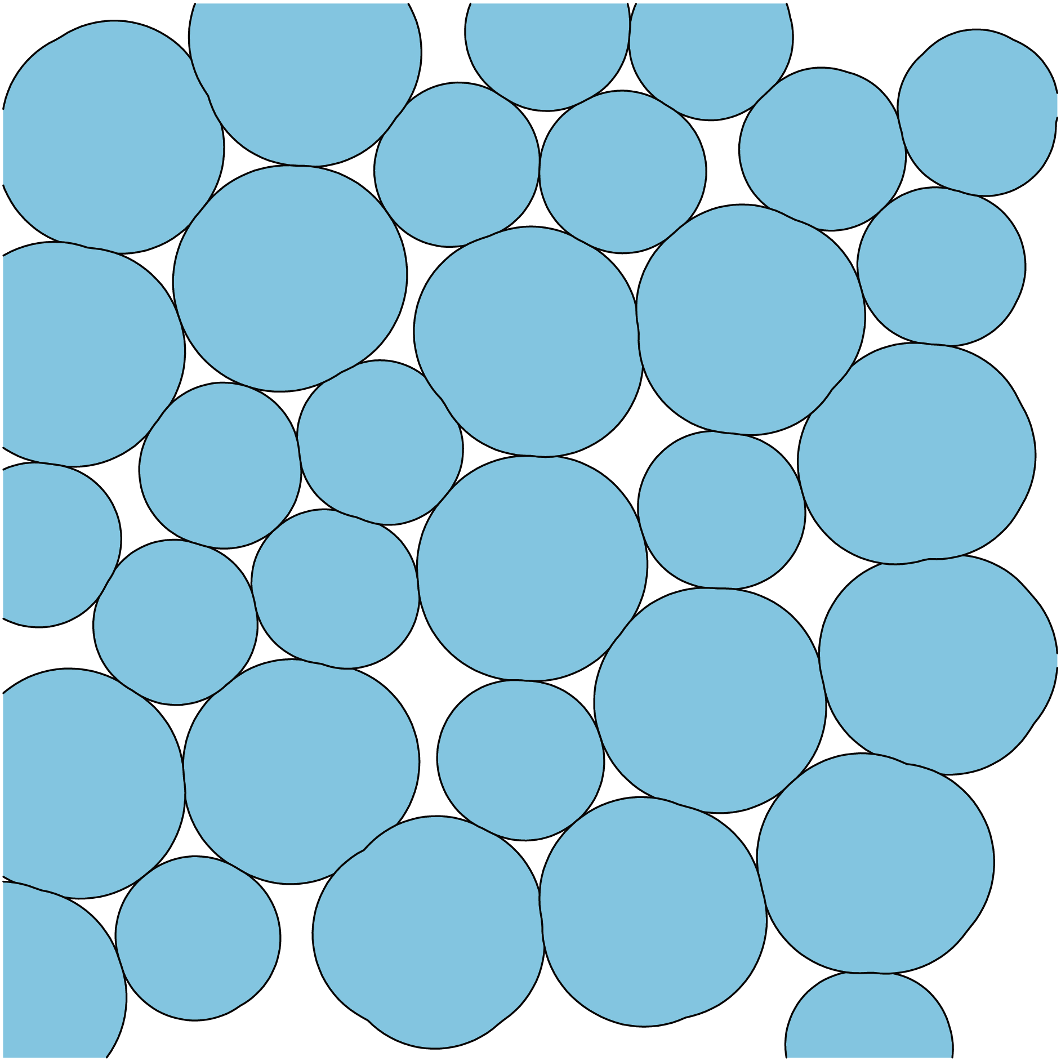
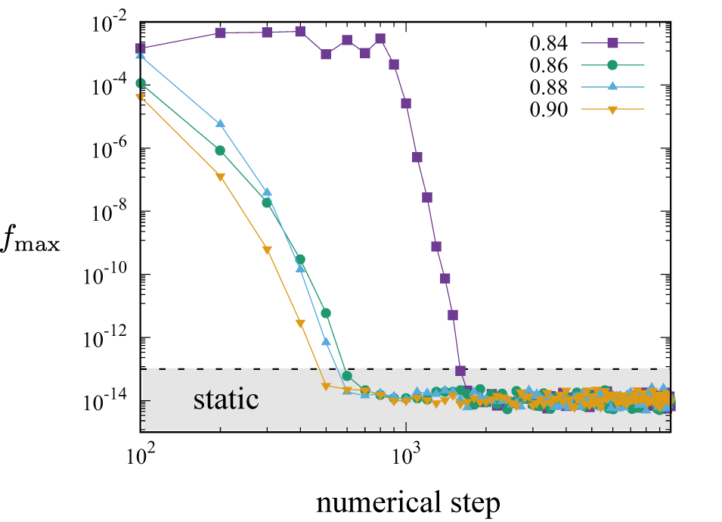
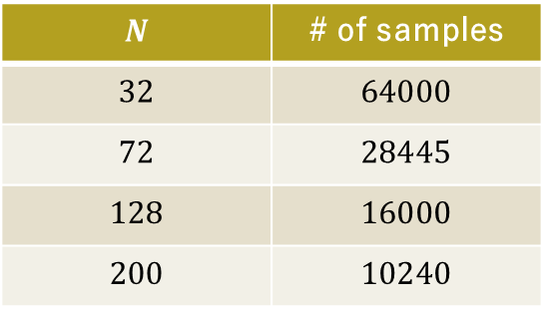
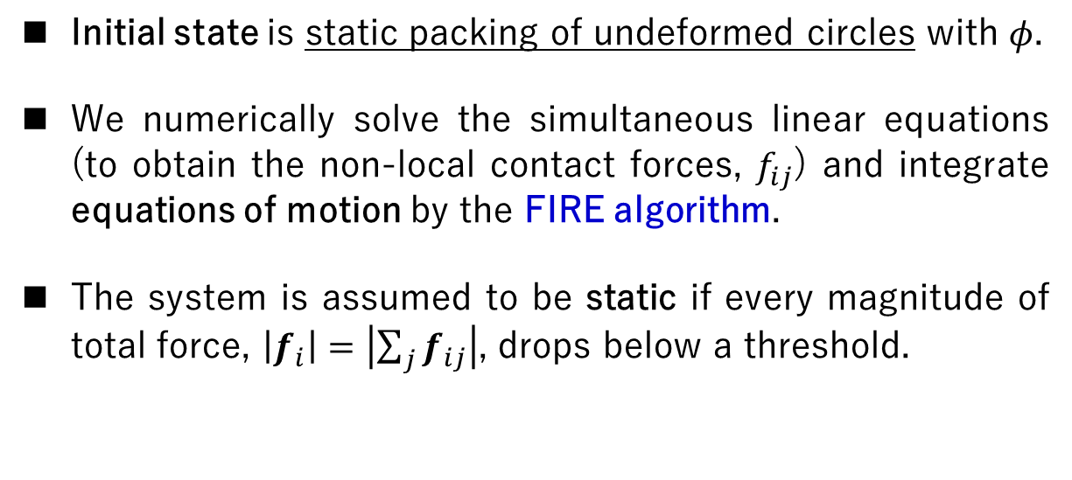
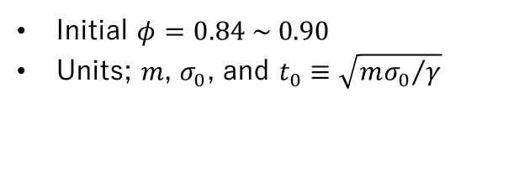
Energy minimization
Initial state (undeformed circles)
Initial state is static packing of undeformed circles with $φ$.
We numerically solve the simultaneous linear equations (to obtain the non-local contact forces, $f_{ij}$) and integrate equations of motion by the FIRE algorithm.
The system is assumed to be static if every magnitude of total force, $\left|f_{i}\right|=\left|\sum_{j}{f_{ij}}\right|$, drops below a threshold.
Final state (deformable foams)
Initial $φ=0.84 \sim 0.90$
Units; $m$, $σ_{0}$, and $t_{0}≡\sqrt{{mσ_{0}}/γ}$
$$N$$ | # of samples
$$32$$ | $$64000$$
$$72$$ | $$28445$$
$$128$$ | $$16000$$
$$200$$ | $$10240$$

Slide 9
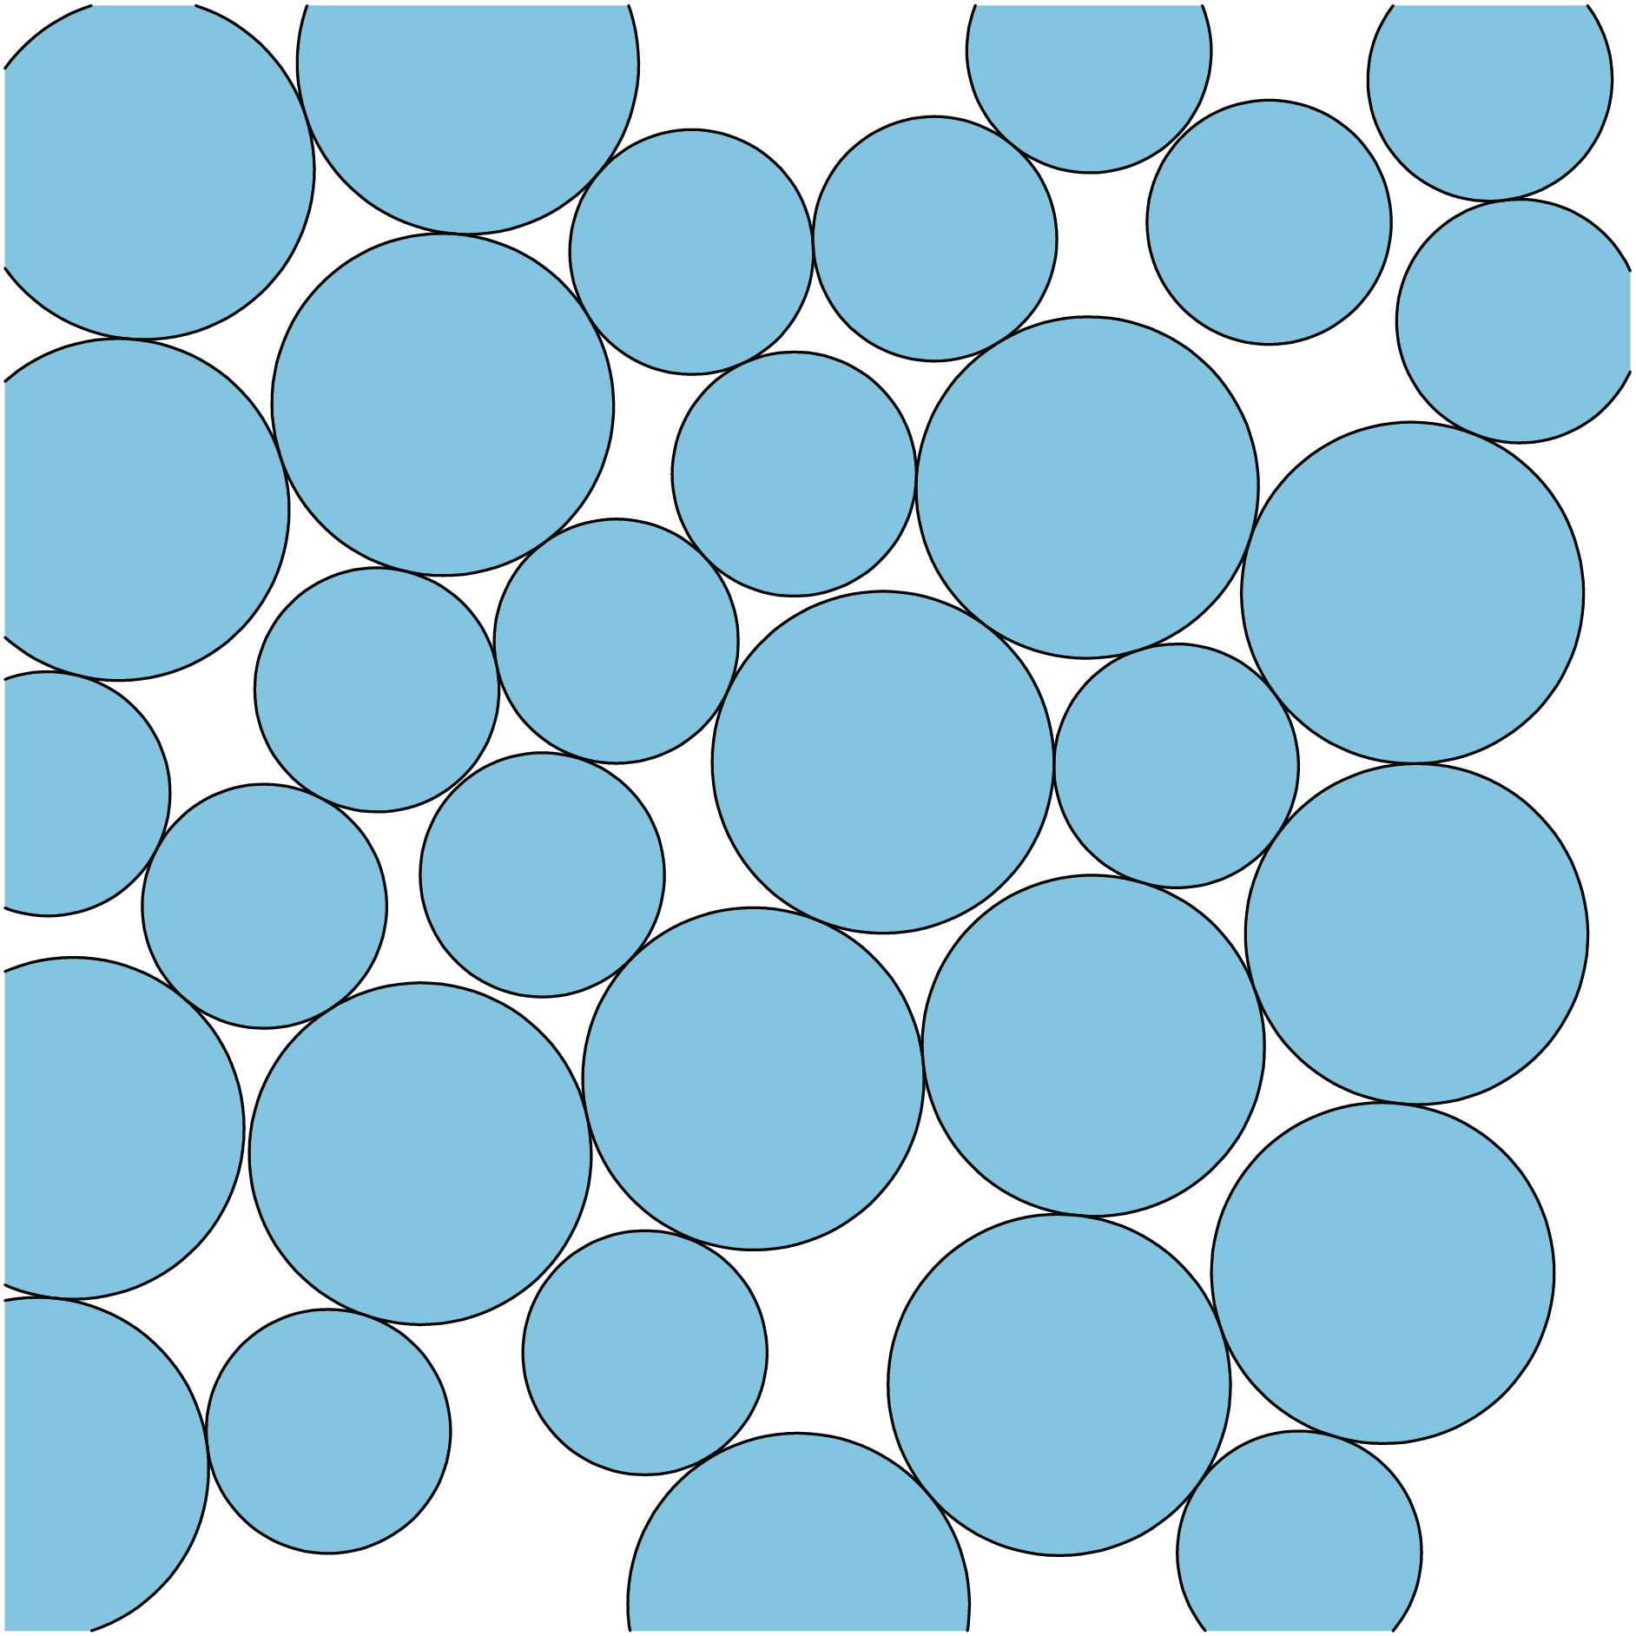
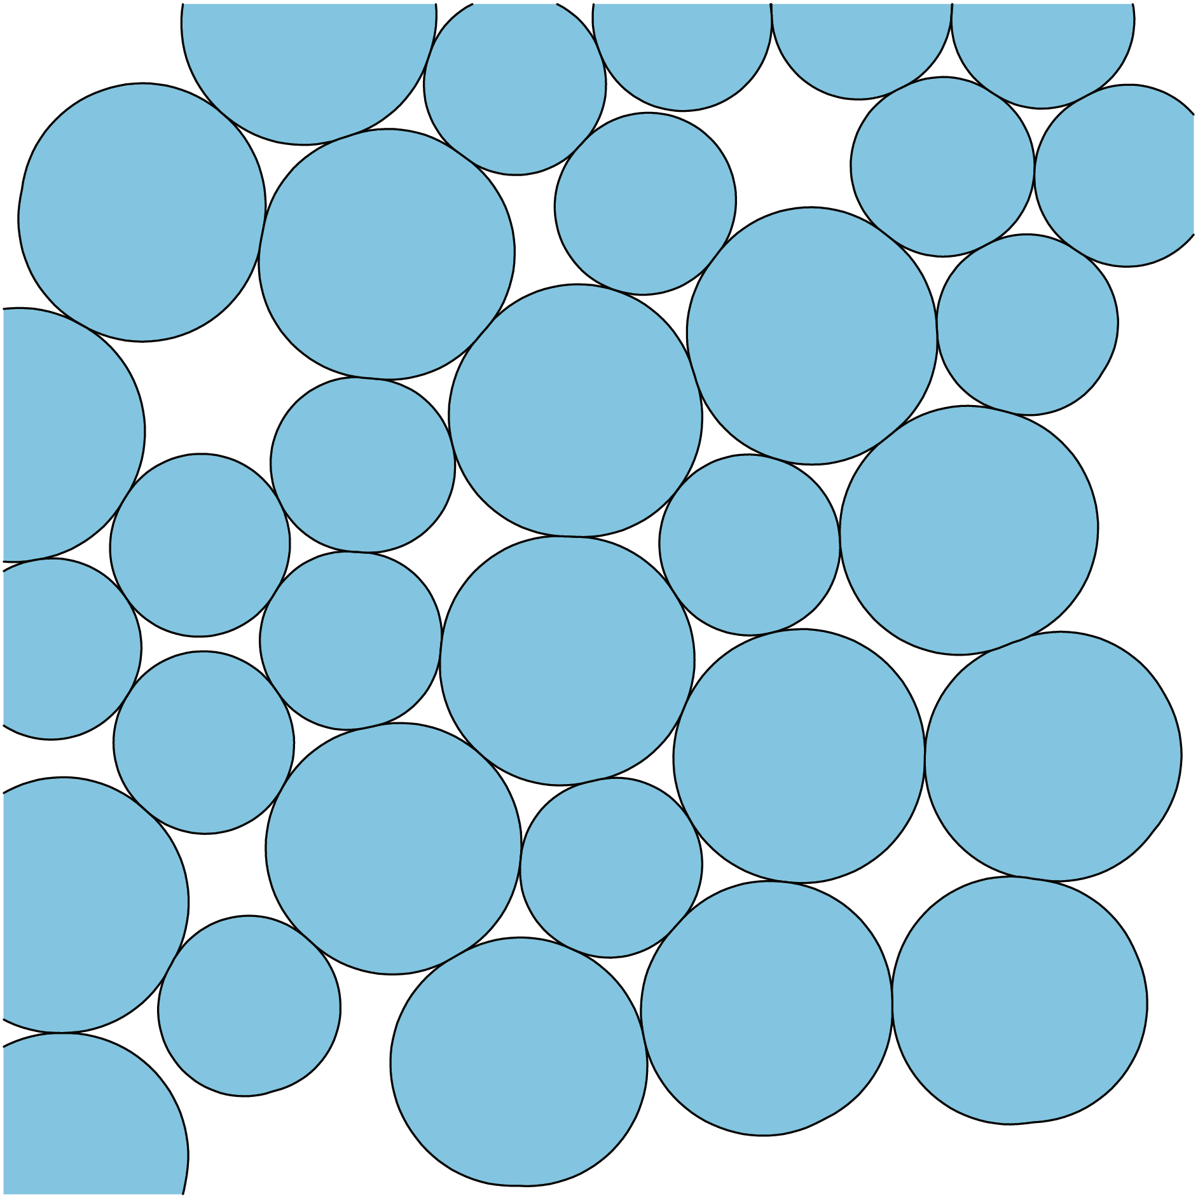
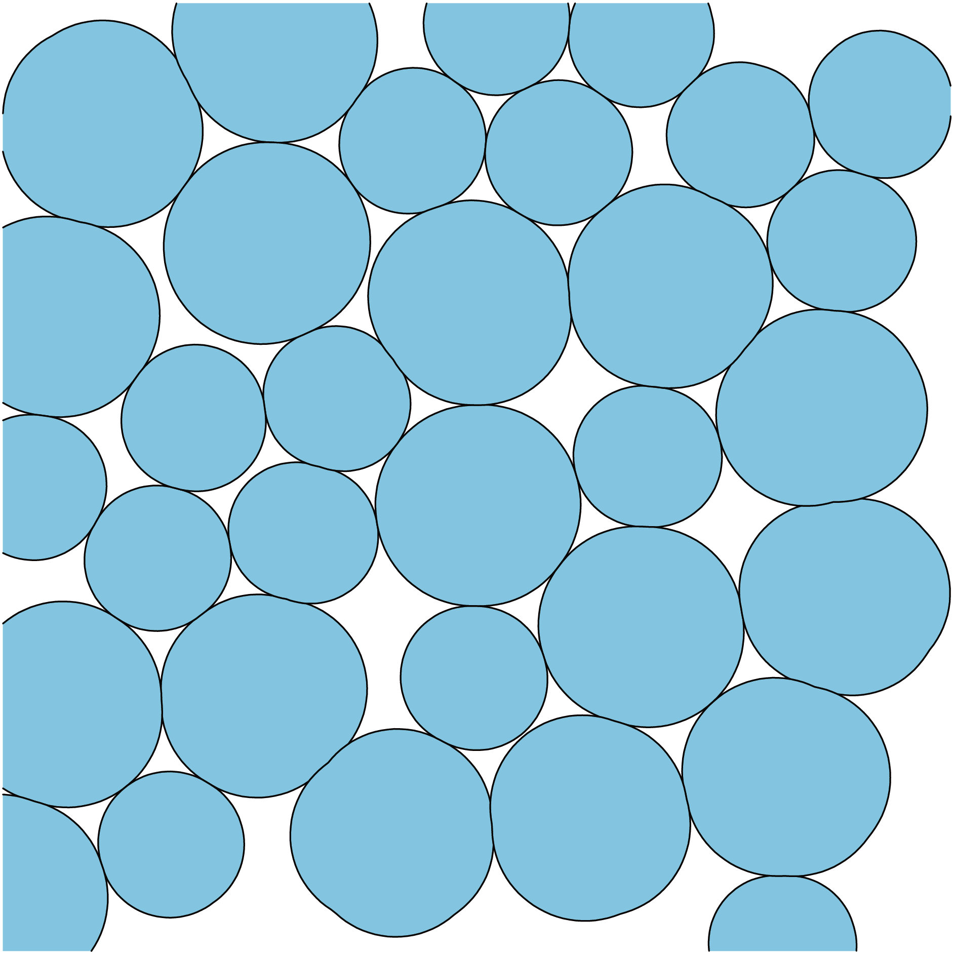
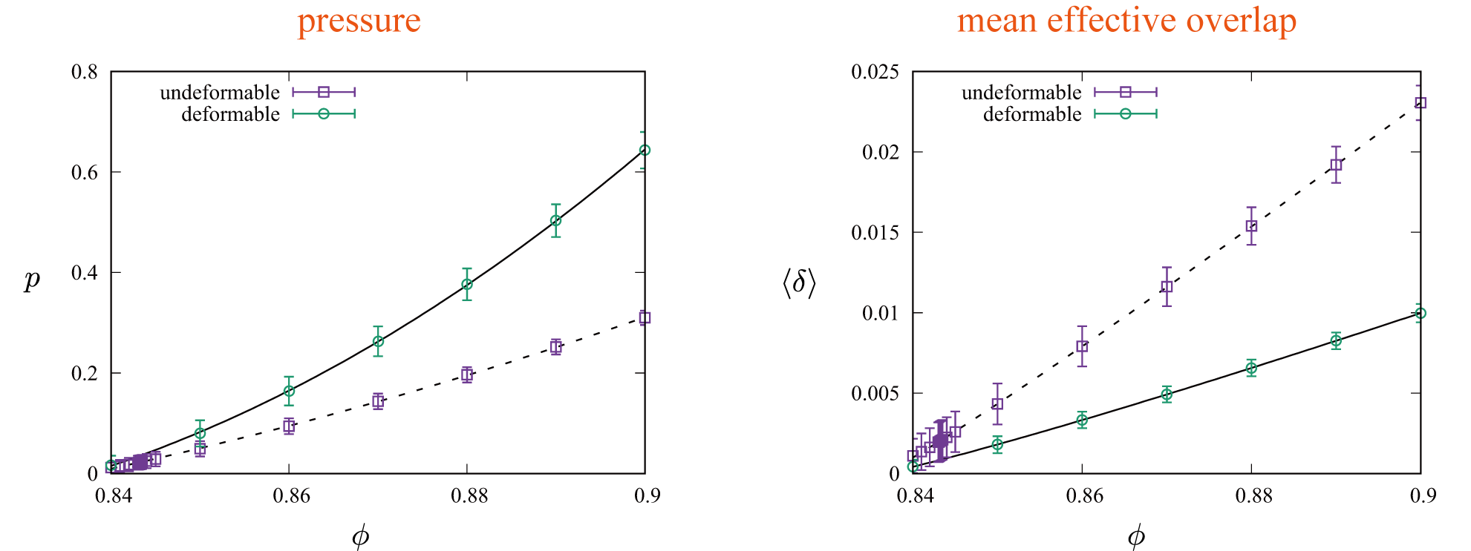

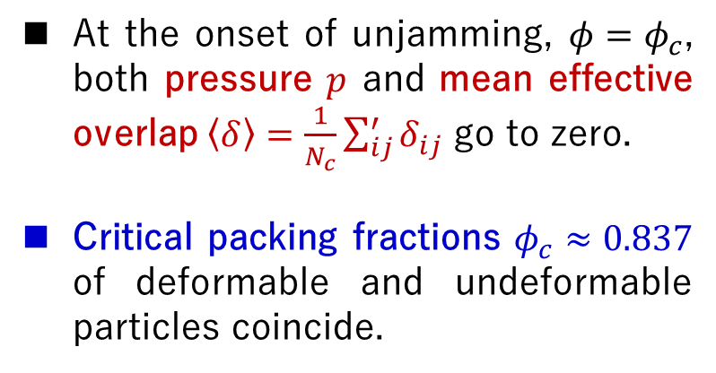


Critical “initial” packing fraction
$$φ$$
$$p→0, \left\langle δ\right\rangle →0$$
$$φ_{c}$$
At the onset of unjamming, $φ=φ_{c}$, both pressure $p$ and mean effective overlap $\left\langle δ\right\rangle =\frac{1}{N_{c}}\sum_{ij}^{′}{δ_{ij}}$ go to zero.
Critical packing fractions $φ_{c}≈0.837$ of deformable and undeformable particles coincide.

Slide 10
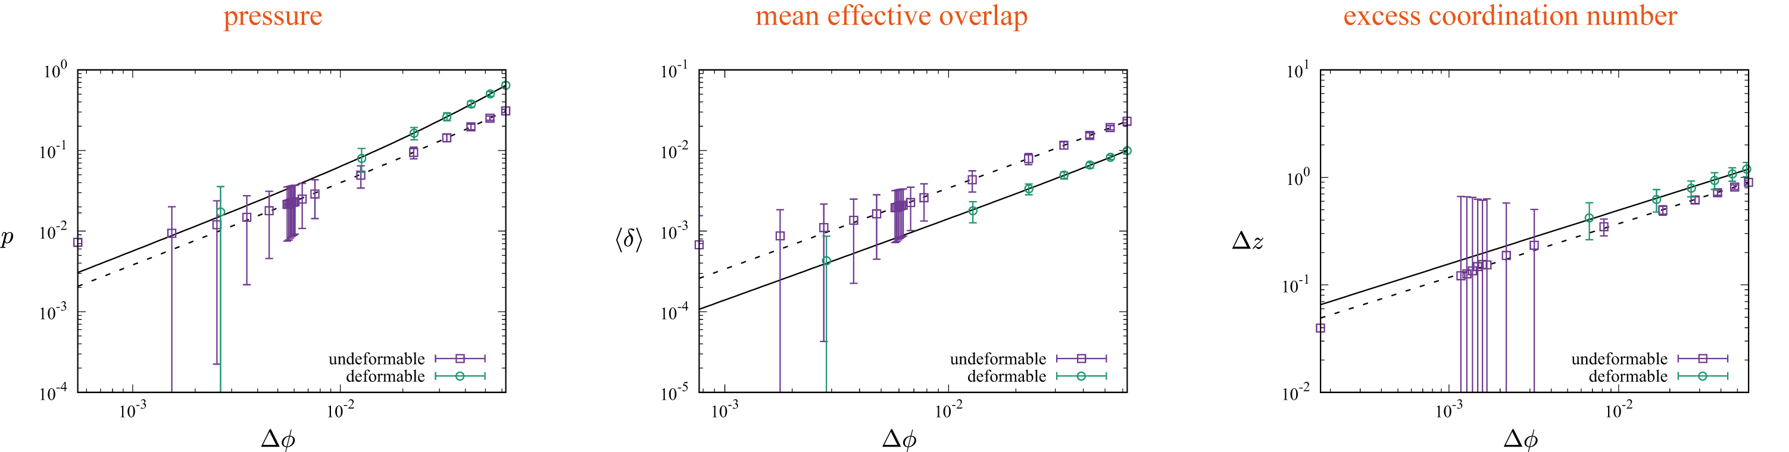
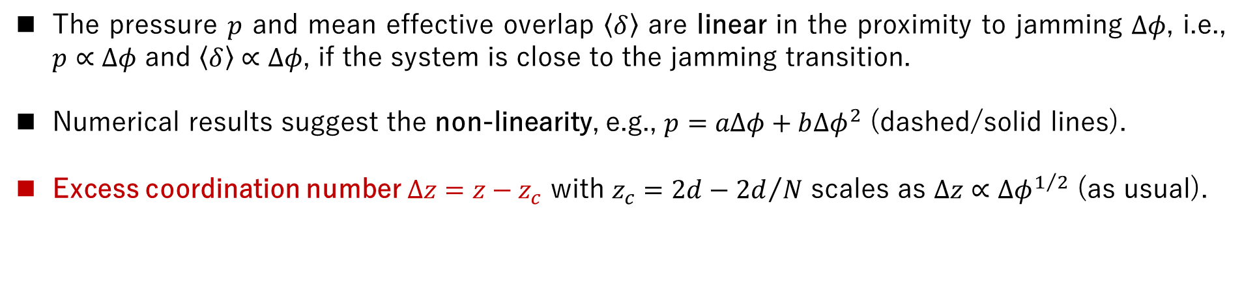
Critical scaling
The pressure $p$ and mean effective overlap $\left\langle δ\right\rangle$ are linear in the proximity to jamming $∆φ$, i.e., $p∝∆φ$ and $\left\langle δ\right\rangle ∝∆φ$, if the system is close to the jamming transition.
Numerical results suggest the non-linearity, e.g., $p=aΔφ+b{Δφ}^{2}$ (dashed/solid lines).
Excess coordination number $Δz=z−z_{c}$ with $z_{c}=2d−{2d}/N$ scales as $Δz∝{∆φ}^{1/2}$ (as usual).

Slide 11
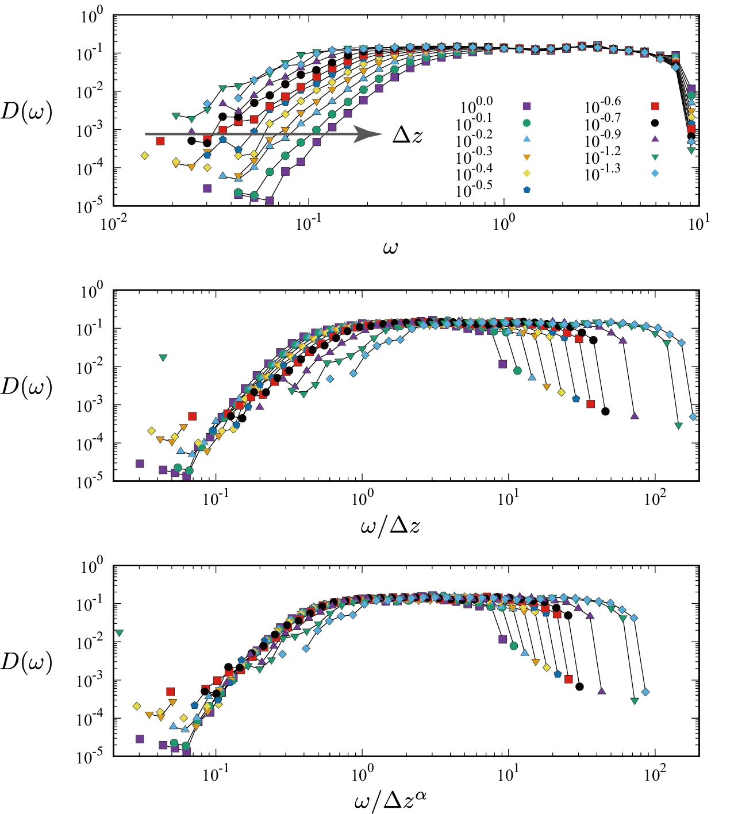
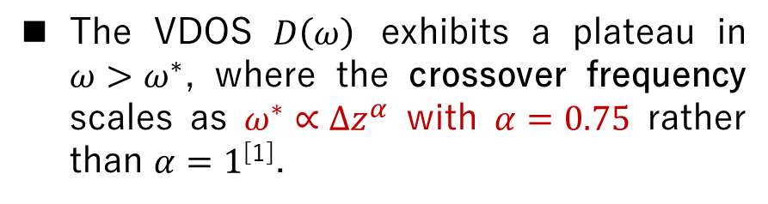
Vibrational properties
The VDOS $D\left(ω\right)$ exhibits a plateau in $ω>ω^{∗}$, where the crossover frequency scales as $ω^{∗}∝{∆z}^{α}$ with $α=0.75$ rather than $α=1$^{[1]}.
[1] M. Wyart, S.R. Nagel, and T.A. Witten, Europhys. Lett. 72, 486 (2005).

Slide 12
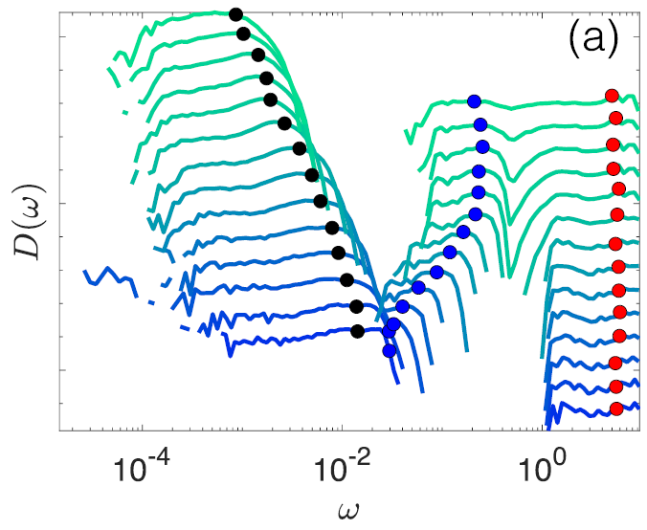
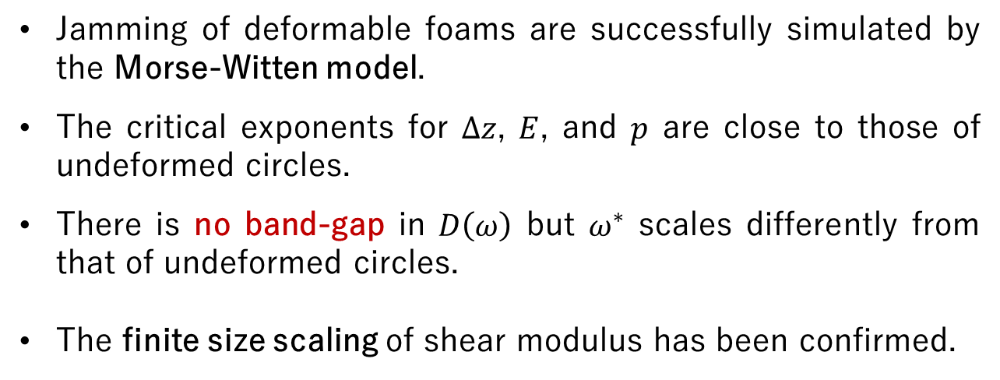
Summary
We have examined the effects of deformability of soft athermal particles
on the critical scaling, normal modes, and shear modulus near jamming.
Deformable polygons by
J. D. Treado et al., Phys. Rev. Materials 5, 055605 (2021).
Jamming of deformable foams are successfully simulated by the Morse-Witten model.
The critical exponents for $Δz$, $E$, and $p$ are close to those of undeformed circles.
There is no band-gap in $D\left(ω\right)$ but $ω^{∗}$ scales differently from that of undeformed circles.
The finite size scaling of shear modulus has been confirmed.

