Slide 1
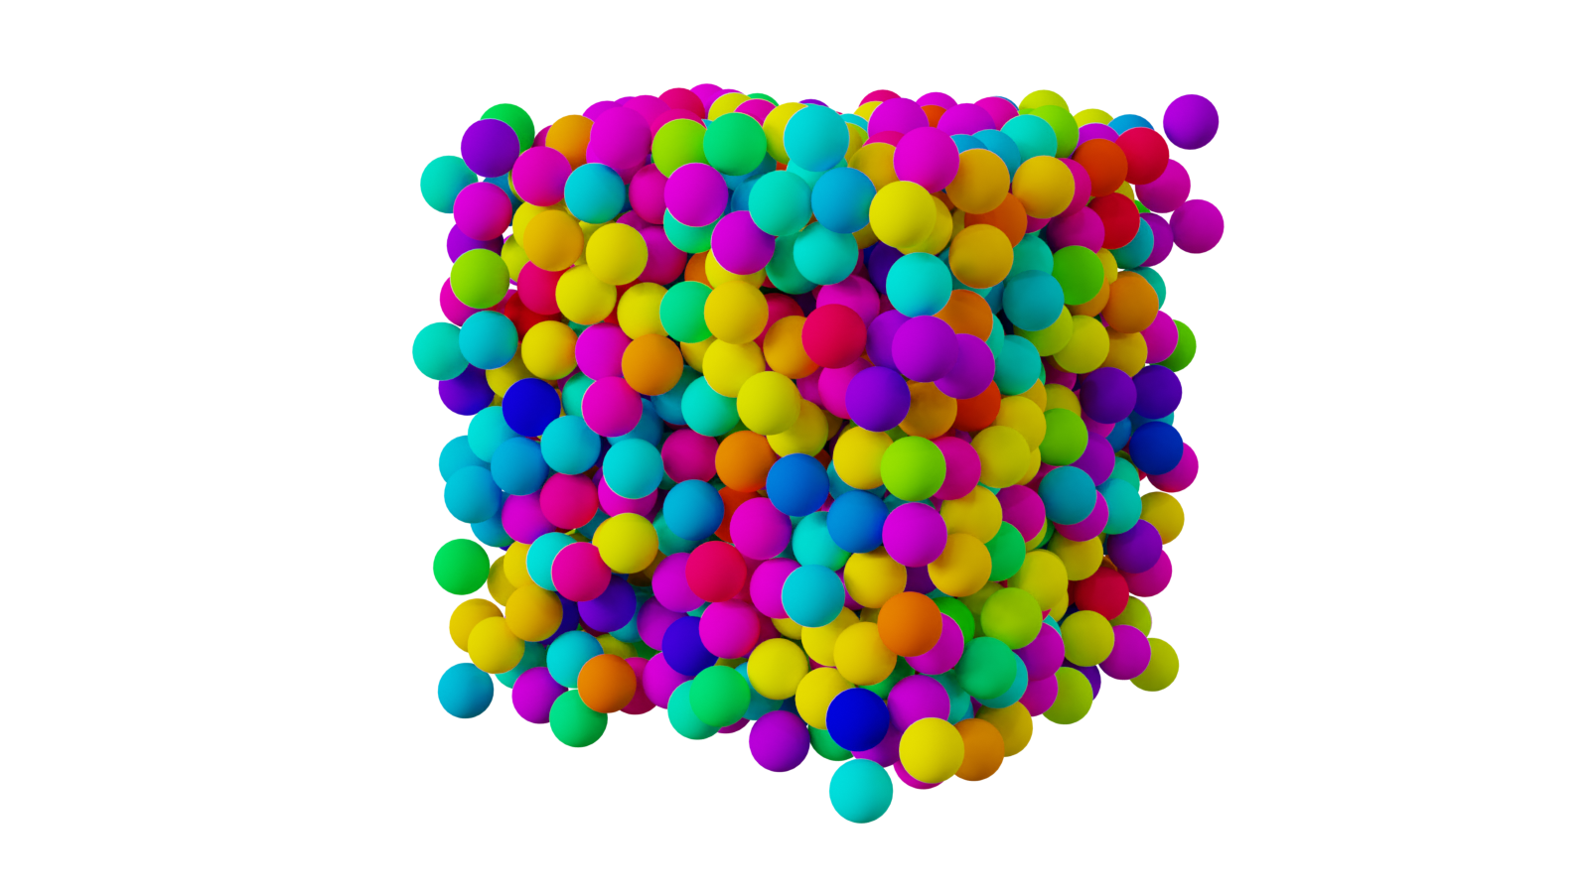



Mini-workshop on "Jamming, rheology and granular matter“
July 8th, 2025
Kinetic theory of
moderately dense dry granular particles under a simple shear
Shunsuke Iizuka¹, 〇Satoshi Takada¹, Hisao Hayakawa²
¹Tokyo Univ. Agri. & Tech., ²YITP, Kyoto Univ.

Slide 2
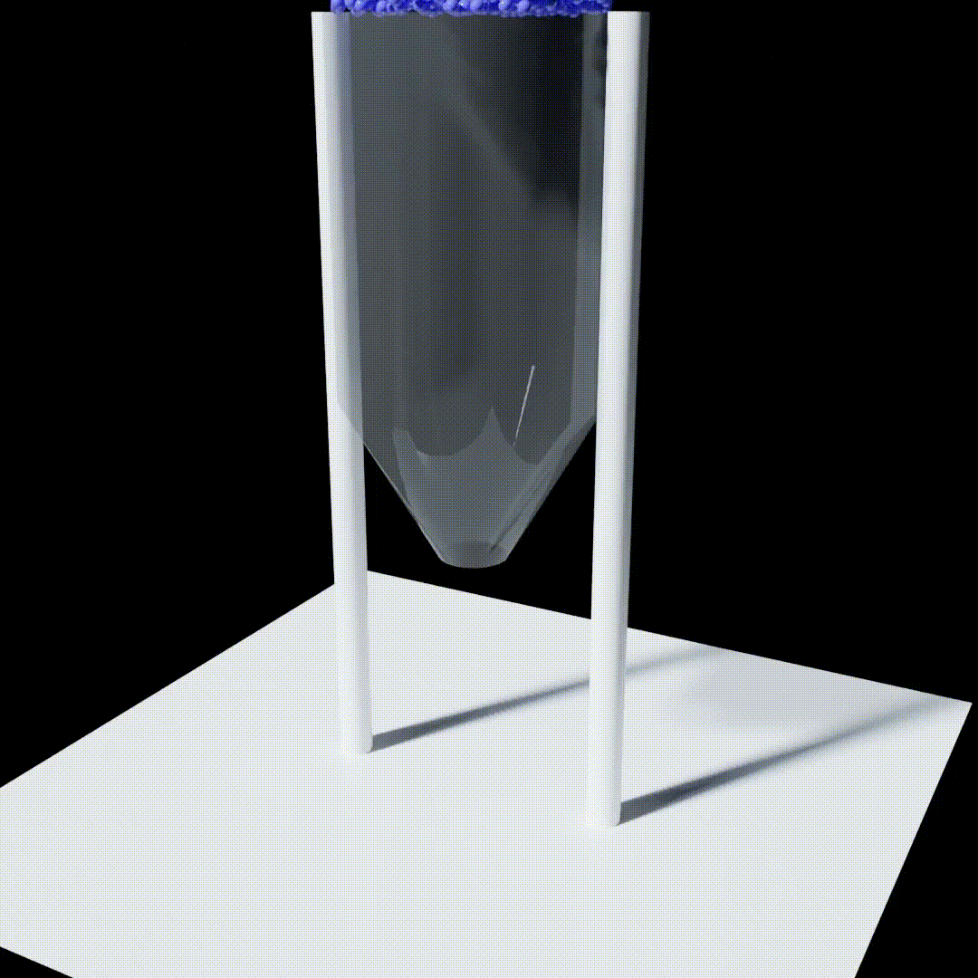
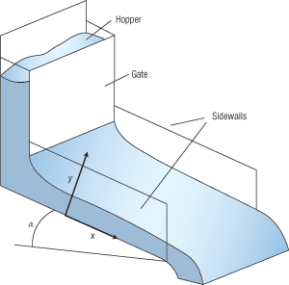
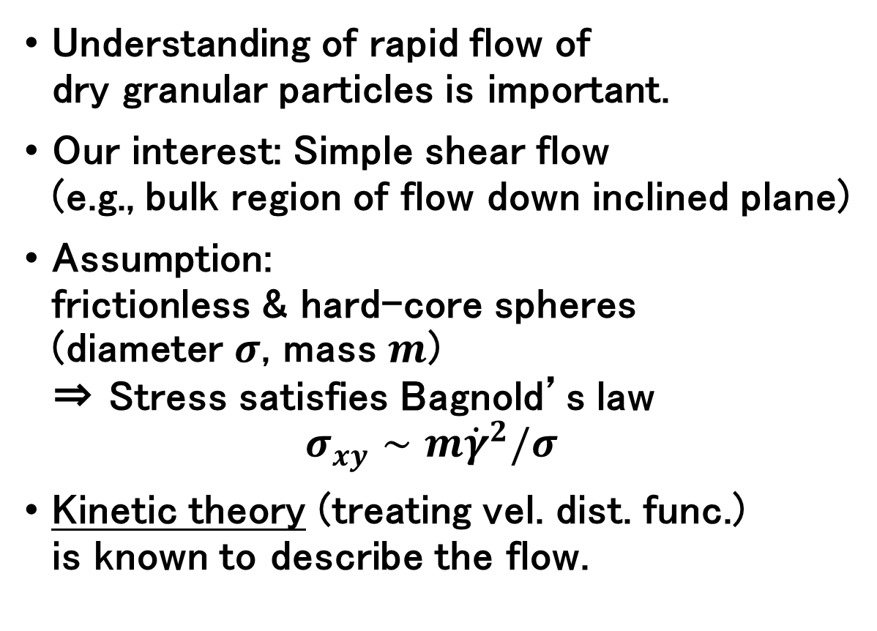
Introduction
Understanding of rapid flow of
dry granular particles is important.
Our interest: Simple shear flow
(e.g., bulk region of flow down inclined plane)
Assumption:
frictionless & hard-core spheres
(diameter $σ$, mass $m$)
⇒ Stress satisfies Bagnold’s law
$σ_{xy}∼m{\dot{γ}}^{2}/σ$
Kinetic theory (treating vel. dist. func.)
is known to describe the flow.
shear

Slide 3
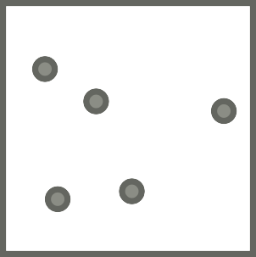


Why “gas theory”?
In this study, we consider the kinetic theory of granular “gases.”
Theory for denser systems is not easy to construct.
Kinetic theory has a long history.
Validity has been checked by many people.
Lecture course of statistical mechanics starts from gases.
Our approach
?
Our approach:
“From dilute to moderately dense”
From dilute to dense

Slide 4
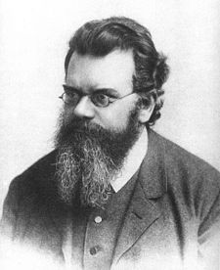
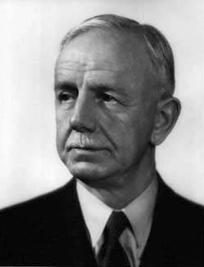

Hydrodynamic description
Our approach
Try to derive hydrodyn. eqs.
for granular gas flows
Dilute gases ($φ≪1$):
inelastic Boltzmann equation
Moderately dense gases ($φ≲0.5$):
inelastic Enskog equation
“Garzó and Dufty, PRE (1999)” is well-known.
⇒ Theory for homogeneous cooling state
Many people use this theory “without doubt.”
?
From dilute to dense
Boltzmann
Enskog

Slide 5
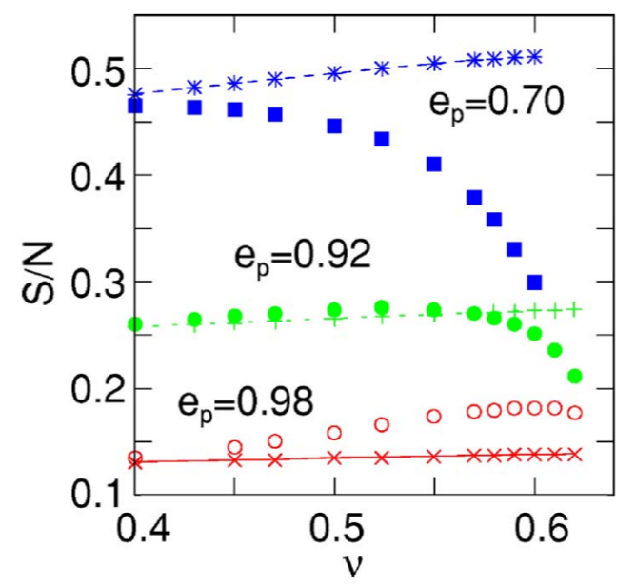
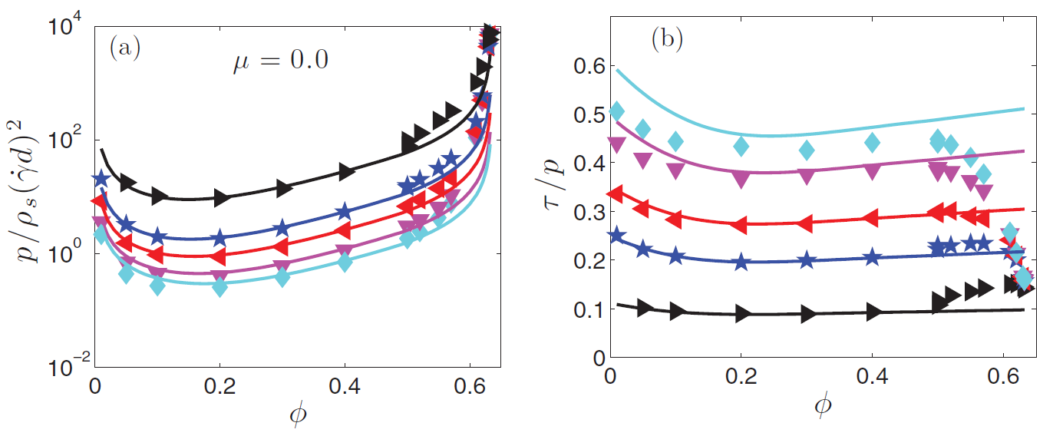
Validity of GD theory
Validity of GD theory is examined by simulations.
(e.g. Mitarai & Nakanishi (2007), Chialvo & Sundaresan (2013))
However, this is not true.
This theory is NOT applicable for sheared flows.
⇒ Why?
Theory seems to works well for $φ≲0.49$ (Alder transition).

Slide 6
However, GD theory is NOT applicable for sheared flows.
Why? ⇒ Base state is different!
GD theory:
= Homogenous cooling state (no external force)
Base state is homogeneous and isotropic.
✓ Viscosity: determined by the local fluctuation
of velocity gradient
※ Normal stress differences are
also important for shear flows,
but GD theory cannot predict them.
Our interest = sheared flow
= Base state is homogeneous but anisotropic.
  Viscosity: should be determined
  by homogeneous sheared state
GD theory is NOT applicable as it is.
Our motivation:
To construct the theory by considering a proper base state.

Slide 7
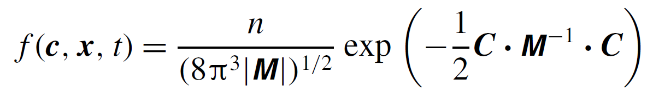
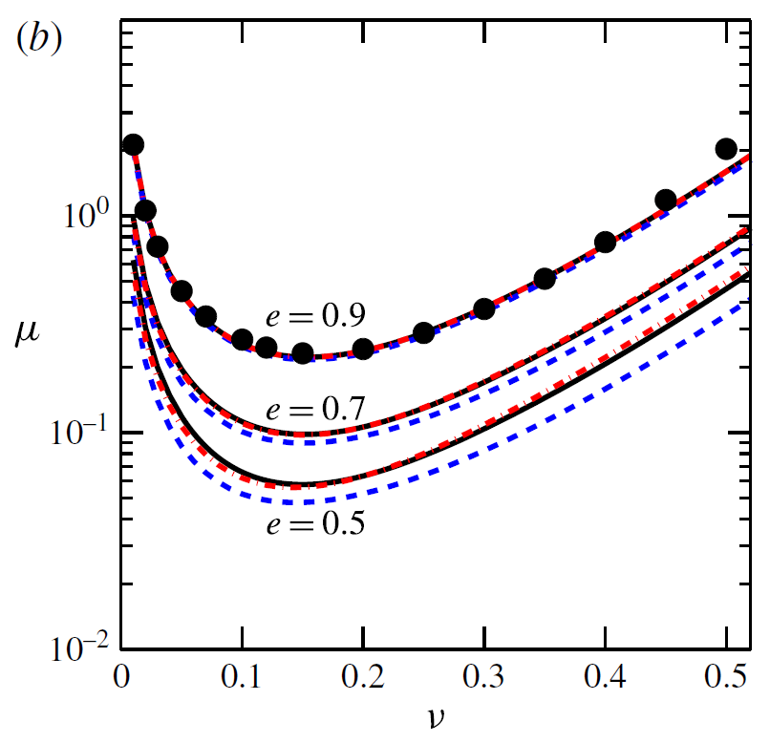
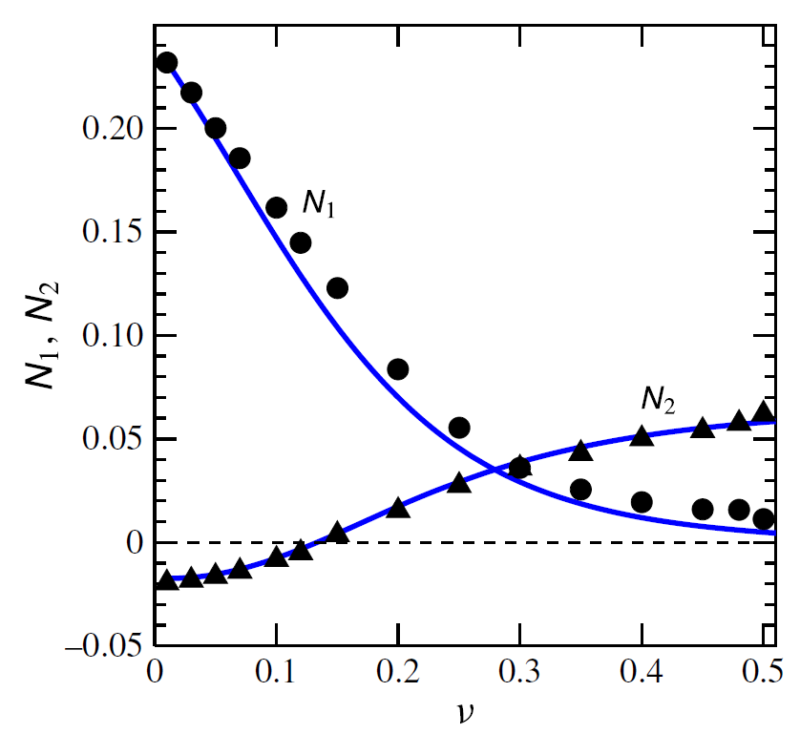
Another approach
Saha & Alam JFM (2016) constructed the kinetic theory
in terms of the anisotropic Gaussian model.
  Perfect agreement in the wide range of the volume fraction

Slide 8
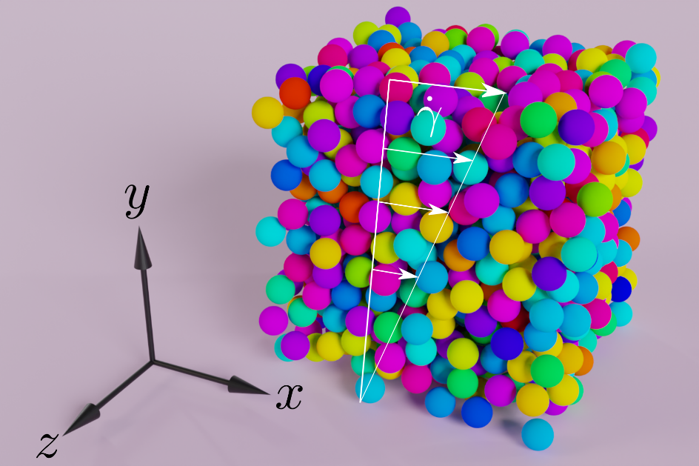
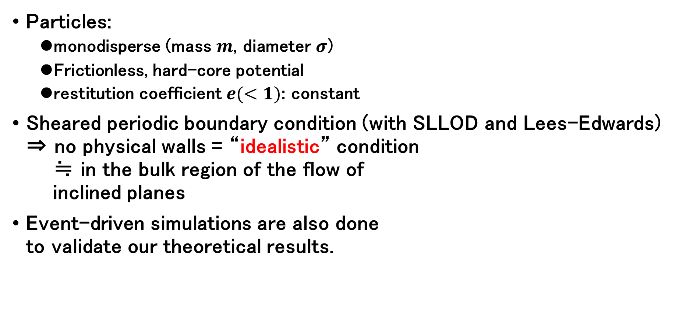



Model and setup
$$U(r)$$
Particles:
  monodisperse (mass $m$, diameter $σ$)
  Frictionless, hard-core potential
  restitution coefficient $e(<1)$: constant
Sheared periodic boundary condition (with SLLOD and Lees-Edwards)
⇒ no physical walls = “idealistic” condition
≒ in the bulk region of the flow of
inclined planes
Event-driven simulations are also done
to validate our theoretical results.
$$σ$$
$$r$$

Slide 9
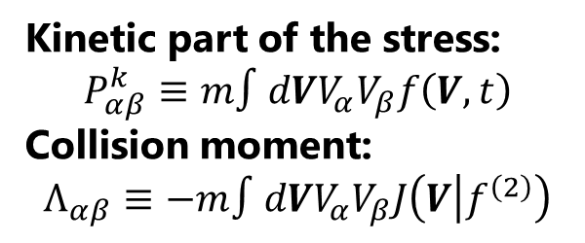
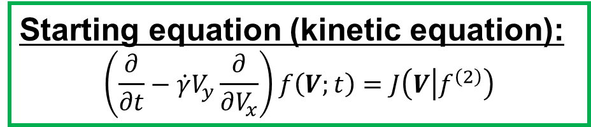
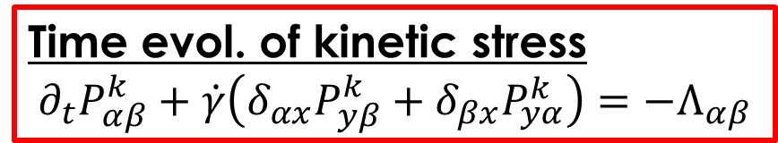
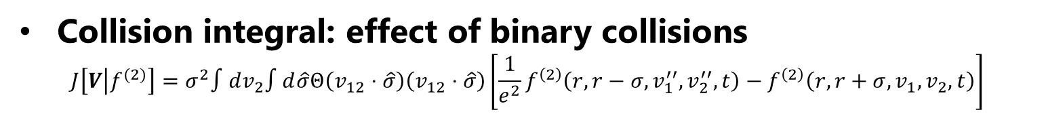
Kinetic theory of sheared granular flows
Starting equation (kinetic equation):
$$\left(\frac{∂}{∂t}−\dot{γ}V_{y}\frac{∂}{∂V_{x}}\right)f\left(V;t\right)=J\left(V | f^{\left(2\right)}\right)$$
Time evol. of one-body vel. dist. func.
shear
collisions
Collision integral: effect of binary collisions
$J\left[V | f^{(2)}\right]=σ^{2}∫dv_{2}∫d\hat{σ}Θ\left(v_{12}⋅\hat{σ}\right)\left(v_{12}⋅\hat{σ}\right)\left[\frac{1}{e^{2}}f^{\left(2\right)}\left(r,r−σ,v_{1}^{′′},v_{2}^{′′},t\right)−f^{\left(2\right)}\left(r,r+σ,v_{1},v_{2},t\right)\right]$
$f^{\left(2\right)}\left(r_{1},r_{2},v_{1},v_{2},t\right)$: two-body distribution function
※ Kinetic eq. is not closed for one-body dist. func.
$∫dVmV_{α}V_{β}×(kinetic eq.)$
Kinetic part of the stress:
$$P_{αβ}^{k}≡m∫dVV_{α}V_{β}f\left(V, t\right)$$
Collision moment:
$$Λ_{αβ}≡−m∫dVV_{α}V_{β}J\left(V | f^{\left(2\right)}\right)$$
Time evol. of kinetic stress
$$∂_{t}P_{αβ}^{k}+\dot{γ}\left(δ_{αx}P_{yβ}^{k}+δ_{βx}P_{yα}^{k}\right)=−Λ_{αβ}$$

Slide 10
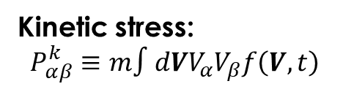
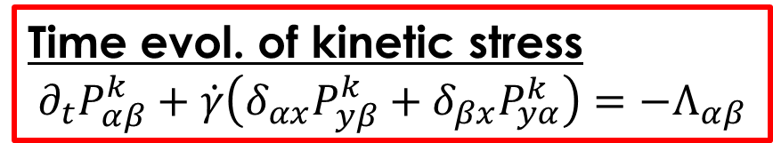

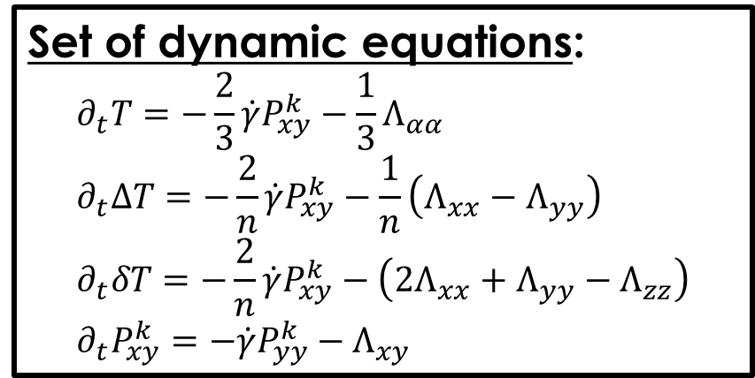
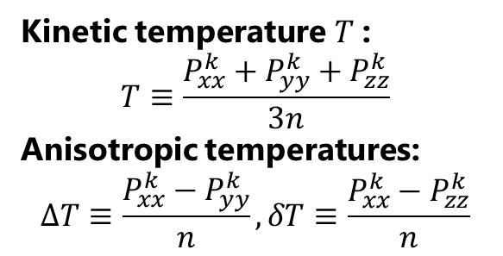
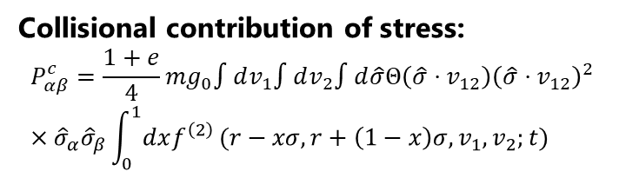
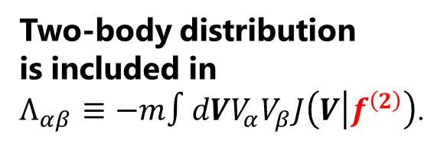
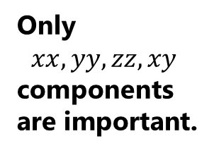
Kinetic theory of sheared granular flows
Time evol. of kinetic stress
$$∂_{t}P_{αβ}^{k}+\dot{γ}\left(δ_{αx}P_{yβ}^{k}+δ_{βx}P_{yα}^{k}\right)=−Λ_{αβ}$$
Kinetic stress:
$$P_{αβ}^{k}≡m∫dVV_{α}V_{β}f\left(V, t\right)$$
Kinetic temperature $T$:
$$T≡\frac{P_{xx}^{k}+P_{yy}^{k}+P_{zz}^{k}}{3n}$$
Anisotropic temperatures:
$$ΔT≡\frac{P_{xx}^{k}−P_{yy}^{k}}{n}, δT≡\frac{P_{xx}^{k}−P_{zz}^{k}}{n}$$
Set of dynamic equations:
$$∂_{t}T=−\frac{2}{3}\dot{γ}P_{xy}^{k}−\frac{1}{3}Λ_{αα} \\ ∂_{t}ΔT=−\frac{2}{n}\dot{γ}P_{xy}^{k}−\frac{1}{n}\left(Λ_{xx}−Λ_{yy}\right) \\ ∂_{t}δT=−\frac{2}{n}\dot{γ}P_{xy}^{k}−\left(2Λ_{xx}+Λ_{yy}−Λ_{zz}\right) \\ ∂_{t}P_{xy}^{k}=−\dot{γ}P_{yy}^{k}−Λ_{xy}$$
Only
$$xx, yy, zz, xy$$
components are important.
for $T, ΔT,δT,P_{xy}^{k}$
Collisional contribution of stress:
$$P_{αβ}^{c}=\frac{1+e}{4}mg_{0}∫dv_{1}∫dv_{2}∫d\hat{σ}Θ\left(\hat{σ}⋅v_{12}\right){\left(\hat{σ}⋅v_{12}\right)}^{2} \\ ×{\hat{σ}}_{α}{\hat{σ}}_{β}\int_{0}^{1}{dxf^{\left(2\right)}}(r−xσ,r+\left(1−x\right)σ,v_{1},v_{2};t)$$
Up to here, no approximation. BUT, not solvable!
Why? ⇒ not closed for the one-body distribution
Two-body distribution
is included in
$Λ_{αβ}≡−m∫dVV_{α}V_{β}J\left(V | f^{\left(2\right)}\right)$.
We need a closure.

Slide 11

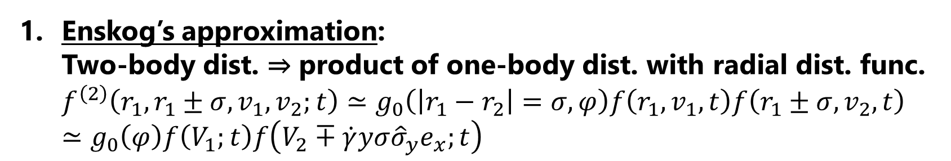
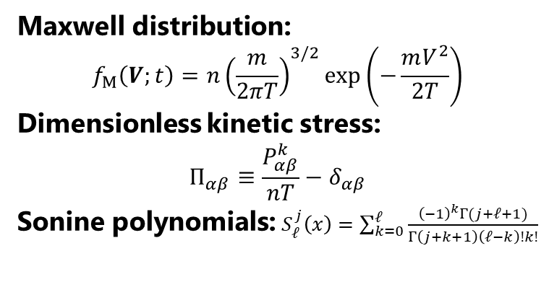
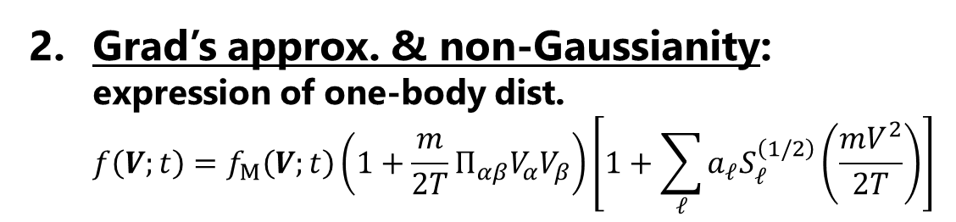
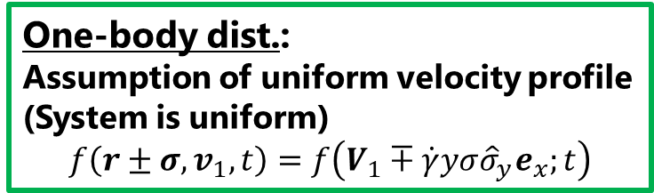
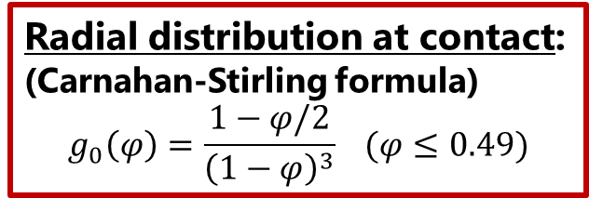
Two approximations as closure
Enskog’s approximation:
Two-body dist. ⇒ product of one-body dist. with radial dist. func.
$f^{\left(2\right)}\left(r_{1},r_{1}±σ,v_{1},v_{2};t\right)≃g_{0}\left(\left|r_{1}−r_{2}\right|=σ,φ\right)f\left(r_{1},v_{1},t\right)f\left(r_{1}±σ,v_{2},t\right)$
$≃g_{0}\left(φ\right)f\left(V_{1};t\right)f\left(V_{2}∓\dot{γ}yσ{\hat{σ}}_{y}e_{x};t\right)$
Radial distribution at contact:
(Carnahan-Stirling formula)
$$g_{0}\left(φ\right)=\frac{1−φ/2}{{\left(1−φ\right)}^{3}} (φ≤0.49)$$
One-body dist.:
Assumption of uniform velocity profile
(System is uniform)
$$f\left(r±σ,v_{1},t\right)=f\left(V_{1}∓\dot{γ}yσ{\hat{σ}}_{y}e_{x};t\right)$$
Grad’s approx. & non-Gaussianity:
expression of one-body dist.
$f\left(V;t\right)=f_{M}\left(V;t\right)\left(1+\frac{m}{2T}Π_{αβ}V_{α}V_{β}\right)\left[1+\sum_{ℓ}{a_{ℓ}S_{ℓ}^{\left(1/2\right)}\left(\frac{mV^{2}}{2T}\right)}\right]$
Maxwell distribution:
$$f_{M}\left(V;t\right)=n{\left(\frac{m}{2πT}\right)}^{3/2}exp\left(−\frac{mV^{2}}{2T}\right)$$
Dimensionless kinetic stress:
$$Π_{αβ}≡\frac{P_{αβ}^{k}}{nT}−δ_{αβ}$$
Sonine polynomials: $S_{ℓ}^{j}\left(x\right)=\sum_{k=0}^{ℓ}{\frac{{\left(−1\right)}^{k}Γ(j+ℓ+1)}{Γ\left(j+k+1\right)\left(ℓ−k\right)!k!}}$
$a_{2}^{NE}\left(e\right)=\frac{16\left(1−e\right)\left(1−2e^{2}\right)}{81−17e+30e^{2}(1−e)}$ (van Noije & Ernst (1998))

Slide 12
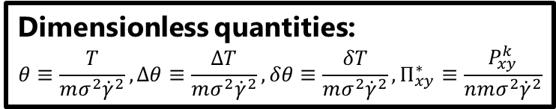
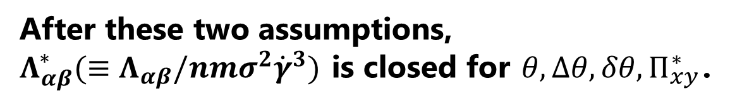
Closed equations
Dimensionless quantities:
$$θ≡\frac{T}{mσ^{2}{\dot{γ}}^{2}}, Δθ≡\frac{ΔT}{mσ^{2}{\dot{γ}}^{2}}, δθ≡\frac{δT}{mσ^{2}{\dot{γ}}^{2}}, Π_{xy}^{∗}≡\frac{P_{xy}^{k}}{nmσ^{2}{\dot{γ}}^{2}}$$
After these two assumptions,
$Λ_{αβ}^{∗}(≡Λ_{αβ}/nmσ^{2}{\dot{γ}}^{3})$ is closed for $θ, Δθ,δθ, Π_{xy}^{∗}$.
Previously,
lower-order terms were already known ⇒
(up to sixth order)
Santos, Montanero, Dufty, & Brey, PRE (1998)
Montanero, Garzó, Santos, & Brey, JFM (1999)
Takada, Hayakawa, Santos, & Garzó, PRE (2020)
This study: Full-order solutions are derived.
$$Λ_{αβ}^{∗}=Λ_{αβ}^{∗}(θ,Δθ,δθ,Π_{xy}^{∗},a_{2})$$

Slide 13
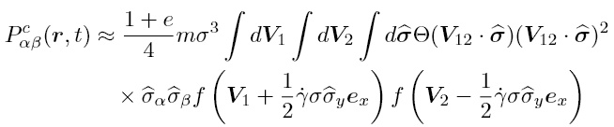
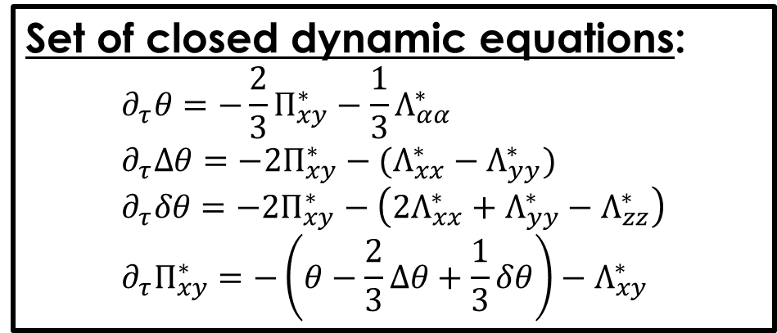
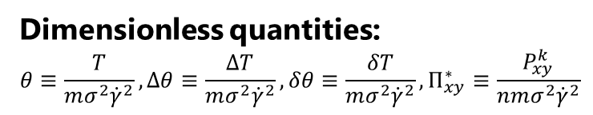


Dynamic equations
Set of closed dynamic equations:
$$∂_{τ}θ=−\frac{2}{3}Π_{xy}^{∗}−\frac{1}{3}Λ_{αα}^{∗} \\ ∂_{τ}Δθ=−2Π_{xy}^{∗}−(Λ_{xx}^{∗}−Λ_{yy}^{∗}) \\ ∂_{τ}δθ=−2Π_{xy}^{∗}−\left(2Λ_{xx}^{∗}+Λ_{yy}^{∗}−Λ_{zz}^{∗}\right) \\ ∂_{τ}Π_{xy}^{∗}=−\left(θ−\frac{2}{3}Δθ+\frac{1}{3}δθ\right)−Λ_{xy}^{∗}$$
$$τ≡\dot{γ}t$$
Dimensionless quantities:
$$θ≡\frac{T}{mσ^{2}{\dot{γ}}^{2}}, Δθ≡\frac{ΔT}{mσ^{2}{\dot{γ}}^{2}}, δθ≡\frac{δT}{mσ^{2}{\dot{γ}}^{2}}, Π_{xy}^{∗}≡\frac{P_{xy}^{k}}{nmσ^{2}{\dot{γ}}^{2}}$$
$$Λ_{αβ}^{∗}=Λ_{αβ}^{∗}(θ,Δθ,δθ,Π_{xy}^{∗},a_{2})$$
Dynamics are determined
by solving these coupled equations.
Collisional contribution of stress is also evaluated as:
We focus on the steady-state solution.

Slide 14
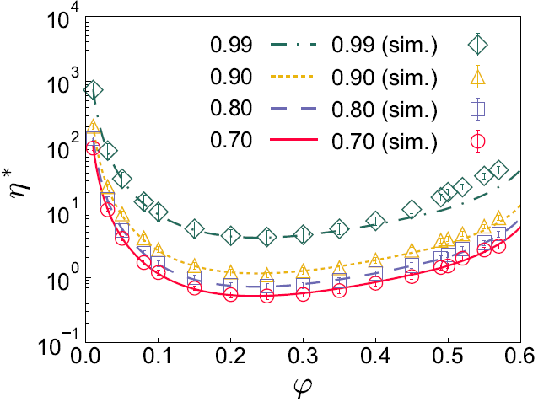
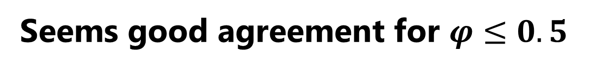

Results: viscosity
$$η^{∗}=−Π_{xy}^{k}$$
Seems good agreement for $φ≤0.5$

Slide 15
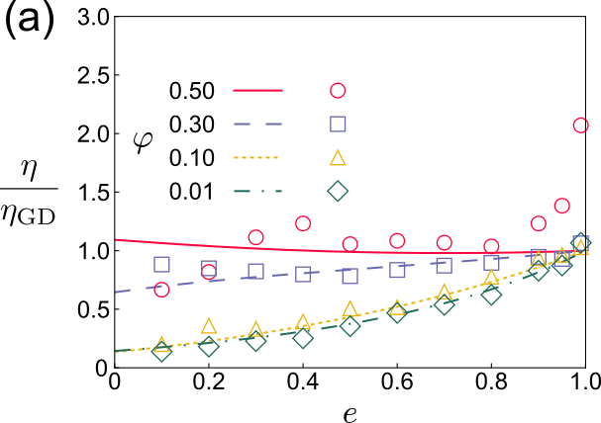
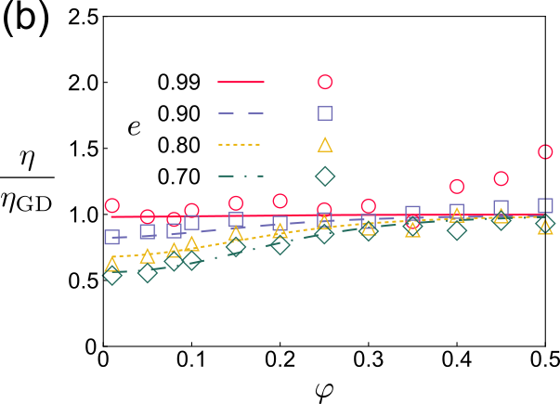
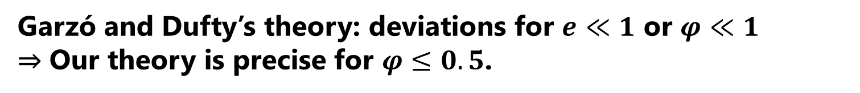
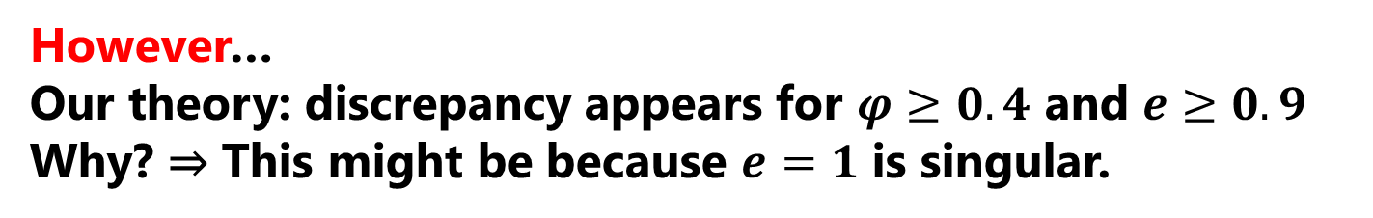
Deviation from GD theory
Ratio of the viscosity $η$ from our theory to GD theory $η_{GD}$
Garzó and Dufty’s theory: deviations for $e≪1$ or $φ≪1$
⇒ Our theory is precise for $φ≤0.5$.
However…
Our theory: discrepancy appears for $φ≥0.4$ and $e≥0.9$
Why? ⇒ This might be because $e=1$ is singular.

Slide 16
Kinetic temperature
Kinetic temperature $θ=\frac{T}{md^{2}{\dot{γ}}^{2}}$
The temperature shows better agreement than the viscosity.

Slide 17
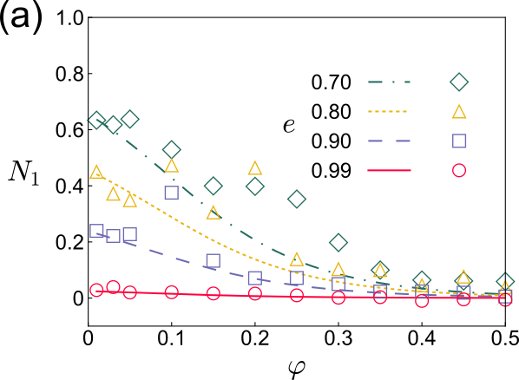
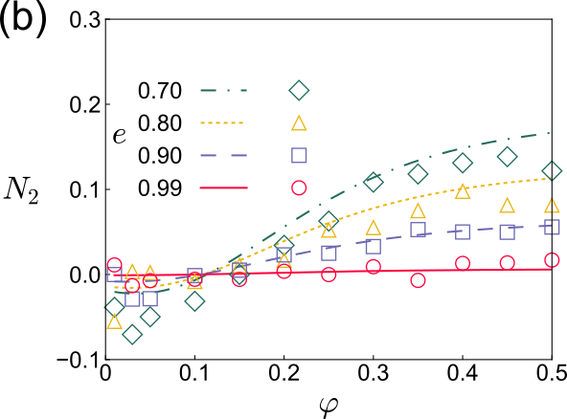
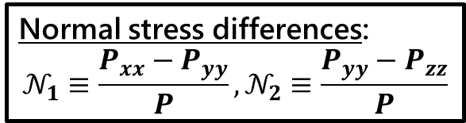
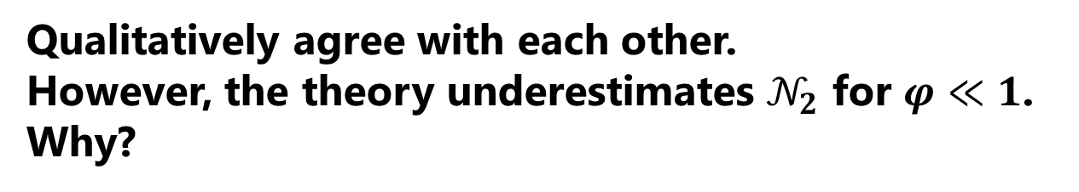
Normal stress differences
Normal stress differences:
$$𝒩_{1}≡\frac{P_{xx}−P_{yy}}{P},𝒩_{2}≡\frac{P_{yy}−P_{zz}}{P}$$
Because the system is anisotropic,
the normal stress differences are also important.
(👉 GD theory cannot explain these quantities.)
Qualitatively agree with each other.
However, the theory underestimates $𝒩_{2}$ for $φ≪1$.
Why?

Slide 18
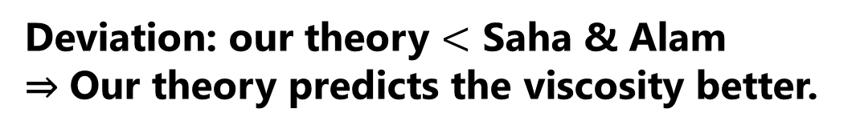
Comparison with other approach
Relative error of the viscosity with the simulation data
👉 Saha & Alam, JFM (2016)
Deviation: our theory $<$ Saha & Alam
⇒ Our theory predicts the viscosity better.

Slide 19
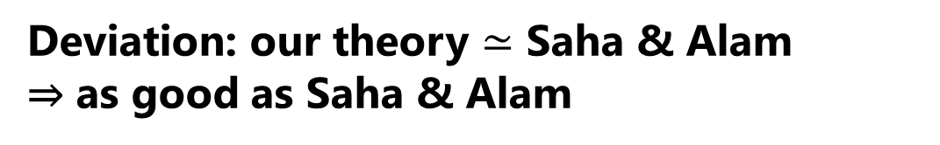
Comparison with other approach
Relative error of the second normal stress difference with the simulation data
Deviation: our theory $≃$ Saha & Alam
⇒ as good as Saha & Alam

Slide 20
Discussion
What is the future directions of this study?
Sheared condition under realistic situations
(like chute flow etc.)
⇒ We have been working it
using Chapman-Enskog approach.
Binary or polydisperse systems
The formulation is done, but the segregation is not added.

Slide 21
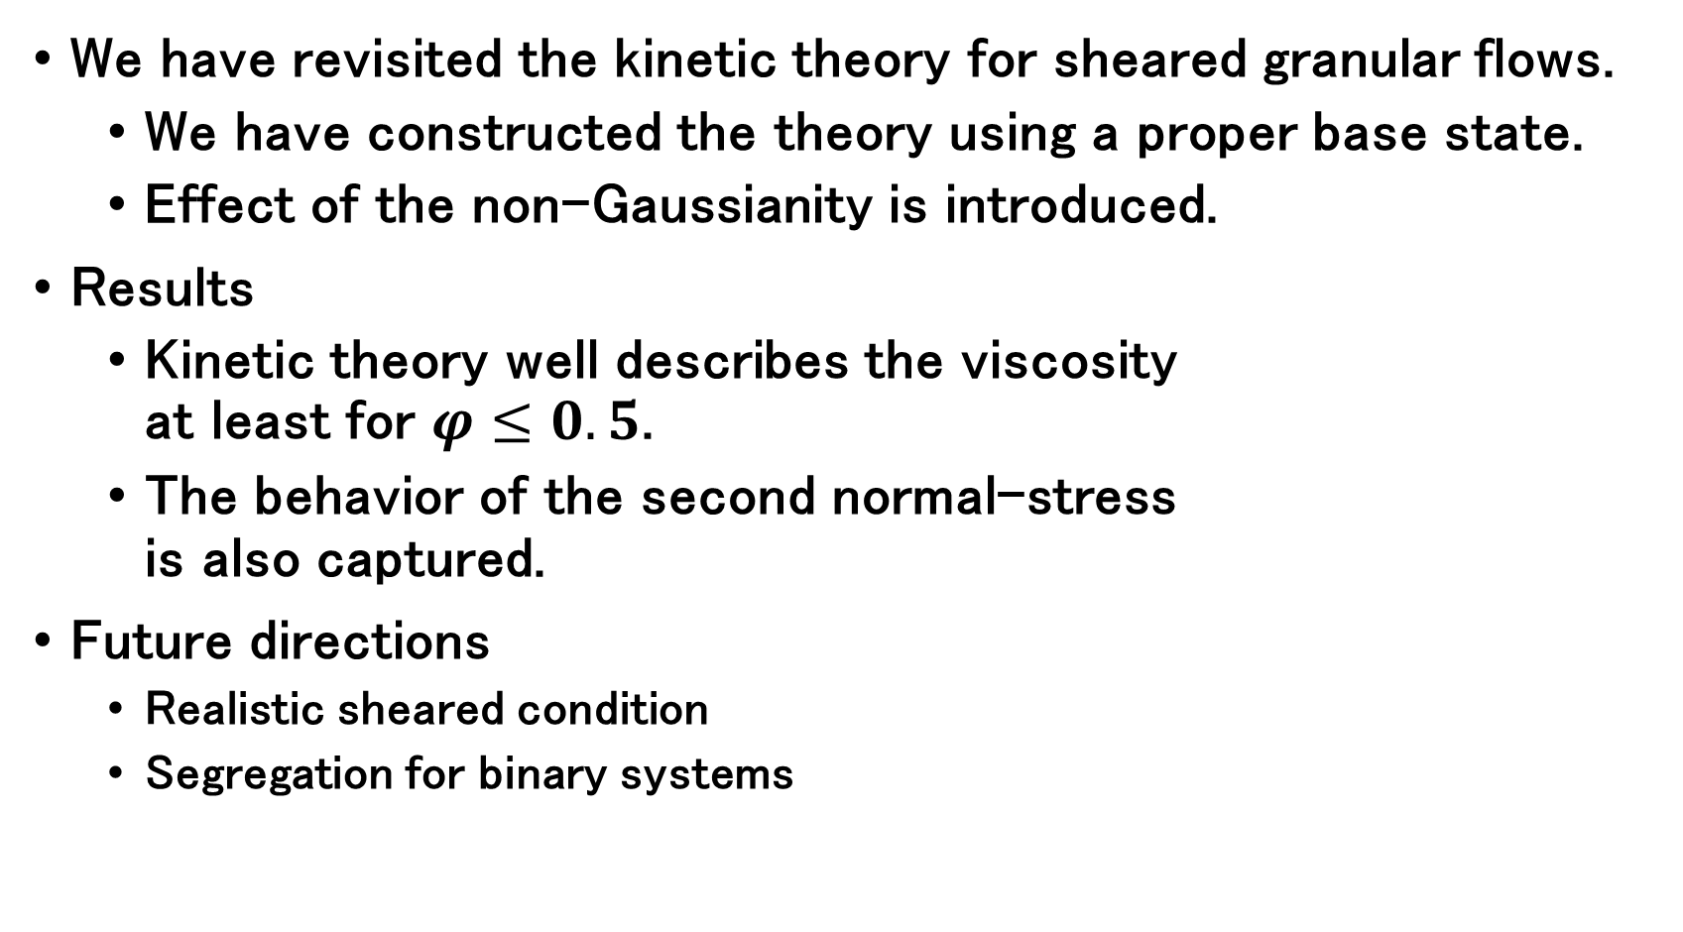
Summary
We have revisited the kinetic theory for sheared granular flows.
  We have constructed the theory using a proper base state.
  Effect of the non-Gaussianity is introduced.
Results
  Kinetic theory well describes the viscosity
  at least for $φ≤0.5$.
  The behavior of the second normal-stress
  is also captured.
Future directions
  Realistic sheared condition
  Segregation for binary systems

