Slide 1


Investigation of the Coulomb Contribution to Nuclear Structure
Kenta Hagihara^{A}, Takashi Nakatsukasa^{B,A}, Nobuo Hinohara^{B,A}
Univ. Tsukuba^{A}, Center for Computational Sciences^{B}
Notes:
Toroidal shape in hyper heavy nuclei (via cranking something?)
C effects on Bobble shape
Electron screening effects in outer crust region (interesting)
Fission fragment (daughter nucleus A~52?)
Nilsson diagram and the C

Slide 2

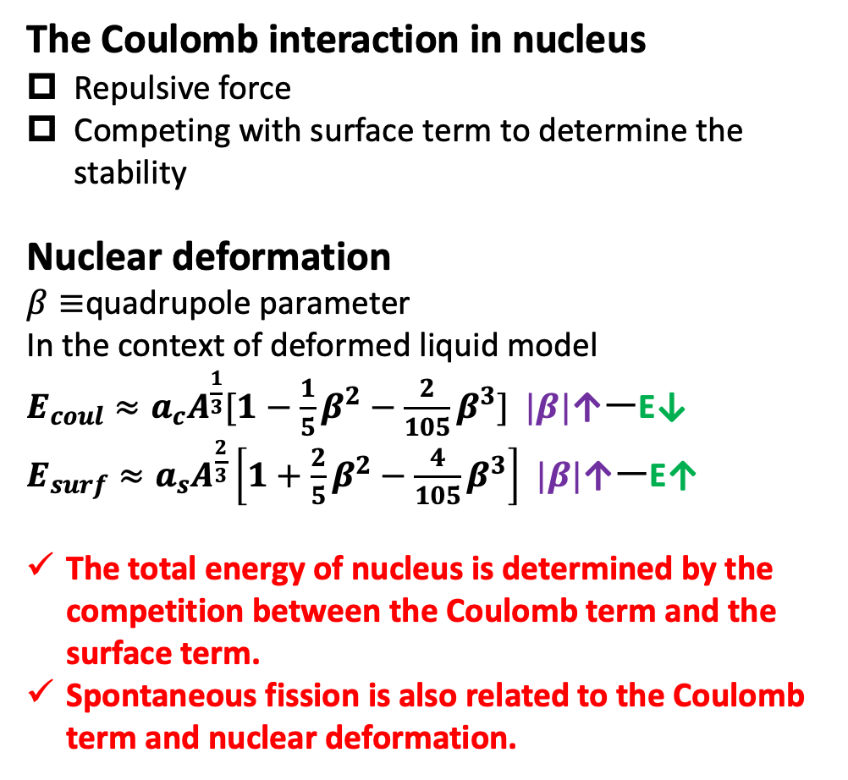
The C interaction in finite nuclei
Introduction
The Coulomb interaction in nucleus
Repulsive force
Competing with surface term to determine the stability
Nuclear deformation
$β≡$quadrupole parameter
In the context of deformed liquid model
$E_{coul}≈a_{c}A^{\frac{1}{3}}[1−\frac{1}{5}β^{2}−\frac{2}{105}β^{3}]$ $|β|$↑ーE↓
$E_{surf}≈a_{s}A^{\frac{2}{3}}\left[1+\frac{2}{5}β^{2}−\frac{4}{105}β^{3}\right]$ $|β|$↑ーE↑
The total energy of nucleus is determined by the competition between the Coulomb term and the surface term.
Spontaneous fission is also related to the Coulomb term and nuclear deformation.
Motivation
We can isolate and evaluate contributions beyond the nuclear force that influence nuclear deformation and the location of the drip lines.
It provides insight into nuclear deformation and spontaneous fission.
It may allow us to discuss previously unexplored or unknown phenomena.
Content
Solving the HFB equation under the assumption of axial symmetry, we investigate the ground-state properties of even-even nuclei.
How the Coulomb interaction affects the expectation values.
Notes:
Today, I will introduce the role of the Coulomb interaction in atomic nuclei.
The Coulomb force between protons is a repulsive force. This means that protons push each other away.
Inside a nucleus, there is also the nuclear force. The nuclear force pulls nucleons together at short distance.
So, there is a competition: the Coulomb force tries to expand the nucleus, and the nuclear force tries to keep it compact.
This competition determines the stability and the shape of nuclei.
Next, I explain nuclear deformation.
We introduce a deformation parameter, beta. Beta describes how much the nucleus deviates from a spherical shape.
In the liquid drop model, the Coulomb energy and the surface energy can be expanded as functions of beta.
The important point is this:
When the nucleus deforms, the Coulomb energy decreases, but the surface energy increases.
So the total energy of the nucleus is determined by the balance between these two terms.
For heavy nuclei, the Coulomb effect becomes large. This is why deformation is often favored in heavy systems.
Spontaneous fission is also related to this competition between Coulomb energy and surface energy.
Now I explain the motivation of this work.
Usually, in nuclear structure studies, we focus mainly on the nuclear force.
In this study, we try to isolate and evaluate the Coulomb interaction separately.
We want to understand:
How much does the Coulomb force affect nuclear deformation? How does it influence the position of the drip lines? How does it change physical quantities such as energy and Fermi levels?
In this work, we solve the Hartree–Fock–Bogoliubov equation under the assumption of axial symmetry.
We investigate even–even nuclei in their ground states.
Then we analyze how changing the Coulomb interaction affects physical quantities of the nucleus.

Slide 3
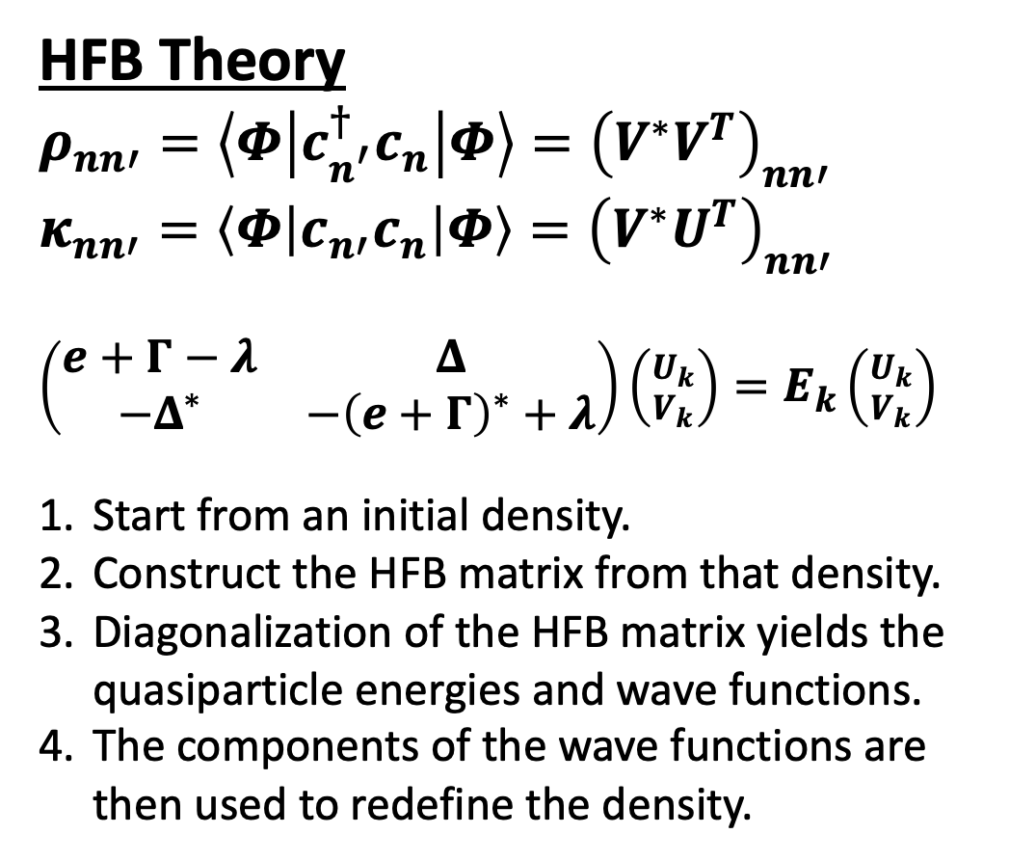
The C interaction in finite nuclei
HFB theory and HFBTHO
HFB Theory
$ρ_{nn′}=\left\langle Φ\left|c_{n^{′}}^{†}c_{n}\right|Φ\right\rangle ={\left(V^{∗}V^{T}\right)}_{nn′}$
$κ_{nn′}=\left\langle Φ\left|c_{n′}c_{n}\right|Φ\right\rangle ={\left(V^{∗}U^{T}\right)}_{nn′}$
$\left(\begin{matrix}e+Γ−λ & Δ \\ −Δ^{∗} & −{\left(e+Γ\right)}^{∗}+λ\end{matrix}\right)\left({U_{k} \atop V_{k}}\right)=E_{k}\left({U_{k} \atop V_{k}}\right)$
Start from an initial density.
Construct the HFB matrix from that density.
Diagonalization of the HFB matrix yields the quasiparticle energies and wave functions.
The components of the wave functions are then used to redefine the density.
HFBTHO
Hartree-Fock-Bogoliubov equation solver
self-consistent calculation assuming the axial symmetry and the time-reversal symmetry
Quasi-particle wave functions are constructed by the deformed harmonic oscillator basis in the cylindrical coordinates
Deformed nuclei, weakly bound nuclei
Notes:
An initial densityは、Woods-Saxon potentialを仮定したシュレディンガー方程式を解くことで得る。
密度とペアリング密度を使って、エネルギーが定義できる。そのエネルギーを変分することでハミルトニアンが得られる。
そのハミルトニアンを使ってHFB行列を定義。
そして対角化することで

Slide 4
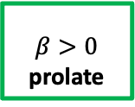
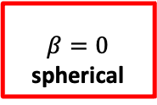
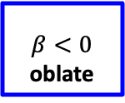
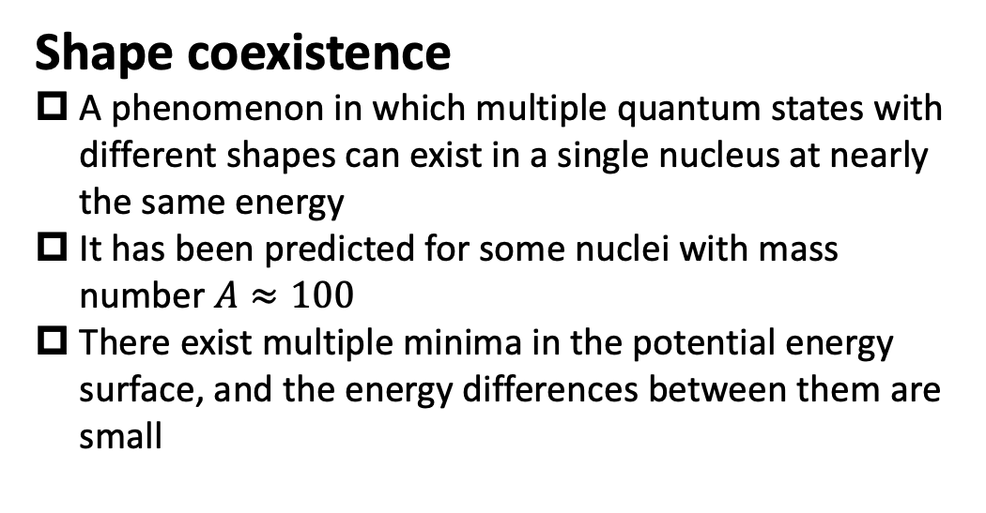
The C interaction in finite nuclei
Nuclear quadrupole deformation
Shape coexistence
A phenomenon in which multiple quantum states with different shapes can exist in a single nucleus at nearly the same energy
It has been predicted for some nuclei with mass number $A≈100$
There exist multiple minima in the potential energy surface, and the energy differences between them are small
Prolate dominance
In the harmonic-oscillator model, particle-hole symmetry suggests a symmetric behavior of nuclear deformation.
However, both experiments and theoretical calculations show that many even-even nuclei are prolate deformed in their ground states.
Possible mechanism One of the explanations is that, when high-j orbitals split, the change is larger on the prolate side, which may favor prolate deformation.
$$β<0$$
oblate
$$β=0$$
spherical
$$β>0$$
prolate

Slide 5
The C interaction in finite nuclei
$β_{2}$ SLY4
BLUE: oblate shape
YELLOW: spherical
RED: prolate
BLACK: very prolate
Magic numbers are not affected by the Coulomb interaction
Proton-rich nuclei become unbound due to the repulsive force (natural)
Neutron drip-line is shifted to neutron-rich region (new!!)
Deformation becomes larger
No Coulomb
Coulomb
Notes:
Beta2が何か

Slide 6
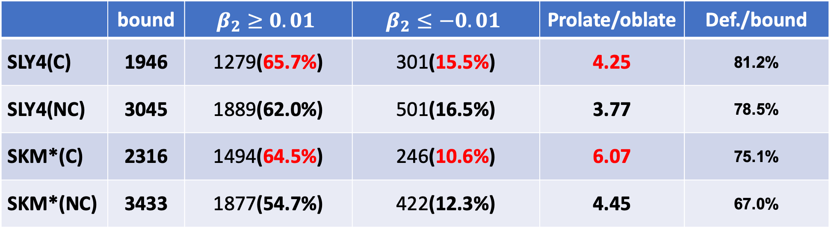
The C interaction in finite nuclei
How many nuclei ?
 | bound | $$β_{2}≥0.01$$ | $$β_{2}≤−0.01$$ | Prolate/oblate | Def./bound
SLY4(C) | 1946 | 1279(65.7%) | 301(15.5%) | 4.25 | 81.2%
SLY4(NC) | 3045 | 1889(62.0%) | 501(16.5%) | 3.77 | 78.5%
SKM*(C) | 2316 | 1494(64.5%) | 246(10.6%) | 6.07 | 75.1%
SKM*(NC) | 3433 | 1877(54.7%) | 422(12.3%) | 4.45 | 67.0%
Systematic Trend
The Coulomb interaction enhances the prolate shape, reduces the oblate shape
It makes spherical become deformed

Slide 7
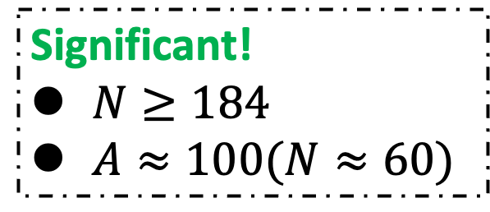
The C interaction in finite nuclei
Oblate to prolate
Significant!
$N≥184$
$A≈100(N≈60)$

Slide 8
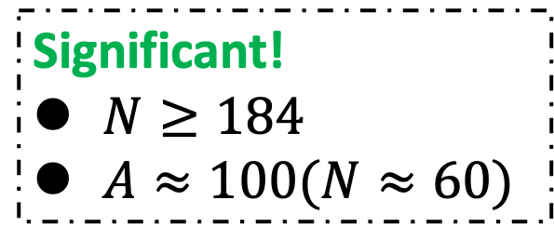
The C interaction in finite nuclei
${Δ|β}_{2}|≡{|β}_{2}^{C}| −|β_{2}^{NC}|$ (SLY4)
Significant!
$N≥184$
$A≈100(N≈60)$

Slide 9
The C interaction in finite nuclei
Constrained HFB for ¹⁰⁰Sr $(δ\left[E\left[ρ, κ\right]−λ_{N}\left\langle \hat{N}\right\rangle −λ_{20}\left\langle {\hat{Q}}_{20}\right\rangle \right]=0 )$
The potential energy surface (PES) changes due to the Coulomb interaction
At the large deformed area, the Coulomb energy itself favors the oblate deformation
At the medium deformed area, there are no significant change in the Coulomb energy

Slide 10
The C interaction in finite nuclei
A possible mechanism of the prolate dominance
Nuclei with prolate ground states often lie in regions of larger deformation than those with oblate ground states.
In contrast, oblate ground states are often found in regions of smaller deformation.
The Coulomb interaction does not differ significantly between prolate and oblate shapes at small deformation.
However, because prolate shapes are typically associated with larger deformation, they gain a larger Coulomb-energy advantage than oblate shapes.
That’s why, prolate shape can be energetically more favored, which may be one of the reasons why many nuclei exhibit the prolate shapes
Notes:
ミニマムの位置ではプロレートの方がエネルギー的にお得になるので、多くの原子核はプロレートになりやすい

Slide 11

The change in neutron drip line
The Change in Neutron Drip-Line
$$β_{2}$$
Bound nuclei in the PRESENCE of Coulomb
C interaction of repulsive force acts to BIND Nuclei in super neutron-rich region
Some nuclei are bound only when the C is considered.
Deformed nuclei: larger deformation can lower the total energy
Spherical nuclei: C increases the radius
→ Single particle energy lowers around fermi energy

Slide 12
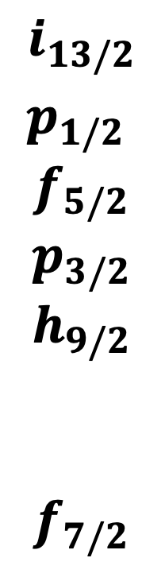
The change in neutron drip line
Canonical neutron s.p.e. ¹⁶⁸Sn
$$i_{13/2}$$
$$p_{1/2}$$
$$f_{5/2}$$
$$p_{3/2}$$
$$h_{9/2}$$
$$f_{7/2}$$
The presence of the C. int. decreases the s.p.e.
The smaller fermi energy bind the nucleus
Notes:
1i13/2, 3p1/2, 2 f5/2, 3p3/2, 1h9/2, and 2 f7/2

Slide 13
The change in neutron drip line
Density distribution
With the Coulomb interaction, both neutron and proton density distributions change to be expanded
Notes:
1i13/2, 3p1/2, 2 f5/2, 3p3/2, 1h9/2, and 2 f7/2

Slide 14
The change in neutron drip line
$Δrms≡rms\left(C\right)−rms\left(NC\right)[fm]$
With the Coulomb interaction, root mean square radius (rms) systematically gets larger

Slide 15
The C interaction in finite nuclei
Conclusion, Work in progress & Next plan
Conclusion
The Coulomb interaction
Enhances the quadrupole deformation
Promotes the prolate dominance
Also affects the single-particle energies to lower them, which results in the change in neutron drip line
Work in progress
Analysis for octupole deformation
Single-particle description
Upcoming
Shapes of nuclei in outer crust of the neutron stars
Searching the bubble shapes
Spontaneous fission
Mass asymmetry of fission fragments
(Excited states, time-dependent theory, reaction and the deformation, hyper-nuclei, etc.)

