Slide 1
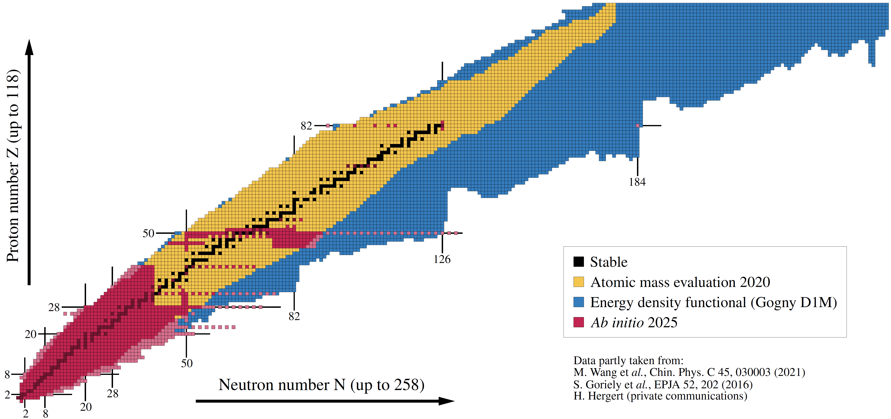
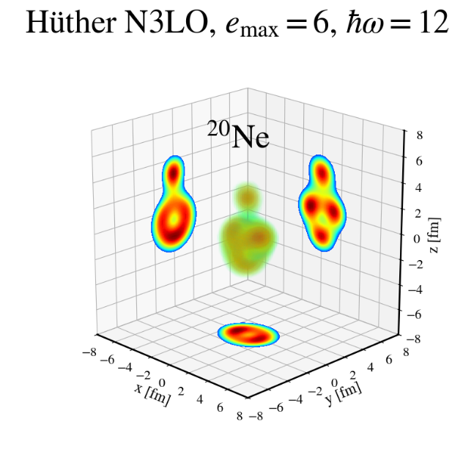
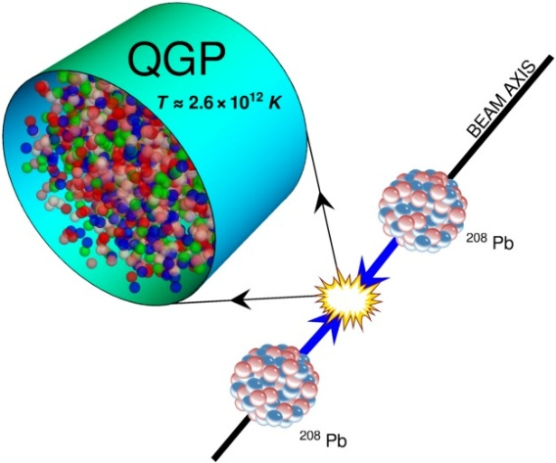

Imaging (two-body) correlations in atomic nuclei
Employing low- and high-energy processes
Ab initio nuclear theory
versus
Ultra-relativistic ion-ion collisions
Figure: B. Bally
Intersection of nuclear structure and high-energy nuclear collisions 2026
Yukawa Institute for Theoretical Physics, 13–24 avr. 2026, Kyoto, Japan
Thomas DUGUET
DPhN, CEA-Saclay, France

Slide 2









Collaborators on ab initio many-body methods/calculations
J.-P. Blaizot
G. Blanchon
S. Bofos
J.-P. Ebran
T. Demartini
M. Dupuis
M. Frosini
L. Heitz
A. Porro
S. Sainato
V. Somà
P. Tamagno
E. Thiriont–Bernolle
L. Zurek
G. Hagen
T. Papenbrock
H. Hergert
P. Navratil
M. Aytekin
B. Bally
R. Roth
Tichai
U. Vernik
P. Demol
S. Jeon
A. Scalesi
G. Giacalone

Slide 3
Contents
⦿ Introduction
⦿ The ab initio nuclear many-body problem and many-body expansion methods
⦿ The projected generator coordinate method
⦿ Rotational properties, deformation and correlations
⦿ Kumar invariant operators
⦿ Interface between low- and high-energy physics
⦿ Azimuthal flow versus quantum correlations in nuclei
⦿ Imaging two-body correlations from ab initio quantum rotor in 8 ≤ Z ≤ 28 nuclei
⦿ From the quantum to the classical rotor
⦿ Connection with Kumar invariant
⦿ Adding shape fluctuations
⦿ Dependence of the interface on the intrinsic and apparent theoretical resolution scale

Slide 4
Contents
⦿ Introduction
⦿ The ab initio nuclear many-body problem and many-body expansion methods
⦿ The projected generator coordinate method
⦿ Rotational properties, deformation and correlations
⦿ Kumar invariant operators
⦿ Interface between low- and high-energy physics
⦿ Azimuthal flow versus quantum correlations in nuclei
⦿ Imaging two-body correlations from ab initio quantum rotor in 8 ≤ Z ≤ 28 nuclei
⦿ From the quantum to the classical rotor
⦿ Connection with Kumar invariant
⦿ Adding shape fluctuations
⦿ Dependence of the interface on the intrinsic and apparent theoretical resolution scale

Slide 5
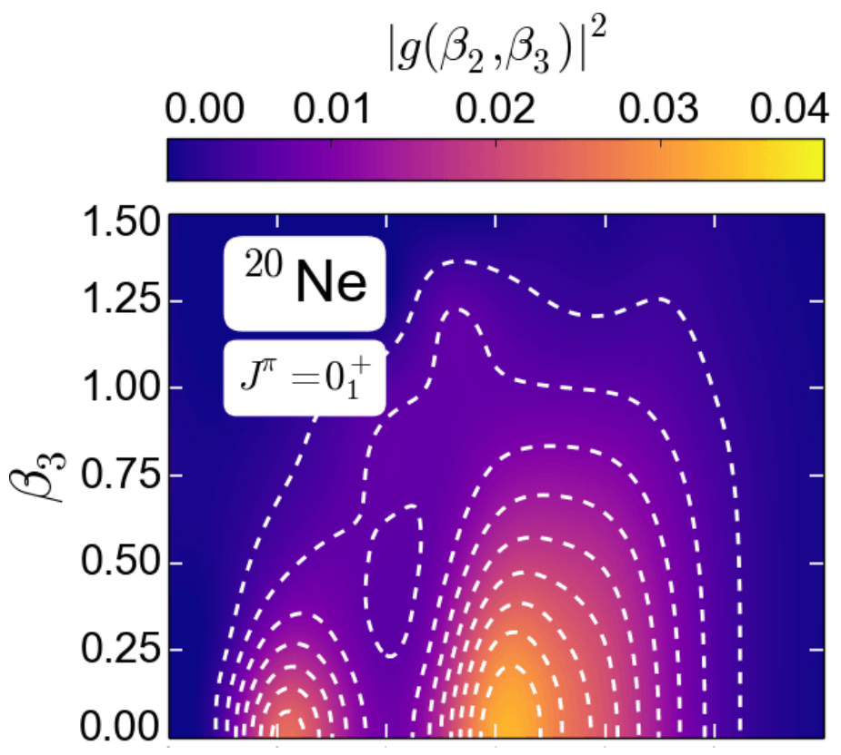
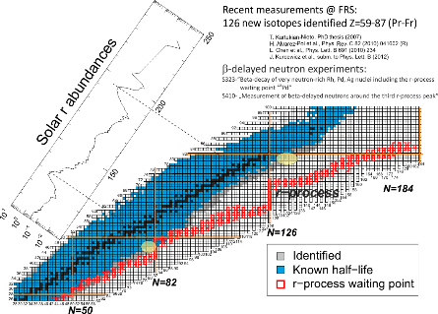
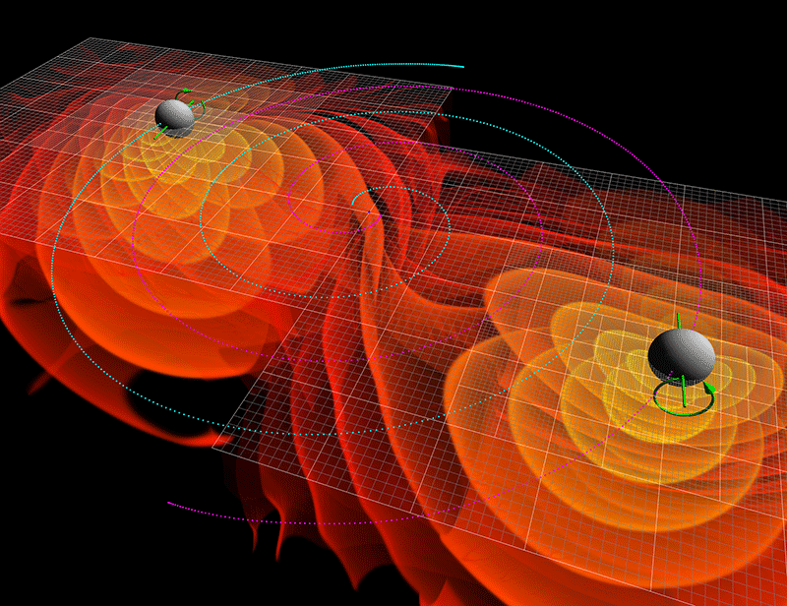
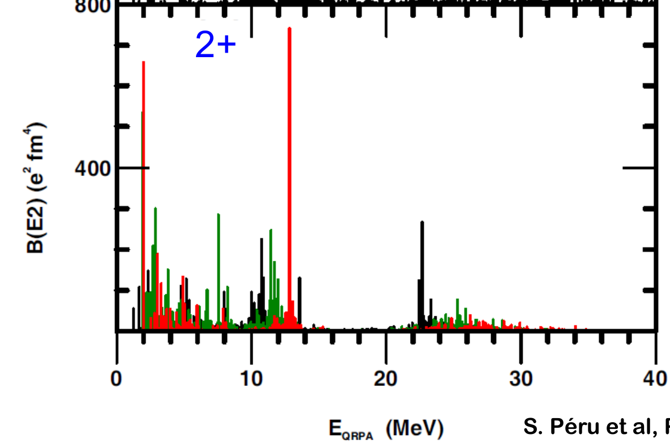
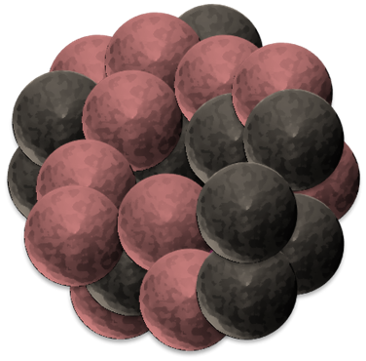
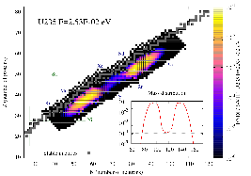
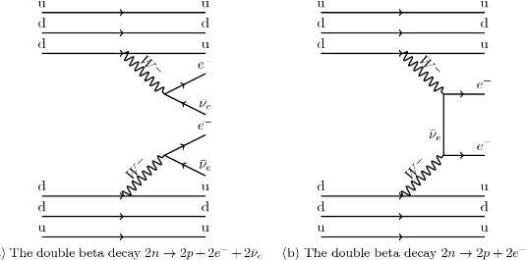

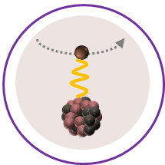
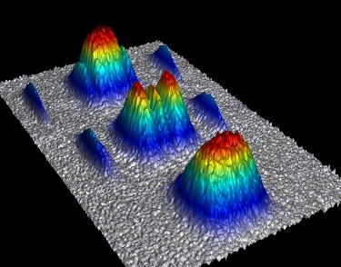
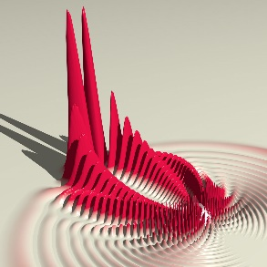
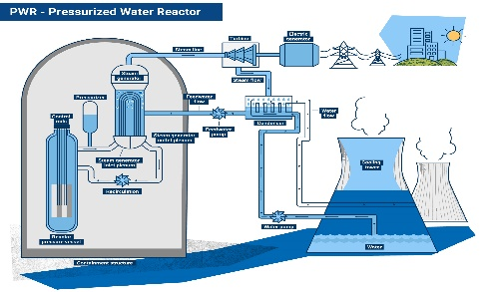
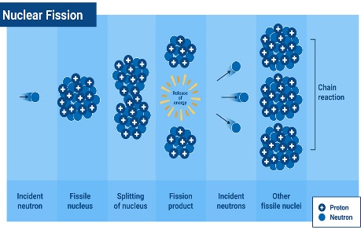
The atomic nucleus as a 4-components quantum mesoscopic system
An extremely rich and diverse phenomenology
Nucleus: bound (or resonant) state of Z protons and N neutrons
“Ab initio” (= In medias res) long-term endeavor
Can nuclear systems be convincingly described
From structure-less nucleons and their interactions: right balance of reductionism vs emergence?
Rooted into QCD in a systematically improvable way: sound connection via EFT(s)?
Systematically: complete phenomenology up to (super) heavy nuclei?
Accurately enough: relevant to experimental investigations/applications?
Astrophysics
Neutron star, supernovae, nucleo-synthesis…
Ground-state
masses, radii, density distributions …
Excitation spectra
energies, transition probabilities, response function to electroweak probes, …
Standard model of particle physics
0ν2β, unitarity of CKM matrix, PT
Ab Initio
Practical benefit = work in progress… yet to be proven
Decay modes
lifetime, yields, …
Nuclear observables can be
Described consistently
With (small enough) uncertainties
Extrapolated in a controlled fashion
Reactions
cross sections, …
Mesoscopic many-body systems
Molecules, atoms, cold atom gases…
Nuclear data applications
Nuclear energy, nuclear defense…

Slide 6

Ab initio theoretical scheme
In this talk “Ab initio” theoretical scheme
=
Chiral effective field theory (χEFT) based on Weinberg Power Counting (WPC)
Exponential curse with A
Systematic expansion of H
Full solution | Ψ_{k} >
Limited to A ~ 16

Slide 7



Ab initio theoretical scheme
In this talk “Ab initio” theoretical scheme
=
Chiral effective field theory (χEFT) based on Weinberg Power Counting (WPC)
Exponential → Polynomial cost
Systematic expansion of H
Systematic expansion of | Ψ_{k} >
Double expansion systematically improvable towards well-defined limit
H
| Ψ_{k} >
Uncertainties evaluation
Chiral EFT truncation
LECs adjustement
Rank reduction of V^{3N}
Basis truncation
Expansion truncation

Slide 8
Ab initio theoretical scheme : 1) expansion of H
Ab initio = Chiral EFT = low-energy realization of QCD
Effective degrees of freedom
Nucleons
Hadronic Physics
QCD
Pions
m_{π} = 150MeV
800MeV
Manifestation of chiral symmetry breaking at low energy
[Weinberg, Gasser, Leutwyler, van Kolck, ..]
150MeV
+ …
High-energy via contact interactions
Physics of nuclei
χEFT
N
N
∞ # operators compatible with symmetries of QCD
𝜋
+ …
Pion-driven interactions explicit
N
N
1) Organize via expected importance in (Q/Λ_{χ})^{ν} = Power Counting

Slide 9
Ab initio theoretical scheme : 1) expansion of H
Similar expansion for any observable

Slide 10
Ab initio theoretical scheme : 1) expansion of H
Ab initio = Chiral EFT = low-energy realization of QCD
Effective degrees of freedom
Nucleons
Hadronic Physics
QCD
Pions
m_{π} = 150MeV
800MeV
Manifestation of chiral symmetry breaking at low energy
[Weinberg, Gasser, Leutwyler, van Kolck, ..]
150MeV
+ …
High-energy via contact interactions
Physics of nuclei
χEFT
N
N
∞ # operators compatible with symmetries of QCD
𝜋
+ …
Pion-driven interactions explicit
N
N
1) Organize via expected importance in (Q/Λ_{χ})^{ν} = Power Counting
2) Truncate at working order k → Systematic uncertainty (1)
3) Adjust Low Energy Couplings → Statistical uncertainty (2)
∼(15−30) LECS to be inferred from data

Slide 11
Ab initio theoretical scheme : 1) expansion of H
Ab initio = Chiral EFT = low-energy realization of QCD
Effective degrees of freedom
Nucleons
Hadronic Physics
QCD
Pions
m_{π} = 150MeV
800MeV
Manifestation of chiral symmetry breaking at low energy
[Weinberg, Gasser, Leutwyler, van Kolck, ..]
150MeV
+ …
High-energy via contact interactions
Physics of nuclei
χEFT
N
N
∞ # operators compatible with symmetries of QCD
𝜋
+ …
Major challenges
Pion-driven interactions explicit
►Can k-body, k>3, be omitted in A>>3?
→Few calc. with 4-body in light nuclei
►N^{3/4}LO 2N for high precision; 3N? 4N?
→Under development; scarcely used
►Non-renormalizability of WPC
→RG-invariant variants exist but not used
►Error estimation&propagation
►Two body currents and S≠0 sector
N
N
1) Organize via expected importance in (Q/Λ_{χ})^{ν} = Power Counting
2) Truncate at working order k → Systematic uncertainty (1)
3) Adjust Low Energy Couplings → Statistical uncertainty (2)

Slide 12
Ab initio theoretical scheme : 2) expansion of |Ψ >
with
One-body Hilbert space
A-body Hilbert space
with
Symmetry group: U(1)_{N}xU_{Z}(1)xSU(2)_{J}xI_{Π}
One-body basis size
« The curse of dimensionality »
Expansion many-body methods = polynomially scaling methods
Hamiltonian partitioning
Unperturbed state
Fully correlated state
Wave operator
« Easy »
to solve
Expansion series
Static (collective) correlations
Vary quickly with N&Z
Dynamical correlations
~Independent of N&Z
Mean-field-like =
Symmetry
Nature of the state
Nature of the expansion
Symm. conserving: closed shell
Symm. breaking: open shell(s)
Symm. breaking + restoration: open shell(s)
SC-SR: spherical HF
SB-SR: deformed HF(B)
SC-MR: PGCM
Pert.: MBPT
Non pert.: CC, SCGF, IM-SRG
More accurate/expensive
Many more nuclei (2012→)
Truncate at working order n → Cost O(n_{dim}^{q(n)} )
→ Systematic uncertainty (3)
[Arthuis, Barbieri, Binder, Bogner, Demol, Duguet, Frosini, Hagen, Heinz, Hergert, Roth, Papenbrock, Somà, Schwenk, Tichai…]

Slide 13
Contents
⦿ Introduction
⦿ The ab initio nuclear many-body problem and many-body expansion methods
⦿ The projected generator coordinate method
⦿ Rotational properties, deformation and correlations
⦿ Kumar invariant operators
⦿ Interface between low- and high-energy physics
⦿ Azimuthal flow versus quantum correlations in nuclei
⦿ Imaging two-body correlations from ab initio quantum rotor in 8 ≤ Z ≤ 28 nuclei
⦿ From the quantum to the classical rotor
⦿ Connection with Kumar invariant
⦿ Adding shape fluctuations
⦿ Dependence of the interface on the intrinsic and apparent theoretical resolution scale

Slide 14
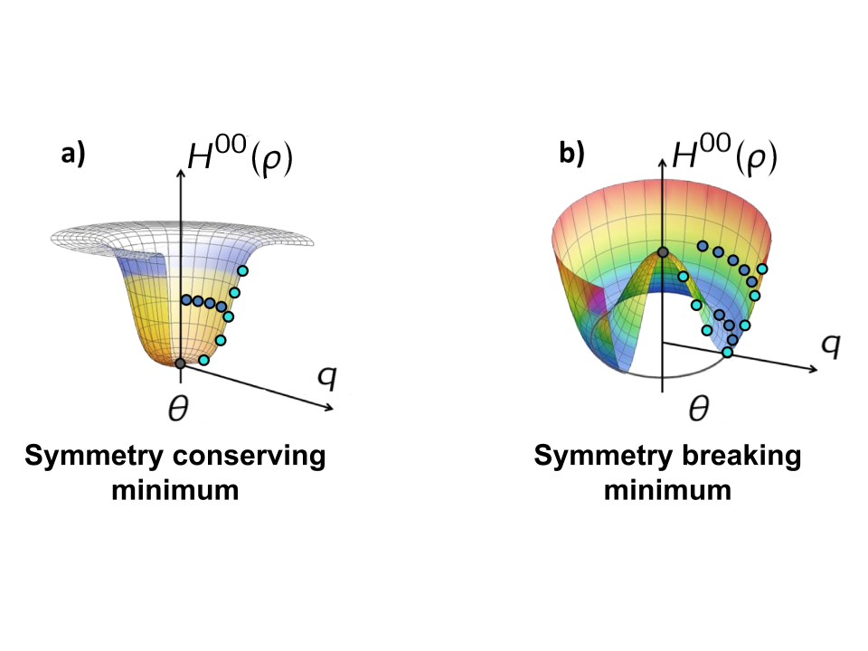
Projected generator coordinate method + perturbation theory
with
One-body Hilbert space
A-body Hilbert space
with
Symmetry group: U(1)_{N}xU_{Z}(1)xSU(2)_{J}xI_{Π}
Expansion many-body methods = polynomially scaling methods
Hamiltonian partitioning
Unperturbed state
Fully correlated state
« Easy »
to solve
Expansion series
SC-MR state from the projected generator coordinate method (PGCM)
State-specific MR PGCM-PT
Mixing of dHFB states constrained to different q values
Frosini et al., EPJA (2022)
Symmetry restoration
PGCM-PT(2) (n_{dim}⁸): Not today
⸙Collective correlations only
→Dominant for present purpose
⸙ Dynamical correlations to be added
q = collective « deformations »: β₂₀ and β₃₀ for today
q_{min}
θ = collective rotation angles: Restore J^{π}, N and Z for today
SB dHFB unperturbed state
PGCM = adds/accesses collective fluctuations/excitations

Slide 15
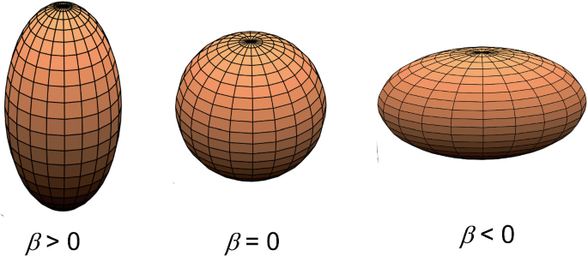
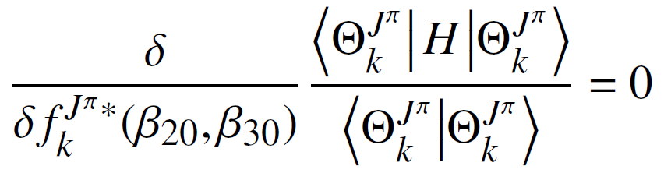
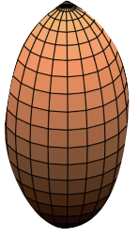
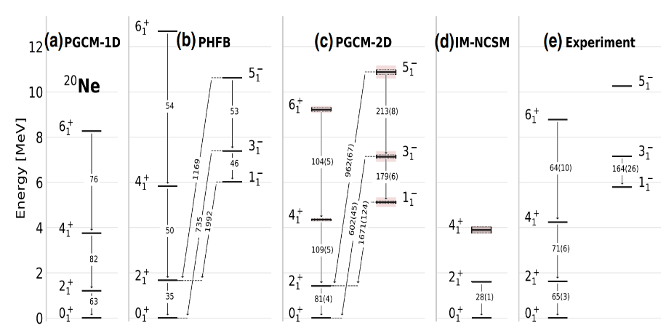

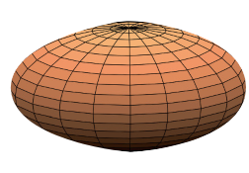






The projected generator coordinate method
Mixes β₂₀ and β₃₀
Restore J, π, N, Z
Breaks J, π, N, Z
Constrained SB dHFB mean-field states
PGCM
Mixing coefficients
q = β₂₀ and β₃₀
$$|Φ\left(q_{1}\right)〉$$
$$|Φ\left(q_{2}\right)〉$$
$$|Φ\left(q_{n}\right)〉$$
Euler angles
Rotator
Shape fluctuations
►Collective (static) GS correlations
►Vibrational excitations
Hill, Wheeler, PR (1953)
Wigner function
Collective spectroscopy
Symmetry projection
Missing dynamical correlations
►Little affect spectroscopy
►Charge radius
►Two-body correlations?
$$P^{J}|Φ\left(q_{1}\right)〉$$
$$P^{J}|Φ\left(q_{2}\right)〉$$
$$P^{J}|Φ\left(q_{n}\right)〉$$
Shape rotation
►Collective (static) GS correlations
►Rotational excitations
Frosini et al. EPJA (2022)
Ground-state → J=0 → Spherical
Reduction to pure (quantum) rotor
Minimum of dHFB energy
PHFB
Intrinsic axial deformations β₂₀(dHFB) and β₃₀(dHFB)
No shape fluctuation and associated correlations

Slide 16
Contents
⦿ Introduction
⦿ The ab initio nuclear many-body problem and many-body expansion methods
⦿ The projected generator coordinate method
⦿ Rotational properties, deformation and correlations
⦿ Kumar invariant operators
⦿ Interface between low- and high-energy physics
⦿ Azimuthal flow versus quantum correlations in nuclei
⦿ Imaging two-body correlations from ab initio quantum rotor in 8 ≤ Z ≤ 28 nuclei
⦿ From the quantum to the classical rotor
⦿ Connection with Kumar invariant
⦿ Adding shape fluctuations
⦿ Dependence of the interface on the intrinsic and apparent theoretical resolution scale

Slide 17
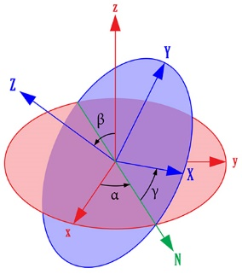
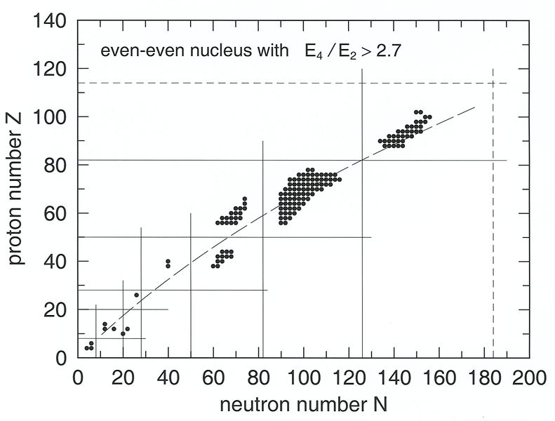
Rotational properties: from experiment to theory
I. The symmetry
II. The phenomenology
Symmetry
Observable patterns dictated by SU(2) symmetry
Energies labeled by J and independent of M
Selection rules for EM(λ) transitions
Ab initio nuclear A-body problem viewpoint
Do rotational properties emerge from basic interactions between the nucleons?
►Non-trivial as 𝑩 ≪ energy scale of elementary excitations
►2N+3N interactions are adjusted on 2-body+3-body systems
Eigenstates within ab initio theoretical scheme are a priori very different from pure rotor model
►How much coupling to vibrations and non-collective correlations amend the rotational picture?
►Can spatial nucleonic correlations be characterized more directly and quantitatively?
►While varying N&Z to modulate the dominance of collective (rotational&vibrational) and non collective?
Observable patterns
Set of states organized according to
Strong E2 transitions in the set scaling with
Concerns nuclear ground states in between doubly magic ones
+
III. The model
= adiabatic rotor model
IV. The interpretation
= emergent symmetry breaking
Cannot be anticipated from dof + H
Is not fully realized
Eigenstate
Deformed intrinsic state
Rotational motion
Features
1) Spontaneous breaking of SU(2)
GS has lower symmetry than H
GS = wave packet mixing IRREPs
Goldstone boson = rotation
Higgs mode = vibration
1)
Lessons
Links a specific subset of states together
Excellent account of idealized patterns
Built in separation of rotational degrees of freedom
Disturbed by coupling to vib. and ind. dynamics
2) Finite system = breaking only emergent
Symmetry is actually enforced
Lower symmetry imprints excitations
Rotational bands and transitions
2)

Slide 18
Deformation, rotation and two-body correlations
►Deformation = powerful notion to manipulate with care leading to many imprecise/incorrect/meaningless… statements
►For an excellent historical review
History of the concept of nuclear shape
D. Verney, Eur. Phys. J. A (2025) 61
In “The intersection of low-energy nuclear structure and high-energy nuclear collisions” Eds. T. Duguet, G. Giacalone, V. Somà, Y. Zhou
►To summarize
The J=0 ground state of even-even nuclei is never deformed: the 1-body local density distribution is spherical
Symmetry breaking cannot be realized in a finite system
Its emergent character manifests itself
►Into the way the system excites
►Via patterns left onto the k-body density matrix with k>1, e.g. 2-body density matrix (in the transverse plane)
Tranverse plane
►Quadrupole rotor model
Nucleonic position
Blaizot, Giacalone, EPJA (2025)
1-body axially deformed intrinsic density
= orientation of deformed body
= deformation parameter
Characteristic of deformed nuclei
1- and 2-body laboratory density in transverse plane
= spherical
Proportional to intrinsic deformation
Azimuthal modulation
►Ok… but traditional way to access ground-state two-body correlations and link them to deformation: Kumar invariants

Slide 19
Contents
⦿ Introduction
⦿ The ab initio nuclear many-body problem and many-body expansion methods
⦿ The projected generator coordinate method
⦿ Rotational properties, deformation and correlations
⦿ Kumar invariant operators
⦿ Interface between low- and high-energy physics
⦿ Azimuthal flow versus quantum correlations in nuclei
⦿ Imaging two-body correlations from ab initio quantum rotor in 8 ≤ Z ≤ 28 nuclei
⦿ From the quantum to the classical rotor
⦿ Connection with Kumar invariant
⦿ Adding shape fluctuations
⦿ Dependence of the interface on the intrinsic and apparent theoretical resolution scale

Slide 20
Kumar invariant operators Q_{l}^{(n)} (l>1,n>1)
I. Kumar invari ant operator (ex here for l=2)
II. Axial rotor model and interpretation of Kumar
Kumar, PRL (1972)
1) Sum reduced to 2₁⁺
2) Related to Q₀² and β₂₀²
Electric quadrupole one-body operator
n=2
n=4
Kumar invariants
Ground-state effective deformation by generalization/analogy
Q₂⁽²⁾ average
Q₂⁽²⁾ dispersion
with
Kumar operators
Invariant with respect to reference frame
►No a priori reference to intrinsic reference frame
►Computable for any symmetry conserving/laboratory frame eigenstate of H
►Quantify (e.g. two-body quadrupole) correlations of any origin: rotational, vibration, non-collective
Intepretation
►Traditional interpretation still relates to rotor model and intrinsic frame deformation
►Model-dependent interpretation whose application to any eigenstate of H is highly questionable
►If doing so, ground-state effective “deformation” value typically not well defined
Experimental access
►Access via low-energy experiment challenging (especially for Q_{l}^{(n)} with l and/or n>2)
►Is there a way to directly access these (spatial) correlations?
B(E2; 0₁⁺→2_{k}⁺)
Ground-state <Q₂⁽²⁾>^{RR} proportional to β₂₀² via 2 steps approximation
Is that connection within rotor model correct?
<Q₂⁽²⁾> captures in fact complete quadrupolar correlations
Is attributing it fully to an (effective) deformation making any sense?
Completeness
Reduced EM transition probabilities
Ground-state
all 2⁺ states
III. Q₂⁽²⁾ versus Q₂⁽⁴⁾
IV. Reconstruction of <Q₂^{(2,4)>} via sum over excited states
GS
Configuration interaction calculations
sd and pf valence spaces
Empirical valence-space interactions
Configuration interaction calculations
sd, pf and sdpf valence spaces
Empirical valence-space interactions
Henderson, PRC (2020)
Poves, Nowacki, Alhassid, PRC (2020)
Fluctuation of Q₂⁽²⁾ in ground state is typically about 25%-50%
Effective deformation language: B₂²(LE) not strictly defined
Many-body correlations language: 4-body ≤~ 2-body
Limiting to 1st state as in rotor model provides 70% of full value
<Q₂^{(2,4)}> require ~5 first states to reach 90% of full value
→Challenging via low-energy, e.g. Coulomb excitation, experiments

Slide 21
Contents
⦿ Introduction
⦿ The ab initio nuclear many-body problem and many-body expansion methods
⦿ The projected generator coordinate method
⦿ Rotational properties, deformation and correlations
⦿ Kumar invariant operators
⦿ Interface between low- and high-energy physics
⦿ Azimuthal flow versus quantum correlations in nuclei
⦿ Imaging two-body correlations from ab initio quantum rotor in 8 ≤ Z ≤ 28 nuclei
⦿ From the quantum to the classical rotor
⦿ Connection with Kumar invariant
⦿ Adding shape fluctuations
⦿ Dependence of the interface on the intrinsic and apparent theoretical resolution scale

Slide 22
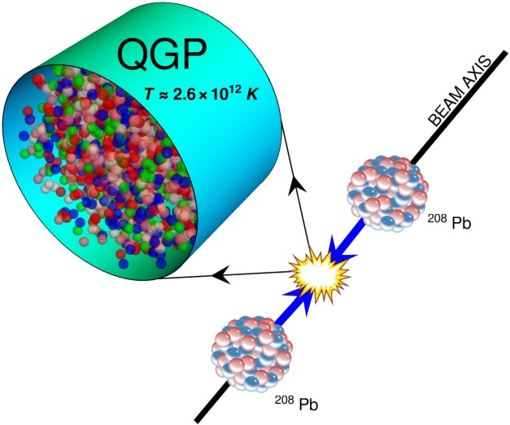
Interface between low- and high-energy physics
Ultra-relativistic ion-ion collisions
Gardim et al., NP (2020)
Study of QGP
Anisotropic hadronic flow
How does that relate to (a quantum mechanical description of) nuclear structure?
Modern “flow paradigm”
Luzum, JPG (2011)
Independent direction within an event
Averaging over events = correlations arise from event-by-event fluctuations
Fourier decomposition
Determined deterministically through hydrodynamic evolution
Results from initial conditions = (energy/density) profile of matter s(x,y) created shortly after the collision
The spatial characteristics of s(x,y) are characterized through its normalized eccentricities (l>0)
Giacalone, arXiv:2208.06839
with

Slide 23
Contents
⦿ Introduction
⦿ The ab initio nuclear many-body problem and many-body expansion methods
⦿ The projected generator coordinate method
⦿ Rotational properties, deformation and correlations
⦿ Kumar invariant operators
⦿ Interface between low- and high-energy physics
⦿ Azimuthal flow versus quantum correlations in nuclei
⦿ Imaging two-body correlations from ab initio quantum rotor in 8 ≤ Z ≤ 28 nuclei
⦿ From the quantum to the classical rotor
⦿ Connection with Kumar invariant
⦿ Adding shape fluctuations
⦿ Dependence of the interface on the intrinsic and apparent theoretical resolution scale

Slide 24
Azimuthal flow versus quantum correlations in nuclei
Giacalone, EPJA (2023)
Duguet et al., PRL (2025)
Conditions (can be generalized)
►Ultra-central collisions: anisotropic flow driven by inter-nucleon spatial correlations in collided ground states
►Symmetric collisions: allows to reduce the information to a single nucleus
Questions of interest (non exhaustive)
►Which multi-particle correlations in the final state is sensitive to what type of correlations?
►Are they all only sensitive to collective deformation-type correlations?
►Is the classical picture regarding how the collision of deformed nuclei occurs valid?
►Are, e.g., two-particle correlations in the final state such as Var(V_{l}) driven by (up to) two-body correlations?
►What features of the strong interactions are probed? Sensitivity to parameters, EFT truncation, resolution scale?
But first: how does that connection to N-nucleon correlations works?
1) Linear hydrodynamic
To be revisited later…
Particularly well satisfied for l=2,3 and/or ultra-central collisions
Gardim et al, PRC (2012,2015)
1
2) Linearized approximation of initial state fluctuations of the entropy density at midrapidity
Blaizot, Broniowski, Ollitrault, PLB (2014)
2
Correlation functions
3) Parametrization of the QGP entropy density
T_{R}ENTo ansatz
3
Thickness function
=
Matter density in TP

Slide 25
Azimuthal flow versus quantum correlations in nuclei
Giacalone, EPJA (2023)
Duguet et al., PRL (2025)
One-body local ground-state density
3
2
4
Two-body local ground-state density

Slide 26
Azimuthal flow versus quantum correlations in nuclei
Duguet et al., PRL (2025)
Contains scalar component
Contains scalar component
4
1
= one-body eccentricity operator
=0 for 0⁺ states
Probes two-body correlations
Non-scalar = r^{l} Y_{l}^{-l}
= one-body part of squared eccentricity operator
= two-body part of squared eccentricity operator
Eccentricity variance = ground-state expectation value of one- and two-body local operators
Two-particle observable Var(V_{l}) is induced by up to two-body correlations
Deformed surface of the intrinsic one-body density distribution
►Classical axial rigid rotor model
with
Effective deformation
2-body part of E_{l}⁽¹⁾ E_{l}⁽¹⁾ only!
Nothing to do with deformation!

Slide 27
Contents
⦿ Introduction
⦿ The ab initio nuclear many-body problem and many-body expansion methods
⦿ The projected generator coordinate method
⦿ Rotational properties, deformation and correlations
⦿ Kumar invariant operators
⦿ Interface between low- and high-energy physics
⦿ Azimuthal flow versus quantum correlations in nuclei
⦿ Imaging two-body correlations from ab initio quantum rotor in 8 ≤ Z ≤ 28 nuclei
⦿ From the quantum to the classical rotor
⦿ Connection with Kumar invariant
⦿ Adding shape fluctuations
⦿ Dependence of the interface on the intrinsic and apparent theoretical resolution scale

Slide 28



Imaging two-body correlations in 8 ≤ Z ≤ 28 nuclei
Systematic axial PHFB calculations = axial quantum rotor
Intrinsic axial deformations β₂₀(dHFB) and β₃₀(dHFB)
Full quantum projection on J^{π} = 0⁺
No shape fluctuation and associated correlations
No non-collective (p-h-type) correlations
EM1.8/2.0 χEFT nuclear Hamiltonian
Kebeler et al., PRC (2011)
$$β_{l0}^{2}$$
PHFB
PGCM
PGCM-PT
Correlations content
Bofos et al., arXiv:2602.09890

Slide 29
Imaging two-body correlations in 8 ≤ Z ≤ 28 nuclei
Systematic axial PHFB calculations = axial quantum rotor
Intrinsic axial deformations β₂₀(dHFB) and β₃₀(dHFB)
Full quantum projection on J^{π} = 0⁺
No shape fluctuation and associated correlations
No non-collective (p-h-type) correlations
EM1.8/2.0 χEFT nuclear Hamiltonian
Kebeler et al., PRC (2011)
Quadrupole eccentricity variance
►Positive but close to zero at magic numbers N or Z=20,28
►Mild fluctuations and essentially decreases with A
►Dominated by the (uninformative) 1/A term from <ε₂²>^{(1b)}
►<ε₂²>^{(2b)} ~<ε₂²>^{(1b)} for A~50
PHFB
Bofos et al., arXiv:2602.09890

Slide 30
Imaging two-body correlations in 8 ≤ Z ≤ 28 nuclei
Systematic axial PHFB calculations = axial quantum rotor
Intrinsic axial deformations β₂₀(dHFB) and β₃₀(dHFB)
Full quantum projection on J^{π} = 0⁺
No shape fluctuation and associated correlations
No non-collective (p-h-type) correlations
EM1.8/2.0 χEFT nuclear Hamiltonian
Kebeler et al., PRC (2011)
Quadrupole eccentricity variance
►Positive but close to zero at magic numbers N or Z=20,28
►Mild fluctuations and essentially decreases with A
►Dominated by the (uninformative) 1/A term from <ε₂²>^{(1b)}
►<ε₂²>^{(2b)} has no dependence in A & ~<ε₂²>^{(1b)} for A~50
Quadrupole eccentricity variance
►Positive but close to zero at magic numbers N or Z=20,28
►Mild fluctuations and essentially decreases with A
►Dominated by the (uninformative) 1/A term from <ε₂²>^{(1b)}
► <ε₂²>^{(2b)} ~<ε₂²>^{(1b)} for A~50
PHFB
Effective quadrupole “deformation” parameter
►Informative part about correlations from <ε₂²>^{(2b)} only
►Small negative values at magic numbers N or Z=20,28 (!?)
►Positive values at mid shells with fluctuations
►Large positive values around ²⁰Ne
→Strong collective correlations = “static deformation”
→Remember: only rotational correlations so far!
Bofos et al., arXiv:2602.09890

Slide 31
Imaging two-body correlations in 8 ≤ Z ≤ 28 nuclei
Systematic axial PHFB calculations = axial quantum rotor
Intrinsic axial deformations β₂₀(dHFB) and β₃₀(dHFB)
Full quantum projection on J^{π} = 0⁺
No shape fluctuation and associated correlations
No non-collective (p-h-type) correlations
EM1.8/2.0 χEFT nuclear Hamiltonian
Kebeler et al., PRC (2011)
Relation of PHFB B₂²(HE) to intrinsic deformation β₂₀²(dHFB)
► Very strong correlations for 0₁⁺ ground states
→Internal consistency of the (quantum) rotor model
►Negative offset from the first diagonal!?
→Explained at β₂₀ = 0 due to Pauli (absent from classical RR!)
→Seems to decrease with A and slightly increase with β₂₀²
→Analytical/numerical proof under way
r=0.98
Blaizot, Giacalone, Lovato, arXiv:2512.18926
PHFB
Blaizot, Duguet, unpublished/Bofos et al., unpublished
Conclusion on the extraction from HIC observable
► Under the assumption of a purely rotational nucleus (!)
→<ε₂²>[β₂₀]- <ε₂²>[β₂₀=0] ≈ β₂₀²
→Combine with Var(V₂) from nucleus with ~A and β₂₀ ≈ 0
Bofos et al., arXiv:2602.09890

Slide 32
Contents
⦿ Introduction
⦿ The ab initio nuclear many-body problem and many-body expansion methods
⦿ The projected generator coordinate method
⦿ Rotational properties, deformation and correlations
⦿ Kumar invariant operators
⦿ Interface between low- and high-energy physics
⦿ Azimuthal flow versus quantum correlations in nuclei
⦿ Imaging two-body correlations from ab initio quantum rotor in 8 ≤ Z ≤ 28 nuclei
⦿ From the quantum to the classical rotor
⦿ Connection with Kumar invariant
⦿ Adding shape fluctuations
⦿ Dependence of the interface on the intrinsic and apparent theoretical resolution scale

Slide 33
From the quantum to the classical rotor model
Classical rotor underlines the way practitioners see how HIC
1) Time scale « justifies » a snapshot-frozen orientation picture in each event
2) Average over events includes an averaging over orientation of each deformed body
HIC are of course performed with quantal nuclei
1) Angular momentum projection has no time-scale associated to it
2) Nuclei colliding are spherical and there is no resolution of the intrinsic frame
Duguet et al., PRL (2025)
Dobaczewski et al., PRR (2025)
Ke, arXiv:2509.09549
It is a matter of k-body (k>1) correlations!
Bofos et al., unpublished
^{and}
^{Local} ^{two-body density}
^{Pauli exchange presently kept}
^{SWT}
^{Needle approx.}
Average relative error: 5.10⁻⁴
^{→Quickly decreases with A}
^{Neglect Pauli exchange term}
Classical approximation to the quantum symmetry restoration
►Excellent approximation for PHFB B₂²(HE)
►Must be further checked at more elaborate, e.g. PGCM, levels

Slide 34
Contents
⦿ Introduction
⦿ The ab initio nuclear many-body problem and many-body expansion methods
⦿ The projected generator coordinate method
⦿ Rotational properties, deformation and correlations
⦿ Kumar invariant operators
⦿ Interface between low- and high-energy physics
⦿ Azimuthal flow versus quantum correlations in nuclei
⦿ Imaging two-body correlations from ab initio quantum rotor in 8 ≤ Z ≤ 28 nuclei
⦿ From the quantum to the classical rotor
⦿ Connection with Kumar invariant
⦿ Adding shape fluctuations
⦿ Dependence of the interface on the intrinsic and apparent theoretical resolution scale

Slide 35
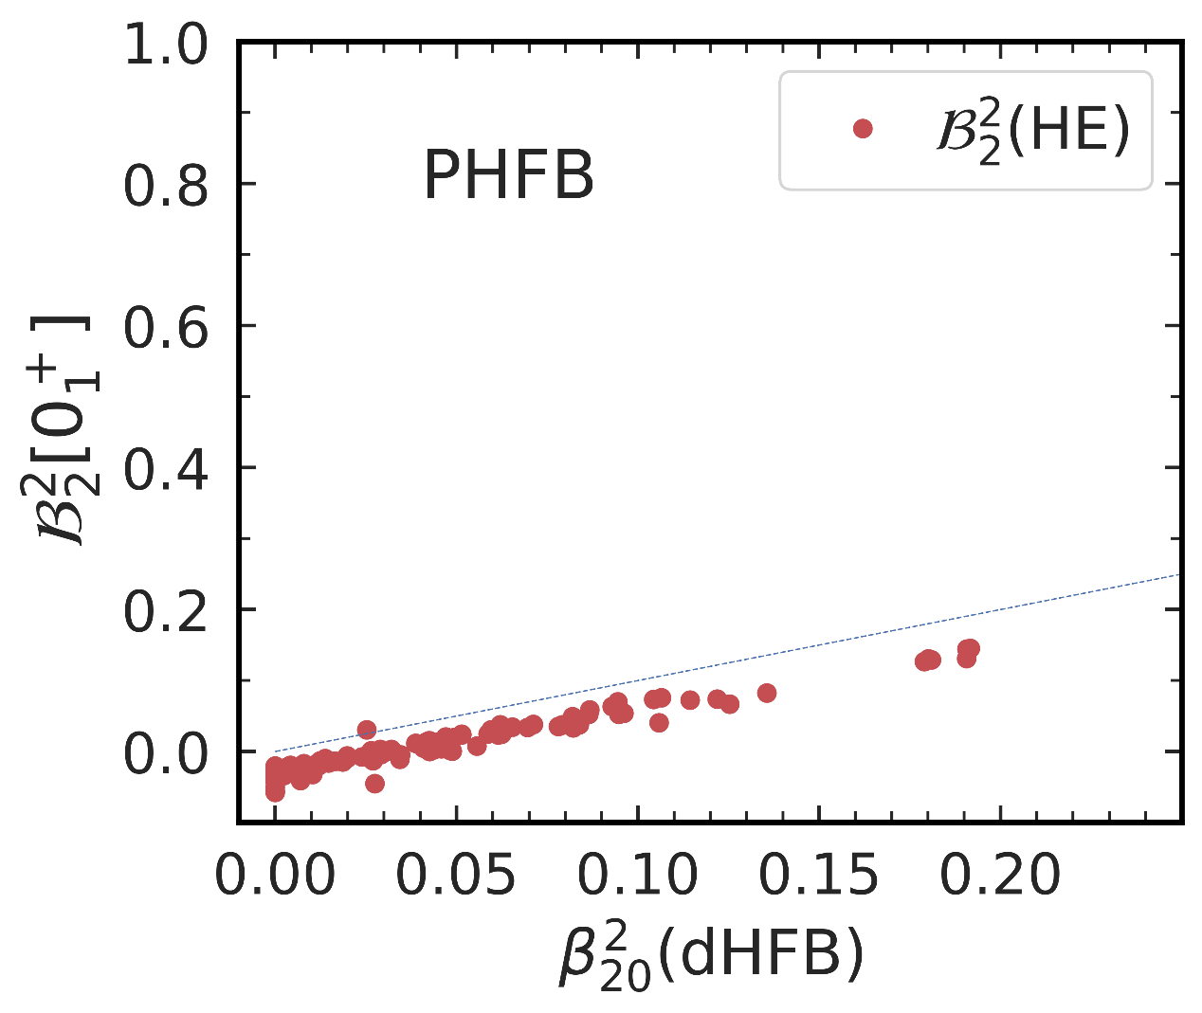
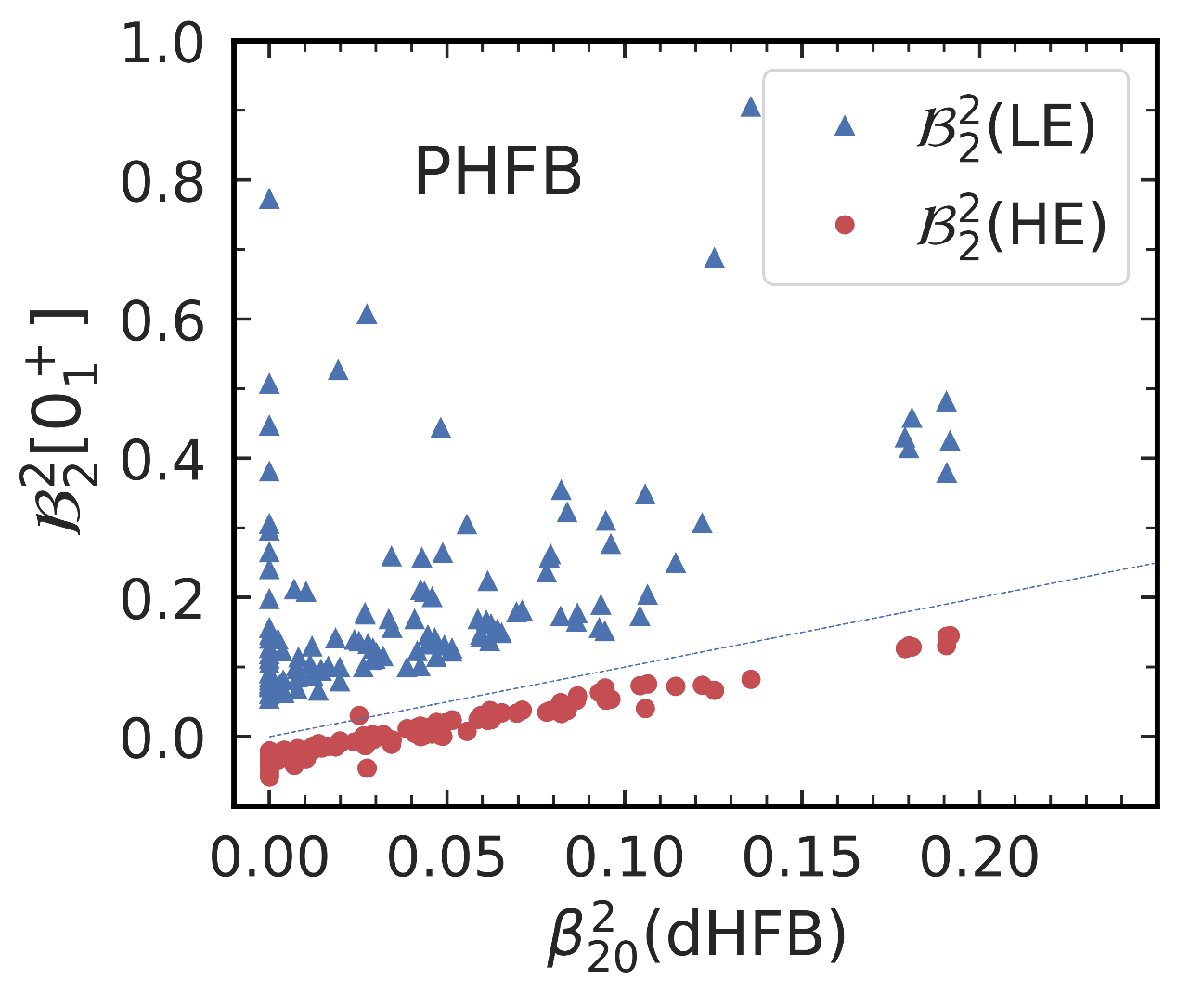
Connection with Kumar operator and B₂²(LE)
Systematic axial PHFB calculations = axial quantum rotor
EM1.8/2.0 χEFT nuclear Hamiltonian
Kebeler et al., PRC (2011)
r=0.50
r=0.98
Relation of PHFB B₂²(LE) to intrinsic deformation β₂₀²(dHFB)
►Weak correlations for 0₁⁺ ground states
→Even for RR model <Q₂⁽²⁾> is NOT a good measure of β₂₀²!
►Are HE and LE operators different or is the interpretation wrong!?
For J=0 only L=0 component active
+
« HE »
RR
RR
Var(V_{l}) in HIC probes the mass Kumar !
CR
« LE »
RR
Lost 1/A term along the way through RR
Why
Bofos et al., arXiv:2602.09890
wrongly includes 1/A term!

Slide 36
Connection with Kumar operator and B₂²(LE)
Systematic axial PHFB calculations = axial quantum rotor
EM1.8/2.0 χEFT nuclear Hamiltonian
Kebeler et al., PRC (2011)
Relation of PHFB B₂²(LE) to intrinsic deformation β₂₀²(dHFB)
►Weak correlations for 0₁⁺ ground states
→Even for RR model <Q₂⁽²⁾> is NOT a good measure of β₂₀²!
►Are HE and LE operators different or is the interpretation wrong!?
B₂²(LE) versus B₂²(HE) (prop tp β₂₀² in PHFB)
► B₂²(LE) strongly overestimates B₂²(HE)
►Match for large Axβ₂₀²
►Wrong x3 for best nuclei in sample (A=80)
« HE »
RR
RR
Ok = so far so good…
CR
« LE »
…but nuclei are not perfect rotors…
RR
Lost 1/A term along the way through RR
…need to enrich the perspective!
Bofos et al., arXiv:2602.09890
wrongly includes 1/A term!

Slide 37
Contents
⦿ Introduction
⦿ The ab initio nuclear many-body problem and many-body expansion methods
⦿ The projected generator coordinate method
⦿ Rotational properties, deformation and correlations
⦿ Kumar invariant operators
⦿ Interface between low- and high-energy physics
⦿ Azimuthal flow versus quantum correlations in nuclei
⦿ Imaging two-body correlations from ab initio quantum rotor in 8 ≤ Z ≤ 28 nuclei
⦿ From the quantum to the classical rotor
⦿ Connection with Kumar invariant
⦿ Adding shape fluctuations
⦿ Dependence of the interface on the intrinsic and apparent theoretical resolution scale

Slide 38

Extension to PGCM calculations for ¹²C, ¹⁶O, ^{20,22}Ne
Systematic axial PGCM calculations along β₂₀ and β₃₀
Add fluctuations of β₂₀(dHFB) and β₃₀(dHFB)
Full quantum projection on J^{π} = 0⁺
No non-collective (p-h-type) correlations
EM1.8/2.0 χEFT nuclear Hamiltonian
Kebeler et al., PRC (2011)
$$β_{l0}^{2}$$
PHFB
PGCM
PGCM-PT
Correlations content
Zhao et al., PRL (2024)
Xu et al., arXiv:2504.19644
Hagino, Kitazawa, PRC (2025)
Liu et al., arXiv:2509.0937
Bofos et al., arXiv:2602.09890

Slide 39
Extension to PGCM calculations for ¹²C, ¹⁶O, ^{20,22}Ne
Systematic axial PGCM calculations along β₂₀ and β₃₀
Add fluctuations of β₂₀(dHFB) and β₃₀(dHFB)
Full quantum projection on J^{π} = 0⁺
No non-collective (p-h-type) correlations
EM1.8/2.0 χEFT nuclear Hamiltonian
Kebeler et al., PRC (2011)
Effect of shape fluctuations on ground-state B₂²(HE)
►Significant increase of B₂²(HE) in well deformed systems
→ΔB₂²(HE) = +17%/43%/38%/61% for ¹⁶O/¹²C/²²Ne/²⁰Ne
→Much too weak collectivity in ¹⁶O: trend with β₂₀² will change
► B₂²(HE) larger (by up to 1/3 here) than RR β₂₀²
→Adding dynamical correlations will further change this
→Higher-order cumulants to differentiate nature of correlations
Hagino, Kitazawa, PRC (2025) ; Liu et al., arXiv:2509.0937
Effect of shape fluctuations on ground-state B₃²(HE)
►B₃²(HE) is entirely driven by shape fluctuations (β₃₀=0 in the 4 cases)
►Remains essentially 0 in ¹²C
►Large (moderate) increase in ¹⁶O and ²⁰Ne (²²Ne)
Bofos et al., arXiv:2602.09890

Slide 40
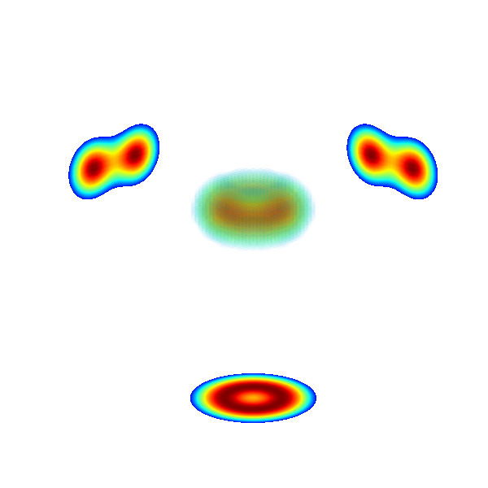
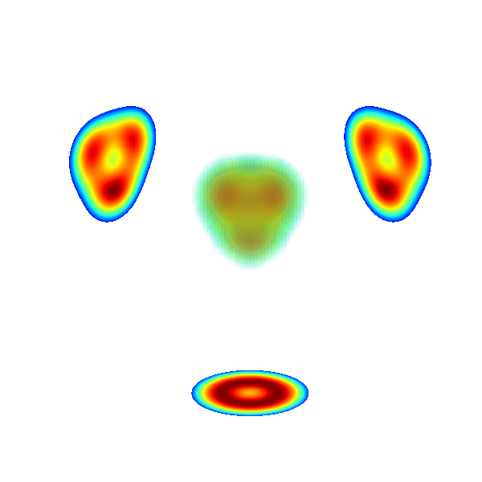
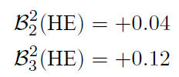

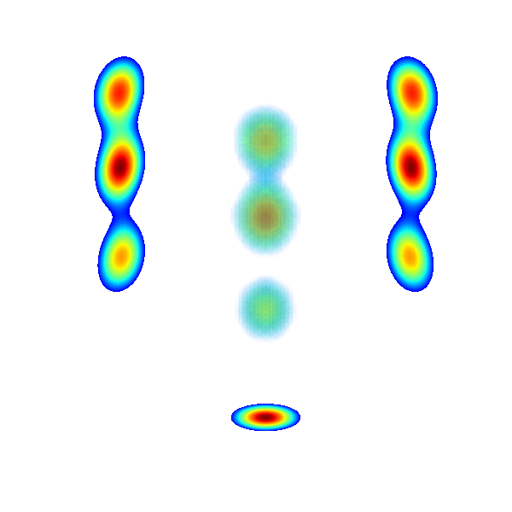
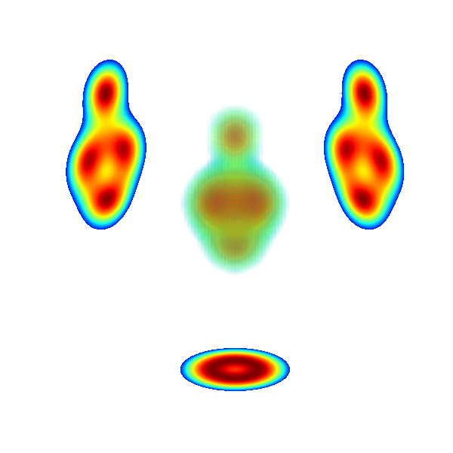





Extension to PGCM calculations for ¹²C, ¹⁶O, ^{20,22}Ne
Systematic axial PGCM calculations along β₂₀ and β₃₀
Add fluctuations of β₂₀(dHFB) and β₃₀(dHFB)
Full quantum projection on J^{π} = 0⁺
No non-collective (p-h-type) correlations
Some of the next steps
<δε_{l}²>₀₊ from full-scale triaxial PGCM calculations of 0₁⁺ and 0₂⁺ in ¹²C, ¹⁶O, ^{20,22}Ne
►Current axial PGCM not sufficient
►Triaxial octupole is key for fully realistic clustering (e.g. Hoyle state and ¹⁶O g.s.)
Interaction sensitivity analysis
►Quantify sensitivity of ground-state Cov(E_{l}⁽¹⁾) to χEFT interaction operators at N^{ν}LO
►Correlates with other observables believed to be sensitive to such correlations
Three-particle correlations
►Cov(E_{l}⁽²⁾ ,r_{perp}²) is sensitive to triaxiality in leading order
►Operator formulation + systematic triaxial PHFB and PGCM calculations
EM1.8/2.0 χEFT nuclear Hamiltonian
Kebeler et al., PRC (2011)
Intrinsic densities, clustering and eccentricity variance
¹²C
¹⁶O
Bally et al., unpublished
NLEFT
QMC
$$0_{1}^{+}$$
$$0_{1}^{+}$$
Ekstrom et al., unpublished
Mehrabpour et al., arXiv:2604.00619
Hoyle state
²⁰Ne
Bofos et al., unpublished
$$0_{2}^{+}$$
$$0_{1}^{+}$$
Bofos et al., arXiv:2602.09890
Blaizot et al., arXiv:2512.18926

Slide 41
Contents
⦿ Introduction
⦿ The ab initio nuclear many-body problem and many-body expansion methods
⦿ The projected generator coordinate method
⦿ Rotational properties, deformation and correlations
⦿ Kumar invariant operators
⦿ Interface between low- and high-energy physics
⦿ Azimuthal flow versus quantum correlations in nuclei
⦿ Imaging two-body correlations from ab initio quantum rotor in 8 ≤ Z ≤ 28 nuclei
⦿ From the quantum to the classical rotor
⦿ Connection with Kumar invariant
⦿ Adding shape fluctuations
⦿ Dependence of the interface on the intrinsic and apparent theoretical resolution scale

Slide 42
Surplus structure in mathematical theories
Mathematical structure
Unitary transformation
T. Duguet, unpublished
.
→Isomorphy can in fact be with a substructure
P ⬄ M C M’
M’ = full needed mathematical structure
→Surplus S = M’ – M
Relations among elements of S
Relations between elements of M and S
→Examples
Complex numbers for alternating current
EM potential via local gauge invariance
May lead to extension of P: positron
Unitary transformations in QM (λ freedom)
m’₁
Non observables
.
ESPE, SF…
m’₂
WF, Operator
S
M’
.
.
Mathematical entities
m₁
A-body eigenvalue
.
m₃
M
Observables
m₂
A-body amplitude
Corresponding theoretical scheme = The pertinent degrees of freedom → Intrinsic resolution scale Λ
Their interactions
The dynamical equation governing their physical state
Isomorphism P ⬄ M
Physical structure
.
.
p₂
p₁
.
P
Physical entities
p₃
Full empirical world
1) Quantities used for interpretation are often non-observable
Subpart of interest
So?
2) Value and correlation with observables depend on apparent scale λ
3) Consistent interpretations require same fixed λ (“gauge”)
“The interpretation of gauge symmetry”
M. Redhead In Symmetries in Physics, Philosophical Reflections, Edited by K. Brading and E. Castellani
(+ my adaption/extension)

Slide 43
Resolution scale and gauge freedom of theoretical description
χEFT operators expansion
Different k-body contributions depending on truncation order
Intrinsic resolution scale Λ built in = shorter-range physics not explicitly resolved
Apparent resolution scale freedom through unitary SRG transformation
Unitary freedom from surplus structure
Transformed many-body state
λ dependent
λ independent
Transformed operator
λ dependent
Non observables
Consistent components needed
☀️
Observable
Compensate
to make up
observable
🌦
But the interpretations change
λ dependent
λ independent
Ex: Hamiltonian eigenvalues versus eigenstates
λ dependent
Gauge-dependent operators
But interpretations change
Critical for compensation process in observables
Remark: if truncated at fixed O^{nn} at each λ (as done in practice) = actual change of intrinsic resolution scale

Slide 44
Imaging correlations via ultra-relativistic ion-ion collisions
Impact on the link between azimuthal flow and the quantum structure of the collided nuclei?
Duguet et al., PRL (2025)
Two-particle observable
Hydrodynamic
Initial state model
Two-particle correlations
1
2
But this formal connection must depend on
the intrinsic resolution scale Λ (i.e. included short-range) to some degree
the arbitrary apparent scale λ for the azimuthal flow to be independent of it
Tight connection to
-Two-particle operator
-Two-particle correlations
Need to allow for a broader perspective
T. Duguet, unpublished
Need first to relax step 1
Teaney, Yan, PRC (2011)
Gardim et al, PRC (2012,2015)
→Deterministic hydrodynamic
Hydrodynamic response insensitive to very small scales
+W_{lm} with l≠0 small wrt relevant scales (system’s size)
→2D Fourier transform of the entropy density
Small m encode long-range structure
Large m encode shorter-range structure
→Translational invariant expansion
l encodes Fourier components in φ
Cumulants such that
…
Choice of frame for r_{perp} such that
Flow is an (l-dependent) unknown function of the cumulants through hydrodynamic

Slide 45
Imaging correlations via ultra-relativistic ion-ion collisions
Double expansion of f_{l} in m and in powers of asymmetric cumulants
T. Duguet, unpublished
Shorter-range corrections
Higher power corrections
Linear terms
Dimensionless
Dimensionfull
Dimensionfull
Generalized eccentricities
Dimensionless
Dimensionless
with
Linear terms
Coupling between different eccentricities
+
+
+…
Longest-range contributions
V_{l} independent on λ (depends on Λ) while ε_{l’m} depend on λ (and Λ)
What is an appropriate power counting depending on intrinsic resolution scale and chosen apparent scale?
expected as leading order
Gardim et al, PRC (2015)
Anomalous power counting for in non-central collisions
Gardim et al, PRC (2015)
Contribution from expected to decrease when lowering the resolution scale Λ
Lowering λ expected to decrease shorter-range contributions while increasing higher orders

Slide 46
Imaging correlations via ultra-relativistic ion-ion collisions
Two-particle observable of interest
T. Duguet, unpublished
Depends on λ
Consequences for step 2
Probe l=2 part of
Probe shorter range of
Depends on λ
Probe (up to)
Eventually up to
Depends on λ
Conclusions
Two-particle flow observable dominantly probe long-range two-body correlations but
→Sub-leading contributions from shorter-range two-body correlations
→Sub-leading contributions from higher k-body correlations
→Their weights depend on intrinsic and apparent resolution scales = imaging/interpretation depends on such choices
Full fledge effective theory expansion of azimuthal flow variance operator (and any other operator of interest)
→Empirical study needed to identify relevant power counting

Slide 47









Ab initio theoretical scheme : 2) expansion of |Ψ >
with
One-body Hilbert space
A-body Hilbert space
with
Symmetry group: U(1)_{N}xU_{Z}(1)xSU(2)_{J}xI_{Π}
Expansion many-body methods = polynomially scaling methods
Hamiltonian partitioning
Unperturbed state
Fully correlated state
« Easy »
to solve
Expansion series
$${\sim ndim}^{4}$$
$${\sim ndim}^{5}$$
$${\sim ndim}^{6}$$
$${\sim ndim}^{7}$$
$${\sim ndim}^{8}$$
$${\sim ndim}^{9}$$
$\sim ndim$^{A}
(B)MBPT(2)
(B)MBPT(3)
(B)MBPT(4)
…
Diag.
CI
Ex: SR
HF(B)
(B)CCSD
(B)CCSDT
IMSRG(2)
IMSRG(3)
(G)SCGF(2)
(G)SCGF(3)
BE:
Few 10% errors
Several % errors
Work-horse = few % error
State-of-the-art (approx. n_{dim}⁷) = sub% error
n_{dim} is x10 in doubly open-shell nuclei (SC) versus closed-shell nuclei (SB) → 10⁵⁻⁷ more expensive!
More complete but greater computational cost

Slide 48
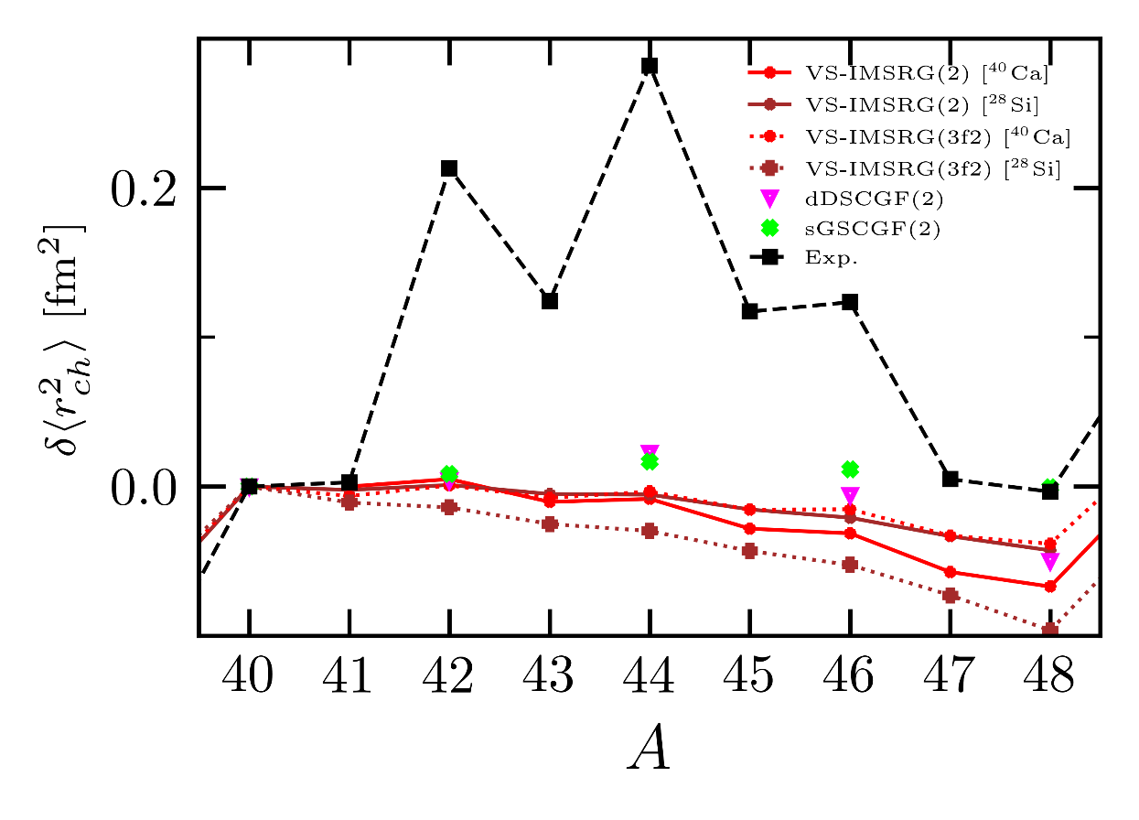
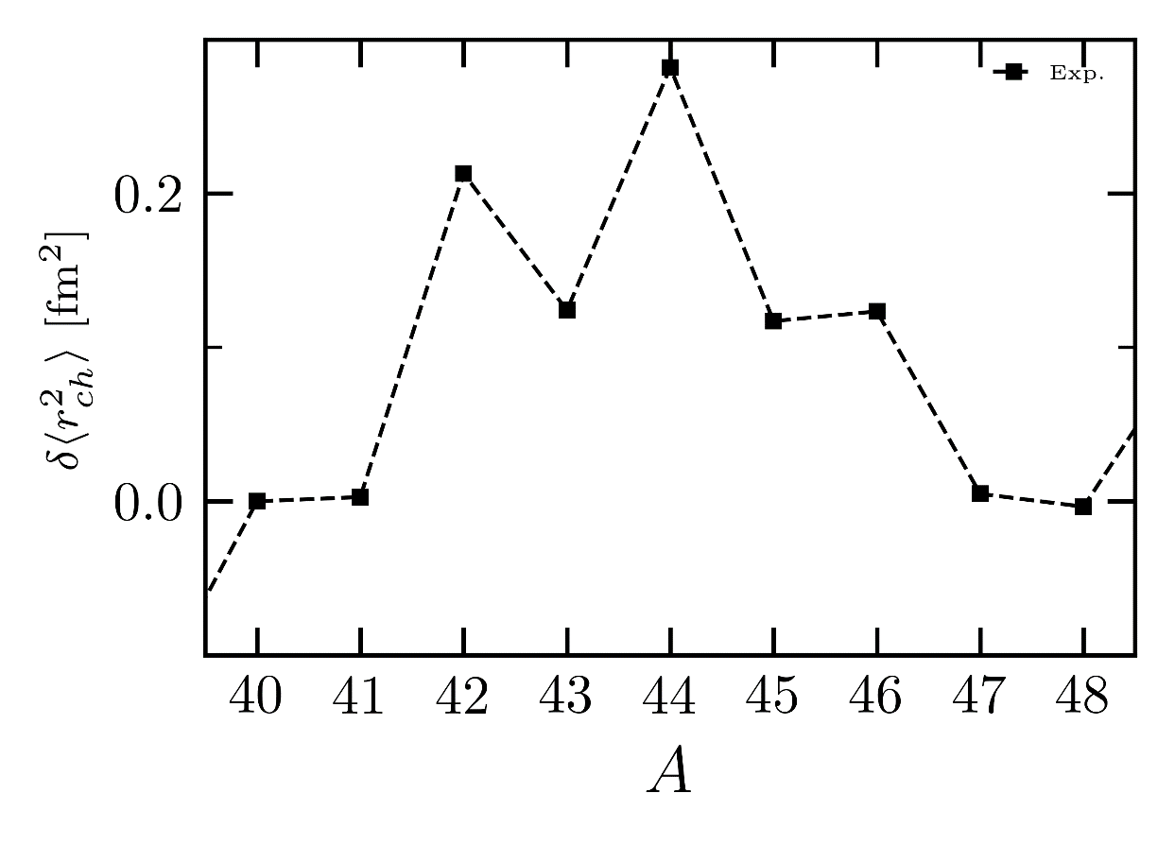
Example: Infamous puzzle of charge radii in ⁴⁰⁻⁴⁸Ca isotopes
Evolution of charge radii in spherical ⁴⁰⁻⁴⁸Ca isotopes
►Unusual behavior as a function of neutron number
→r_{ch}(⁴⁸Ca)=r_{ch}(⁴⁰Ca) in spite of 8 more neutrons in ⁴⁸Ca!
→Parabolic arch in between with a maximum in ⁴⁴Ca
→Pronounced odd-even staggering (odd being smaller)
►No current ab initio method/approx reproduce the trend
→Unclear what physics is currently missing
Isotopic shift relative to ⁴⁰Ca
Scalesi et al., unpublished
→Theorists gathered in a collaboration to solve 45y-standing puzzle!
Speculations from phenomenological models
►Breakdown of Z=20 magic number
►Key role of l=2 and l=3 collective shape fluctuations
→r_{ch}(⁴⁸Ca)=r_{ch}(⁴⁰Ca) ↔ Decrease of <δε₃²>₀₊
→Parabolic arch of r_{ch}(^{A}Ca) ↔ Behavior of <δε₂²>₀₊
Ex: No such correlations in PHFB results
Caurier et al., PLB (2001)
Barranco, Broglia, PLB (1985)
Imaging correlations at play via HIC would be very useful
► Quantify <δε_{l}²>₀₊ for l=2,3,4,5
► Maybe more intricate three-body correlations!?
Bofos et al., arXiv:2602.09890

Slide 49

When ab initio nuclear structure impacts the LHC
Giacalone et al., PRL 2025
Hydrodynamic simulation
1
(Largest ever) PGCM calculations (10⁷ CPUh)
PGCM
2
--- OO
--- NeNe
3
NLEFT
4
¹⁶O
²⁰Ne
--- PGCM
--- NLEFT
5
6
Tetrahedron α clustering
Bowling-pin ¹⁶O+α cluster
7
Enhancement in ultra central collisions
8
9
Consistent ab initio predictions
10
1-day ²⁰Ne+²⁰Ne@CERN – July 8th 2025

Slide 50
When ab initio nuclear structure impacts the LHC
ALICE collaboration, arXiv:2509.06428
ATLAS collaboration, arXiv:2509.05171
CMS collaboration, arXiv:2510.02580
1
2
v₂ rises and decrease towards centrality
→Hydrodynamic response to initial geometry
→Consistent with droplet of QGP
PGCM and NEFT v₂&v₃ consistent with data
3
v₂
v₂
4
OO
NeNe
v₃
v₃
5
6
7
NeNe/OO takes out systematic hydro error
→Strong rise of v₂ towards ultra centrality →Probe of strong quad. correl. in ²⁰Ne
→PGCM prediction in outstanding agreement!
NeNe/OO
v₃
8
v₂
9
10
Room for improvement
→PGCM and NLEFT predictions for ²²Ne needed (10% of natural Neon beam used at LHC)
→Sample 2-body PGCM density matrix and evaluate 2-body correlation v₂ operator
Duguet et al., PRL (2025)

