Slide 1
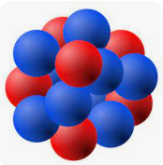
Recent Progress in Nuclear Lattice Effective Field Theory
Bing-Nan Lu
吕炳楠
Graduate School of China Academy of Engineering Physics
中物院研究生院
Intersection of nuclear structure and high-energy nuclear collisions 2026 Apr 16, 2026,YITP, Kyoto (via zoom)

Slide 2
Contents
Introduction to Lattice QMC
Non-perturbative QMC and sign problem
Perturbative QMC
Summary and perspective

Slide 3

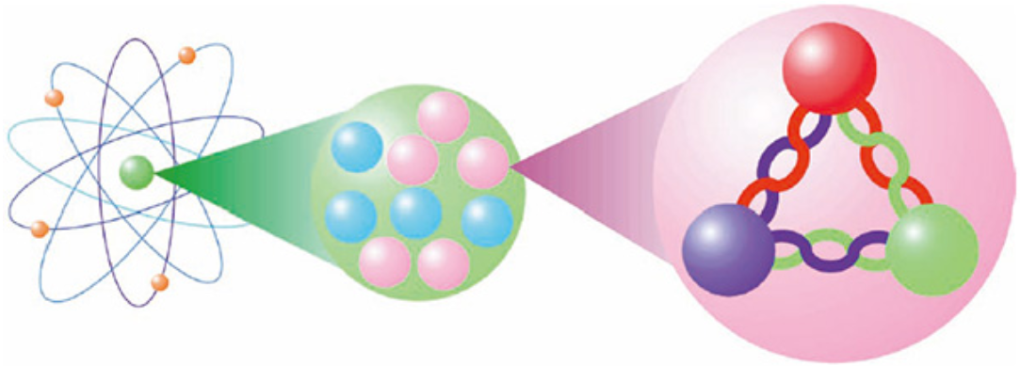
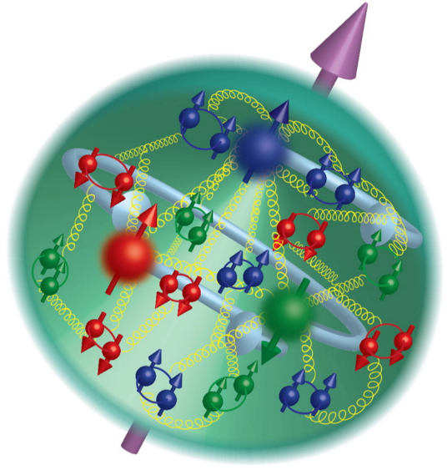
Hierarchy of strongly interacting systems
QCD Quark Confinement
Quarks are confined in nucleons
Nuclear forces among nucleons are emergent phenomena
Notes:
The starting point is the quantum chromodynamics, the SU(3) gauge field theory for quarks and gluons.
The nonlinear interactions produce extremely strong attractions among quarks at low energies, resulting in the well-known phenomena known as confinement.
In the typical energy scales in nuclei, there is no free quark.
For example, the typical nucleon separation energy in a nucleus is a few MeV, while the lowest excitation energy in a nucleon is Delta1232, three hundred MeV above the nucleon ground state.
Thus to describe the nuclear structure we only need to include the nucleon degrees of freedom.
The interactions among the nucleons are emergent phenomena completely determined by the underlying QCD.

Slide 4
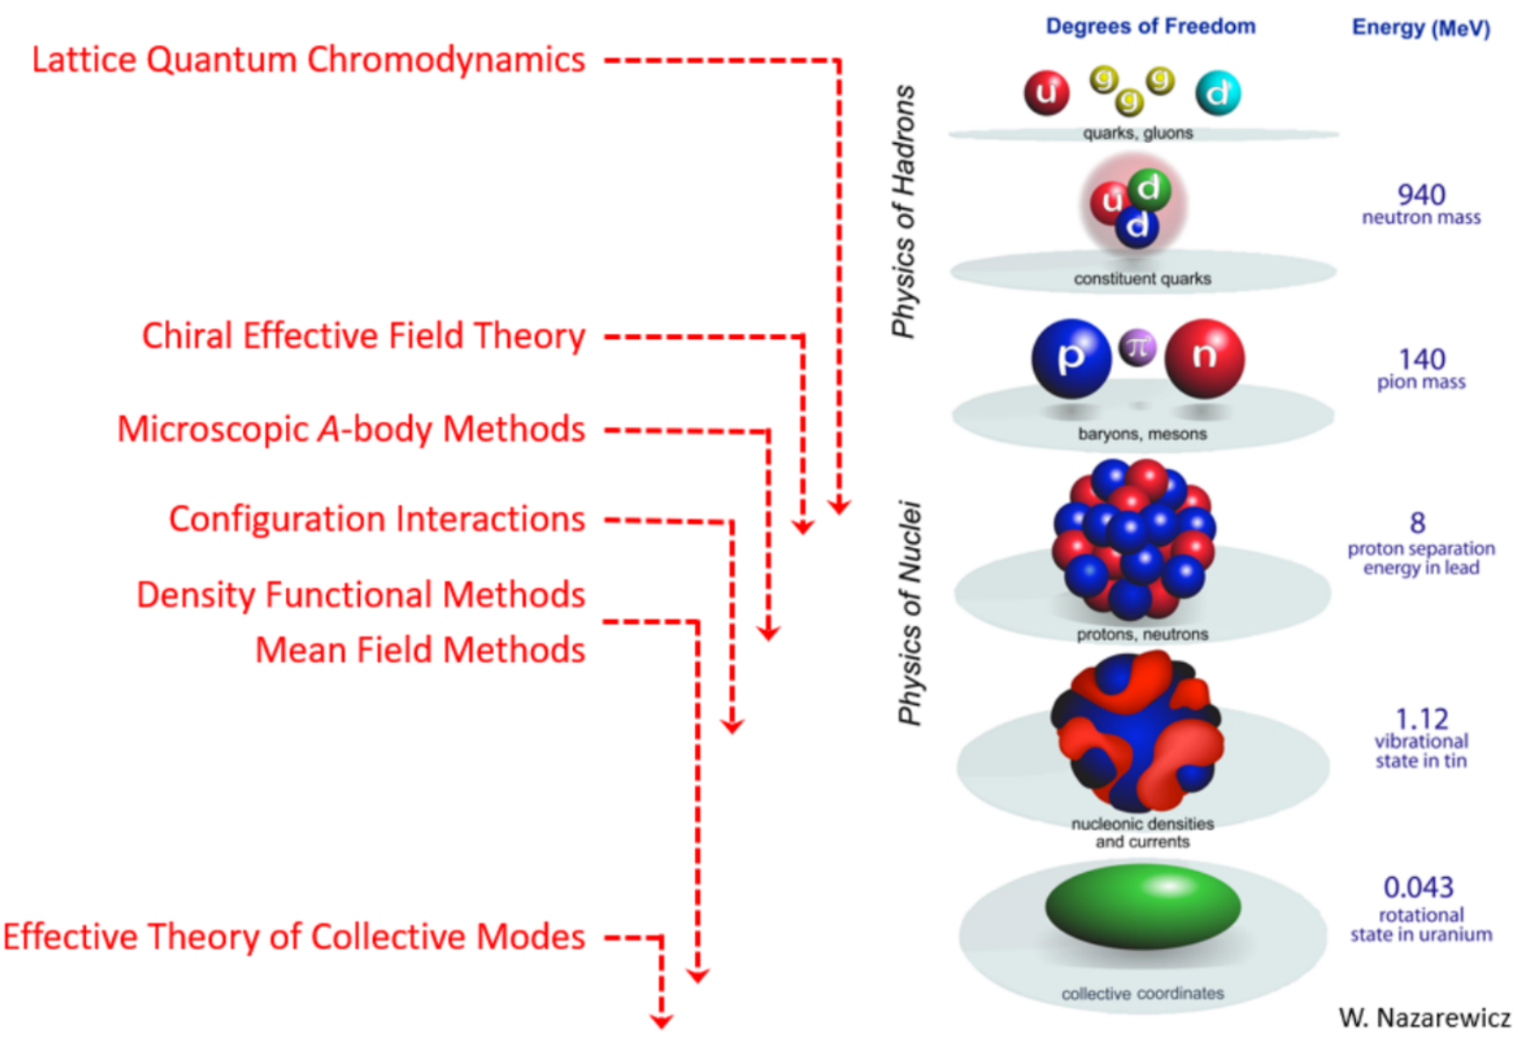
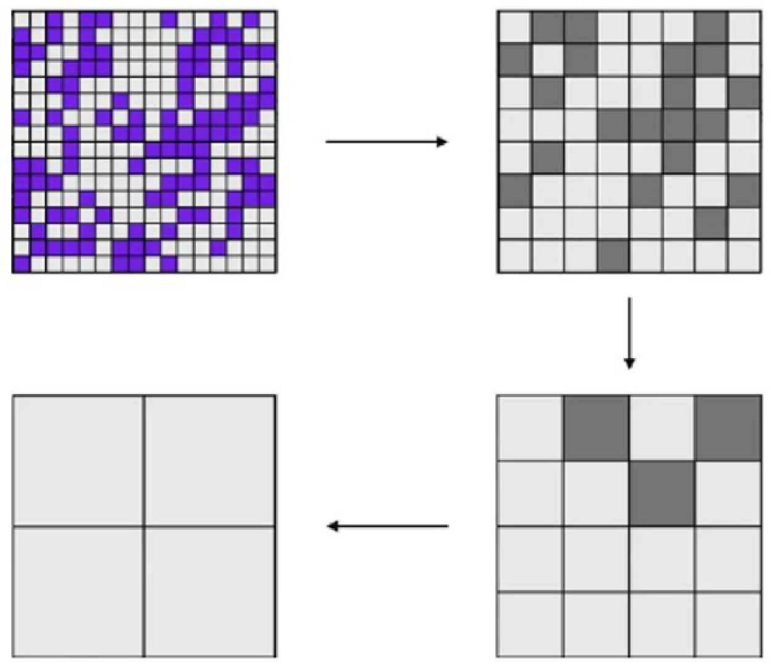
What is a nuclear EFT?
Modern nuclear force constructions are based on the Effective Field Theory
Theoretical foundation of EFT is the Wilsonian renormalization group:
High-momentum details can be integrated out & hidden in LECs
Low-momentum physics kept invariant under RG transformations

Slide 5
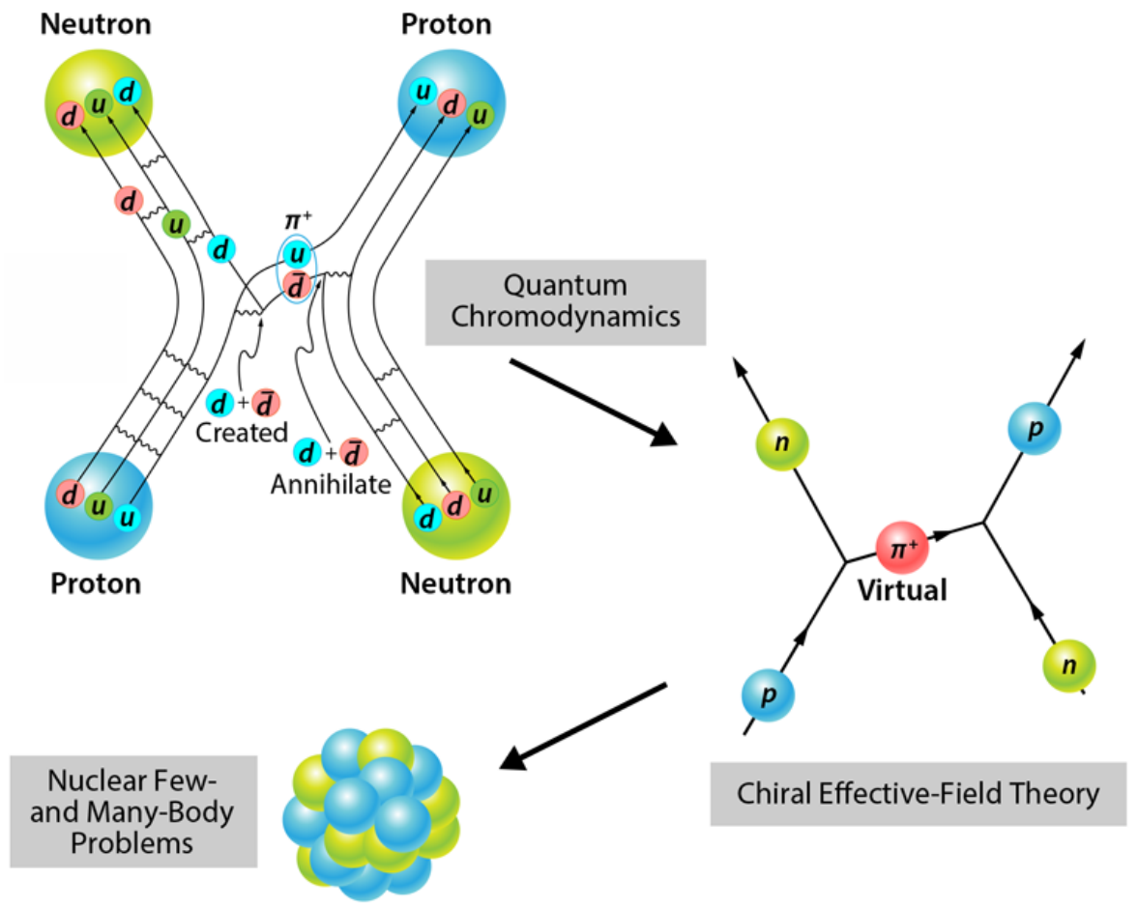
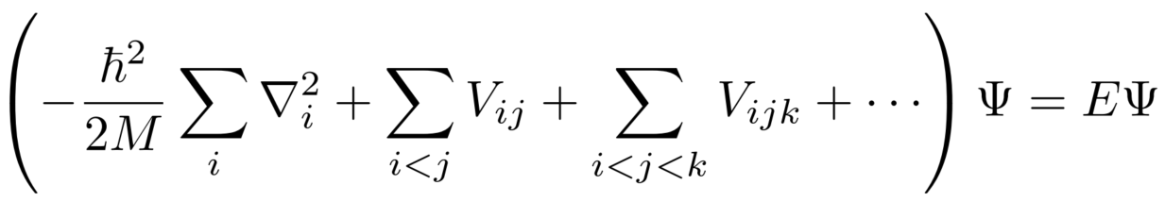
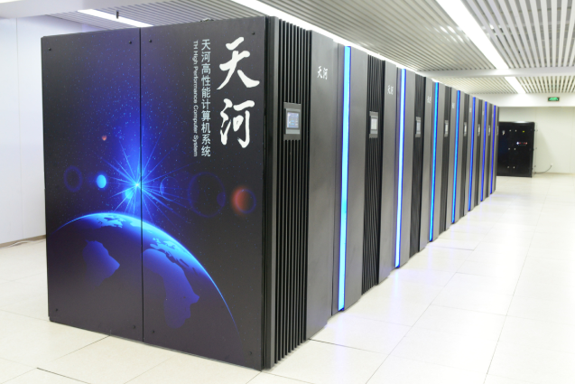
What is nuclear ab initio calculations?
Nuclear forces
Notes:
Because of such separation of scales, we can simply write down the nucleon-nucleon interactions and solve the corresponding Schrodinger equation to get the nuclear structure properties.
This is the standard paradigm of nuclear ab initio calculations.
The picture is that the nucleons exchange pions and other heavy mesons that can be absorbed into a series of nucleon-nucleon potential.
There is a whole industry of deriving such nuclear forces based on underlying symmetries.
Our task I to solve the quantum many-body problems using modern algorithms and supercomputers.

Slide 6
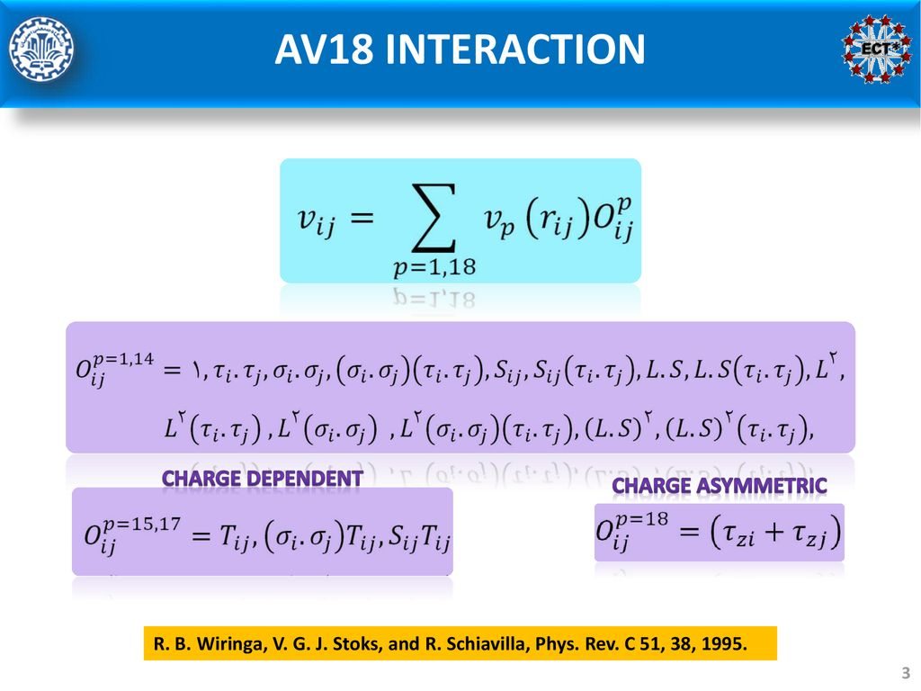
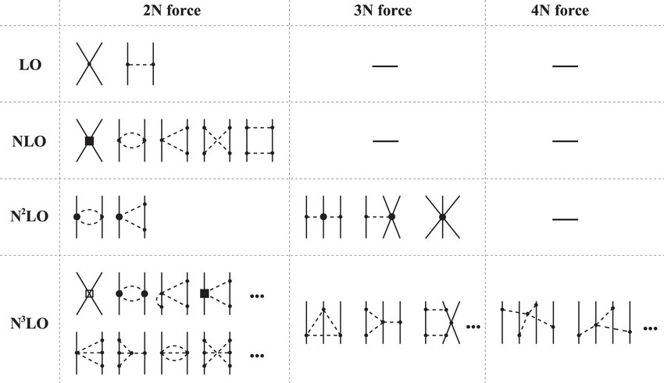
Typical nuclear forces
complicated operator structures emerging from QCD
Nuclear chiral EFT
Notes:
Now there are tens or hundreds of different nuclear forces on the market.
Here I show two most popular examples.
The AV18 interaction was developed thirty years ago in the Argone national laboratory in the US.
The digits 18 denotes the total number of terms in this potential.
Each term has a specific spin and isospin structure, and v_p is short range functions of the nucleon coordinates.
Such interaction has around twenty parameters that are fixed by fitting to the nucleon-nucleons scattering data.
Another version of the nuclear force is the chiral effective field theory, firstly proposed by Steven Weinberg in 1990s.
Here the nuclear forces are organized into a infinite series of Feymann diagrams, we have leading order, next-to leading order, next-to-next-to leading order, and so on.
The contributions from higher orders are smaller and we can make a reasonable truncation in practical calculations.
If we sum over all terms, its prediction should converge to the results from the QCD.
In modern nuclear ab initio calculations, we mostly truncate at the N3LO.
At this order there are more than twenty parameters, similar to the phenomenological forces like the AV18.

Slide 7
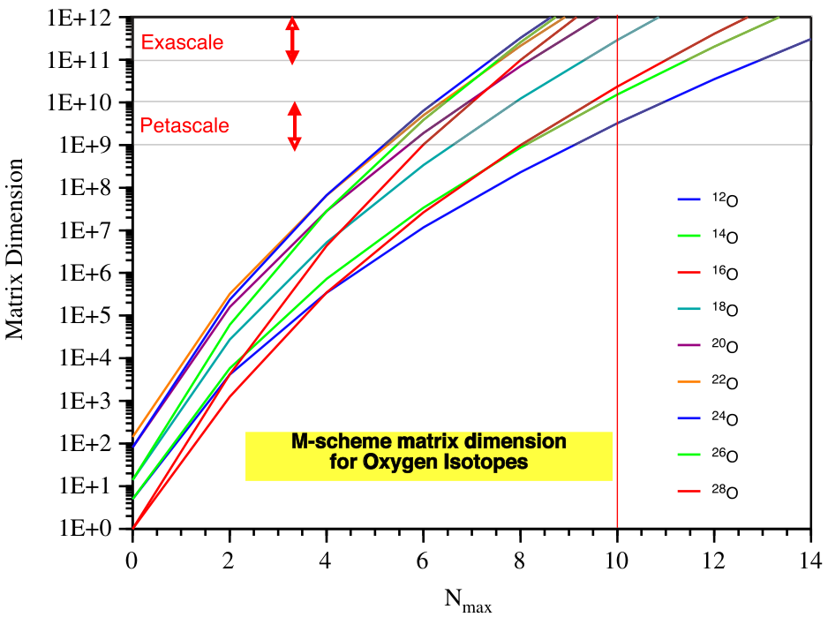
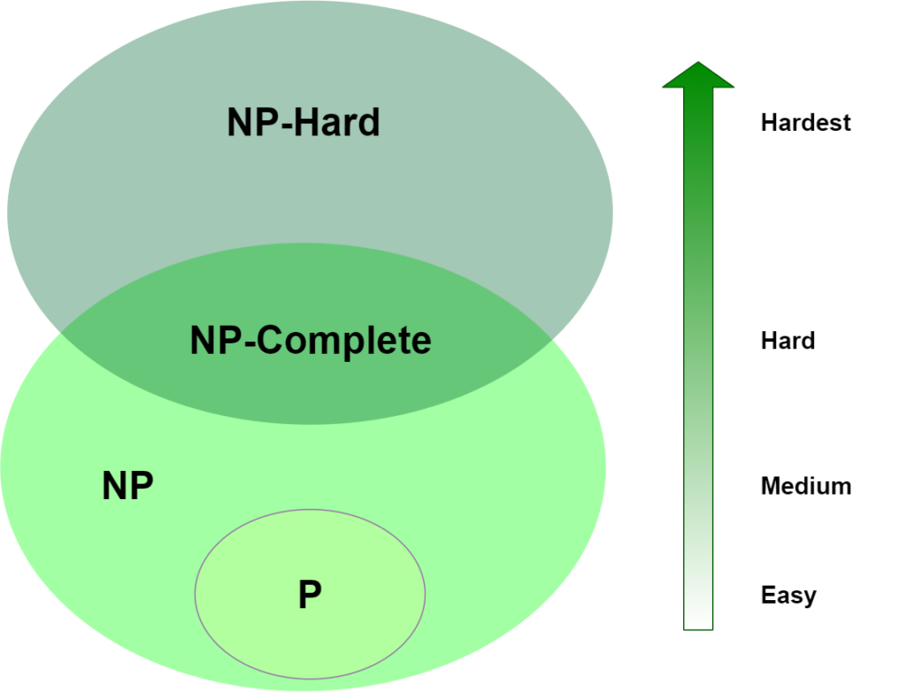
Complexity of nuclear many-body problem
Exponentially increasing Hilbert space
Find ground state of a general
Hamiltonian is NP-Hard
P: Solvable within polynomial time
NP: Verifiable within polynomial time
Notes:
While building the nuclear forces is already a difficult task, solving the corresponding Schrodinger equation is even more challenging.
Here the problem is the intrinsic complexity of the quantum many-body problem.
We know that the dimension of the many-body Hilbert space increases exponentially as a function of the particle number.
Here I show the dimension of the Hamiltonian matrix as function of the single-particle basis for simulating several light oxygen nuclei.
We see that the required computational power exceeds the capability of the most powerful supercomputer available today.
This is why the direct diagonalization algorithms are limited up to twenty nucleons.
Generally, the problems for a computer can be classified according to their complexity.
Here P means the problem can be solved within polynomial time scaling using certain algorithms.
NP means the problem might not be solved within polynomial time, but we can verify a given answer within polynomial time.
Because finding the general ground state has an exponential complexity, we believe that it belongs to one of the most hardest category, the NP-Hard problems.
If one can find a efficient algorithm for solving the ground states within exact polynomial time, he has proven P = NP and earn one million dollars prize from the Clay institute.
However, this is quite impossible and we believe that such general-purpose algorithm does not exist.
But fortunately, for certain very-specific quantum many-body systems we do have polynomial algorithm.

Slide 8


Complexity of Nuclear many-body problem
Models with strong interactions present great challenges
4. General quantum many-body problem (NP-hard)
Exact diagonalization
Quantum computing
3. Problems perturbatively solvable
QMC with sign problem
(Nuclear ab initio calculations)
Problems analytically solvable
only possible in 1-d systems
2. Problems with polynomial algorithms
QMC without sign problem
Notes:
We can simply divide quantum many-body problems into four categories.
For several simple toy-models in low-dimensions we can find analytical solutions, e.g., the one-dimensional bosons interacting with delta-forces, such exactly solvable models have given us valuable insights.
The second class of problems can be numerically solved using polynomial algorithms, such as quantum Monte Carlo algorithms if there is no sign problem. I will explain it later.
The third class of problems can not be solved within polynomial time, but we can apply perturbation theory order by order to extract reasonable approximations of the final answer.
In this case we generally rely on the Feynmann diagrams.
One important thing is that summing over the Feynmann diagrams up to high orders is also polynomially complex.
Finally, the most general many-body problem can only be solved using direct diagonalization or quantum computing techniques, which is still far from mature.

Slide 9
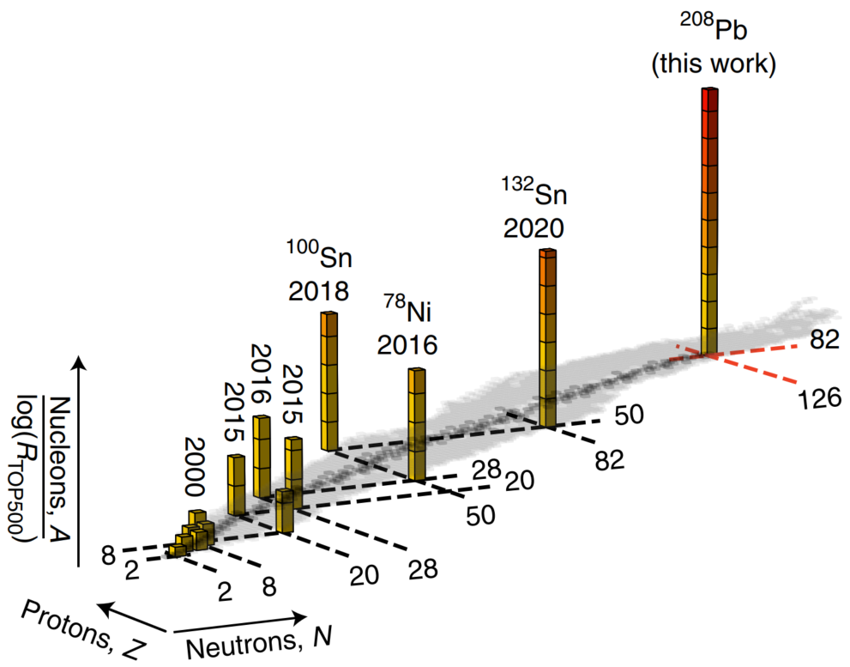

Nuclear ab initio algorithms
No core shell model: $A≤20$
Green’s function Monte Carlo: $A≤20$
Coupled cluster: $A≤100$
In-medium similarity renormalization group: $A≤100$
Nuclear lattice effective field theory: $A≤100$
Developments of algorithms and hardware rapidly push the frontiers of nuclear ab initio calculations
mass / temperature / strangeness /… Rapid growth in last decade
Hu et al., Nature Physics, 18, 1196 (2022)
Notes:
In nuclear physics, there exists several efficient quantum many-body solvers.
For example, the no core shell model calculate the matrix elements of the Hamiltonian in a harmonic oscillator basis, then perform direct diagonalization.
The direct no core shell model calculations are mostly limited to light nuclei.
We also have the coupled cluster method, taking into account the most important many-body correlations, thus can be applied to much heavier nuclei.
We also have methods based on the Monte Carlo techniques, such as the Green’s function Monte Carlo and Nuclear lattice effective field theory.
In last ten to twenty years we have seen a rapid increase of the nuclear ab initio calculations.
This is a plot showing that the nuclei calculated using the IMSRG method.
We see that the mass limit for ab initio calculations has just been broken in the last decades since 2015.
The ab initio simulations for heavy nuclei is a large new territory waiting to be explored.

Slide 10
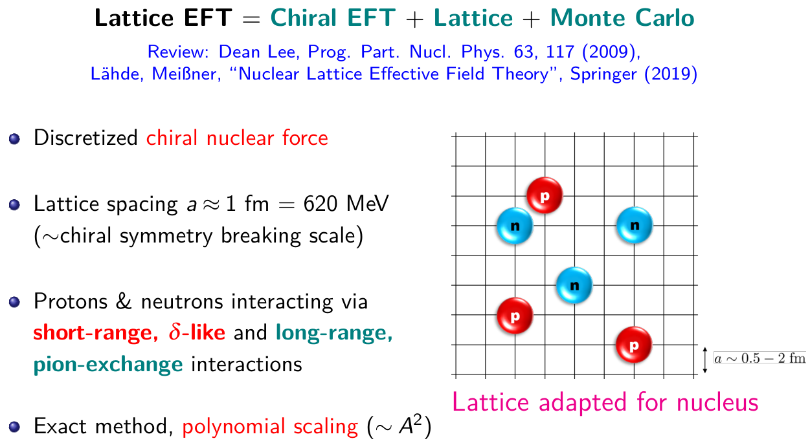
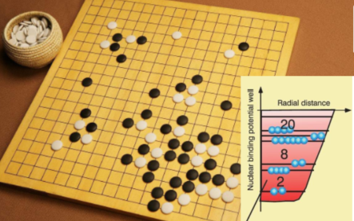
Lattice EFT: A many-body EFT solver
Solve the non-perturbative
nuclear many-body problem by sampling all configurations
Many-body correlations emerge naturally without a reference mean-field solution

Slide 11
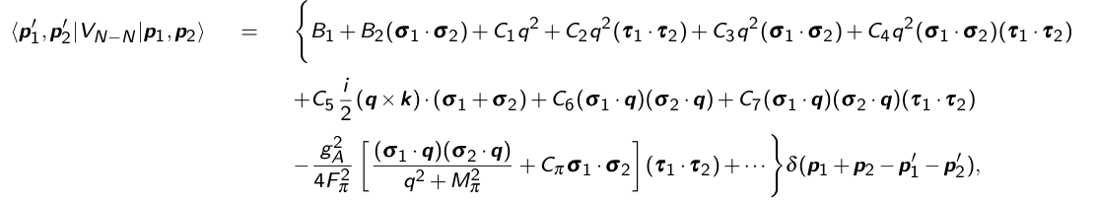



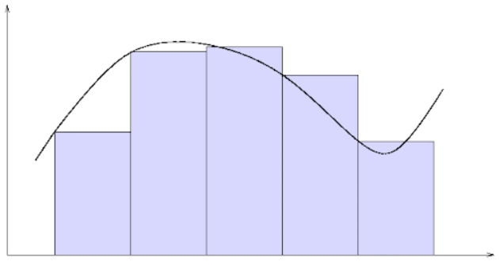
Naïve discretization of chiral Hamiltonian
Derivative → Finite difference / FFT
Integration → Summation
Discretization error $O(a^{N})$ → Systematically improvable

Slide 12
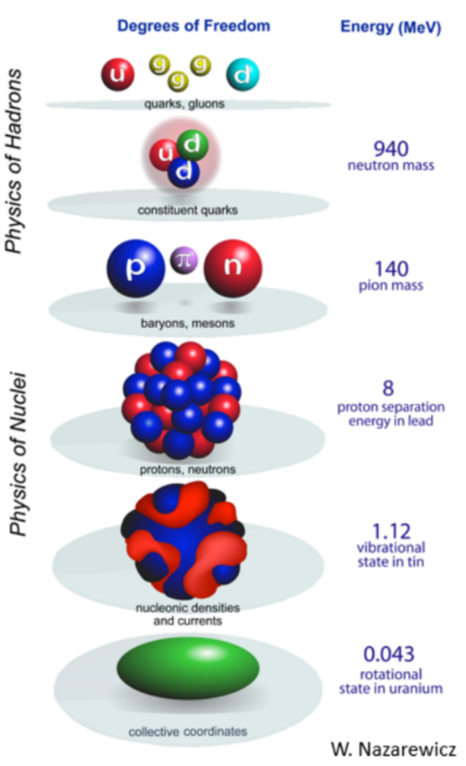
Dual role of the lattice
Lattice is used to discretize the action
and regulate the delta-functions
QCD coupling is dimensionless
→ QCD is renormalizable
→ Safe to take the continuum limit $a→0$
EFT couplings has negative mass dimensions
→EFT is non-renormalizable
→Break down at a small lattice spacing
Example: Wigner bound Wigner, PR98, 145 (1955)
For $Λ→∞$, effective range $r_{eff}≤0$
However, experimental n-p scattering $r_{eff}≈1$ fm

Slide 13
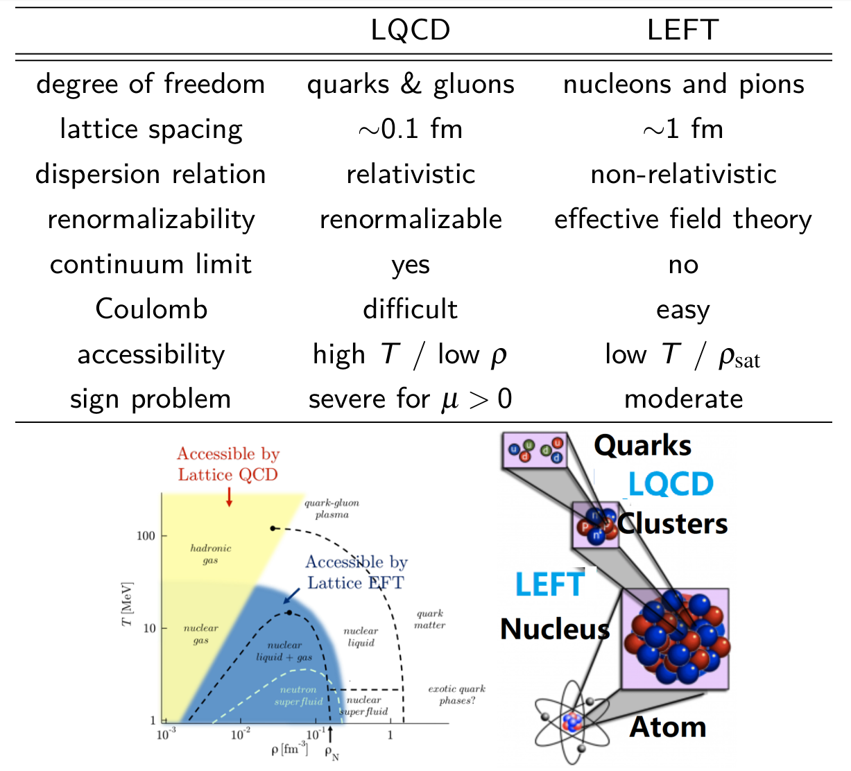
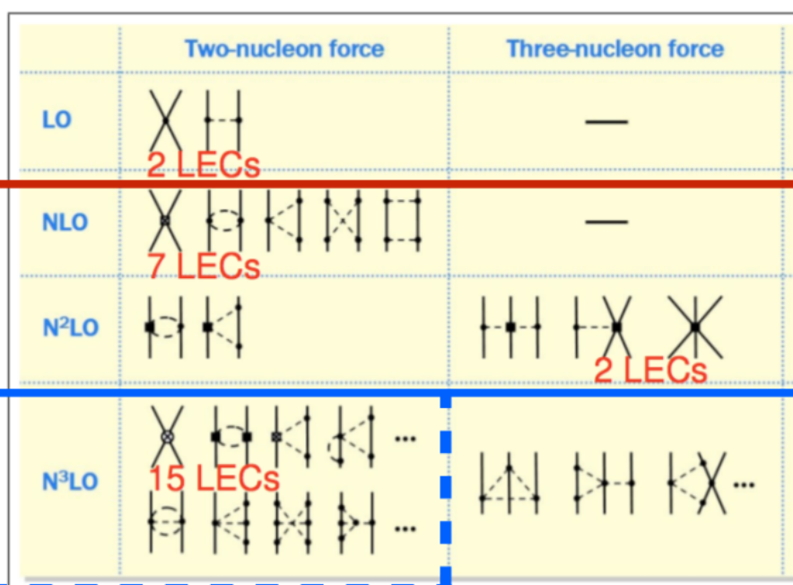
Compare Lattice EFT and Lattice QCD
Lattice EFT share a lot of common features
with Lattice QCD. However,
Non-rel. → particle number conservation
Quadratic dispersion relation → no Fermion doubling problem
EFT contains non-renormalizable terms → no continuum limit

Slide 14
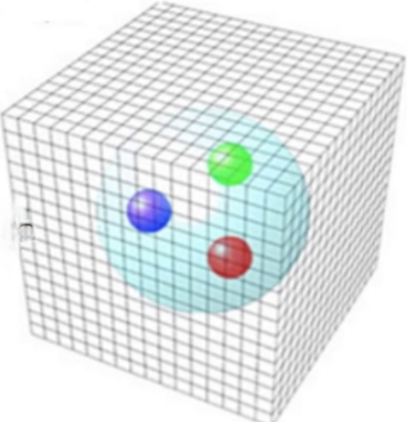
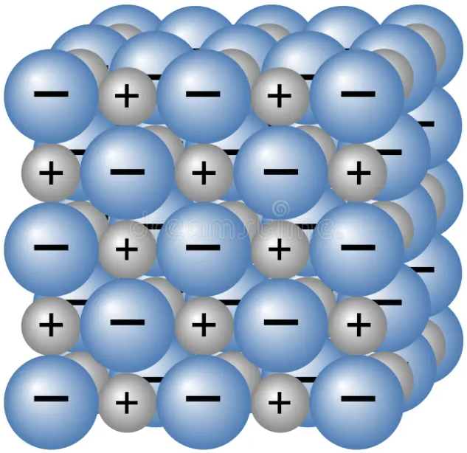

Decoupling of real physics from the lattice
In lattice field theories, the lattices are introduced artificially
Induce lattice artifacts → contaminations to observables
Predictions should be independent of the lattice spacing & geometry
Real crystal lattice
Lattice field theory
Scaffold

Slide 15
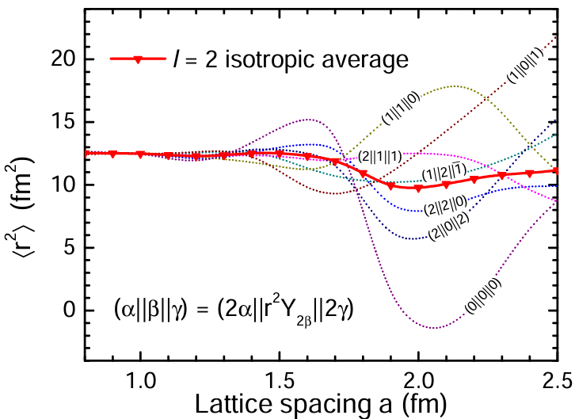
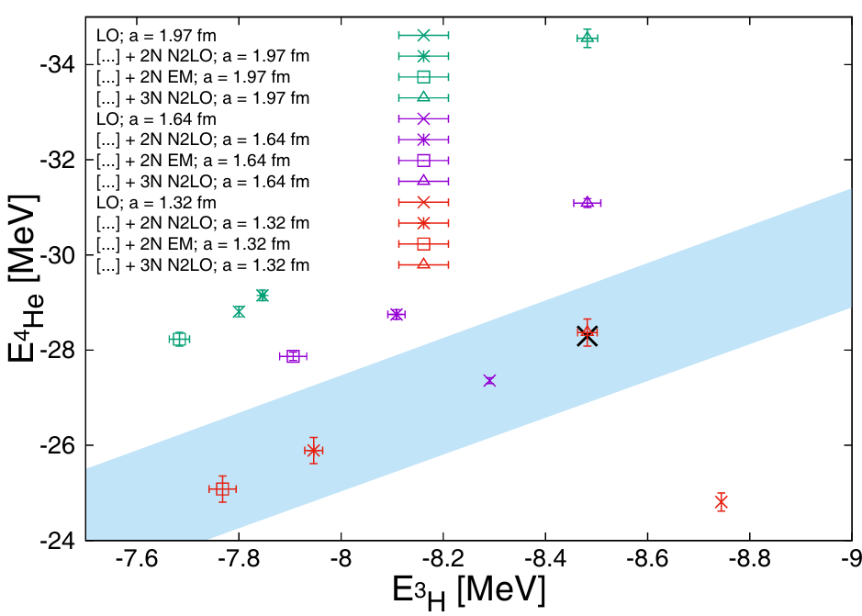
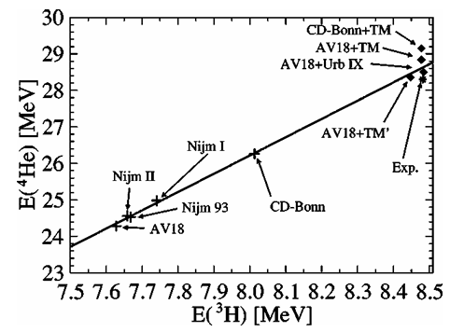
Consequences of lattice artifacts
Matrix elements of tensor operators
Lu et al., Phys. Rev. D 92, 014506 (2015)
Tjon line with varying lattice spacing
Klein et al., Eur.Phys. J. A 54, 121 (2018)
Tjon line is universal for
modern nuclear forces
Tjon, Phys. Lett. B 56, 217 (1975)
Nogga et al., Phys. Rev. C 65, 054003 (2002)
Symmetries and universalities are independent of details of interactions
→ Sensitive indicators for non-physical artifacts

Slide 16
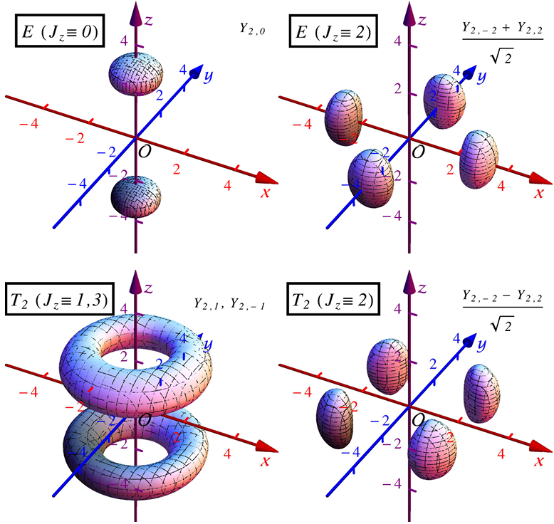
Symmetry breaking on the lattice
Lattice artifacts break fundamental symmetries
SO(3) rotational symmetry
Translational invariance
Galilean invariance
? Chiral and Gauge
Induce systematic errors difficult to quantify
Symmetries can be restored
Average over orientations
Supplemental counter terms to Hamiltonian
→ Symanzik improvement
Symanzik, Nucl. Phys. B 226, 187 (1983); Nucl. Phys. B 226, 205 (1983)
Add non-renormalizable terms that vanish in continuum limit: $H→H+aO^{(1)}+a^{2}O^{(2)}+a^{3}O^{(3)}+…$
Cancels lattice artifacts → Achieving continuum limit at finite lattice spacing
Lu et al., Phys. Rev. D 90, 034507 (2014); Phys. Rev. D 92, 014506 (2015)

Slide 17
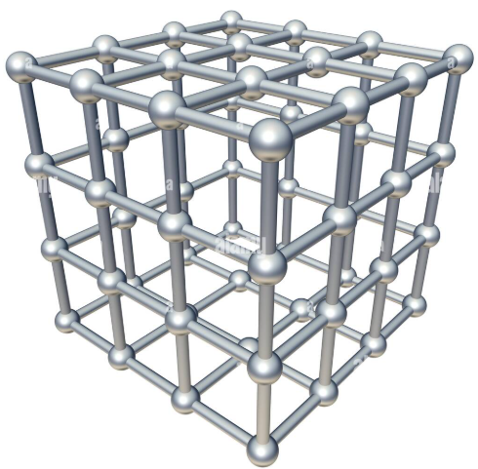
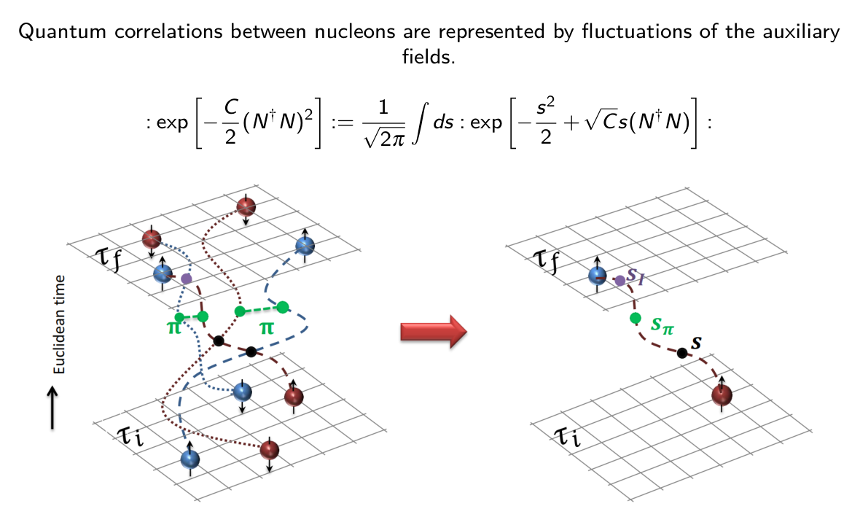
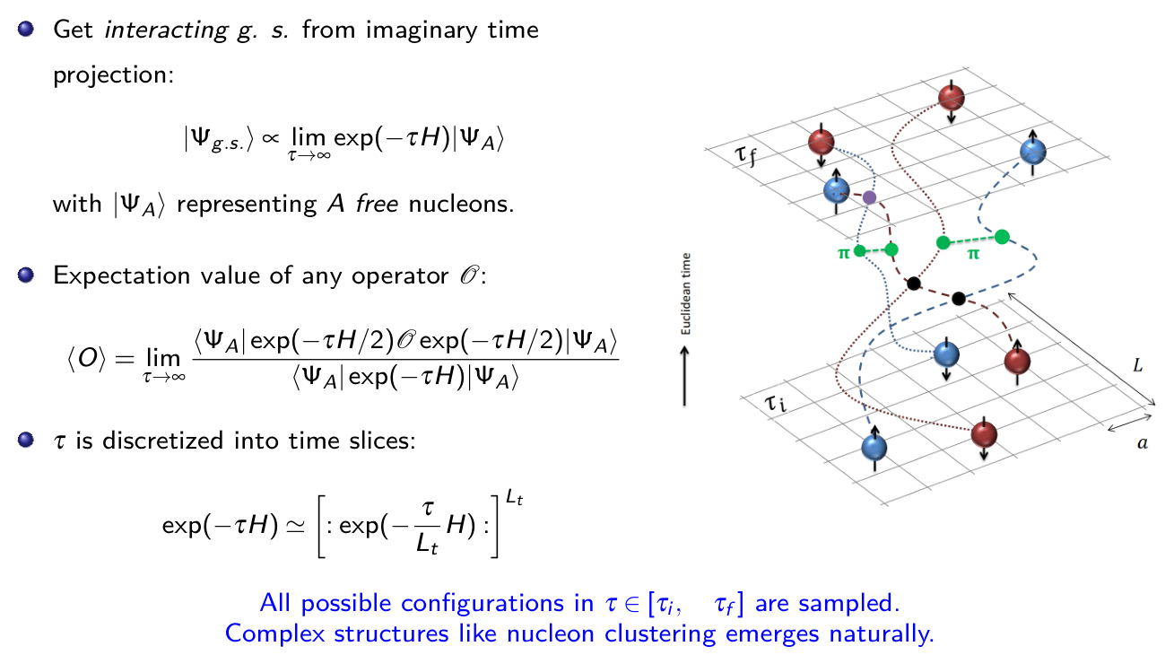
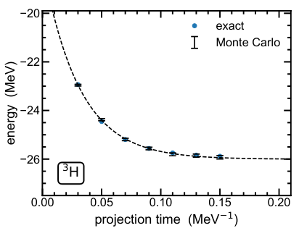
Lattice EFT: A many-body EFT solver

Slide 18
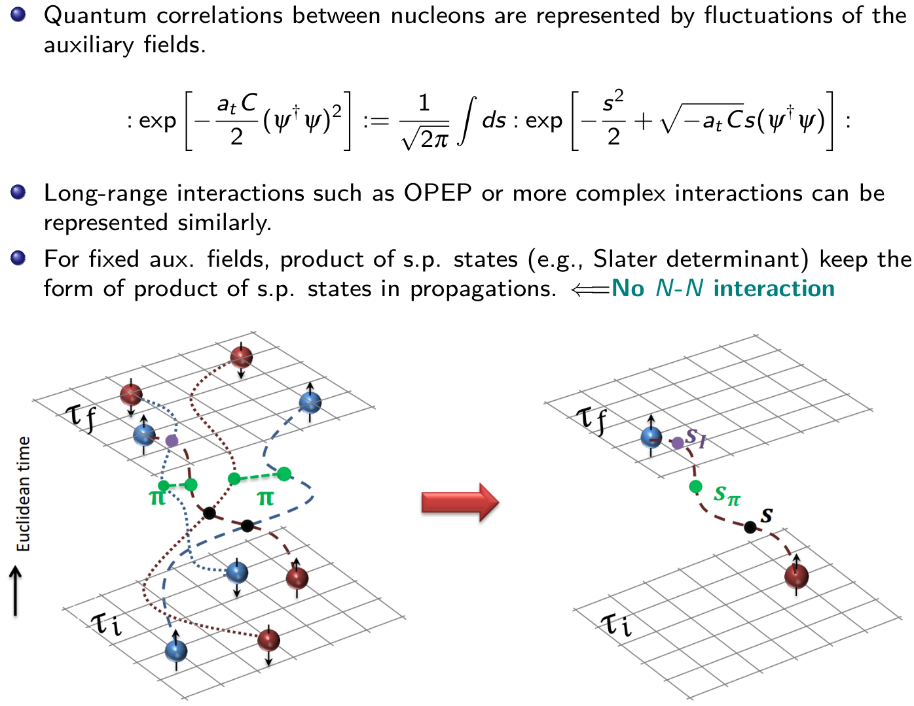
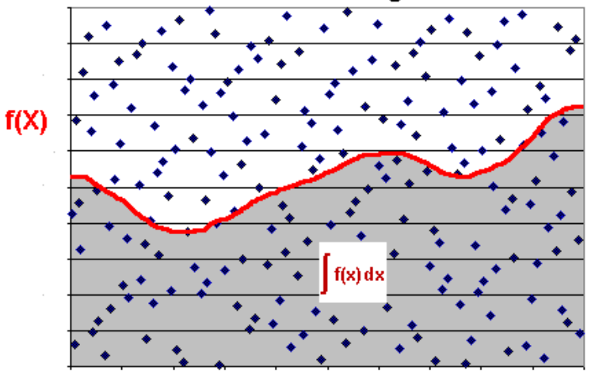
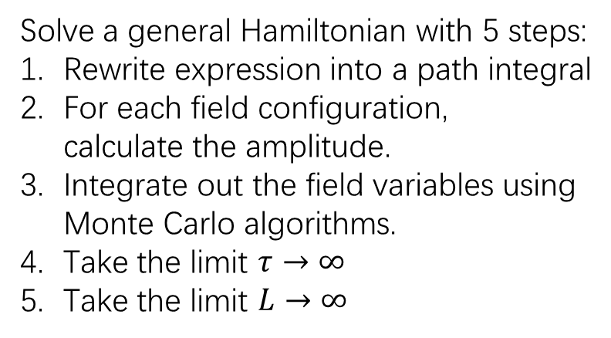
Lattice EFT: A many-body EFT solver
Solve a general Hamiltonian with 5 steps:
Rewrite expression into a path integral
For each field configuration, calculate the amplitude.
Integrate out the field variables using Monte Carlo algorithms.
Take the limit $τ→∞$
Take the limit $L→∞$

Slide 19
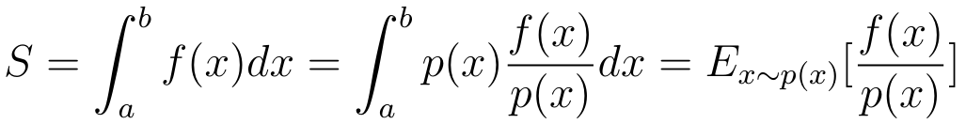
Quantum Monte Carlo
Solve quantum many-body problem using stochastic sampling
Optimization in high-dimensional parameter space ← e.g., neuron network
High-dimensional integrals
QMC methods for condensed matter, nuclear physics, atomic-molecular physics, high-energy physics, etc.
Compute integrals using importance sampling
Key point: Generate a set of samples with probability distribution p(x)
If p(x) is simple（e.g., Gaussian, uniform, etc.), direct sampling
If p(x) is complex, use Metropolis algorithm

Slide 20
Contents
Introduction to Lattice QMC
Non-perturbative QMC and sign problem
Perturbative QMC
Summary and perspective

Slide 21
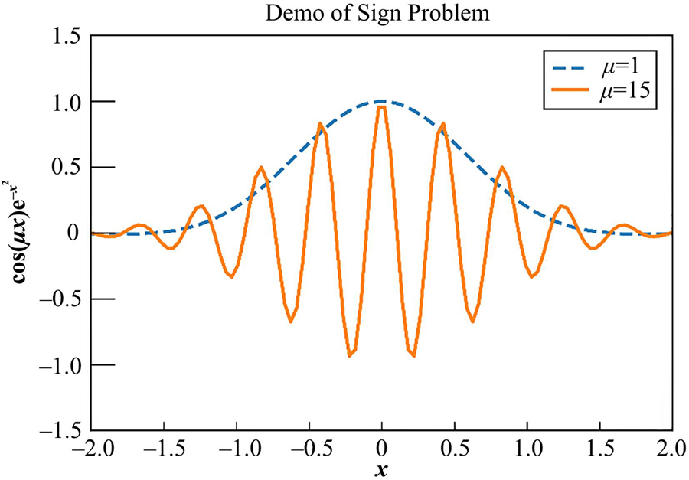
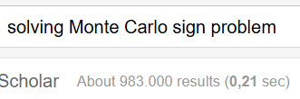
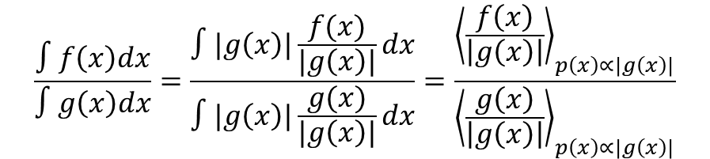
Sign problem in quantum Monte Carlo
$$\frac{∫f\left(x\right)dx}{∫g\left(x\right)dx}=\frac{∫|g\left(x\right)|\frac{f(x)}{|g\left(x\right)|}dx}{∫|g\left(x\right)|\frac{g(x)}{|g\left(x\right)|}dx}=\frac{{\left\langle \frac{f\left(x\right)}{\left|g\left(x\right)\right|}\right\rangle }_{p\left(x\right)∝|g\left(x\right)|}}{{\left\langle \frac{g\left(x\right)}{\left|g\left(x\right)\right|}\right\rangle }_{p\left(x\right)∝|g\left(x\right)|}}$$
Sign problem arises for repulsive interactions
or unbalanced fermions
Coulomb interaction
Hard core in NN potentials
Tensor forces
Three-body forces
Unpaired pinholes
…
Very few interactions and systems
can be simulated directly
Large statistical errors
Signal-noise issue
Bad scaling → errors increase exponentially with system size
No universal solution → NP-hard problem M. Troyer and U.-J. Wiese, PRL94, 170201 (2005)

Slide 22
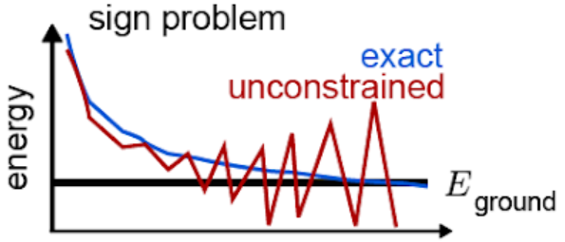
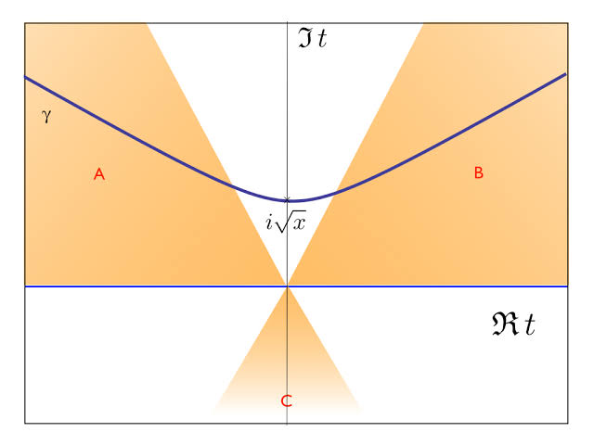
Sign problem in quantum Monte Carlo
Quantum Monte Carlo transform the quantum many-body problems into high-dimensional integrals
QMC Statistical error ~O(N^{-1/2}) ← Polynomial scaling!
Sign problem occurs when the integrand is NOT positive definite
Sign problem scales exponentially with particle number
Solutions: Constrained-path, fixed-nodes, Lefschetz thimble, etc.
Rely on approximations or induces systematic biases ← Not exact even with infinite number of samples!
No-free-lunch theorem
Notes:
The Quantum Monte Carlo method has a very interesting feature that its computational complexity is independent of the dimension.
As a stochastic method, the QMC calculations are accompanied by a statistical error proportional to one over square root of N.
For calculating the high-dimensional path integrals like that generated in lattice EFT, we apply the importance sampling method, which means that we view the quantum amplitudes as a probability distribution and generate samples accordingly.
However, this is only possible if the amplitudes are positive numbers.
In many cases the amplitudes have negative or even complex components, in this case we say there is a sign problem.
The sign problem is more severe for fermionic systems due to the anti-symmetrization nature of the wave functions.
Now the sign problem is a main obstacle for applying the QMC for solving the quantum many-body problem.
There has been millions of papers talking about the solution of the sign problem in QMC, but there is no general-purpose solution so far.
If we have a sign problem, the statistical error will increase exponentially as functions of system volume, time and particle number.
Thus even if the sign problem is mild and tolerable for light nuclei, it will always destroy our simulation for heavier nuclei.
This is the reason why in may years the nuclear QMC simulations are mostly limited to light nuclei, although we believe that a pure QMC has a polynomial complexity.
To recover this nice polynomial scaling, one method is to build rigorously sign-problem-free models.
In this case the amplitudes are positive definite, allowing us to solve the nuclear many-body problem from light to heavy nuclei with remarkably high numerical precision.
However, so far such models are mostly simple toy models that are not quite useful.

Slide 23
Examples of sign-problem-free QMC
Sign-problem-free algorithms exist but mostly confined to specific models
Lattice QCD with two identical quark species
Nuclear Lattice EFT with Wigner-SU(4) interactions (even-even nuclei)
Repulsive Fermi-Hubbard model at half-filling
Kane-Mele-Hubbard model
Half-filled Kondo lattice model
Positivity of the fermionic determinant is protected by the time-reversal symmetry
Sufficient condition for absence of the sign problem in the fermionic quantum Monte Carlo algorithm, C.-J. Wu and S.-C. Zhang, PRB71, 155115 (2005)
Sign-problem-free fermionic quantum Monte Carlo: Developments and Applications, Z.-X. Li and H. Yao, Annu. Rev. Condens. Matter Phys. 10, 337 (2019)
Notes:
Here we present several examples of the sign-problem-free QMC models in various fields.

Slide 24
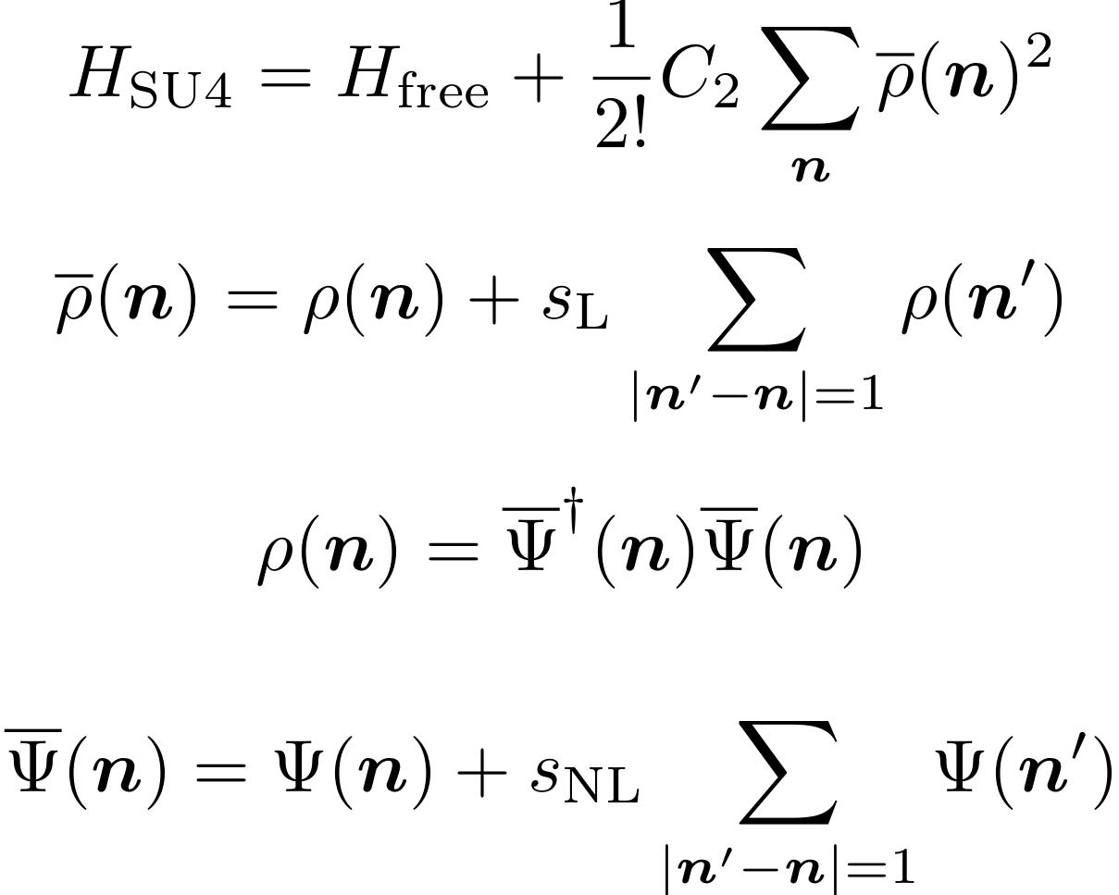
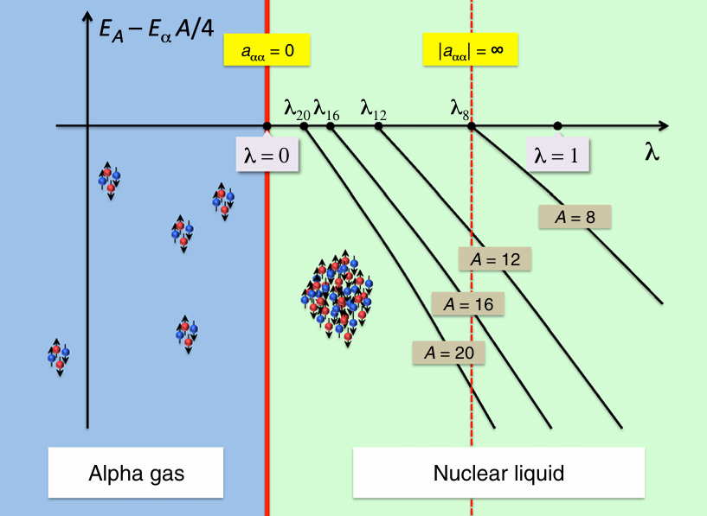
Nuclear binding near a quantum phase transition
The nuclear force can be either local (position-dependent)
or non-local (velocity-dependent).
Locality is an essential element for nuclear binding.
S. Elhatisari et al., PRL 117, 132051 (2016)
Challenge: Minimal nuclear force
That reproduce the binding pattern
Simple Wigner-SU(4) central force fails!

Slide 25
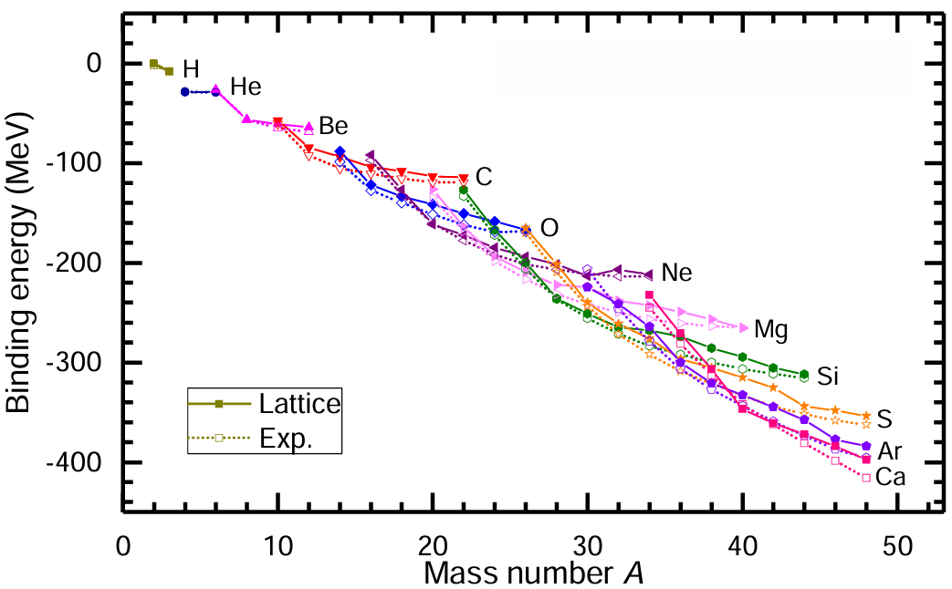
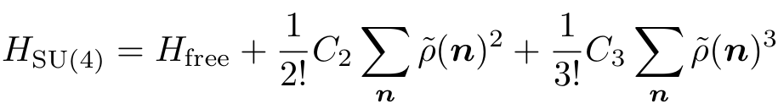
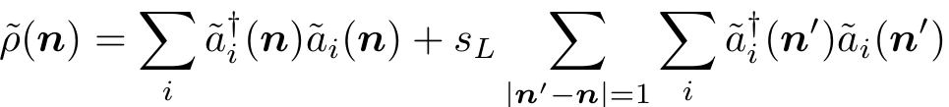
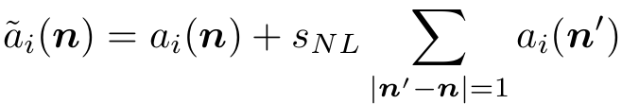
“Essential element” Hamiltonian as zeroth order
Wigner-SU(4) symmetry + paired fermions
= Immunity to sign problem
Wigner, Phys. Rev. 51, 106 (1937)
Also inspired by the unexpected effectiveness of
the locality in nuclear forces
Elhatisari et al., PRL 117, 132501 (2016)
Applicable in nuclear spectroscopy, clustering,
thermodynamics, electromagnetic transition, …
pros: non-perturbative, small statistical errors
cons: low-fidelity, large theory uncertainties
BNL et al., PLB 797, 134863 (2019)

Slide 26
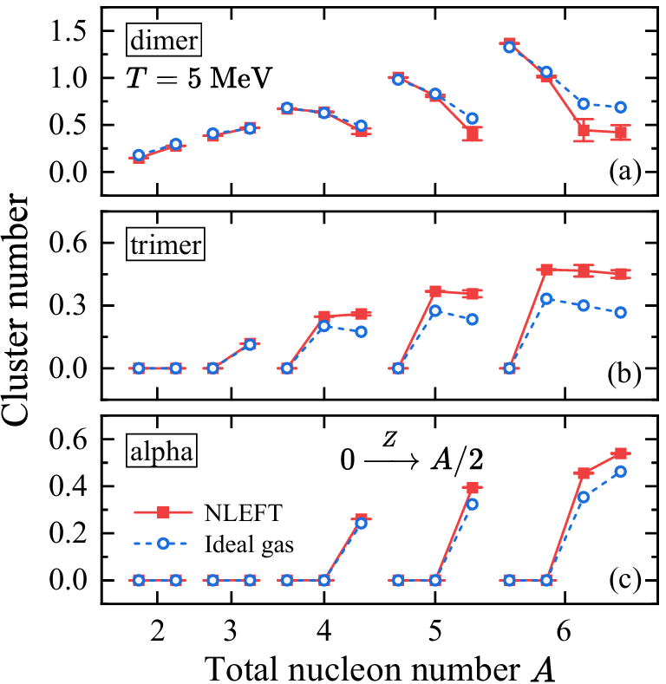
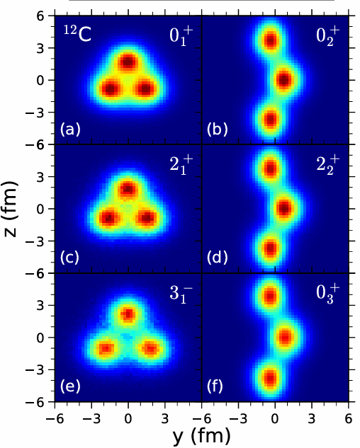
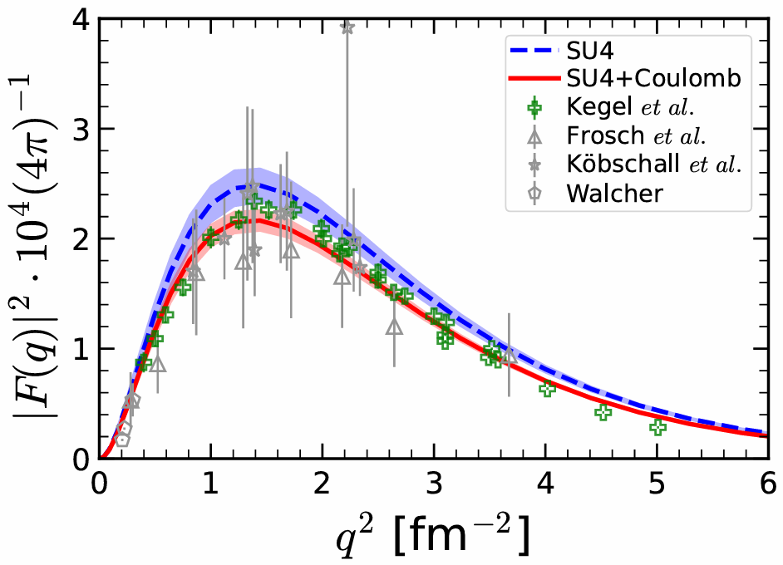
Applications of Wigner-SU(4) interaction
Ab initio calculations of the isotopic dependence of nuclear clustering, S. Elhatisari et al., PRL 119, 222505 (2017)
Emergent geometry and duality in the carbon nucleus, S. Shen et al., EPJA 57, 276 (2021); S. Shen et al., Nat. Comm. 14, 2777 (2023);
Ab initio study of nuclear clustering in hot dilute nuclear matter, Z. Ren et al., PLB 850, 138463 (2024)
Ab initio calculation of the alpha-particle Monopole transition form factor, Ulf-G. Meißner et al., PRL 132, 062501 (2024)
Ab initio study of the beryllium isotopes ⁷Be to ¹²Be, S. Shen et al., PRL 134, 162503 (2025)

Slide 27
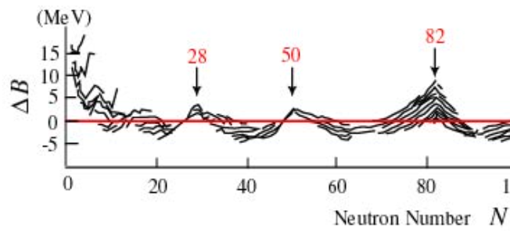



Improved Wigner-SU(4) interaction
Wigner-SU(4) symmetry is an approximate symmetry -Lack correct shell structure → Spin-orbit coupling
We introduce a spin-orbit coupling
Wigner-SU(4) symmetry does not mix spin-up and spin-down particles → Fermion determinant factorized into two identical parts: det(Z) = det(Zu)² >= 0 → Fermionic sign problem avoided!
Spin-orbit term act equivalently for spin-up and spin-down particles → Fermion determinant keeps positive definite
Z.-W. Niu and BL, PRL135-222504 (2025)

Slide 28




Proof for the positivity of the determinant
The nucleons evolve independently under the auxiliary fields.
Time-reversal pairs are NOT broken by the spin-orbit coupling
Matrix elements of the fermionic correlation matrix respect a special symmetry

Slide 29

Proof for the positivity of the determinant

Slide 30




Gradient Descent method
We fit to binding energies of ⁴He, ¹⁶O, ²⁴Mg, ²⁸Si, ³²S, ⁴⁰Ca using a derivative-based optimization method
The derivatives are calculated using the Feynman-Hellmann theorem,
Typically converge within 10 iterations ← precise and unbiased derivative computation is essential!
“LAT-OPT1”

Slide 31



Results from LAT-OPT1

Slide 32

Results from LAT-OPT1: Charge densities
Charge densities calculated using pinhole algorithm
Elhatisari et al., PRL119, 222505 (2017)
Pinhole algorithm induce mild sign problem, not available for A>=40. See partial pinhole algorithm for a solution Zheng-Xue Ren et al., PRL135-152502 (2025)

Slide 33


Results from LAT-OPT1: Heavy nuclei
Sign-problem-free QMC scales polynomially towards heavy nuclei
Extract binding energy of ¹⁰⁰Sn with ~1 MeV precision using ~30000 CPU hours (10 days on AMD EPYC 9554@3.1GHz, 128 CPU cores)
Relative errors <0.1% for heavy nuclei

Slide 34





Results from LAT-OPT1: Heavy nuclei
Spin-orbit energy enhanced for new magic numbers 28, 50, 82, etc., indicating shell structure emergence
Remarkable generalization capability ← all quantum correlation included

Slide 35



Results from LAT-OPT1: Nuclear clustering
D. T. Tran et al., Nat. Comm. 9, 1594 (2018)

Slide 36




Exactly solvable phenomenological nuclear force
Ab initio calculations
Realistic interactions fitted to few-body data
Challenging to solve, particularly for heavy nuclei
Phenomenological methods
Phenomenological interactions fitted to finite nuclei
Easy to solve, however lack correlations
Sign-problem-free QMC
Phenomenological interactions fitted to finite nuclei
Scalable and unbiased, full quantum correlations ← spectrum, reaction, clustering, …
LAT-OPT1 has one-to-one correspondence to Skyme force with 6 parameters except for $x_{0}$

Slide 37
Contents
Introduction to Lattice QMC
Non-perturbative QMC and sign problem
Perturbative QMC
Summary and perspective

Slide 38


Go beyond leading order
Complicated structures of the nuclear forces can be included using perturbation theory

Slide 39

Precision lattice chiral nuclear forces
Lattice chiral forces determined with A≤3
Fit to NN phase shifts at NLO
Borasoy et al., EPJA 35, 343 (2008)
Fit three-body forces to triton
Epelbaum et al., EPJA 41, 125 (2009)
Precision method for mixing angles
BNL et al., PLB 760, 309 (2016)
Fit to NN phase shifts at N2LO Alarcon et al., EPJA 53, 83 (2017)
Fit to NN phase shifts at N3LO Li et al., PRC 98, 044002 (2018)
Pion-exchange potentials are taken from
the continuum expressions
Reinert et al., EPJA 54, 86 (2018)

Slide 40




Overcome Circumvent sign problem in NLEFT
Sign problem is severe for fermionic systems
Conventional approach:
Hamiltonian without sign problem (e.g., SU4)
+ first order perturbation theory
Borasoy et al., EPJA 31, 105 (2007)
Go beyond the 1st order perturbation theory:
Symmetry-Sign extrapolation
Lähde et al., EPJA 51, 92 (2015)
Eigenvector continuation
Frame et al., PRL121, 032501 (2018)
Perturbative quantum Monte Carlo method
Lu et al., PRL 128, 242501 (2022)
Wave function matching method
Elhatisari et al., Nature 630, 59 (2024)
Rank-one operator method
Ma et al., PRL 132, 232502 (2024)

Slide 41


Limitations of first order perturbation theory
In these cases, we should not trust the first order perturbation theory and need to go beyond:
First order corrections are too large
Hard-core interactions with soft zeroth order
States near the bound-continuum threshold
Explicit symmetry breaking due to perturbations
Near the level crossing
For improving the precision, we also need higher-order corrections
Conventional Rayleigh-Schrödinger perturbation theory is not applicable for projection Monte Carlo calculations
Excited states
expensive in NLEFT

Slide 42





Perturbative quantum Monte Carlo
Expand the projected ground states:
The normalized wave function:
Courtesy of Teng Wang
(Imaginary) time-dependent perturbation theory
BNL et al., PRL 128, 242501 (2022)

Slide 43



Partial energy contributions
Target interaction = NLO two-body contact terms
+ One-Pion-Exchange Potential
+ N2LO three-body $c_{E}$ term
+ Coulomb force
All determined for $A≤3$
Zeroth order interaction = “essential element”
$$H_{N2LO}=H_{SU4}+(H_{N2LO}−H_{SU4})$$
With different strength of the
zeroth order interaction, ¹⁶O
converge to the same energy
Large second order corrections,
account for 20% of total energies.
Unusual. Anything wrong?

Slide 44




Comparison with Rayleigh-Schrödinger scheme
We compare three methods for 2nd correction
Perturbative QMC
Rayleigh-Schrödinger
Cauchy formula
For ²H in a box all methods agree excellently
However, R-S method needs hundreds of
excited states, converge slowly
Cauchy formula not applicable for $A>3$
All state with $E≤E_{max}$ included
Each point corresponds to a state

Slide 45


Pinhole algorithm

Slide 46





Nuclear thermodynamics from lattice EFT
nuclear liquid v.s. normal liquid
nuclear force v.s. van der Waals force
nuclear liquid-gas phase transition
v.s. water liquid-gas phase transition
Ab initio calculation for liquid-gas phase
transition in symmetric nuclear matter
based on lattice EFT
BNL et al., PRL 125, 192502 (2020)
10~1000 times speed up with new
Pinhole-trace algorithm

Slide 47



Calculations with high-fidelity nuclear forces
Calculations with N³LO chiral forces:
Binding energies and radii S. Elhatisari et al., Nature 630, 59 (2024)
Structure factors at finite temperature
Y. Ma et al., PRL 132, 232502 (2024)
Structures of beryllium isotopes
S. Shen et al., PRL 134, 162503 (2025)
Structures of carbon and oxygen isotopes
Y. Song et al., 2502.18722 (2025)

Slide 48



Calculations with high-fidelity nuclear forces
Calculations with N³LO chiral forces (continued):
Hypernuclei F. Hildenbrand et al., EPJA 60,215 (2024)
Triton beta-decay
S. Elhatisari et al., PLB 859, 139086 (2024)
Structure of silicon isotopes
S. Zhang et al., 2411.17462 (2024)
Hyper-neutron matter H. Tong et al., Sci. Bull. 70, 825 (2025)
DD*K three-hadron system Z. Zhang et al., PRD 111, 036002 (2025)
Correlation in light nuclei J. Liu et al., EPJA 61, 85 (2025)
Beta-decay of ⁶He T. Wang et al., 2503.23840 (2025)

Slide 49
Contents
Introduction to Lattice QMC
Non-perturbative QMC and sign problem
Perturbative QMC
Summary and perspective

Slide 50
Summary and perspective
Hardware + Algorithms → Nuclear ab initio methods
Quantum Monte Carlo offers exact solutions within polynomial time
Central challenge: Sign problem ← Scales exponentially
Strategy I: Design & Optimize sign-problem-free nuclear forces Key: Wigner-SU(4) & time-reversal symm.
Strategy II: Perturbative expansion non-perturbative, first order correction, second order correction, …
Lattice nuclear forces are essential
Phenomenological interactions without sign problem
Chiral EFT with systematic expansion LO, NLO, NNLO, …
Symmetry restoration, renormalization group invariance, universality, finite volume effects, …
Ab initio algorithms establish foundations for many interesting problems
Clustering, thermodynamics, shell evolution, shape phase transition, …
Thank you for your attention!

