Slide 1


Intersection of nuclear structure and high-energy nuclear collisions 2026
13-24 April 2026 Yukawa Institute for Theoretical Physics, Kyoto University, Kyoto, Japan
Future ion collisions at CERN
QGP
(deconfinement)
LHC
Temperature
RHIC
SPS
Machines capabilities, limitations and upgrade opportunities
FAIR/JINR
AGS
Critical Point
SIS
Reyes Alemany Fernández
Hadronic matter
Colour super-conductor
CERN
Beams Department
Accelerator and Beam Physics Group
$$(π, p, n)$$
On behalf of the Future Ions Working Group, Oxygen for LHC Project & Physics Beyond Colliders Accelerator Opportunities Working Group
Vacuum
Nuclear matter
Neutron stars
Barion density

Slide 2
Outline
Overview of the CERN Ion Complex
Diverse Scientific Program
Assessing feasibility & identifying limitations
Ion Complex Upgrade (ICU) Proposal

Slide 3
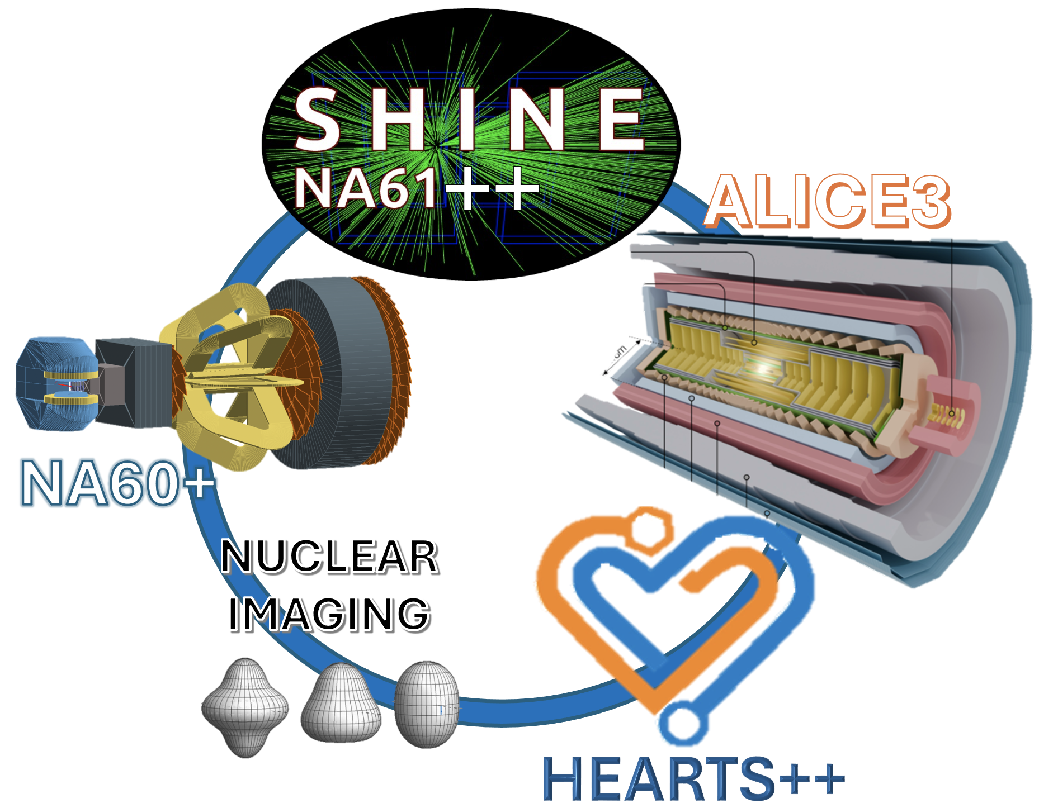
Diverse Scientific Program

Slide 4



Motivation: future scientific opportunities
Experimental landscape at CERN (proposals)
Experimentally tested
R. Alemany Fernandez, Intersection of nuclear structure and high-energy nuclear collisions, April 2026

Slide 5
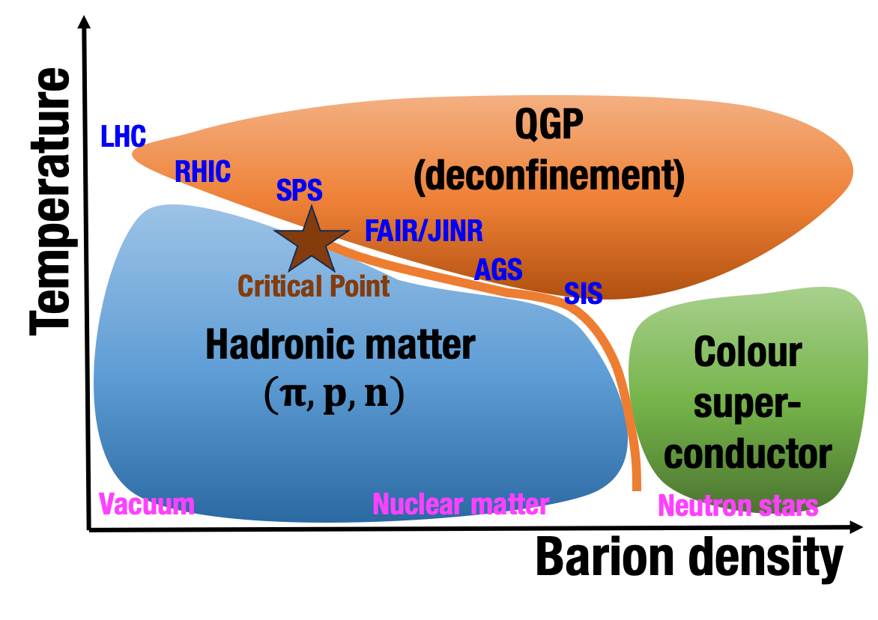
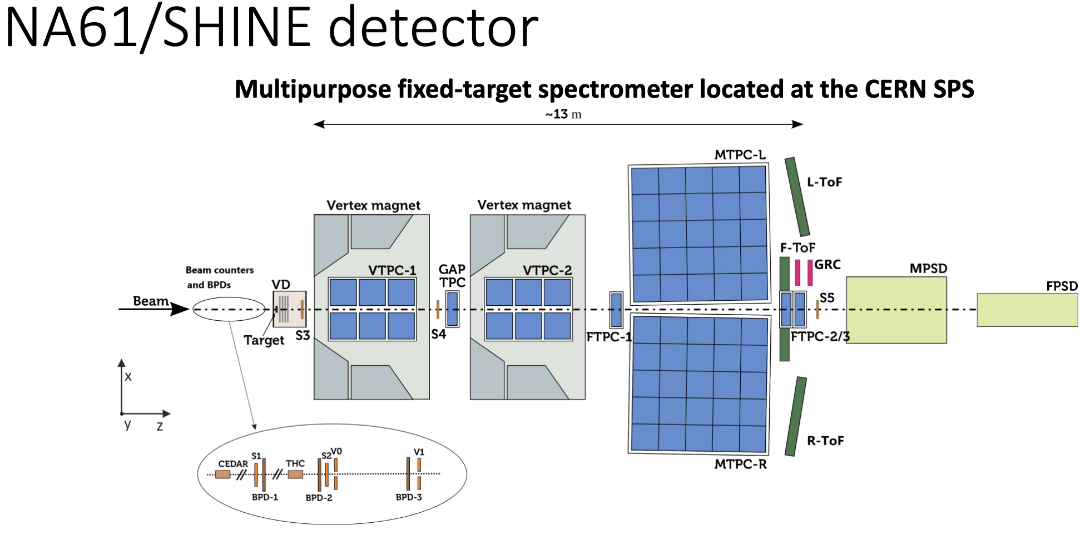
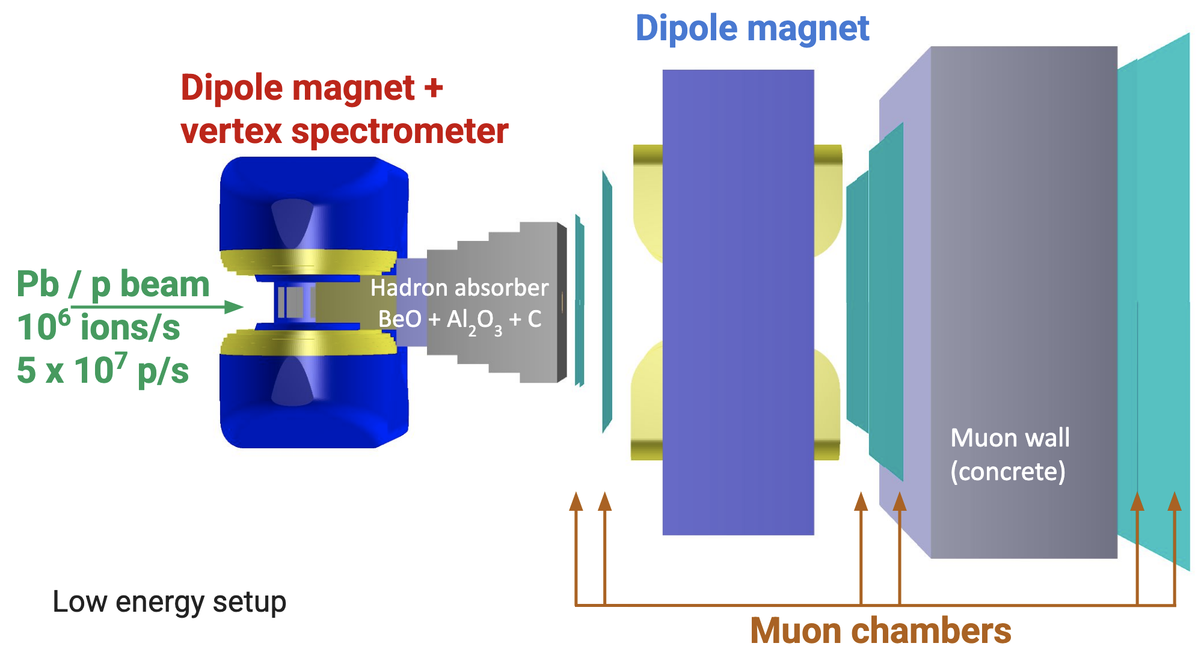
Motivation: future scientific opportunities
Experimental landscape at CERN (proposals)
SPS North Area
Run 4
NA60+ detector
Onset of deconfinement and chiral symmetry restoration (m_{q}=0)
Smooth connection between HE colliders and LE experiments
System size & energy scans
Seweryn Kowalski
Giacomo Alocco
Experimentally tested
HEARTS++[1]: High-Energy Accelerators for Radiation Testing and Shielding for space applications
SPS NA[2-4]: SPS North Area Fixed Target Experiments
PoP[5]: Proof of Principle Experiment
R. Alemany Fernandez, Intersection of nuclear structure and high-energy nuclear collisions, April 2026

Slide 6
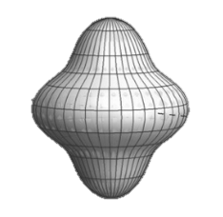
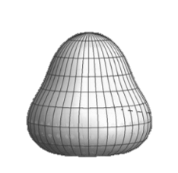
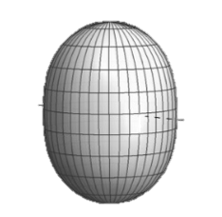
Motivation: future scientific opportunities
Experimental landscape at CERN (proposals)
Transport properties & coefficients
Time-evolution of temperature
Thermalization & hadronization
Jet quenching
Partonic re-scattering
Clustering
Fixed-target collisions ➔ SMOG2
SPS North Area
Run 4
A >>; L_{nn} >> Run 3
Run 5
Pilot runs
Picked up, so far, because of synergy with other proposals.
However …
Experimentally tested
HEARTS++[1]: High-Energy Accelerators for Radiation Testing and Shielding for space applications
SPS NA[2-4]: SPS North Area Fixed Target Experiments
PoP[5]: Proof of Principle Experiment
R. Alemany Fernandez, Intersection of nuclear structure and high-energy nuclear collisions, April 2026

Slide 7

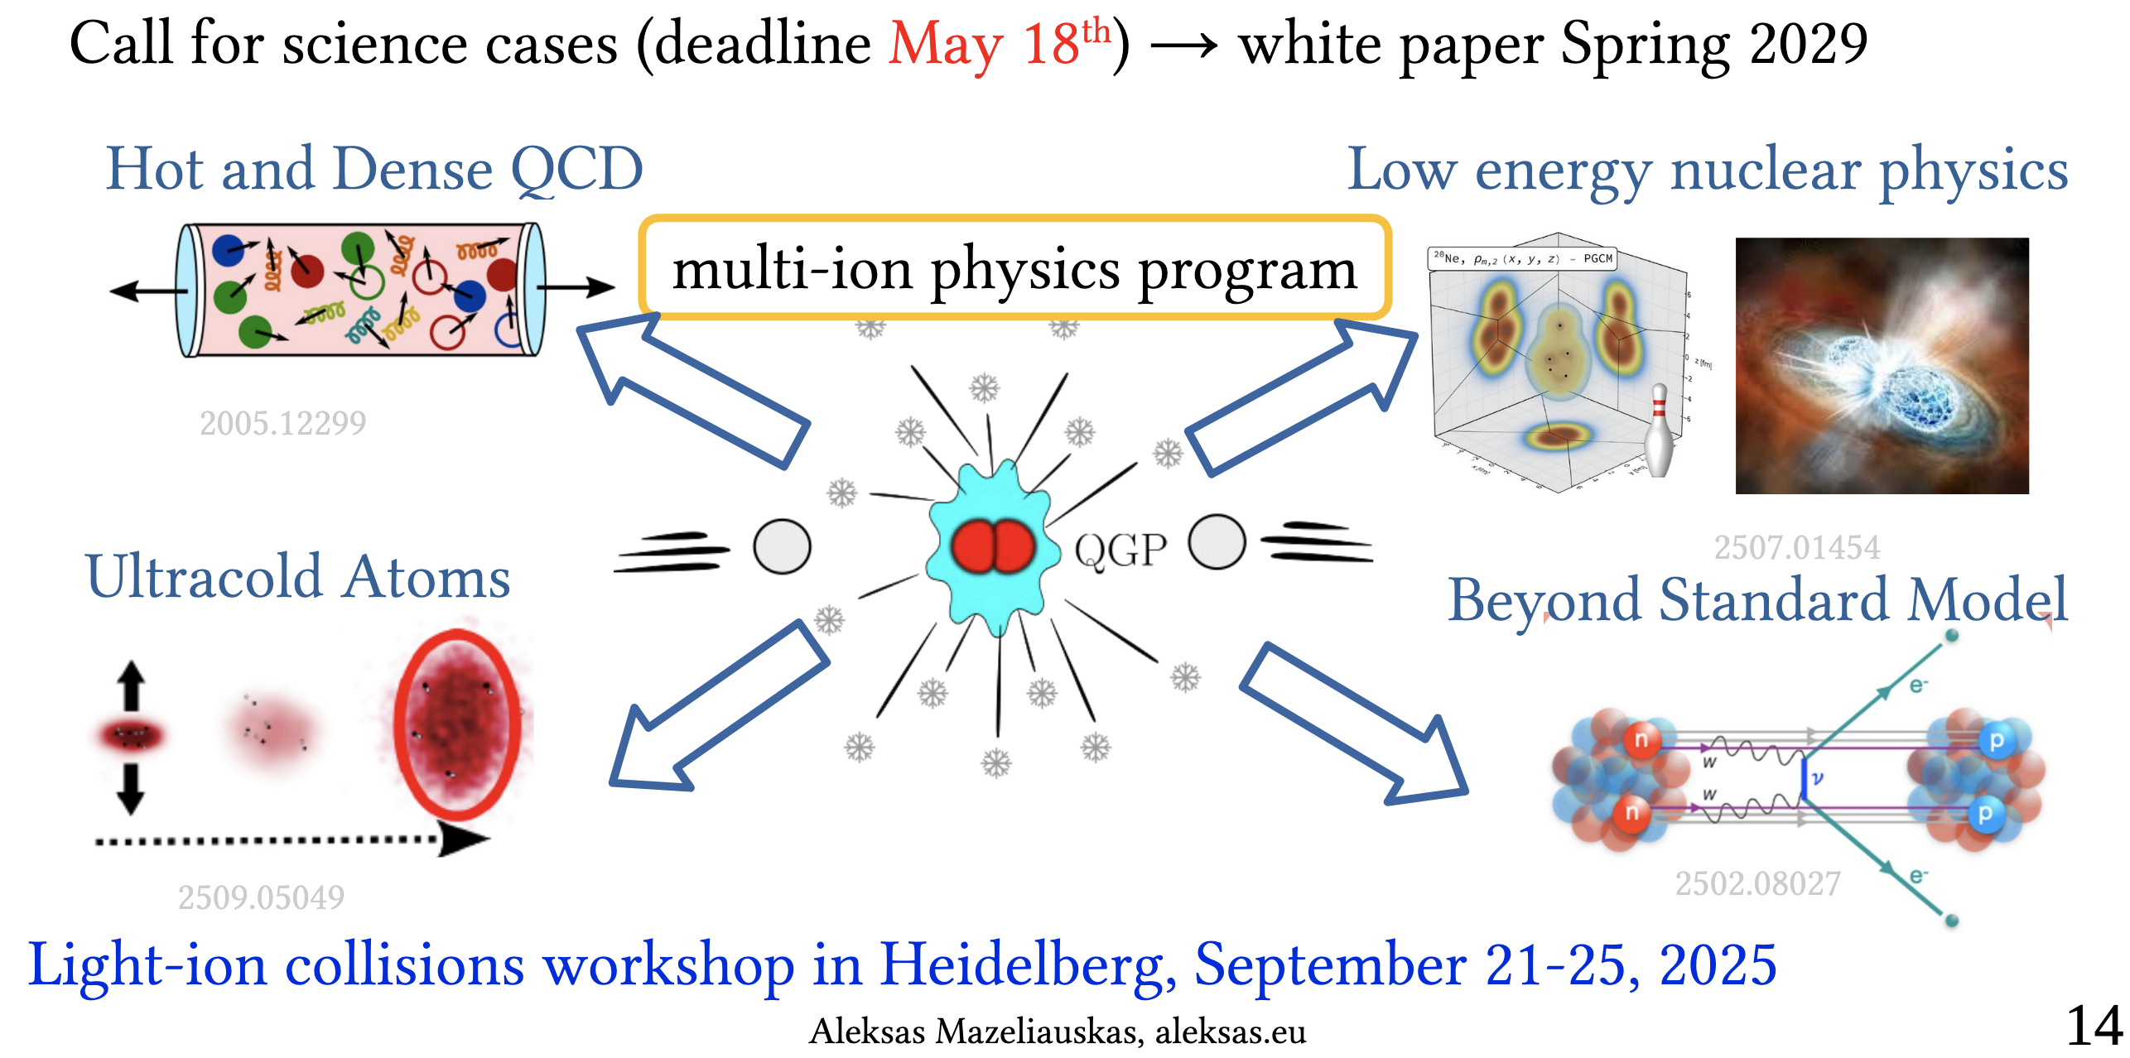


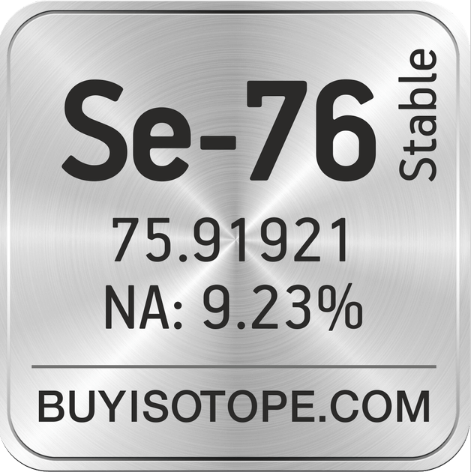
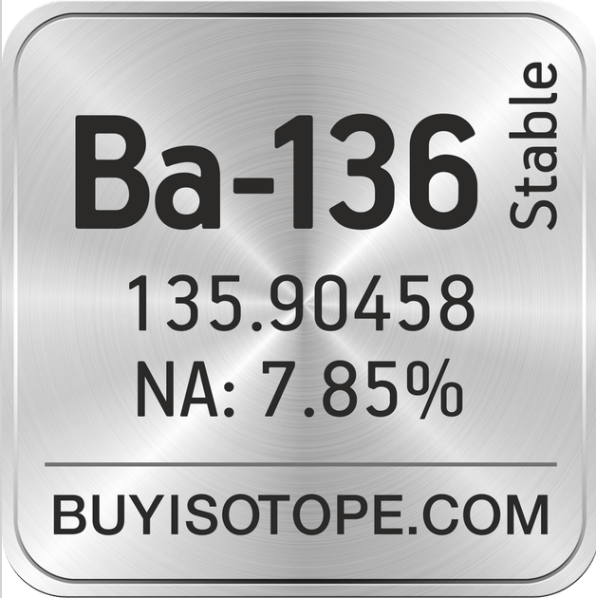
New Ions @LHC Run 4 initiative [link]
4
4
99.999
2026
Aleksas Mazeliauskas
Our aim is to collect science cases for potentially high-impact and viable run scenarios in a
comprehensive White Paper, which will be submitted to experimental collaborations and committees for consideration in the planning of Run 4. This will be a four-step process:
1.Identification of science cases with ions [deadline May 2026]
2.Abstract submission of prospective physics studies [deadline Sept 2026]
3.Completion of the research studies [deadline Sept 2028]
4.Assembly of the White Paper [deadline spring 2029]
…
R. Alemany Fernandez, Intersection of nuclear structure and high-energy nuclear collisions, April 2026

Slide 8
Motivation: future scientific opportunities
Experimental landscape at CERN (proposals)
Multiple and strong synergies
SPS North Area
Run 4
A >>; L_{nn} >> Run 3
Run 5
Pilot runs
PS fixed target
15’ switch 4 species
SPS PoP
Experimentally tested
HEARTS++[1]: High-Energy Accelerators for Radiation Testing and Shielding for space applications
SPS NA[2-4]: SPS North Area Fixed Target Experiments
PoP[5]: Proof of Principle Experiment
R. Alemany Fernandez, Intersection of nuclear structure and high-energy nuclear collisions, April 2026

Slide 9
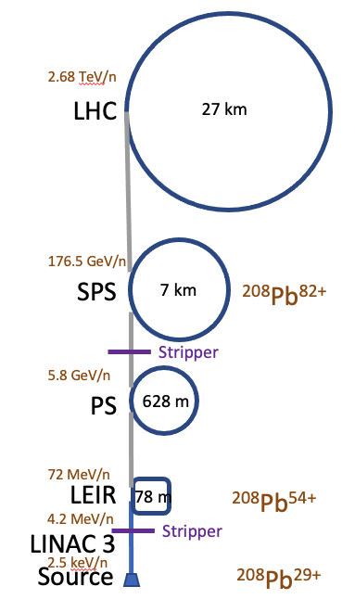
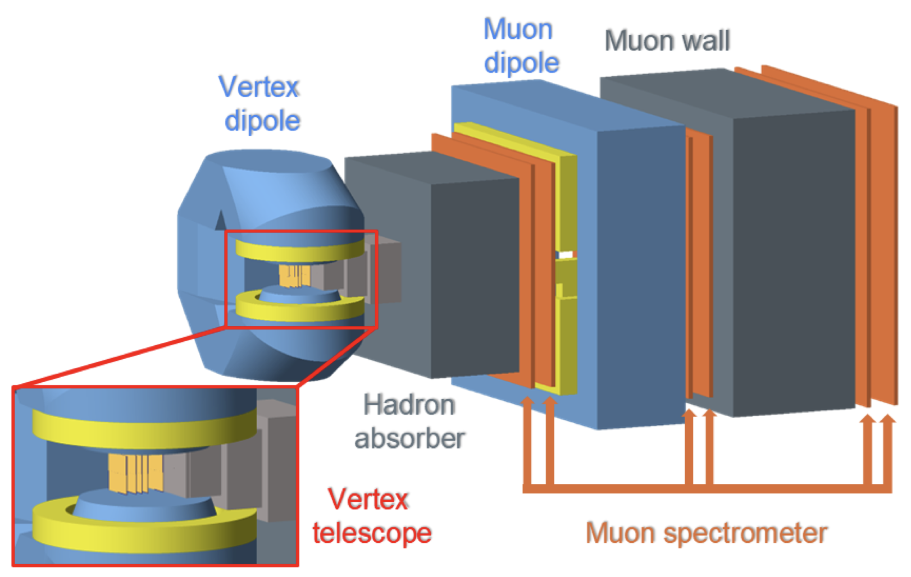
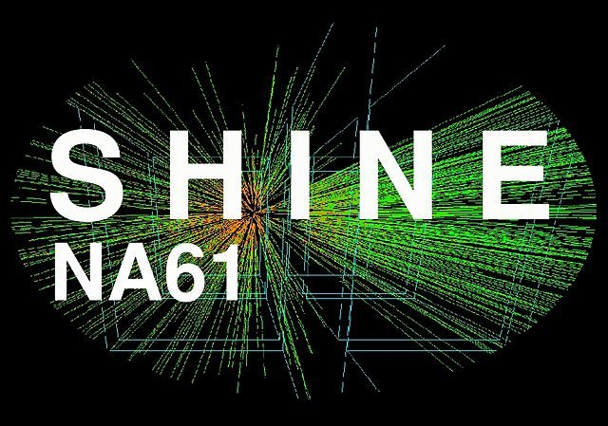

Overview of the CERN Ion Complex
CMS
ALICE
LHCb
ATLAS
North Area fixed target
NA60+
++
East Area fixed target
++

Slide 10
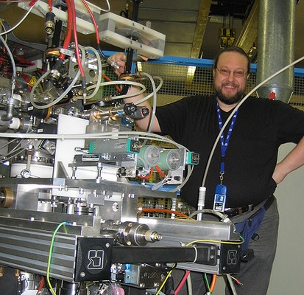






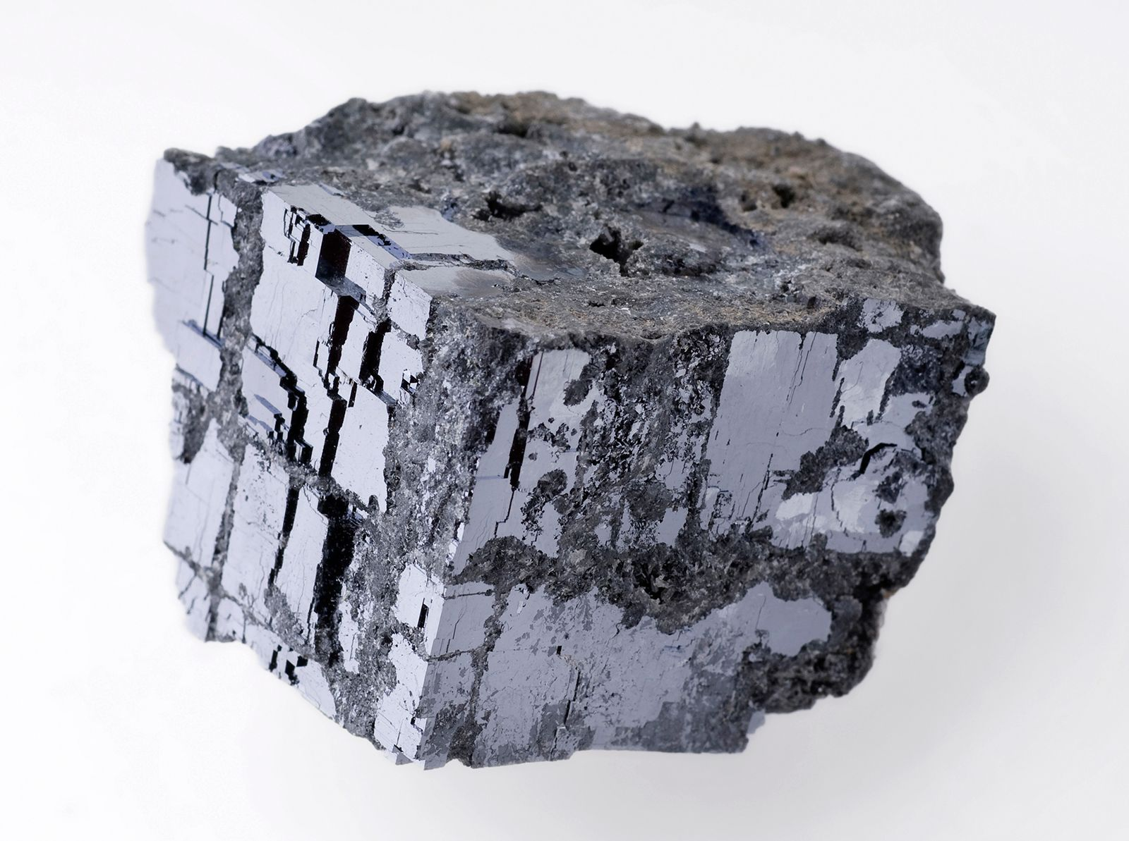






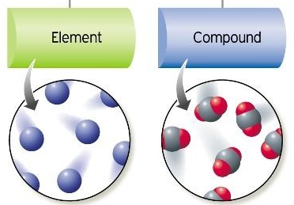


Overview of the CERN Ion Complex:
Source limitations
The Only One Source to deliver operational and R&D beams
1 Electron Cyclotron Resonance Ion Source (ECRIS), installed in 2005
2.68 TeV/n
LHC
27 km
176.5 GeV/n
SPS
7 km
²⁰⁸Pb⁸²⁺
Stripper
5.8 GeV/n
PS
628 m
72 MeV/n
Purity
LEIR
78 m
²⁰⁸Pb⁵⁴⁺
4.2 MeV/n
Stripper
LINAC 3
2.5 keV/n
Source
²⁰⁸Pb²⁹⁺
Ca-40 vapor pressure is not compatible with our type of resistive oven ➔ another over needs to be designed
Ge-76 high melting point ➔ not enough oven power; alternatively: suitable compounds: GeSe and GeSe2
Ca-48 is a very rare, 0.187% abundance; enriched Ca-48 is needed ➔ > 500000 $ / gr (isotopically pure Pb-208 = 1300 $/gr, 1.5 gr/2 weeks
R. Alemany Fernandez, Intersection of nuclear structure and high-energy nuclear collisions, April 2026

Slide 11
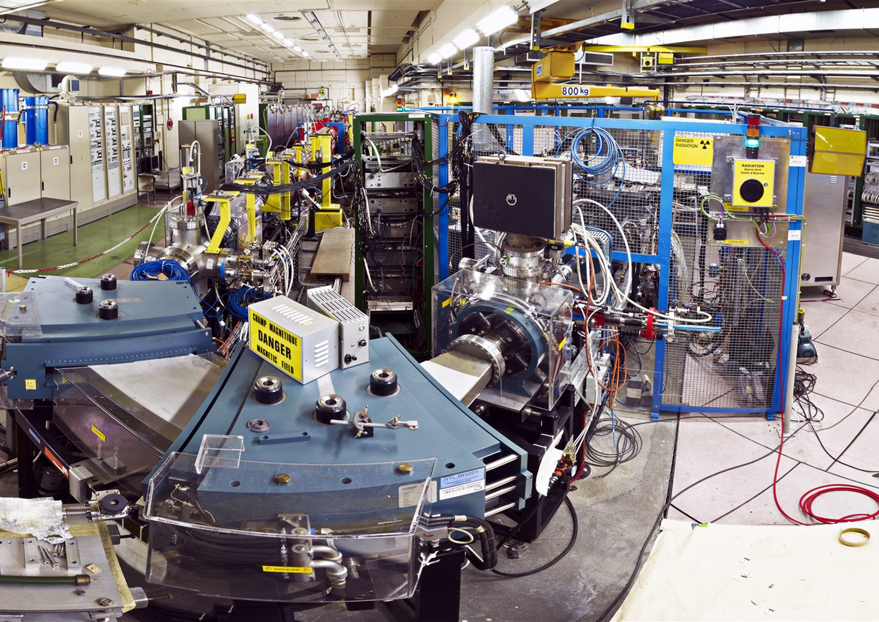
Linac 3 (1994)
Stripping foil Pb29+ ➔ Pb54+
Interdigital-H (IH) linac 4.2 MeV/n
RFQ
Pb @2.5 keV/n
One hall contains all power systems and the accelerator, access is needed during operation
Creates radiation protection limitations which are due to:
Source x-rays
IH RF cavity x-rays (limit to RF field and repetition rate)
Neutron production (an issue more for lighter ions)
Spectrometer to select Pb29+
R. Alemany Fernandez, Intersection of nuclear structure and high-energy nuclear collisions, April 2026

Slide 12
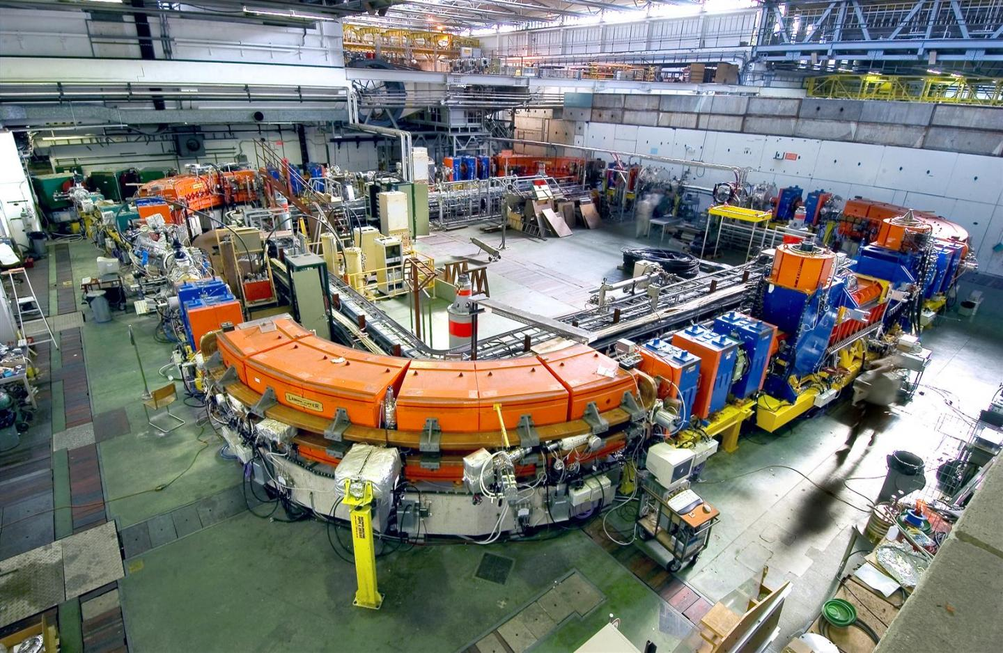
Low Energy Ion ring (LEIR)
Accumulation of ~300 µs pulses from Linac3: multi-turn injection and electron cooling
Beam capture in 1, 2 or 3 bunches
Acceleration to 72 MeV/n (²⁰⁸Pb⁵⁴⁺)
Transfer to the PS
R. Alemany Fernandez, Intersection of nuclear structure and high-energy nuclear collisions, April 2026

Slide 13
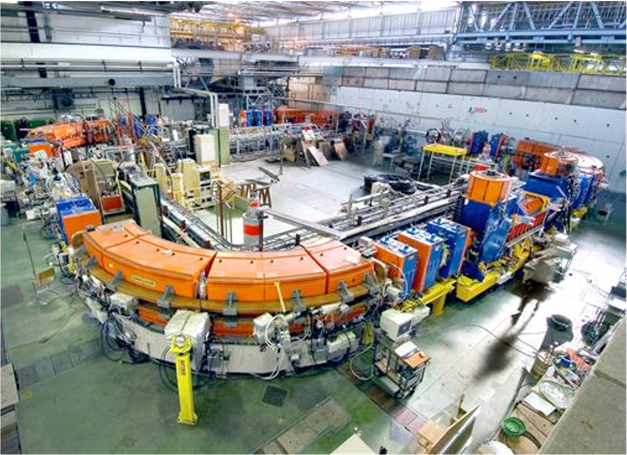

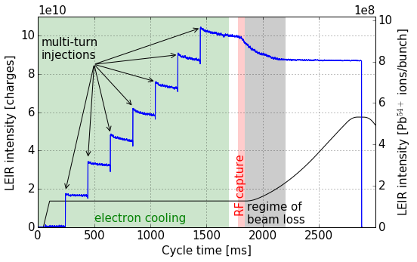



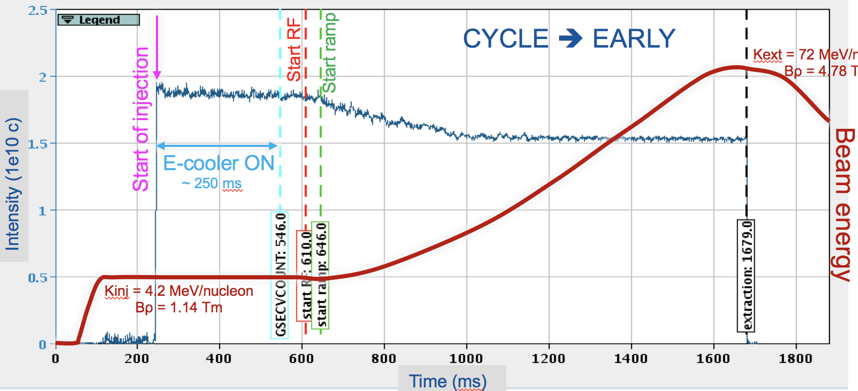
Low Energy Ion ring (LEIR)
Accumulation of ~200 µs pulses from Linac3: multi-turn injection and electron cooling (A↓ Cooling efficiency ↓)
Capture in 1, 2 or 3 bunches
Acceleration to 72 MeV/n (²⁰⁸Pb⁵⁴⁺)
Transfer to the PS
Injection from Linac3
TO REACH HIGHEST LHC LUMINOSITY
LHC PILOT RUNS LIKE Xe(2017)/O(2025)
R. Alemany Fernandez, Intersection of nuclear structure and high-energy nuclear collisions, April 2026

Slide 14
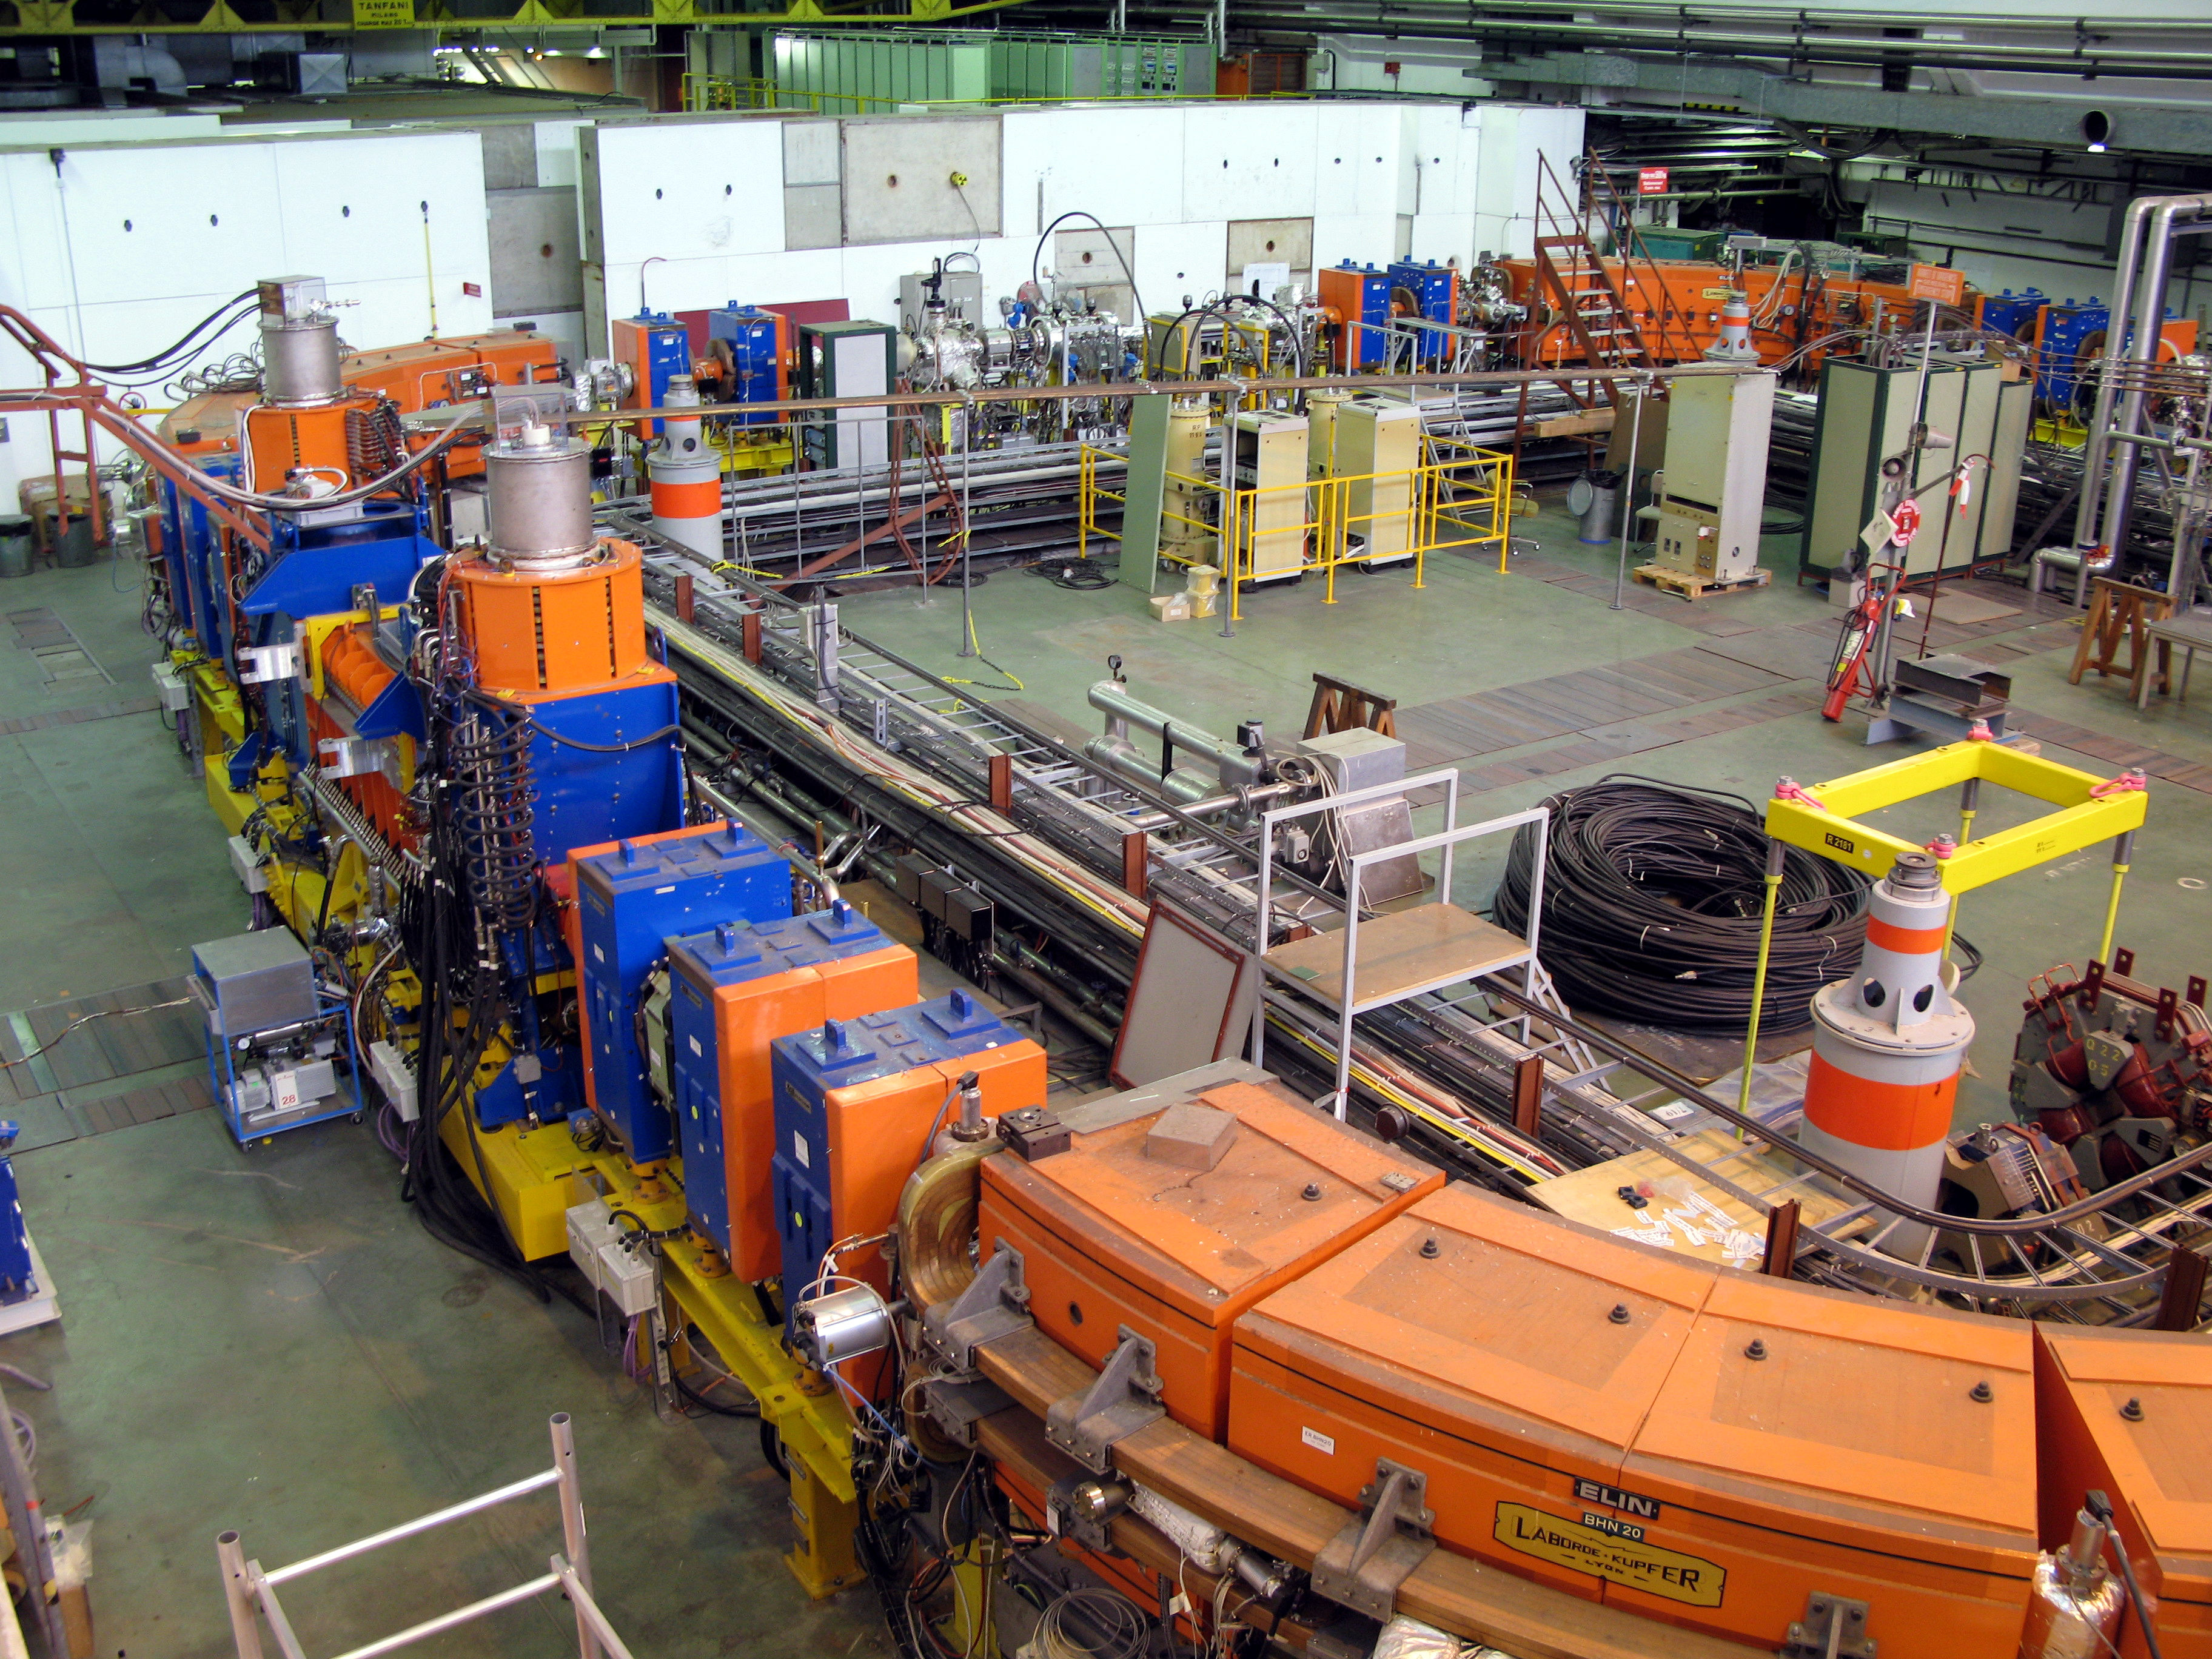
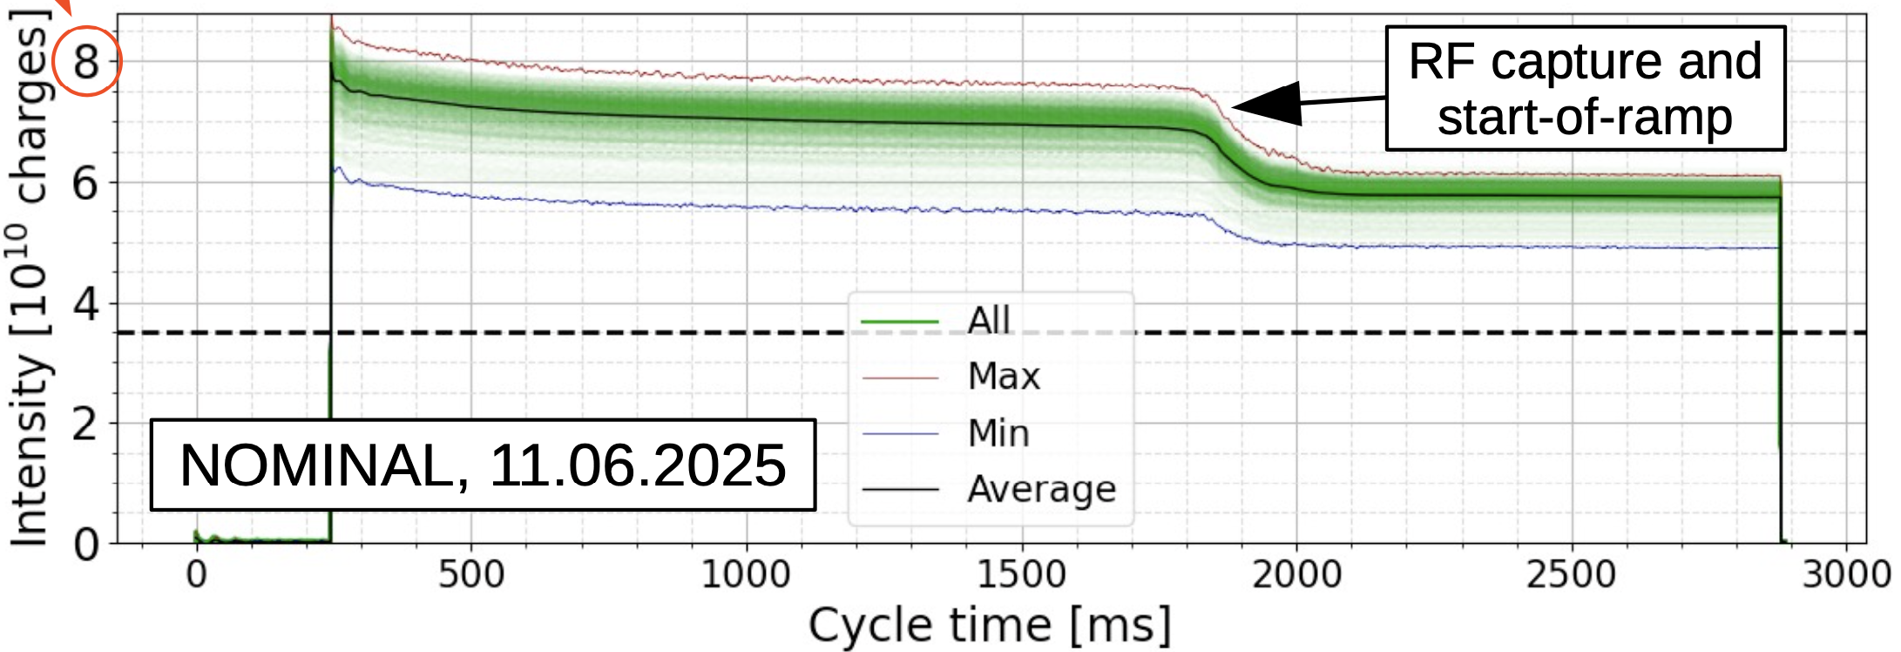
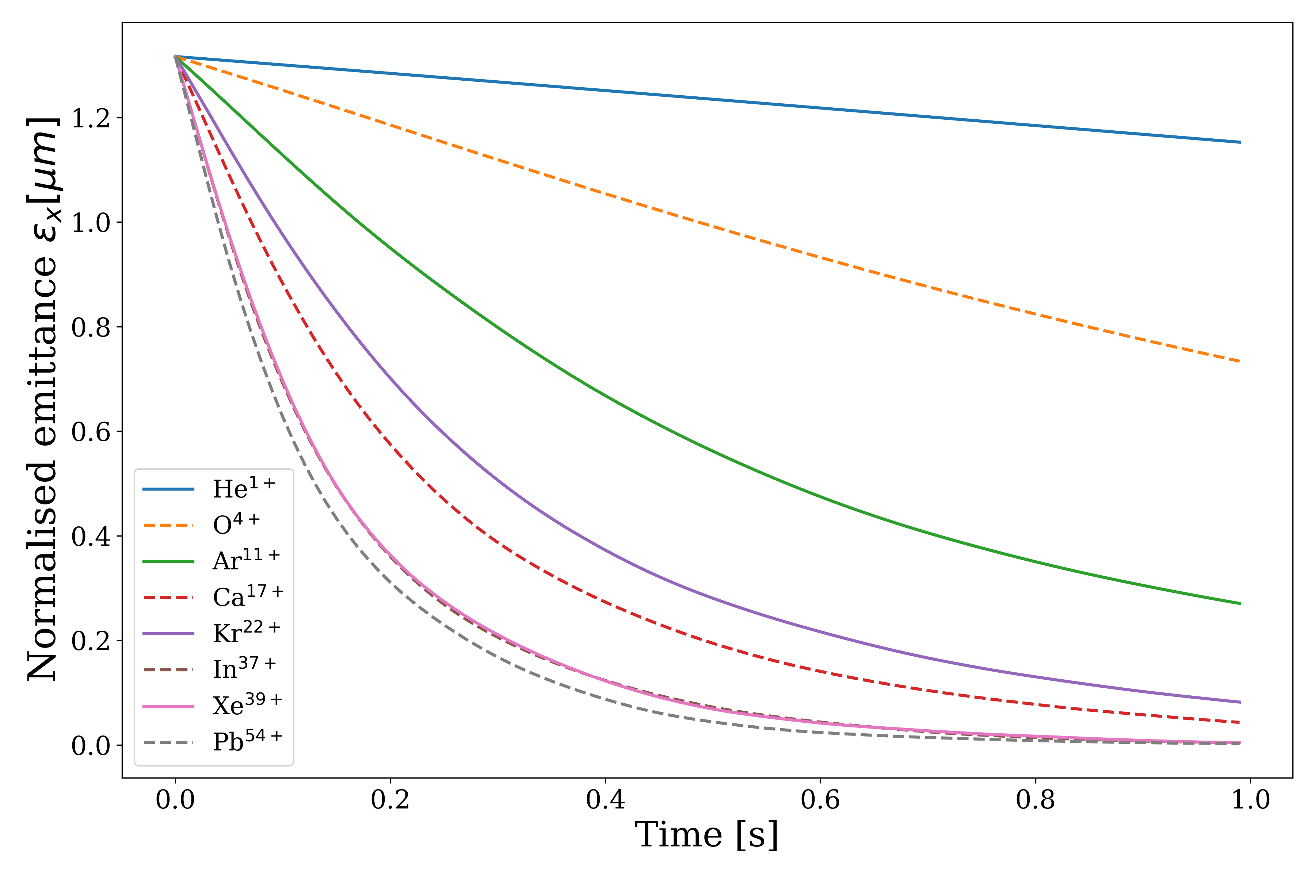
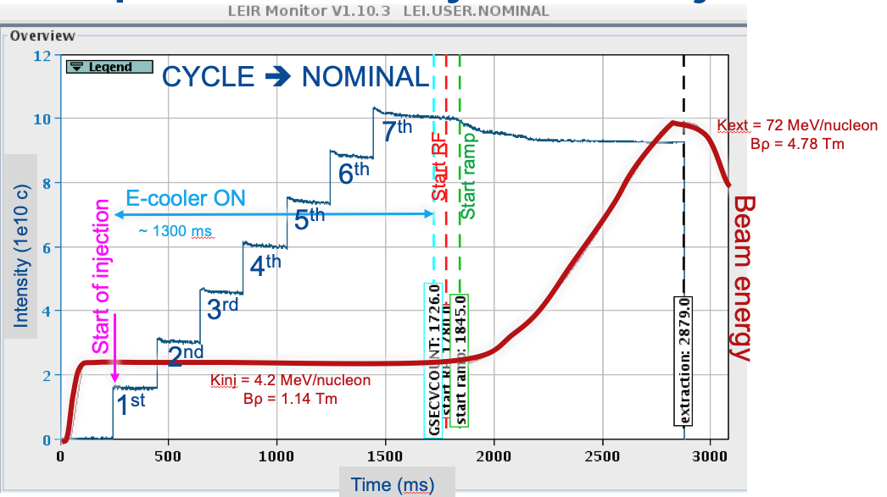
Low Energy Ion ring (LEIR)
Electron cooler section
Beam cooling (transverse phase space reduction)
Simulation of LEIR
e-cooling times
for different ions
O4+
O4+
With O4+ 1 injection ➔ 1800 ms cooling time
O4+ is a gas ➔ 8e10 charges/injection
Pb54+
e-
V_{e} = 1.002 V_{Pb}
Measures beam size
long-range Coulomb "grazing" interactions ➔ more efficient the higher the charge
Pb54+
Pb54+
With Pb54+ 7-8 injections/200 ms
Pb54+ is a solid ➔ 2e10 charges/injection
E-Cooling time
R. Alemany Fernandez, Intersection of nuclear structure and high-energy nuclear collisions, April 2026

Slide 15
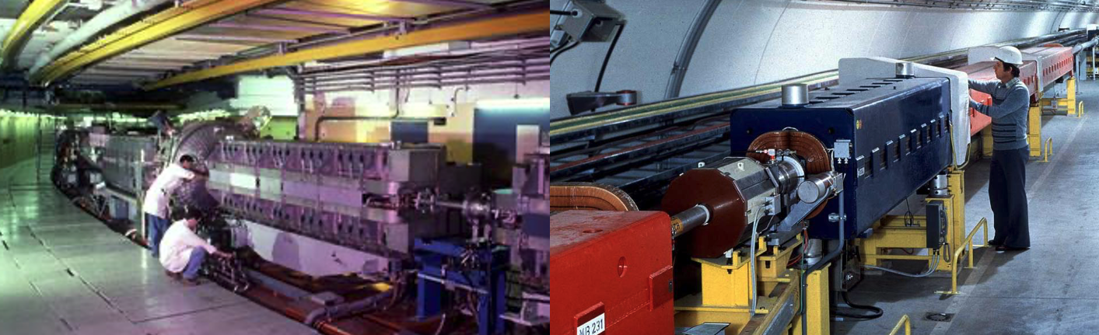
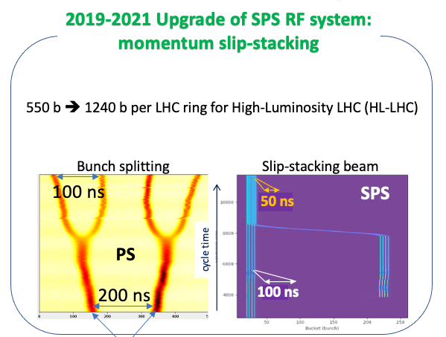
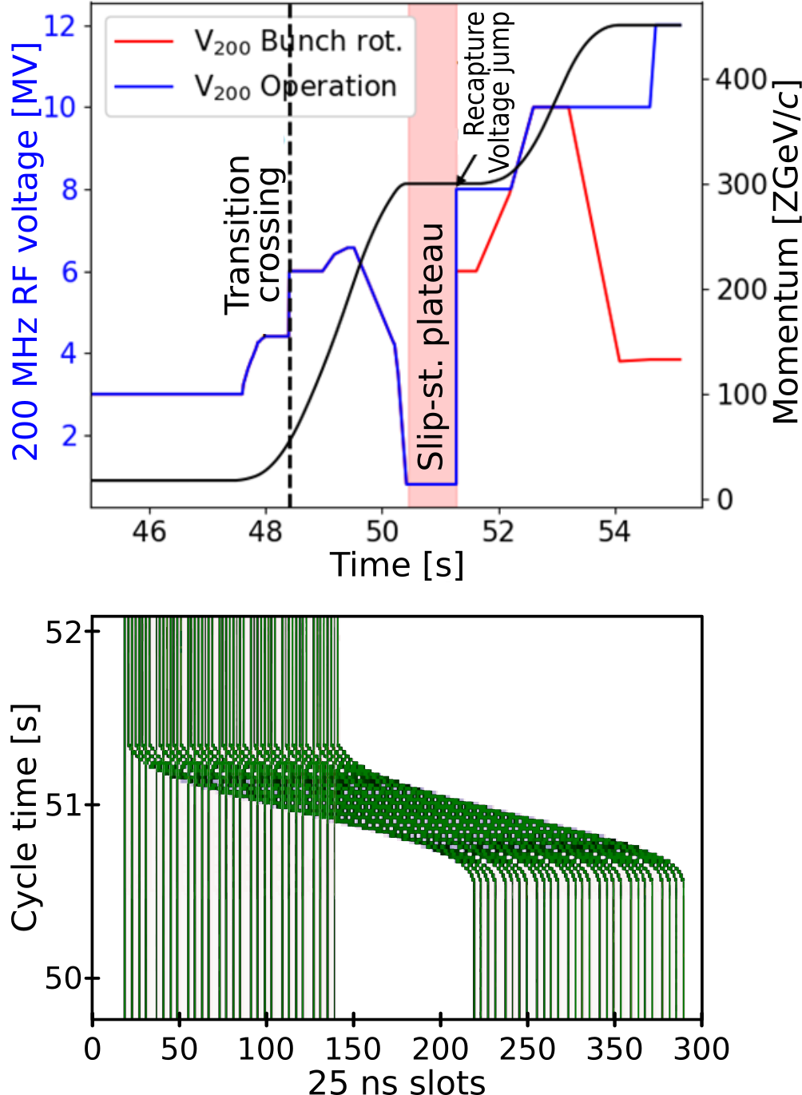
Proton-Synchrotron (PS) & Super PS (SPS)
PS
SPS
56 b – 50 ns
Time evolution during the cycle
7 injections from PS
7 injections from PS
Longitudinal plane
2 bunches from LEIR
R. Alemany Fernandez, Intersection of nuclear structure and high-energy nuclear collisions, April 2026

Slide 16

Assessing feasibility & identifying limitations

Slide 17

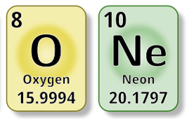

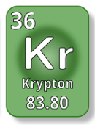
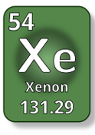
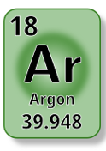
Performance assessment for LHC beams
2015
2017
2023
2024
2025
Experimental tests
R. Alemany Fernandez, Intersection of nuclear structure and high-energy nuclear collisions, April 2026

Slide 18
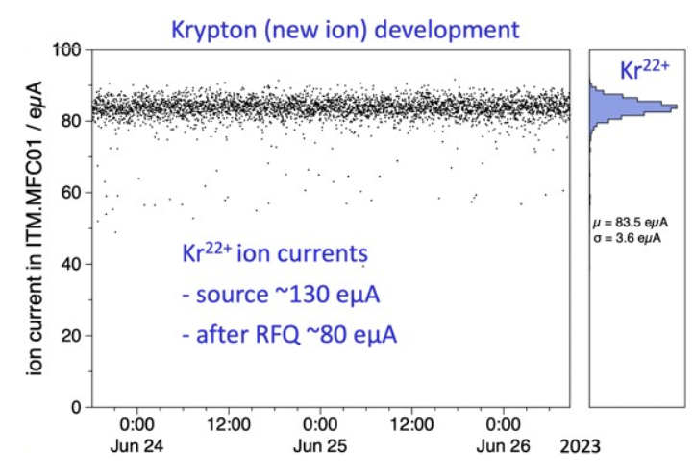
Performance assessment for LHC beams
2015
2017
2023
2024
2025
Experimental tests
~ 80 euA
Test up to the RFQ
R. Alemany Fernandez, Intersection of nuclear structure and high-energy nuclear collisions, April 2026

Slide 19
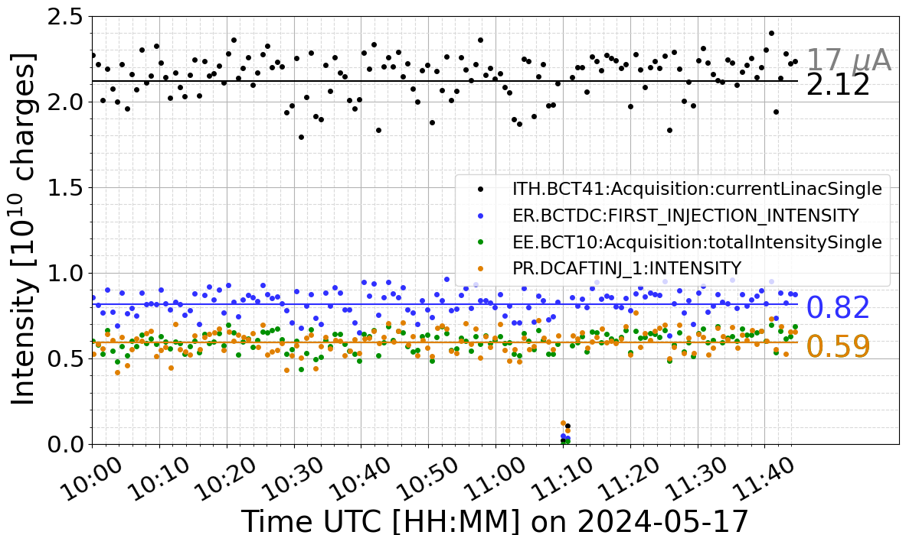
Performance assessment for LHC beams
2015
2017
2023
2024
2025
Experimental tests
Linac 3
²⁴Mg⁷⁺
LEIR
PS
Test up to PS extraction
8 weeks of test
Several bottle necks encountered but solutions are available
R. Alemany Fernandez, Intersection of nuclear structure and high-energy nuclear collisions, April 2026

Slide 20
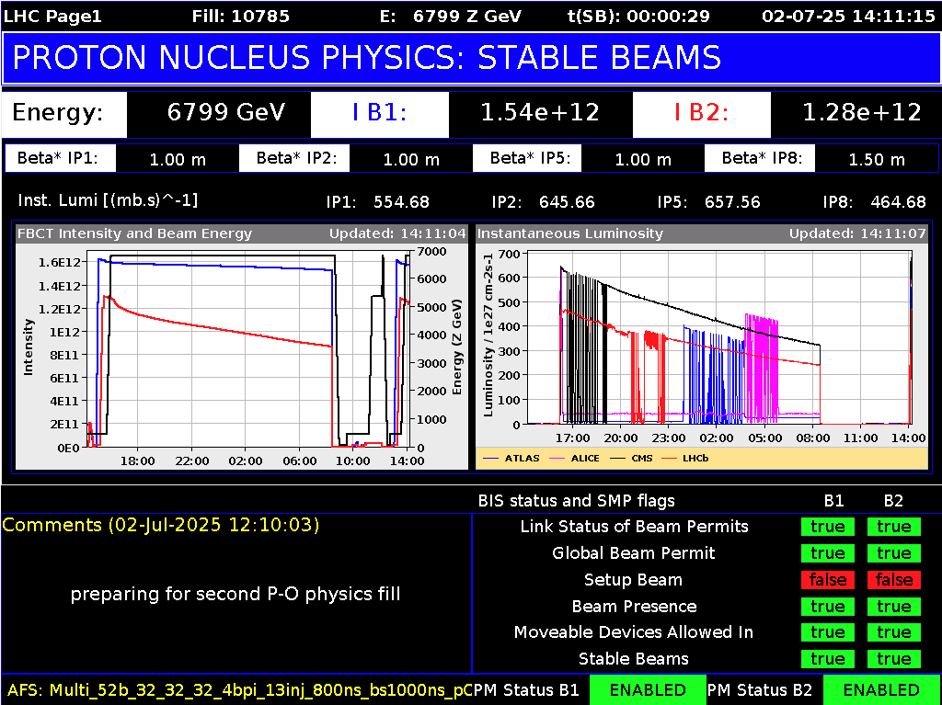
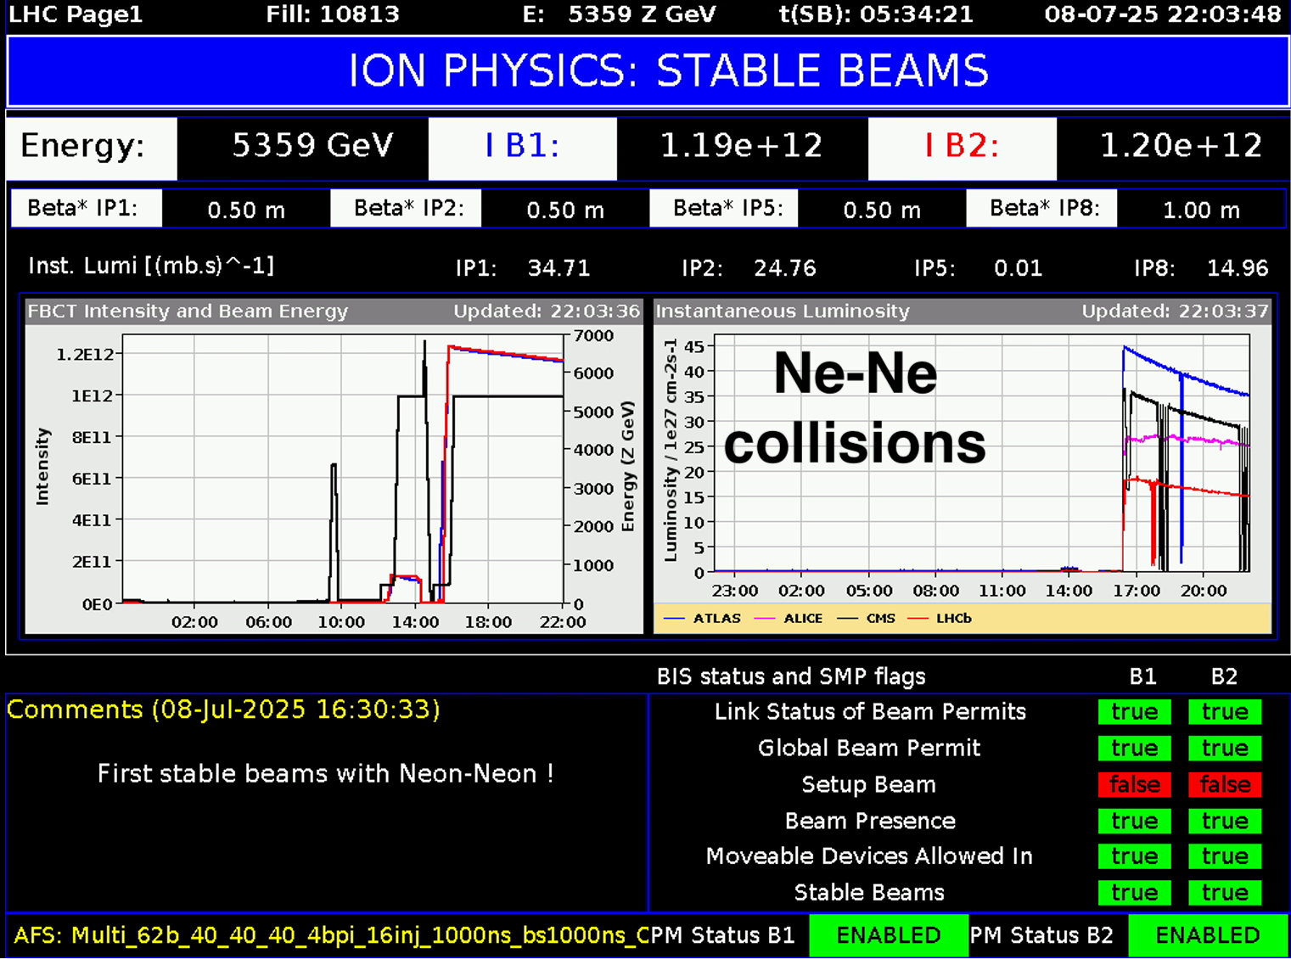
Performance assessment for LHC beams
2015
2017
2023
2024
2025
Experimental tests
p-O on target
O-O lumi surpassed by factor 11_{IP1&5} (6)_{IP2&8}
p-O
OXY4LHC project (2021)
Source/Linac3
241 eµA from source
91 eµA (30 eµA for Pb54+) from Linac3 30% above target
Ne-Ne lumi surpassed by factor 9 (5.6)_{IP8}
R. Alemany Fernandez, Intersection of nuclear structure and high-energy nuclear collisions, April 2026

Slide 21
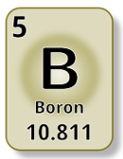

Performance assessment for LHC beams
Experimental tests
2027
2028
Up to PS
O Ar Xe
Up to Linac3
Cocktail beams
R. Alemany Fernandez, Intersection of nuclear structure and high-energy nuclear collisions, April 2026

Slide 22

Ion Complex Upgrade (ICU) Proposal

Slide 23

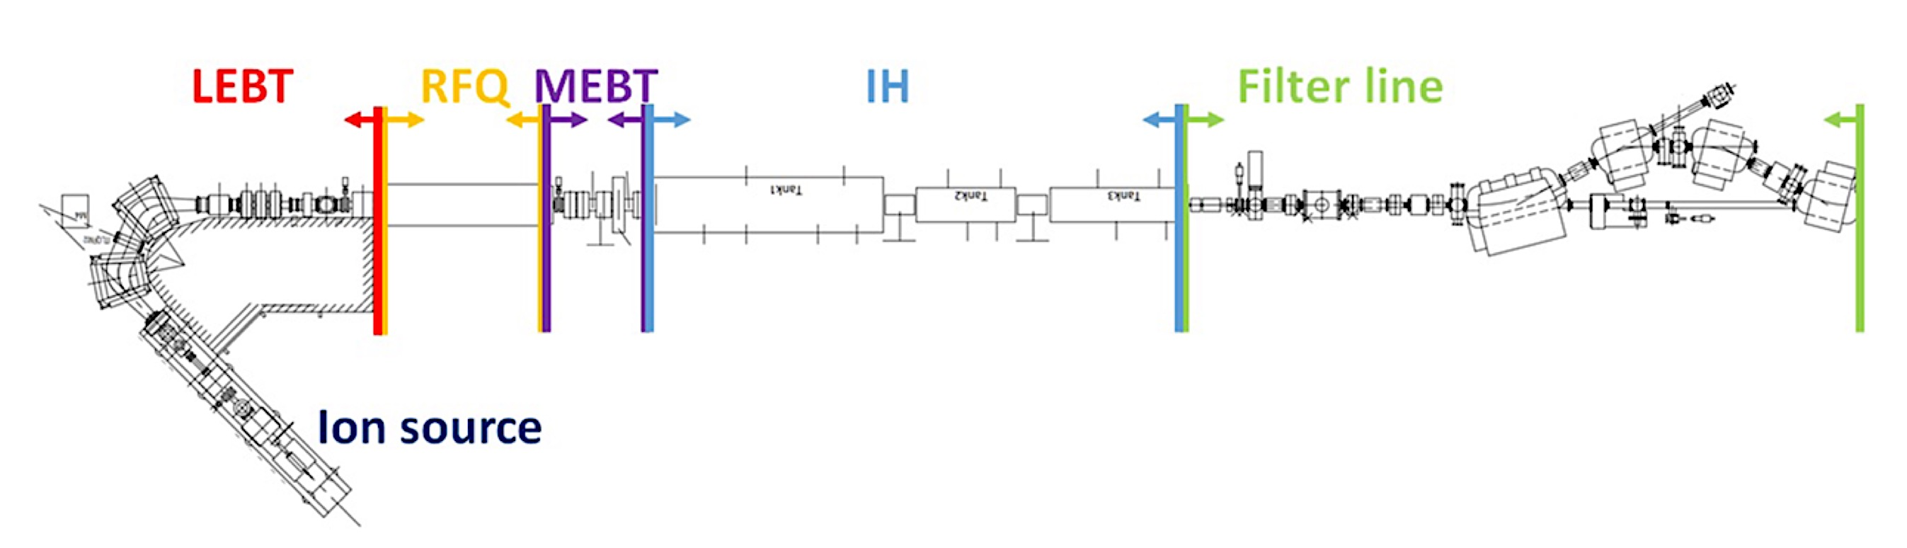
Ion Complex Upgrade (ICU) Proposal
New additional LINAC 3 source and beam diagnostic lines (IBE)
Operate up to 4 ions per year
Parallel operation and commissioning of the new ions at the source
Connection of ion sources and beam instrumentation
Fast (15’) switching between ions
Parallel operation and commissioning of the new ions whole complex
New source
LINAC 3
IBE
CAV 1
CAV 2
CAV 3
Existing
Beam to LEIR
IBE
10/14
R. Alemany Fernandez, Intersection of nuclear structure and high-energy nuclear collisions, April 2026

Slide 24
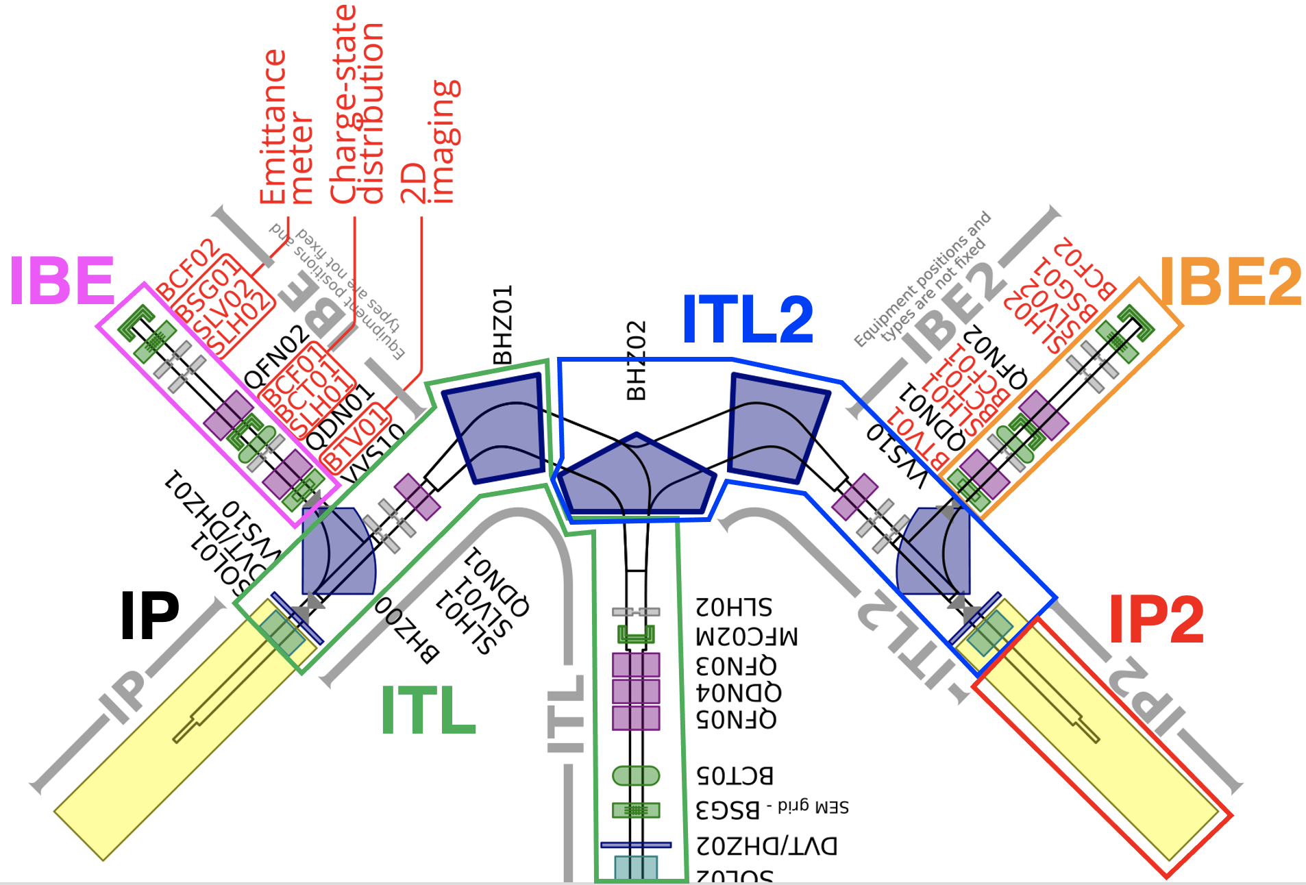
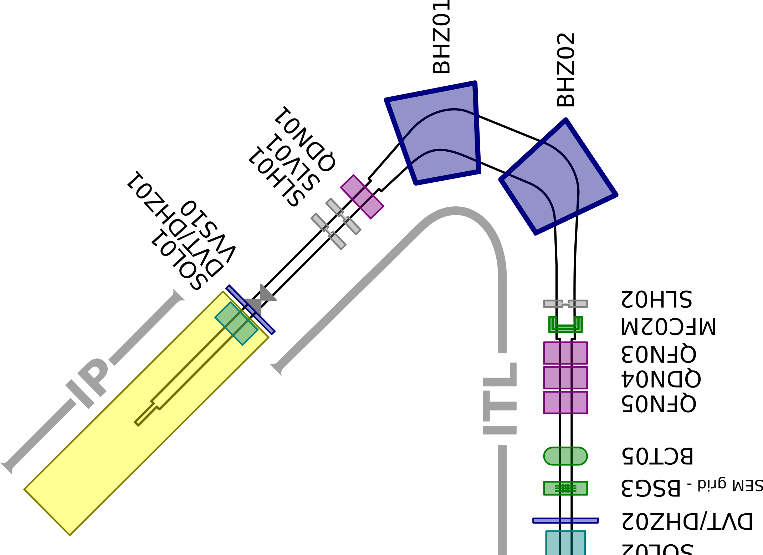
Ion Complex Upgrade (ICU)
Today layout
Future layout*
Beam diagnostic line 1
Beam diagnostic line 2
Beam direction
Source 1
Source 1
Source 2
Beam direction
* Indicative, not yet fixed
R. Alemany Fernandez, Intersection of nuclear structure and high-energy nuclear collisions, April 2026

Slide 25
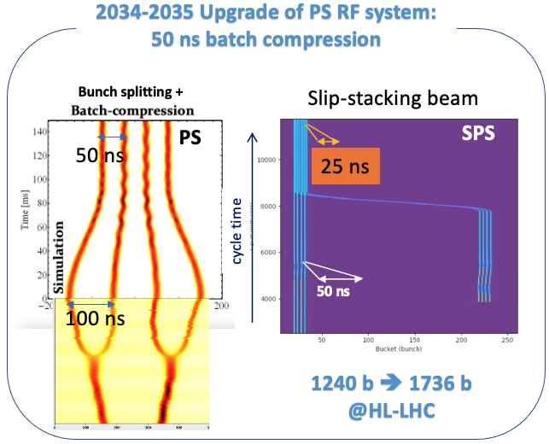
Ion Complex Upgrade (ICU) Proposal
25 ns bunch spacing[19]
Increase LHC luminosity by increasing number of bunches ➔ reduce bunch spacing ➔ 2 new PS RF cavities needed
Baseline: 4 bunches – 50 ns out of PS
14 injections from PS to SPS
40% more bunches into LHC
9 extra injections per LHC ring
Upgrade: 6 bunches – 50 ns out of PS
14 injections from PS to SPS
60% more bunches to LHC
5 extra injections per LHC ring
16 injections from PS to SPS
70% more bunches to LHC
1 extra injection per LHC ring
PRESENT
1240 b ➔ 1736 b (+40%)
FUTURE
Though less bunch intensity but better emittance and SPS transmission efficiency
R. Alemany Fernandez, Intersection of nuclear structure and high-energy nuclear collisions, April 2026

Slide 26

Ion Complex Upgrade Impact
2 ion sources + beam diagnostic lines ➔ unlocking diversity
LHC light ion pilot runs & NA61++ Mg(B,O) ➔ 1st half of the year
LHC & NA60+ heavy ion physics ➔ 2nd half of the year
HEARTS++ ➔ 15’ switching times
R&D for post-LS4 ions for LHC
Hybrid ion collisions at LHC
Key game changer
11/14
R. Alemany Fernandez, Intersection of nuclear structure and high-energy nuclear collisions, April 2026

Slide 27
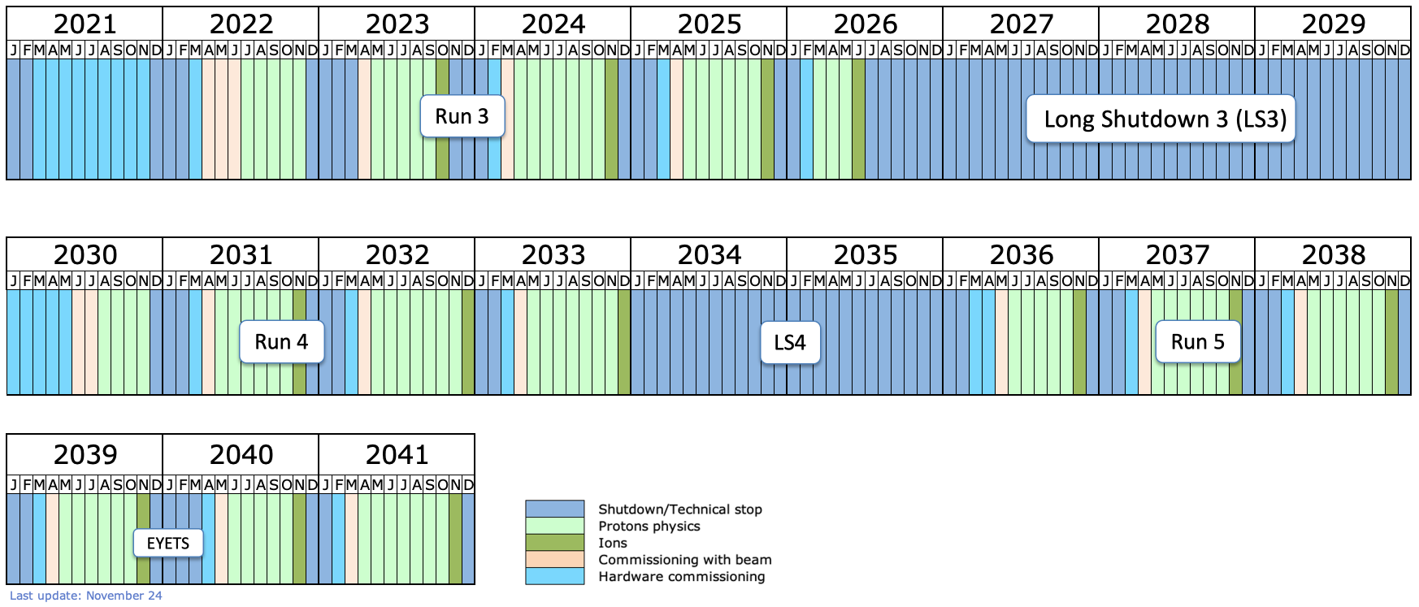
Run 4 and Run 5 tentative schedule
¹⁶O⁸⁺ & ²⁰Ne¹⁰⁺
HL-LHC installation (p+)
ALICE3 & LHCb installation(*)
IONS
Run 4: HL-LHC (2030-2033)
Yearly Pb-Pb or p-Pb runs using the current operation mode
No ion run in 2030
Possibility of short pilot runs with other ions (not approved)
Post-LS4:
ALICE3 detector operational
Goal ➔ significantly higher nucleon-nucleon luminosity (likely another ion than Pb)
Possibility of short pilot runs with other ions
(*) pending approval
R. Alemany Fernandez, Intersection of nuclear structure and high-energy nuclear collisions, April 2026

Slide 28


Slide 29
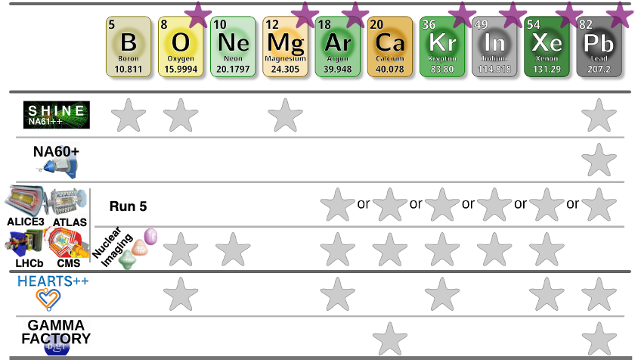
Conclusions
Increased interest of physics with lighter ions from different physics communities and facilities
All show important synergies ➔ explore different physics landscapes with the same effort
The current CERN Ion Accelerator Complex offers opportunities to test new ions at the same time it fulfils its physics production commitments
But we are hitting the limits
To go beyond these limits an upgrade of part of the Ion Complex is needed
We can rather easily provide ion-gasses for pilot runs, e.g. O-O, p-O, Xe-Xe, Ne-Ne …
High Luminosity is more involved and more time is needed for study&preparation
Alternative ion species could increase the NN luminosity beyond Run 4
Simulations show with optimistic scenario a gain of factor ~4 w.r.t. baseline PbPb scenario
To be studied if LHC can handle the higher intensities (beam losses etc)
Alternative ion species offer the possibility to carry out LHC pilot runs every operational year to study QGP vs system size and nucleus structure
12/12
R. Alemany Fernandez, Intersection of nuclear structure and high-energy nuclear collisions, April 2026

Slide 30
New Ions @LHC Run 4 initiative [link]
4
4
99.999
2026
Aleksas Mazeliauskas
Our aim is to collect science cases for potentially high-impact and viable run scenarios in a
comprehensive White Paper, which will be submitted to experimental collaborations and committees for consideration in the planning of Run 4. This will be a four-step process:
1.Identification of science cases with ions [deadline May 2026]
2.Abstract submission of prospective physics studies [deadline Sept 2026]
3.Completion of the research studies [deadline Sept 2028]
4.Assembly of the White Paper [deadline spring 2029]
…
R. Alemany Fernandez, Intersection of nuclear structure and high-energy nuclear collisions, April 2026

Slide 31
Acknowledgments
Gianluigi ARDUINI
Theodoros ARGYROPOULOS
Hannes BARTOSIK
Giulia BELLODI
Thomas BOETTCHER
Roderik BRUCE,
Brian Andrew COLE,
Andrea DAINESE
Heiko DAMERAU
Antonello DI MAURO,
Davide GAMBA
Ruben GARCIA ALIA
Edgar MAHNER
Saverio MARIANI
Alexander Philipp KALWEIT
Detlef KUCHLER,
Georgios KRINTIRAS
Peter Martin KRUYT
Yannis PAPAPHILIPPOU
Stefano REDAELLI
Giovanni RUMOLO
Richard SCRIVENS
Maciej SLUPECKI
Natalia TRIANTAFYLLOU
Marco VAN LEEUWEN
Wilke VAN DER SCHEE
Elias Walter WAAGAARD
Andreas WAETS
Jing WANG
Markus WIDORSKI
Urs WIEDEMANN
R. Alemany Fernandez, 16th Workshop on critical point and onset of deconfinement, April 2026
R. Alemany Fernandez, LHCP Conference, Jun 2024

Slide 32
References
[1] HEARTS++: High-Energy Accelerators for Radiation Testing and Shielding for space applications, https://hearts-project.eu/
[2] NA61++: M. Mackowiak-Pawlowska et al. Addendum to the NA61/SHINE Proposal: Request for light ions beams in Run 4. https://cds.cern.ch/record/2867952, 2023
[3] NA60+: C Ahdida et al. Letter of Intent: the NA60+ experiment. http://cds.cern.ch/record/2845241, 2022
[4] PBC Report, Ion beams requirements for the North Area experiments post-LS3, CERN-PBC Report-2025-002, https://cds.cern.ch/record/2926928?ln=en
[5] GF PoP: M. W. Krasny, Gamma Factory Proof-of-Principle experiment, https://inspirehep.net/literature/1822075, 2019
[6] M. Slupecki et al, Ions: overview and outlook across the complex, https://indico.cern.ch/event/1439972/contributions/6159134/attachments/2984739/5257913/2024-12-11-IonsOverviewJAP.pdf
[7] R. Bruce, 2024 Ion Run Summary, https://indico.cern.ch/event/1484357/contributions/6255476/attachments/2980040/5246958/2024.12.04--LMC--2024_ion_run_summary.pdf; R. Bruce et al., Exceeding high-luminosity LHC performance targets during the 2024 Pb-Pb ion run, IPAC2025
[8] OXY4LHC project: M. Slupecki et al, LHC Oxygen Run Preparation in the CERN Injector Complex, CERN-ACC-NOTE-2024-0001
[9] R. Bruce et al., Studies for an LHC pilot run with oxygen beams, IPAC2021, Campinas, SP, Brazil, doi:10.18429/JACoW-IPAC2021-MOPAB005
[10] OppO opportunities at the LHC, https://indico.cern.ch/event/975877; J. Brewer et al., Opportunities of OO and pO collisions at the LHC, arXiv:2103.01939
[11] Magnesium tests: M. Slupecki et al, CERN ion injector complex performance during 2024 magnesium test, https://cds.cern.ch/record/2929494, 2025
[12] E. Waagaard et al., Update on LHC ion performance in Runs 5-6, https://indico.cern.ch/event/1415726/contributions/6115811/attachments/2942450/5171839/Waagaard_2024_10_08_Update_on_LHC_heavy_ion_performance.ppt
[13] R. Bruce et al., Performance and luminosity models for heavy-ion operation at the CERN Large Hadron Collider, Eur. Phys. J. Plus 136 (2021) 745. https://doi.org/10.1140/epjp/s13360-021-01685-5
[14] R. Bruce et al., Time evolution of the luminosity of colliding heavy-ion beams in BNL Relativistic Heavy Ion Collider and CERN Large Hadron Collider, Phys. Rev. ST Accel. Beams 13 (2010) 091001. doi:10.1103/PhysRevSTAB.13.091001
[15] N. Triantafyllou, Summary of Oxygen luminosity projections, https://indico.cern.ch/event/1538760/contributions/6482253/attachments/3057566/5406037/LPC28.04.2025_oxygen_lumi_projections.pdf, “Oxygen Run Update Scenarios”, https://indico.cern.ch/event/1534858/contributions/6472802/attachments/3052204/5397035/LBOC180_oxygen_run_update_scenarios.pdf
[16] Light Ion Collisions at LHC, https://indico.cern.ch/event/1436085/
[17] G. Giacalone et al, The unexpected uses of a bowling pin: exploiting ²⁰Ne isotopes for precision characterizations of collectivity in small systems, arXiv:2402.05995v1
[18] G. Giacalone et al. The unexpected uses of a bowling pin: anisotropic flow in fixed-target 208Pb+20Ne collisions as a probe of quark-gluon plasma, arXiv:2405.20210v1
[19] N. Triantafyllou, “Luminosity expectations for Ne-Ne pilot collisions at LHC”, https://indico.cern.ch/event/1411924/
[20] R. Alemany Fernandez et al., PS RF Cavities for 50 ns Ion Bunch Spacing User Specification for the Study Phase, EDMS DOC 3233949
R. Alemany Fernandez, 16th Workshop on critical point and onset of deconfinement, April 2026
R. Alemany Fernandez, LHCP Conference, Jun 2024

Slide 33
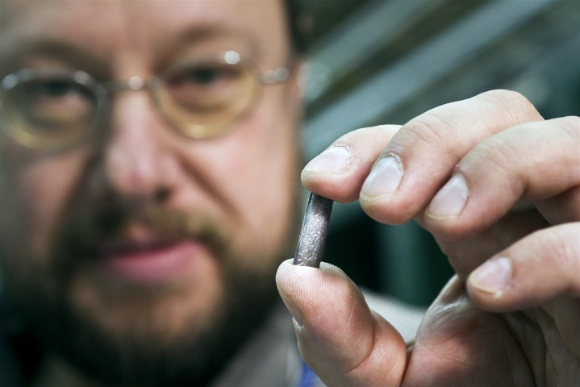
Overview of the CERN Ion Complex
2.68 TeV/n
LHC
27 km
2 X 23 injections SPS to LHC of 56-b 50 ns ➔ 1240-b 50 ns per beam HL-LHC
176.5 GeV/n
X 7
X 7
SPS
7 km
²⁰⁸Pb⁸²⁺
50 ns
Momentum slip-stacking
Stripper
14 injections PS to SPS of 4-b 100 ns
5.8 GeV/n
PS
628 m
100 ns
1 Electron Cyclotron Resonance Ion Source (ECRIS), installed in 2005
72 MeV/n
The metal is heated to ~800°C and ionized to become plasma
LEIR
78 m
²⁰⁸Pb⁵⁴⁺
4.2 MeV/n
Stripper
200 ns
Solid isotopically pure ²⁰⁸Pb is placed in a ceramic crucible that sits in an "oven"
Equipped with gas injection and 2 microwave ovens
LINAC 3
2.5 keV/n
Source
²⁰⁸Pb²⁹⁺
The source can also be set up to deliver
O, Ar, Xe …
R. Alemany Fernandez, 16th Workshop on critical point and onset of deconfinement, April 2026

Slide 34
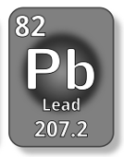
Performance assessment for LHC beams
Experimental tests
Lead physics run ➔ HL-iLHC already
Excellent, stable Pb⁵⁴⁺ beam from Linac3 with ≥ 30 e𝝻A
SPS slip-stacking with HL-LHC parameters demonstrated
2024-2026 ➔ reliable&stable delivery of very-high performant beams
IP1,2,5 Integrated lumi in
2024 = 1.9 nb⁻¹
2025 = 2.0-2.9 nb⁻¹
IP8 Integrated lumi in
2024 = 0.5 nb⁻¹
2025 = 0.94 nb⁻¹
SPS 14 injections from PS
56 bunches
50 ns
Slip stacking plateau @300 GeV
……
14
3
2
1
28 bunches
100 ns
28 bunches
100 ns
R. Alemany Fernandez, 16th Workshop on critical point and onset of deconfinement, April 2026

Slide 35
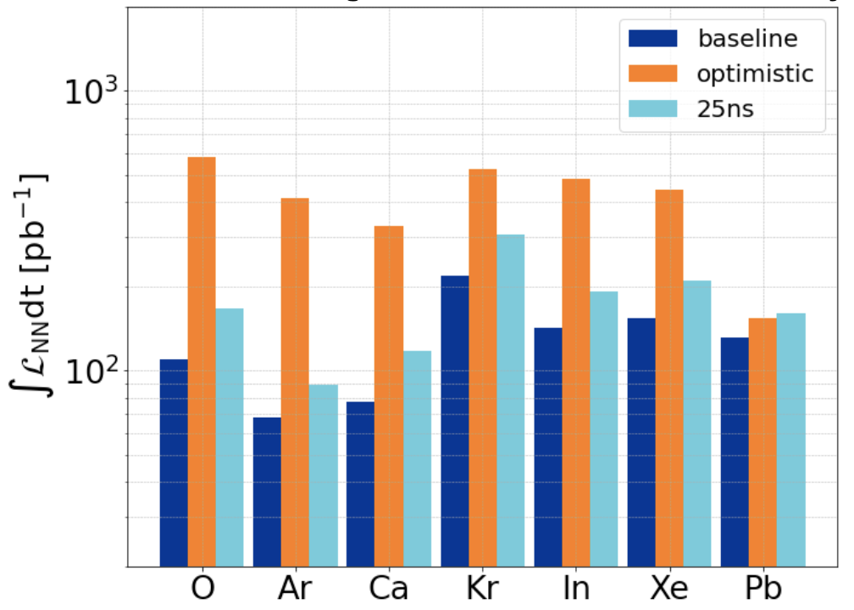
Performance assessment for LHC beams
Benchmark simulations
First time an LHC Injector Model being developed for ions including:
Space charge
Intra Beam Scattering growth rates
Tune shifts from Space Charge
Beam gas interactions studies with Pb & Mg
LEIR Electron cooler
Nucleon-Nucleon integrated luminosity for 1 month run
O: ~600 pb⁻¹
Pb: ~150 pb⁻¹
Baseline:
today’s Ion Complex
Optimistic:
PS no-splitting
Isotope&charge optimization
Extra injection from Linac3
LHC operational eff. 65%
Eb=7Z TeV
Xing/2 = 130 μrad
β∗ = 40 cm
25 ns: 4b – 50 ns from PS
https://doi.org/10.1016/j.nima.2025.171118
CTE: Collider Time Evolution tracking software ➔luminosity burn-off, Intra Beam Scattering, and synchrotron radiation damping
10/15
R. Alemany Fernandez, 16th Workshop on critical point and onset of deconfinement, April 2026

Slide 36
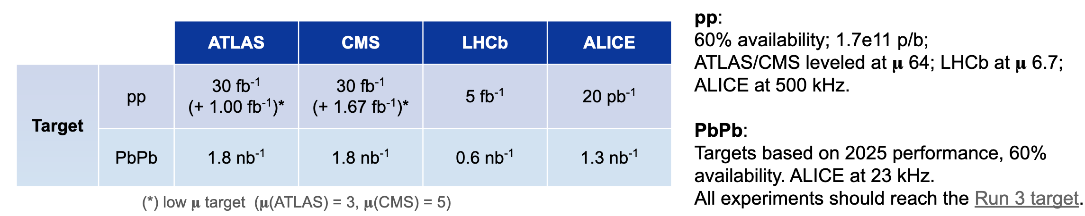
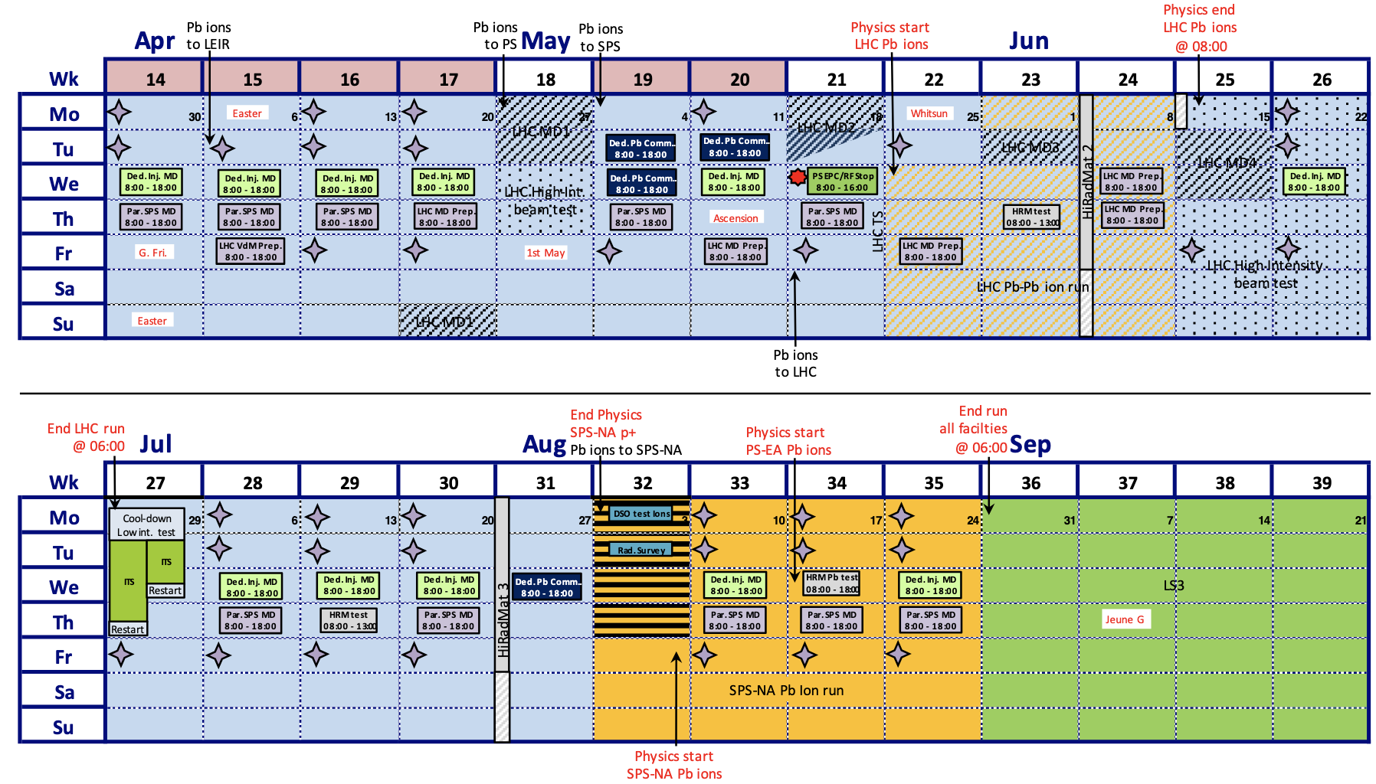
LHC
Luminosity targets for PbPb collisions in 2026 (presented in Chamonix 2026):
SPS
Today
LHC
PbPb Run
SPS NA
PbPb Run
R. Alemany Fernandez, 16th Workshop on critical point and onset of deconfinement, April 2026

Slide 37
New Ions at LHC: examples of proposals
Masses <= 10 (⁴He, ⁶Li, ¹⁰B)
Addresses small system collectivity and energy loss as a continuation of oxygen and neon
Lot of work foreseeable in conjunction with first-principles nuclear theory (NLEFT, PGMC, QMC, NCSM , … )
Ion species with same A/Z
Li+Li (A=6) followed by He+He (A=4)
B+B (A=10) followed by He+He (A=4)
B+B (A=10) followed by Li+Li (A=6) ➔ both solids ➔ second source needed
Alternative: A-A followed by p-A (or vice versa) for nPDF uncertainties
Synergy with NA61++ ➔ Boron
Masses A ≈ 40 (⁴⁸Ca)
Addresses neutron skin and Equation Of State (EOS)
Nuclear skin determinations from potentially different probes; resolves CREX discrepancy
Synergy: neutron star EOS, driplines and r-process
Ion species:
Short run of ⁴⁸Ca
More optimal: ⁴⁸Ca+⁴⁸Ca followed by one fill of ⁴⁰Ar+⁴⁰Ar [testing precision flow predictions]
Ultra strong case: ⁴⁸Ca+⁴⁸Ca followed by ⁴⁰Ca+⁴⁰Ca ➔ second source needed
Masses A ≈ 80 (⁷⁶Ge)
Addresses 0νββ decay matrix elements
Theory uncertainties on NMEs reduced by experimental information from collisions
Ion species:
Short run of ⁷⁶Ge [selected for ton-scale next-gen experiments?]
More optimal: ⁷⁶Ge+⁷⁶Ge followed by one fill of ⁷⁸Kr+⁷⁸Kr [testing precision flow predictions]
Ultra strong case: ⁷⁶Ge+⁷⁶Ge followed by ⁷⁶Se+⁷⁶Se ➔ second source needed
11/14
R. Alemany Fernandez, 16th Workshop on critical point and onset of deconfinement, April 2026

