Slide 1



Benchmarking Nuclear Matrix Elements of 0$νββ$ Decay with High-Energy Nuclear Collisions
Xin Zhang
Collaborators: Yi Li, Giuliano Giacalone, Jiangming Yao
Intersection of nuclear structure and high-energy nuclear collisions 2026
Notes:
完成其他幻灯片的准备工作后，删除此幻灯片。

Slide 2
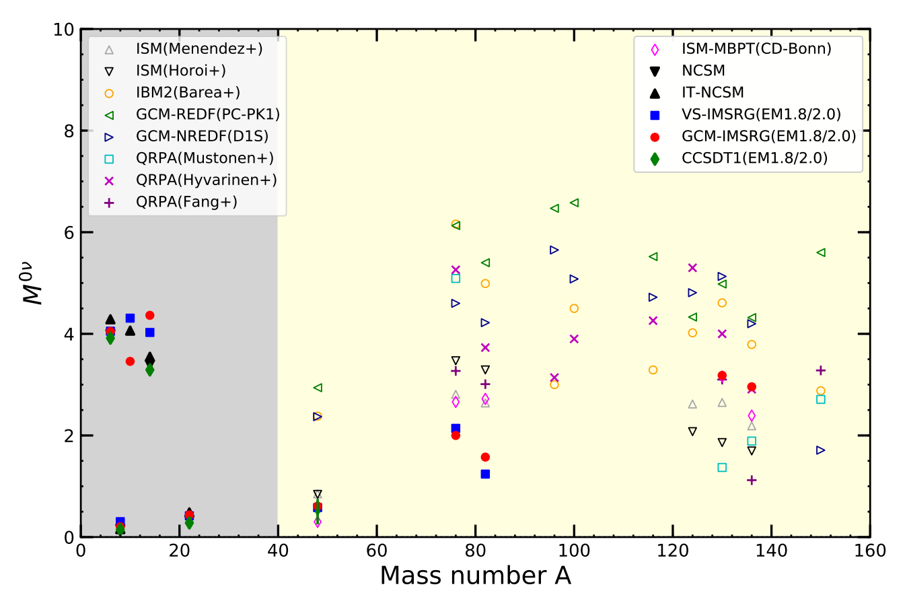
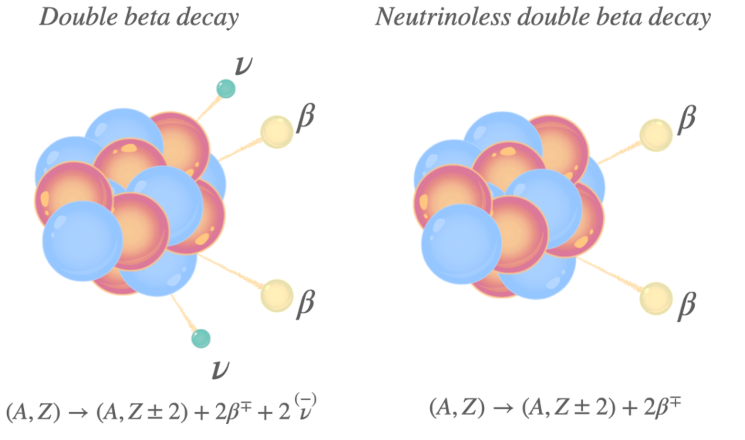
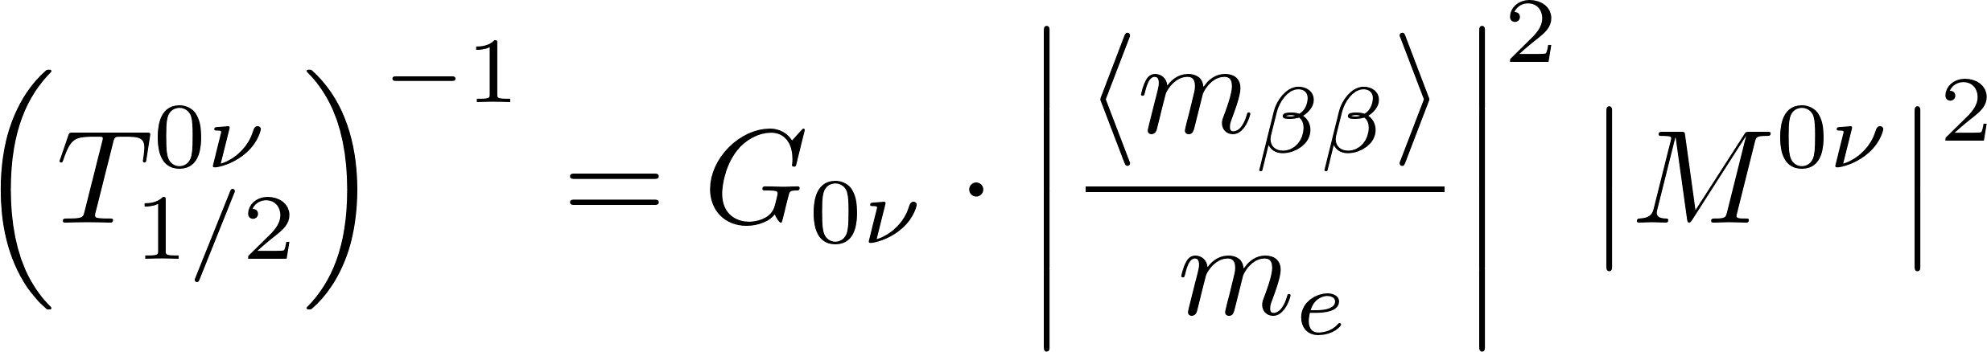
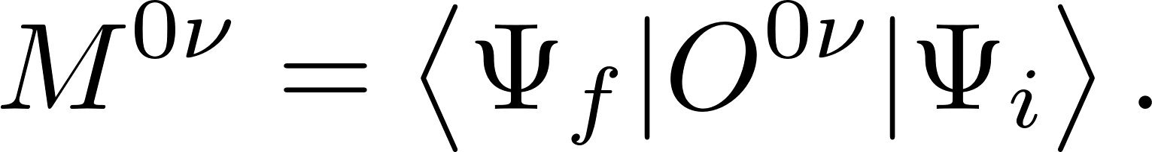
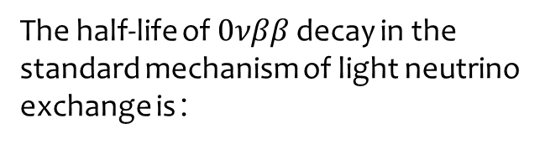
The half-life of $0νββ$ decay in the standard mechanism of light neutrino exchange is：
The matrix element (NME) is:
Various nuclear models predict NMEs that differ by three to more!
We need to perform correlation analysis and uncertainty quantification for each model to understand this discrepancy.
J, M, Yao et al., PPNP. 126, 103965 (2022)

Slide 3
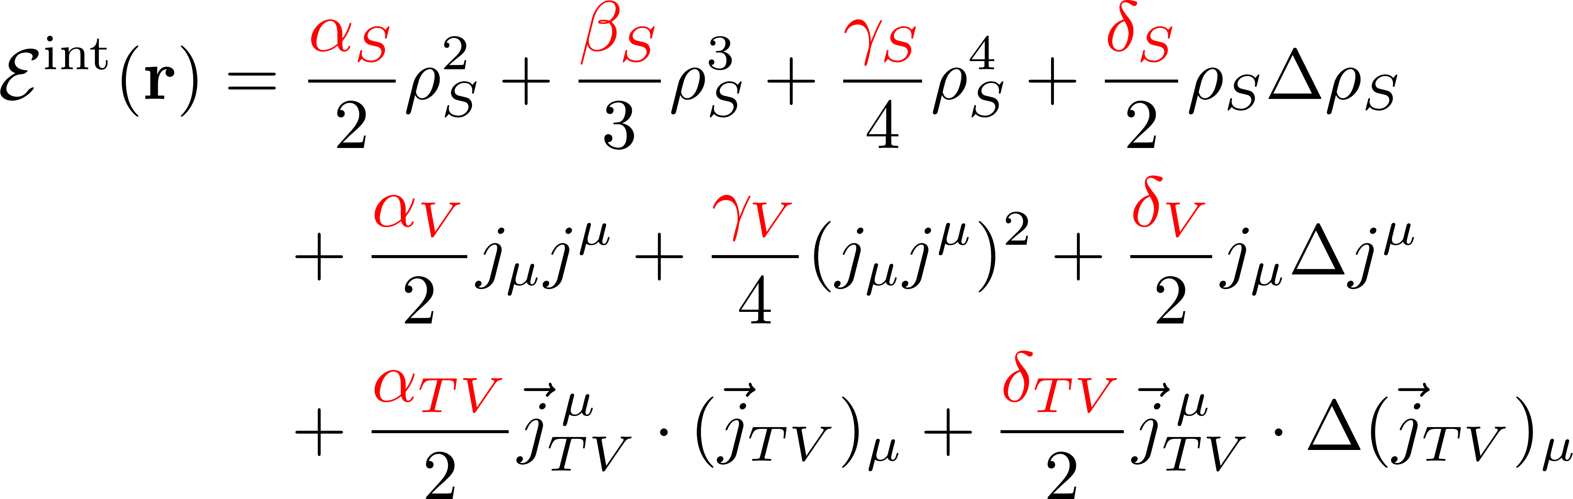
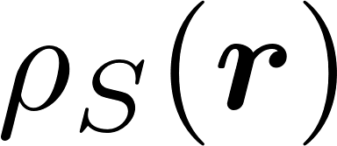
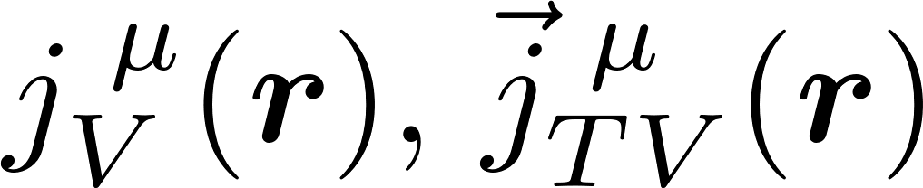
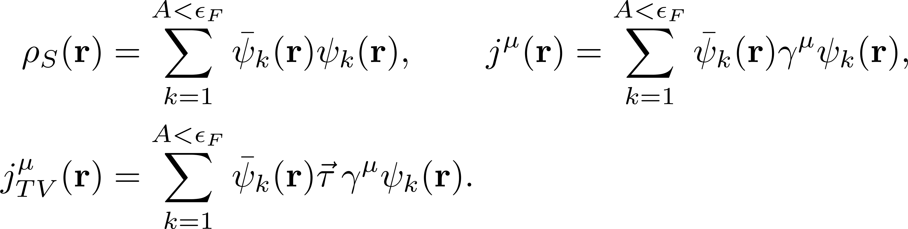
Covariant Density Functional Theory (CDFT)
The CDFT starts from the following energy density functional (EDF) under the mean-field approximation:
The interaction part with low-energy constants
The local densities and currents are :

Slide 4
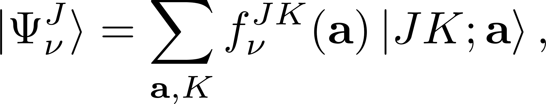
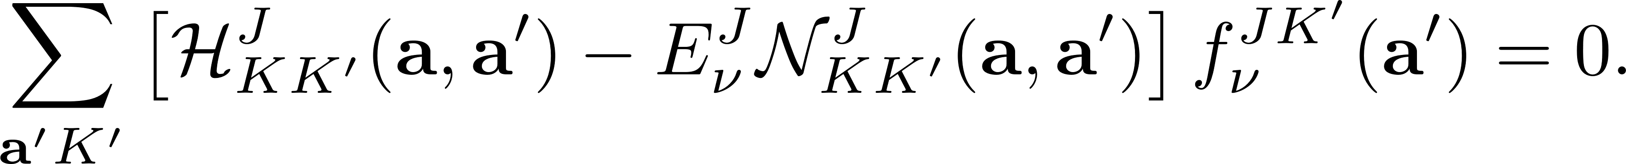
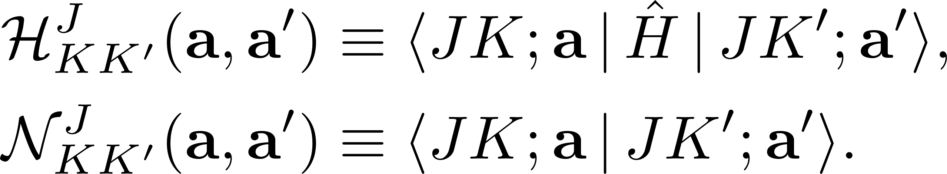
The GCM wave function is expanded on a set of non-orthogonal basis for a certain EDF:
P. Ring and P. Schuck, The nuclear many-body problem (1980)
where are symmetry-projected quasiparticle vacuum.
The variational principle yields the Hill-Wheeler-Griffin (HWG) equation :
The Hamiltonian kernels $ℋ$ and norm kernels $𝒩$ are given by :
Energy density functionals : Rodríguez 2010 PRL; Vaquero 2013 PRL; Song 2014 PRC; Yao 2015 PRC
Shell model Hamiltonian : Jiao 2017 PRC; Jiao 2018 PRC
Chiral EFT interaction : Yao 2020 PRL

Slide 5
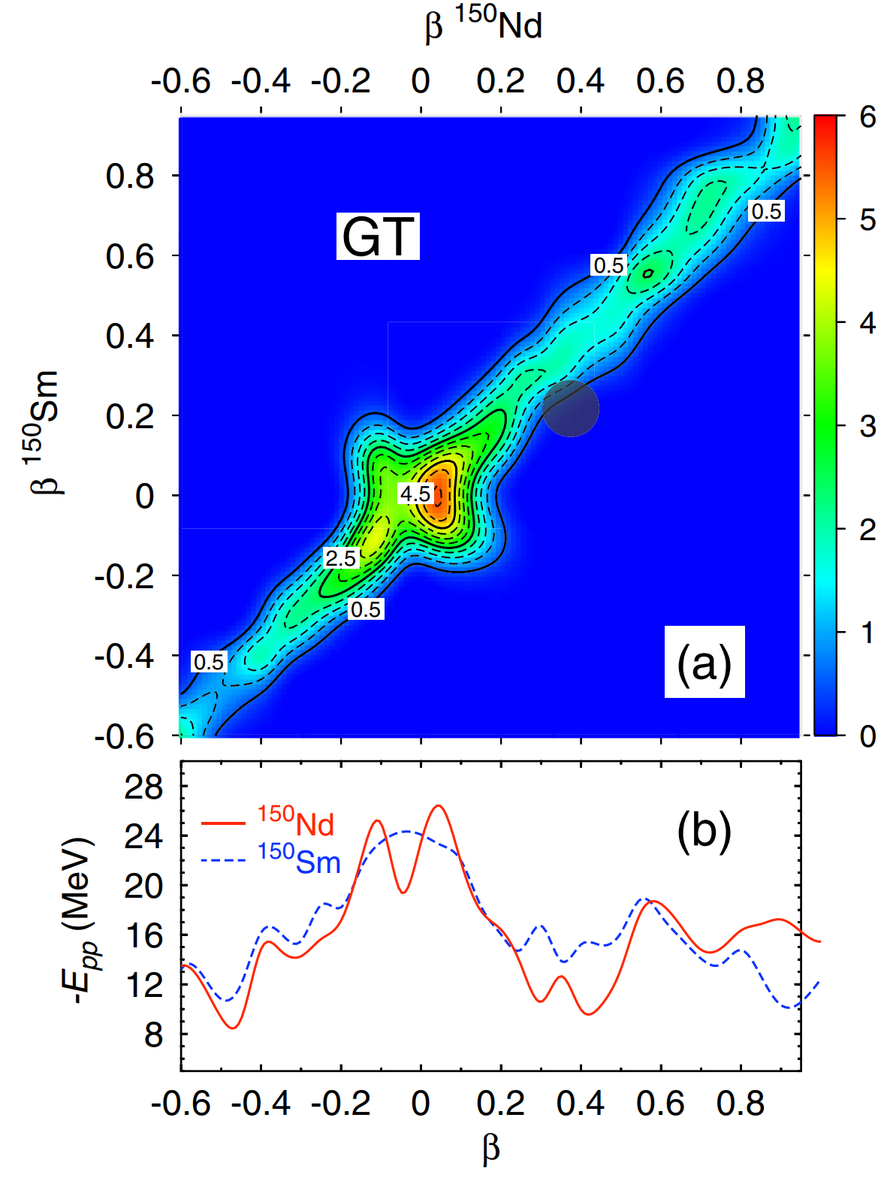
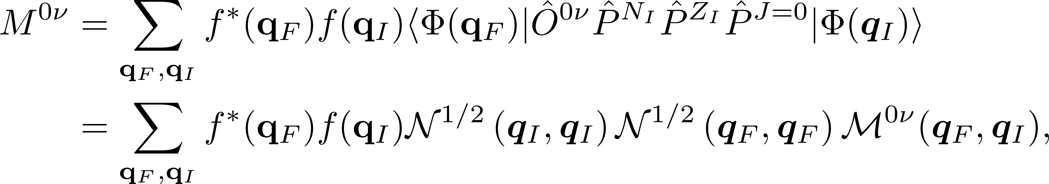
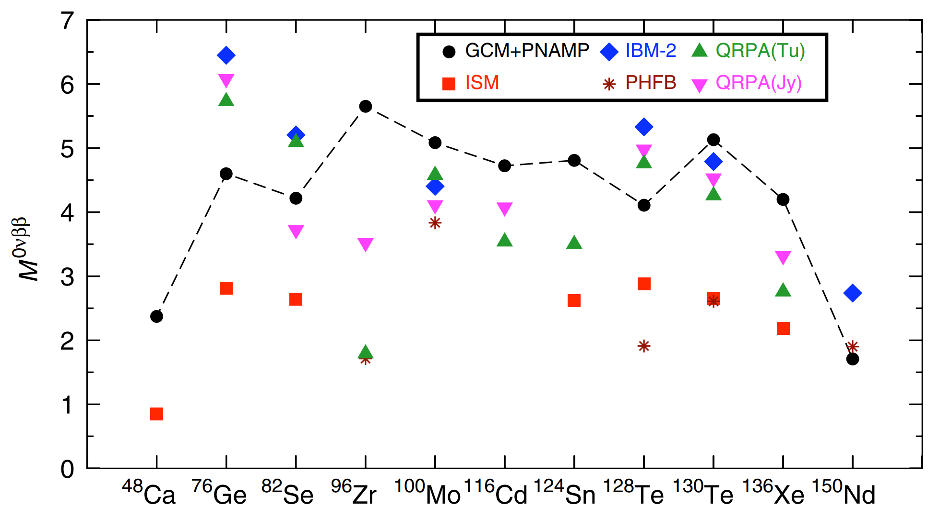
NME calculated by GCM show explicit effect of deformations:
Tomás R. Rodríguez et al., PRL 105, 252503(2010)

Slide 6
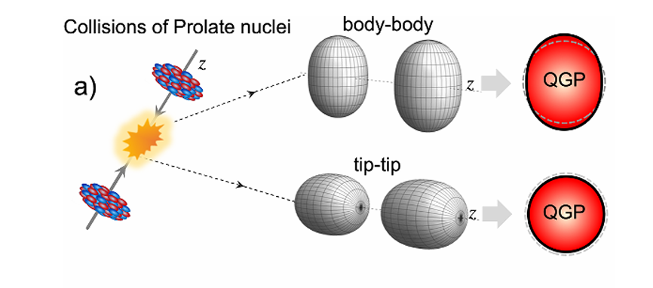
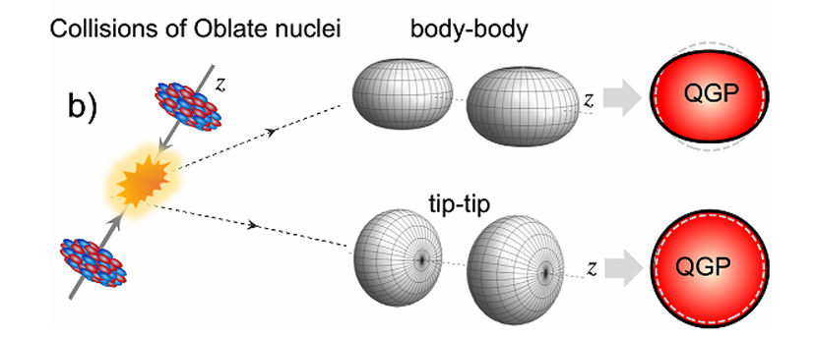
The STAR Collaboration, Rep. Prog. Phys. 88 108601 (2025)
The initial shape of the nuclei can be inferred from the observables of the collision’s final state.
Do these observables have correlations with the NME? How to implement the correlation analysis?

Slide 7
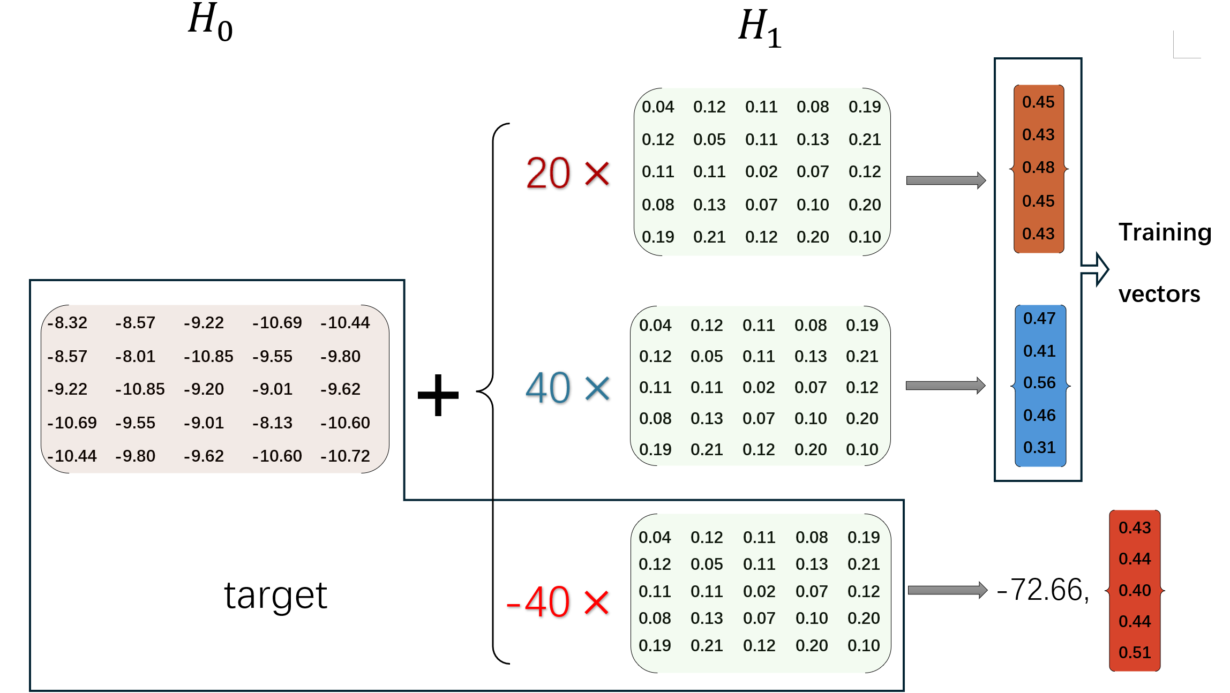
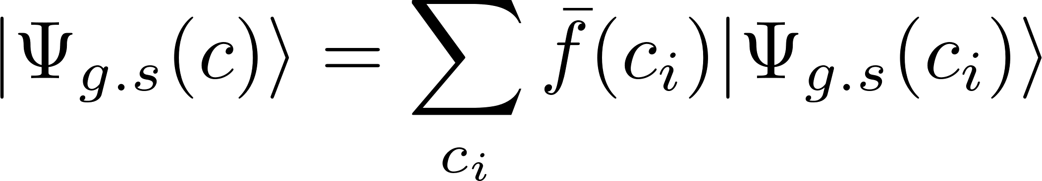
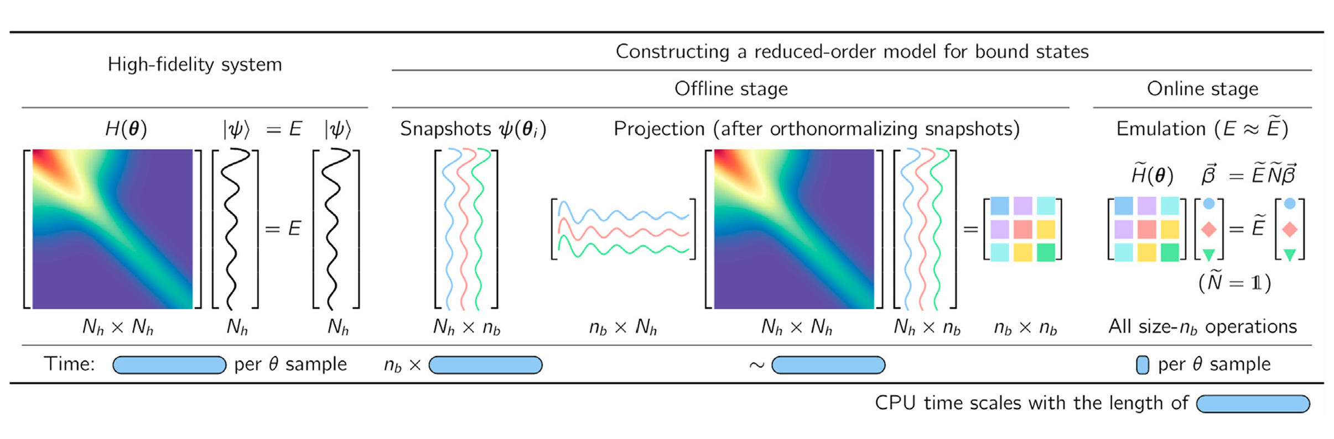
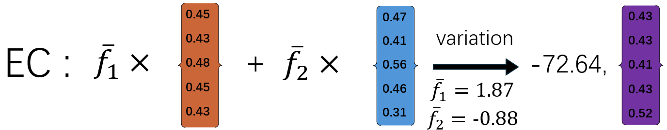
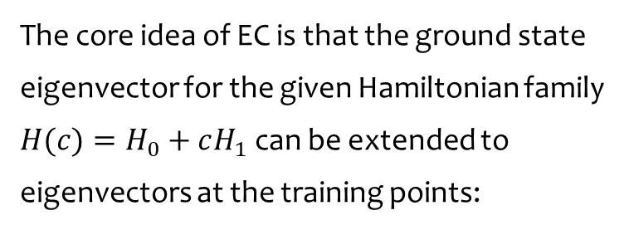
Eigenvector Continuation(EC)
The core idea of EC is that the ground state eigenvector for the given Hamiltonian family $H(c)=H_{0}+cH_{1}$can be extended to eigenvectors at the training points:
Dillon Frame et al., PRL 121，032501 (2018)
C. Drischler et al., Front. Phys. 10, 1092931 (2023)

Slide 8
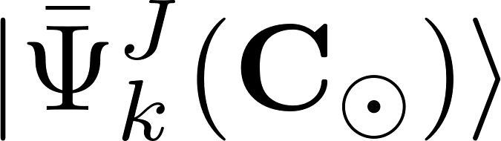
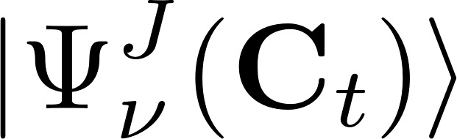
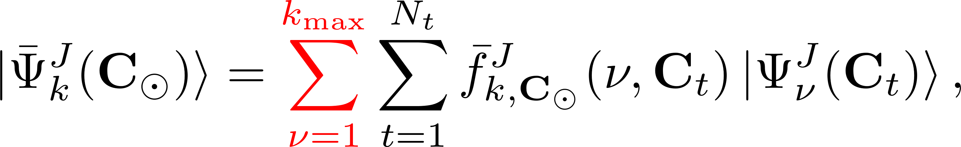
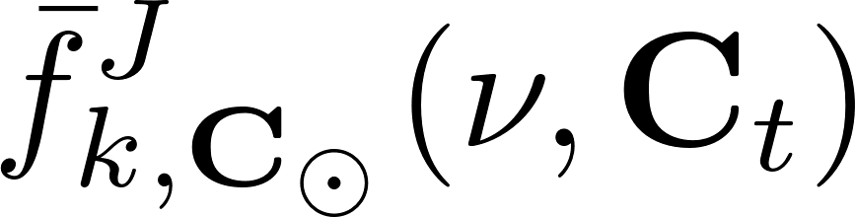
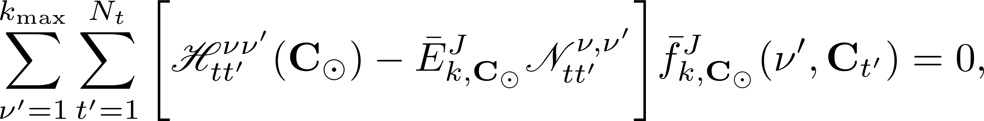
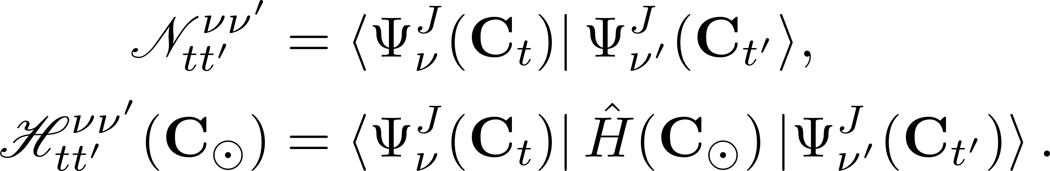
In SP-CDFT, the k-th wave function of a target EDF is expanded in terms of the basis wave functions of the first $k_{\text{max}}$ states by the $N_{t}$ training EDFs,
The mixing coefficient is determined by the following equation,
Here, we define the norm and Hamiltonian kernels of the EC method for a target EDF,

Slide 9
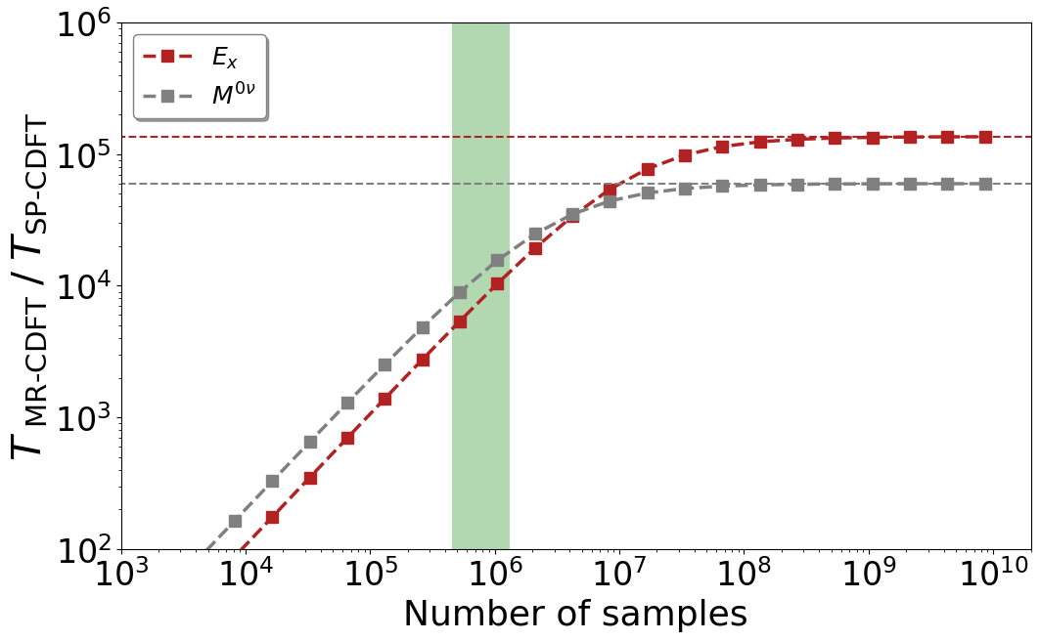
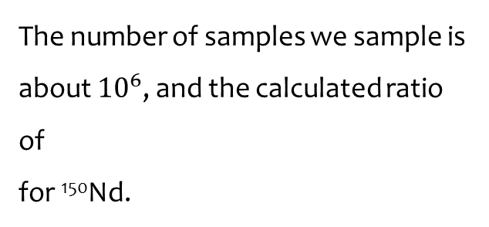
The number of samples we sample is about ${10}^{6}$, and the calculated ratio of
for ¹⁵⁰Nd.
The SP-CDFT allows us within half an hour using a PC, to predict nuclear low-lying states for 1.3 millions of EDF samples which would otherwise take years with the MR-CDFT.
FIG. The ratio of the computation time of MR-CDFT calculation to that of SP-CDFT calculation for ¹⁵⁰Nd

Slide 10
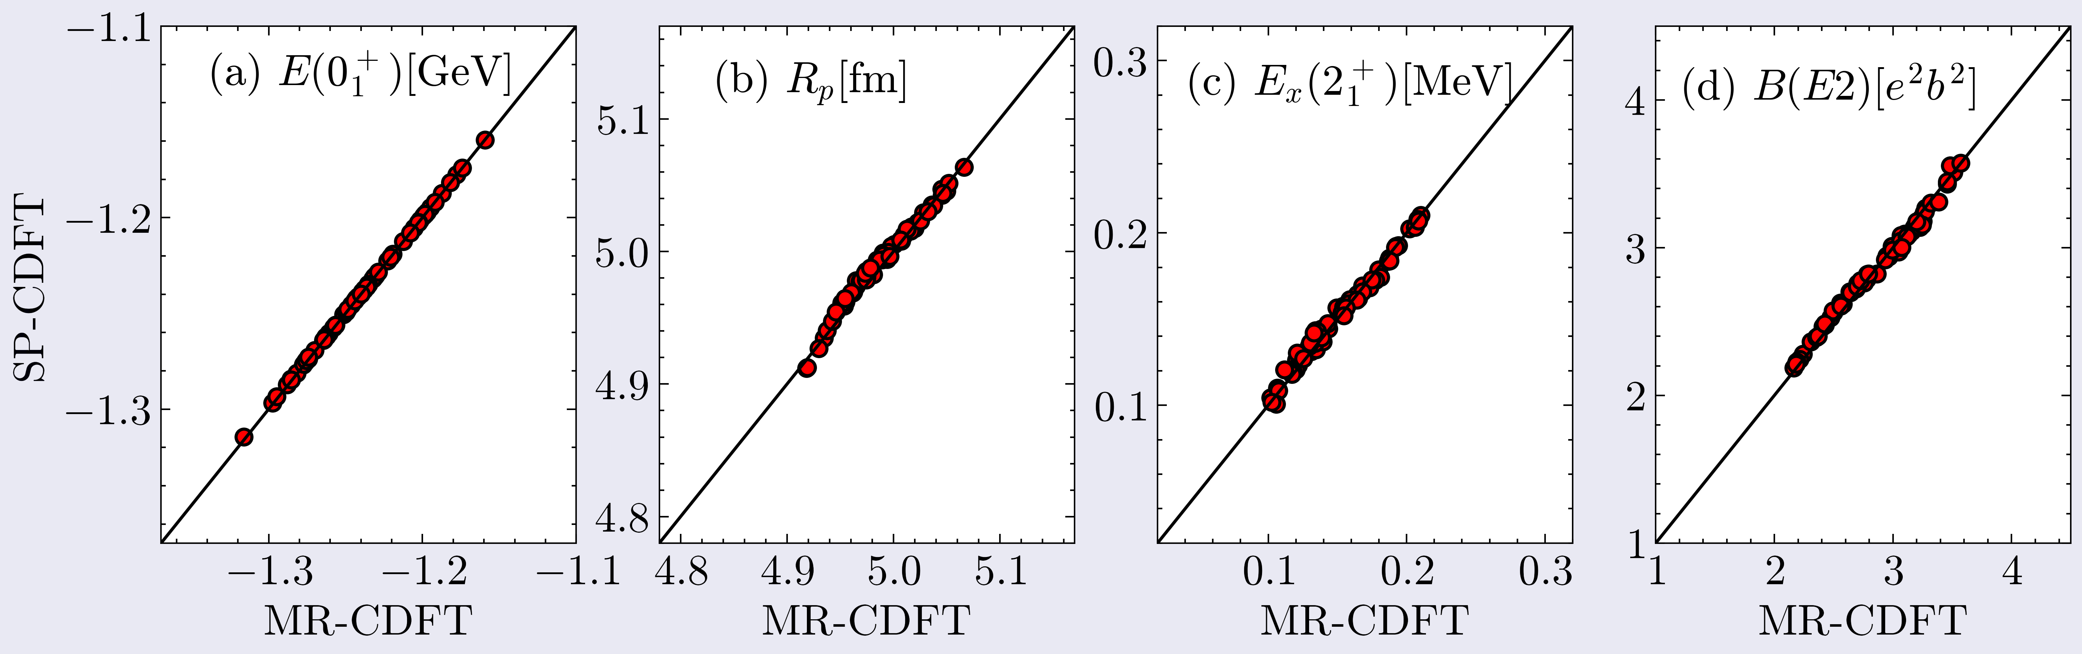
Benchmark calculation using 64 testing set (¹⁵⁰Nd)
The relative error for the ground state properties are all within 0.3%
The relative error for the low-lying states properties are all within 13%, due to the overlap of errors between the ground state and the lower-lying state.

Slide 11
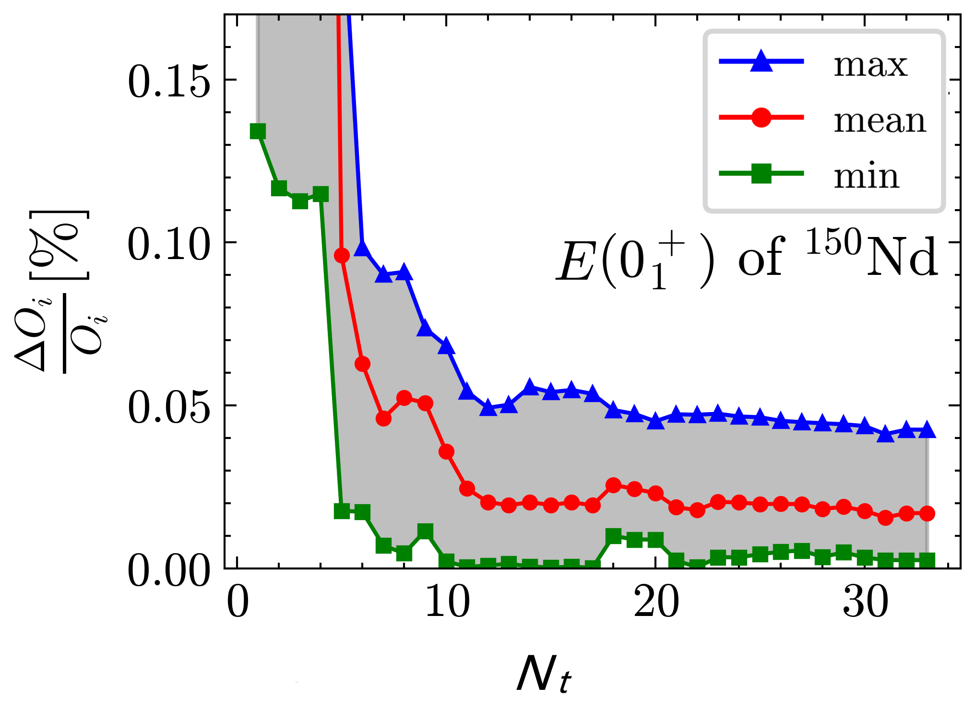
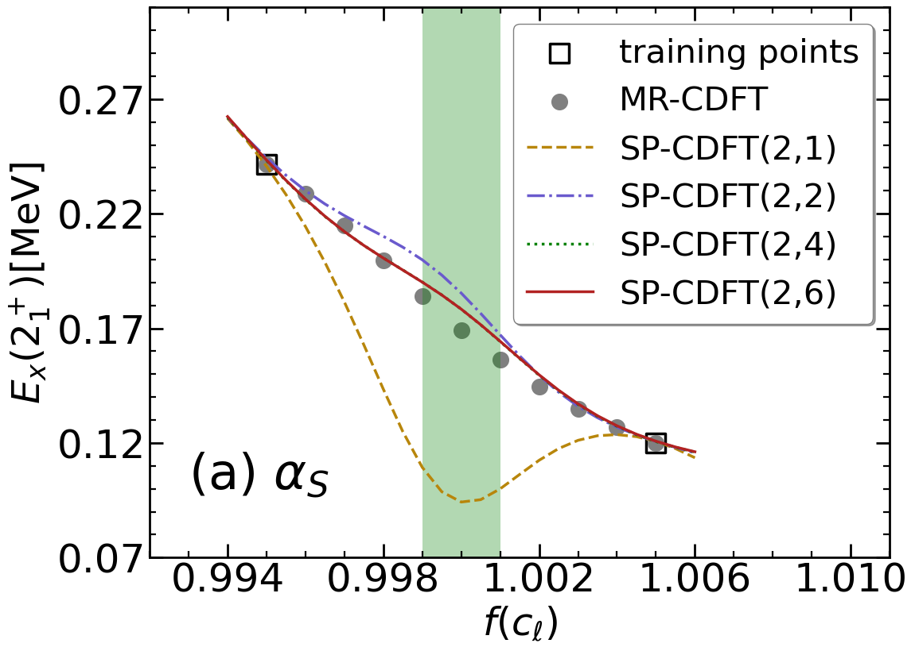
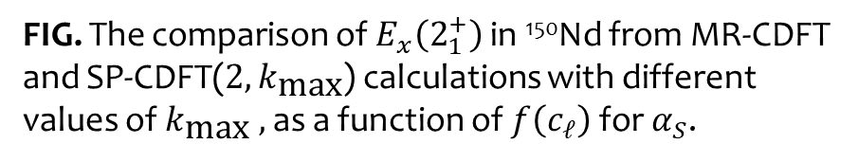
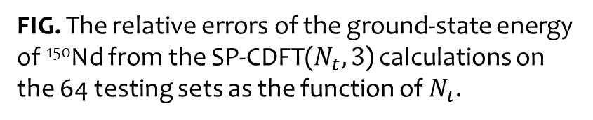
We use the symbol SP-CDFT($N_{t}$, $k_{\text{max}}$) to mark the number of two hyperparameters.
We introduce a scaling factor $f\left(c_{ℓ}\right)=c_{ℓ}/c_{ℓ}^{0}$ for each parameter in $C$ , where $c_{ℓ}^{0}$ is the value of the coupling constant $c_{ℓ}$ in the PC-PK1.
FIG. The relative errors of the ground-state energy of ¹⁵⁰Nd from the SP-CDFT($N_{t},3$) calculations on the 64 testing sets as the function of $N_{t}$.
FIG. The comparison of $E_{x}\left(2_{1}^{+}\right)$ in ¹⁵⁰Nd from MR-CDFT and SP-CDFT($2,k_{\text{max}}$) calculations with different values of $k_{\text{max}} ,$as a function of $f\left(c_{ℓ}\right)$ for $α_{S}$.

Slide 12
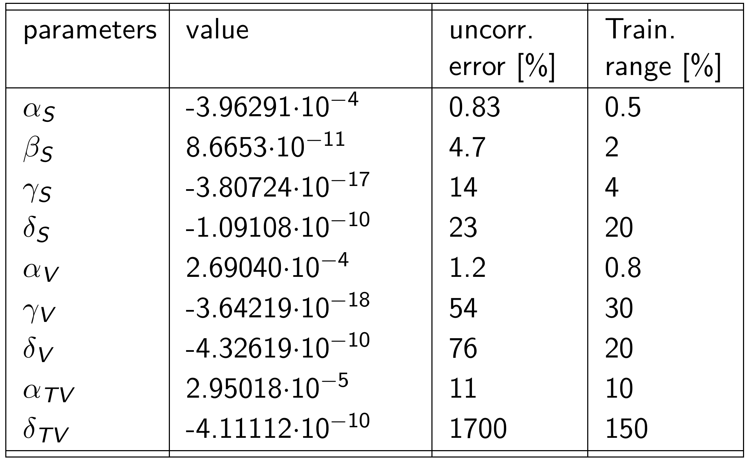
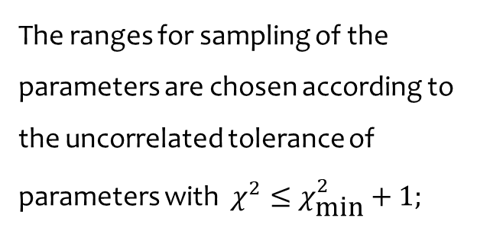
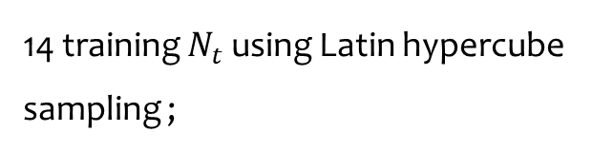
The ranges for sampling of the parameters are chosen according to the uncorrelated tolerance of parameters with $χ^{2}≤χ_{\text{min}}^{2}+1;$
T. Bürvenich et al., Phys. Rev. C 65, 044308 (2002)
14 training $N_{t}$ using Latin hypercube sampling ;
1.3 million samples using quasi Monte-Carlo (MC) sampling with a uniform distribution.
P. W. Zhao et al., Phys. Rev. C 82, 054319 (2010)

Slide 13
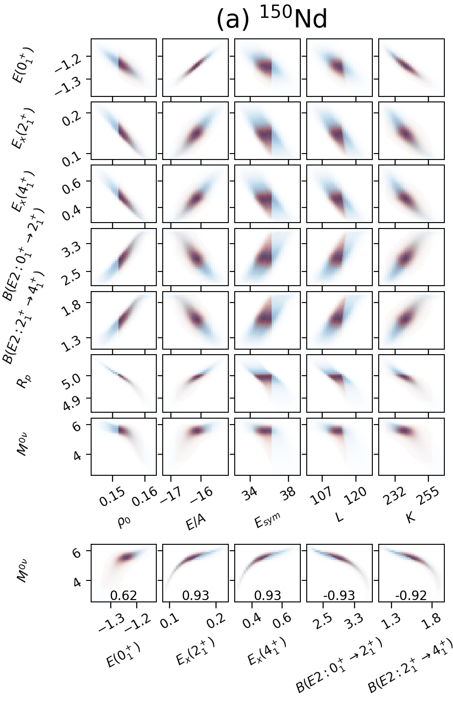
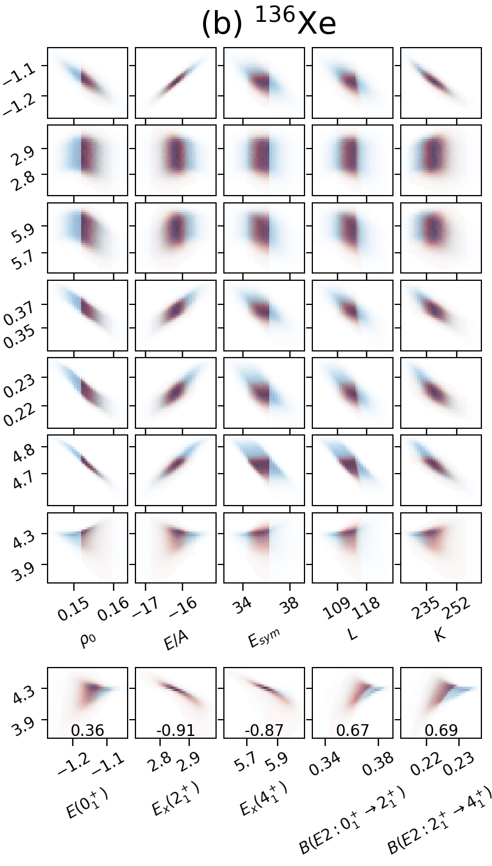

Uncertainty analysis of $M^{0ν}$
Samples of EDFs: 1310720
(in blue).
Samples of EDFs refined with
the nuclear matter properties:
457380 (in red).
The correlations of the
quantities for nuclear matter
with M^{0ν} are weak.
There are rather strong
correlations between the M0ν
and nuclear low-lying states,
but these correlations vary with
nucleus.
X. Zhang, C. C. Wang, C. R. Ding, and J. M. Yao, Phys. Rev. C 112, L021302 (2025)

Slide 14
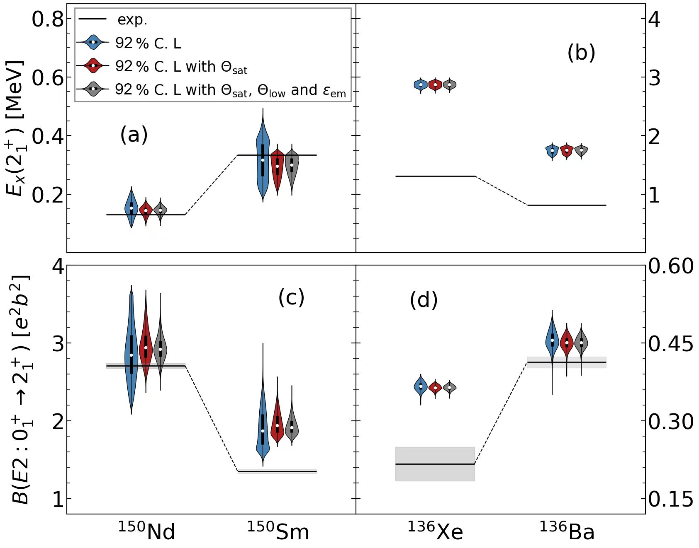


Uncertainty analysis of $M^{0ν}$
The collectivity of the single-magic nucleus ¹³⁶Xe is overestimated due to the lack of particle-hole excitation configurations in the model space.
C. R. Ding et al., PRC 108, 054304 (2023)
The statistical uncertainties from the nine parameters in the particle-hole part of the EDF are within 9% for the excitation energies and 5% for the $E2$ transition strengths

Slide 15
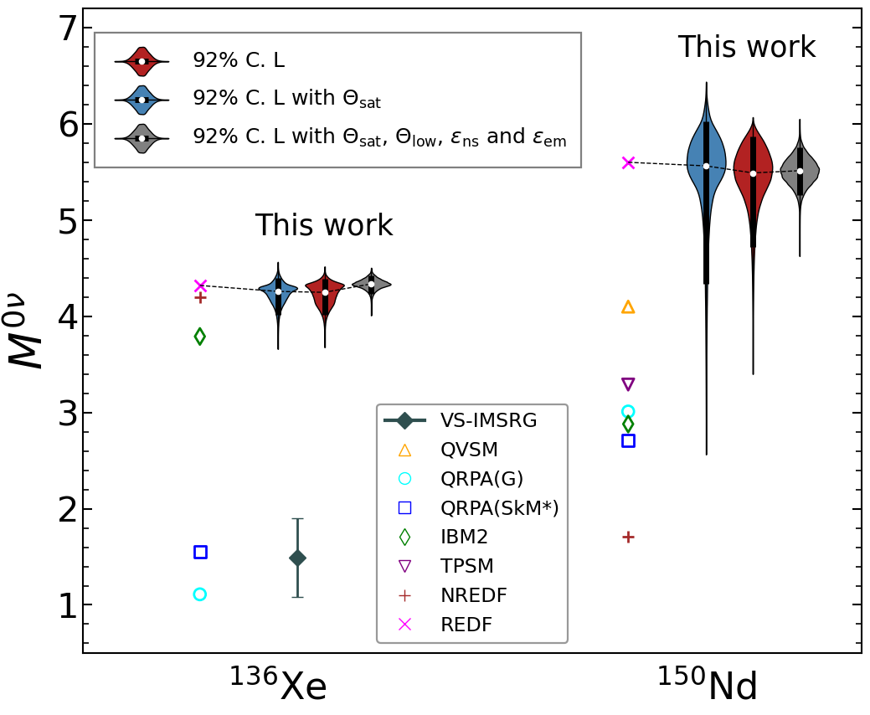

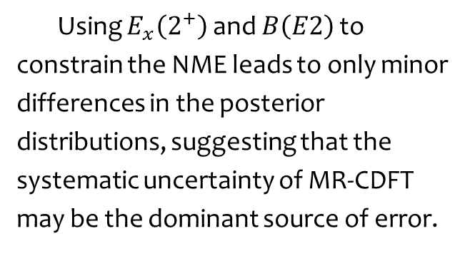
Uncertainty analysis of $M^{0ν}$
The final mean value and statistical uncertainty (68% confidence level) of the NME are 5.51(14), and 4.33(5) for ¹⁵⁰Nd and ¹³⁶Xe, respectively, in line with the values 5.60 and 4.32 by the PC-PK1.
Using $E_{x}\left(2^{+}\right)$ and $B\left(E2\right)$ to constrain the NME leads to only minor differences in the posterior distributions, suggesting that the systematic uncertainty of MR-CDFT may be the dominant source of error.

Slide 16
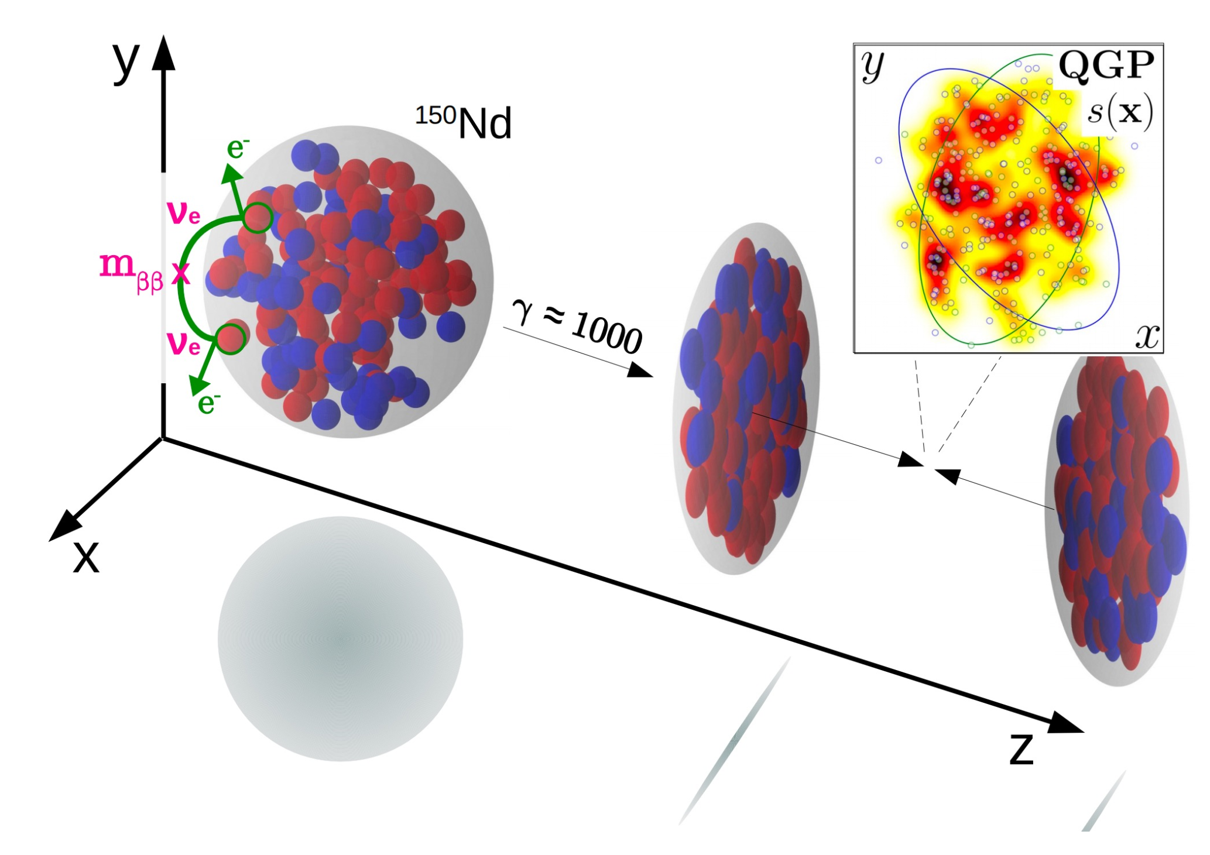
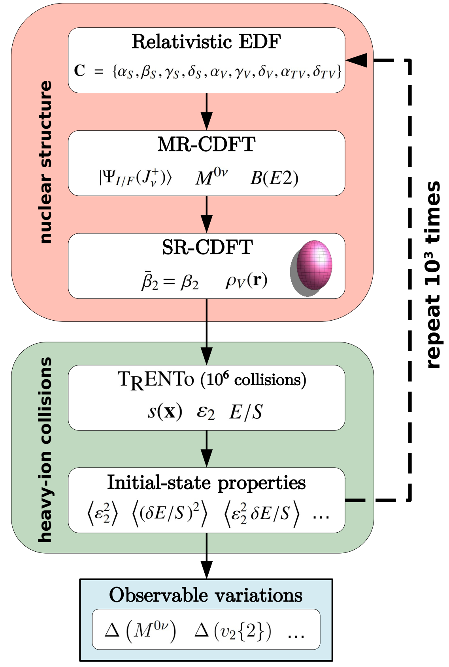
FIG. Collider experiments with isobars provide robust probes of the nuclear geometry.
Y.Li, X. Zhang, G. Giacalone, J. M. Yao, Phys. Rev. Lett. 135, 022301 (2025)

Slide 17
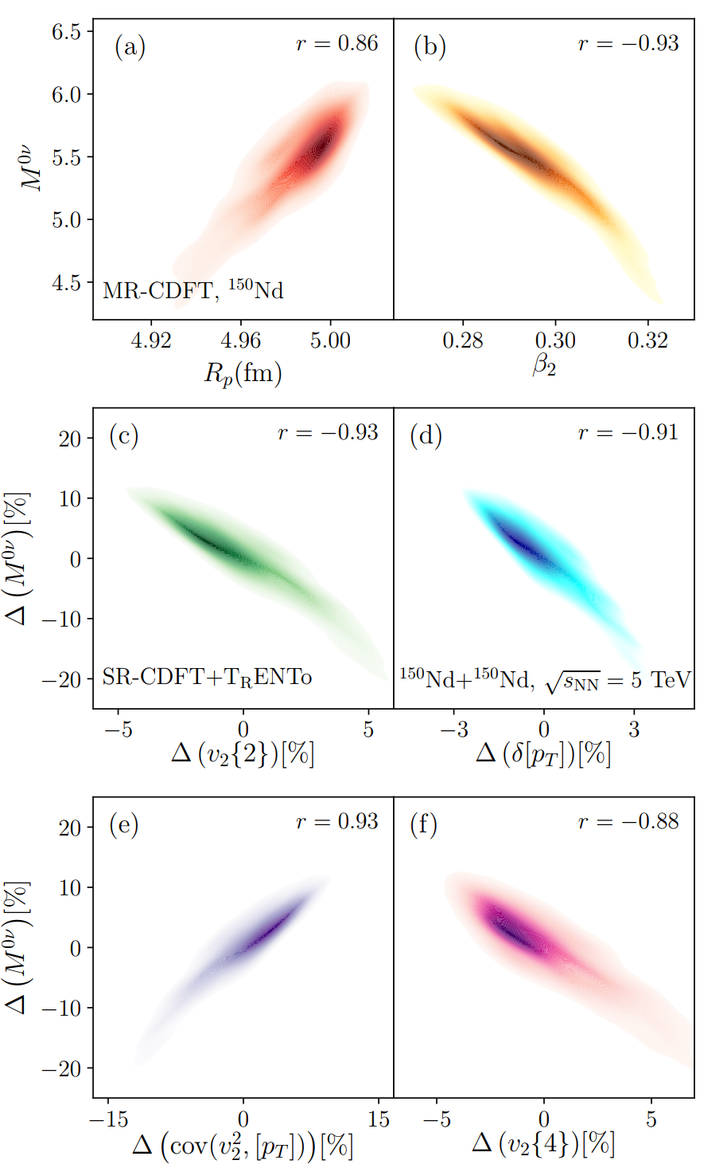
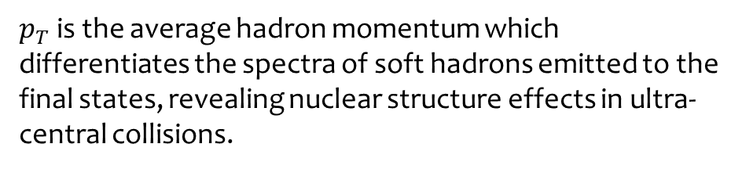
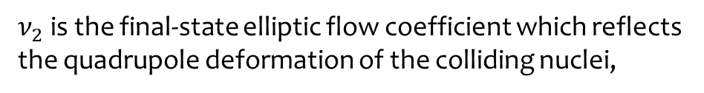
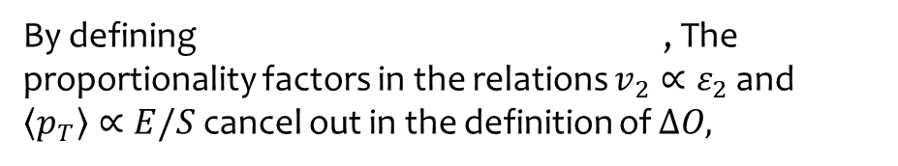
By defining , The proportionality factors in the relations $v_{2}∝ε_{2}$ and $\left\langle p_{T}\right\rangle ∝E/S$ cancel out in the definition of $ΔO,$
$ν_{2}$ is the final-state elliptic flow coefficient which reflects the quadrupole deformation of the colliding nuclei,
$p_{T}$ is the average hadron momentum which differentiates the spectra of soft hadrons emitted to the final states, revealing nuclear structure effects in ultra-central collisions.
All of these variations are strongly correlated with the value of the NME.
By extending the high-energy data to the Bayesian analysis should effectively improve the extraction of the nuclear deformation.

Slide 18
Summary
We have developed SP-CDFT to emulate MR-CDFT.
By using SP-CDFT, We have conducted the first statistical analysis of the correlation between NMEs of 0νββ decay and observables from HIC using covariant density functional theory (CDFT).
The high-energy collision observables investigated in this study exhibit a strong correlation with NME, offering a promising way for constraining NME in the future.
Prospect
The method is readily extendable to more candidate nuclei and we can combine with experimental data to constrain the value of NME.

Slide 19
Thank you!

