Slide 1

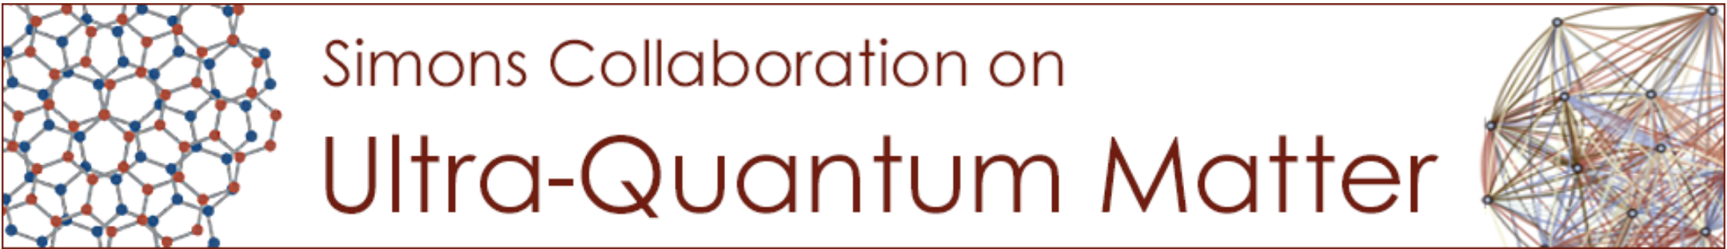
A Solvable Model with Exact Lattice Chiral Symmetry
Shu-Heng Shao (MIT)
Zhiyao Lu, Sahand Seifnashri, SHS [2604.06307]
See also: Ryan Thorngren, John Preskill, Lukasz Fidkowski [2601.04304]
Lukasz Fidkowski, Cenke Xu, Carolyn Zhang [2510.17969]

Slide 2
Chiral symmetry
Chiral symmetries, roughly speaking, are symmetries that act differently on the left and right degrees of freedom.
The realization of exact chiral symmetries on the lattice is not only of intrinsic theoretical interest, but may also have practical implications for numerical computations.
In recent years, there has been a lot of progress in generalizing the notion of symmetries in quantum field theory and in lattice systems.
These developments have led to new understandings of chiral symmetries.

Slide 3
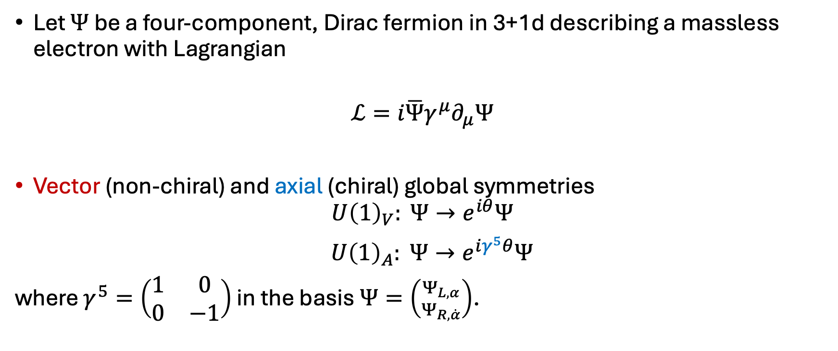
Example: electron
Let $Ψ$ be a four-component, Dirac fermion in 3+1d describing a massless electron with Lagrangian
$$ℒ=i\overline{Ψ}γ^{μ}∂_{μ}Ψ$$
Vector (non-chiral) and axial (chiral) global symmetries
$$U{\left(1\right)}_{V}: Ψ→e^{iθ}Ψ$$
$U{\left(1\right)}_{A}: Ψ→e^{iγ^{5}θ}Ψ$
where $γ^{5}=\left(\begin{matrix}1 & 0 \\ 0 & −1\end{matrix}\right)$ in the basis $Ψ=\left({Ψ_{L,α} \atop Ψ_{R,\dot{α}}}\right)$.

Slide 4
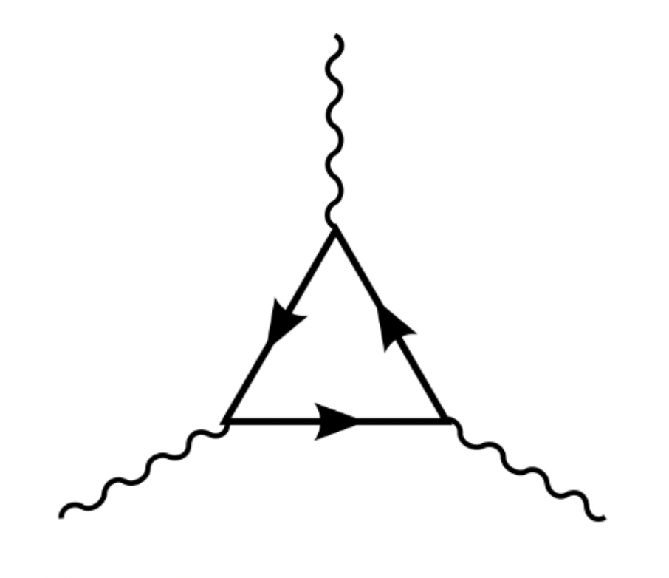
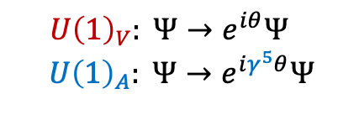
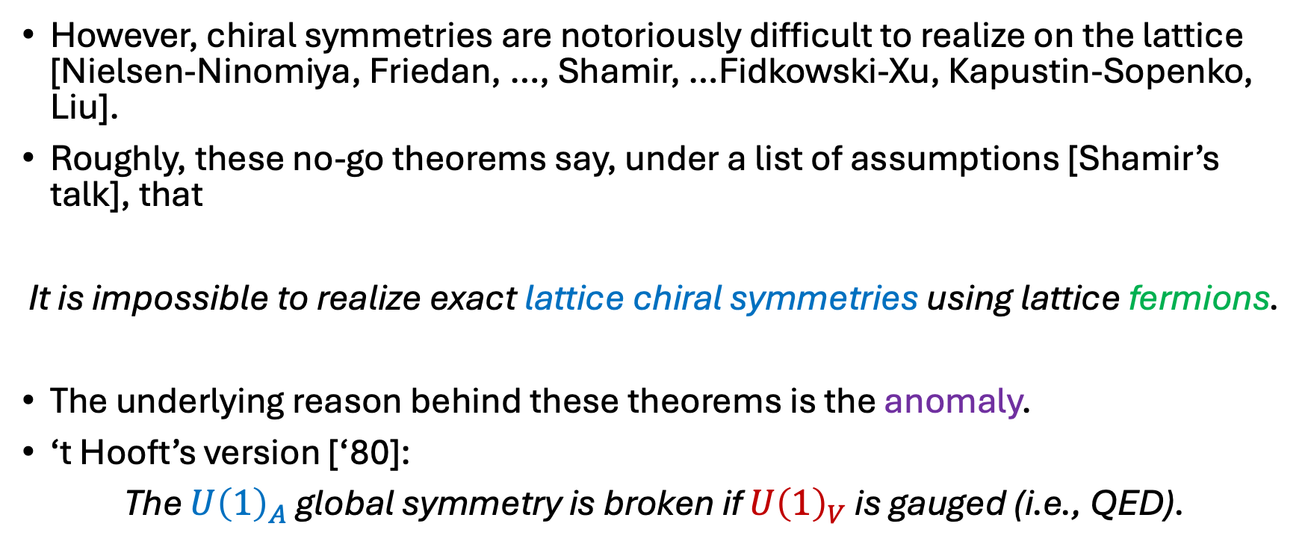



No-go theorems
$$U{\left(1\right)}_{A}$$
$$U{\left(1\right)}_{V}: Ψ→e^{iθ}Ψ$$
$U{\left(1\right)}_{A}: Ψ→e^{iγ^{5}θ}Ψ$
$$U{\left(1\right)}_{V}$$
$$U{\left(1\right)}_{V}$$
However, chiral symmetries are notoriously difficult to realize on the lattice [Nielsen-Ninomiya, Friedan, …, Shamir, …Fidkowski-Xu, Kapustin-Sopenko, Liu].
Roughly, these no-go theorems say, under a list of assumptions [Shamir’s talk], that
It is impossible to realize exact lattice chiral symmetries using lattice fermions.
The underlying reason behind these theorems is the anomaly.
‘t Hooft’s version [‘80]:
The $U{\left(1\right)}_{A}$ global symmetry is broken if $U{\left(1\right)}_{V}$ is gauged (i.e., QED).

Slide 5
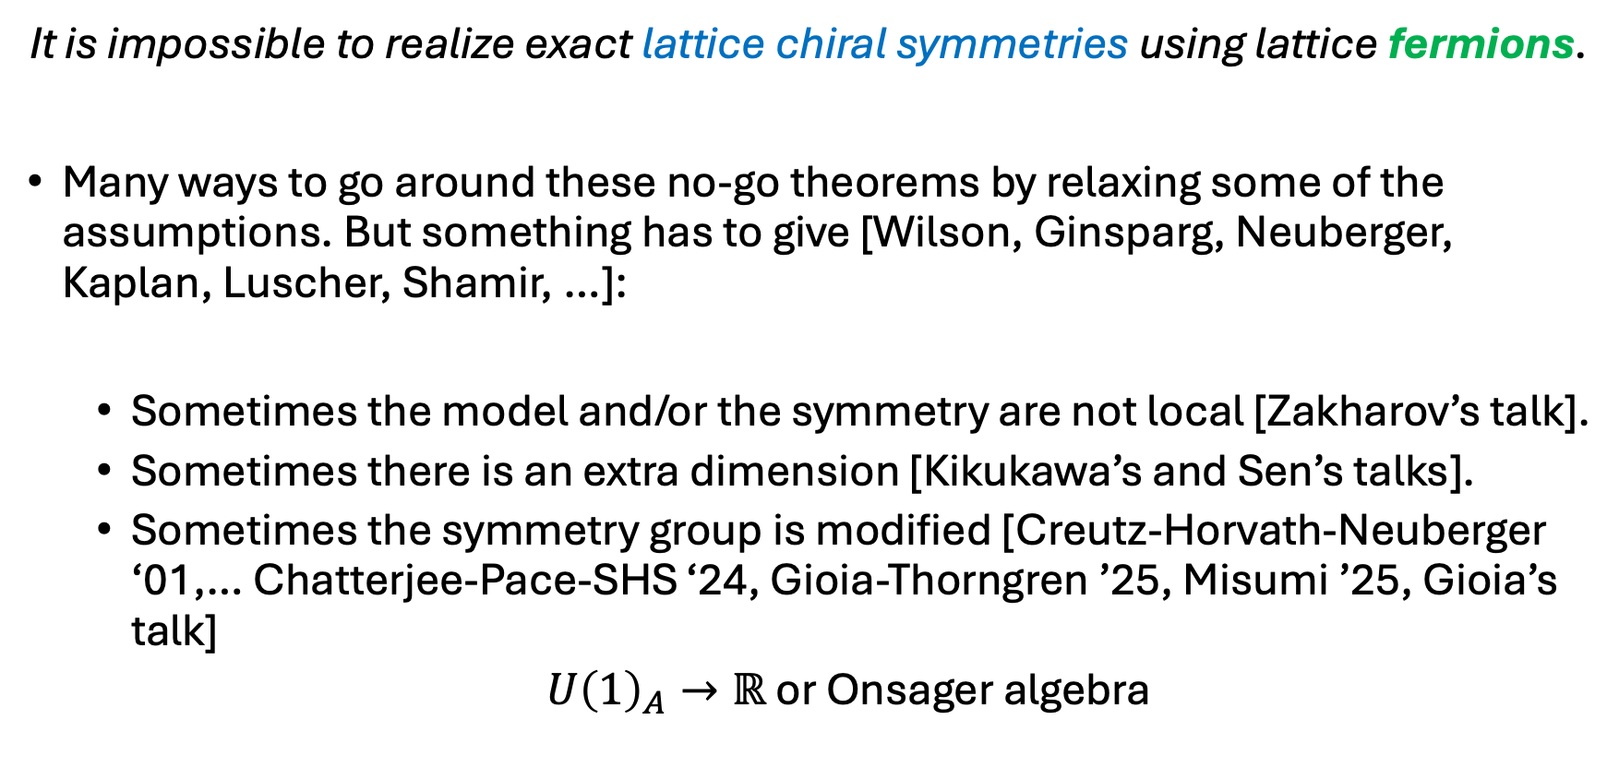
Going around the no-go theorems
It is impossible to realize exact lattice chiral symmetries using lattice fermions.
Many ways to go around these no-go theorems by relaxing some of the assumptions. But something has to give [Wilson, Ginsparg, Neuberger, Kaplan, Luscher, Shamir, …]:
  Sometimes the model and/or the symmetry are not local [Zakharov’s talk].
  Sometimes there is an extra dimension [Kikukawa’s and Sen’s talks].
  Sometimes the symmetry group is modified [Creutz-Horvath-Neuberger ‘01,… Chatterjee-Pace-SHS ‘24, Gioia-Thorngren ’25, Misumi ’25, Gioia’s talk]
  $U{\left(1\right)}_{A}→ℝ$ or Onsager algebra

Slide 6
Anomalies from the Onsager algebra
3+1d
chiral anomaly
Fermi surface
Kim-Pace-SHS
(PRL ‘26)
Onogi-Yamaoka ’25
Misumi-Onogi-Yamaoka ‘26
Onsager algebra
Chatterjee-Pace-SHS (PRL ‘25)
Pace-Kim-Chatterjee-SHS
(PRL ‘25)
Gioia-Thorngren (PRL ‘25)
1+1d
Schwinger anomaly
2+1d
parity anomaly
3+1d
Witten’s SU(2) anomaly

Slide 7
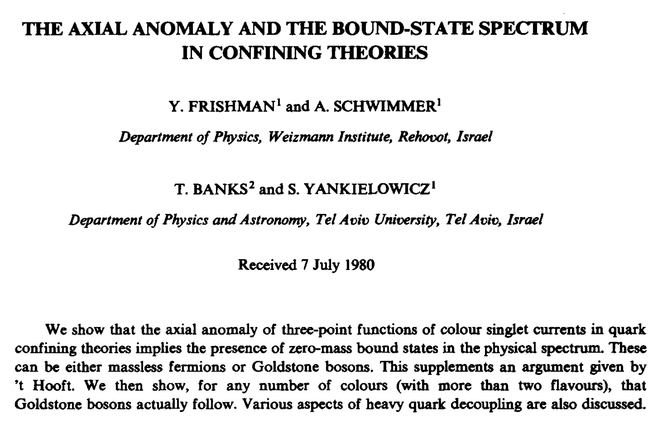
Going around the no-go theorems
It is impossible to realize exact lattice chiral symmetries using lattice fermions.
… unless we use lattice bosons.
Chiral symmetries in bosonic 1+1d lattice models [Sulejmanpasic-Gattringer, Gorantla-Lam-Seiberg-SHS,…, Cheng-Seiberg, Fazza-Sulejmanpasic, Seifnashri].
But in 3+1d?
difficult because of
Nielsen-Ninomiya

Slide 8
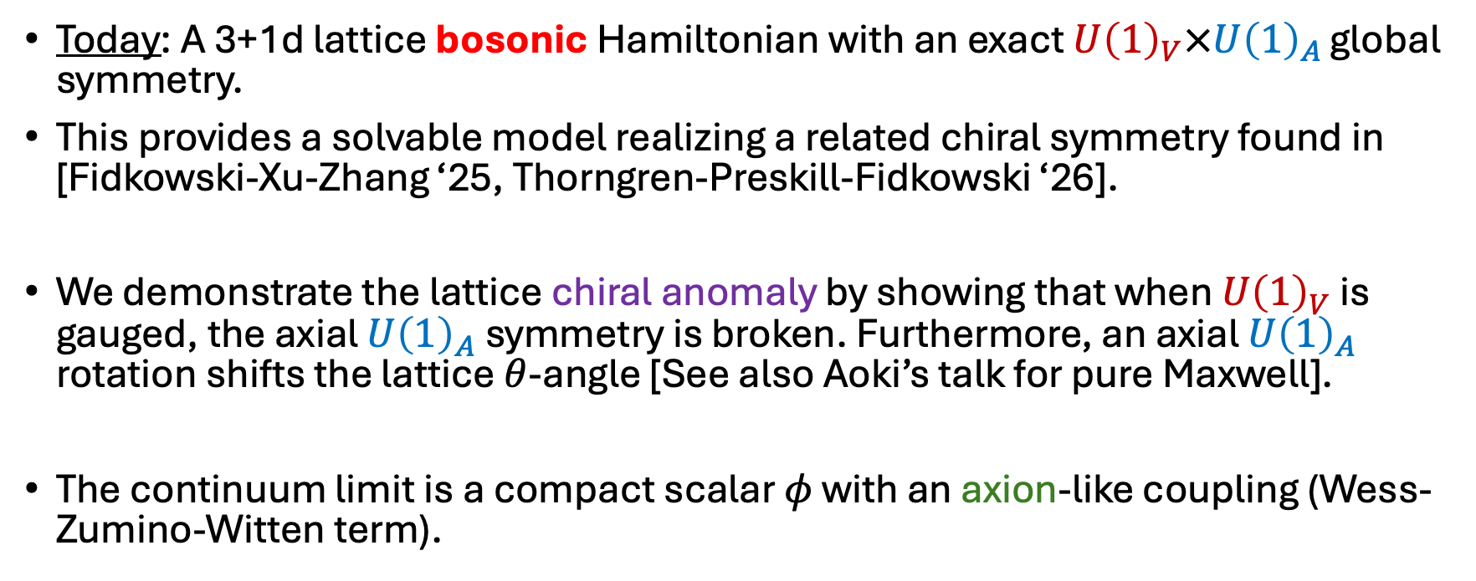
Chiral symmetry from lattice bosons
$$U{\left(1\right)}_{A}$$
$$U{\left(1\right)}_{V}$$
$$U{\left(1\right)}_{V}$$
Today: A 3+1d lattice bosonic Hamiltonian with an exact $U{\left(1\right)}_{V}×U{\left(1\right)}_{A}$ global symmetry.
This provides a solvable model realizing a related chiral symmetry found in [Fidkowski-Xu-Zhang ‘25, Thorngren-Preskill-Fidkowski ‘26].
We demonstrate the lattice chiral anomaly by showing that when $U{\left(1\right)}_{V}$ is gauged, the axial $U{\left(1\right)}_{A}$ symmetry is broken. Furthermore, an axial $U{\left(1\right)}_{A}$ rotation shifts the lattice $θ$-angle [See also Aoki’s talk for pure Maxwell].
The continuum limit is a compact scalar $φ$ with an axion-like coupling (Wess-Zumino-Witten term).

Slide 9
A solvable model

Slide 10
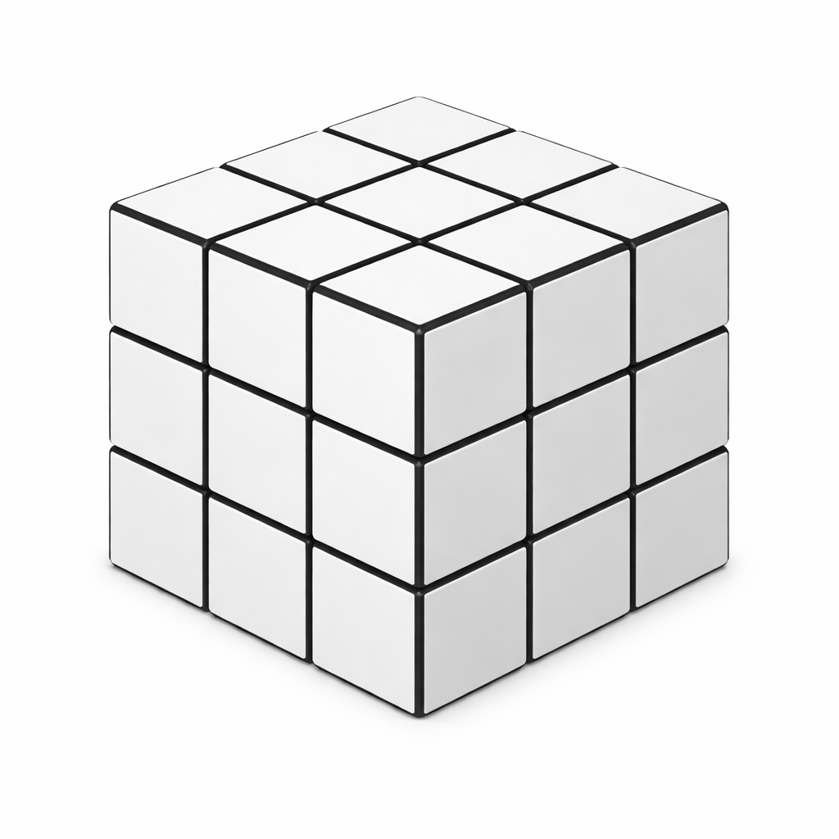
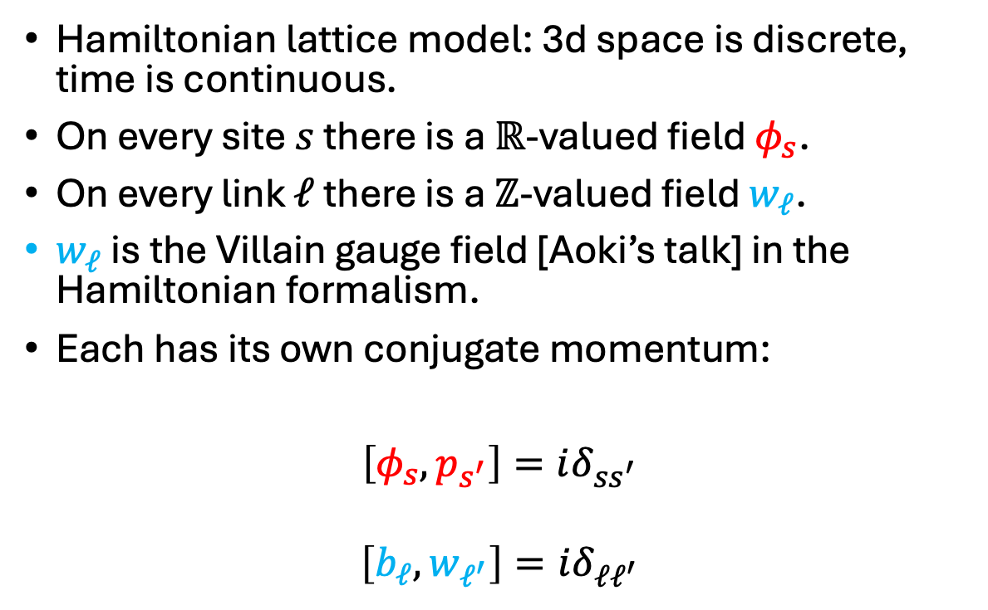


Lattice fields
Hamiltonian lattice model: 3d space is discrete, time is continuous.
On every site $s$ there is a $ℝ$-valued field $φ_{s}$.
On every link $ℓ$ there is a $ℤ$-valued field $w_{ℓ}$.
$w_{ℓ}$ is the Villain gauge field [Aoki’s talk] in the Hamiltonian formalism.
Each has its own conjugate momentum:
$\left[φ_{s},p_{s^{′}}\right]=iδ_{ss^{′}}$
$$\left[b_{ℓ},w_{ℓ^{′}}\right]=iδ_{ℓℓ^{′}}$$
$$φ_{s},p_{s}$$
$$w_{ℓ},b_{ℓ}$$

Slide 11
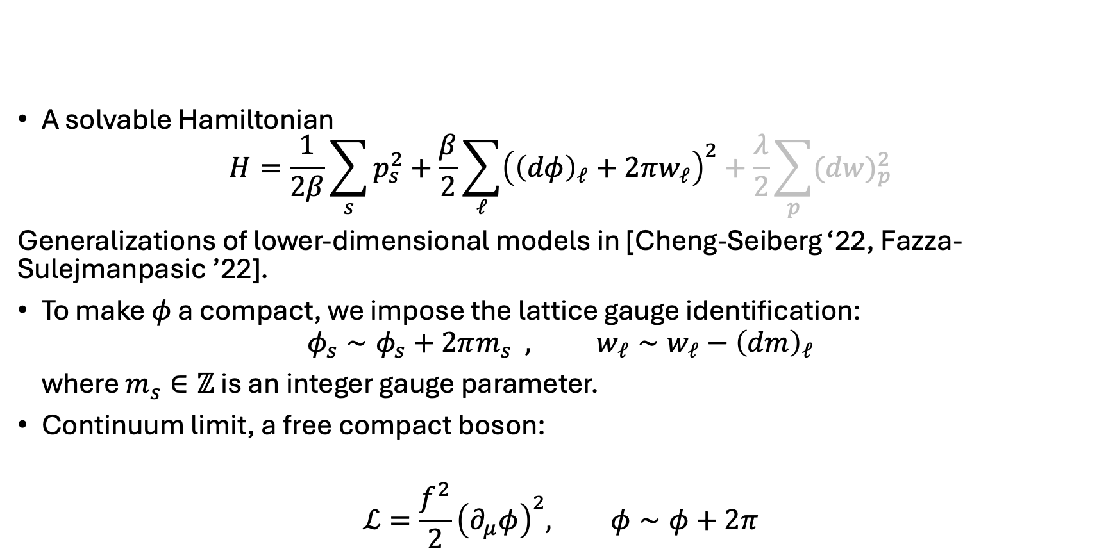


A solvable Hamiltonian
[Lu-Seifnashri-SHS]
$$φ_{s},p_{s}$$
A solvable Hamiltonian
$$H=\frac{1}{2β}\sum_{s}{p_{s}^{2}}+\frac{β}{2}\sum_{ℓ}{{\left({\left(dφ\right)}_{ℓ}+2πw_{ℓ}\right)}^{2}}+\frac{λ}{2}\sum_{p}{{(dw)}_{p}^{2}}$$
Generalizations of lower-dimensional models in [Cheng-Seiberg ‘22, Fazza-Sulejmanpasic ’22].
To make $φ$ a compact, we impose the lattice gauge identification:
$$φ_{s}∼φ_{s}+2πm_{s} , w_{ℓ}∼w_{ℓ}−{\left(dm\right)}_{ℓ}$$
where $m_{s}∈ℤ$ is an integer gauge parameter.
Continuum limit, a free compact boson:
$$ℒ=\frac{f^{2}}{2}{\left(∂_{μ}φ\right)}^{2}, φ∼φ+2π$$
$$w_{ℓ},b_{ℓ}$$

Slide 12
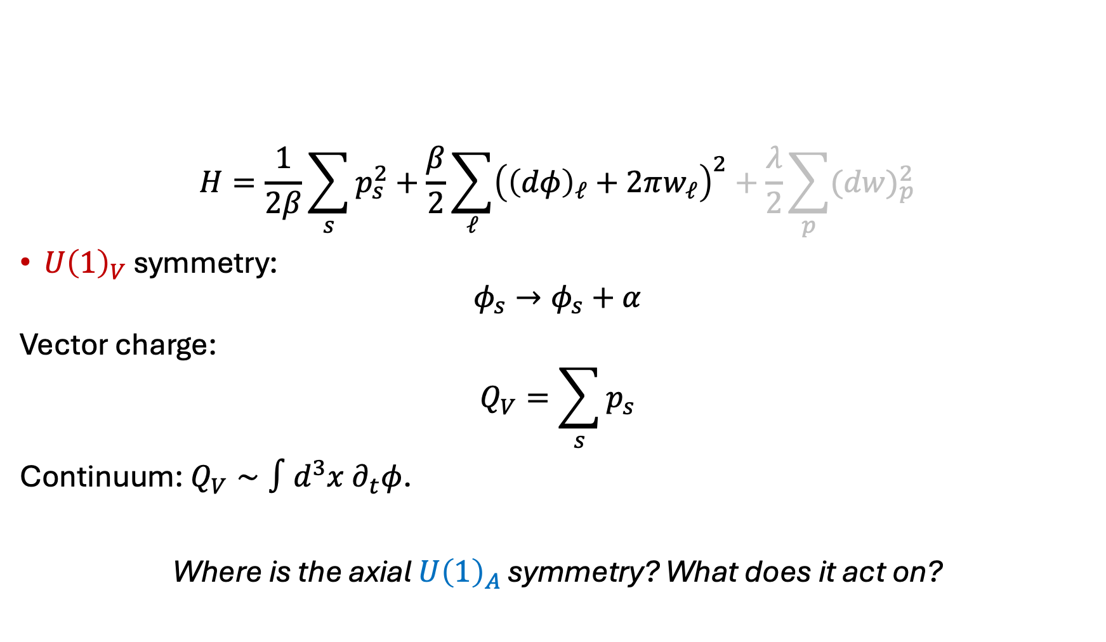

Global symmetries
$$φ_{s},p_{s}$$
$$H=\frac{1}{2β}\sum_{s}{p_{s}^{2}}+\frac{β}{2}\sum_{ℓ}{{\left({\left(dφ\right)}_{ℓ}+2πw_{ℓ}\right)}^{2}}+\frac{λ}{2}\sum_{p}{{(dw)}_{p}^{2}}$$
$U{\left(1\right)}_{V}$ symmetry:
$$φ_{s}→φ_{s}+α$$
Vector charge:
$$Q_{V}=\sum_{s}{p_{s}}$$
Continuum: $Q_{V}∼∫d^{3}x ∂_{t}φ$.
Where is the axial $U{\left(1\right)}_{A}$ symmetry? What does it act on?
$$w_{ℓ},b_{ℓ}$$

Slide 13
Lattice chiral symmetry

Slide 14
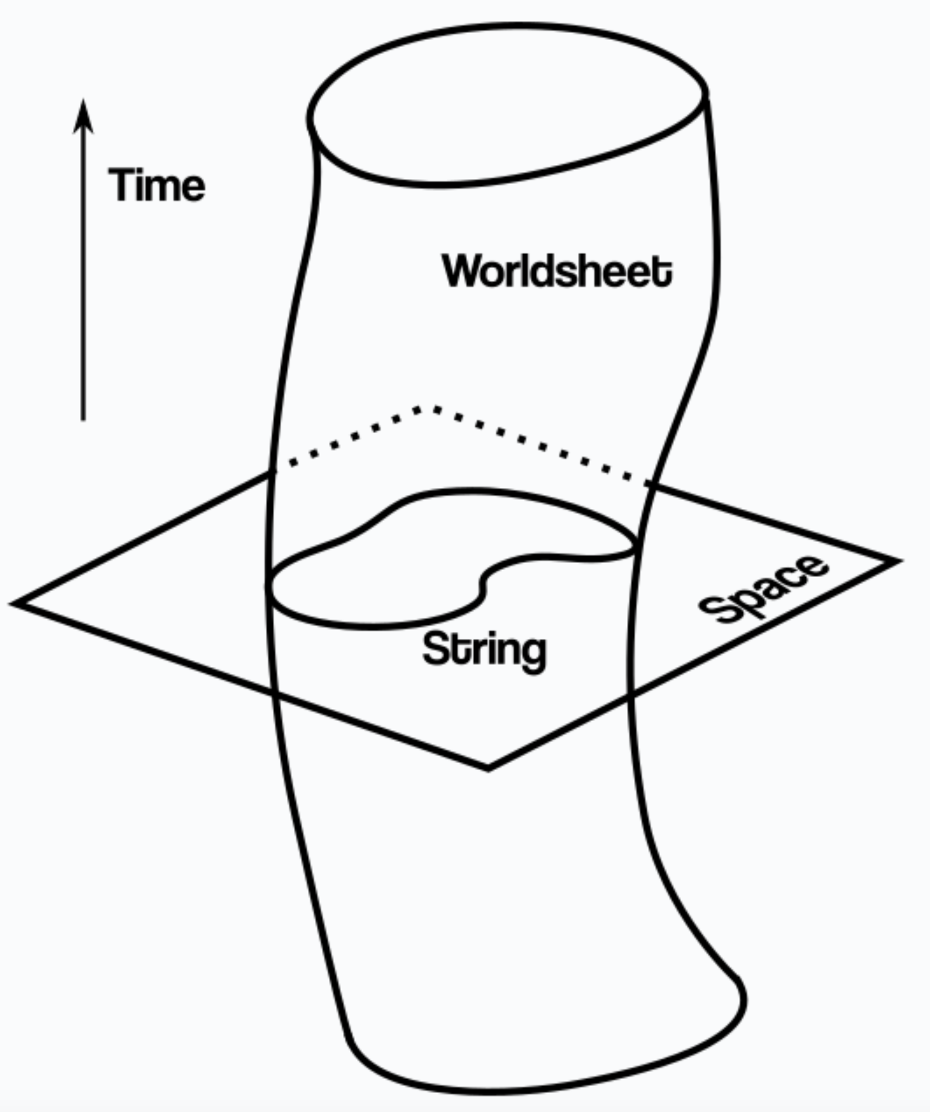
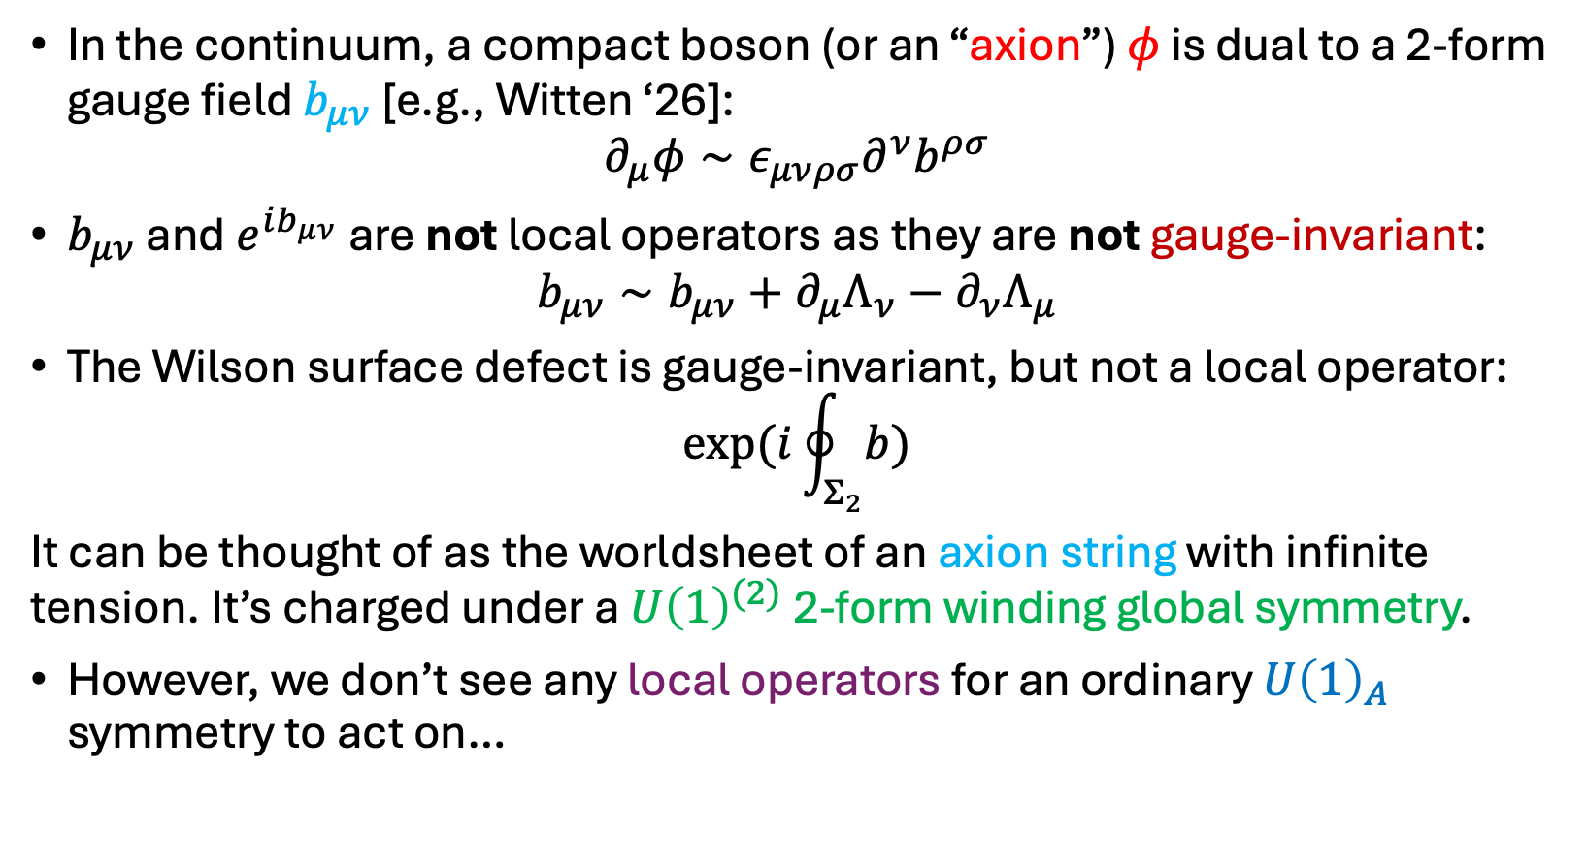
Axion string in the continuum
In the continuum, a compact boson (or an “axion”) $φ$ is dual to a 2-form gauge field $b_{μν}$ [e.g., Witten ‘26]:
$$∂_{μ}φ∼ε_{μνρσ}∂^{ν}b^{ρσ}$$
$b_{μν}$ and $e^{ib_{μν}}$ are not local operators as they are not gauge-invariant:
$$b_{μν}∼b_{μν}+∂_{μ}Λ_{ν}−∂_{ν}Λ_{μ}$$
The Wilson surface defect is gauge-invariant, but not a local operator:
$$\exp{(i\oint_{Σ_{2}}{b})}$$
It can be thought of as the worldsheet of an axion string with infinite tension. It’s charged under a $U{\left(1\right)}^{(2)}$ 2-form winding global symmetry.
However, we don’t see any local operators for an ordinary $U{\left(1\right)}_{A}$ symmetry to act on…

Slide 15
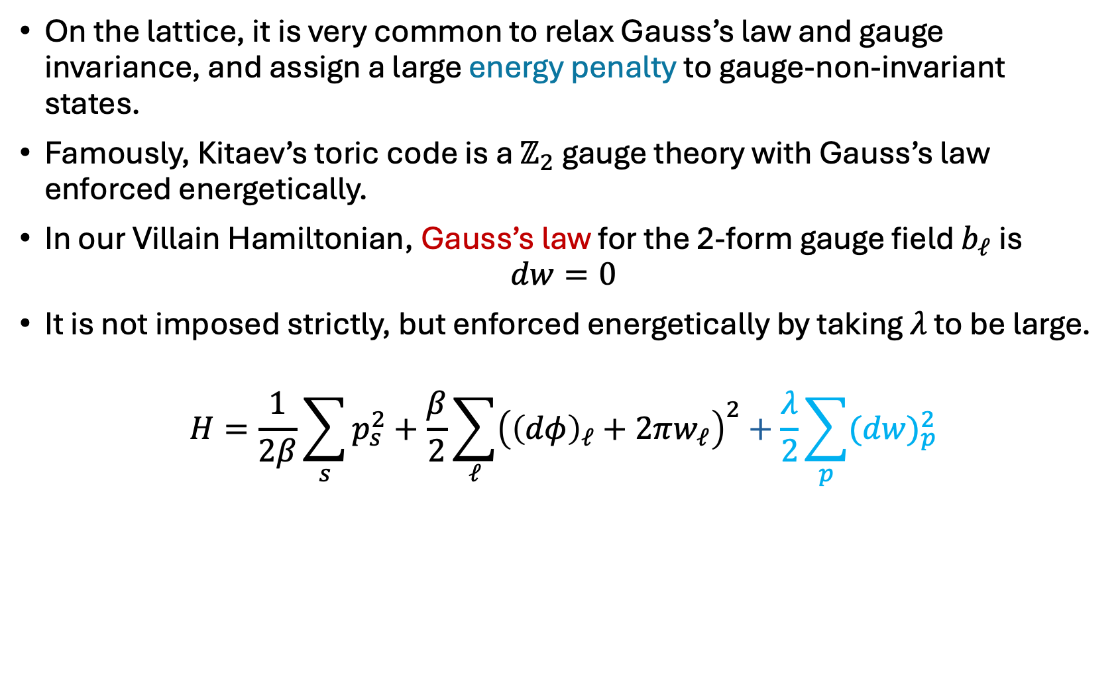


Relaxing Gauss’s law
[Lu-Seifnashri-SHS]
$$φ_{s},p_{s}$$
$$w_{ℓ},b_{ℓ}$$
On the lattice, it is very common to relax Gauss’s law and gauge invariance, and assign a large energy penalty to gauge-non-invariant states.
Famously, Kitaev’s toric code is a $ℤ_{2}$ gauge theory with Gauss’s law enforced energetically.
In our Villain Hamiltonian, Gauss’s law for the 2-form gauge field $b_{ℓ}$ is
$$dw=0$$
It is not imposed strictly, but enforced energetically by taking $λ$ to be large.
$$H=\frac{1}{2β}\sum_{s}{p_{s}^{2}}+\frac{β}{2}\sum_{ℓ}{{\left({\left(dφ\right)}_{ℓ}+2πw_{ℓ}\right)}^{2}}+\frac{λ}{2}\sum_{p}{{(dw)}_{p}^{2}}$$

Slide 16

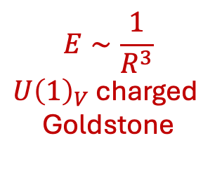

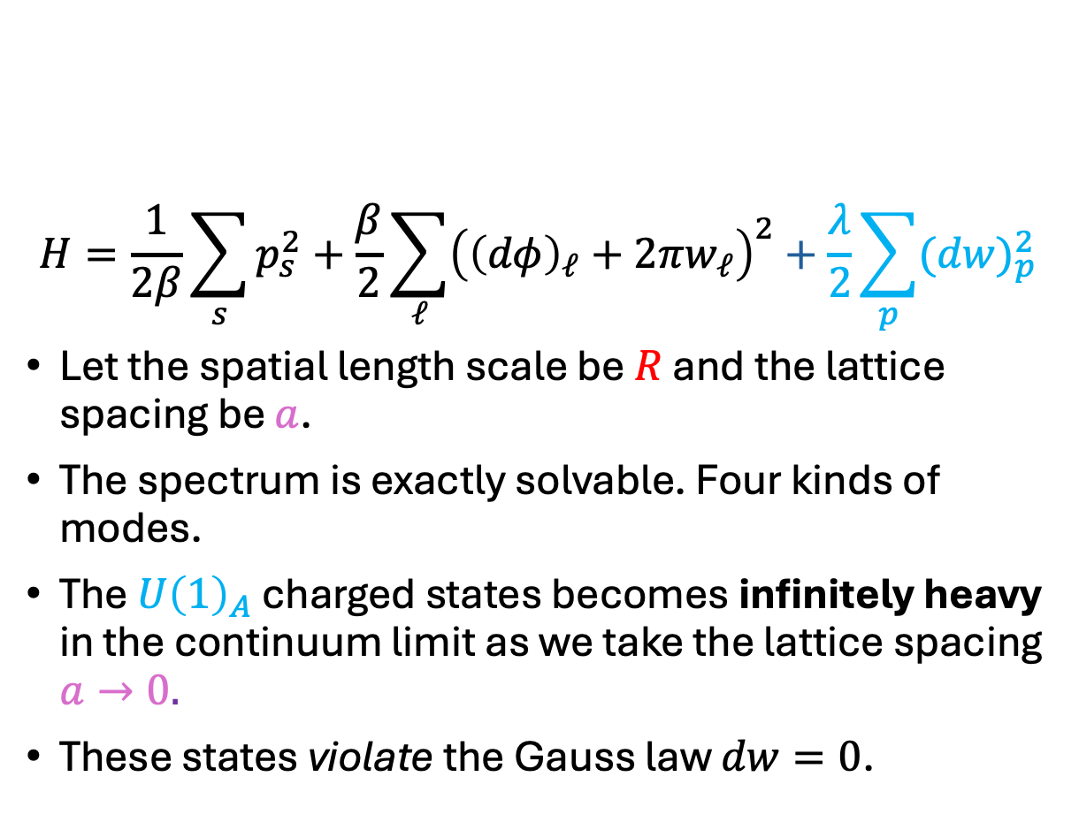
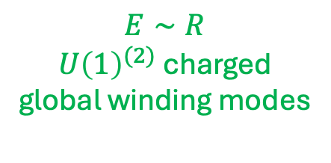
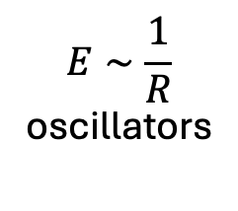
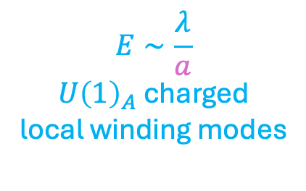
A solvable spectrum
[Lu-Seifnashri-SHS]
$$E$$
$$E∼\frac{λ}{a}$$
$U{\left(1\right)}_{A}$ charged
local winding modes
$$dw≠0$$
$$H=\frac{1}{2β}\sum_{s}{p_{s}^{2}}+\frac{β}{2}\sum_{ℓ}{{\left({\left(dφ\right)}_{ℓ}+2πw_{ℓ}\right)}^{2}}+\frac{λ}{2}\sum_{p}{{(dw)}_{p}^{2}}$$
Let the spatial length scale be $R$ and the lattice spacing be $a$.
The spectrum is exactly solvable. Four kinds of modes.
The $U{\left(1\right)}_{A}$ charged states becomes infinitely heavy in the continuum limit as we take the lattice spacing $a→0.$
These states violate the Gauss law $dw=0$.
$$E∼R$$
$U{\left(1\right)}^{(2)}$ charged
global winding modes
$$E∼\frac{1}{R}$$
oscillators
$$E∼\frac{1}{R^{3}}$$
$U{\left(1\right)}_{V}$ charged
Goldstone
$β$ dependence is suppressed. It needs to be scaled wrt $a$.

Slide 17
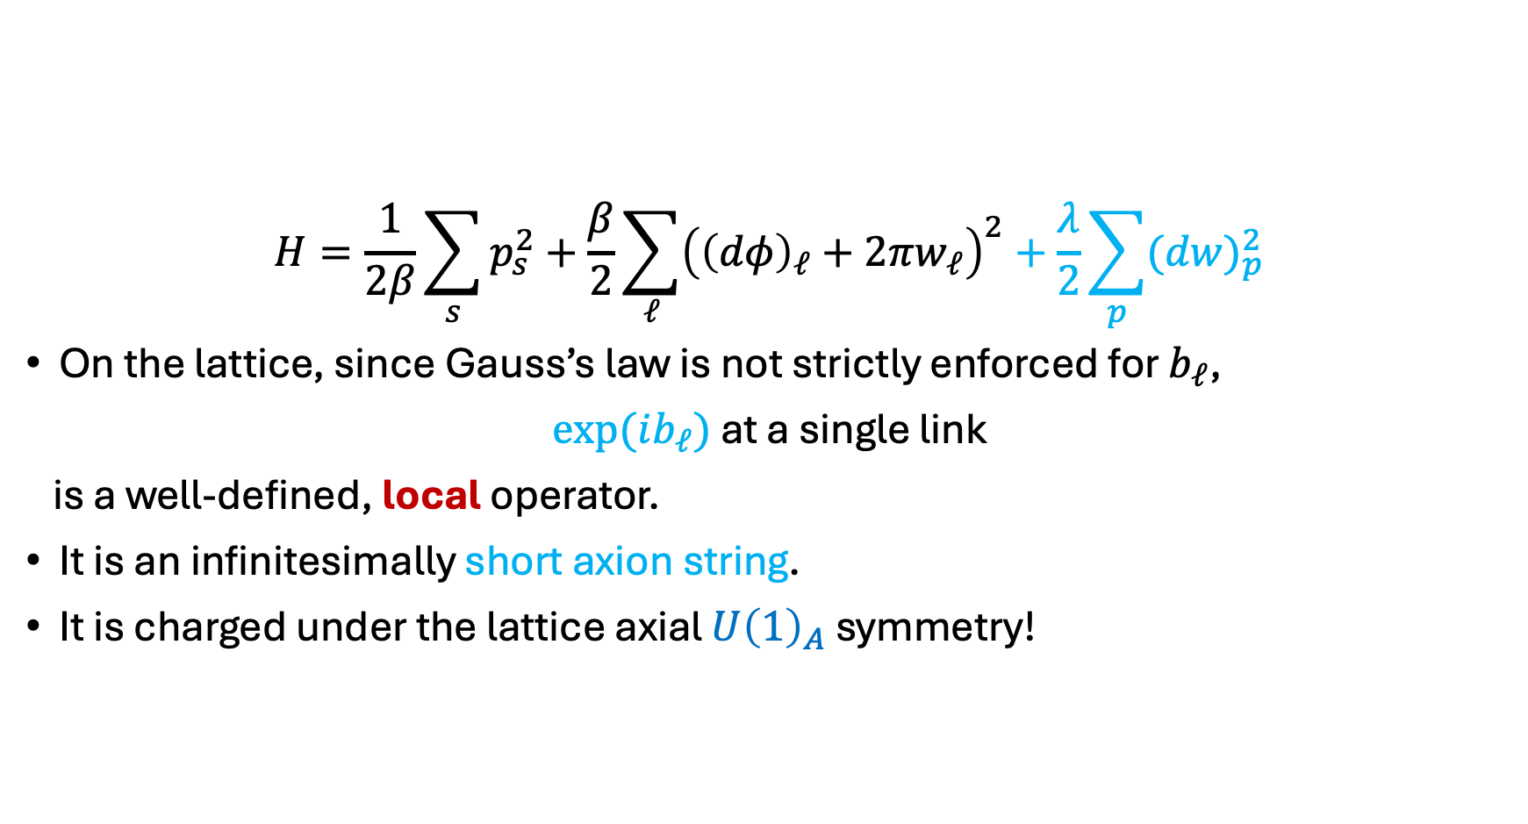

Short axion string
[Lu-Seifnashri-SHS]
$$H=\frac{1}{2β}\sum_{s}{p_{s}^{2}}+\frac{β}{2}\sum_{ℓ}{{\left({\left(dφ\right)}_{ℓ}+2πw_{ℓ}\right)}^{2}}+\frac{λ}{2}\sum_{p}{{(dw)}_{p}^{2}}$$
On the lattice, since Gauss’s law is not strictly enforced for $b_{ℓ}$,
$\exp{(ib_{ℓ})}$ at a single link
is a well-defined, local operator.
It is an infinitesimally short axion string.
It is charged under the lattice axial $U{\left(1\right)}_{A}$ symmetry!
$$\exp{(ib_{ℓ})}$$

Slide 18

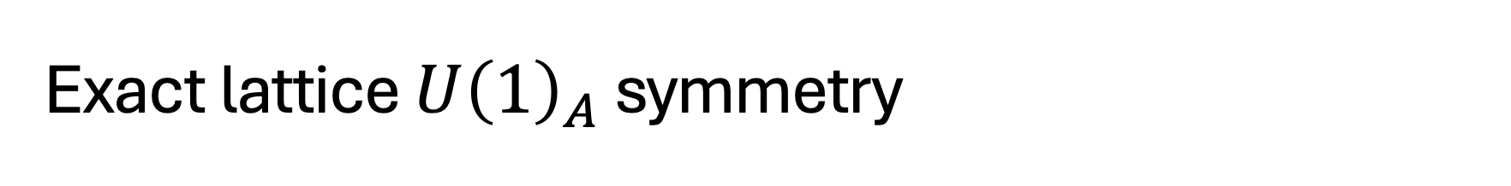
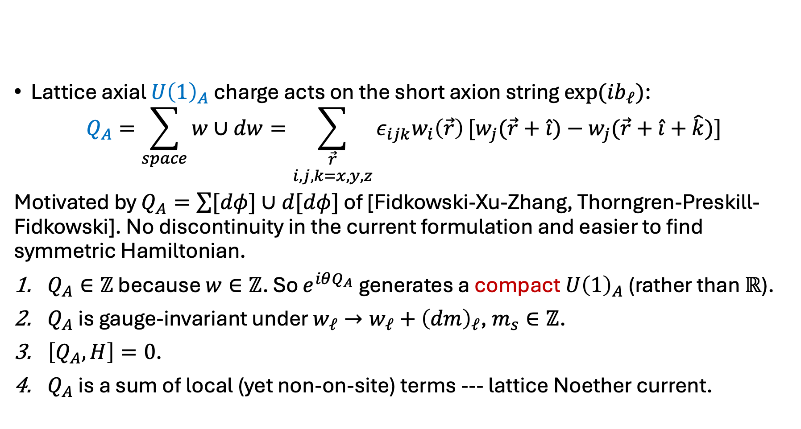
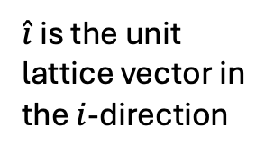
Exact lattice $U{\left(1\right)}_{A}$ symmetry
$$φ_{s},p_{s}$$
$\hat{i}$ is the unit lattice vector in the $i$-direction
$$w_{ℓ},b_{ℓ}$$
Lattice axial $U{\left(1\right)}_{A}$ charge acts on the short axion string ${\exp{(ib}}_{ℓ})$:
$$Q_{A}=\sum_{space}{w∪dw}=\sum_{\begin{aligned}\vec{r} \\ i,j,k=x,y,z\end{aligned}}{ε_{ijk}w_{i}\left(\vec{r}\right)}[w_{j}(\vec{r}+\hat{i})−w_{j}(\vec{r}+\hat{i}+\hat{k})]$$
Motivated by $Q_{A}=\sum{[dφ]∪d[dφ]}$ of [Fidkowski-Xu-Zhang, Thorngren-Preskill-Fidkowski]. No discontinuity in the current formulation and easier to find symmetric Hamiltonian.
$Q_{A}∈ℤ$ because $w∈ℤ$. So $e^{iθQ_{A}}$ generates a compact $U{\left(1\right)}_{A}$ (rather than $ℝ$).
$Q_{A}$ is gauge-invariant under $w_{ℓ}→w_{ℓ}+{\left(dm\right)}_{ℓ}$, $m_{s}∈ℤ$.
$\left[Q_{A},H\right]=0$.
$Q_{A}$ is a sum of local (yet non-on-site) terms --- lattice Noether current.
$[x]$=closest integer to $x$
Notes:
Not graded commutative at the cochain level

Slide 19








Locality-preserving symmetry
[Lu-Seifnashri-SHS]
The lattice axial $U{\left(1\right)}_{A}$ symmetry is locality-preserving. It maps a short axion string to local operators:
$$\left[Q_{A},e^{ib_{ℓ}}\right]=\left({\left(dw\right)}_{ℓ+(\frac{1}{2},\frac{1}{2},\frac{1}{2})}+ {\left(dw\right)}_{ℓ−(\frac{1}{2},\frac{1}{2},\frac{1}{2})}\right) e^{ib_{ℓ}}$$
The axial charge of the string depends on the vortices nearby. It acts as a controlled gate.
$$dw$$
$$e^{ib_{ℓ}}$$
$$ℓ_{3}$$
$$ℓ_{2}$$
$$dw$$
$$=w_{ℓ_{1}}+w_{ℓ_{2}}+w_{ℓ_{3}}+w_{ℓ_{4}}$$
$$dw$$
$$ℓ_{4}$$
$$ℓ_{1}$$
Orientation arrows
not shown.
Notes:
Ultra-local

Slide 20
Lattice chiral anomaly

Slide 21






Anomalies of a massless electron
$$U{\left(1\right)}_{V}: Ψ→e^{iθ}Ψ$$
$U{\left(1\right)}_{A}: Ψ→e^{iγ^{5}θ}Ψ$
$$U{\left(1\right)}_{A}$$
$$U{\left(1\right)}_{A}$$
$$U{\left(1\right)}_{A}$$
$$U{\left(1\right)}_{V}$$
$$U{\left(1\right)}_{V}$$
$$U{\left(1\right)}_{A}$$
$$U{\left(1\right)}_{A}$$
grav
grav

Slide 22
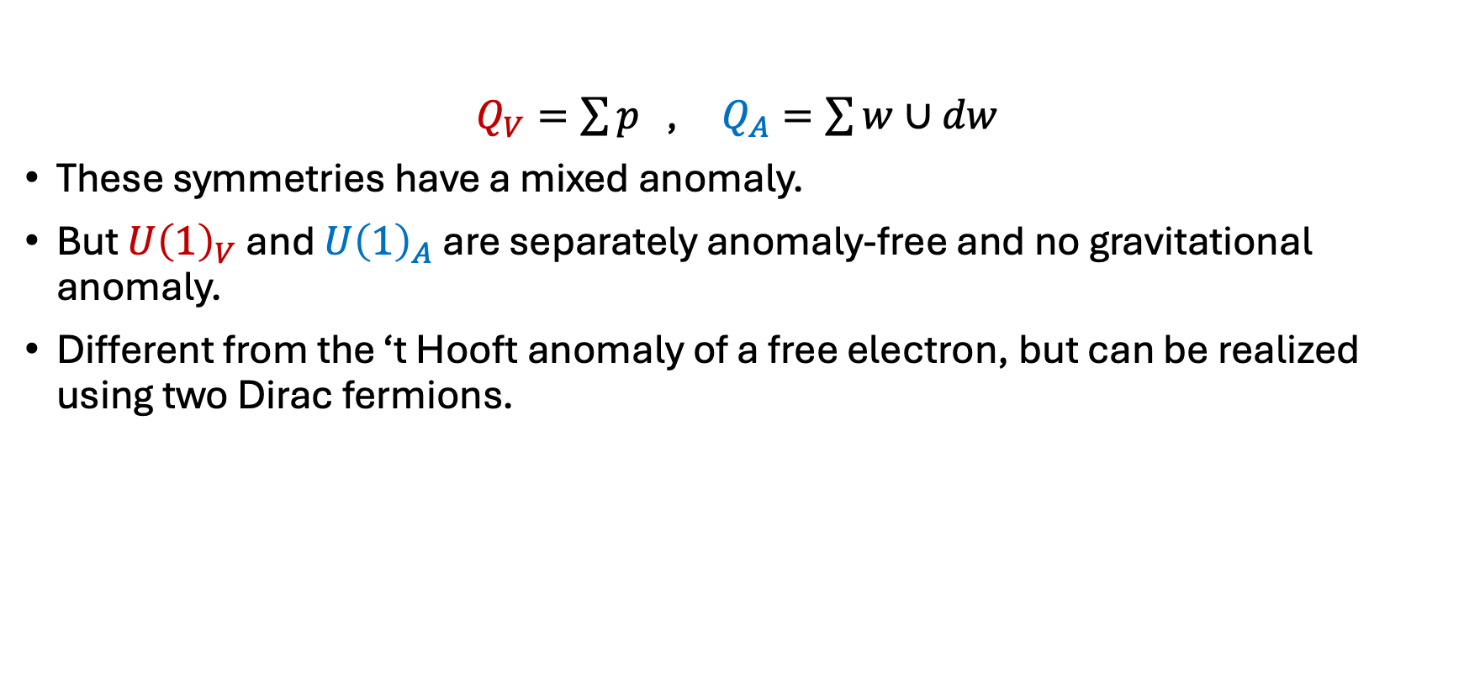

Lattice chiral anomaly
 | $$ψ^{1}$$ | $$ψ^{2}$$ | $$ψ^{3}$$ | $$ψ^{4}$$
$$U{\left(1\right)}_{V}$$ | 1 | -1 | 0 | 0
$$U{\left(1\right)}_{A}$$ | 1 | 1 | -1 | -1
[Cordova-Dumitrescu-Intriligator ‘18]
$Q_{V}=\sum{p}$ , $Q_{A}=\sum{w∪dw}$
These symmetries have a mixed anomaly.
But $U{\left(1\right)}_{V}$ and $U{\left(1\right)}_{A}$ are separately anomaly-free and no gravitational anomaly.
Different from the ‘t Hooft anomaly of a free electron, but can be realized using two Dirac fermions.
$$U{\left(1\right)}_{A}$$
$$U{\left(1\right)}_{A}$$
$$U{\left(1\right)}_{A}$$
$$U{\left(1\right)}_{V}$$
$$U{\left(1\right)}_{V}$$
$$U{\left(1\right)}_{A}$$
$$U{\left(1\right)}_{A}$$
grav
grav

Slide 23
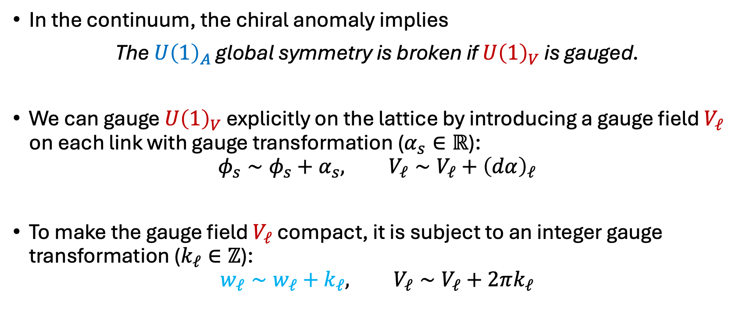
Lattice chiral anomaly
$$U{\left(1\right)}_{A}$$
$$φ_{s},p_{s}$$
$$w_{ℓ},b_{ℓ}$$
$$U{\left(1\right)}_{V}$$
$$U{\left(1\right)}_{V}$$
In the continuum, the chiral anomaly implies
The $U{\left(1\right)}_{A}$ global symmetry is broken if $U{\left(1\right)}_{V}$ is gauged.
We can gauge $U{\left(1\right)}_{V}$ explicitly on the lattice by introducing a gauge field $V_{ℓ}$ on each link with gauge transformation ($α_{s}∈ℝ$):
$$φ_{s}∼φ_{s}+α_{s}, V_{ℓ}∼V_{ℓ}+{\left(dα\right)}_{ℓ}$$
To make the gauge field $V_{ℓ}$ compact, it is subject to an integer gauge transformation ($k_{ℓ}∈ℤ$):
$$w_{ℓ}∼w_{ℓ}+k_{ℓ}, V_{ℓ}∼V_{ℓ}+2πk_{ℓ}$$

Slide 24

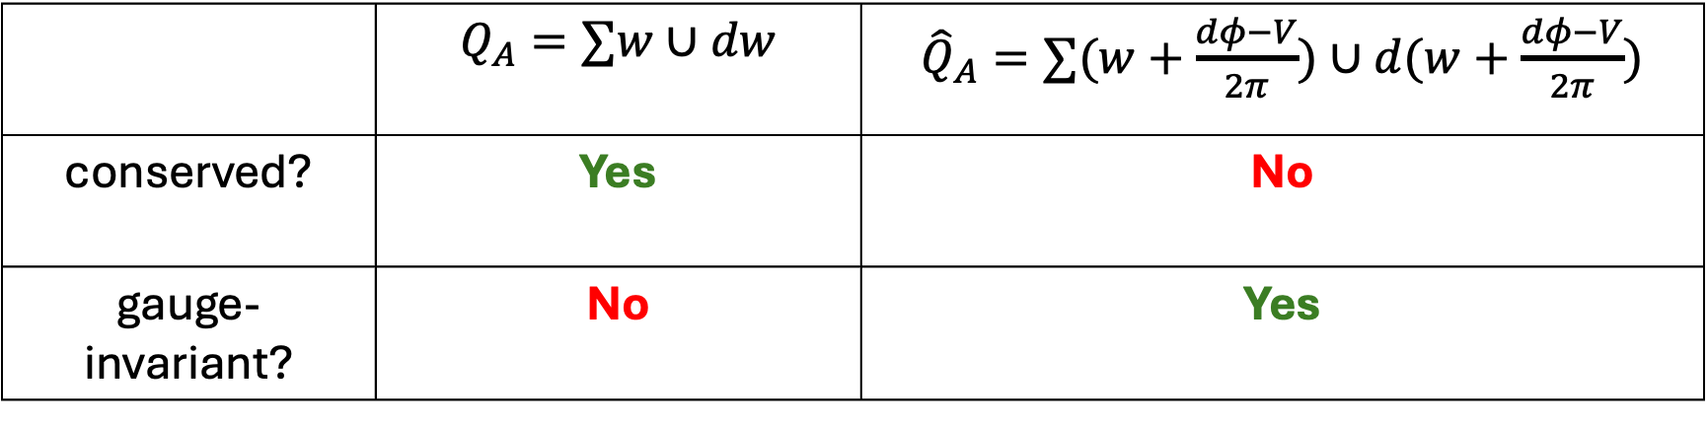
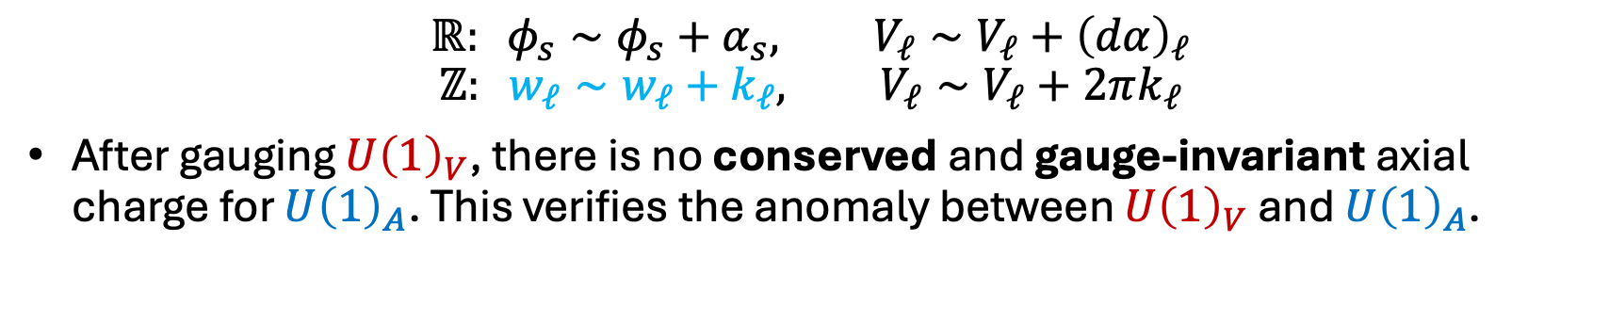
Chiral anomaly on the lattice
$$ℝ: φ_{s}∼φ_{s}+α_{s}, V_{ℓ}∼V_{ℓ}+{\left(dα\right)}_{ℓ}$$
$$ℤ: w_{ℓ}∼w_{ℓ}+k_{ℓ}, V_{ℓ}∼V_{ℓ}+2πk_{ℓ}$$
After gauging $U{\left(1\right)}_{V}$, there is no conserved and gauge-invariant axial charge for $U{\left(1\right)}_{A}$. This verifies the anomaly between $U{\left(1\right)}_{V}$ and $U{\left(1\right)}_{A}$.
 | $Q_{A}=∑w∪dw$ | ${\hat{Q}}_{A}=∑(w+\frac{dφ−V}{2π})∪d(w+\frac{dφ−V}{2π})$
conserved? | Yes | No
gauge-invariant? | No | Yes
$$w_{ℓ}∈ℤ$$

Slide 25
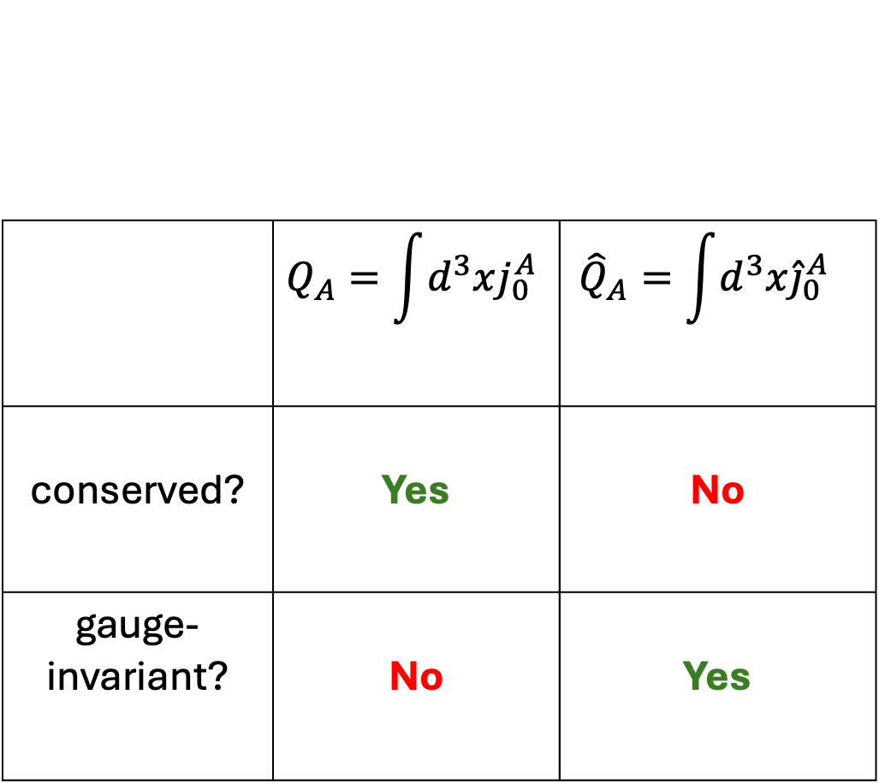
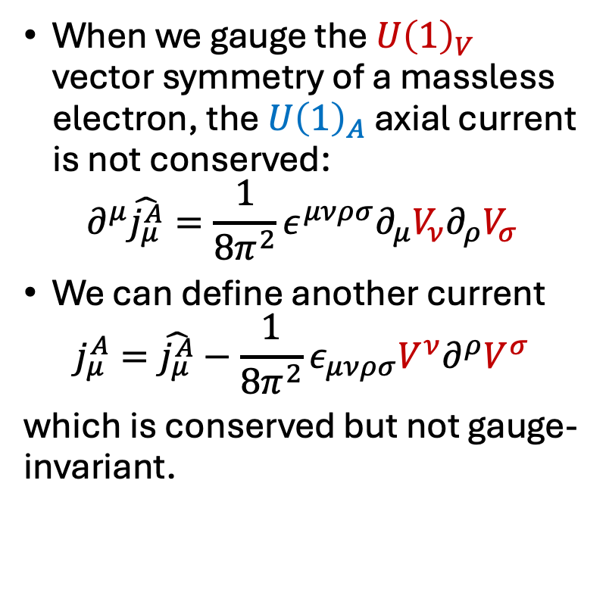
Chiral anomaly in the continuum
When we gauge the $U{\left(1\right)}_{V}$ vector symmetry of a massless electron, the $U{\left(1\right)}_{A}$ axial current is not conserved:
$$∂^{μ}\hat{j_{μ}^{A}}=\frac{1}{{8π}^{2}}ε^{μνρσ}∂_{μ}V_{ν}∂_{ρ}V_{σ}$$
We can define another current
$$j_{μ}^{A}=\hat{j_{μ}^{A}}−\frac{1}{8π^{2}}ε_{μνρσ}V^{ν}∂^{ρ}V^{σ}$$
which is conserved but not gauge-invariant.
 | $$Q_{A}=\int{d^{3}xj_{0}^{A}}$$ | $${\hat{Q}}_{A}=\int{d^{3}x{\hat{j}}_{0}^{A}}$$
conserved? | Yes | No
gauge-invariant? | No | Yes

Slide 26
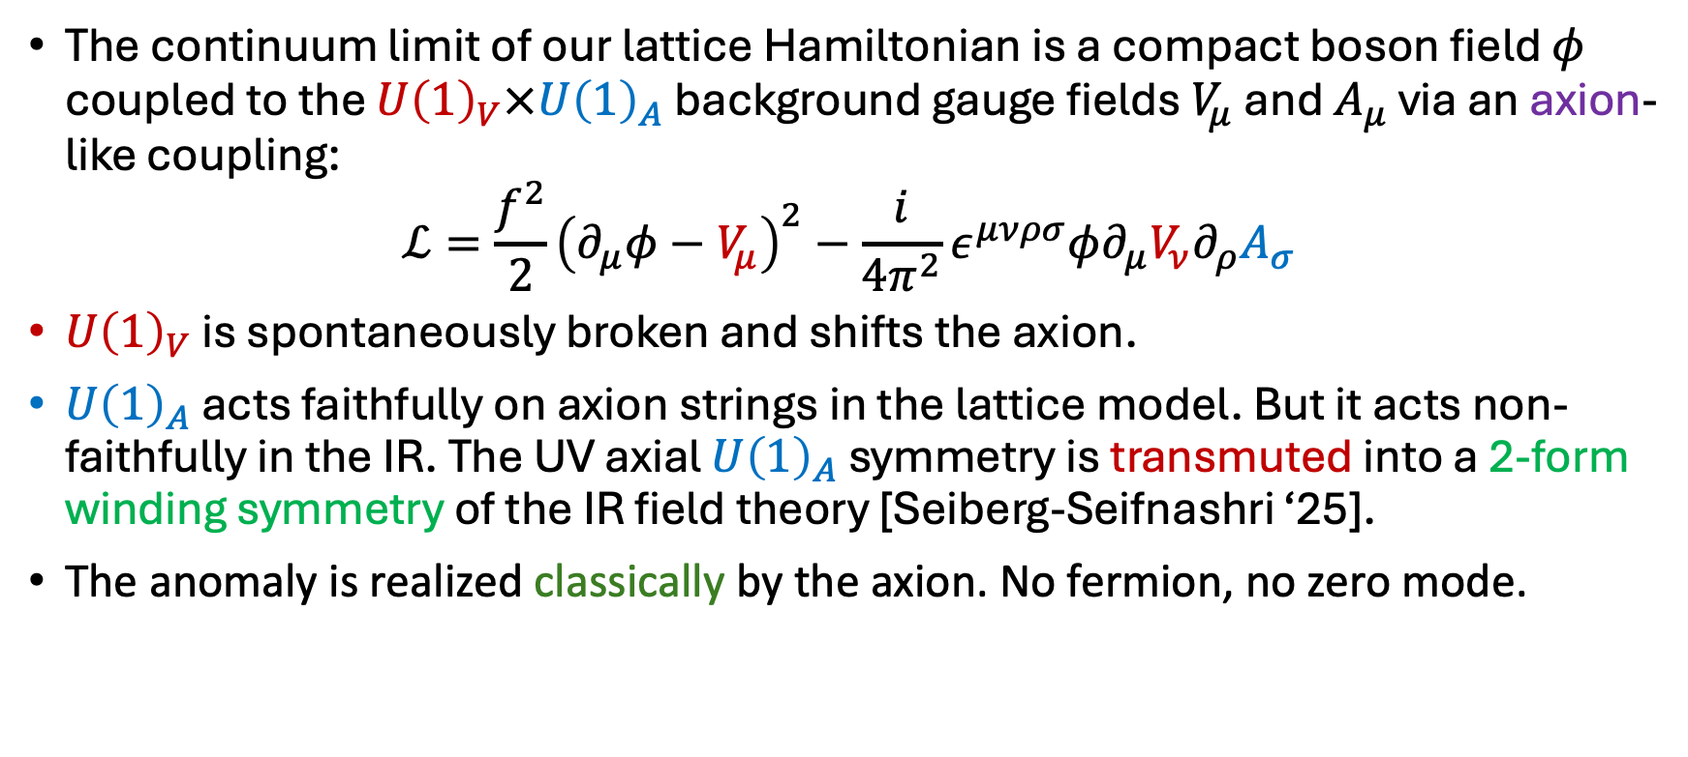
Continuum limit and anomaly-matching
The continuum limit of our lattice Hamiltonian is a compact boson field $φ$ coupled to the $U{\left(1\right)}_{V}×U{\left(1\right)}_{A}$ background gauge fields $V_{μ}$ and $A_{μ}$ via an axion-like coupling:
$$ℒ=\frac{f^{2}}{2}{\left(∂_{μ}φ−V_{μ}\right)}^{2}−\frac{i}{4π^{2}}ε^{μνρσ}φ∂_{μ}V_{ν}∂_{ρ}A_{σ}$$
$U{\left(1\right)}_{V}$ is spontaneously broken and shifts the axion.
$U{\left(1\right)}_{A}$ acts faithfully on axion strings in the lattice model. But it acts non-faithfully in the IR. The UV axial $U{\left(1\right)}_{A}$ symmetry is transmuted into a 2-form winding symmetry of the IR field theory [Seiberg-Seifnashri ‘25].
The anomaly is realized classically by the axion. No fermion, no zero mode.
Notes:
Can be viewed as a WZW term if embedded into nonabelian theory.

Slide 27





Generalized global symmetries
Anomalies often lead to generalized symmetries upon gauging.
Villain Hamiltonian is a perfect playground for generalized symmetries!
$$U{\left(1\right)}_{A}$$
lattice: [Lu-Seifnashri-SHS]
2-group
continuum:
[Cordova-Dumitrescu-Intriligator ‘18]
lattice: [Fidkowski-Xu-Zhang ‘25]
non-invertible symmetry
continuum:
[Choi-Lam-SHS ‘22, Cordova-Ohmori ‘22]
gauge $U{\left(1\right)}_{A}$
gauge $U{\left(1\right)}_{V}$
$$U{\left(1\right)}_{V}$$
$$U{\left(1\right)}_{V}$$

Slide 28
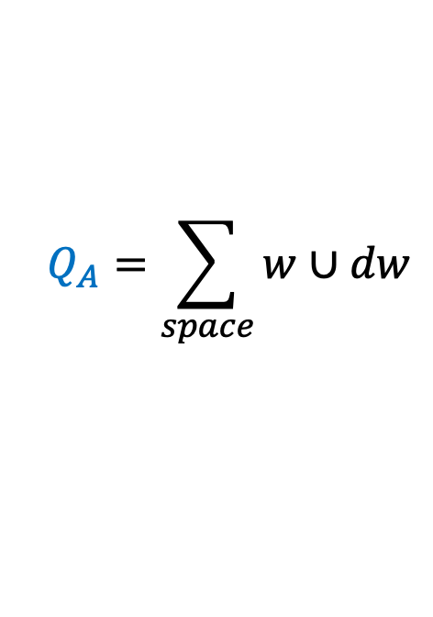
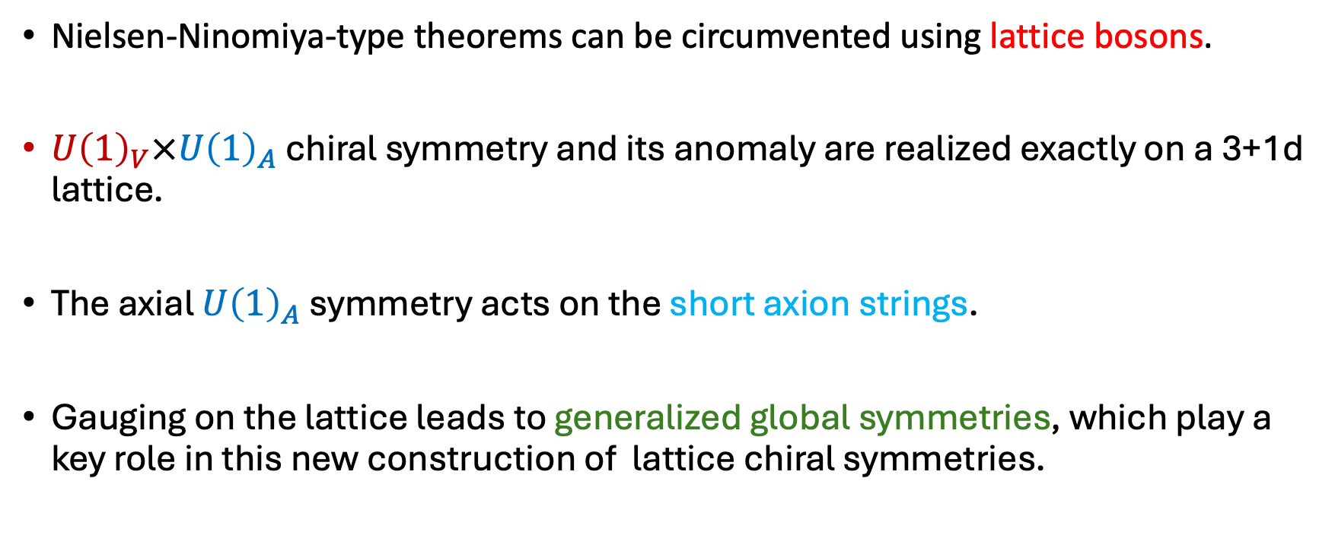
Summary
$$Q_{A}=\sum_{space}{w∪dw}$$
Nielsen-Ninomiya-type theorems can be circumvented using lattice bosons.
$U{\left(1\right)}_{V}×U{\left(1\right)}_{A}$ chiral symmetry and its anomaly are realized exactly on a 3+1d lattice.
The axial $U{\left(1\right)}_{A}$ symmetry acts on the short axion strings.
Gauging on the lattice leads to generalized global symmetries, which play a key role in this new construction of lattice chiral symmetries.

Slide 29
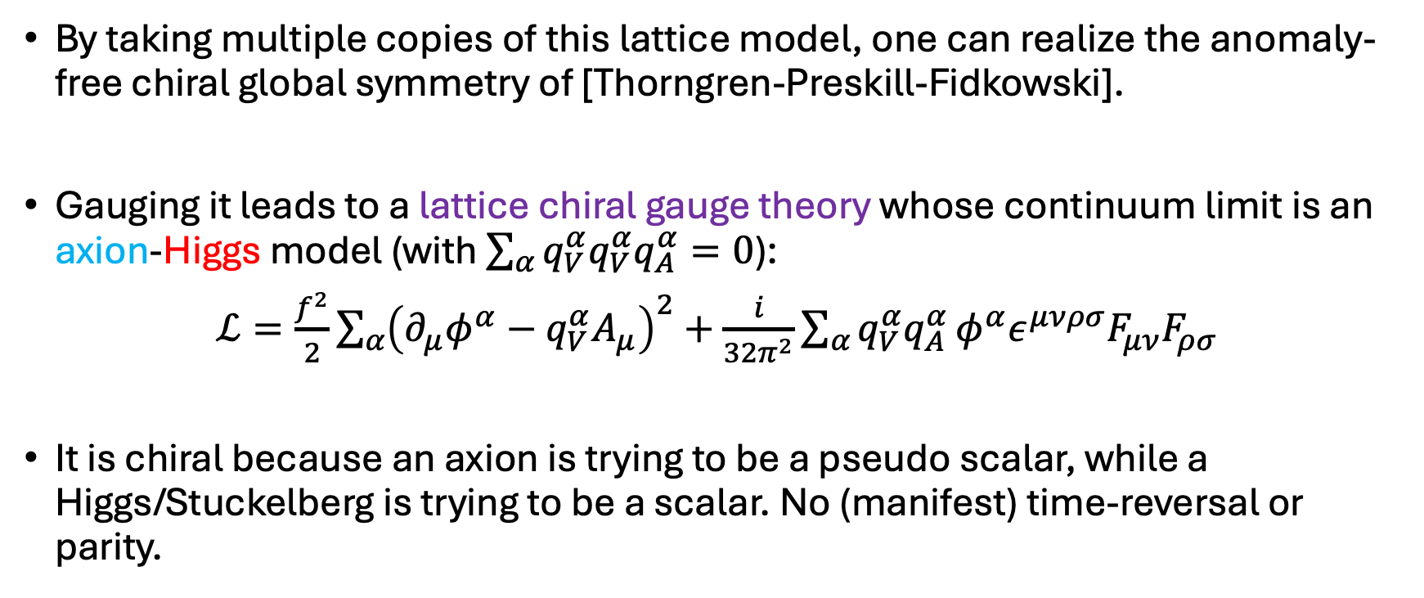
Outlook: New lattice chiral gauge theory?
By taking multiple copies of this lattice model, one can realize the anomaly-free chiral global symmetry of [Thorngren-Preskill-Fidkowski].
Gauging it leads to a lattice chiral gauge theory whose continuum limit is an axion-Higgs model (with $\sum_{α}{q_{V}^{α}q_{V}^{α}q_{A}^{α}=0}$):
$ℒ=\frac{f^{2}}{2}\sum_{α}{{\left(∂_{μ}φ^{α}−q_{V}^{α}A_{μ}\right)}^{2}}+\frac{i}{32π^{2}}\sum_{α}{q_{V}^{α}q_{A}^{α}}φ^{α}ε^{μνρσ}F_{μν}F_{ρσ}$
It is chiral because an axion is trying to be a pseudo scalar, while a Higgs/Stuckelberg is trying to be a scalar. No (manifest) time-reversal or parity.

Slide 30
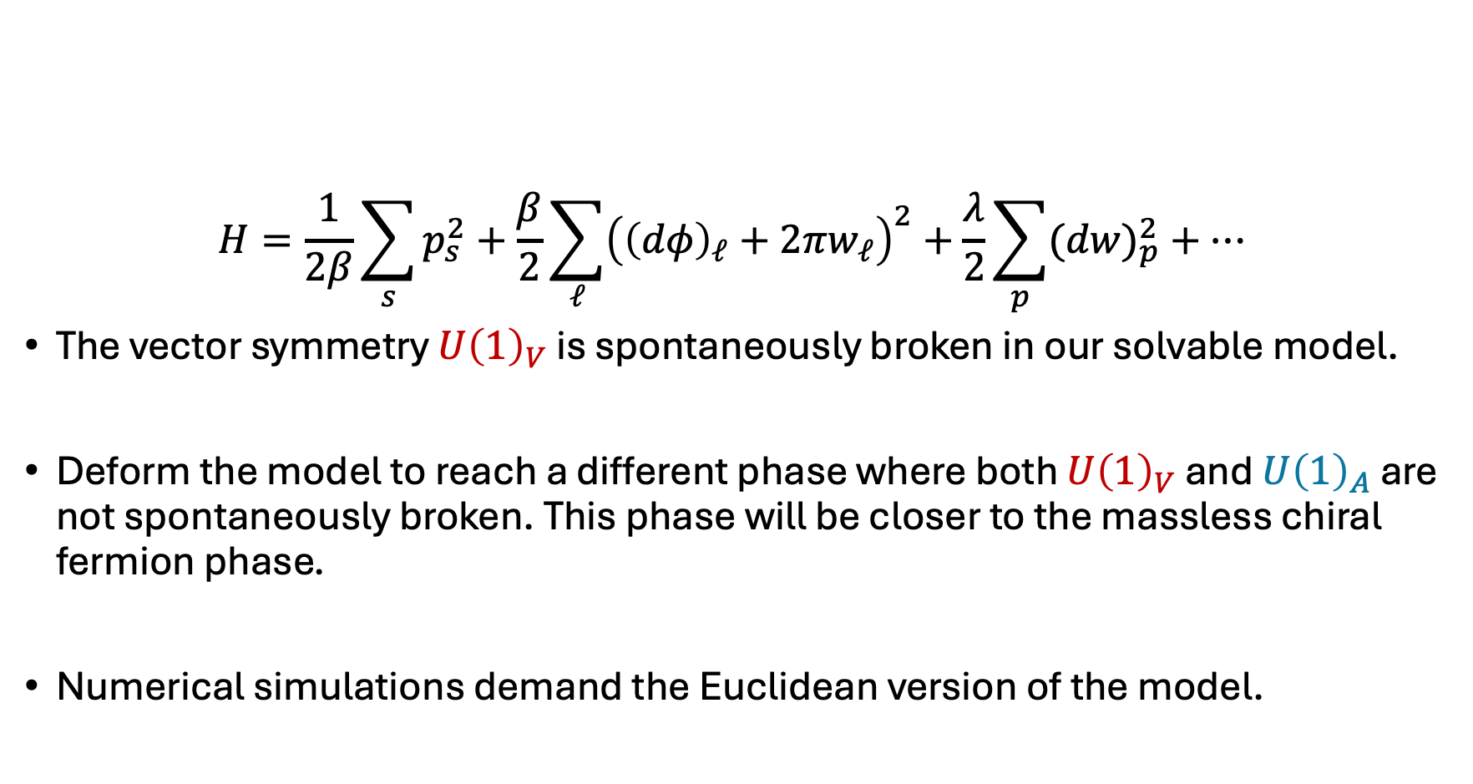
Outlook: New phase
$$H=\frac{1}{2β}\sum_{s}{p_{s}^{2}}+\frac{β}{2}\sum_{ℓ}{{\left({\left(dφ\right)}_{ℓ}+2πw_{ℓ}\right)}^{2}}+\frac{λ}{2}\sum_{p}{{(dw)}_{p}^{2}}+…$$
The vector symmetry $U{\left(1\right)}_{V}$ is spontaneously broken in our solvable model.
Deform the model to reach a different phase where both $U{\left(1\right)}_{V}$ and $U{\left(1\right)}_{A}$ are not spontaneously broken. This phase will be closer to the massless chiral fermion phase.
Numerical simulations demand the Euclidean version of the model.

