Slide 1



Boost invariant solution of dissipative spin hydrodynamic framework and thermal dilepton production
“QCD Critical Point and Hydrodynamic Evolution”
Yukawa institute of theoretical physics , Kyoto University.
1st June – 4th June
Sejal Singh
PhD Scholar BITS Pilani| Sophia University
Based on arXiv:2604.04533
Co-authors: Sourav Dey, Arpan Das, Hiranmaya Mishra, Amaresh Jaiswal
1/20

Slide 2
Why Spin Hydrodynamics?
2/20

Slide 3
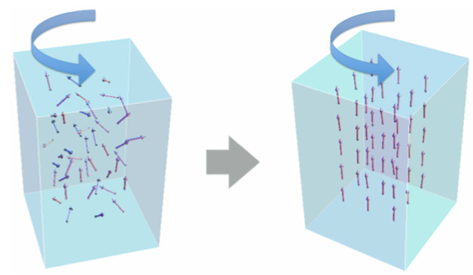
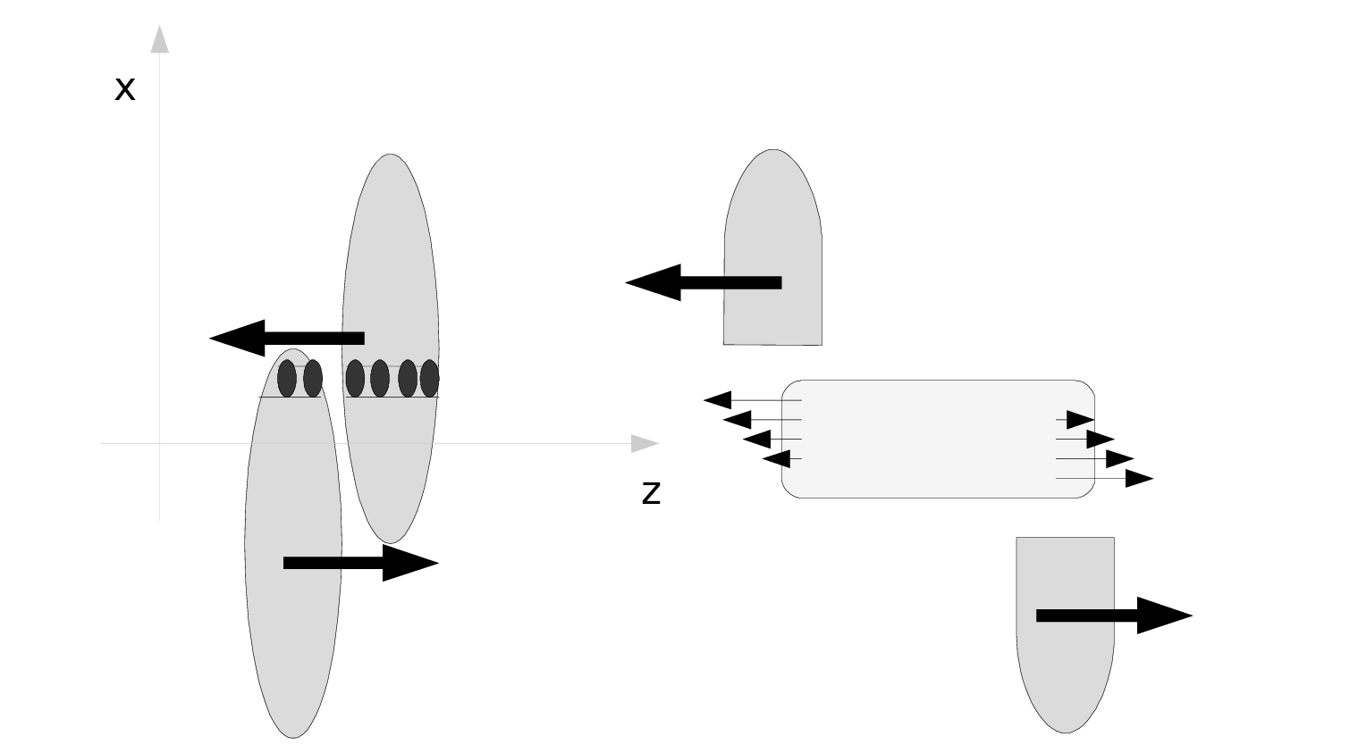
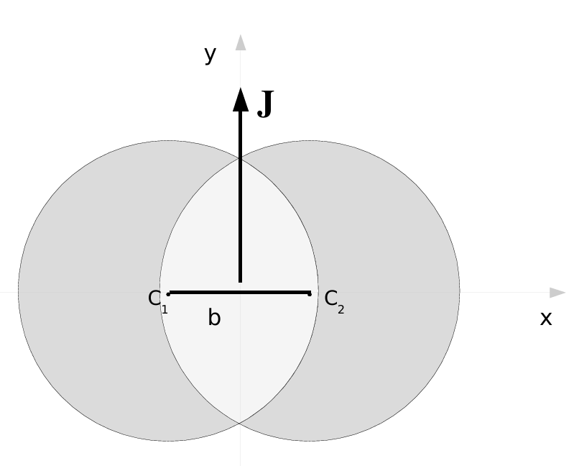
Polarization in non-central HIC
Barnett effect
Lorentz Contracted Nuclei
Inhomogeneous density profile
Interaction Region
Beam axis →
Longitudinal plane
Transverse Plane
F. Becattini, F. Piccinini, J. Rizzo, Phys. Rev. C 77, 024906 (2008)
Y. Jiang, Z.-W. Lin, J. Liao, Phys. Rev. C 94, 044910 (2016)
M. Matsuo, J. Ieda, and S. Maekawa, Front. Phys. 3, 54 (2015).
3/20

Slide 4
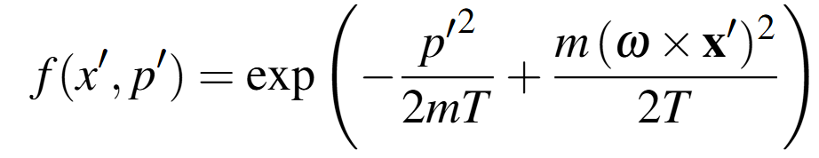
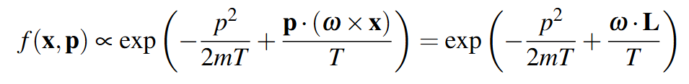
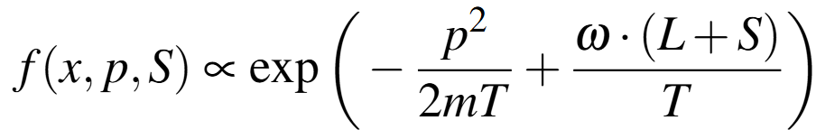
Polarization due to rotation
Analogy: Classical gas in rigidly rotating vessel.
In thermodynamic equilibrium the gas will also have a velocity field: v = ω × x Equilibrium particle distribution function in a comoving frame is given by:
α
In external lab frame
We can extend this to particle with spin
Particles are now polarized.
S.J. Barnett PhysRev.6.239-270(1915)
4/20

Slide 5
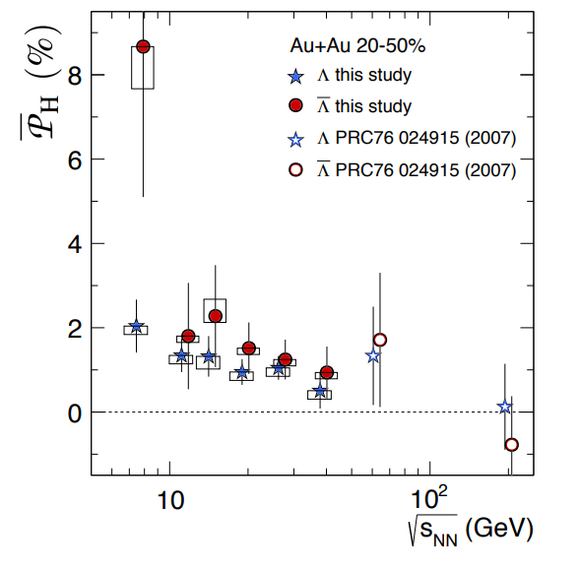
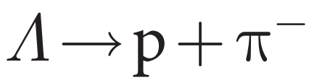
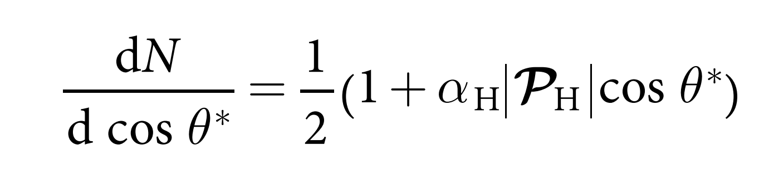
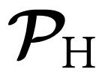


Evidence of polarization
Global Λ hyperon polarization
Angular distribution of decay products:
: Polarization vector in hyperon rest frame
: Angle between daughter proton momentum and polarization vector
Fig: The average global polarisation of hyperons in Au + Au collision.
STAR Collaboration, Nature 548, 62–65 (2017)
5/20

Slide 6
Spin Hydrodynamic Framework
6/20

Slide 7
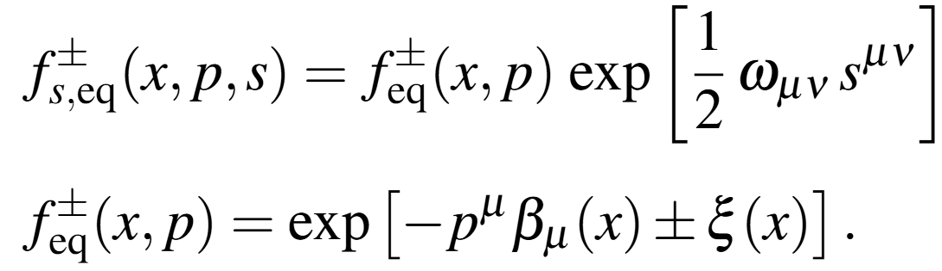
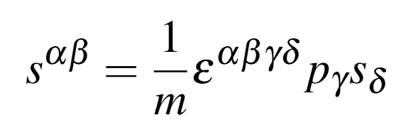

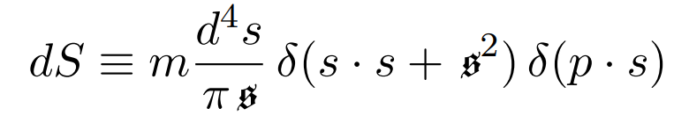
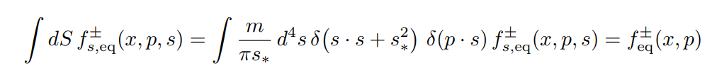
Spin Distribution Function
The equilibrium distribution function is defined as
We introduce spin half particles with internal angular momentum
Six additional degrees of freedom arising from conservation of angular momentum are specified by the antisymmetric tensor known as spin chemical potential.
Integral measure:
Florkowski et al., Phy. Rev. D 97, 116017 (2018)
7/20

Slide 8
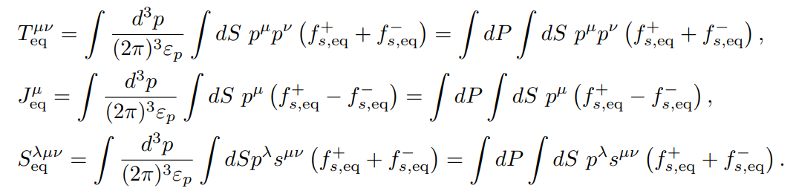
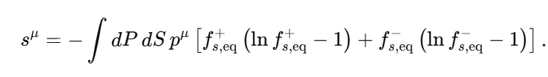

Energy momentum tensor
Charge current
Spin tensor
Entropy current
Samapan Bhadury et.al., Phys. Rev. D 103, 014030 (2021)
8/20

Slide 9


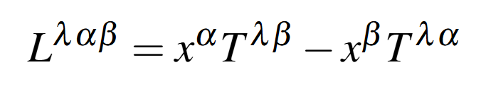
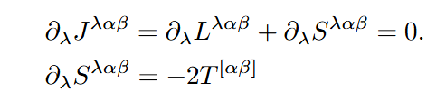
Hydrodynamics with angular momentum
Each fluid cell has its own spin and angular momentum
where, orbital angular momentum is given by Noether theorem
Hydrodynamic evolution of such a fluid should ensure conservation of total angular momentum
In case the energy-momentum is fully symmetric, conservation of total angular momentum is simply conservation of spin:
→ Spin Hydro
W. Florkowski et al. Prog. Part. Nucl. Phys. 108, 103709 (2019)
Florkowski et al., Phys. Rev. C 97, 041901(R) (2018)
Bhadury et al., Phys. Rev. D 103, 014030 (2021)
K. Hattori et al., Phys. Lett. B 795, 100–106 (2019)
9/20

Slide 10
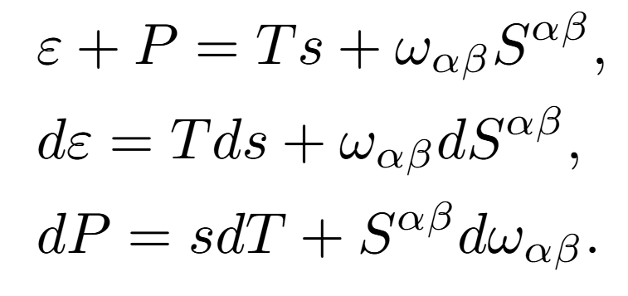
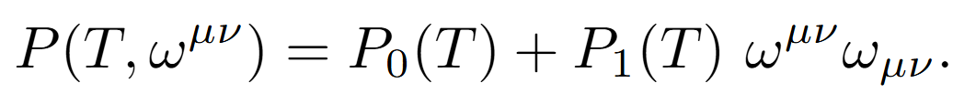




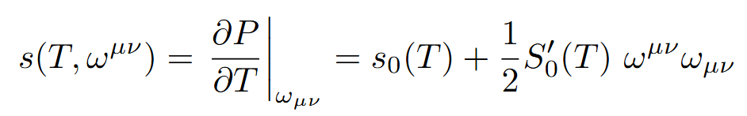
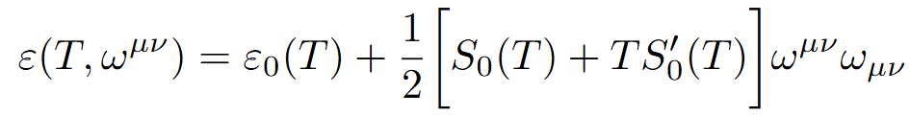
Thermodynamic Relations
Generalized thermodynamic laws to include spin contributions:
These equations imply that pressure P can be treated as a function of ω^{µν} and T .Hence, we assume the generalized form of pressure as:
Here, P₀(T) represents pressure of spinless fluid.
Thus we can find spin equation of state:
~
where, We can find other thermodynamic quantities similarly
Biswas et al. Phys. Rev. D 107, 094022 (2023)
10/20

Slide 11
Boost Invariant Solution
11/20

Slide 12
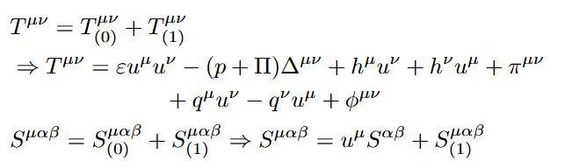



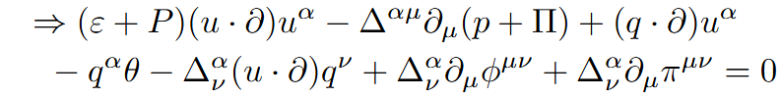
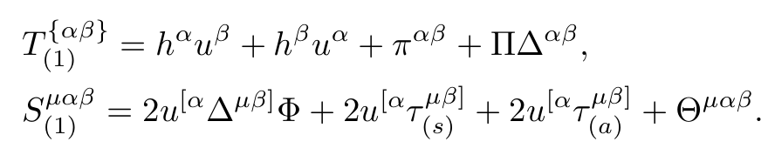
First order Spin Hydrodynamics
We derive the solution of boost-invariant spin hydrodynamic equations considering first-order terms in gradient expansion :
Equation of motion(in Landau frame) of the dynamics are given by :
For we use the most general decomposition of third rank tensor antisymmetric in last two indices
No. of independent components: 1 5 3 9
12/20

Slide 13

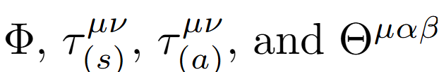
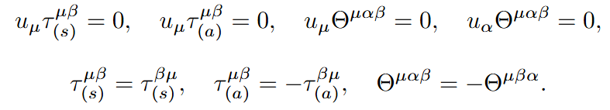

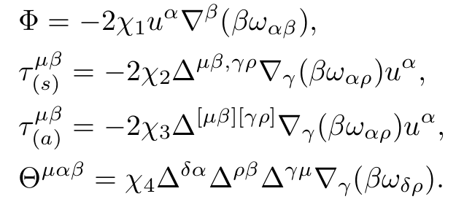


Dissipative currents: Principle of entropy production
Total entropy of the system is given by
[1]*
The first order terms appearing in spin tensor are and they satisfy following conditions:
We find the following dissipative currents:
We assume that the system only expands along the beam axis and we use the Bjorken flow velocity profile
*S. Dey, A. Das, Phys. Rev. D 111, 074037 (2025)
13/20

Slide 14
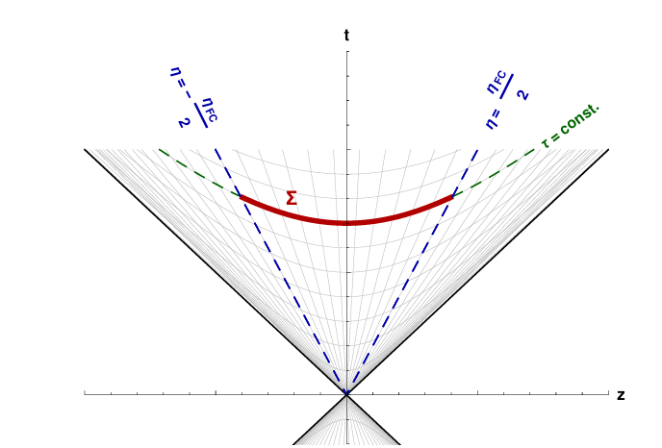
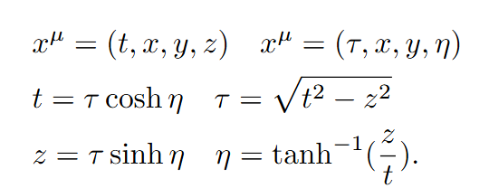
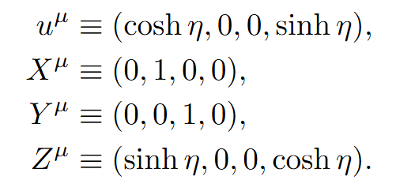

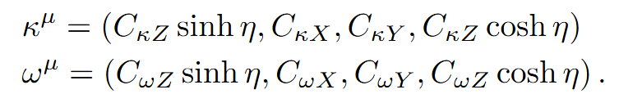
Bjorken Flow
To describe this flow we use Milne coordinates:
There is no expansion along the transverse direction, initially transverse velocities are zero.
For simplicity we define the basis vector as :
Fig: hypersurface of boost invariant fire cylinder
W. Florkowski et al Phys. Rev. C 99, 044910 (2019)
→Spin chemical potential is given by such that in the given basis
14/20

Slide 15
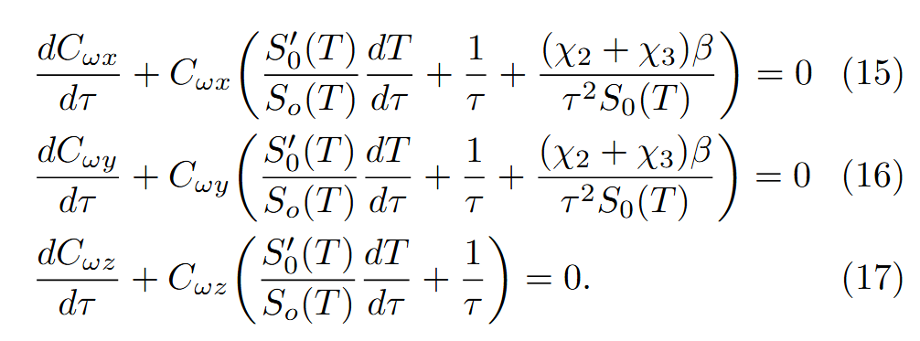
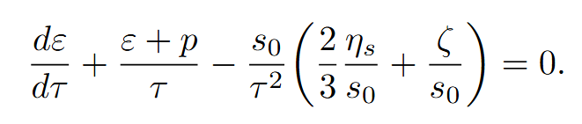
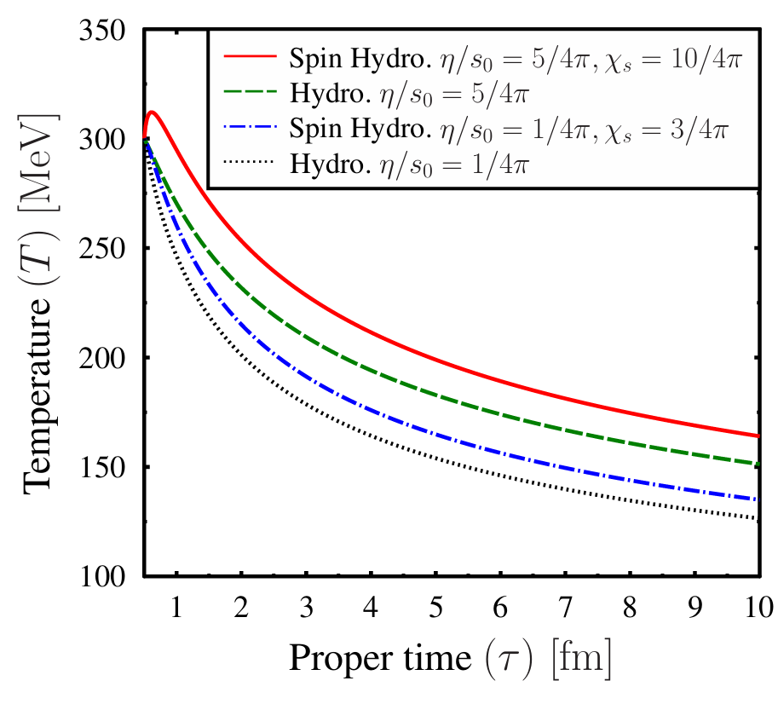
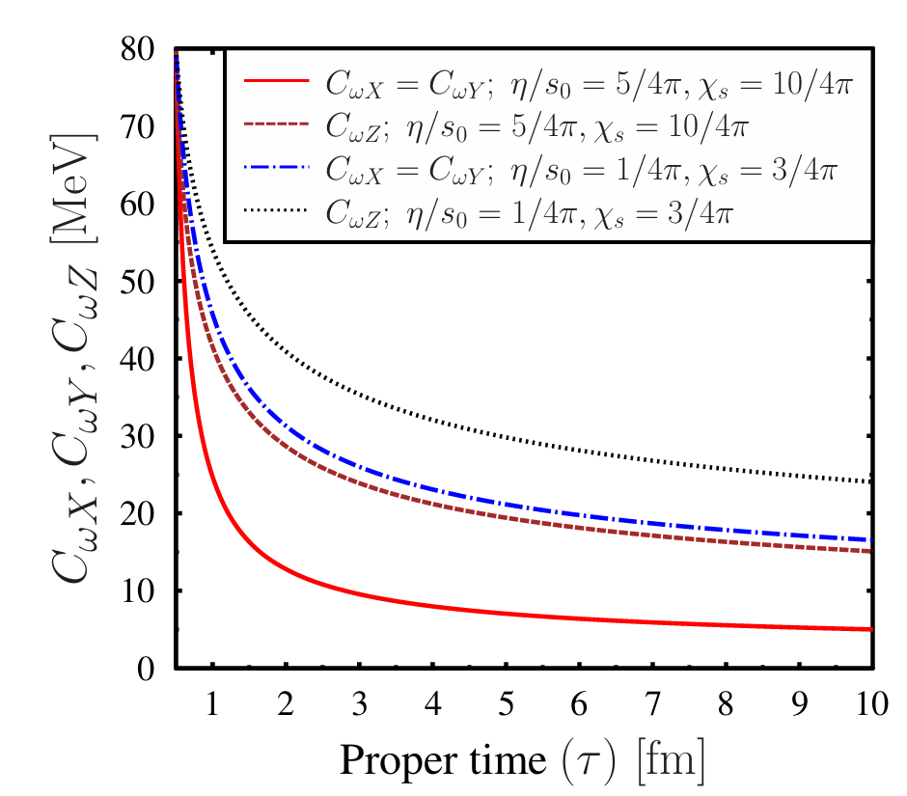
Results
15/20

Slide 16
Application to Dilepton Production
16/20

Slide 17
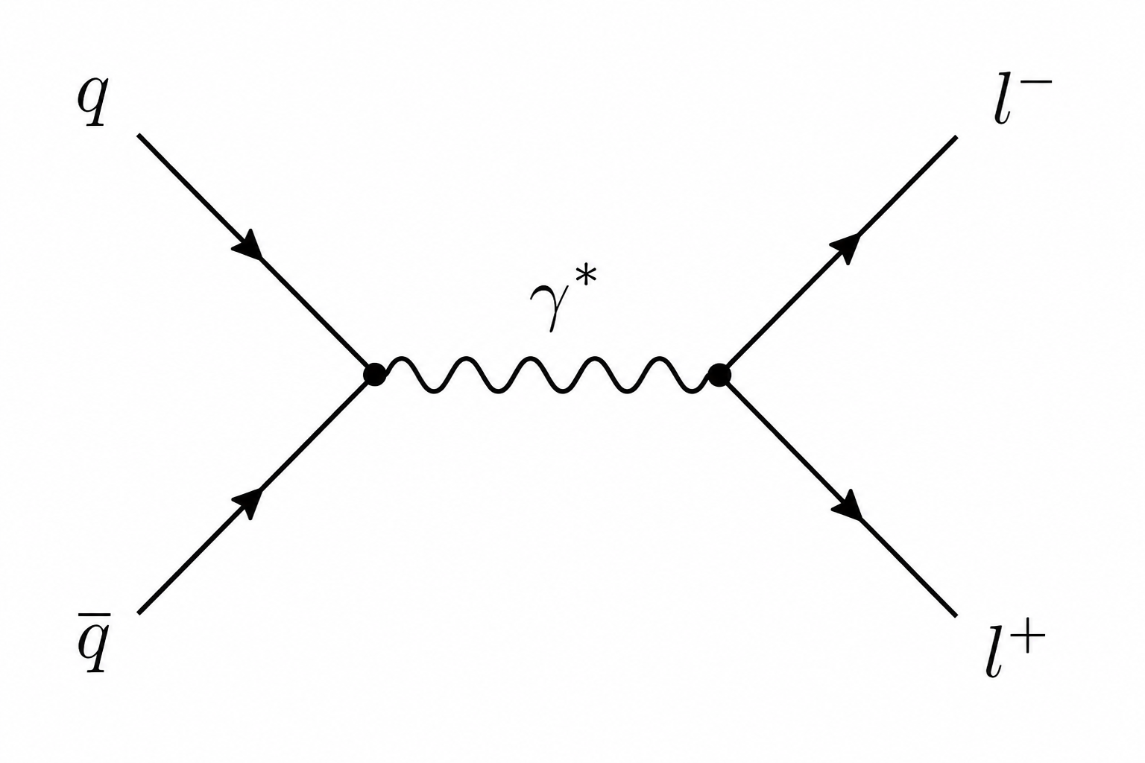
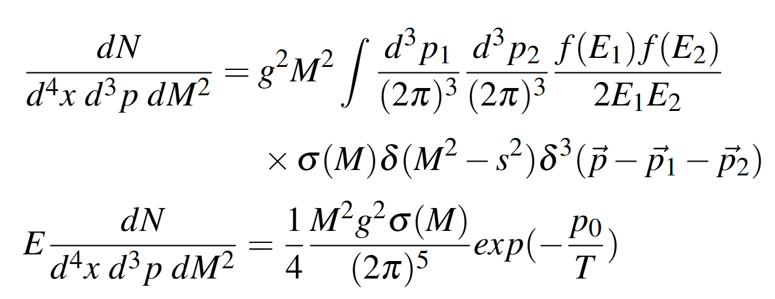
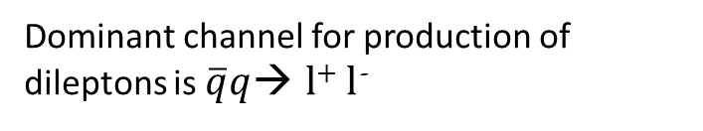
Dileptons as probes
Ideal Probe: small interaction cross-section, does not interact via strong forces
Dileptons and Photons which interact electromagnetically are ideal probes of the temperature of QGP
Effects of spin enter through T
Dominant channel for production of dileptons is $\overline{q}$​$q$→ l⁺ l⁻
Vogt, Ultrarelativistic Heavy-Ion Collisions (Elsevier, 2007, 2nd edition).
Singh et al., Phys. Rev. D 100, 014016 (2019).
17/20

Slide 18
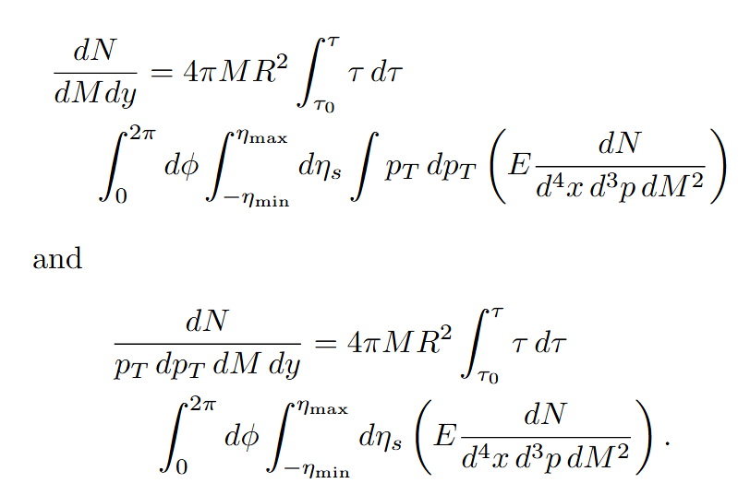
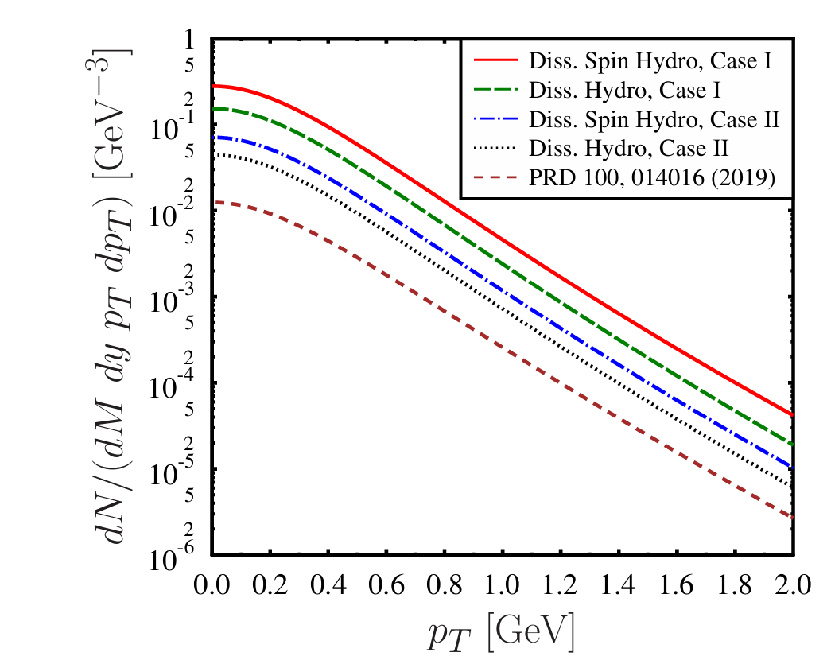
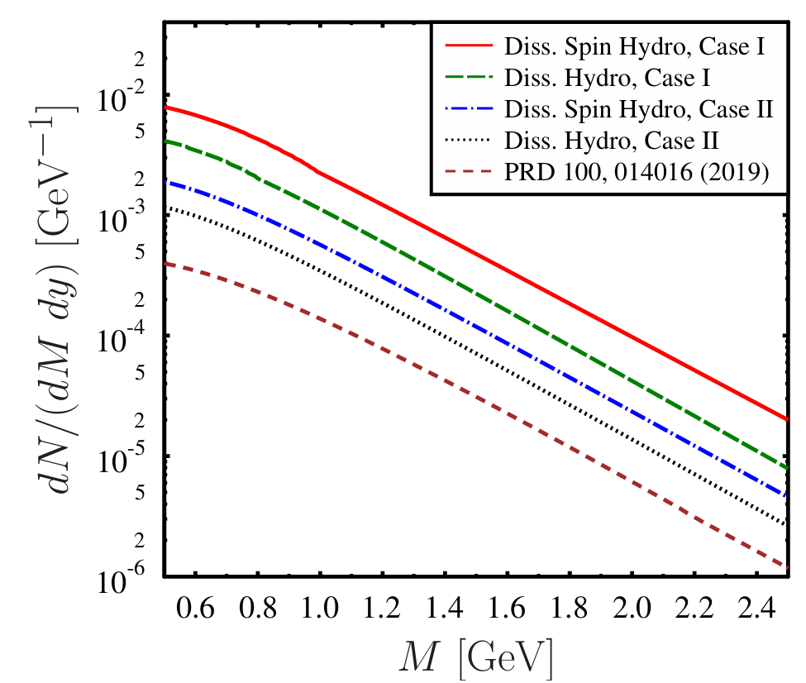
18/20

Slide 19
Results
In this study we find the boost invariant solution of spin hydrodynamic framework and spin chemical potential is treated as a leading-order hydrodynamic variable.
We observed that the decay of all spin components is indirectly affected by the shear viscosity through the temperature evolution of the medium.
Spin degrees of freedom modify the temperature evolution of the longitudinally expanding medium.
We found that the slower cooling in spin hydrodynamics enhances the dilepton production rate compared to the standard dissipative hydrodynamic case.
Thermal dileptons may serve as an indirect probe of spin transport in the quark-gluon plasma.
19/20

Slide 20
Summary and Outlook
A more realistic description would require the use of an equation of state obtained from lattice QCD together with microscopic estimates of the spin transport coefficients.
Inclusion of finite baryon density, transverse expansion, and realistic initial conditions is required for a realistic model
Numerical simulations of spin hydrodynamics have been somewhat underexplored in current literature and requires 2nd order corrections
Measured fluctuations = Critical fluctuation + Non-critical fluctuations
Thank you for your attention
Sejal Singh
p20230473@pilani.bits–pilani.ac.in
s-singh-4d3@sophia.ac.jp
20/20

Slide 21
Backups

Slide 22
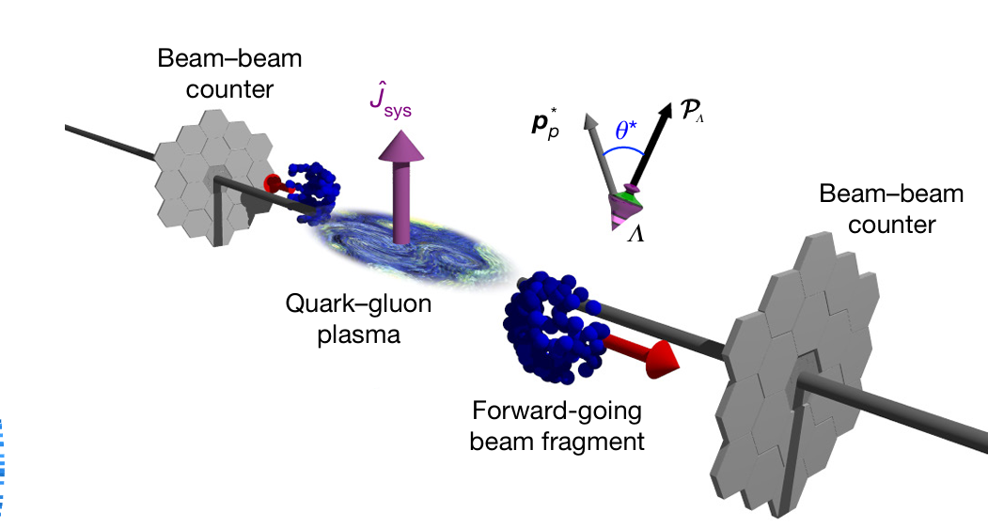
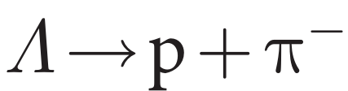
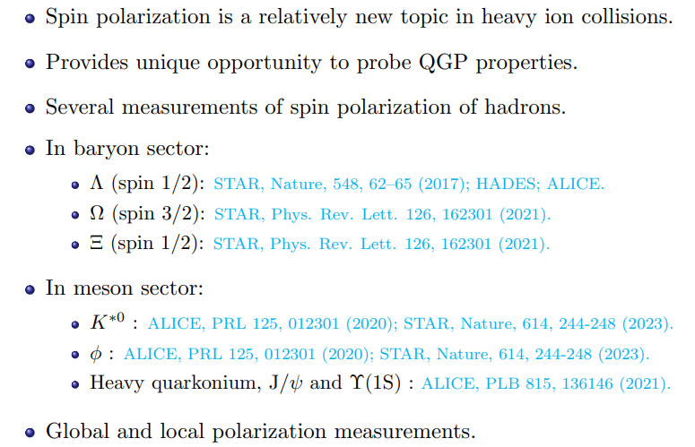
Other measurements
The proton tends to be emitted along the spin direction of the parent Λ.
- ‘Self Analyzing Property’.
Spin polarization measurement

Slide 23
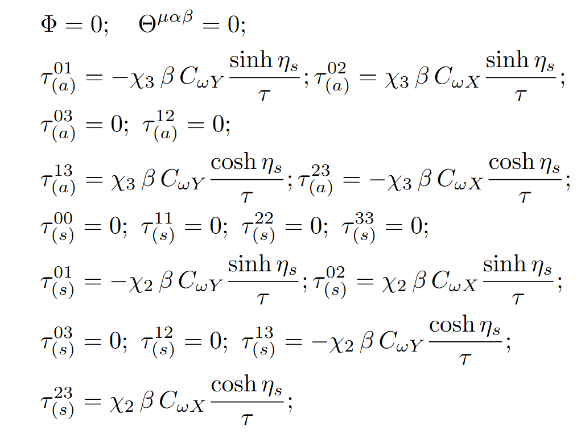
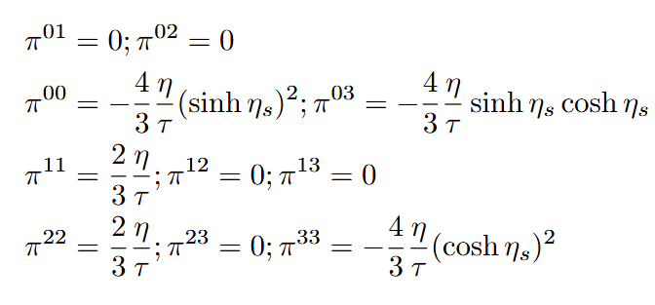
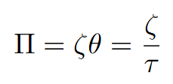
Dissipative current components in Bjorken Flow

Slide 24
Initial conditions used
We choose :
Thermalization time scale τ0 = 0.5 fm to start the hydrodynamic evolution.
Initial temperature is T(τ0) = T0 = 300 MeV and CωX(τ0) = CωY(τ0) = CωZ(τ0) = 80MeV.
We consider such a value of CωX, CωY, and CωZ so that they are small as compared to the temperature.
The mass of the medium particles is m0 = 200 MeV4.
We consider two different choices of the transport coefficients,
1. η/s0 = 5/4π, χs = 10/4π,
2. is η/s0 = 1/4π, χs = 3/4π.

Slide 25
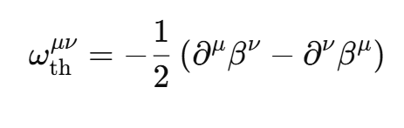
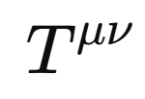


Ordering of spin chemical potential
In literature, different hydrodynamic ordering of the spin chemical potential has been considered
For anti-symmetric energy-momentum tensor it can be determined by thermal vorticity
If the energy-momentum tensor is symmetric, then in even global equilibrium the spin chemical potential and the thermal vorticity need not be related.
Since can always be made symmetric using pseudo gauge transformation we consider
R. Biswas et al., Phys. Rev. D 107, 094022 (2023).

Slide 26

2nd order spin hydro
Relativistic second-order spin hydrodynamics: An entropy-current analysis- PHYSICAL REVIEW D 108, 014024 (2023)

Slide 27

Global polarization by Spin Hydro
“Spin Polarization of Λ hyperons from Dissipative Spin Hydrodynamics”
Sapna Sushant K. Singh, David Wagner

