Slide 1
Critical dynamics in an expanding system with baryon diffusion and chiral condensate
Azumi Sakai (Nagasaki Institute of Applied Science)
Koichi Murase (Osaka Univ.)
Hirotsugu Fujii (Nishogakusha Univ.)
Tetsufumi Hirano (Sophia Univ.)
This talk is based on: Phys. Rev. C 112 (2025) 2, 024907
Workshop on “QCD Critical Point and Hydrodynamic Evolution”
Yukawa Institute for Theoretical Physics, 2026 June 2nd

Slide 2
Outline
Introduction
  Phase diagram of QCD
  Critical fluctuations
Model
  Coupled Langevin equations
Results
  Space-time evolution
  Two-point correlation functions
Summary and outlook

Slide 3
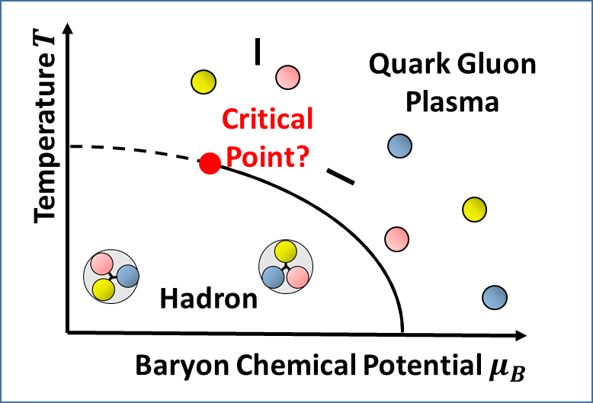
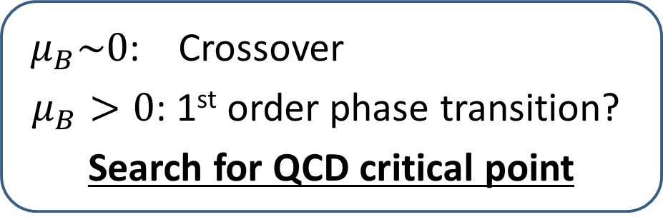
QCD phase diagram
High-energy
heavy-ion collisions
QGP
high temperature and/or high density
e.g. High-energy heavy-ion collisions
⇒ Properties of QGP
$μ_{B}\sim 0$: Crossover
$μ_{B}>0$: 1st order phase transition?
Search for QCD critical point
Fig. Schematic phase diagram of QCD

Slide 4
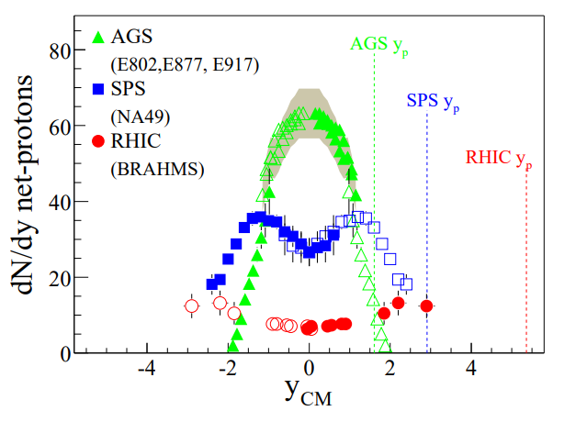





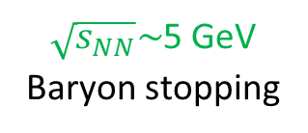

Beam energy scan experiment
High-energy
heavy-ion collisions
QGP
$$μ_{B}\sim 0$$
QGP
$$μ_{B}>0$$
Beam Energy Scan
$\sqrt{s_{NN}}\sim$200 GeV
$\sqrt{s_{NN}}\sim$5 GeV
Baryon stopping
$\sqrt{s_{NN}}=$ 5 GeV
$\sqrt{s_{NN}}=$ 17 GeV
Fig. Schematic phase diagram of QCD
$\sqrt{s_{NN}}=$ 200 GeV
Bearden et al. BRAHMS Collaboration (2004)
Dynamical framework for describing critical dynamics?

Slide 5
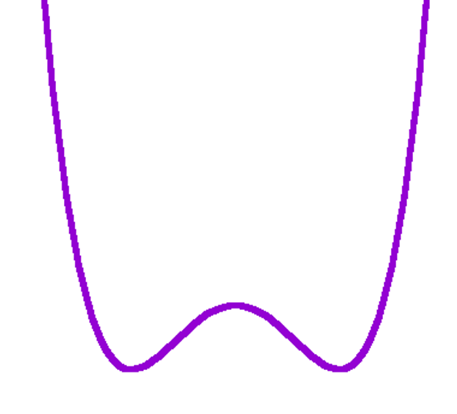
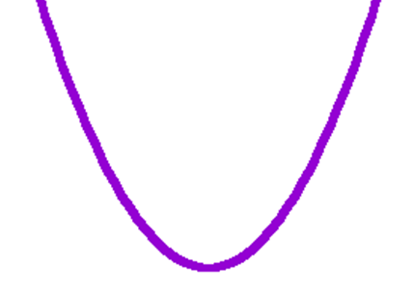
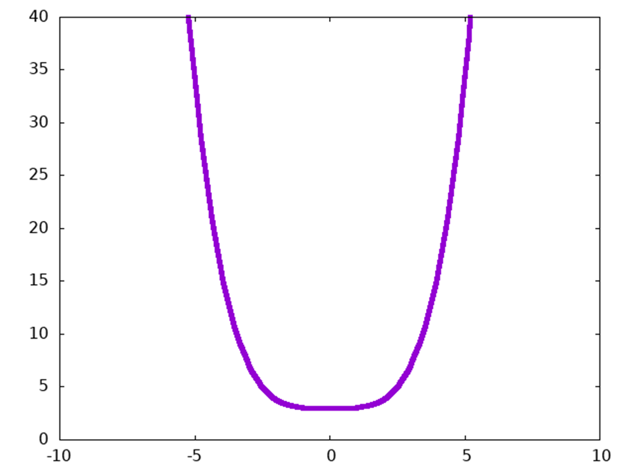






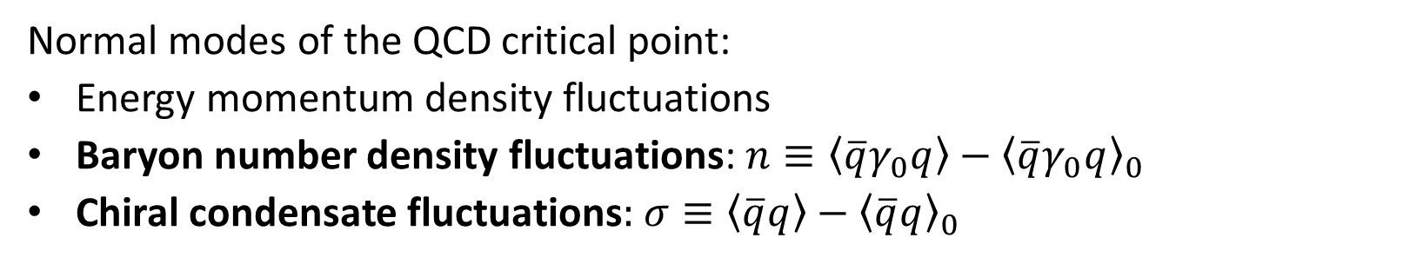



Critical fluctuations
$$V(φ)$$
$$V(φ)$$
$$V(φ)$$
$$φ$$
$$φ$$
$$φ$$
QGP phase
$$T>T_{c}$$
Critical point
$$T=T_{c}$$
Large fluctuations
Hadron phase
$$T<T_{c}$$
Normal modes of the QCD critical point:
Energy momentum density fluctuations
Baryon number density fluctuations: $n≡\left\langle \overline{q}γ_{0}q\right\rangle −{\left\langle \overline{q}γ_{0}q\right\rangle }_{0}$
Chiral condensate fluctuations$:$ $σ≡\left\langle \overline{q}q\right\rangle −{\left\langle \overline{q}q\right\rangle }_{0}$

Slide 6
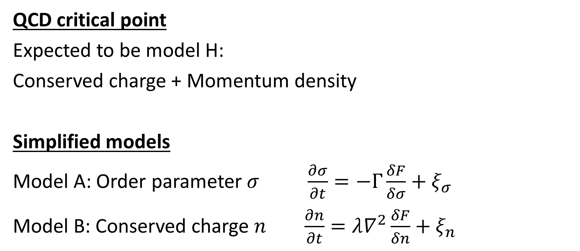
Effective models of the critical dynamics
QCD critical point
Expected to be model H:
Conserved charge + Momentum density
Simplified models
Model A: Order parameter $σ$ $\frac{∂σ}{∂t}=−Γ\frac{δF}{δσ}+ξ_{σ}$
Model B: Conserved charge $n$ $\frac{∂n}{∂t}=λ∇^{2}\frac{δF}{δn}+ξ_{n}$

Slide 7
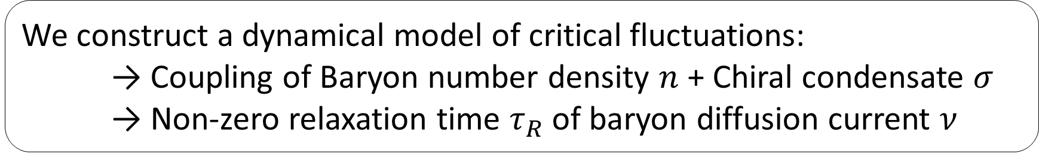
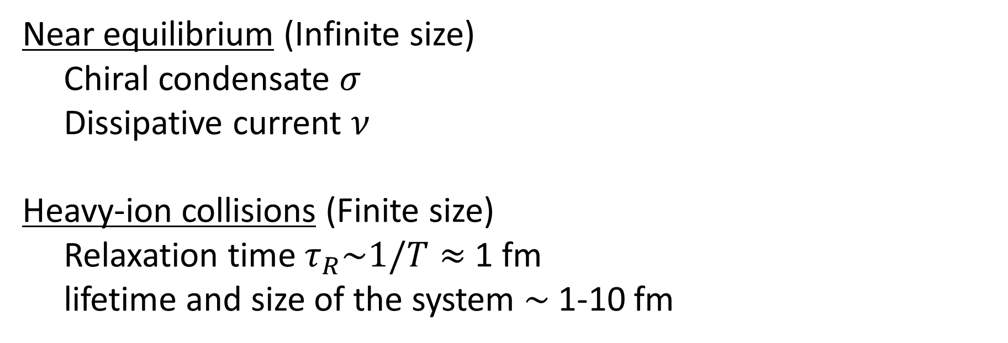
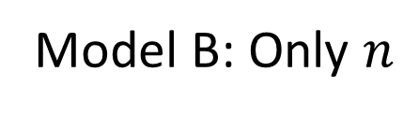
Scale separation
Near equilibrium (Infinite size)
Chiral condensate $σ$
Dissipative current $ν$
Heavy-ion collisions (Finite size)
Relaxation time $τ_{R}\sim 1/T≈$ 1 fm
lifetime and size of the system $\sim$ 1-10 fm
Fast mode → Ignored
Model B: Only $n$
Time-scale separation
is non-trivial
We construct a dynamical model of critical fluctuations:
→ Coupling of Baryon number density $n$ + Chiral condensate $σ$
→ Non-zero relaxation time $τ_{R}$ of baryon diffusion current $ν$

Slide 8

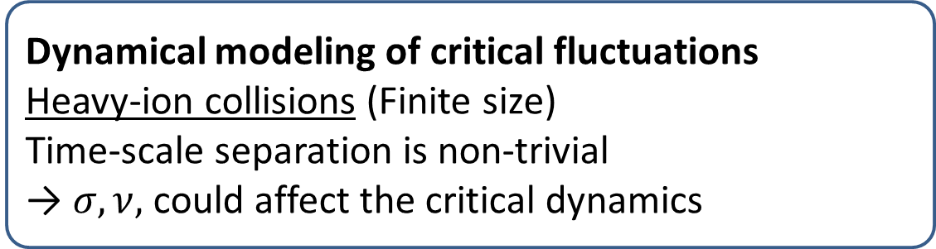

Purpose of study
Search for the QCD critical point
Dynamical modeling of critical fluctuations
Heavy-ion collisions (Finite size)
Time-scale separation is non-trivial
→ $σ,ν,$ could affect the critical dynamics
Fig. Schematic phase diagram of QCD
We construct a dynamical model of critical fluctuations:$n\text{−}σ\text{−}ν$ system
Analyze the Green’s functions and correlations
Understand the effect of $σ$and $ν$

Slide 9
Outline
Introduction
  Phase diagram of QCD
  Critical fluctuations
Model
  Coupled Langevin equations
Results
  Space-time evolution
  Two-point correlation functions
Summary and outlook

Slide 10
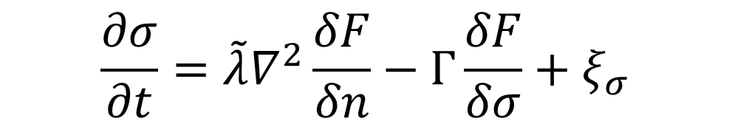
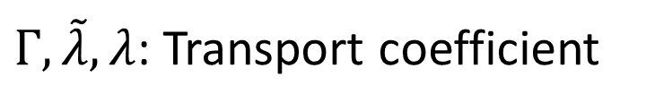
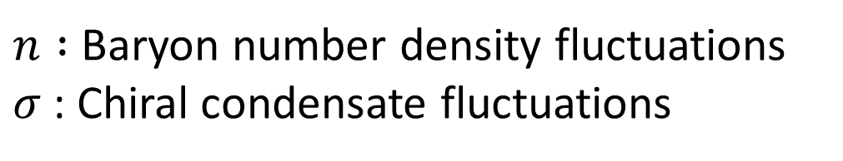

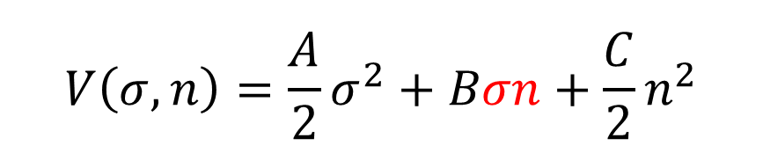


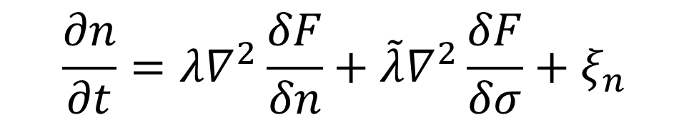
Coupled Langevin equations ($n$-$σ$system)
Free energy functional $F\left[σ, n\right]$
$\int{d^{3}x}\left[\frac{a}{2}{\left(∂_{i}σ\right)}^{2}+b∂_{i}σ∂_{i}n+\frac{c}{2}{\left(∂_{i}n\right)}^{2}+V(n,σ)\right]$
Model A: $\frac{∂σ}{∂t}=−Γ\frac{δF}{δσ}+ξ_{σ}$
Model B: $\frac{∂n}{∂t}=λ∇^{2}\frac{δF}{δn}+ξ_{n}$
Coupling
$$V\left(σ, n\right)=\frac{A}{2}σ^{2}+Bσn+\frac{C}{2}n^{2}$$
$$\frac{∂n}{∂t}=λ∇^{2}\frac{δF}{δn}+\tilde{λ}∇^{2}\frac{δF}{δσ}+ξ_{n}$$
$$\frac{∂σ}{∂t}=\tilde{λ}∇^{2}\frac{δF}{δn}−Γ\frac{δF}{δσ}+ξ_{σ}$$
$n :$ Baryon number density fluctuations
$σ$: Chiral condensate fluctuations
$A, B,C$: Potential parameters
D.T. Son, M.A. Stephanov, Phys.Rev. D70 (2004) 056001
H. Fujii, M. Ohtani, Phys.Rev.D70:014016,2004
$Γ, \tilde{λ}, λ$: Transport coefficient

Slide 11
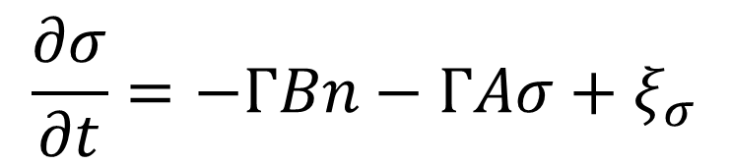
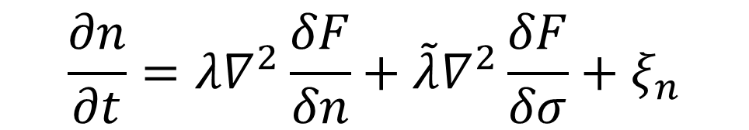
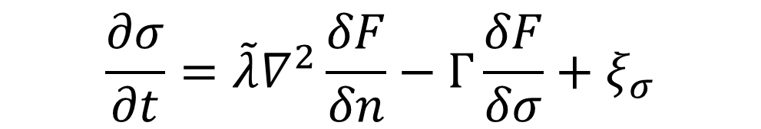
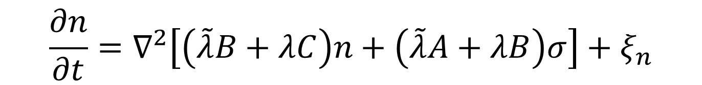
Coupled Langevin equations ($n$-$σ$system)
Free energy functional $F\left[σ, n\right]$
$\int{d^{3}x}\left[\frac{a}{2}{\left(∂_{i}σ\right)}^{2}+b∂_{i}σ∂_{i}n+\frac{c}{2}{\left(∂_{i}n\right)}^{2}+V(n,σ)\right]$
$$\frac{∂n}{∂t}=λ∇^{2}\frac{δF}{δn}+\tilde{λ}∇^{2}\frac{δF}{δσ}+ξ_{n}$$
$$\frac{∂σ}{∂t}=\tilde{λ}∇^{2}\frac{δF}{δn}−Γ\frac{δF}{δσ}+ξ_{σ}$$
Coupling
$$V\left(σ, n\right)=\frac{A}{2}σ^{2}+Bσn+\frac{C}{2}n^{2}$$
Calculate the functional derivative
$$\frac{∂n}{∂t}=∇^{2}\left[\left(\tilde{λ}B+λC\right)n+\left(\tilde{λ}A+λB\right)σ\right]+ξ_{n}$$
$$\frac{∂σ}{∂t}=−ΓBn−ΓAσ+ξ_{σ}$$
leading derivative terms

Slide 12
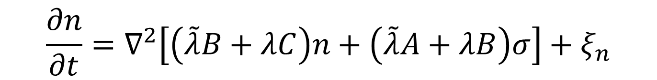
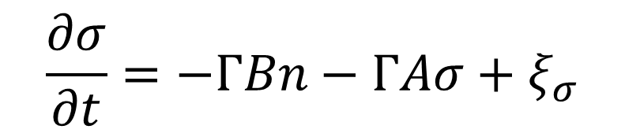
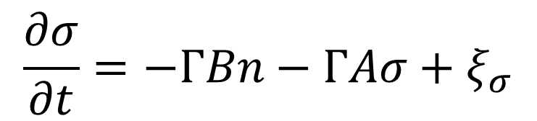
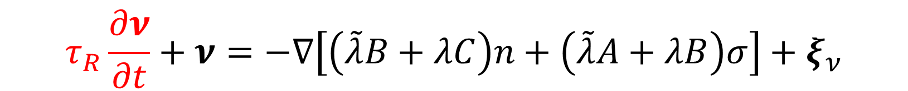
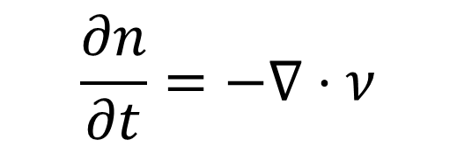
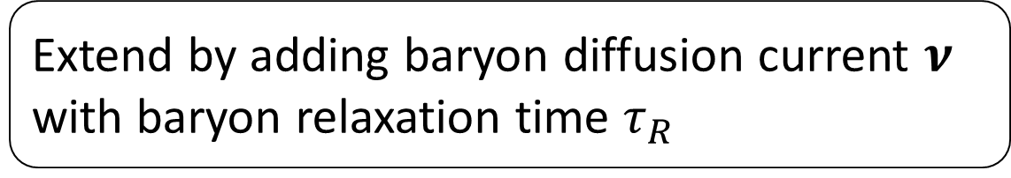
Coupled Langevin equations ($n$-$σ\text{−}ν$ system)
$$\frac{∂n}{∂t}=∇^{2}\left[\left(\tilde{λ}B+λC\right)n+\left(\tilde{λ}A+λB\right)σ\right]+ξ_{n}$$
$$\frac{∂σ}{∂t}=−ΓBn−ΓAσ+ξ_{σ}$$
Extend by adding baryon diffusion current $ν$
with baryon relaxation time $τ_{R}$
$$\frac{∂n}{∂t}=−∇⋅ν$$
New!
$$\frac{∂σ}{∂t}=−ΓBn−ΓAσ+ξ_{σ}$$
$$τ_{R}\frac{∂ν}{∂t}+ν=−∇\left[\left(\tilde{λ}B+λC\right)n+\left(\tilde{λ}A+λB\right)σ\right]+ξ_{ν}$$

Slide 13

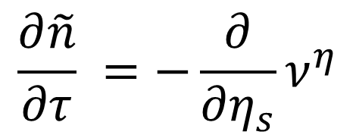

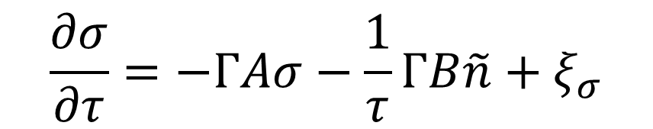
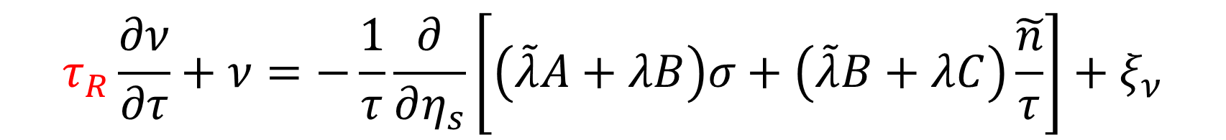
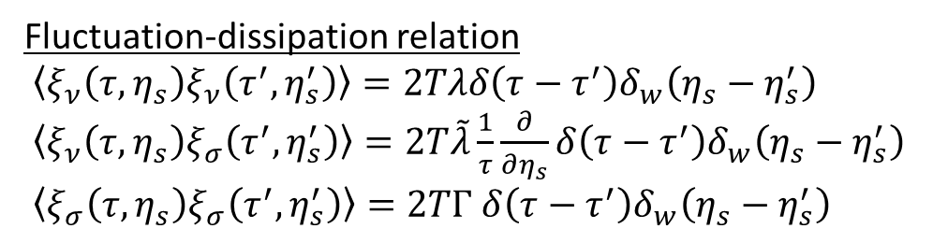

Coupled Langevin equations ($n$-$σ\text{−}ν$ system) in $τ−η_{s}$ space
Rewrite the equation in $τ$-$η_{s}$ space
$$\frac{∂\tilde{n}}{∂τ} =−\frac{∂}{∂η_{s}}ν^{η}$$
Fluctuation-dissipation relation
$\left\langle ξ_{ν}\left(τ,η_{s}\right)ξ_{ν}\left(τ^{′},η_{s}^{′}\right)\right\rangle =2Tλδ\left(τ−τ^{′}\right)δ_{w}\left(η_{s}−η_{s}^{′}\right)$
$\left\langle ξ_{ν}\left(τ,η_{s}\right)ξ_{σ}\left(τ^{′},η_{s}^{′}\right)\right\rangle =2T\tilde{λ}\frac{1}{τ}\frac{∂}{∂η_{s}}δ\left(τ−τ^{′}\right)δ_{w}\left(η_{s}−η_{s}^{′}\right)$
$\left\langle ξ_{σ}\left(τ,η_{s}\right)ξ_{σ}\left(τ^{′},η_{s}^{′}\right)\right\rangle =2TΓ$ $δ\left(τ−τ^{′}\right)δ_{w}\left(η_{s}−η_{s}^{′}\right)$
$$\frac{∂σ}{∂τ}=−ΓAσ−\frac{1}{τ}ΓB\tilde{n}+ξ_{σ}$$
$T：$Temperature
$$τ_{R}\frac{∂ν}{∂τ}+ν=−\frac{1}{τ}\frac{∂}{∂η_{s}}\left[\left(\tilde{λ}A+λB\right)σ+\left(\tilde{λ}B+λC\right)\tilde{\frac{n}{τ}}\right]+ξ_{ν}$$
$$(\tilde{n}≡τn)$$

Slide 14
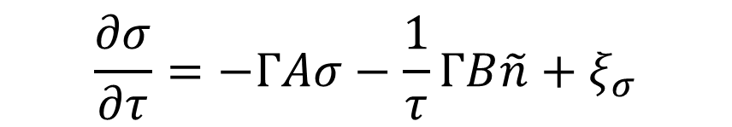
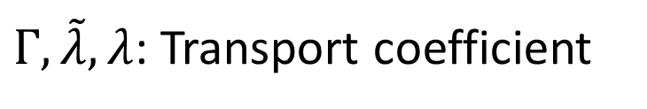
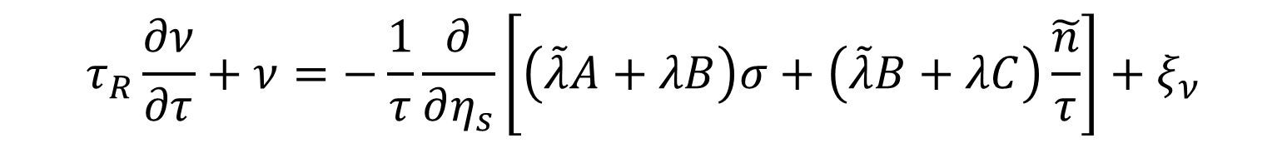
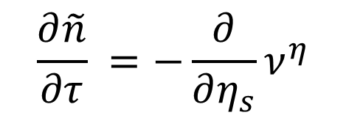
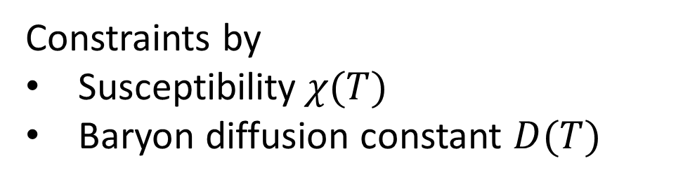

Temperature dependent parameters
$$\frac{∂\tilde{n}}{∂τ} =−\frac{∂}{∂η_{s}}ν^{η}$$
$$\frac{∂σ}{∂τ}=−ΓAσ−\frac{1}{τ}ΓB\tilde{n}+ξ_{σ}$$
$$τ_{R}\frac{∂ν}{∂τ}+ν=−\frac{1}{τ}\frac{∂}{∂η_{s}}\left[\left(\tilde{λ}A+λB\right)σ+\left(\tilde{λ}B+λC\right)\tilde{\frac{n}{τ}}\right]+ξ_{ν}$$
Constraints by
Susceptibility$χ(T)$
Baryon diffusion constant $D(T)$
$A, B,C$: Potential parameters
$Γ, \tilde{λ}, λ$: Transport coefficient

Slide 15
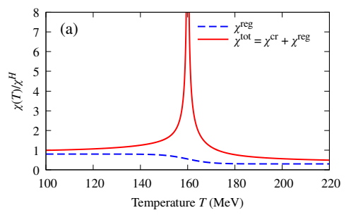
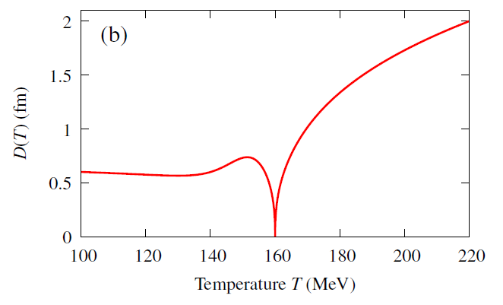

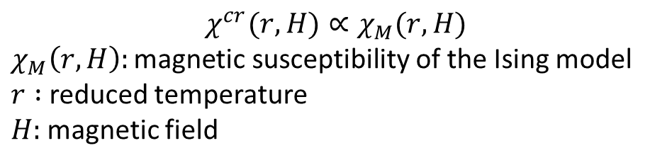

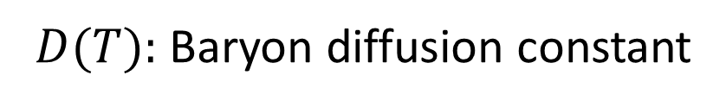
Susceptibility and diffusion constant
$χ(T):$ Susceptibility
$D(T):$ Baryon diffusion constant
$$T_{c}=160 MeV$$
$$χ^{cr}(r,H)∝χ_{M}(r,H)$$
$χ_{M}\left(r,H\right):\text{magnetic} \text{susceptibility}$of the Ising model
$r :$reduced temperature
$H:$magnetic field
M. Sakaida et al., Phys. Rev. C 95, 064905 (2017)

Slide 16
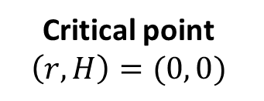


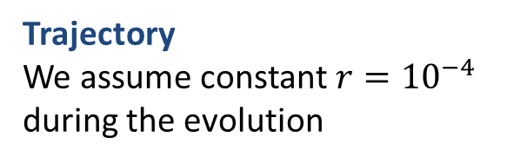

Mapping between $(r,H)$ and $(T, μ_{B})$
$χ(T):$ Susceptibility
QGP phase
$$H$$
$$r$$
Critical point
$$\left(r,H\right)=(0, 0)$$
Temperature T
Hadron phase
$$T_{c}=160 MeV$$
Baryon chemical potential μ_{B}
$$χ^{cr}(r,H)∝χ_{M}(r,H)$$
$χ_{M}\left(r,H\right):\text{magnetic} \text{susceptibility}$of the Ising model
$r :$reduced temperature
$H:$magnetic field
Trajectory
We assume constant $r={10}^{−4}$
during the evolution

Slide 17





Potential parameters $A,B,C$
$$\frac{TA(T)}{Δ}=χ^{tot} \left(T\right)$$
$$\frac{T}{C(T)}=χ^{reg} \left(T\right)$$
$B\left(T\right)=1$
Constraints by
susceptibility
Assume the coupling to be constant
for simplicity
$$V\left(σ, n\right)=\frac{A}{2}σ^{2}+Bσn+\frac{C}{2}n^{2}$$
$$Δ=A(T)C(T)−{B(T)}^{2}$$

Slide 18




Temperature dependence of potential $V\left(σ, n\right)$
$$V\left(σ, n\right)=\frac{A}{2}σ^{2}+Bσn+\frac{C}{2}n^{2}$$
$Δ=0$ at Tc
Leads to flat direction

Slide 19








Transport coefficient $Γ, \tilde{λ}, λ$
Determine $λ$ to reproduce the diffusion coefficient
$\frac{λ(T) Δ}{A(T)}=D\left(T\right)$
$Γ\left(T\right)A\left(T\right)=1$
$\tilde{λ}(T)=0$
For simplicity
Assume
No correlation between
$ξ_{ν}\left(x\right)$ and $ξ_{σ}\left(x^{′}\right)$
$$\frac{∂σ}{∂t}=−ΓBn−ΓAσ+ξ_{σ}$$
Both $Γ, λ$ increase at $T_{c}$ in this setup
Our model is linearized system
→ Divergence arising from
non-linear coupling
is effectively contained in $λ$
Fluctuation-dissipation relation
$$\left\langle ξ_{ν}\left(τ,η_{s}\right)ξ_{σ}\left(τ^{′},η_{s}^{′}\right)\right\rangle =2T\tilde{λ}\frac{1}{τ}\frac{∂}{∂η_{s}}δ\left(τ−τ^{′}\right)δ_{w}\left(η_{s}−η_{s}^{′}\right)$$

Slide 20


Numerical setups
Bjorken expansion
Temperature: $T\left(τ\right)=T_{0}{\left(\frac{τ_{00}}{τ}\right)}^{c_{s}^{2}}$
Initial temperature: $T_{0}=220 MeV$
Initial time: $τ_{0}=1.0 fm$
Sound velocity: $c_{s}^{2}=0.15$
Critical temperature: $T_{c}=160$ MeV

Slide 21
Outline
Introduction
  Phase diagram of QCD
  Critical fluctuations
Model
  Coupled Langevin equations
Results
  Space-time evolution
  Two-point correlation functions
Summary and outlook

Slide 22










Green’s function of $n$ and $σ$ above $T_{c}$
$$τ_{in}:1.0 fm$$
Initial conditions:
$$\tilde{n}\left(η_{s},τ_{in}\right)=δ_{w}\left(η_{s}\right)=\frac{1}{\sqrt{2πw^{2}}}e^{−\frac{η_{s}^{2}}{2w^{2}}}$$
$σ\left(η_{s},τ_{in}\right)=0$, $ν\left(η_{s},τ_{in}\right)=0$
$τ_{in}=1.0 fm$, $w=0.02$
Without noise $ξ=0$,
Baryon vector density
$\tilde{n}≡τn$
$$\tilde{n}\left(η_{s},τ\right)$$
$σ≠0$ at $τ>τ_{0}$
→negative σ is induced by the positive n
$τ_{R}=0$fm$: \tilde{n}$ instantly diffuses to large $η_{s}$
$τ_{R}>0$fm$: \tilde{n}$ diffuses at a finite speed
$$σ\left(η_{s} ,τ\right)$$
Two peaks move to the$±η_{s}$ directions in a finite speed $v$ with finite relaxation time $τ_{R}$

Slide 23






Green’s function of $n$ and $σ$ near $T_{c}$
$$τ_{in}:7.7 fm$$
Initial conditions:
$$\tilde{n}\left(η_{s},τ_{in}\right)=δ_{w}\left(η_{s}\right)=\frac{1}{\sqrt{2πw^{2}}}e^{−\frac{η_{s}^{2}}{2w^{2}}}$$
$σ\left(η_{s},τ_{in}\right)=0$, $ν\left(η_{s},τ_{in}\right)=0$
$τ_{in}=7.7 fm$, $w=0.02$
Without noise $ξ=0$,
Baryon vector density
$\tilde{n}≡τn$
$$\tilde{n}\left(η_{s},τ\right)$$
$σ≠0$ at $τ>τ_{0}$
→negative σ is induced by the positive n
$τ_{R}=0$fm$: \tilde{n}$ instantly diffuses to large $η_{s}$
$τ_{R}>0$fm$: \tilde{n}$ diffuses at a finite speed
$$σ\left(η_{s} ,τ\right)$$
Each peak splits into two peaks at $T_{c}$ and propagates to $±η_{s}$
caused by the divergence of the kinetic coefficient λ
23

Slide 24









Green’s function of $n$ and $σ$ near $T_{c}$
$$τ_{in}:7.7 fm$$
$$\tilde{n}\left(η_{s},τ\right)$$
$$τ_{c}$$
$$τ_{in}: 1.0 fm$$
$$τ_{in}:7.7 fm$$
$$σ\left(η_{s} ,τ\right)$$
Each peak splits into two peaks at $T_{c}$ and propagates to $±η_{s}$
caused by the divergence of the kinetic coefficient λ
24

Slide 25





Evolution of $n,$ $σ$, and $ν$
above $T_{c}$
near $T_{c}$

Slide 26



Two-point correlation functions
Settings
With noise terms $ξ$
Initial conditions:
$$τ_{00}=0.6 fm$$
$$σ\left(η_{s},τ_{00}\right)=0$$
$$\tilde{n}\left(η_{s},τ_{00}\right)=0$$
$$ν\left(η_{s},τ_{00}\right)=0$$
We expect stable distribution
at $τ_{0}=1.0$fm
with $T=T_{0}=220$ MeV
Periodic boundary condition
Maximum at $Δη_{s}=0$
Negative dip
  Integration of $\tilde{n}$ is conserved
  More significant below the $T_{c}$with larger $τ_{R}$

Slide 27

Two-point correlation functions
Settings
With noise terms $ξ$
Initial conditions:
$$τ_{00}=0.6 fm$$
$$σ\left(η_{s},τ_{00}\right)=0$$
$$\tilde{n}\left(η_{s},τ_{00}\right)=0$$
$$ν\left(η_{s},τ_{00}\right)=0$$
We expect stable distribution
at $τ_{0}=1.0$fm
with $T=T_{0}=220$ MeV
Periodic boundary condition
Maximum at $Δη_{s}=0$
Negative dip
  Integration of $\tilde{n}$ is conserved
  More significant below the $T_{c}$with larger $τ_{R}$

Slide 28





Temperature dependence of correlation function
Equilibrium value
${\left\langle \tilde{n}(0)\tilde{n}(0)\right\rangle }_{eq}=τ^{2}{\left\langle n\left(0\right)n\left(0\right)\right\rangle }_{eq}$
$=τ^{2}χ^{tot}δ_{w}(0)$
$χ^{tot}$: Susceptibility
$δ_{w}(Δη_{s})$: Smeared delta function
$$τ^{2}χ^{tot}δ_{w}(0)$$
Peaks shift to a lower temperature
$\left\langle \tilde{n}(0)\tilde{n}(0)\right\rangle$is larger with $τ_{R}$ at low temperature
Enhancement remains at lower temperature
→ Favored for detecting the signal
of critical fluctuations in experiments

Slide 29
Outline
Introduction
  Phase diagram of QCD
  Critical fluctuations
Model
  Coupled Langevin equations
Results
  Space-time evolution
  Two-point correlation functions
Summary and outlook

Slide 30

Summary
We constructed a second-order model for critical fluctuations in an expanding system
  Baryon density fluctuation $n$ + Chiral condensate fluctuation $σ$
  Diffusion current $ν$with baryon relaxation time $τ_{R}$
Space-time evolution
  Two peaks move in a finite speed $v$ with finite relaxation time $τ_{R}$
  Each peak splits into two peaks at $T_{c}$
Correlation function
  Negative dip is more significant below the $T_{c}$with larger $τ_{R}$
Temperature dependence of correlation function
  Enhancement at low $T$
  → Favored for detecting the signal of critical fluctuations

Slide 31

Outlook
Nonlinear effects coming from higher order terms in the free energy functional
Implementation in a state-of-the-art dynamical model
Related works on dynamical models
Fluctuating hydrodynamics
A. Sakai et al. PRC 102, 064903 (2020), PLB 829 (2022) 137053
K. Kuroki et al. PLB 842 (2023) 137958
Simulations of Xe+Xe collisons, analysis in progress, supercomputer SQUID
(3+1)-dimensional hydrodynamic calculation with finite $μ_{B}$
M. Oya et al. paper in progress Stay tuned!
Thank you for your attention!

