Slide 1

Weakly Nonlinear Analysis Using a Hessian Matrix with Wavenumber Dependence
Mini-workshop on “Rheology of dense materials“
March 18th, 2026
Kota Noto, Kuniyasu Saitoh(A),
Harukuni Ikeda, Hisao Hayakawa
YITP, Kyoto Sangyo Univ.(A)
@ YITP K206
Notes:
15min talk 5min discussion
Today, I will present a weakly nonlinear analysis based on a Hessian matrix with wave-number dependence.
I am Kota Noto, and this is a joint work with Kuniya Saito, Haruki Ikeda, and Hisao Hayakawa.

Slide 2
Outline
Introduction of Hessian Matrix
Unstable Modes from the Wavenumber-Dependent Hessian Matrix
Weakly Nonlinear Analysis of Unstable Modes
Notes:
Here is the outline of my talk. First, I will briefly introduce the Hessian matrix. Then, I will discuss unstable modes from the wavenumber-dependent Hessian matrix. Finally, I will present a weakly nonlinear analysis of these unstable modes.

Slide 3
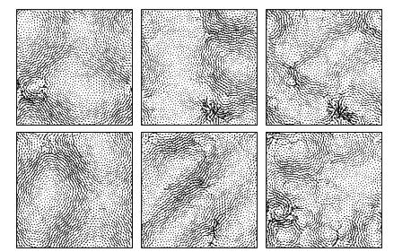
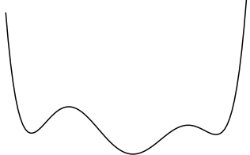
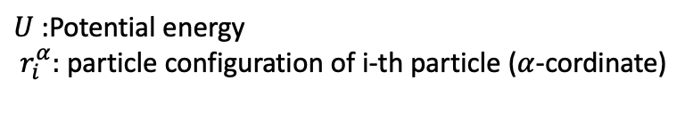

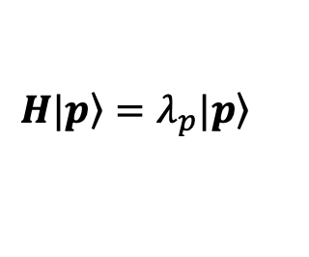
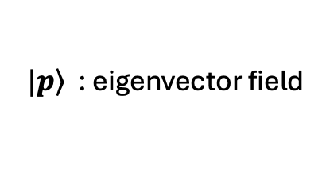
Hessian Matrix
We can get other property
(DOS, Shear modules ,,, )
$$H|\left.p\right\rangle =λ_{p}|\left.p\right\rangle$$
$U$ :Potential energy
$r_{i}^{α}:$ particle configuration of i-th particle ($α$-cordinate)
Eigenvalue analysis of 2N degree
$λ_{p}$: corresponding to curvature of PEL
$|\left.p\right\rangle$ : eigenvector field
PEL in a 2N-dimention
Notes:
Now, I would like to discuss amorphous solids, especially granular materials.
Here, we consider the athermal limit, where thermal fluctuations are absent.
We study particle packings like this one. Since amorphous materials are disordered systems, we analyze them directly using the particle configurations
To study such systems, we often use the Hessian matrix, as shown here.
From the Hessian matrix, we can obtain various physical properties, such as the density of states and the shear modulus.
By solving its eigenvalue problem, we obtain the eigenvalues and eigenvectors.
Physically, each eigenvalue represents the curvature of the potential-energy landscape along the direction of the corresponding eigenvector, which describes a displacement field in configuration space.
Therefore, if all eigenvalues are positive, the system returns to the original state after a small perturbation. In contrast, if a negative eigenvalue exists, the perturbation drives the system to another state.

Slide 4
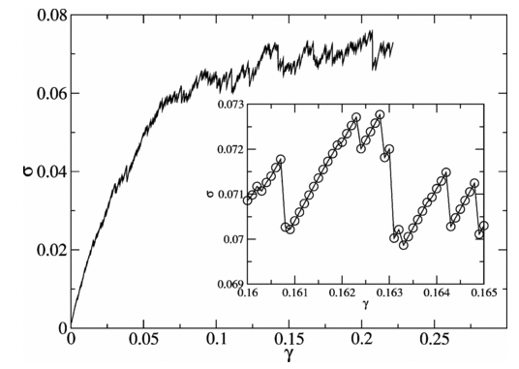
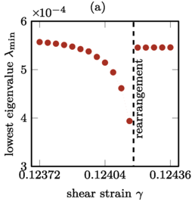
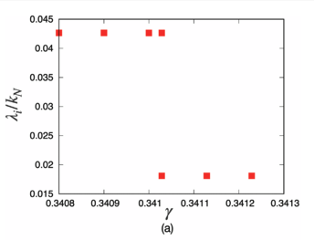
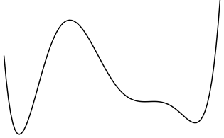

Unstable Particle Configuration
$$λ_{p}∼\sqrt{γ_{c}−γ}$$
Heltzian
Harmonic
C. E. Maloney and A. Lemaître PRE (2006)
F. Ebrahem et al., Phys. Rev. E 102, 033006 (2020).
D. Ishima et al., PRE 2023
Repeatedly performing eigenvalue analysis for different particle configurations is necessary.
Motivation
・Focus on configurations that already possess negative eigenvalues.
・Analyze configurations that become unstable with a single perturbation from the initial condition.
・Include nonlinear terms to suppress the divergence.
Notes:
To obtain an unstable mode, we often apply shear to the system.
This is the stress–strain curve.
When we apply a small shear strain, the stress increases gradually. However, as the shear strain becomes larger, the system eventually reaches an instability, resulting in an avalanche-like event at a point like this.
If we zoom in on this region, we can see the potential-dependent relation between the shear strain and the eigenvalue, as shown here. The unstable mode appears at this jump in the eigenvalue.
However, to obtain such an unstable mode in this way, we need to continuously apply shear to the system. As a result, we must repeatedly perform eigenvalue analyses for many different particle configurations during the deformation process.
In this study, I instead focus on configurations that already possess negative eigenvalues. Then, I analyze instability caused by a single perturbation from the initial condition. Finally, I include nonlinear terms to suppress the divergence.

Slide 5


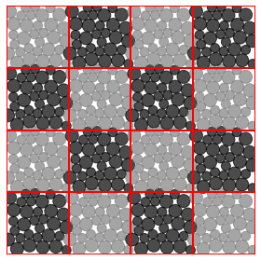



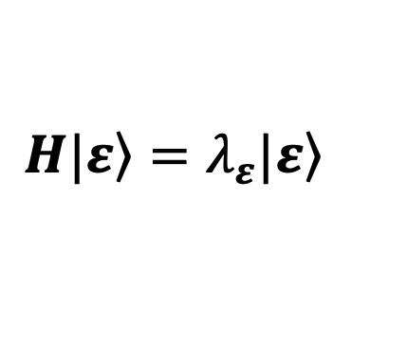
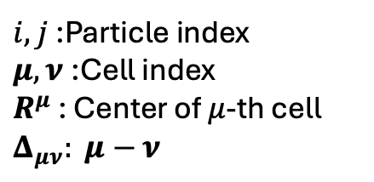
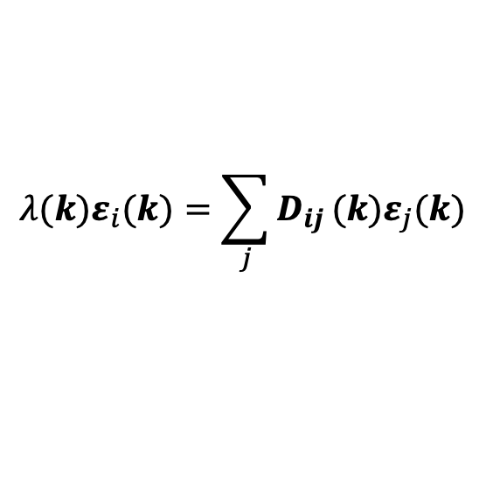
Hessian matrix including wave vector
Hessian matrix
$$H|\left.ε\right\rangle =λ_{ε}|\left.ε\right\rangle$$
Hessian matrix including wavenumber
$$λ(k)ε_{i}(k)=\sum_{j}{D_{ij}}(k)ε_{j}(k)$$
S. Schoenholz et al. Soft Matter, 9, 11000 (2013).
$i, j$:Particle index
$μ, ν$:Cell index
$R^{μ}$ : Center of $μ$-th cell
$Δ_{μν}: μ−$ $ν$
To introduce the wave vector, we consider a tiled structure.
We consider overdamped dynamics.
Fourier transform
Notes:
Next, I will explain how wave-number dependence is introduced into the Hessian matrix.
This is the usual Hessian matrix, together with its eigenvalue equation.
By introducing wave-number dependence, the Hessian matrix takes the following form. This formulation was studied by Schonzholz in 2013.
To introduce the wave vector, we consider a tiled structure like this.
We first prepare a packing, and then replicate it to construct the tiled system.
Under the usual periodic boundary condition, corresponding particles in different cells move in exactly the same way.
Here, however, the same particles in different cells are allowed to move independently, as shown in the figure.
We then consider overdamped dynamics in this tiled structure. By applying the Fourier transform, we obtain this equation, and finally derive D_{IJ} in the following form.
今までの解析は、k = 0の正の固有値のみを用いて行われてきた。
システムに負の固有モードが存在する場合、
変形を加えた際の応答を
理論解析およびシュミレーションを用いて確かめる。

Slide 6
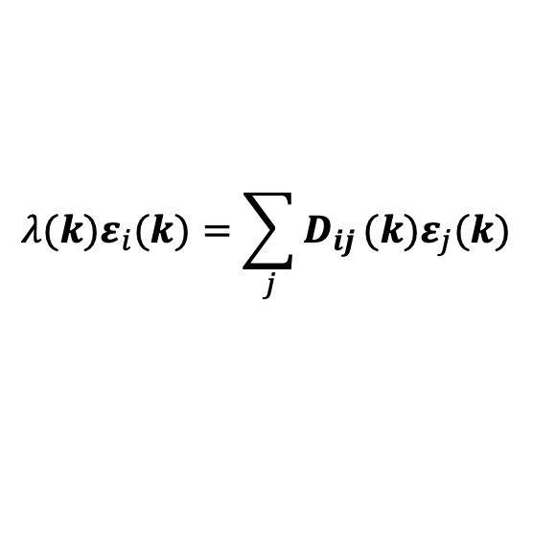
Dispersion relation
$$λ(k)ε_{i}(k)=\sum_{j}{D_{ij}}(k)ε_{j}(k)$$
Dispersion relation
Eigenvecotr field
Notes:
Since D_{IJ} is wave-vector-dependent, its eigenvalues and eigenvectors also depend on the wave vector.
As a result,. we can describe a dispersion-relation-like structure, as shown here.
This is an example of a sample packing
As shown in the figure, negative eigenvalues appear along certain directions.
This is the eigenvector corresponding to the unstable mode.
The Goldstone mode at k = 0 changes continuously and gradually evolves into the unstable mode.

Slide 7
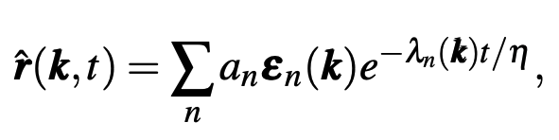



Use Edge Mode
Case: $\left|k\right|=\frac{π}{L}$ -> Wavelength = $2L$
Deformation of X mode
infinite system
2cell system
The outer boundary is periodic.
lowest eigenvector
Notes:
So, we obtain an unstable mode, and when \lambda becomes negative, R diverges.
To capture this behavior, we perform simulations and see how the system responds to a perturbation.
For simplicity, we focus on the edge mode in this region.
Here, k=\pi/L, which means that the wavelength is 2L.
In the infinite system, the corresponding deformation mode looks like this.
To simulate this mode, we consider only two cells, which are enough to represent one wavelength of this deformation.
In the two-cell system, the outer boundary is periodic, while the same particle in different cells is allowed to move independently.
As the initial perturbation, I choose the lowest eigenvector, as shown here.

Slide 8
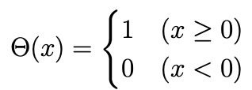

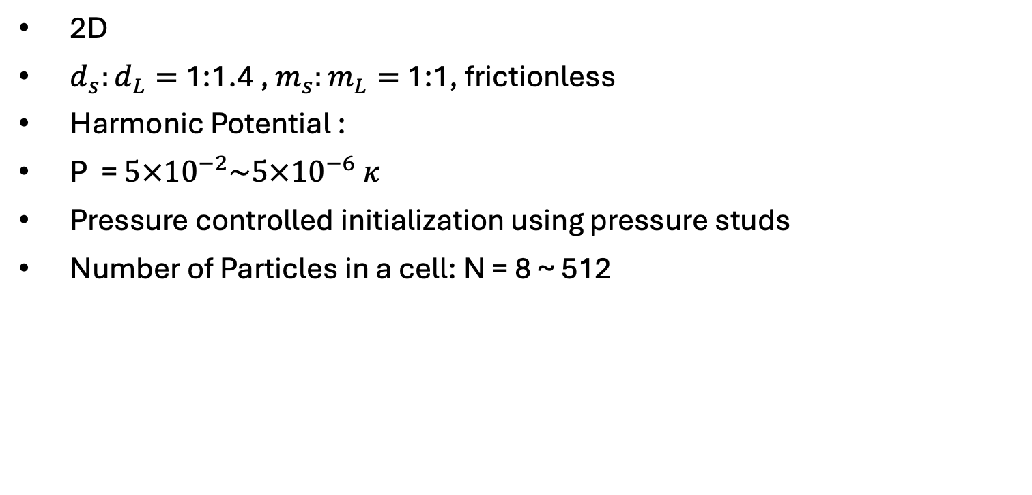
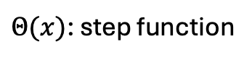
Setup of simulation
$Θ(x)$: step function
2D
$d_{s}:d_{L}=$1:1.4 , $m_{s}:m_{L}=$1:1, frictionless
Harmonic Potential :
P = $5×{10}^{−2}\sim 5×{10}^{−6} κ$
Pressure controlled initialization using pressure studs
Number of Particles in a cell: N = 8 ~ 512
Notes:
This is the setup of my simulation.
I consider a two-dimensional bidisperse frictionless system with a harmonic potential.
The control parameters are the pressure and the system size, as shown here.

Slide 9

Lowest eigenvector
B$={10}^{−4}$
Stable case
Unstable case
deformation
response
deformation
Response
Returns to the original state after deformation
Amplifies the deformation further
→Unstable modes can be captured！
Notes:
Then, I apply a perturbation to the system along the lowest eigenvector.
I use a packing with this dispersion relation. Here, the Y-direction mode has a positive eigenvalue, whereas the X-direction mode has a negative eigenvalue.
First, I consider the stable case, namely the Y direction, and apply a perturbation along the lowest eigenvector.
As shown here, the system returns to the original state after the deformation.
In contrast, when I apply a perturbation in the X direction, which is the unstable case, the deformation is further amplified.
In this way, we can clearly observe the unstable mode.

Slide 10
Response of various perturbations
Sinusoidal wave
Square wave
Lowest eigenvector
The responses are independent of the initial perturbations.
Notes:
Next, I change the form of the initial perturbation.
For example, I use a sinusoidal wave and a square wave.
In both cases, the response is the same as that obtained from the lowest-eigenvector perturbation.
This indicates that the response is independent of the form of the initial perturbation.

Slide 11
Outline
Introduction of Hessian Matrix
Derivation of Unstable Modes with Wavenumber
Weakly Nonlinear Analysis for Unstable Modes
Notes:
So, we obtain the unstable mode.
As the next step, I perform a weakly nonlinear analysis based on this unstable mode.

Slide 12
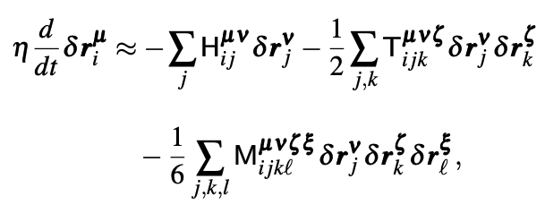
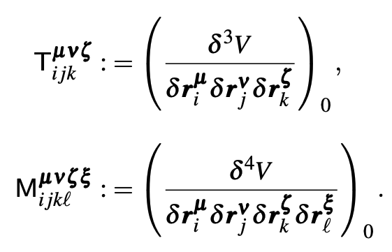
Weakly nonlinear analysis
Since the first-order term leads to a divergence,
we include higher-order terms in the expansion to suppress the divergence.
Overdamped equation
Weakly nonlinear analysis
Notes:
If we keep only the first-order term, the system diverges.
In reality, however, the divergence is suppressed because the system eventually evolves to another state.
To describe this behavior, we include higher-order terms that suppress the divergence.
We expand the potential to higher-order terms to capture nonlinear effects.
expand the potential to higher-order terms

Slide 13
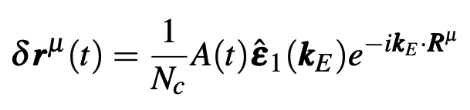
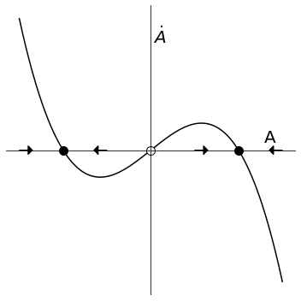
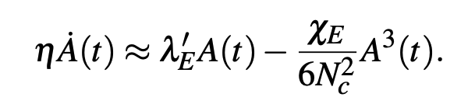
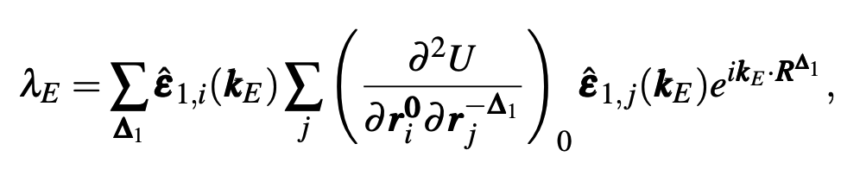

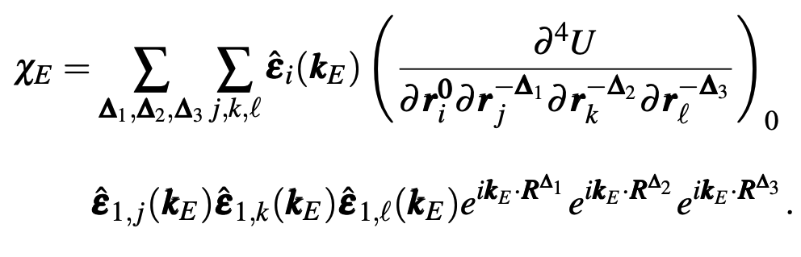
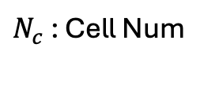
Nonlinear equation
Inverse Fourie transform
$N_{c}$ : Cell Num
We get bellow equation
evaluated at the saddle point
Notes:
By applying the inverse Fourier transform to the previous equation, we obtain the following amplitude equation.
Here, \lambda' = -\lambda, and therefore \lambda' is positive.
Also, \chi is a coefficient that comes from the fourth-order term of the potential.
This equation shows that the amplitude grows because of \lambda', while the nonlinear term suppresses that growth.
In this way, it captures the transition of the system to another state.
Both \lambda' and \chi are evaluated at the saddle point.
take a contraction of the tensor

Slide 14

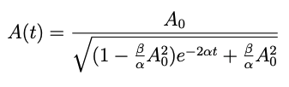


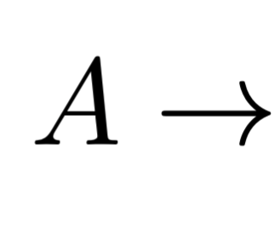
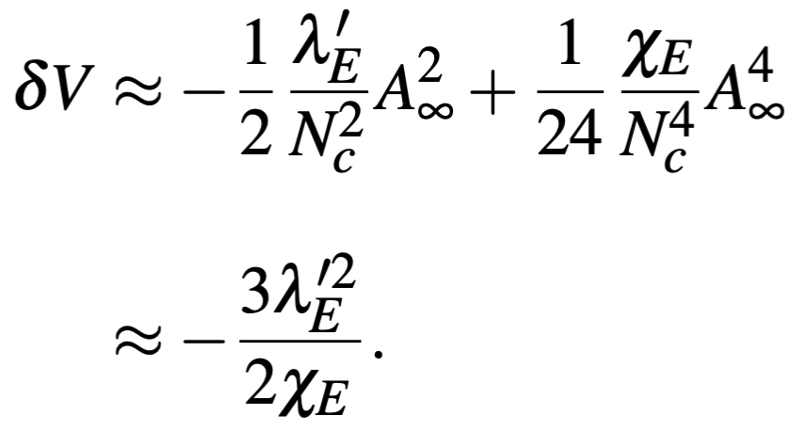
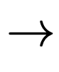


Time Evolution
・Amplitude
Then, we obtain
$$t→∞$$
・Potential
$$t→∞$$
Notes:
This equation can be solved analytically, and we obtain the following relation.
In the long-time limit, that is, as t \to \infty, the amplitude approaches the following value.
We can also derive the change in the potential.
By substituting the long-time amplitude, we obtain the potential change after relaxation.

Slide 15



Comparison with simulations
η Dependence
$$P=5×{10}^{−2}$$
$$P=5×{10}^{−4}$$
$$P=5×{10}^{−6}$$
• Quantitatively different, qualitatively consistent
Notes:
“Finally, I compare the theoretical prediction with the simulation.
The left panel shows the time evolution of the potential change.
The dotted lines are the theoretical results, and the solid lines are the simulation results.
The colors represent different values of \eta , which is a parameter in the theory.
The overall behavior is reproduced well, although the final relaxed values do not exactly agree.
This is the result for a single sample.
The right panel shows the scatter plot obtained by varying the pressure and the system size.
The dotted line is a fitting line, and the solid line is the theoretical prediction.
Although individual samples do not show quantitative agreement, the average behavior and the slope are consistent with the theory.
So, the results are quantitatively different, but qualitatively consistent.
Finally, I compare the theoretical prediction with the simulation.
This figure shows the time evolution of the potential change.
The dotted lines indicate the theoretical results, and the solid lines indicate the simulation results.
The colors correspond to different values of \eta, which is a parameter in the theory.
As shown here, the overall behavior is reproduced well, although the final relaxed values do not completely agree.
This result is for a single sample.
Next, using the same simulation, I vary the pressure and the system size.
In this way, I obtain the following scatter plot.
In this figure, the dotted line is a fitting line, and the solid line is the theoretical prediction given by this form.
Although individual samples do not show quantitative agreement with the theoretical prediction, the average behavior and the slope are consistent with the theory.
This is the plot when η is varied. The potential change does not perfectly match, but the response agrees quantitatively when the parameter is varied.”

Slide 16



Summary
We investigated the response of a system with negative eigenmodes by applying external perturbations.
Regardless of the type of perturbation, the negative eigenmode dominates, leading to the same response.
Weakly nonlinear analysis supports the relationship between the energy decrease and the corresponding eigenvalue.
$$P=5×{10}^{−2}$$
$$P=5×{10}^{−4}$$
$$P=5×{10}^{−6}$$
Notes:
To conclude, we investigated the response of a system with a negative eigenmode to an external perturbation.
Regardless of the form of the perturbation, the negative eigenmode becomes dominant and leads to the same response.
We also analyzed the relationship between the potential change after relaxation and the corresponding eigenvalue.
Thank you for your attention.

