Slide 1

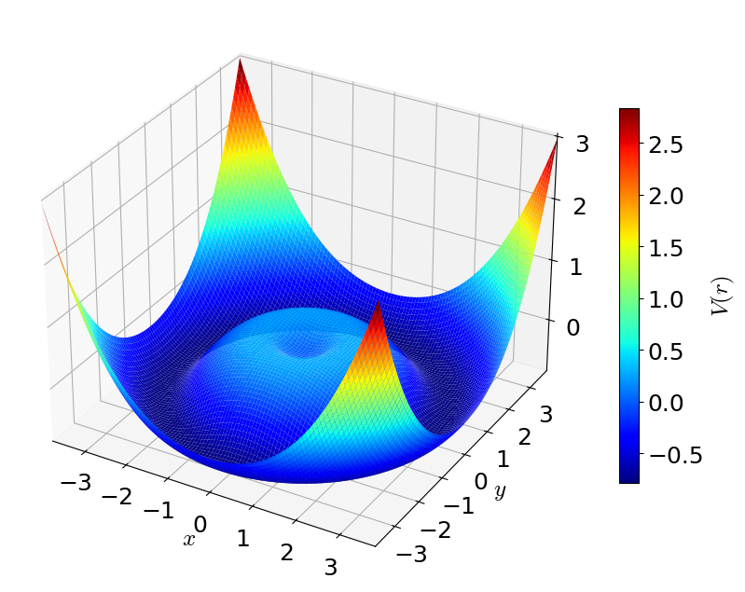

Mpemba effect
in a two-dimensional bistable potential
Hisao Hayakawa (YITP, Kyoto Univ.)
Satoshi Takada (TUAT)

Slide 2
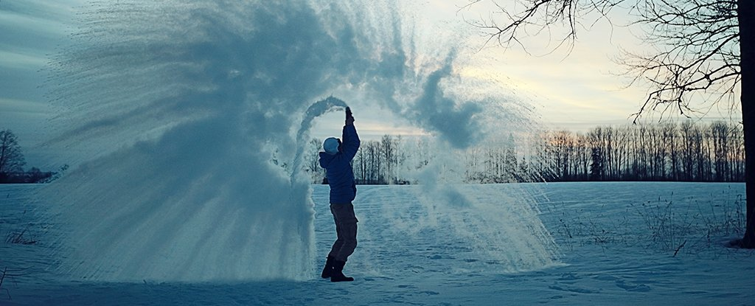
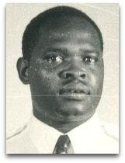
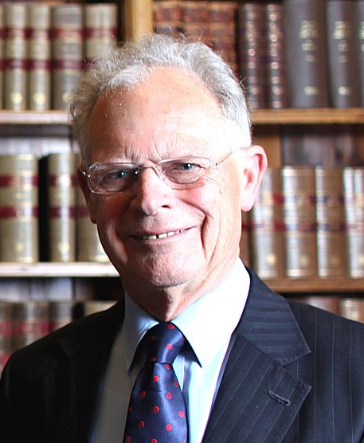
What is the Mpemba effect?
Mpemba effect:
Hotter water can freeze or cool faster than colder water under the same conditions.
In 1963, Erasto B. Mpemba noticed (rediscovered)
this phenomenon when he prepared ice cream.
Several proposed mechanisms:
Evaporation, Enhanced convection, Reduction of dissolved gases,
Differences in supercooling, Changes in heat transfer conditions
But not yet established…
Is the Mpemba effect fake?

Slide 3
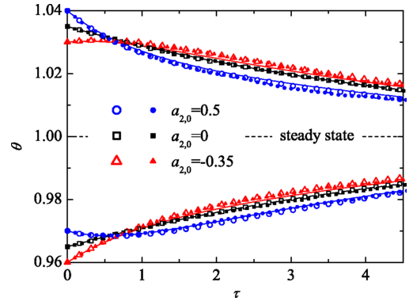
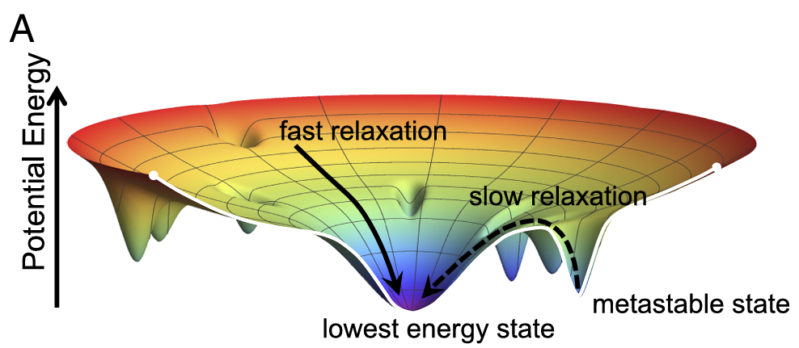
Recent theoretical viewpoint
Generalized Mpemba effect:
Anomalous relaxation in nonequilibrium systems
Focus on relaxation dynamics, not on the freezing process itself
A hotter initial state may relax faster toward equilibrium
From equilibrium states
From nonequilibrium states
Lu & Raz (2017)
Lasanta et al. (2017)
Markovian dynamics
Relaxation: determined by projection onto slow eigenmodes
Granular gases
Relaxation depends on vel. dist. (kurtosis)

Slide 4
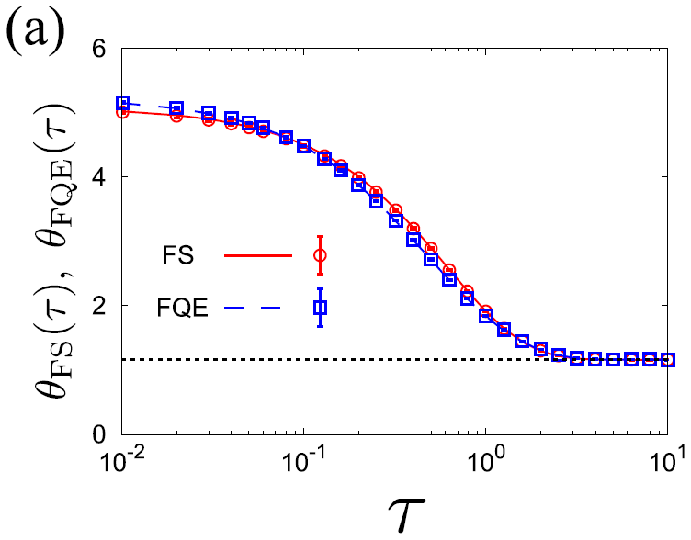
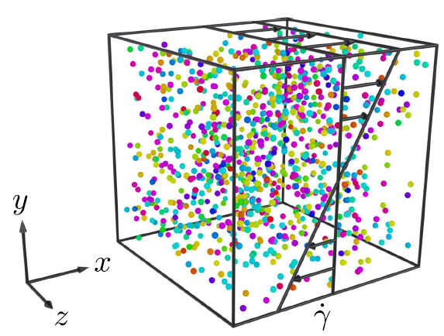
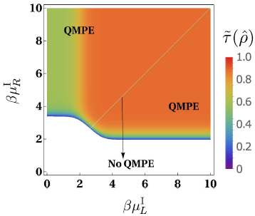
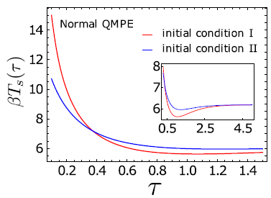
Our previous works on the Mpemba effect
From nonequilibrium states
Inertial suspensions (Particles + solvent)
👉 Takada, Hayakawa, & Santos, Phys. Rev. E 103, 032901 (2021)
Analyzed using kinetic theory
Physical origin of the Mpemba effect is
in the early stage.
Viscous heating
Quantum Mpemba effect
👉 Chatterjee, Takada, & Hayakawa,
Phys. Rev. Lett. 131, 080402 (2023)
Quantum dot coupled to reservoirs
Relaxation is governed by
Liouvillian eigenmodes

Slide 5
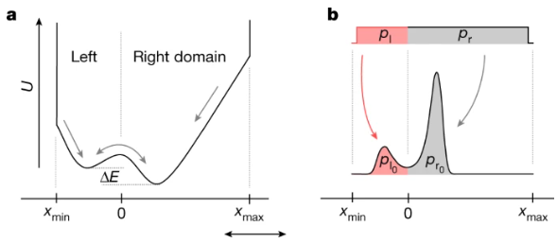
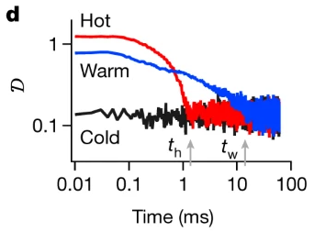
Experimental viewpoint
Kumar & Bechhoefer (2020)
Colloidal experiment inspired
by Lu & Raz (2017)
Optical trap experiment
Relaxation of probability distributions
Experimental observation of
the Mpemba effect as anomalous relaxation
Potential landscape: often used as an intuitive concept,
but it is difficult to compute in practice.
Is it possible to construct a solvable model?
👉 1D system: previous talk by Yue Liu

Slide 6
Aim of this work
Motivation:
Can we construct an exactly solvable 2D model exhibiting the Mpemba effect?
We consider a Brownian particle in a two-dimensional bistable potential.
We analyze the relaxation dynamics using
spectral decomposition of the Fokker–Planck operator.
Our goal:
We clarify the condition for the Mpemba effect
in a continuous system without confining walls.

Slide 7
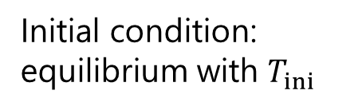
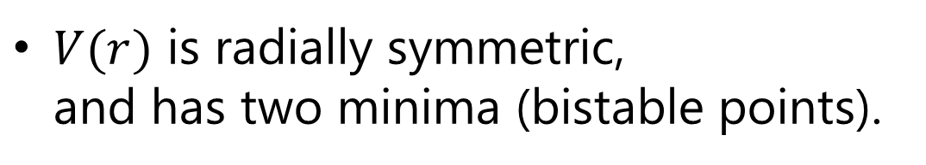


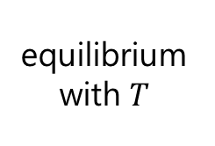
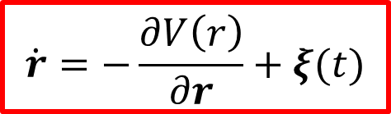

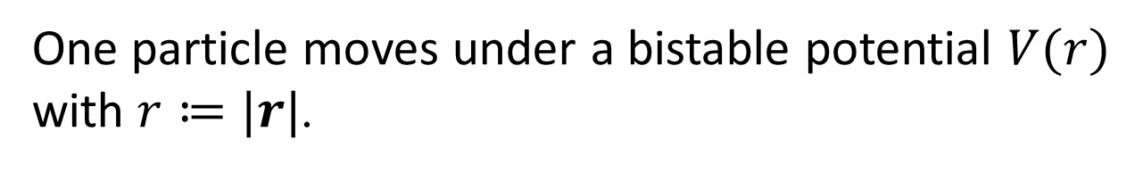

Model: Langevin dynamics
One particle moves under a bistable potential $V(r)$ with $r≔|r|$.
$V(r)$ is radially symmetric,
and has two minima (bistable points).
Equation of motion = Langevin eq.
$$\dot{r}=−\frac{∂V\left(r\right)}{∂r}+ξ(t)$$
$$\left\langle ξ\left(t\right)\right\rangle =0, \left\langle ξ_{α}\left(t\right)ξ_{β}\left(t^{′}\right)\right\rangle =2Tδ_{αβ}δ\left(t−t^{′}\right)$$
Quench protocol
$$t=0$$
$$t$$
Initial condition:
equilibrium with $T_{ini}$
equilibrium with $T$
Relaxation process
$$T_{ini}→T$$

Slide 8
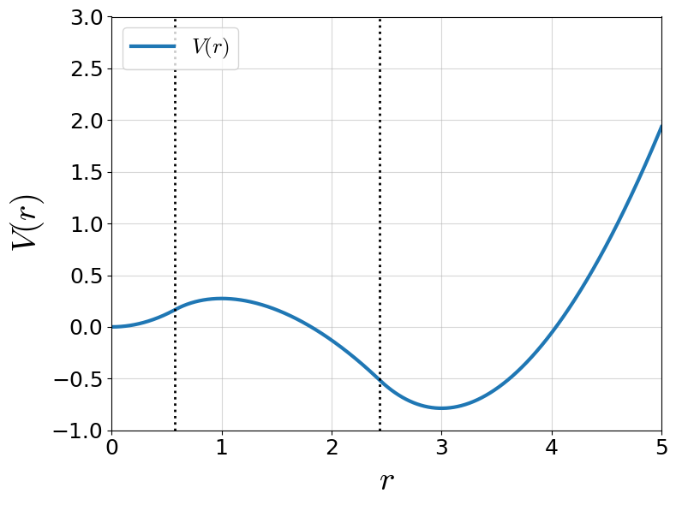
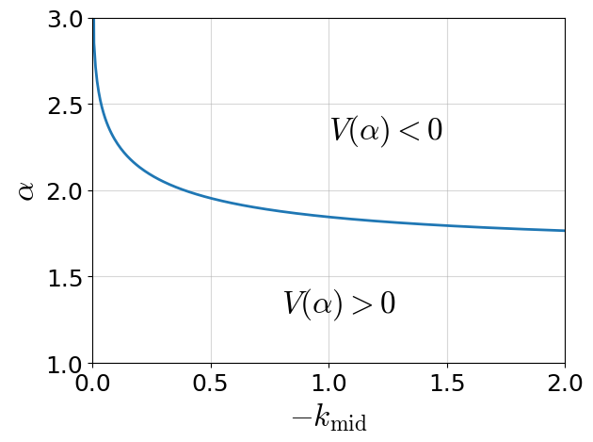
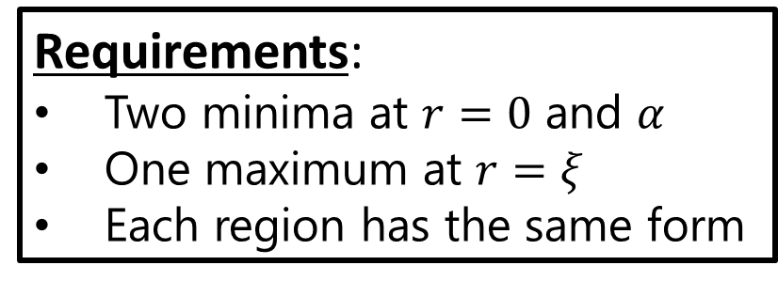


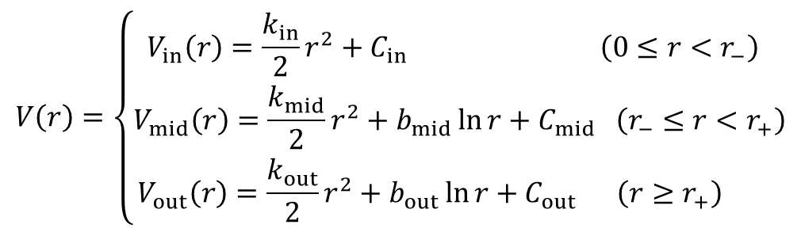

Solvable potential
How to construct a bistable potential $V(r)$?
$$r_{−}$$
$$r_{+}$$
Requirements:
Two minima at $r=0$ and $α$
One maximum at $r=ξ$
Each region has the same form
We propose a piecewise potential
consisting of three (inner, middle, outer) regions
(Each region = quadratic + logarithmic)
$$V\left(r\right)=\left\{\begin{aligned}V_{in}\left(r\right)=\frac{k_{in}}{2}r^{2}+C_{in} \left(0≤r<r_{−}\right) \\ V_{mid}\left(r\right)=\frac{k_{mid}}{2}r^{2}+b_{mid}\ln{r}+C_{mid} \left(r_{−}≤r<r_{+}\right) \\ V_{out}\left(r\right)=\frac{k_{out}}{2}r^{2}+b_{out}\ln{r}+C_{out} \left(r≥r_{+}\right) \end{aligned}\right.$$
$$k_{in}=k_{out}=ξ=1$$
Fokker-Planck equation becomes analytically solvable.

Slide 9
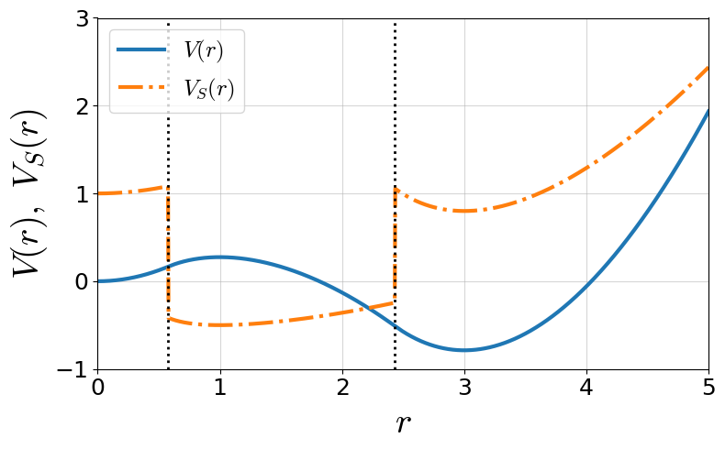

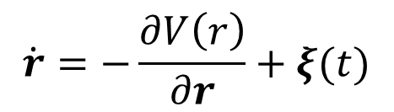
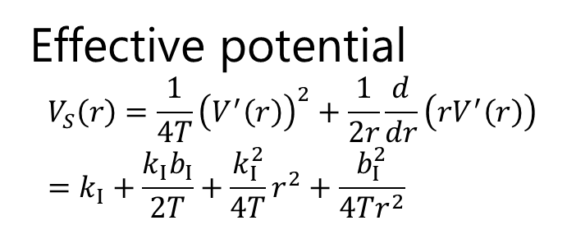
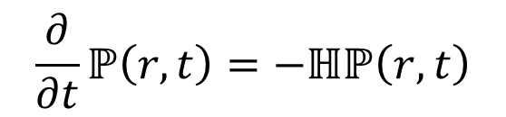
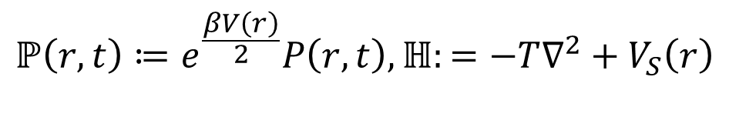
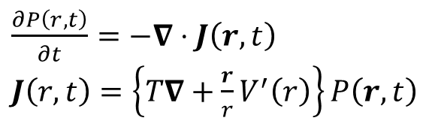
Mapping to Schrödinger equation
Langevin eq.
Fokker-Planck eq.
$$\dot{r}=−\frac{∂V\left(r\right)}{∂r}+ξ(t)$$
$\frac{∂P\left(r,t\right)}{∂t}=−∇⋅J\left(r,t\right)$
$J\left(r,t\right)=\left\{T∇+\frac{r}{r}V^{′}\left(r\right)\right\}P\left(r,t\right)$
Effective potential
$$V_{S}\left(r\right)=\frac{1}{4T}{\left(V^{′}\left(r\right)\right)}^{2}+\frac{1}{2r}\frac{d}{dr}\left(rV^{′}\left(r\right)\right) \\ =k_{I}+\frac{k_{I}b_{I}}{2T}+\frac{k_{I}^{2}}{4T}r^{2}+\frac{b_{I}^{2}}{4Tr^{2}}$$
Schrödinger eq.
$$ℙ\left(r,t\right)≔e^{\frac{βV\left(r\right)}{2}}P\left(r,t\right),ℍ:=−T∇^{2}+V_{S}\left(r\right)$$
$$\frac{∂}{∂t}ℙ\left(r,t\right)=−ℍℙ\left(r,t\right)$$
$$I∈(in, middle, out)$$
Problem is mapped onto the eigenvalue problem:

Slide 10
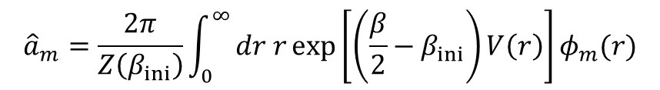
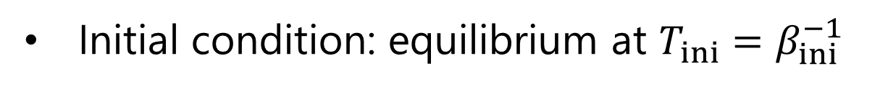
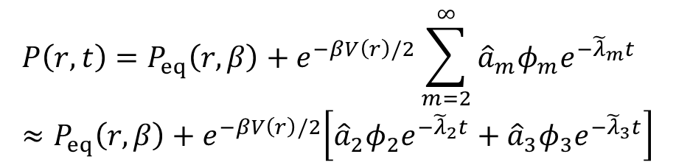


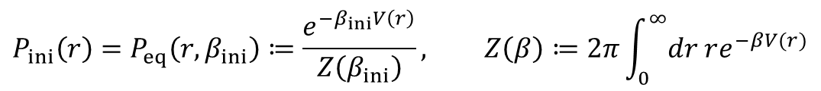
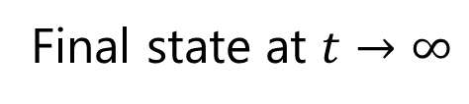
Construction of a solution
Initial condition: equilibrium at $T_{ini}=β_{ini}^{−1}$
$$P_{ini}\left(r\right)=P_{eq}\left(r,β_{ini}\right)≔\frac{e^{−β_{ini}V\left(r\right)}}{Z\left(β_{ini}\right)}, Z\left(β\right)≔2π\int_{0}^{∞}{dr re^{−βV(r)}}$$
Effective potential $V_{S}\left(r\right)$: isotropic
System is kept isotropic:
$$ℍφ_{n}\left(r\right)={\tilde{λ}}_{n}φ_{n}(r)$$
Spectrum representation
$$P\left(r,t\right)=P_{eq}\left(r,β\right)+e^{−βV\left(r\right)/2}\sum_{m=2}^{∞}{{\hat{a}}_{m}φ_{m}e^{−{\tilde{λ}}_{m}t}} \\ ≈P_{eq}\left(r,β\right)+e^{−βV\left(r\right)/2}\left[{\hat{a}}_{2}φ_{2}e^{−{\tilde{λ}}_{2}t}+{\hat{a}}_{3}φ_{3}e^{−{\tilde{λ}}_{3}t}\right]$$
$${\hat{a}}_{m}=\frac{2π}{Z\left(β_{ini}\right)}\int_{0}^{∞}{dr r\exp\left[\left(\frac{β}{2}−β_{ini}\right)V\left(r\right)\right]φ_{m}(r)}$$
Final state at $t→∞$

Slide 11
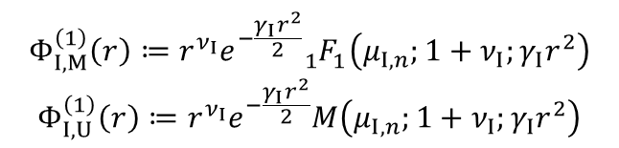
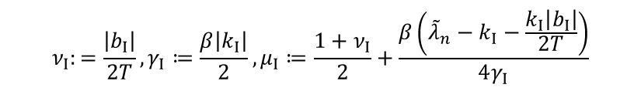
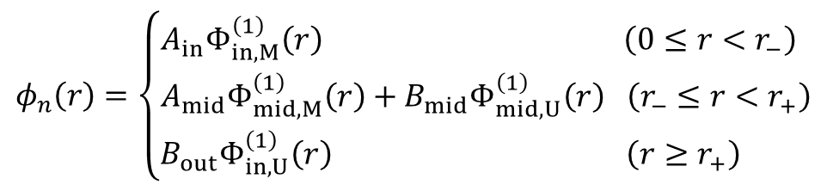
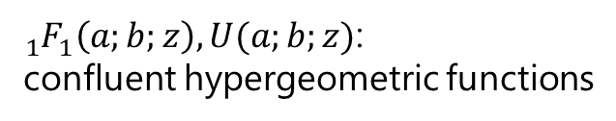
General solution of $φ_{m}$
$ℍφ_{n}\left(r\right)={\tilde{λ}}_{n}φ_{n}(r)$ has two independent solutions:
$$φ_{n}\left(r\right)=\left\{\begin{aligned}A_{in}Φ_{in,M}^{\left(1\right)}\left(r\right) \left(0≤r<r_{−}\right) \\ A_{mid}Φ_{mid,M}^{\left(1\right)}\left(r\right)+B_{mid}Φ_{mid,U}^{\left(1\right)}\left(r\right) \left(r_{−}≤r<r_{+}\right) \\ B_{out}Φ_{in,U}^{\left(1\right)}\left(r\right) \left(r≥r_{+}\right) \end{aligned}\right.$$
$$Φ_{I,M}^{\left(1\right)}\left(r\right)≔r^{ν_{I}}e^{−\frac{γ_{I}r^{2}}{2}}{}_{1}^{ }{F_{1}^{ }}\left(μ_{I,n};1+ν_{I};γ_{I}r^{2}\right)$$
$$Φ_{I,U}^{\left(1\right)}\left(r\right)≔r^{ν_{I}}e^{−\frac{γ_{I}r^{2}}{2}}M\left(μ_{I,n};1+ν_{I};γ_{I}r^{2}\right)$$
${}_{1}^{ }{F_{1}^{ }}\left(a;b;z\right), U(a;b;z)$:
confluent hypergeometric functions
$$ν_{I}:=\frac{\left|b_{I}\right|}{2T}, γ_{I}≔\frac{β\left|k_{I}\right|}{2}, μ_{I}≔\frac{1+ν_{I}}{2}+\frac{β\left({\tilde{λ}}_{n}−k_{I}−\frac{k_{I}\left|b_{I}\right|}{2T}\right)}{4γ_{I}}$$
Note:
Constants $A_{I}$ and $B_{I}$ should be determined
by boundary / matching conditions.
A solution should not diverge at $r→0$ and $r→∞$.

Slide 12
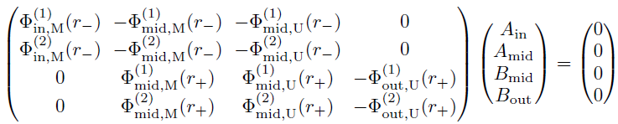
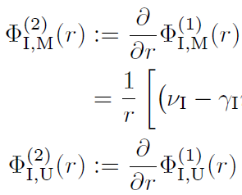
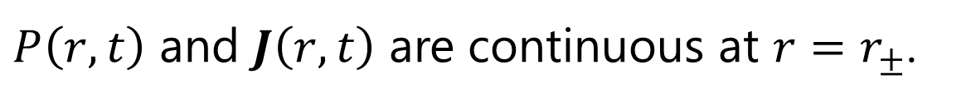
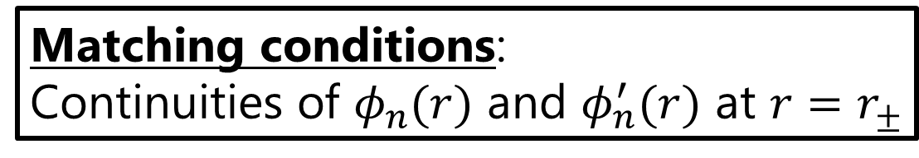




Eigenvalue spectrum
$P\left(r,t\right)$ and $J\left(r,t\right)$ are continuous at $r=r_{±}$.
$$r_{−}$$
$$r_{+}$$
Matching conditions:
Continuities of $φ_{n}(r)$ and $φ_{n}^{′}(r)$ at $r=r_{±}$
$$=ℳ(λ)$$
The system has a nontrivial solution only if
$$\det{ℳ(λ)}=0$$

Slide 13
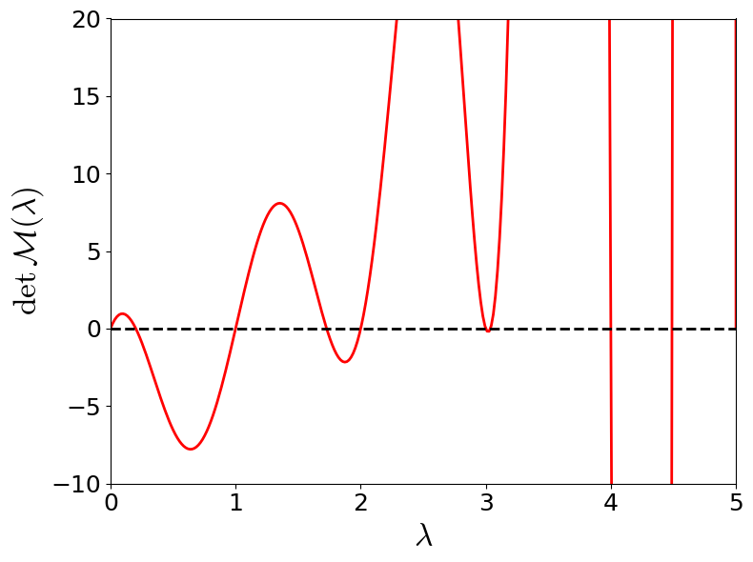
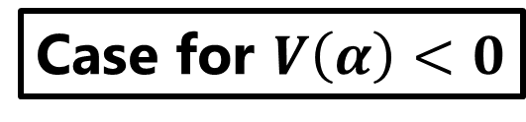
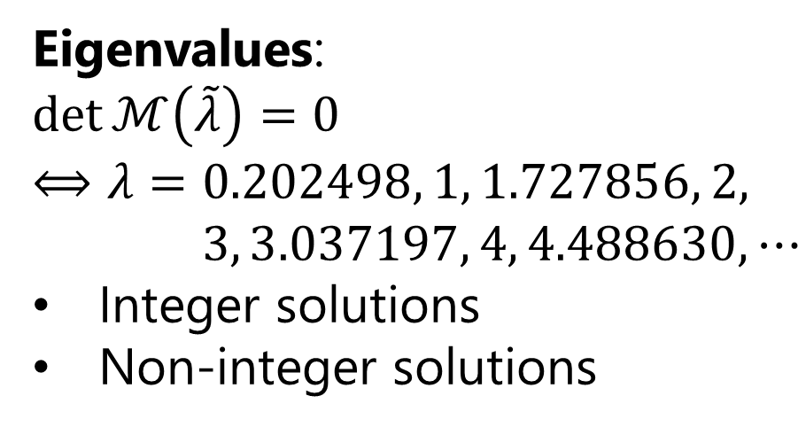
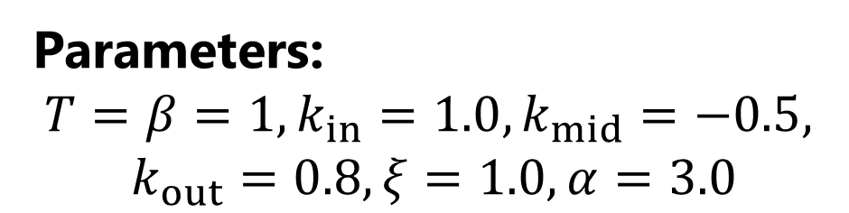
Demonstration of the Mpemba effect
Case for $V\left(α\right)<0$
Potential
Parameters:
$$T=β=1, k_{in}=1.0, k_{mid}=−0.5,$$
$$k_{out}=0.8, ξ=1.0, α=3.0$$
deeper
Eigenvalues:
$$\det{ℳ\left(\tilde{λ}\right)}=0 \\ ⟺λ=0.202498, 1, 1.727856, 2, \\ 3, 3.037197, 4, 4.488630, ⋯$$
Integer solutions
Non-integer solutions
overcomplete
(not acceptable)
$${\tilde{λ}}_{2}=0.202498, {\tilde{λ}}_{3}=1.727856,{\tilde{λ}}_{4}=3.037197,{\tilde{λ}}_{5}=4.488630, ⋯$$

Slide 14
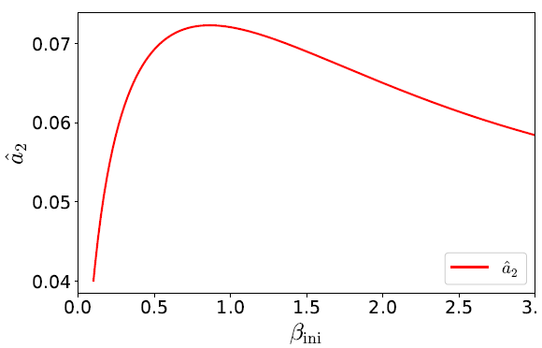
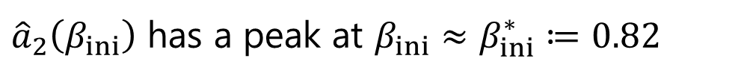
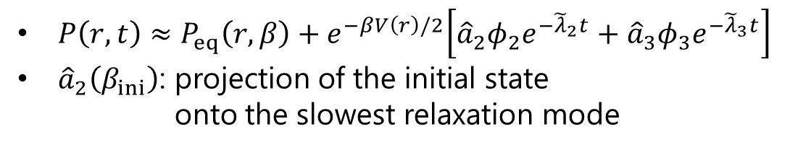
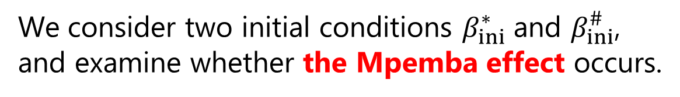
Demonstration of the Mpemba effect
$${\tilde{λ}}_{2}=0.202498, {\tilde{λ}}_{3}=1.727856,{\tilde{λ}}_{4}=3.037197,{\tilde{λ}}_{5}=4.488630, ⋯$$
${\hat{a}}_{2}\left(β_{ini}\right)$ has a peak at $β_{ini}≈β_{ini}^{∗}≔0.82$
$P\left(r,t\right)≈P_{eq}\left(r,β\right)+e^{−βV\left(r\right)/2}\left[{\hat{a}}_{2}φ_{2}e^{−{\tilde{λ}}_{2}t}+{\hat{a}}_{3}φ_{3}e^{−{\tilde{λ}}_{3}t}\right]$
${\hat{a}}_{2}\left(β_{ini}\right)$: projection of the initial state
onto the slowest relaxation mode
We consider two initial conditions $β_{ini}^{∗}$ and $β_{ini}^{\#}$,
and examine whether the Mpemba effect occurs.

Slide 15
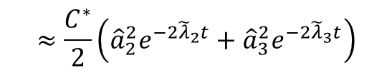
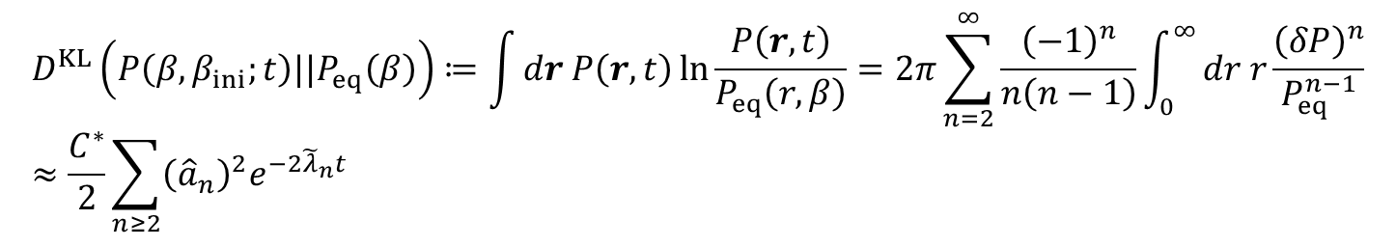



Kullback-Leibler divergence
How to discuss the Mpemba effect?
Kullback-Leibler (KL) divergence
“Measure of the difference” between two probability distributions $P(r)$ and $Q(r)$
$$D^{KL}(P|\left|Q\right)≔\int_{ }^{ }{dr P\left(r\right)}ln\frac{P(r)}{Q(r)}$$
In our system,
$P(r,t)$ : distribution at time $t$
$P_{eq}\left(r, β\right)$: equilibrium distribution (final state)
$$D^{KL}\left(P\left(β,β_{ini};t\right)||P_{eq}\left(β\right)\right)≔\int_{ }^{ }{dr P\left(r,t\right)}ln\frac{P\left(r,t\right)}{P_{eq}\left(r,β\right)}=2π\sum_{n=2}^{∞}{\frac{{\left(−1\right)}^{n}}{n\left(n−1\right)}\int_{0}^{∞}{dr r\frac{{\left(δP\right)}^{n}}{P_{eq}^{n−1}}}} \\ ≈\frac{C^{∗}}{2}\sum_{n≥2}{{\left({\hat{a}}_{n}\right)}^{2}e^{−2{\tilde{λ}}_{n}t}}$$
$$≈\frac{C^{∗}}{2}\left({\hat{a}}_{2}^{2}e^{−2{\tilde{λ}}_{2}t}+{\hat{a}}_{3}^{2}e^{−2{\tilde{λ}}_{3}t}\right)$$
$$C^{∗}=2πZ\left(β\right)\int_{0}^{∞}{dr rφ_{n}{\left(r\right)}^{2}}$$
Two-mode approximation

Slide 16







When does the Mpemba effect occurs?
KL divergence $D^{KL}\left(P\left(β_{ini},β;t\right)||P_{eq}\left(β\right)\right)≈\frac{C^{∗}}{2}\left({\hat{a}}_{2}^{2}e^{−2{\tilde{λ}}_{2}t}+{\hat{a}}_{3}^{2}e^{−2{\tilde{λ}}_{3}t}\right)$
Two initial conditions:
Equilibrium with $β_{ini}^{∗}$ (peak of ${\hat{a}}_{2}$)
Equilibrium with $β_{ini}^{\#}$
Relaxation
Equilibrium with $β$
Necessary condition of the Mpemba effect:
$ℱ\left(β_{ini}^{\#},β_{ini}^{∗}\right)≔\frac{Δ_{3}}{Δ_{2}}<−1$
$$Δ_{n}≔{\left({\hat{a}}_{2}\left(β_{ini}^{\#}\right)\right)}^{2}−{\left({\hat{a}}_{2}\left(β_{ini}^{∗}\right)\right)}^{2}$$
Example of the Mpemba effect
$β_{ini}^{∗}=0.82, β_{ini}^{\#}=0.50$ to $β=1$
Difference of the KL divergences
$ΔD≔D^{KL}\left(①\right)−$ $D^{KL}\left(②\right)$
⇒ The Mpemba effect occurs!

Slide 17


When does the Mpemba effect occur?
Range of $β_{ini}^{\#}$

Slide 18



Phase diagram of the Mpemba effect
Phase diagram for $k_{in}=k_{out}=ξ=1$
Mpemba effect occurs only when $V\left(α\right)<0$?

Slide 19



Discussion
The Mpemba effect depends on system parameters
$k_{in}$ and $k_{out}$
Smaller $k_{out}$→ Mpemba effect is more likely to occur?
Outer region of the potential seems to play
an important role
Tentative result:
$k_{in}=1, ξ=1, V\left(α\right)=0$
Mpemba effect never occurs?

Slide 20

Summary
We have
constructed exactly solvable 2D model of
the Mpemba effect.
obtained eigenmodes analytically.
derived the Mpemba condition:
$ℱ\left(β_{ini}^{\#},β_{ini}^{∗}\right)≔\frac{Δ_{3}}{Δ_{2}}<−1.$
demonstrated the crossing of the KL divergence.
drawn the phase diagram.

Slide 21


More terms
What happens when we consider more terms…

Slide 22


