Slide 1
Hunting for quark flavor violating decay
H(125) -> b s at FCC-ee
K. Hidaka
Tokyo Gakugei University
Collaboration with
Aman Desai (Adelaide University)
PPP2026, Aug 24-28 2026, Univ. of Kyoto

Slide 2
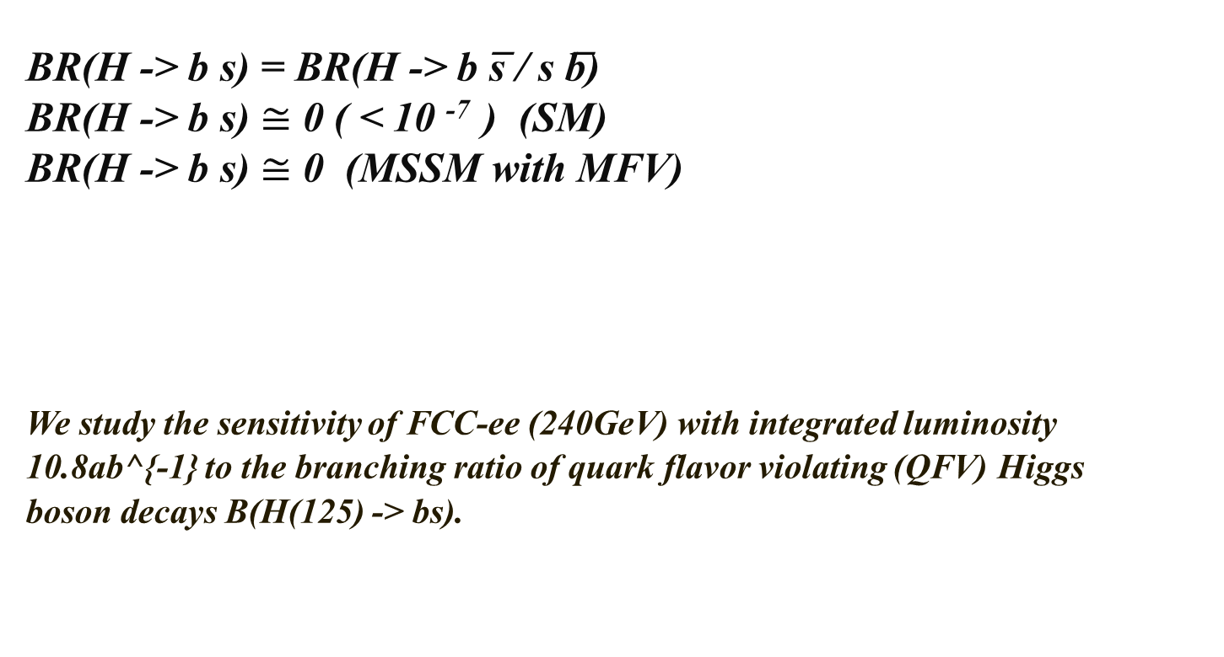
1. Introduction
BR(H -> b s) = BR(H -> b s̅ / s b̅)
BR(H -> b s) $≅$ 0 ( < 10 ⁻⁷ ) (SM)
BR(H -> b s) $≅$ 0 (MSSM with MFV)
We study the sensitivity of FCC-ee (240GeV) with integrated luminosity
10.8ab^{-1} to the branching ratio of quark flavor violating (QFV) Higgs
boson decays B(H(125) -> bs).
BR(H -> b s) can be as large as ~ 0.15% (MSSM with QFV)!
(H. Eberl, K. Hidaka, E. Ginina, Phys. Rev. D 113, 015011 (2026) [arXiv:2511.20523])
(See also Gomez-Heinemeyer-Rehman, PR D93 (2016) 095021 [arXiv:1511.04342]. )

Slide 3
2. MC event generation
- Signal (SIG) events are e^- e^+ -> Z H(-> b s)
with Z -> e^+ e^-, mu^+ mu^-, nu nubar, q qbar.
- We generate luminosity-scaled SIG & BG(Background) Monte Carlo (MC) events
at parton level based on SIG & BG cross sections at LO in the SM.
- The SIG MC events at parton level are generated by using MadGraph5_aMC@NLO [1].
Pythia8 [2] was used to simulate parton showering and hadronization including
ISR/FSR effects.
[1] JHEP 07 (2014) 079, [1405.0301]
[2] Comput. Phys. Commun. 191 (2015) 159–177, [1410.3012].
- The BG MC events at parton level are generated by using Whizard [3].
Pythia6 [4] was used to simulate parton showering and hadronization including
ISR/FSR effects.
[3] Eur. Phys. J. C 71 (2011) 1742, [0708.4233].
[4] JHEP 05 (2006) 026, [hep-ph/0603175].
- The SIG and BG MC events at hadron level are simulated (converted to events at detector level)
using the IDEA detector [5] concept and the fast detector simulation framework Delphes.
[5] arXiv:2502.21223.
- The generated BG event sample at the detector level is part of the winter 2023 production campaign [6].
[6] https://fcc-physics-events.web.cern.ch/fcc-ee/rec/winter2023/IDEA.

Slide 4
3. MC event sample analysis
- The MC generated SIG and BG events at the detector level are selected using
physics-motivated selection-cuts together with channel-dependent BDT classifiers
(BDT cuts) in order to separate (discriminate) the SIG events from BG events efficiently.
- Jet-flavor identification (tagging) is important in separating (discriminating)
SIG events from BG events.
Jet-flavor tagging is performed using the ParticleNET jet-tagging algorithm [7].
[7] Eur. Phys. J. C 82 (2022) 646, [2202.03285].
- The statistical analysis is carried out with the CMS Combine software [8].
[8] Comput. Softw. Big Sci. 8 (2024) 19, [2404.06614].
- We can estimate expected 1 sigma error of B(H -> b s) measurement
by fitting to BDT-score distribution of luminosity-scaled (SIG + BG) events
after all selections by varying B(H -> b s).
- We can estimate expected 95% CL upper limit on B(H -> b s)
by fitting to BDT-score distribution of luminosity-scaled BG events
after all selections by varying B(H -> b s).
- In this way, we estimate
(A) expected 1 sigma error of B(H -> b s) measurement at FCC-ee(240GeV).
(B) expected 95% CL upper limit on B(H -> b s) at FCC-ee(240GeV).

Slide 5
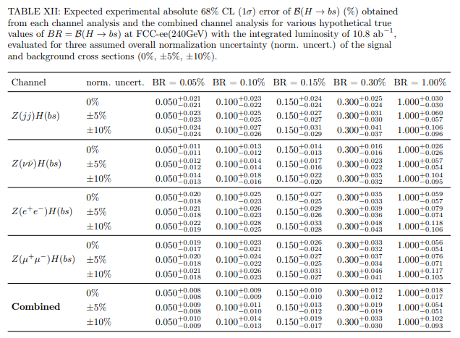
4. Results
4.1 Expected 1 sigma error of B(H -> b s) measurement

Slide 6
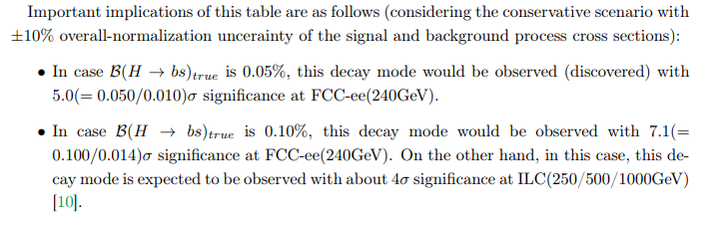
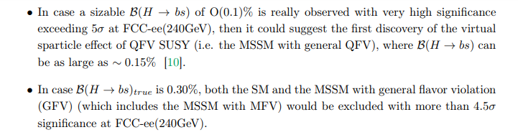
Important implications of TABLE XII
[10] Phys. Rev. D 113 (2026) 015011, [2511.20523].

Slide 7
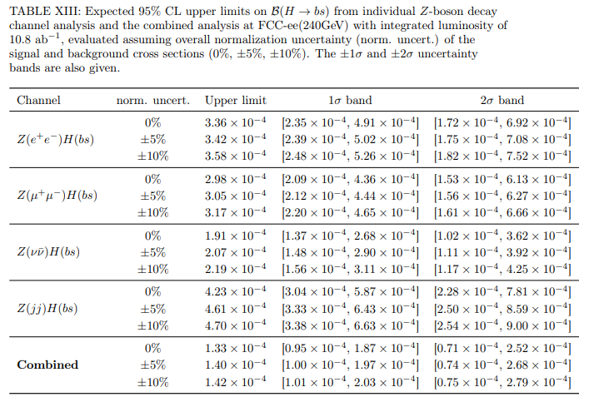
4.2 Expected 95% CL upper limit on B(H -> b s) (Method 1)

Slide 8
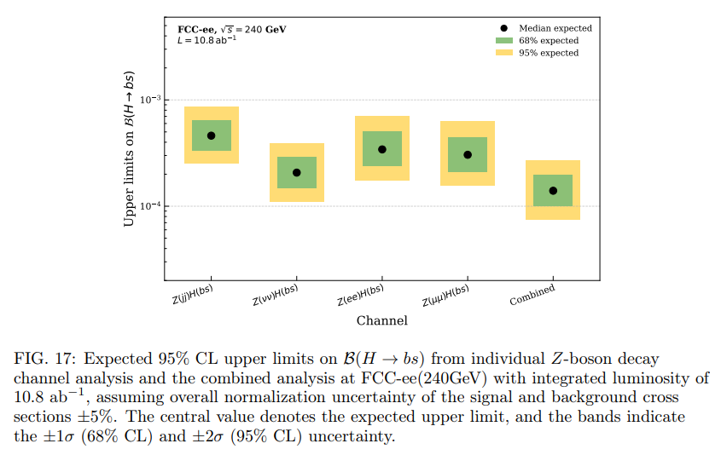
4.2 Expected 95% CL upper limit on B(H -> b s) (Method 1)
(continued)

Slide 9
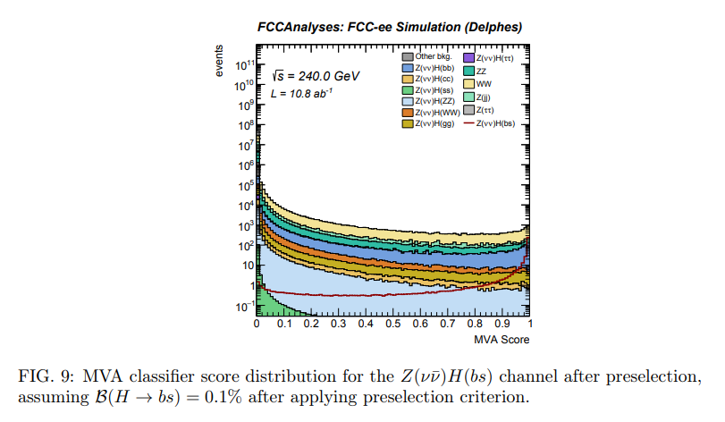
4.3 Expected 95% CL upper limit on B(H -> b s) (Method 2)

Slide 10
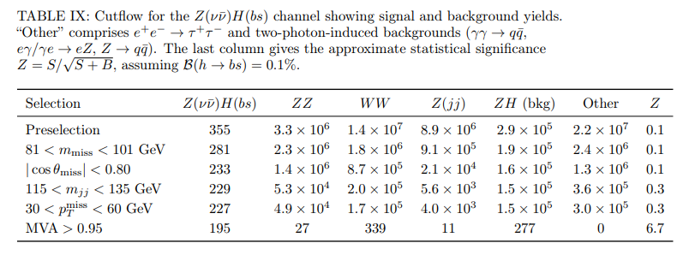
4.3 Expected 95% CL upper limit on B(H -> b s) (Method 2)
(continued)

Slide 11
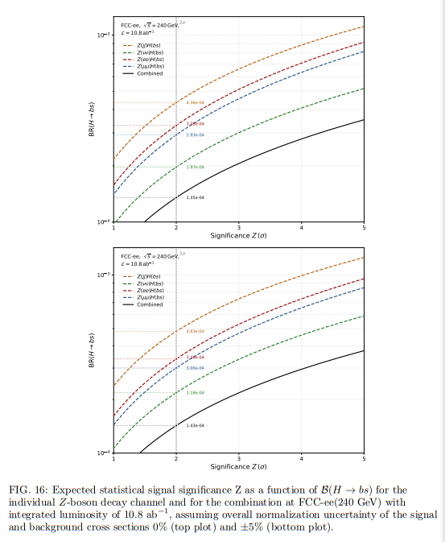
4.3 Expected 95% CL upper limit on B(H -> b s) (Method 2)
(continued)
Expected 95%CL upper limit of
B(H -> bs) is given by B(H -> bs)(Z=2).

Slide 12
5. Conclusion
- We have studied the sensitivity of FCC-ee(240GeV) with integrated luminosity of 10.8 ab^-1
to QFV Higgs boson decay branching ratio B(H → b s).
- We analyzed the MC generated signal event samples for four signal channels
e- e+ -> Z(ee)H(bs), Z(mu mu)H(bs), Z(nu nu)H(bs), and Z(qq)H(bs), where
Z(qq)H(bs) includes Z(tau tau)H(bs).
- We analyzed the signal and background event samples using the IDEA detector concept
and the fast detector simulation framework Delphes.
- For signal and background event sample, physics-motivated selection cuts and then a
channel-specific BDT classifier were applied to enhance signal to background ratio efficiently.
- As for the analysis of the expected error of B(H → b s) measurement,
we have found that this measurement is very powerful in testing and distinguishing models
such as the SM and the MSSM with general QFV.
- As for the expected upper limit on B(H → b s), combining all four channels yields an expected
95% CL upper limit of 1.33(1.40)X10^{-4}, assuming 0% (+/-5%) overall normalization
uncertainty of the signal and background cross sections, demonstrating that the FCC-ee(240GeV)
with integrated luminosity of 10.8 ab^-1 has very strong sensitivity to this QFV decay mode at
the 10^{-4} level.
- Our analysis strongly suggests that the branching ratio B(H → b s) measurement could be
a quite interesting and important experiment at FCC-ee(240GeV).

